Slide 1

Recursive Exploration II
A journey of a thousand miles begins with a single step.
—Lao Tzu, 6th century B.C.E.
Chris Piech
CS 106B
Lecture 9
Jan 27, 2016

Slide 2

One Line Change to Starter

Slide 3
Wrapper Functions
int gcd(int a, int b) {
return 0;
}

Slide 4
Wrapper Functions
int gcdHelper(int a, int b, Stack<string> myStack) {
/// now the params are changed.
return 0;
}
int gcd(int a, int b) {
Stack<string> myStack;
return gcdHelper(a, b, myStack);
}

Slide 5
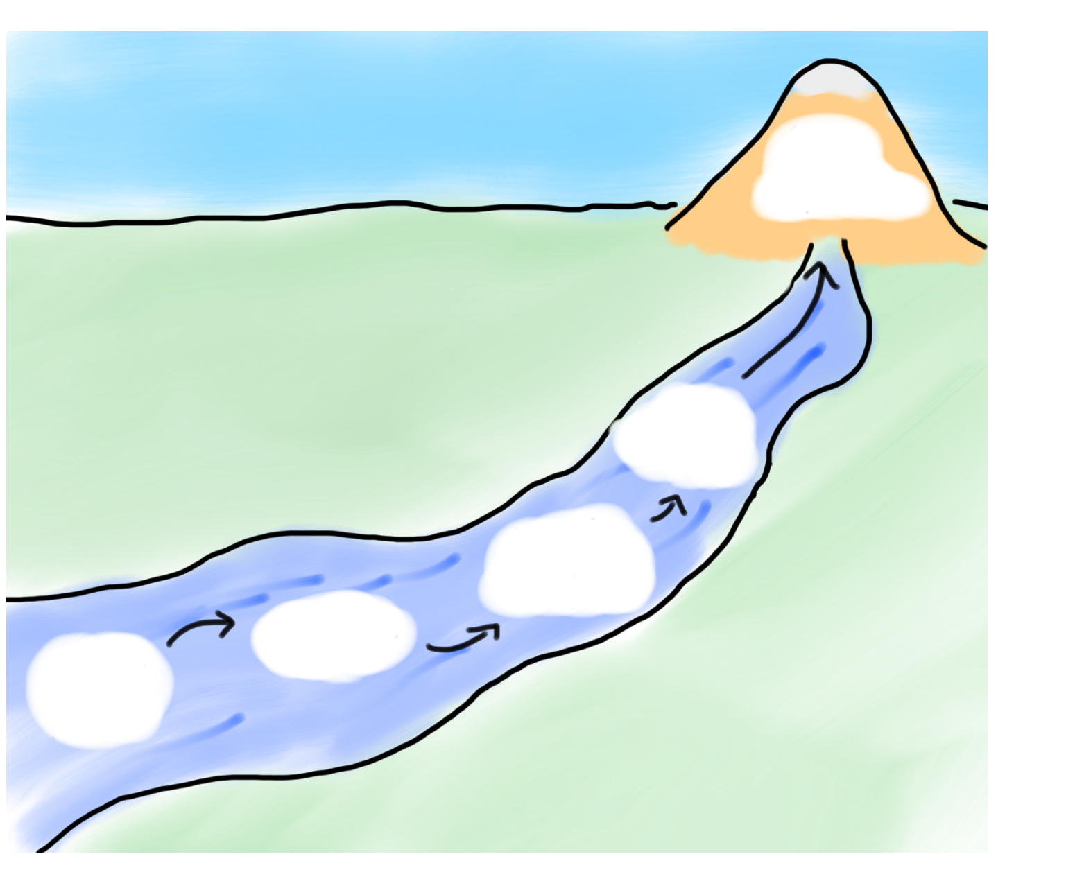

Today’s Route
Backtracking
Tree
Examples
Tree
framework
9 Letters
Decision
trees
Exploration River

Slide 6
Decision Trees

Slide 7
Decision Tree
Undergrad
Oceanography
Native Studies
CS
AI
HCI
Graphics
CompBio
Research
Startup

Slide 8
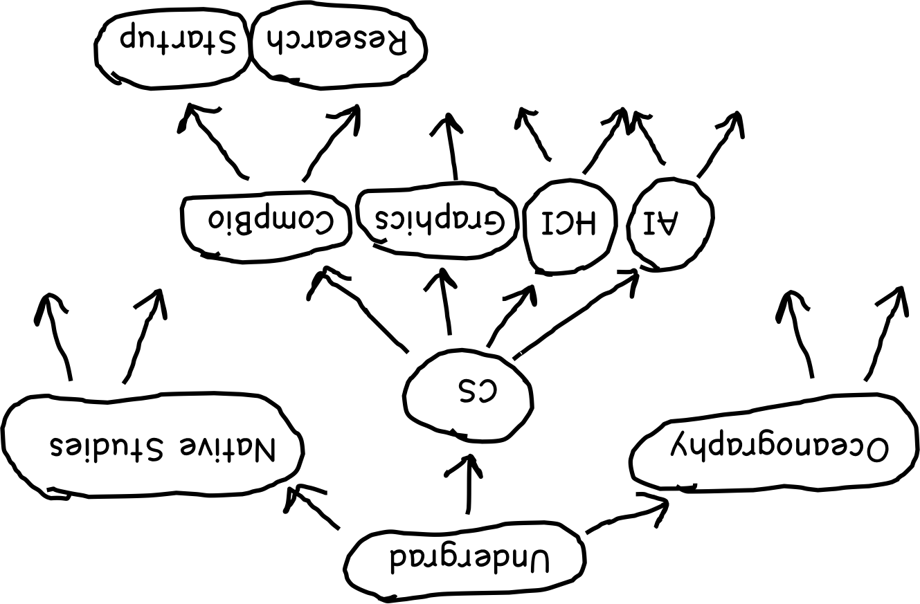
Decision Tree

Slide 9

Decision Tree

Slide 10
Decision Tree

Slide 11
Decision Tree
Undergrad
Oceanography
Native Studies
CS
AI
HCI
Graphics
CompBio
Research
Startup

Slide 12
Tree Template

Slide 13
Tree Template
// a general template for working with trees
void recursiveExploration( state ) {
if (simpleCase || foundSolution) {
// base case
return without recursing.
} else {
// recursive case
for(each possible nextState from state) {
recursiveExploration(nextState);
}
}
}
State is the top of a tree
And so is nextState
Current
state
Option 0
Option n
Option 1
Generally you will do other work
Next
state 0
Next
state n
Next
state 1

Slide 14
Start Simple

Slide 15
Output all Files on Computer

Slide 16
File System
My Documents

Slide 17
File System
My Documents
Research
Writing
Teaching

Slide 18
File System
My Documents
Research
Writing
Teaching
cs106a
cs106b
cs221

Slide 19
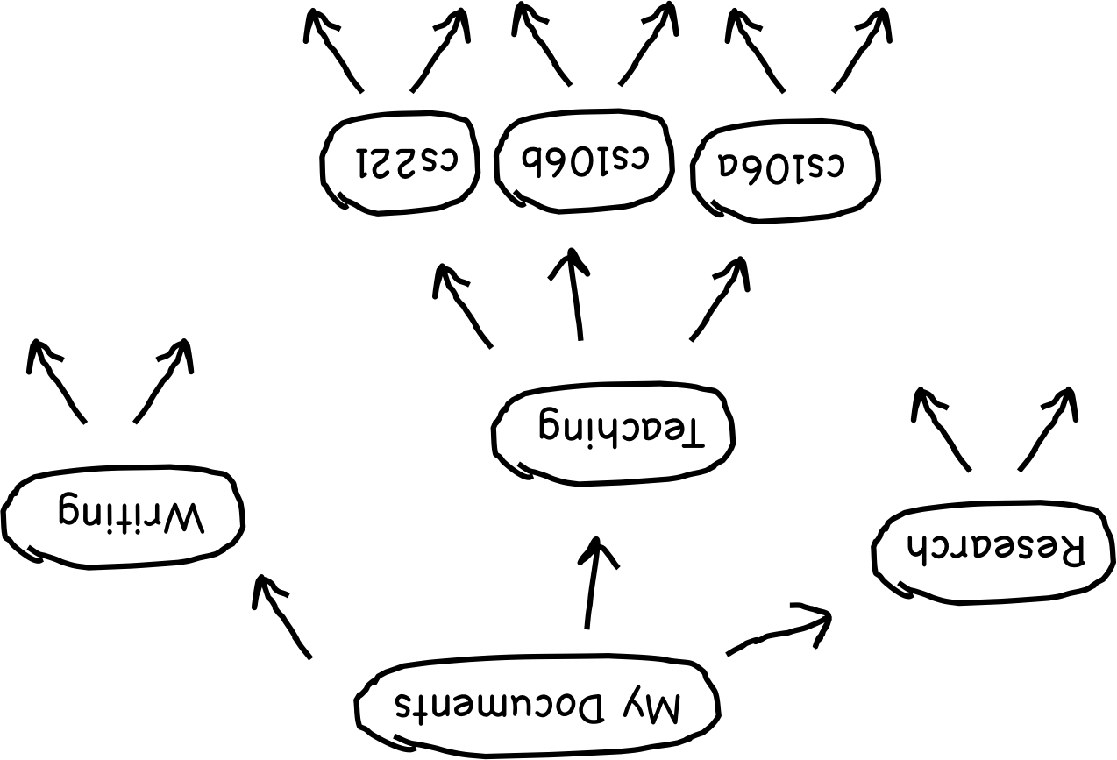
File System

Slide 20
File System

Slide 21
File System

Slide 22
File System
My Documents
Research
Writing
Teaching
cs106a
cs106b
cs221

Slide 23
File System
My Documents
Research
Writing
Teaching
cs106a
cs106b
cs221

Slide 24
File System
My Documents
Research
Writing
Teaching
cs106a
cs106b
cs221

Slide 25
Tree Template

Slide 26
Tree Template
// a general template for working with trees
void recursiveExploration( state ) {
if (simpleCase || foundSolution) {
// base case
return without recursing.
} else {
// recursive case
for(each possible nextState from state) {
recursiveExploration(nextState);
}
}
}

Slide 27
Tree Template
// a general template for working with trees
void recursiveExploration(string currDir) {
if (simpleCase || foundSolution) {
// base case
return without recursing.
} else {
// recursive case
for(each possible nextState from state) {
recursiveExploration(nextState);
}
}
}

Slide 28
Tree Template
// a general template for working with trees
void recursiveExploration(string currDir) {
if (simpleCase || foundSolution) {
// base case
return without recursing.
} else {
// recursive case
for(each possible nextState from state) {
recursiveExploration(nextState);
}
}
}

Slide 29
Tree Template
// a general template for working with trees
void recursiveExploration(string currDir) {
if (!isDirectory(currDirr)) {
// base case
cout << currDirr << endl;
} else {
// recursive case
for(each possible nextState from state) {
recursiveExploration(nextState);
}
}
}

Slide 30
Tree Template
// a general template for working with trees
void recursiveExploration(string currDir) {
if (!isDirectory(currDirr)) {
// base case
cout << currDirr << endl;
} else {
// recursive case
for(each possible nextState from state) {
recursiveExploration(nextState);
}
}
}

Slide 31
Tree Template
// a general template for working with trees
void recursiveExploration(string currDir) {
if (!isDirectory(currDirr)) {
// base case
cout << currDirr << endl;
} else {
// get all next states
Vector<string> dirFiles;
listDirectory(currDir, dirFiles);
// recursive case
for(each possible nextState from state) {
recursiveExploration(nextState);
}
}
}

Slide 32
Tree Template
// a general template for working with trees
void recursiveExploration(string currDir) {
if (!isDirectory(currDirr)) {
// base case
cout << currDirr << endl;
} else {
// get all next states
Vector<string> dirFiles;
listDirectory(currDir, dirFiles);
// recursive case
for(each possible nextState from state) {
recursiveExploration(nextState);
}
}
}

Slide 33
Tree Template
// a general template for working with trees
void recursiveExploration(string currDir) {
if (!isDirectory(currDirr)) {
// base case
cout << currDirr << endl;
} else {
// get all next states
Vector<string> dirFiles;
listDirectory(currDir, dirFiles);
// recursive case
for(string file : dirFiles) {
string next = currDir + “/” + file;
recursiveExploration(next);
}
}
}

Slide 34
Output All Files
// a general template for working with trees
void recursiveExploration(string currDir) {
if (!isDirectory(currDirr)) {
// base case
cout << currDirr << endl;
} else {
// get all next states
Vector<string> dirFiles;
listDirectory(currDir, dirFiles);
// recursive case
for(string file : dirFiles) {
string next = currDir + “/” + file;
recursiveExploration(next);
}
}
}

Slide 35
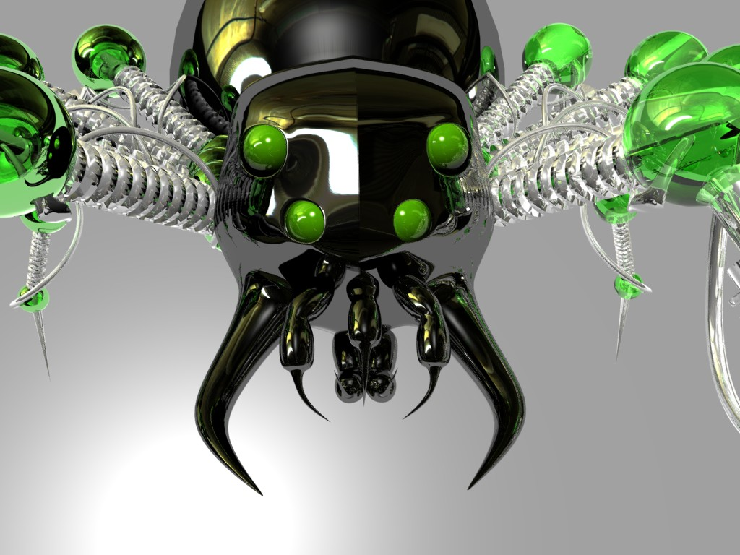
Recursive Exploration on the Internet

Slide 36

Looking For Treasure

Slide 37

Found Treasure Map but Lost it

Slide 38
Today’s Route
Backtracking
Many
Examples
Tree
framework
9 Letters
Decision
trees
Exploration River

Slide 39
Today’s Route
Backtracking
Many
Examples
Tree
framework
9 Letters
Decision
trees
Exploration River

Slide 40
Trees are Everywhere

Slide 41
Prerequisites
recursive exploration
recursion
collections
functionCalls
simpleC++
simpleC++

Slide 42
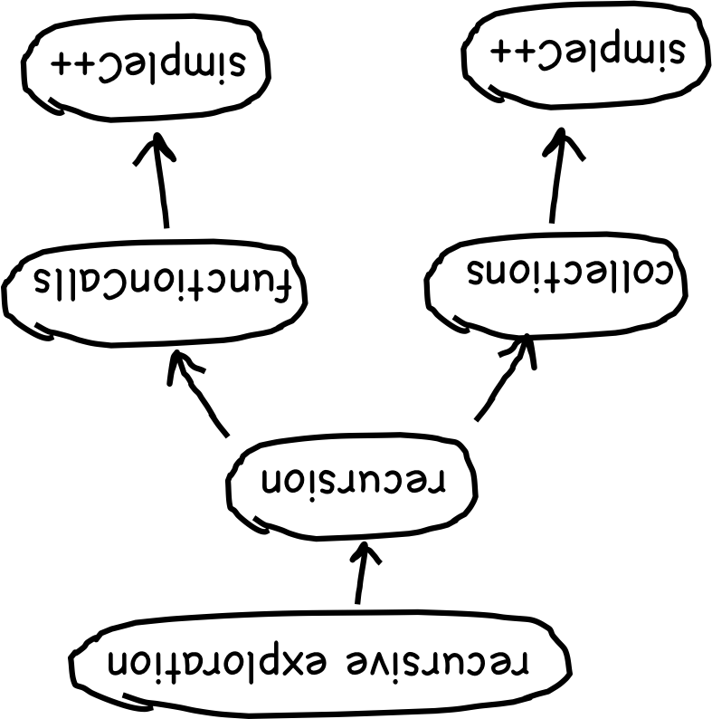
Prerequisites

Slide 43
Prerequisites

Slide 44
Prerequisites

Slide 45
Trees are Everywhere

Slide 46
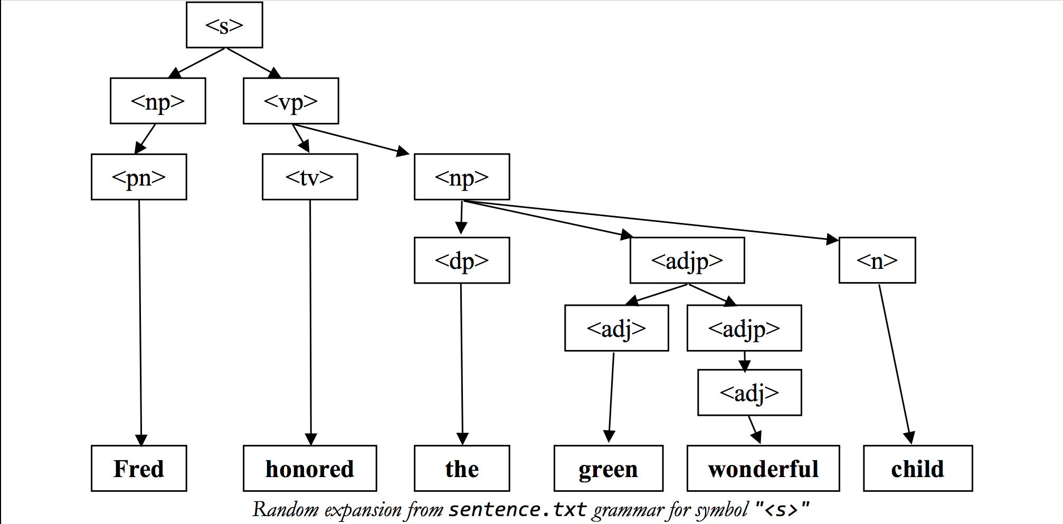
Syntax Tree

Slide 47
Syntax Tree

Slide 48
Syntax Tree

Slide 49
Today’s Route
Backtracking
Tree
Examples
Tree
framework
9 Letters
Decision
trees
Exploration River

Slide 50
Today’s Route
Backtracking
Tree
Examples
Tree
framework
9 Letters
Decision
trees
Exploration River

Slide 51
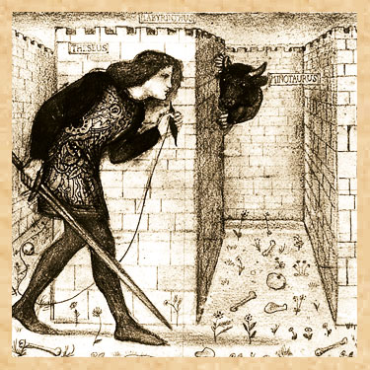

Labyrinth

Slide 52
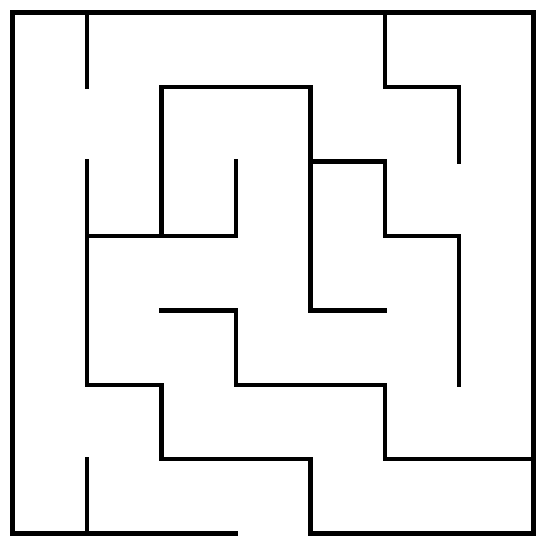
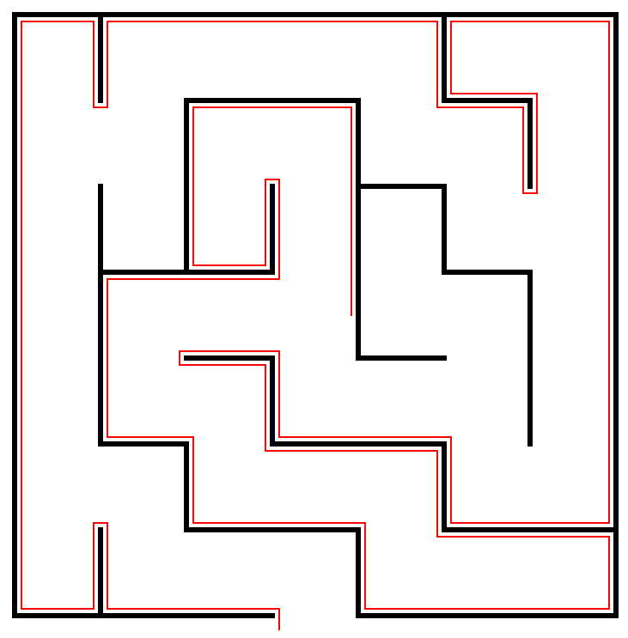
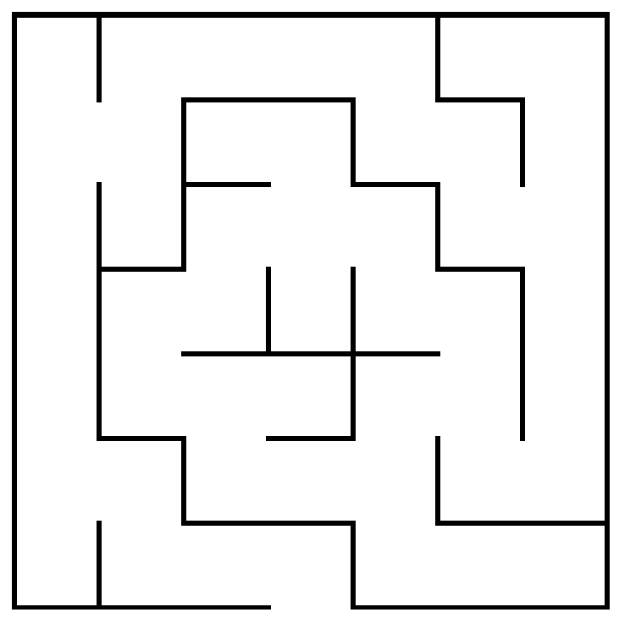
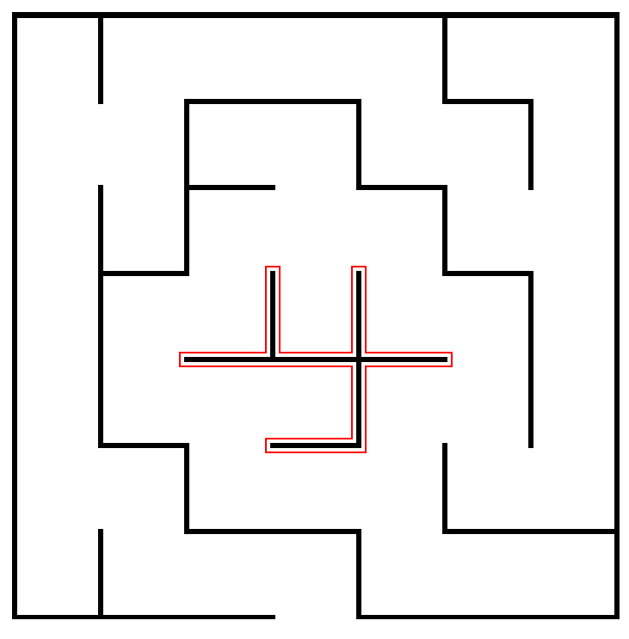
Right Hand Rule
The most widely known strategy for solving a maze is called the right-hand rule, in which you put your right hand on the wall and keep it there until you find an exit.
If Theseus applies the right-hand rule in this maze, the solution path looks like this.
Unfortunately, the right-hand rule doesn’t work if there are loops in the maze that surround either the starting position or the goal.
In this maze, the right-hand rule sends Theseus into an infinite loop.
Θ
Θ
Θ

Slide 53
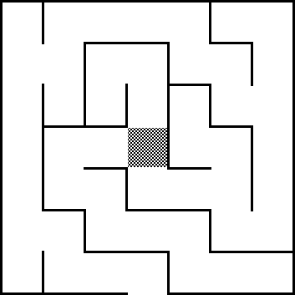
Maze Decision Tree
Θ
Θ
Θ
Θ

Slide 54
Enumerated Types in C++
It is often convenient to define new types in which the possible values are chosen from a small set of possibilities. Such types are called enumerated types.
In C++, you define an enumerated type like this:
enum name { list of element names };
The code for the maze program uses enum to define a new type consisting of the four compass points, as follows:
enum Direction {
NORTH, EAST, SOUTH, WEST
};
You can then declare a variable of type Direction and use it along with the constants NORTH, EAST, SOUTH, and WEST.

Slide 55
Maze Collection
/*
* Class: Maze
* -----------
* This class represents a two-dimensional maze contained in a rectangular
* grid of squares. The maze is read in from a data file in which the
* characters '+', '-', and '|' represent corners, horizontal walls, and
* vertical walls, respectively; spaces represent open passageway squares.
* The starting position is indicated by the character 'S'. For example,
* the following data file defines a simple maze:
*
* +-+-+-+-+-+
* | |
* + +-+ + +-+
* |S | |
* +-+-+-+-+-+
*/
class Maze {
public:

Slide 56
Maze Collection
bool isOutside(Point pt);
bool wallExists(Point pt, Direction dir);
void markSquare(Point pt);
void unmarkSquare(Point pt);
bool isMarked(Point pt);

Slide 57
Maze

Slide 58
The SolveMaze Function
/*
* Function: solveMaze
* Usage: solveMaze(maze, start);
* ------------------------------
* Attempts to generate a solution to the current maze from the specified
* start point. The solveMaze function returns true if the maze has a
* solution and false otherwise. The implementation uses recursion
* to solve the submazes that result from marking the current square
* and moving one step along each open passage.
*/
bool solveMaze(Maze & maze, Point start) {
if (maze.isOutside(start)) return true;
if (maze.isMarked(start)) return false;
maze.markSquare(start);
for (Direction dir = NORTH; dir <= WEST; dir++) {
if (!maze.wallExists(start, dir)) {
if (solveMaze(maze, adjacentPoint(start, dir))) {
return true;
}
}
}
maze.unmarkSquare(start);
return false;
}

Slide 59
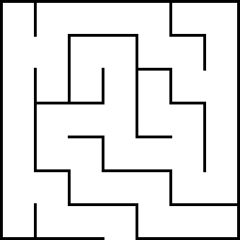

Tracing the SolveMaze Function
bool solveMaze(Maze & maze, Point start) {
if (maze.isOutside(start)) return true;
if (maze.isMarked(start)) return false;
maze.markSquare(start);
for (Direction dir = NORTH; dir <= WEST; dir++) {
if (!maze.wallExists(start, dir)) {
if (solveMaze(maze, adjPt(start, dir))) {
return true;
}
}
}
maze.unmarkSquare(start);
return false;
}
x
x
x
x
x
x
x
bool solveMaze(Maze & maze, Point start) {
if (maze.isOutside(start)) return true;
if (maze.isMarked(start)) return false;
maze.markSquare(start);
for (Direction dir = NORTH; dir <= WEST; dir++) {
if (!maze.wallExists(start, dir)) {
if (solveMaze(maze, adjPt(start, dir))) {
return true;
}
}
}
maze.unmarkSquare(start);
return false;
}
bool solveMaze(Maze & maze, Point start) {
if (maze.isOutside(start)) return true;
if (maze.isMarked(start)) return false;
maze.markSquare(start);
for (Direction dir = NORTH; dir <= WEST; dir++) {
if (!maze.wallExists(start, dir)) {
if (solveMaze(maze, adjPt(start, dir))) {
return true;
}
}
}
maze.unmarkSquare(start);
return false;
}
x
x
x
x
x
x
x
x
x
x
x
x
x
Θ
x
x
x
Θ
x
x
x
x
x
Θ
x
x
x
x
x
x
x
Θ
start
dir
dir
(3, 3)
EAST
SOUTH
EAST
SOUTH
NORTH
start
NORTH
start
dir
dir
(3, 2)
(3, 4)
Don’t follow the recursion more than one level.
Depend on the recursive leap of faith.

Slide 60
Reflections on Maze
The solveMaze program is a useful example of how to search all paths that stem from a branching series of choices. At each square, the solveMaze program calls itself recursively to find a solution from one step further along the path.
To give yourself a better sense of why recursion is important in this problem, think for a minute or two about what it buys you and why it would be difficult to solve this problem iteratively.
In particular, how would you answer the following questions:
  What information does the algorithm need to remember as it proceeds with the solution, particularly about the options it has already tried?
  In the recursive solution, where is this information kept?
  How might you keep track of this information otherwise?

Slide 61
Reflections on Maze
Suppose that the program has reached the following position:
x
Θ
x
x
x
x
How does the algorithm keep track of the “big picture” of what paths it still needs to explore?

Slide 62
Each Frame Remembers One Choice
bool solveMaze(Maze & maze, Point start) {
if (maze.isOutside(start)) return true;
if (maze.isMarked(start)) return false;
maze.markSquare(start);
for (Direction dir = NORTH; dir <= WEST; dir++) {
if (!maze.wallExists(start, dir)) {
if (solveMaze(maze, adjPt(start, dir))) {
return true;
}
}
}
maze.unmarkSquare(start);
return false;
}
bool solveMaze(Maze & maze, Point start) {
if (maze.isOutside(start)) return true;
if (maze.isMarked(start)) return false;
maze.markSquare(start);
for (Direction dir = NORTH; dir <= WEST; dir++) {
if (!maze.wallExists(start, dir)) {
if (solveMaze(maze, adjPt(start, dir))) {
return true;
}
}
}
maze.unmarkSquare(start);
return false;
}
bool solveMaze(Maze & maze, Point start) {
if (maze.isOutside(start)) return true;
if (maze.isMarked(start)) return false;
maze.markSquare(start);
for (Direction dir = NORTH; dir <= WEST; dir++) {
if (!maze.wallExists(start, dir)) {
if (solveMaze(maze, adjPt(start, dir))) {
return true;
}
}
}
maze.unmarkSquare(start);
return false;
}
bool solveMaze(Maze & maze, Point start) {
if (maze.isOutside(start)) return true;
if (maze.isMarked(start)) return false;
maze.markSquare(start);
for (Direction dir = NORTH; dir <= WEST; dir++) {
if (!maze.wallExists(start, dir)) {
if (solveMaze(maze, adjPt(start, dir))) {
return true;
}
}
}
maze.unmarkSquare(start);
return false;
}
x
Θ
x
x
Θ
x
x
x
x
x
bool solveMaze(Maze & maze, Point start) {
if (maze.isOutside(start)) return true;
if (maze.isMarked(start)) return false;
maze.markSquare(start);
for (Direction dir = NORTH; dir <= WEST; dir++) {
if (!maze.wallExists(start, dir)) {
if (solveMaze(maze, adjPt(start, dir))) {
return true;
}
}
}
maze.unmarkSquare(start);
return false;
}
Θ
bool solveMaze(Maze & maze, Point start) {
if (maze.isOutside(start)) return true;
if (maze.isMarked(start)) return false;
maze.markSquare(start);
for (Direction dir = NORTH; dir <= WEST; dir++) {
if (!maze.wallExists(start, dir)) {
if (solveMaze(maze, adjPt(start, dir))) {
return true;
}
}
}
maze.unmarkSquare(start);
return false;
}
x
x
x
x
x
x
x
x
x
x
x
Θ
Θ
x
Θ
start
dir
start
dir
(3, 3)
SOUTH
(3, 4)
start
dir
EAST
(4, 4)
start
dir
EAST
(3)
NORTH
start
dir
(5, 3)
start
dir
WEST
(4, 3)

Slide 63
Standard Exploration
// a general template for working with trees
void recursiveExploration(string currDir) {
if (!isDirectory(currDirr)) {
// base case
cout << currDirr << endl;
} else {
// get all next states
Vector<string> dirFiles;
listDirectory(currDir, dirFiles);
// recursive case
for(string file : dirFiles) {
string next = currDir + “/” + file;
recursiveExploration(next);
}
}
}
Makes a new “state” parameter

Slide 64
Backtracking often on Reference
// a general template for working with trees
void recursiveExploration(string & currDir) {
if (!isDirectory(currDirr)) {
// base case
cout << currDirr << endl;
} else {
// get all next states
Vector<string> dirFiles;
listDirectory(currDir, dirFiles);
// recursive case
for(string file : dirFiles) {
currDir += “/” + file;
recursiveExploration(next);
currDir = getHead(currDirr);
}
}
}
Changes curr and undoes change.

Slide 65
Backtracking Tree Template
// a general template for working with trees
void recursiveExploration( & state ) {
if (simpleCase || foundSolution) {
// base case
return without recursing.
} else {
// recursive case
for(each possible change from state) {
state = makeChange(state);
recursiveExploration(state);
state = unmakeChange(state);
}
}
}

Slide 66
Backtracking Tree Template II
// a general template for working with trees
void recursiveExploration( & state ) {
if (simpleCase || foundSolution || marked) {
// base case
return without recursing.
} else {
// recursive case
markState(state);
for(each possible change from state) {
recursiveExploration(state);
}
unmarkState(state);
}
}

Slide 67
Today’s Route
Backtracking
Tree
Examples
Tree
framework
9 Letters
Decision
trees
Exploration River

Slide 68
The End

