Slide 1

Before We Get Started

Slide 2

CS198 Section
Leading
cs198@cs.stanford.edu

Slide 3
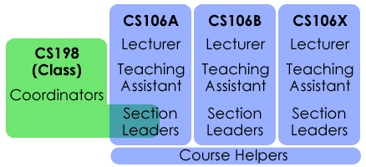
What is Section Leading?
Section leaders help with the teaching and grading of CS106A/B/X

Slide 4
What do Section Leaders do?
Teach a weekly 50 minute section
Help students in the LaIR
Grade CS106 assignments and exams
Hold IGs with students
Have fun!

Slide 5
Prerequisites
For this round of applications, we are looking for applicants who are currently in CS106B/X... and that’s you!
We are looking for section leaders from any major that can relate to students and clearly explain concepts.
Notes:
if you have questions about requirements, send us an email before applying

Slide 6
Times and Requirements
You’ll need to:
Section lead for two quarters!
Take CS198 for 3-4 units (1st quarter only)
Attend staff meetings (Monday, 4:30-6:00PM)
Attend workshops (Mon/Wed evenings)
Fulfill all teaching, LaIR, and grading responsibilities

Slide 7
Why Section Lead?
Teaching is an incredible experience!
Work directly with students
Participate in fun events
Join an amazing group of people
Leave your mark on campus
Notes:
TRUMAN

Slide 8
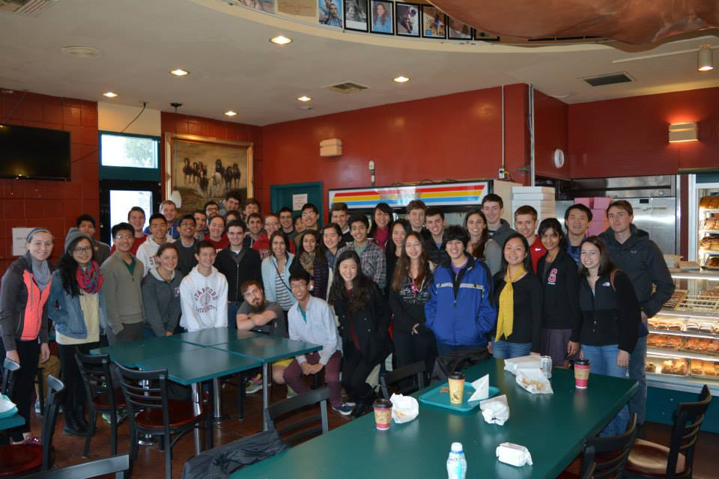
Participate in fun events
SLs keeping it classy for “LaIR Formal”
Welcome breakfast for new SLs

Slide 9
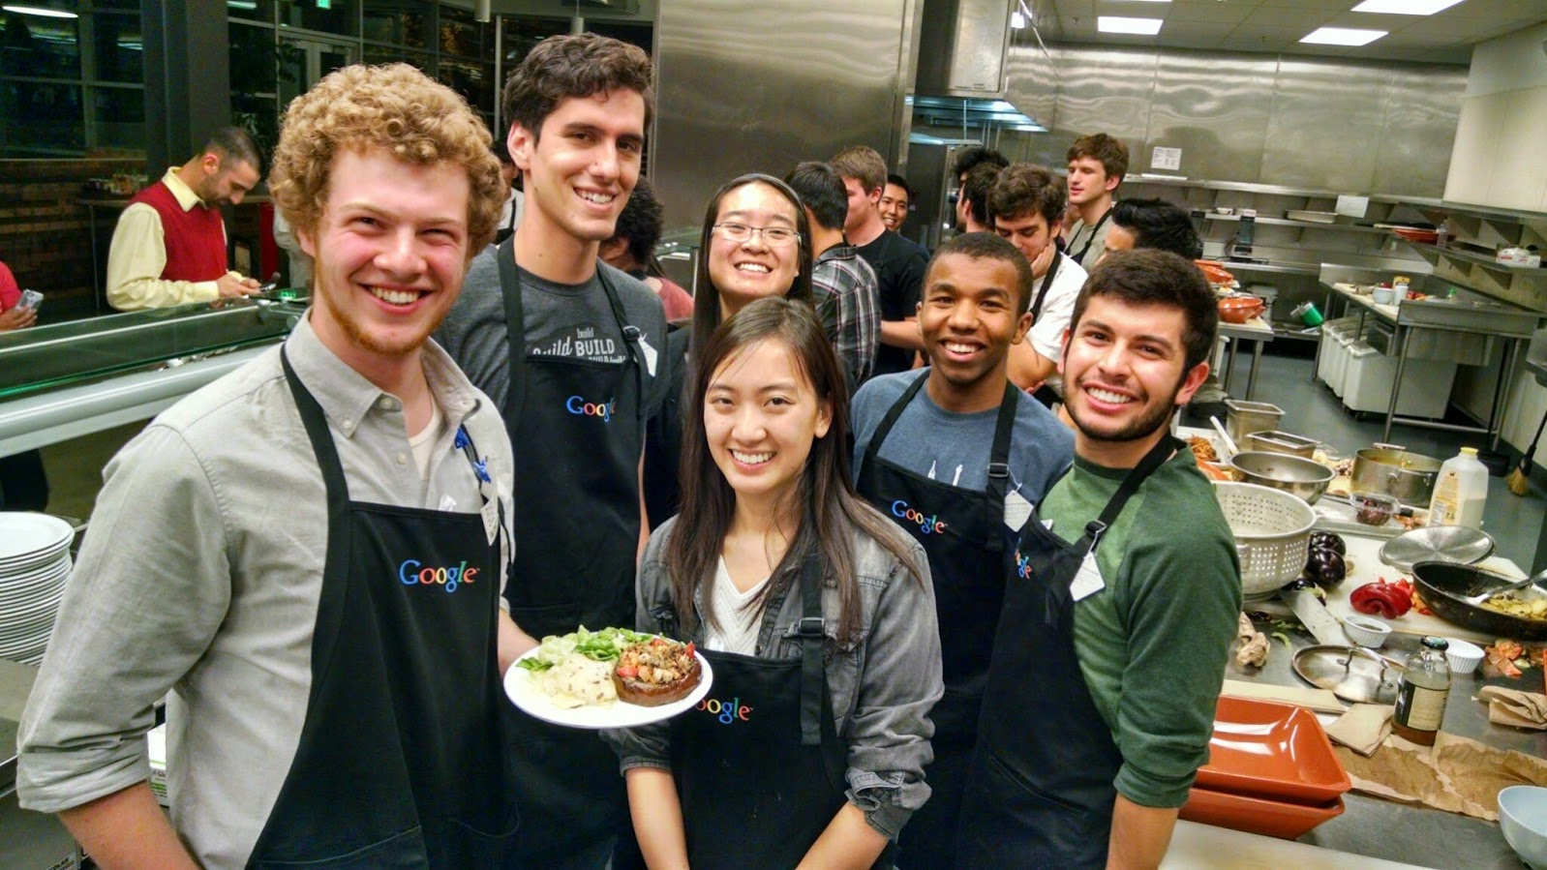

Participate in fun events
SLs at an “Iron Chef” event with Google
SLs on a SF Bay boat cruise with Microsoft

Slide 10



Join an amazing group of people
Mehran Sahami
Professor
Stanford
Marissa Mayer
CEO
Yahoo
Mike Schroepfer
CTO
Facebook

Slide 11
Leave your mark on campus
Section Leading is operated by current undergraduate and MS students.
Section Leading is a great way to make a substantive contribution to a meaningful program on campus.

Slide 12
Apply Now
Applications are open now!
Round 2 deadline: Friday, February 19th
Online application: cs198.stanford.edu
Contact us: cs198@cs.stanford.edu
Notes:
NHIEN

Slide 13
Thanks!

Slide 14
Chris Announcements

Slide 15
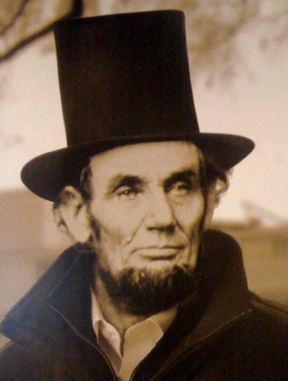
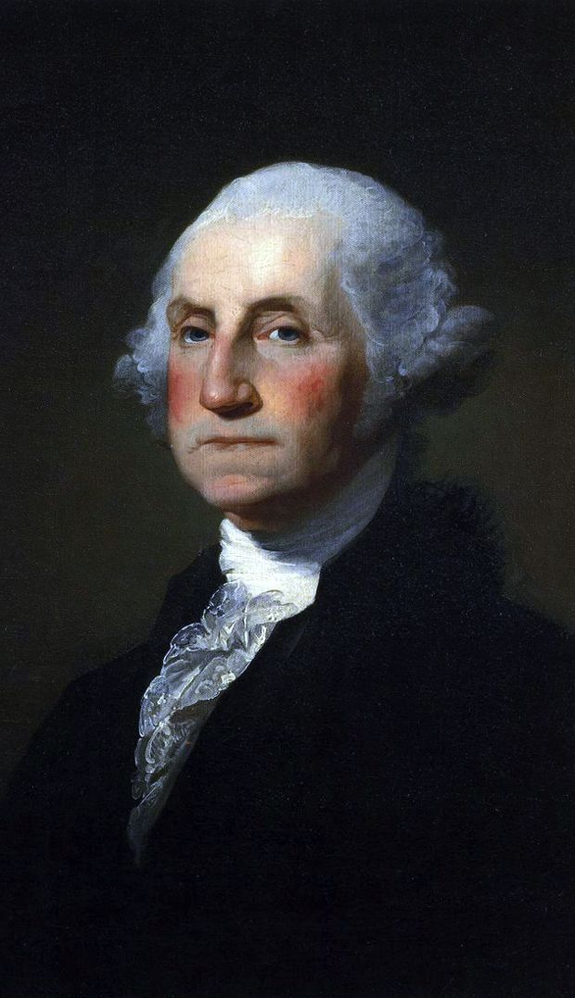

President’s Day

Slide 16
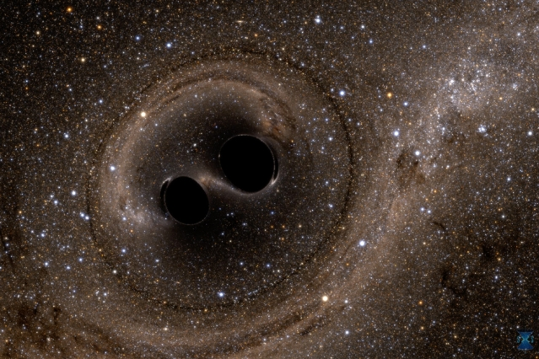
Gravitational Waves Observed

Slide 17

Boggle
Due
Feb 15th

Slide 18

Priority Queue
Start
Feb 15nd
Due
Feb 24th

Slide 19
Priority Queue
Concepts:
Classes
Dynamic Alloc.
Linked Lists
Heaps
Start
Feb 15nd
Due
Feb 24th

Slide 20
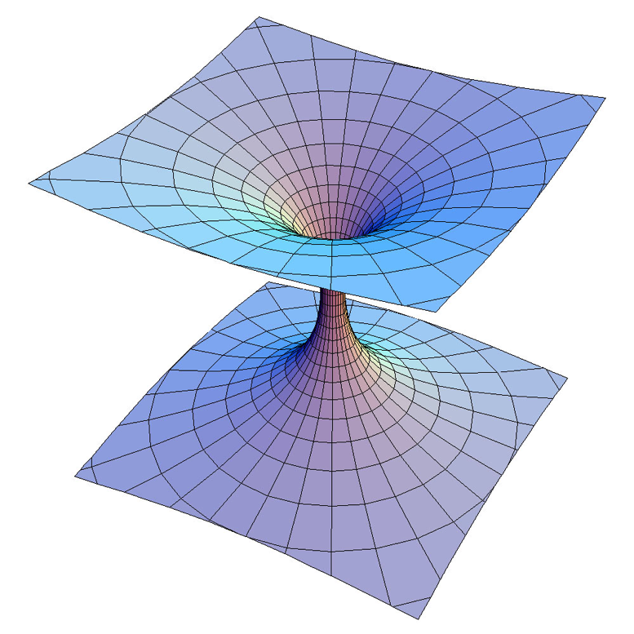

Midterm
Santa
Megan
Mehran
Rudolf
Chris
Get them back on Wednesday
Tell us your favorite song and we’ll create a station that explores that part of the music universe.
Enter Song
Create

Slide 21
Something cool.

Slide 22
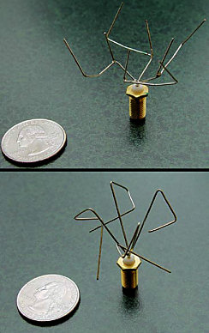
Computer Invented This
Antennae for microsatellites (~25kg)
2006

Slide 23
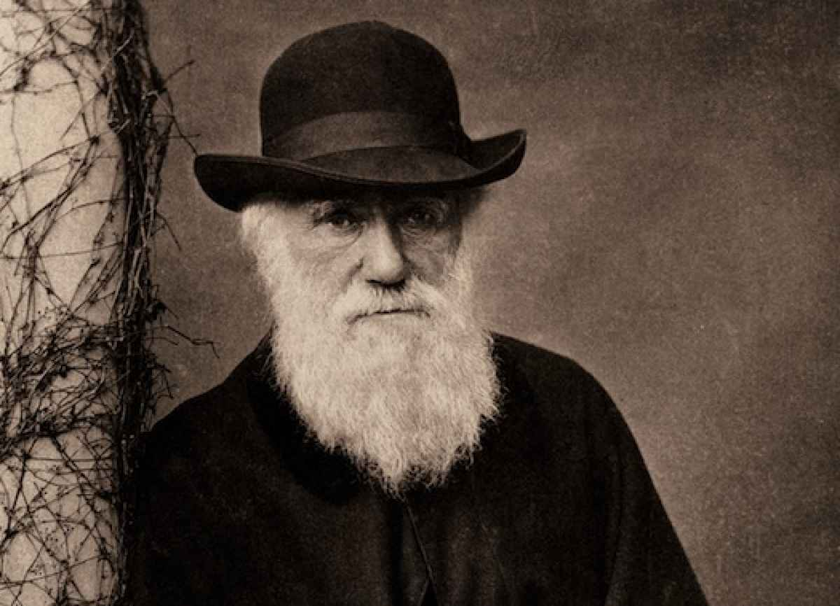
Inspired by Biological Evolution

Slide 24
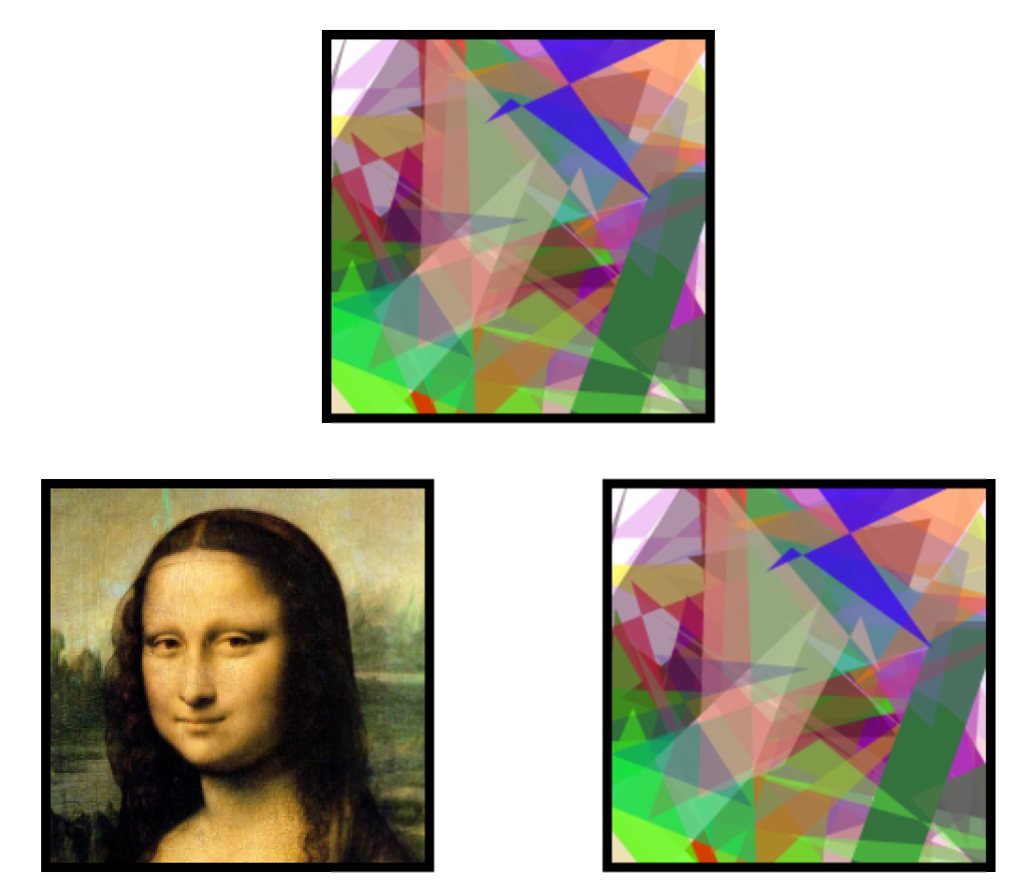
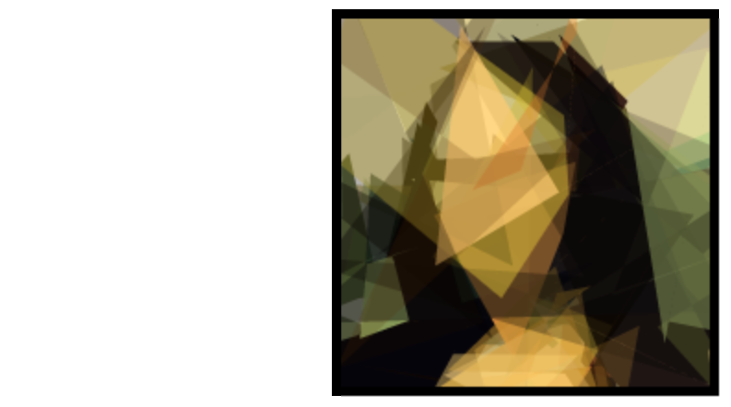


Evolving Mona Lisa
Best
Goal
Last Offspring

Slide 25
How do Evolutionary Algorithms work?

Slide 26
Short answer: PQueues

Slide 27
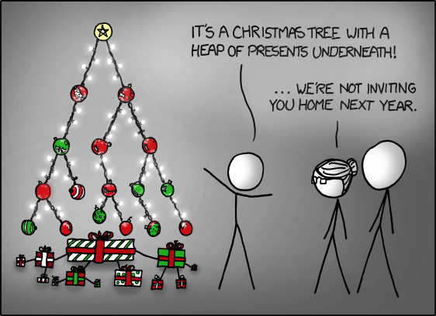

CS 106B, Lecture 17
Priority Queues; Heaps
Priority Queues
+ Heaps
reading:
Programming Abstractions in C++, section 16.5
Chris Piech
CS 106B
Lecture 14
Feb 8, 2016

Slide 28

Today’s Goals
Care About Priority Queues
Learn about Heaps

Slide 29
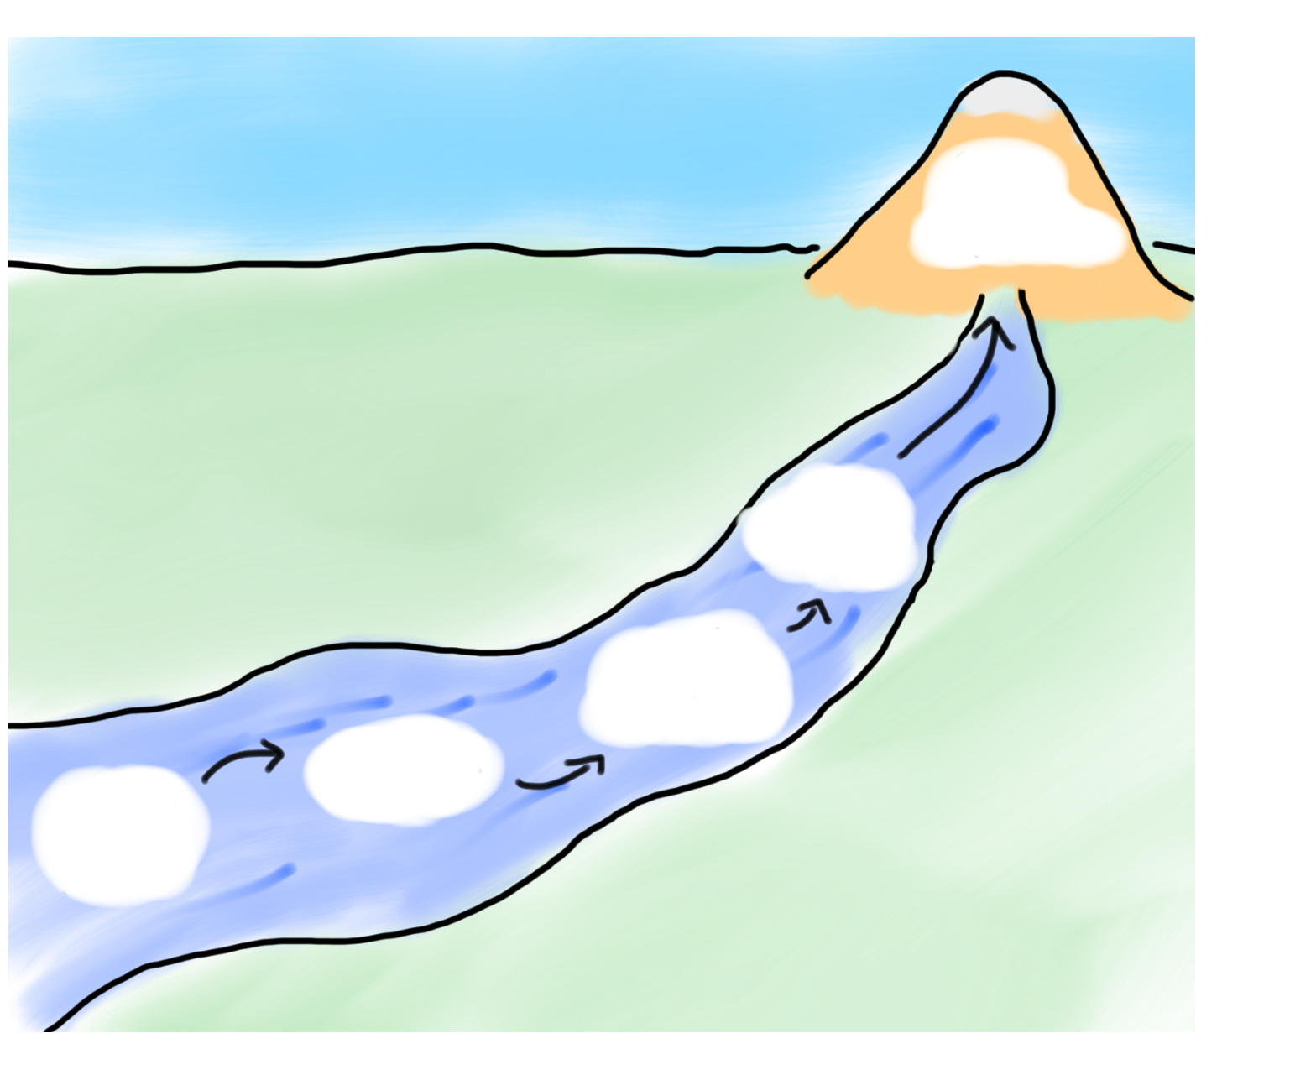
Today’s Goals
Friday
Evolution
Heaps
SL
Priority
Priority Queue of Water
Why

Slide 30

Today’s Goals
Friday
Evolution
Heaps
SL
Priority
Priority Queue of Water
Why

Slide 31
Imagine you worked in the ER

Slide 32
Would look something like this…

Slide 33

Would look something like this…

Slide 34
Prioritization problems
ER scheduling: Scheduling patients for treatment in the ER. A gunshot victim should be treated sooner than a guy with a cold, regardless of arrival time. How do we always choose the most urgent case when new patients continue to arrive?
key operations we want:
add an element (print job, patient, etc.)
Get/remove the most "important" or "urgent" element

Slide 35
Priority Queue ADT
priority queue: A collection of ordered elements that provides fast access to the highest-priority element.
enqueue: adds an element with a given priority
peek: returns highest-priority value
dequeue: removes/returns highest-priority value
pq.enqueue("if", 2);
pq.enqueue("from", 4);
...
"the":3
pq.dequeue()
"if":2
"for":3
"down":4
"from":4
"bye":3
"you":3
"if"
"why":3
priority queue (using lengths as priorities, in this case)

Slide 36
PriorityQueue members
#include "pqueue.h"
  PriorityQueue<string> faculty;
  faculty.enqueue(”Chris", 5); // low priority
  faculty.enqueue("Eric", 2); // high priority
  ...
pq.enqueue(value, pri); | adds value to queue, with the given priority number
pq.dequeue() | returns the value in the queue with highest (minimum) priority; throws an error if queue is empty
pq.peek() | returns highest (minimum) priority element without removing it; throws error if queue is empty
pq.peekPriority() | returns priority of highest (minimum) priority element; throws error if queue is empty
pq.isEmpty() | returns true if queue contains no elements (size 0)
pq.size() | returns the number of elements in the queue
pq.toString() | returns a string such as "{3, 42, -7, 15}"
pq.changePriority(value, pri); | alters an existing element's priority
pq.clear(); | removes all elements of the set

Slide 37
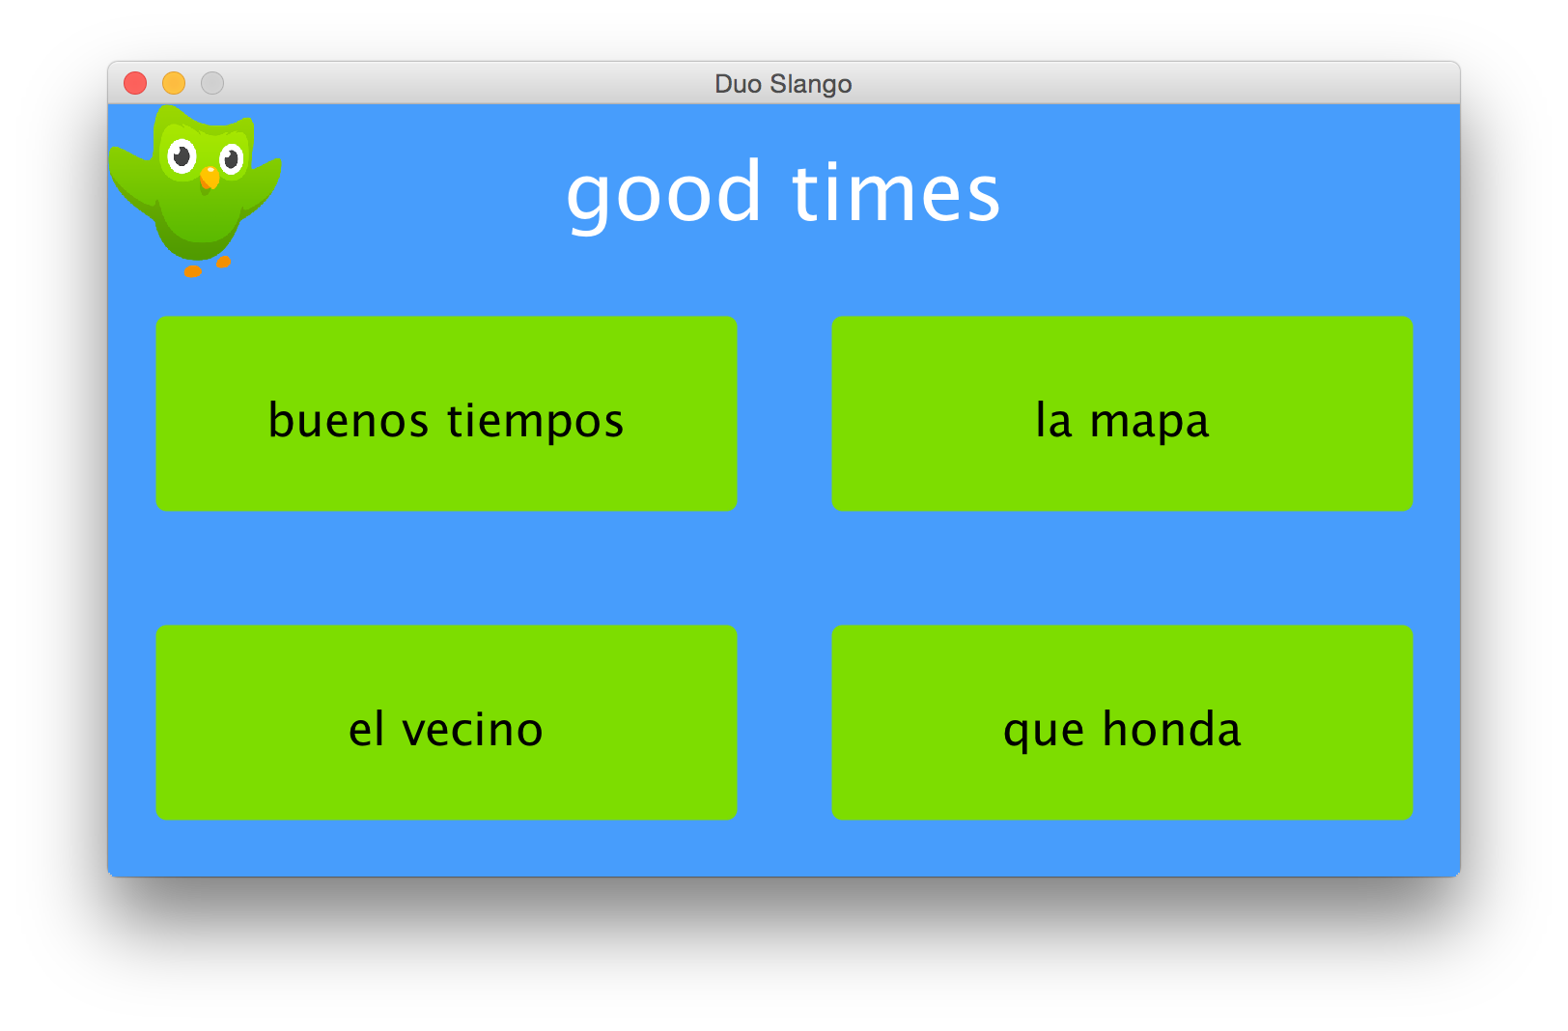
Seen PQueues Before

Slide 38
Exercise: SL scheduling
Every quarter the SLs choose their LaIR hours.
  SLs with more seniority (quarters worked) get to choose first.
  Each line of the input file contains the year the SL began working with us, and the quarter (1=fall, 2=winter, 3=spring, 4=summer).
  Write code to read the list of SLs and output the order of choosing.
  Input file format:
  name year quarter Zack 2014 2
  name year quarter Sara 2012 4
  name year quarter Tyler 2013 1
  ...

Slide 39
And… Here it is!

Slide 40
Exercise solution
PriorityQueue<string> SLs; // read the contents of sls.txt
ifstream input; // into a priority queue
input.open("sls.txt");
string slName;
int year;
int quarter;
while (input >> slName >> year >> quarter) {
// store with year,quarter as priority so that the SLs
// come out of the PQ in descending order of seniority
// (e.g. year=2013, qtr=4 => priority = 1973)
int priority = year – (10 * quarter);
SLs.enqueue(slName, priority);
}
// pull the SLs out of the PQ from most to least seniority
while (!SLs.isEmpty()) {
string sl = SLs.dequeue();
cout << sl << " picks next." << endl;
}

Slide 41
Exercise solution
PriorityQueue<string> SLs; // read the contents of sls.txt
ifstream input; // into a priority queue
input.open("sls.txt");
string slName;
int year;
int quarter;
while (input >> slName >> year >> quarter) {
// store with year,quarter as priority so that the SLs
// come out of the PQ in descending order of seniority
// (e.g. year=2013, qtr=4 => priority = 1973)
int priority = year – (10 * quarter);
SLs.enqueue(slName, priority);
}
// pull the SLs out of the PQ from most to least seniority
while (!SLs.isEmpty()) {
string sl = SLs.dequeue();
cout << sl << " picks next." << endl;
}
Remember that low priorities come out first

Slide 42
What a beautiful ADT!

Slide 43
How does it work?

Slide 44
Implementing PQ
There are several ways one might implement a priority queue.

Slide 45
PQ as Vector
enqueue by adding to end
dequeue by searching for / removing highest-priority element
  What is the big-Oh of enqueue? dequeue? peek?
index | 0 | 1 | 2 | 3 | 4 | 5 | 6 | 7 | 8 | 9
value | x | b | a | m | q | t
priority | 5 | 4 | 8 | 5 | 5 | 2
size | 6 | capacity |  |  | 10

Slide 46
PQ as Sorted Vector
enqueue by adding to proper place to preserve sorted order
dequeue the first element
  What is the big-Oh of enqueue? dequeue? Peek?
index | 0 | 1 | 2 | 3 | 4 | 5 | 6 | 7 | 8 | 9
value | t | b | m | q | x | a
priority | 2 | 4 | 5 | 5 | 5 | 8
size | 6 | capacity |  |  | 10

Slide 47
PQ as Linked List
enqueue by adding to front
dequeue by searching for / removing highest-priority element
  What is the big-Oh of enqueue? dequeue? peek?
val | pri | next
t | 2
val | pri | next
q | 5
val | pri | next
m | 5
front =
val | pri | next
a | 8
val | pri | next
b | 4
val | pri | next
x | 5

Slide 48
PQ as Sorted Linked List
enqueue by adding to proper place to preserve sorted order
dequeue the first element
  What is the big-Oh of enqueue? dequeue? peek?
val | pri | next
t | 2
val | pri | next
b | 4
val | pri | next
m | 5
front =
val | pri | next
q | 5
val | pri | next
x | 5
val | pri | next
a | 8

Slide 49
Sorted = fast dequeue / peek
Unsorted = fast enqueue

Slide 50
Best of both worlds?

Slide 51
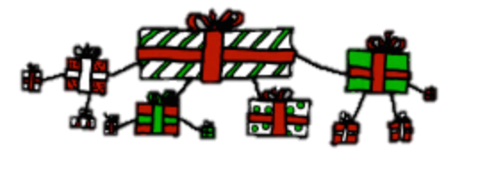
Max Heaps
Tree
Every branch takes you to a “smaller” node

Slide 52






Min Heaps
Tree
Every branch takes you to a “larger” node

Slide 53
Priority Heaps
Tree
Heap Ordered: Every branch takes you to a “greater” node.
Binary: Every node has at most two children.
Complete: There are no “gaps” in the tree.
10
20
80
40
60
85
99
50
76
65

Slide 54
Priority Heaps
Tree
Heap Ordered: Every branch takes you to a “greater” node.
Binary: Every node has at most two children.
Complete: There are no “gaps” in the tree.
Priority 10
Value = “a”
10
Priority 80
Value = “c”
20
80
Priority 40
Value = “p”
40
60
85
99
50
76
65

Slide 55
Priority Heaps
Tree
Heap Ordered: Every branch takes you to a “greater” node.
Binary: Every node has at most two children.
Complete: There are no “gaps” in the tree.
10
20
80
40
60
85
99
50
76
65

Slide 56
Not Priority Heaps
Tree
Not Heap Ordered: Every branch takes you to a “greater” node.
Binary: Every node has at most two children.
Complete: There are no “gaps” in the tree.
10
85
65
40
60
80
99
50
76
20

Slide 57
Priority Heaps
Tree
Heap Ordered: Every branch takes you to a “greater” node.
Binary: Every node has at most two children.
Complete: There are no “gaps” in the tree.
10
20
80
40
60
85
99
50
76
65

Slide 58
Not Priority Heaps
Tree
Heap Ordered: Every branch takes you to a “greater” node.
Not Binary: Every node has at most two children.
Complete: There are no “gaps” in the tree.
10
20
80
40
60
65
85
99
50
76

Slide 59
Priority Heaps
Tree
Heap Ordered: Every branch takes you to a “greater” node.
Binary: Every node has at most two children.
Complete: There are no “gaps” in the tree.
10
20
80
40
60
85
99
50
76
65

Slide 60
Priority Heaps
Tree
Heap Ordered: Every branch takes you to a “greater” node.
Binary: Every node has at most two children.
Not Complete: There are no “gaps” in the tree.
10
20
80
40
60
85
99
50
65

Slide 61
Priority Heaps
Tree
Heap Ordered: Every branch takes you to a “greater” node.
Binary: Every node has at most two children.
Complete: There are no “gaps” in the tree.
10
20
80
40
60
85
99
50
76
65

Slide 62
Priority Heaps
Tree
Heap Ordered: Every branch takes you to a “greater” node.
Binary: Every node has at most two children.
Complete: There are no “gaps” in the tree.
10
20
80
This is the next spot to fill
40
60
85
99
50
76
65

Slide 63
How do we represent that?

Slide 64
Heaps
Since it’s binary and complete, it turns out we can use an array!
index | 0 | 1 | 2 | 3 | 4 | 5 | 6 | 7 | 8 | 9
value |  | t | m | b | x | q | a
priority |  | 2 | 5 | 4 | 5 | 5 | 8
size | 6 | capacity |  |  | 10
  The "start" or "root" index is 1.
  Every index i has a "parent" index: i/2
  Every index has two "child" indexes: i*2, i*2 + 1

Slide 65
Heap as Tree
10
20
80
40
60
85
99
50
76
65
index | 0 | 1 | 2 | 3 | 4 | 5 | 6 | 7 | 8 | 9 | 10 | 11 | 12
value | 0 | 10 | 20 | 80 | 40 | 60 | 85 | 99 | 50 | 76 | 65 | 0 | 0
size | 10 | capacity |  |  | 13

Slide 66
Heap as Tree
10
20
80
40
60
85
99
50
76
65
index | 0 | 1 | 2 | 3 | 4 | 5 | 6 | 7 | 8 | 9 | 10 | 11 | 12
value | 0 | 10 | 20 | 80 | 40 | 60 | 85 | 99 | 50 | 76 | 65 | 0 | 0
size | 10 | capacity |  |  | 13

Slide 67
Heap as Tree
10
20
80
40
60
85
99
50
76
65
  Every index i has a "parent" index: i/2
index | 0 | 1 | 2 | 3 | 4 | 5 | 6 | 7 | 8 | 9 | 10 | 11 | 12
value | 0 | 10 | 20 | 80 | 40 | 60 | 85 | 99 | 50 | 76 | 65 | 0 | 0
size | 10 | capacity |  |  | 13

Slide 68
Heap as Tree
10
20
80
40
60
85
99
50
76
65
index | 0 | 1 | 2 | 3 | 4 | 5 | 6 | 7 | 8 | 9 | 10 | 11 | 12
value | 0 | 10 | 20 | 80 | 40 | 60 | 85 | 99 | 50 | 76 | 65 | 0 | 0
size | 10 | capacity |  |  | 13

Slide 69
Heap as Tree
10
20
80
40
60
85
99
50
76
65
  Every index i has two children at index 2 *i and 2 * i + 1
index | 0 | 1 | 2 | 3 | 4 | 5 | 6 | 7 | 8 | 9 | 10 | 11 | 12
value | 0 | 10 | 20 | 80 | 40 | 60 | 85 | 99 | 50 | 76 | 65 | 0 | 0
size | 10 | capacity |  |  | 13

Slide 70
Heap add (enqueue)
  pq.enqueue("k", 1);
index | 0 | 1 | 2 | 3 | 4 | 5 | 6 | 7 | 8 | 9
value |  | t | m | b | x | q | a
priority |  | 2 | 5 | 4 | 5 | 5 | 8
size | 6 | capacity |  |  | 10

Slide 71
Heap add (enqueue)
  pq.enqueue("k", 1);
index | 0 | 1 | 2 | 3 | 4 | 5 | 6 | 7 | 8 | 9
value |  | t | m | b | x | q | a | k
priority |  | 2 | 5 | 4 | 5 | 5 | 8 | 1
size | 7 | capacity |  |  | 10
Place it in the first empty index

Slide 72
Heap add (enqueue)
  pq.enqueue("k", 1);
index | 0 | 1 | 2 | 3 | 4 | 5 | 6 | 7 | 8 | 9
value |  | t | m | b | x | q | a | k
priority |  | 2 | 5 | 4 | 5 | 5 | 8 | 1
size | 7 | capacity |  |  | 10
Place it in the first empty index
Bubble up to conserve “heap” property

Slide 73
Bubble Up!
  pq.enqueue("k", 1);
index | 0 | 1 | 2 | 3 | 4 | 5 | 6 | 7 | 8 | 9
value |  | t | m | b | x | q | a | k
priority |  | 2 | 5 | 4 | 5 | 5 | 8 | 1
size | 7 | capacity |  |  | 10
Check priority against its parent.
If priority is smaller: swap the two.
Repeat until the priority of the parent is smaller or you reach the top of the tree

Slide 74
Bubble Up!
  pq.enqueue("k", 1);
index | 0 | 1 | 2 | 3 | 4 | 5 | 6 | 7 | 8 | 9
value |  | t | m | b | x | q | a | k
priority |  | 2 | 5 | 4 | 5 | 5 | 8 | 1
size | 7 | capacity |  |  | 10
Check priority against its parent.
If priority is smaller: swap the two.
Repeat until the priority of the parent is smaller or you reach the top of the tree

Slide 75
Bubble Up!
  pq.enqueue("k", 1);
index | 0 | 1 | 2 | 3 | 4 | 5 | 6 | 7 | 8 | 9
value |  | t | m | b | x | q | a | k
priority |  | 2 | 5 | 4 | 5 | 5 | 8 | 1
size | 7 | capacity |  |  | 10
Check priority against its parent.
If priority is smaller: swap the two.
Repeat until the priority of the parent is smaller or you reach the top of the tree

Slide 76
Bubble Up!
  pq.enqueue("k", 1);
index | 0 | 1 | 2 | 3 | 4 | 5 | 6 | 7 | 8 | 9
value |  | t | m | k | x | q | a | b
priority |  | 2 | 5 | 1 | 5 | 5 | 8 | 4
size | 7 | capacity |  |  | 10
Check priority against its parent.
If priority is smaller: swap the two.
Repeat until the priority of the parent is smaller or you reach the top of the tree

Slide 77
Bubble Up!
index | 0 | 1 | 2 | 3 | 4 | 5 | 6 | 7 | 8 | 9
value |  | t | m | k | x | q | a | b
priority |  | 2 | 5 | 1 | 5 | 5 | 8 | 4
size | 7 | capacity |  |  | 10
Check priority against its parent.
If priority is smaller: swap the two.
Repeat until the priority of the parent is smaller or you reach the top of the tree

Slide 78
Bubble Up!
index | 0 | 1 | 2 | 3 | 4 | 5 | 6 | 7 | 8 | 9
value |  | t | m | k | x | q | a | b
priority |  | 2 | 5 | 1 | 5 | 5 | 8 | 4
size | 7 | capacity |  |  | 10
Check priority against its parent.
If priority is smaller: swap the two.
Repeat until the priority of the parent is smaller or you reach the top of the tree

Slide 79
Bubble Up!
index | 0 | 1 | 2 | 3 | 4 | 5 | 6 | 7 | 8 | 9
value |  | t | m | k | x | q | a | b
priority |  | 2 | 5 | 1 | 5 | 5 | 8 | 4
size | 7 | capacity |  |  | 10
Check priority against its parent.
If priority is smaller: swap the two.
Repeat until the priority of the parent is smaller or you reach the top of the tree

Slide 80
Bubble Up!
index | 0 | 1 | 2 | 3 | 4 | 5 | 6 | 7 | 8 | 9
value |  | t | m | k | x | q | a | b
priority |  | 2 | 5 | 1 | 5 | 5 | 8 | 4
size | 7 | capacity |  |  | 10
Check priority against its parent.
If priority is smaller: swap the two.
Repeat until the priority of the parent is smaller or you reach the top of the tree

Slide 81
Bubble Up!
index | 0 | 1 | 2 | 3 | 4 | 5 | 6 | 7 | 8 | 9
value |  | k | m | t | x | q | a | b
priority |  | 1 | 5 | 2 | 5 | 5 | 8 | 4
size | 7 | capacity |  |  | 10
Check priority against its parent.
If priority is smaller: swap the two.
Repeat until the priority of the parent is smaller or you reach the top of the tree

Slide 82
Bubble Up!
index | 0 | 1 | 2 | 3 | 4 | 5 | 6 | 7 | 8 | 9
value |  | k | m | t | x | q | a | b
priority |  | 1 | 5 | 2 | 5 | 5 | 8 | 4
size | 7 | capacity |  |  | 10
Check priority against its parent.
If priority is smaller: swap the two.
Repeat until the priority of the parent is smaller or you reach the top of the tree

Slide 83
Bubble Up!
index | 0 | 1 | 2 | 3 | 4 | 5 | 6 | 7 | 8 | 9
value |  | k | m | t | x | q | a | b
priority |  | 1 | 5 | 2 | 5 | 5 | 8 | 4
size | 7 | capacity |  |  | 10
Check priority against its parent.
If priority is smaller: swap the two.
Repeat until the priority of the parent is smaller or you reach the top of the tree

Slide 84
Bubble Up!
index | 0 | 1 | 2 | 3 | 4 | 5 | 6 | 7 | 8 | 9
value |  | k | m | t | x | q | a | b
priority |  | 1 | 5 | 2 | 5 | 5 | 8 | 4
size | 7 | capacity |  |  | 10
Check priority against its parent.
If priority is smaller: swap the two.
Repeat until the priority of the parent is smaller or you reach the top of the tree

Slide 85
Big O?

Slide 86
Worst Case
10
20
80
40
60
85
99
50
76
65
index | 0 | 1 | 2 | 3 | 4 | 5 | 6 | 7 | 8 | 9 | 10 | 11 | 12
value | 0 | 10 | 20 | 80 | 40 | 60 | 85 | 99 | 50 | 76 | 65 | 0 | 0
size | 10 | capacity |  |  | 13

Slide 87
Worst Case
10
20
80
40
60
85
99
50
76
65
index | 0 | 1 | 2 | 3 | 4 | 5 | 6 | 7 | 8 | 9 | 10 | 11 | 12
value | 0 | 10 | 20 | 80 | 40 | 60 | 85 | 99 | 50 | 76 | 65 | 0 | 0
size | 10 | capacity |  |  | 13

Slide 88
Worst Case
10
20
80
40
60
85
99
50
76
65
What is the depth of the tree?
index | 0 | 1 | 2 | 3 | 4 | 5 | 6 | 7 | 8 | 9 | 10 | 11 | 12
value | 0 | 10 | 20 | 80 | 40 | 60 | 85 | 99 | 50 | 76 | 65 | 0 | 0
size | 10 | capacity |  |  | 13

Slide 89
Worst Case
10
20
80
40
60
85
99
50
76
65
How many times can you divide n by 2?
index | 0 | 1 | 2 | 3 | 4 | 5 | 6 | 7 | 8 | 9 | 10 | 11 | 12
value | 0 | 10 | 20 | 80 | 40 | 60 | 85 | 99 | 50 | 76 | 65 | 0 | 0
size | 10 | capacity |  |  | 13

Slide 90
Worst Case
10
20
80
40
60
85
99
50
76
65
index | 0 | 1 | 2 | 3 | 4 | 5 | 6 | 7 | 8 | 9 | 10 | 11 | 12
value | 0 | 10 | 20 | 80 | 40 | 60 | 85 | 99 | 50 | 76 | 65 | 0 | 0
size | 10 | capacity |  |  | 13

Slide 91

Enqueue Big O?

Slide 92
Peek
  pq.peek() --> "k"
  pq.peekPriority() --> 1
index | 0 | 1 | 2 | 3 | 4 | 5 | 6 | 7 | 8 | 9
value |  | k | m | t | x | q | a | b
priority |  | 1 | 5 | 2 | 5 | 5 | 8 | 4
size | 7 | capacity |  |  | 10
It is trivial to peek at the min-priority element in a heap. It is always located in index 1! What is the Big-Oh?

Slide 93

Peek Big O?

Slide 94
Heap remove (dequeue)
  pq.dequeue() --> "k”
index | 0 | 1 | 2 | 3 | 4 | 5 | 6 | 7 | 8 | 9
value |  | k | c | f | p | e | v | y
priority |  | 1 | 2 | 4 | 7 | 5 | 8 | 6
size | 7 | capacity |  |  | 10
Save the first value
Move the last element to the first
Bubble up the smaller of the children.
Repeat step 3 until you get to the bottom of the tree.

Slide 95
Heap remove (dequeue)
  pq.dequeue() --> "k”
index | 0 | 1 | 2 | 3 | 4 | 5 | 6 | 7 | 8 | 9
value |  | k | c | f | p | e | v | y
priority |  | 1 | 2 | 4 | 7 | 5 | 8 | 6
size | 7 | capacity |  |  | 10
Save the first value
Move the last element to the first
Bubble up the smaller of the children.
Repeat step 3 until you get to the bottom of the tree.

Slide 96
Heap remove (dequeue)
  pq.dequeue() --> "k”
index | 0 | 1 | 2 | 3 | 4 | 5 | 6 | 7 | 8 | 9
value |  | y | c | f | p | e | v | y
priority |  | 6 | 2 | 4 | 7 | 5 | 8 | 6
size | 6 | capacity |  |  | 10
Save the first value
Move the last element to the first
Bubble up the smaller of the children.
Repeat step 3 until you get to the bottom of the tree.

Slide 97
Heap remove (dequeue)
  pq.dequeue() --> "k”
index | 0 | 1 | 2 | 3 | 4 | 5 | 6 | 7 | 8 | 9
value |  | y | c | f | p | e | v
priority |  | 6 | 2 | 4 | 7 | 5 | 8
size | 6 | capacity |  |  | 10
Save the first value
Move the last element to the first
Bubble up the smaller of the children.
Repeat step 3 until you get to the bottom of the tree.

Slide 98
Heap remove (dequeue)
  pq.dequeue() --> "k”
index | 0 | 1 | 2 | 3 | 4 | 5 | 6 | 7 | 8 | 9
value |  | y | c | f | p | e | v
priority |  | 6 | 2 | 4 | 7 | 5 | 8
size | 6 | capacity |  |  | 10
Save the first value
Move the last element to the first
Bubble up the smaller of the children.
Repeat step 3 until you get to the bottom of the tree.

Slide 99
Heap remove (dequeue)
  pq.dequeue() --> "k”
index | 0 | 1 | 2 | 3 | 4 | 5 | 6 | 7 | 8 | 9
value |  | c | y | f | p | e | v
priority |  | 2 | 6 | 4 | 7 | 5 | 8
size | 6 | capacity |  |  | 10
Save the first value
Move the last element to the first
Bubble up the smaller of the children.
Repeat step 3 until you get to the bottom of the tree.

Slide 100
Heap remove (dequeue)
  pq.dequeue() --> "k”
index | 0 | 1 | 2 | 3 | 4 | 5 | 6 | 7 | 8 | 9
value |  | c | y | f | p | e | v
priority |  | 2 | 6 | 4 | 7 | 5 | 8
size | 6 | capacity |  |  | 10
Save the first value
Move the last element to the first
Bubble up the smaller of the children.
Repeat step 3 until you get to the bottom of the tree.

Slide 101
Heap remove (dequeue)
  pq.dequeue() --> "k”
index | 0 | 1 | 2 | 3 | 4 | 5 | 6 | 7 | 8 | 9
value |  | c | y | f | p | e | v
priority |  | 2 | 6 | 4 | 7 | 5 | 8
size | 6 | capacity |  |  | 10
Save the first value
Move the last element to the first
Bubble up the smaller of the children.
Repeat step 3 until you get to the bottom of the tree.

Slide 102
Heap remove (dequeue)
  pq.dequeue() --> "k”
index | 0 | 1 | 2 | 3 | 4 | 5 | 6 | 7 | 8 | 9
value |  | c | y | f | p | e | v
priority |  | 2 | 6 | 4 | 7 | 5 | 8
size | 6 | capacity |  |  | 10
Save the first value
Move the last element to the first
Bubble up the smaller of the children.
Repeat step 3 until you get to the bottom of the tree.

Slide 103
Heap remove (dequeue)
  pq.dequeue() --> "k”
index | 0 | 1 | 2 | 3 | 4 | 5 | 6 | 7 | 8 | 9
value |  | c | e | f | p | y | v
priority |  | 2 | 5 | 4 | 7 | 6 | 8
size | 6 | capacity |  |  | 10
Save the first value
Move the last element to the first
Bubble up the smaller of the children.
Repeat step 3 until you get to the bottom of the tree.

Slide 104
Heap remove (dequeue)
  pq.dequeue() --> "k”
index | 0 | 1 | 2 | 3 | 4 | 5 | 6 | 7 | 8 | 9
value |  | c | e | f | p | y | v
priority |  | 2 | 5 | 4 | 7 | 6 | 8
size | 6 | capacity |  |  | 10
Save the first value
Move the last element to the first
Bubble up the smaller of the children.
Repeat step 3 until you get to the bottom of the tree.

Slide 105
Big O?

Slide 106
Worst Case
10
20
80
40
60
85
99
50
76
99
index | 0 | 1 | 2 | 3 | 4 | 5 | 6 | 7 | 8 | 9 | 10 | 11 | 12
value | 0 | 10 | 20 | 80 | 40 | 60 | 85 | 99 | 50 | 76 | 99 | 0 | 0
size | 10 | capacity |  |  | 13

Slide 107
Worst Case
99
20
80
40
60
85
99
50
76
index | 0 | 1 | 2 | 3 | 4 | 5 | 6 | 7 | 8 | 9 | 10 | 11 | 12
value | 0 | 10 | 20 | 80 | 40 | 60 | 85 | 99 | 50 | 76 | 99 | 0 | 0
size | 10 | capacity |  |  | 13

Slide 108
Worst Case
99
20
80
40
60
85
99
50
76
index | 0 | 1 | 2 | 3 | 4 | 5 | 6 | 7 | 8 | 9 | 10 | 11 | 12
value | 0 | 10 | 20 | 80 | 40 | 60 | 85 | 99 | 50 | 76 | 99 | 0 | 0
size | 10 | capacity |  |  | 13

Slide 109
Worst Case
99
20
80
40
60
85
99
50
76
What is the depth of the tree?
index | 0 | 1 | 2 | 3 | 4 | 5 | 6 | 7 | 8 | 9 | 10 | 11 | 12
value | 0 | 10 | 20 | 80 | 40 | 60 | 85 | 99 | 50 | 76 | 99 | 0 | 0
size | 10 | capacity |  |  | 13

Slide 110
Worst Case
99
20
80
40
60
85
99
50
76
How many times can you divide n by 2?
index | 0 | 1 | 2 | 3 | 4 | 5 | 6 | 7 | 8 | 9 | 10 | 11 | 12
value | 0 | 10 | 20 | 80 | 40 | 60 | 85 | 99 | 50 | 76 | 99 | 0 | 0
size | 10 | capacity |  |  | 13

Slide 111
Enqueue Big O?

Slide 112
See Enqueue / Dequeue
as Trees

Slide 113
Enqueue
When adding to a heap, the value is first placed at bottom-right.
  To restore heap ordering, the newly added element is shifted ("bubbled") up the tree until it reaches its proper place.
  Enqueue 15 at bottom-right; bubble up until in order.
10
10
20
80
15
15
80
40
60
85
99
40
20
20
85
99
50
700
65
15
50
700
65
60
60

Slide 114
Dequeue
To restore heap order, the improper root is shifted ("bubbled") down the tree by swapping with its smaller (higher-pri) child.
  dequeue min of 10; swap up bottom-right leaf of 65; bubble down.
10
65
20
20
20
20
20
80
40
40
40
40
80
40
60
85
99
50
50
50
60
85
99
74
50
65
74
65
65

Slide 115
Today’s Goals
Friday
Evolution
Heaps
SL
Priority
Priority Queue of Water
Why

Slide 116
Today’s Goals
Friday
Evolution
Heaps
SL
Priority
Priority Queue of Water
Why

Slide 117
Evolutionary Algorithms
Antennae for microsatellites (~25kg)
2006

Slide 118
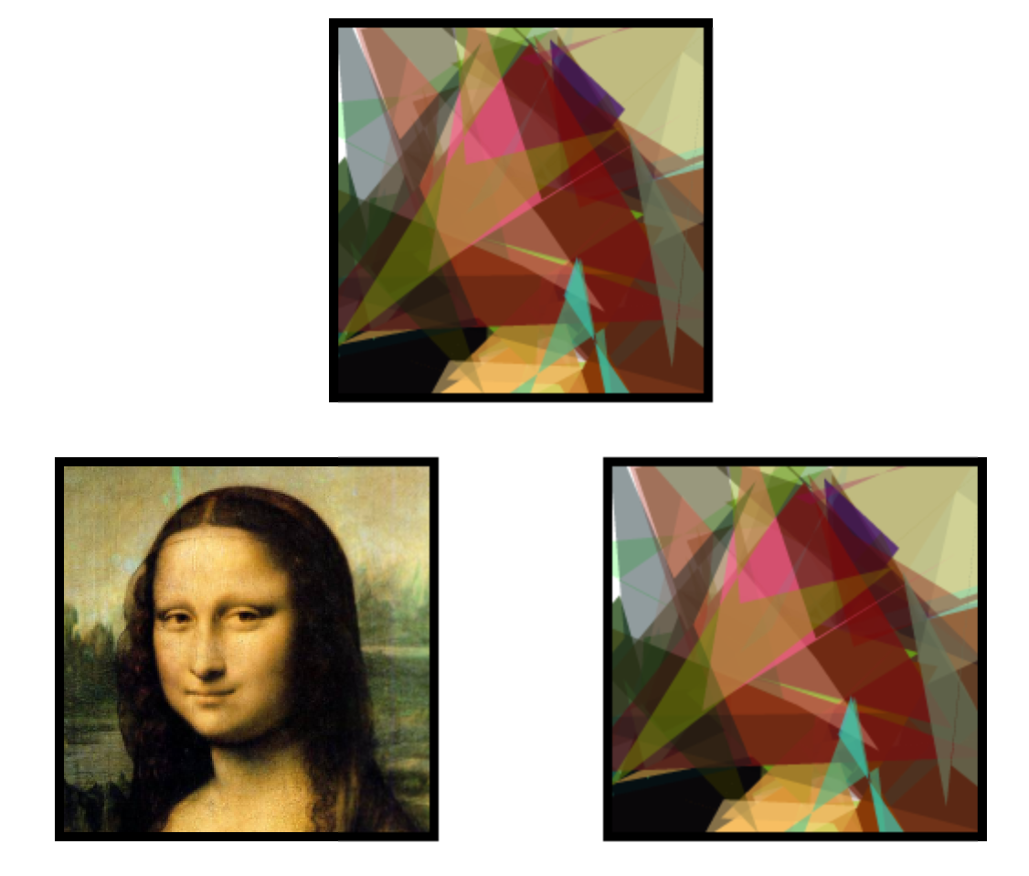
Evolving Mona Lisa

Slide 119
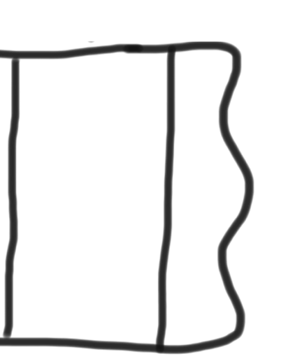
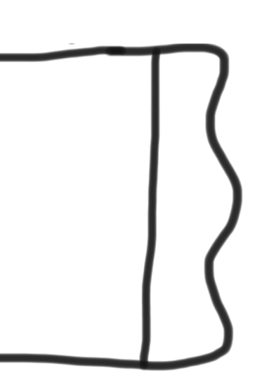
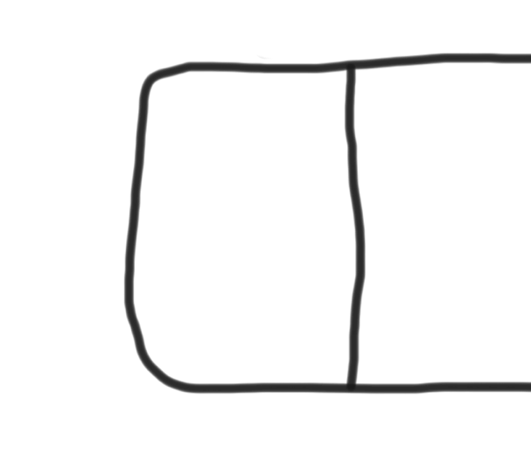
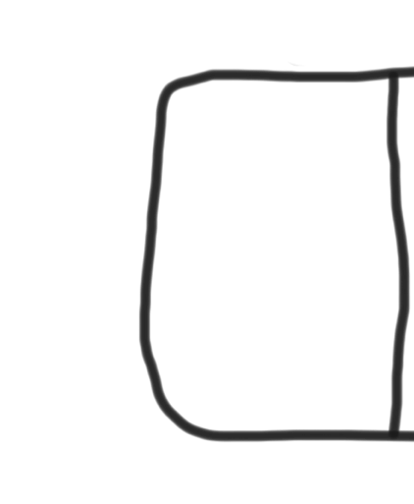

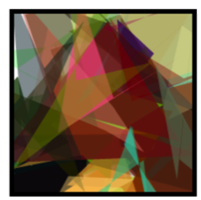
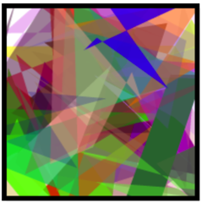

Evolution PQueue
PQueue<Species *> generation
Priority is how different the image is from the target

Slide 120
Natural Selection
PQueue<Species *> generation
Dequeue (and save) the top M species

Slide 121
Natural Selection
PQueue<Species *> generation
Dequeue (and save) the top M species

Slide 122
Natural Selection
PQueue<Species *> generation
Dequeue (and save) the top M species

Slide 123
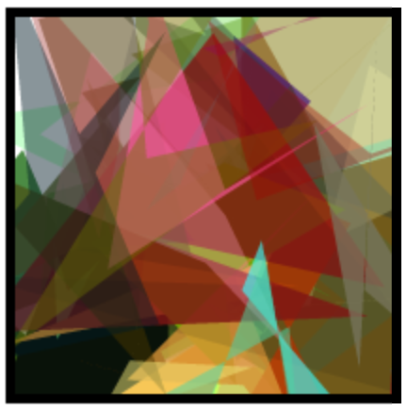
Mate
Species * parent1
Species * parent2
Species * child

Slide 124

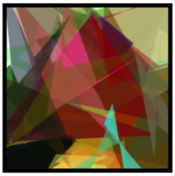
Repopulate
PQueue<Species *> generation
Enqueue all parents

Slide 125



Repopulate
PQueue<Species *> generation
Enqueue all children

Slide 126
Repeat

Slide 127
Evolutionary Algorithms
Pqueue<Species *> alive;
populate pqueue with random species
while(true){
dequeue the best species as parents
mate the parents to produce new children
start a new generation
enqueue the parents and the children
}

Slide 128
Evolutionary Algorithms
Pqueue<Species *> alive;
for(int i = 0; i < N_POP; i++) {
Species * starter = new Species();
alive->enqueue(starter, starter->getFitness());
}
while(true){
Vector<Species *> parents;
for(int i = 0; i < N_SURVIVORS; i++) {
parents.add(alive->dequeue());
}
Vector<Species *> children = mate(parents, N_CHILDREN);
alive.clear();
for(Species * p : parents) {
alive.enqueue(p, p->getFitness());
}
for(Species * c : children) {
alive.enqueue(c, c->getFitness());
}
}

Slide 129
Evolutionary Algorithms
Pqueue<Species *> alive;
for(int i = 0; i < N_POP; i++) {
Species * starter = new Species();
alive->enqueue(starter, starter->getFitness());
}
while(true){
Vector<Species *> parents;
for(int i = 0; i < N_SURVIVORS; i++) {
parents.add(alive->dequeue());
}
Vector<Species *> children = mate(parents, N_CHILDREN);
alive.clear();
for(Species * p : parents) {
alive.enqueue(p, p->getFitness());
}
for(Species * c : children) {
alive.enqueue(c, c->getFitness());
}
}

Slide 130
Evolutionary Algorithms
Pqueue<Species *> alive;
for(int i = 0; i < N_POP; i++) {
Species * starter = new Species();
alive->enqueue(starter, starter->getFitness());
}
while(true){
Vector<Species *> parents;
for(int i = 0; i < N_SURVIVORS; i++) {
parents.add(alive->dequeue());
}
Vector<Species *> children = mate(parents, N_CHILDREN);
alive.clear();
for(Species * p : parents) {
alive.enqueue(p, p->getFitness());
}
for(Species * c : children) {
alive.enqueue(c, c->getFitness());
}
}

Slide 131
Evolutionary Algorithms
Pqueue<Species *> alive;
for(int i = 0; i < N_POP; i++) {
Species * starter = new Species();
alive->enqueue(starter, starter->getFitness());
}
while(true){
Vector<Species *> parents;
for(int i = 0; i < N_SURVIVORS; i++) {
parents.add(alive->dequeue());
}
Vector<Species *> children = mate(parents, N_CHILDREN);
alive.clear();
for(Species * p : parents) {
alive.enqueue(p, p->getFitness());
}
for(Species * c : children) {
alive.enqueue(c, c->getFitness());
}
}

Slide 132
Evolutionary Algorithms
Pqueue<Species *> alive;
for(int i = 0; i < N_POP; i++) {
Species * starter = new Species();
alive->enqueue(starter, starter->getFitness());
}
while(true){
Vector<Species *> parents;
for(int i = 0; i < N_SURVIVORS; i++) {
parents.add(alive->dequeue());
}
Vector<Species *> children = mate(parents, N_CHILDREN);
alive.clear();
for(Species * p : parents) {
alive.enqueue(p, p->getFitness());
}
for(Species * c : children) {
alive.enqueue(c, c->getFitness());
}
}

Slide 133
Evolutionary Algorithms
Pqueue<Species *> alive;
for(int i = 0; i < N_POP; i++) {
Species * starter = new Species();
alive->enqueue(starter, starter->getFitness());
}
while(true){
Vector<Species *> parents;
for(int i = 0; i < N_SURVIVORS; i++) {
parents.add(alive->dequeue());
}
Vector<Species *> children = mate(parents, N_CHILDREN);
alive.clear();
for(Species * p : parents) {
alive.enqueue(p, p->getFitness());
}
for(Species * c : children) {
alive.enqueue(c, c->getFitness());
}
}

Slide 134
Mate
Species * parent1
Species * parent2
010101111101110110101
110100110011001010110

Slide 135
DNA
Species * parent1
Species * parent2
010101111101110110101
110100110011001010110

Slide 136
Crossover
Species * parent1
Species * parent2
010101111101110110101
110100110011001010110
010101111001100110101

Slide 137
Mutation
Species * parent1
Species * parent2
010101111101110110101
110100110011001010110
011101111001100110001

Slide 138
Mate
Species * parent1
Species * parent2
010101111101110110101
110100110011001010110
011101111001100110001
Species * child

Slide 140
Today’s Goals
Friday
Evolution
Heaps
SL
Priority
Priority Queue of Water
Why

Slide 141
Today’s Goals
Friday
Evolution
Heaps
SL
Priority
Priority Queue of Water
Why

Slide 142
Today’s Goals
Care About Priority Queues
Learn about Heaps

