Slide 1
Friday, April 28, 2017
CS 106B
Lecture 12: Memoization and Structs
Programming Abstractions
Spring 2017
Stanford University
Computer Science Department
Lecturer: Chris Gregg
reading:
Programming Abstractions in C++, Chapter 10

Slide 2
Today's Topics
Logistics
  Practice Midterm: went pretty well from our end!
    You can still take the on-computer test and submit for a bonus point on your midterm
  We have put together a midterm information page on the website, with old midterms, study tips, and information about the exam: http://web.stanford.edu/class/cs106b/handouts/midterm.html
Assignment four: Boggle! (now has suggested milestones)
Memoization
More on Structs

Slide 3
The Triangle Game
https://www.youtube.com/watch?v=kbKtFN71Lfs&feature=youtu.be

Slide 4
Assignment 4: Boggle
A classic board game with letter cubes (dice) that is not dog friendly: https://www.youtube.com/watch?v=2shOz1ZLw4c

Slide 5
Assignment 4b: Boggle
In Boggle, you can make words starting with any letter and going to any adjacent letter (diagonals, too), but you cannot repeat a letter-cube.

Slide 6
Memoization
Tell me and I forget. Teach me and I rememoize.*
- Xun Kuang, 300 BCE
* Some poetic license used when translating quote

Slide 7
Beautiful Recursion
Let's look at one of the most beautiful recursive definitions:
Fn = Fn-1 + Fn-2
where F0=0, F1=1
This definition leads to this:

Slide 8
Beautiful Recursion
And this:

Slide 9
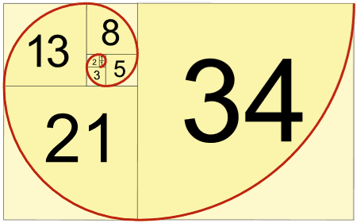
Beautiful Recursion
And this:

Slide 10
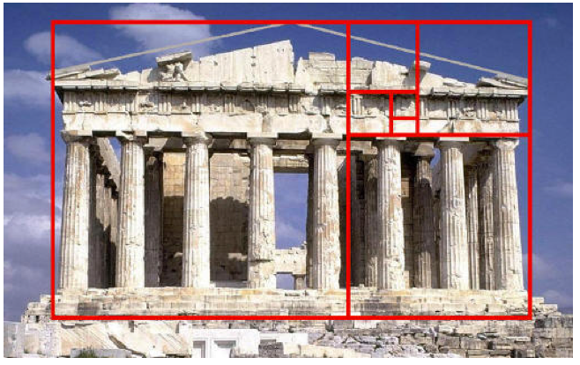
Beautiful Recursion
And this:

Slide 11
Beautiful Recursion
And this:

Slide 12
Beautiful Recursion
And this:

Slide 13
Beautiful Recursion
And this:

Slide 14

The Fibonacci Sequence
Fn = Fn-1 + Fn-2
where F0=0, F1=1
n | 0 | 1 | 2 | 3 | 4 | 5 | 6 | 7 | 8 | 9 | …
Fn | 0 | 1 | 1 | 2 | 3 | 5 | 8 | 13 | 21 | 34
This is particularly easy to code recursively!
long plainRecursiveFib(int n) {
if(n == 0) {
// base case
return 0;
} else if (n == 1) {
// base case
return 1;
} else {
// recursive case
return plainRecursiveFib(n - 1) + plainRecursiveFib(n - 2);
}
}
Let's play!

Slide 15
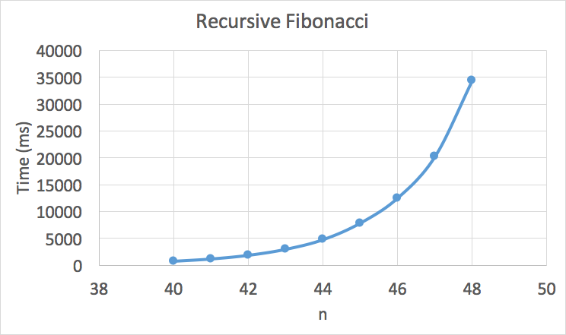
The Fibonacci Sequence
What happened??

Slide 16
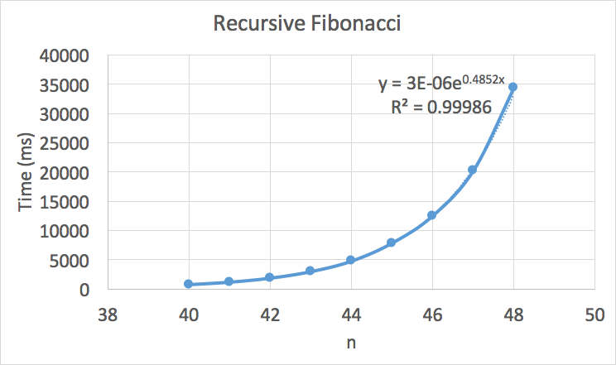
The Fibonacci Sequence
What happened??
O(a^{n})

Slide 17
The Fibonacci Sequence
What happened??
O(a^{n})
https://www.youtube.com/watch?v=qXNqEURmKtA

Slide 18
The Fibonacci Sequence
What happened??
O(a^{n})
https://www.youtube.com/watch?v=qXNqEURmKtA

Slide 19
The Fibonacci Sequence
By the way:
3x10⁻⁶e^{0.4852n}≅O(1.62^{n})
O(1.62^{n}) is technically O(2^{n})
because
O(1.62^{n}) < O(2^{n})
We call this a "tighter bound," and we like round numbers, especially ones that are powers of two. :)

Slide 20
Fibonacci: Recursive Call Tree
n = 5
n = 4
n = 3
n = 3
n = 2
n = 2
n = 1
n = 2
n = 1
n = 1
n = 0
n = 1
n = 0
n = 1
n = 0
This is basically the reverse of binary search: we are splitting into two marginally smaller cases, not splitting into half of the problem size!

Slide 21
Fibonacci: There is hope!
n = 5
n = 4
n = 3
n = 3
n = 2
n = 2
n = 1
n = 2
n = 1
n = 1
n = 0
n = 1
n = 0
n = 1
n = 0
notice! a repeat!
fib(3) is completely calculated twice

Slide 22
Fibonacci: There is hope!
n = 5
n = 4
n = 3
n = 3
n = 2
n = 2
n = 1
n = 2
n = 1
n = 1
n = 0
n = 1
n = 0
n = 1
n = 0
more repeats!

Slide 23
Fibonacci: There is hope!
6
5
4
4
3
3
2
3
2
2
1
2
1
1
0
2
1
1
0
1
0
1
0
1
0
let's leverage all the repeats!

Slide 24
Fibonacci: There is hope!
n = 5
n = 4
n = 3
n = 3
n = 2
n = 2
n = 1
n = 2
n = 1
n = 1
n = 0
n = 1
n = 0
n = 1
n = 0
If we store the result of the first time we calculate a particular fib(n), we don't have to re-do it!

Slide 25

Memoization: Don't re-do unnecessary work!
Memoization: Store previous results so that in future executions, you don’t have to recalculate them.
aka
Remember what you have already done!

Slide 26
Memoization: Don't re-do unnecessary work!
n = 5
n = 4
n = 3
n = 3
n = 2
n = 2
n = 1
n = 2
n = 1
n = 1
n = 0
n = 1
n = 0
n = 1
n = 0
Cache: <empty>

Slide 27
Memoization: Don't re-do unnecessary work!
n = 5
n = 4
n = 3
n = 3
n = 2
n = 2
n = 1
n = 2
n = 1
n = 1
n = 0
n = 1
n = 0
n = 1
n = 0
Cache: <empty>

Slide 28
Memoization: Don't re-do unnecessary work!
n = 5
n = 4
n = 3
n = 3
n = 2
n = 2
n = 1
n = 2
n = 1
n = 1
n = 0
n = 1
n = 0
n = 1
n = 0
Cache: <empty>

Slide 29
Memoization: Don't re-do unnecessary work!
n = 5
n = 4
n = 3
n = 3
n = 2
n = 2
n = 1
n = 2
n = 1
n = 1
n = 0
n = 1
n = 0
n = 1
n = 0
Cache: <empty>

Slide 30
Memoization: Don't re-do unnecessary work!
n = 5
n = 4
n = 3
n = 3
n = 2
n = 2
n = 1
n = 2
n = 1
n = 1
n = 0
n = 1
n = 0
n = 1
n = 0
Cache: <empty>

Slide 31
Memoization: Don't re-do unnecessary work!
n = 5
n = 4
n = 3
n = 3
n = 2
n = 2
n = 1
n = 2
n = 1
n = 1
n = 0
n = 1
n = 0
n = 1
n = 0
Cache: fib(2) = 1

Slide 32
Memoization: Don't re-do unnecessary work!
n = 5
n = 4
n = 3
n = 3
n = 2
n = 2
n = 1
n = 2
n = 1
n = 1
n = 0
n = 1
n = 0
n = 1
n = 0
Cache: fib(2) = 1, fib(3) = 2

Slide 33
Memoization: Don't re-do unnecessary work!
n = 5
n = 4
n = 3
n = 3
n = 2
n = 2
n = 1
n = 2
n = 1
n = 1
n = 0
n = 1
n = 0
n = 1
n = 0
Don't recurse! Use the cache!
Cache: fib(2) = 1, fib(3) = 2

Slide 34
Memoization: Don't re-do unnecessary work!
n = 5
n = 4
n = 3
n = 3
n = 2
n = 2
n = 1
n = 2
n = 1
n = 1
n = 0
n = 1
n = 0
Cache: fib(2) = 1, fib(3) = 2

Slide 35
Memoization: Don't re-do unnecessary work!
n = 5
n = 4
n = 3
n = 3
n = 2
n = 2
n = 1
n = 2
n = 1
n = 1
n = 0
n = 1
n = 0
Don't recurse! Use the cache!
Cache: fib(2) = 1, fib(3) = 2, fib(4) = 3

Slide 36
Memoization: Don't re-do unnecessary work!
n = 5
n = 4
n = 3
n = 3
n = 2
n = 2
n = 1
n = 1
n = 0
Don't recurse! Use the cache!
Cache: fib(2) = 1, fib(3) = 2, fib(4) = 3

Slide 37
Memoization: Don't re-do unnecessary work!
n = 5
n = 4
n = 3
n = 3
n = 2
n = 2
n = 1
n = 1
n = 0
Cache: fib(2) = 1, fib(3) = 2, fib(4) = 3, fib(5) = 5

Slide 38
Memoization: Don't re-do unnecessary work!
n = 5
n = 4
n = 3
n = 3
n = 2
done!
n = 2
n = 1
n = 1
n = 0
Cache: fib(2) = 1, fib(3) = 2, fib(4) = 3, fib(5) = 5

Slide 39
Memoization: Don't re-do unnecessary work!
long memoizationFib(int n) {
Map<int, long> cache;
return memoizationFib(cache, n);
}
setup for helper function

Slide 40
Memoization: Don't re-do unnecessary work!
long memoizationFib(int n) {
Map<int, long> cache;
return memoizationFib(cache, n);
}
long memoizationFib(Map<int, long>&cache, int n) {
if(n == 0) {
// base case #1
return 0;
} else if (n == 1) {
// base case #2
return 1;
} else if(cache.containsKey(n)) {
// base case #3
return cache[n];
}
// recursive case
long result = memoizationFib(cache, n-1) + memoizationFib(cache, n-2);
cache[n] = result;
return result;
}

Slide 41
Memoization: Don't re-do unnecessary work!
Complexity?
n = 5
n = 4
n = 3
n = 3
n = 2
n = 2
n = 1
The recursive path only happens on the left...
O(n log n) if using a map for the cache
n = 1
n = 0
O(n) if using a hashmap for the cache

Slide 42
Fibonacci: the bigger picture
There are actually many ways to write a fibonacci function.
This is a case where the plain old iterative function works fine:
long iterativeFib(int n) {
if(n == 0) {
return 0;
}
long prev0 = 0;
long prev1 = 1;
for (int i=n; i >= 2; i--) {
long temp = prev0 + prev1;
prev0 = prev1;
prev1 = temp;
}
return prev1;
}
Recursion is used often, but not always.

Slide 43
Fibonacci: Okay, one more...
Another way to keep track of previously-computed values in fibonacci is through the use of a different helper function that simply passes along the previous values:
long passValuesRecursiveFib(int n) {
if (n == 0) {
return 0;
}
return passValuesRecursiveFib(n, 0, 1);
}
long passValuesRecursiveFib(int n, long p0, long p1) {
if (n == 1) {
// base case
return p1;
}
return passValuesRecursiveFib(n-1, p1, p0 + p1);
}

Slide 44
More on Structs
We have mentioned structs already -- they are useful for keeping track of related data as one type, which can get used like any other type. You can think of a struct as the Lunchable of the C++ world.
struct Lunchable {
string meat;
string dessert;
int numCrackers;
bool hasCheese;
};
// Vector of Lunchables
Vector<Lunchable> lunchableOrder;

Slide 45
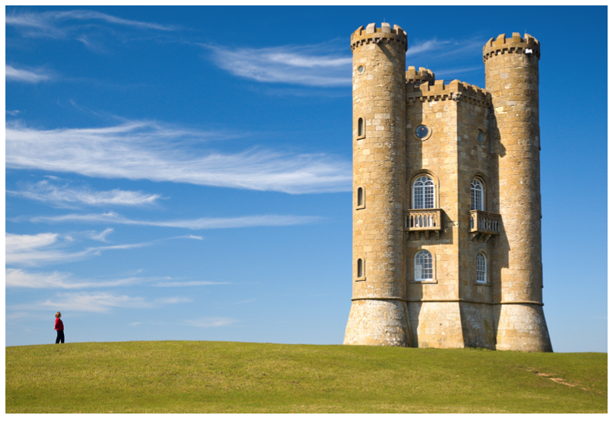
A Real Problem
Your cool picture from that trip to Europe doesn't fit on Instagram!

Slide 46
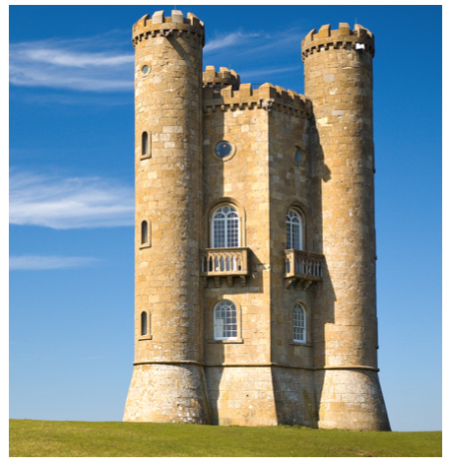
Bad Option #1: Crop
You got cropped out!

Slide 47
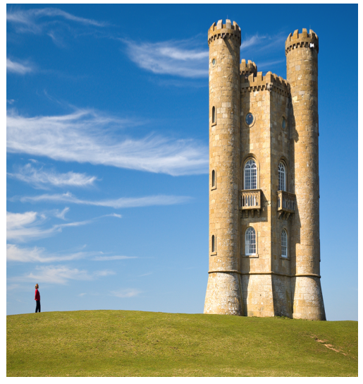
Bad Option #2: Resize
Stretchy castles look weird...

Slide 48
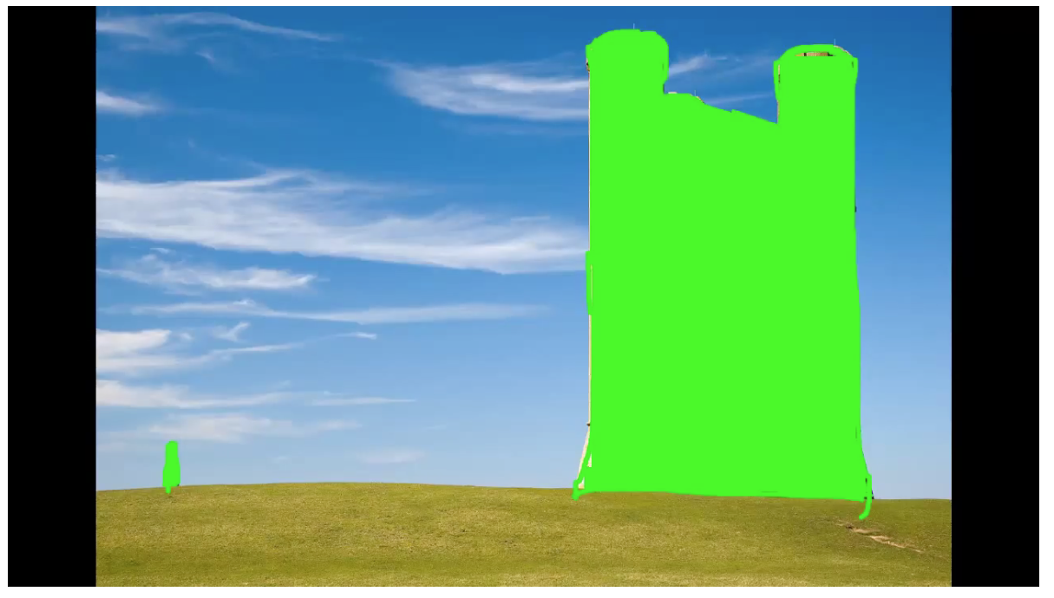
New Algorithm: Seam Carving!

Slide 49
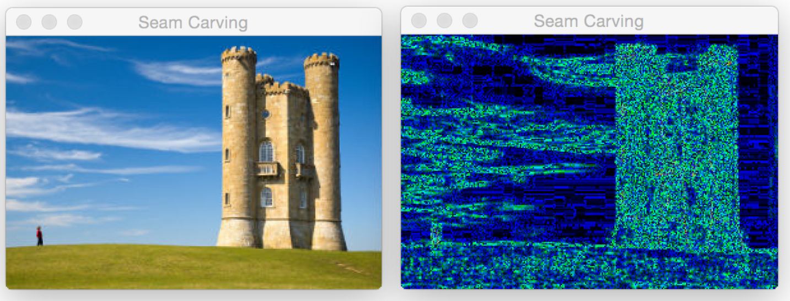
New Algorithm: Seam Carving!
How can you change an image without changing its aspect ration, but while retaining the important information?

Slide 50
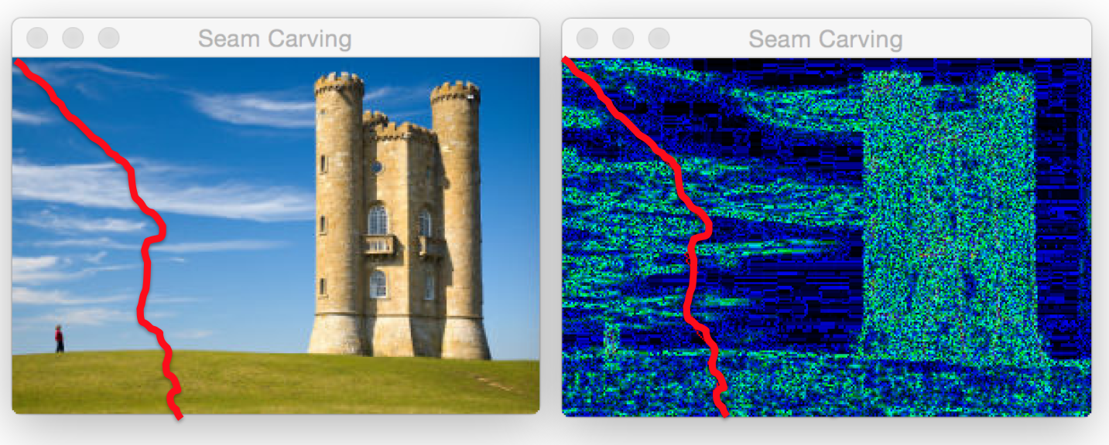
New Algorithm: Seam Carving!
We could delete an entire column of pixels, but we could also weave our way through a path of 1-pixel wide image that removes the least amount of stuff.

Slide 51
How to represent the path
A struct!
struct Coord {
int row;
int col;
};
A path is just a Vector of coordinates:
int main() {
Coord myCord;
myCoord.row = 5;
myCoord.col = 7;
cout << myCord.row << endl;
Vector<Coord> path;
return 0;
}

Slide 52
New Algorithm: Seam Carving!
Important pixels are ones that are considerably different from their neighbors.

Slide 53
New Algorithm: Seam Carving!
Let's write a recursive algorithm that can find the seam that minimizes the sum of all the importances of the pixels.

Slide 54
New Algorithm: Seam Carving!
Vector<Coord> getSeam(Grid<double> &weight, Coord curr);

Slide 55
References and Advanced Reading
References:
  https://en.wikipedia.org/wiki/Fibonacci_number
  https://en.wikipedia.org/wiki/Seam_carving

Slide 56
Extra Slides

