Slide 1

Monday, May 1, 2017
CS 106B
Lecture 13: Classes
Programming Abstractions
Spring 2017
Stanford University
Computer Science Department
Lecturer: Chris Gregg
reading:
Programming Abstractions in C++, Chapter 6

Slide 2
When it Compiles but you get a Runtime Error
Source, Reddit, Feb 8, 2017:
https://www.reddit.com/r/ProgrammerHumor/comments/5srs8b/when_it_compiles_but_you_get_a_runtime_error/

Slide 3
Today's Topics
Logistics
  Midterm Thursday, 7-9pm
  Review Session: Tonight 7-8:30pm, 420-040
Classes
  What are they and why are they important?
  Bouncing Balls
  Decomposition
  Encapsulation
  Elements of a Class, Header files
  public / private
  Constructors / Destructors
  The keyword "this"
  The Fraction Class
  operator overloading

Slide 4
Midterm
Midterm Thursday, 7-9pm
  Information: http://web.stanford.edu/class/cs106b/handouts/midterm.html
Closed Book: You are allowed a 1 page back/front page of notes, plus the reference sheet (also 1 page back/front).
Will have the option of paper or laptop. Make sure your laptop is charged!
Potential topics:
Functions and Pass by Reference
Big O
Use of Collections (Maps, Sets, Stacks, Queues, Vectors and Grids)
Recursion (Definition and Fractals)
Recursive Exploration and Backtracking
Sorting
Memoization

Slide 5

Bouncing Balls Demo

Slide 6
Introduction to Classes
Remember how we said that structs are the Lunchables of the C++ world?
Structs gave us the ability to package data into one place:
struct Lunchable {
string meat;
string dessert;
int numCrackers;
bool hasCheese;
};

Slide 7
Introduction to Classes
But why stop at data? If we're packaging stuff up, let's also package up the functions.
It would be really nice if we could do this:
struct Lunchable {
string meat;
string dessert;
int numCrackers;
bool hasCheese;
int countCalories();
};

Slide 8
Introduction to Classes
Guess what? We can do this! Even in structs! (but not in C, only in C++)
Once we have the ability to package up data and functions into one structure, we have a super-powerful tool, called an "object" that knows how to perform functions on itself, and carries around its own data.
So-called "Object Oriented Programming" has led to the creation of most of the large programs we use today.

Slide 9



The Need for New Types
A C++ "class" is simply a very-slightly modified struct (details to follow).
As with structs, we sometimes want new types:
  A calendar program might want to store information about dates, but C++ does not have a Date type.
  A student registration system needs to store info about students, but C++ has no Student type.
  A music synthesizer app might want to store information about users' accounts, but C++ has no Instrument type.

Slide 10
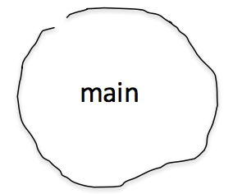
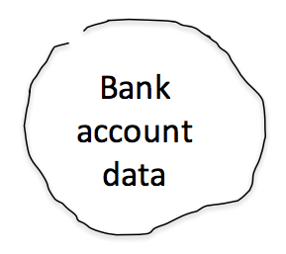
Classes: Encapsulation
The only difference between a struct and a class is the notion of defaults regarding encapsulation. A struct defaults to "public" members, and a class defaults to "private" members.
"Encapsulation" allows the designer of a class to build a "wall of abstraction" around her data:
private data and functions
public functions
withdraw(80)
bank
account
data
main
getBalance()
transfer()
Wall of abstraction

Slide 11
Classes: Encapsulation
The only difference between a struct and a class is the notion of defaults regarding encapsulation. A struct defaults to "public" members, and a class defaults to "private" members.
"Encapsulation" allows the designer of a class to build a "wall of abstraction" around her data:
private data and functions
int main() {
BankAccount checking("Bob", 42);
checking.withdraw(80);
cout << checking.getBalance() << endl;
}
bank
account
data
Wall of abstraction

Slide 12
Classes: Encapsulation
The only difference between a struct and a class is the notion of defaults regarding encapsulation. A struct defaults to "public" members, and a class defaults to "private" members.
"Encapsulation" allows the designer of a class to build a "wall of abstraction" around her data:
private data and functions
int main() {
BankAccount checking("Bob", 42);
checking.withdraw(80);
cout << checking.getBalance() << endl;
}
bank
account
data
withdraw(80)
error: not enough funds!
Wall of abstraction

Slide 13
Classes: Encapsulation
The only difference between a struct and a class is the notion of defaults regarding encapsulation. A struct defaults to "public" members, and a class defaults to "private" members.
"Encapsulation" allows the designer of a class to build a "wall of abstraction" around her data:
private data and functions
int main() {
BankAccount checking("Bob", 42);
checking.withdraw(80);
cout << checking.getBalance() << endl;
}
bank
account
data
getBalance()
42
Wall of abstraction

Slide 14
Classes: Encapsulation
The reason we want encapsulation is so that the end user of our class does not have direct access to the data -- we, as the class designer, control the data completely:
int main() {
BankAccount checking("Bob", 42);
checking.withdraw(80);
cout << checking.getBalance() << endl;
checking.balance = 81.2345;
}
private data and functions
bank
account
data
If we allowed this, our internal class data might not be in a state we can handle (e.g., too many decimal places for a monetary value)
Wall of abstraction

Slide 15
Classes: Encapsulation
So, we block the ability for someone using our class to directly touch the data, and we force them to go through our own functions:
int main() {
BankAccount checking("Bob", 42);
checking.withdraw(80);
cout << checking.getBalance() << endl;
checking.setBalance(81.2345);
}
private data and functions
bank
account
data
Because we control the function, we can do a check on this, and enforce the "only two decimals" limit.
Wall of abstraction

Slide 16
Elements of a Class
member variables: State inside each object.
  Also called "instance variables" or "fields"
  Declared as private
  Each object created has a copy of each field.
member functions: Behavior that executes inside each object.
  Also called "methods"
  Each object created has a copy of each method.
  The method can interact with the data inside that object.
constructor: Initializes new objects as they are created.
  Sets the initial state of each new object.
  Often accepts parameters for the initial state of the fields.

Slide 17
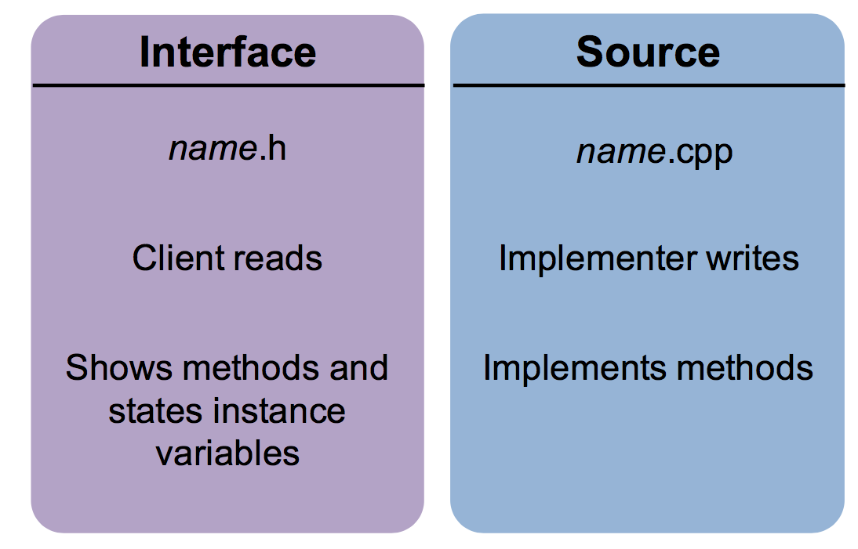
Class Interface Divide

Slide 18
Structure of a .h file
// classname.h
#pragma once
class ClassName {
// class definition
};
This basically says, "if you see this file more than once while compiling, ignore it after the first time"
(so the compiler doesn't think you're trying to define things more than once)

Slide 19
Structure of a .h file
// classname.h
#pragma once
class ClassName {
// class definition
};
This basically says, "if you see this file more than once while compiling, ignore it after the first time"
(so the compiler doesn't think you're trying to define things more than once)
// classname.h
#ifndef _CLASSNAME_H
#define _CLASSNAME_H
class ClassName {
// class definition
};
#endif
Older format, not as nice:

Slide 20
Structure of a .h file
// in ClassName.h
class ClassName {
public:
ClassName(parameters); // constructor
returnType func1(parameters); // member functions
returnType func2(parameters); // (behavior inside
returnType func3(parameters); // each object)
private:
type var1; // member variables
type var2; // (data inside each object)
type func4(); // (private function)
};

Slide 21
Encapsulation defined in .h
// in MyClass.h
class MyClass {
public:
MyClass(parameters); // constructor
returnType func1(parameters); // member functions
returnType func2(parameters); // (behavior inside
returnType func3(parameters); // each object)
private:
type var1; // member variables
type var2; // (data inside each object)
type func4(); // (private function)
};
Any class instance can directly use anything defined as public (but you never directly call a constructor):
MyClass a;
a.func1(arguments)

Slide 22
Encapsulation defined in .h
// in MyClass.h
class MyClass {
public:
MyClass(parameters); // constructor
returnType func1(parameters); // member functions
returnType func2(parameters); // (behavior inside
returnType func3(parameters); // each object)
private:
type var1; // member variables
type var2; // (data inside each object)
type func4(); // (private function)
};
Class instances can not directly use anything defined as private:
MyClass a;
a.var1 = 2; // error!

Slide 23
Constructors and (eventually) Destructors
// in MyClass.h
class MyClass {
public:
MyClass(); // default constructor
MyClass(parameters); // constructor
...
};
When a class instance is created, we say that it is "constructed":
string s1; // uses default constructor
string s2("I'm a string"); // uses a constructor
// that takes 1 string parameter
string s3 = "I'm a string"; // different! (we'll get to that)

Slide 24
The Implicit Parameter
implicit parameter:
The object on which a member function is called.
– During the call chris.withdraw(...),
the object named chris is the implicit parameter.
– During the call aaron.withdraw(...),
the object named aaron is the implicit parameter.
– The member function can refer to that object's member variables.
        We say that it executes in the context of a particular object.
        The function can refer to the data of the object it was called on.
        It behaves as if each object has its own copy of the member functions.

Slide 25
The Keyword This
As in Java, C++ has a this keyword to refer to the current object.
  Syntax: this->member
  Common usage: In constructor, so parameter names can match the names of the object's member variables:
                BankAccount::BankAccount(string name, double balance) {
                this->name = name;
                this->balance = balance;
                }
  this uses -> not . because it is a "pointer"; we'll discuss that later

Slide 26
Let's Start an Example: The Fraction Class
As an example of a class, we're going to define a Fraction class that can deal with rational numbers directly, without decimals.
We are going to walk through the class one step at a time, demonstrating the various parts of a class as we go.

Slide 27
Questions we must answer about the Fraction class:
What data should the class hold?
What kinds of functions (public / private) should our class have?
What constructors could we have?
  What is a good value for a default fraction?
The Fraction Class

Slide 28

The Fraction Class
Class outline
class Fraction {
public:
private:
};
Things we want class users to see
Things we want to keep hidden from class users

Slide 29

The Fraction Class
Class outline
class Fraction {
public:
private:
};
What data would a Fraction class have?
int num; // the numerator
int denom; // the denominator
Why is it private?

Slide 30

The Fraction Class
class Fraction {
public:
private:
int num; // the numerator
int denom; // the denominator
};
void add(Fraction f);
void mult(Fraction f);
double decimal();
int getNum();
int getDenom();
friend ostream& operator<<
(ostream& out, Fraction &frac);
What functions should a fraction class be able to do?
Why are they public?
What is this???

Slide 31
The Fraction Class
class Fraction {
public:
private:
int num; // the numerator
int denom; // the denominator
};
void add(Fraction f);
void mult(Fraction f);
double decimal();
int getNum();
int getDenom();
friend ostream& operator<<
(ostream& out, Fraction &frac);
What is this???
This defines an operator "overload" to make it possible to use the "<<" operator with cout.
We will write this function in a few minutes.

Slide 32
The Fraction Class
class Fraction {
public:
void add(Fraction f);
void mult(Fraction f);
double decimal();
int getNum();
int getDenom();
friend ostream& operator<<
(ostream& out, Fraction &frac);
private:
int num; // the numerator
int denom; // the denominator
};
We need to construct the class when it is called.
What should a "default" fraction look like?
Fraction();
Fraction(int num,int denom);
1 / 1 probably makes the most sense (why not 0/0?)
Should we let the user create an initial fraction, e.g., 3/4?

Slide 33

The Fraction Class
class Fraction {
public:
Fraction();
Fraction(int num,int denom);
void add(Fraction f);
void mult(Fraction f);
double decimal();
int getNum();
int getDenom();
friend ostream& operator<<
(ostream& out, Fraction &frac);
private:
int num; // the numerator
int denom; // the denominator
};
Any other functions?
What about reduce? (necessary for multiplication)
Reduce needs gcd()...
void reduce(); // reduce the fraction
int gcd(int u, int v);

Slide 34

The Fraction Class
#pragma once
#include<ostream>
using namespace std;
class Fraction {
public:
Fraction();
Fraction(int num,int denom);
void add(Fraction f);
void mult(Fraction f);
double decimal();
int getNum();
int getDenom();
friend ostream& operator<<
(ostream& out, Fraction &frac);
private:
int num; // the numerator
int denom; // the denominator
void reduce(); // reduce the fraction
int gcd(int u, int v);
};
Last, but not least...

Slide 35

Let's start writing our functions. We do this in our fraction.cpp file, and we have to define the class that each function belongs to. We also cannot forget to include our header file!
#include "fraction.h"
The default constructor is used when someone wants to just create a default fraction:
Fraction frac;
The Fraction Class
// purpose: the default constructor
// to create a fraction of 1 / 1
// arguments: none
// return value: none
// (constructors don't return anything)
Fraction::Fraction()
{
}

Slide 36
Let's start writing our functions. We do this in our fraction.cpp file, and we have to define the class that each function belongs to. We also cannot forget to include our header file!
#include "fraction.h"
The default constructor is used when someone wants to just create a default fraction:
Fraction frac;
The Fraction Class
// purpose: the default constructor
// to create a fraction of 1 / 1
// arguments: none
// return value: none
// (constructors don't return anything)
Fraction::Fraction()
{
}
This tells the compiler what class we are creating. The double-colon is called the "scope resolution operator" because it helps the compiler resolve the scope of the function.

Slide 37
Let's start writing our functions. We do this in our fraction.cpp file, and we have to define the class that each function belongs to. We also cannot forget to include our header file!
#include "fraction.h"
The default constructor is used when someone wants to just create a default fraction:
Fraction frac;
The Fraction Class
// purpose: the default constructor
// to create a fraction of 1 / 1
// arguments: none
// return value: none
// (constructors don't return anything)
Fraction::Fraction()
{
num = 1;
denom = 1;
}
Pretty simple! We are just setting our two class variables to default values.

Slide 38

We also have an overloaded constructor that takes in two values that the user sets. It is called as follows:
// create a
// 1/2 fraction
Fraction fracA(1,2);
// create a
// 4/6 fraction
Fraction fracB(4,6);
The Fraction Class
// purpose: an overloaded constructor
// to create a custom fraction
// that immediately gets reduced
// arguments: an int numerator
// and an int denominator
Fraction::Fraction(int num,int denom)
{
}

Slide 39

We also have an overloaded constructor that takes in two values that the user sets. It is called as follows:
// create a
// 1/2 fraction
Fraction fracA(1,2);
// create a
// 4/6 fraction
Fraction fracB(4,6);
The Fraction Class
// purpose: an overloaded constructor
// to create a custom fraction
// that immediately gets reduced
// arguments: an int numerator
// and an int denominator
Fraction::Fraction(int num, int denom)
{
this->num = num;
this->denom = denom;
// reduce in case we were given
// an unreduced fraction
reduce();
}

Slide 40

Let's write some more functions...
// create two fractions
Fraction fracA(1,2);
Fraction fracB(2,3);
fracA.mult(fracB);
// fracA now holds 1/3
The Fraction Class
// purpose: to multiply another fraction // with this one with the result being
// stored in this fraction
// arguments: another Fraction
// return value: none
void Fraction::mult(Fraction other)
{
}

Slide 41

Let's write some more functions...
// create two fractions
Fraction fracA(1,2);
Fraction fracB(2,3);
fracA.mult(fracB);
// fracA now holds 1/3
The Fraction Class
// purpose: to multiply another fraction // with this one with the result being
// stored in this fraction
// arguments: another Fraction
// return value: none
void Fraction::mult(Fraction other)
{
// multiplies a Fraction
// with this Fraction
num *= other.num;
denom *= other.denom;
// reduce the fraction
reduce();
}

Slide 42

Let's write some more functions...
// get the decimal value
Fraction fracA(1,2);
double f = fracA.decimal();
cout << f << endl;
output:
0.5
The Fraction Class
// purpose: To return a decimal
// value of our fraction
// arguments: None
// return value: the decimal
// value of this fraction
double Fraction::decimal()
{
}

Slide 43
Let's write some more functions...
// get the decimal value
Fraction fracA(1,2);
double f = fracA.decimal();
cout << f << endl;
output:
0.5
The Fraction Class
// purpose: To return a decimal
// value of our fraction
// arguments: None
// return value: the decimal
// value of this fraction
double Fraction::decimal()
{
// returns the decimal
// value of our fraction
return (double)num / denom;
}

Slide 44

The Fraction Class: reduce()
void Fraction::reduce() {
// reduce the fraction to lowest terms
// find the greatest common divisor
int frac_gcd = gcd(num,denom);
// reduce by dividing num and denom
// by the gcd
num = num / frac_gcd;
denom = denom / frac_gcd;
}

Slide 45

The Fraction Class: gcd() — nice recursive function
int Fraction::gcd(int u, int v) {
if (v != 0) {
return gcd(v,u%v);
}
else {
return u;
}
}

Slide 46

The Fraction Class: overloading <<
Yes, this syntax is a bit strange.
Basically, we are telling the compiler how to cout our Fraction.
You can do something very similar for Boggle.
// purpose: To overload the << operator
// for use with cout
// arguments: a reference to an outstream and the
// fraction we are using
// return value: a reference to the outstream
ostream& operator<<(ostream& out, Fraction &frac) {
out << frac.num << "/" << frac.denom;
return out;
}

Slide 47
References and Advanced Reading
Advanced Reading
  Overloading the assignment operator:
    http://www.learncpp.com/cpp-tutorial/9-14-overloading-the-assignment-operator/
  Constructors and Destructors:
    http://www.cprogramming.com/tutorial/constructor_destructor_ordering.html
References:
  https://www.tutorialspoint.com/cplusplus/cpp_classes_objects.htm
  http://www.cprogramming.com/tutorial/lesson12.html

Slide 48
Extra Slides

Slide 49
The Copy Constructor
The Copy Constructor
Vector<int> a;
a.add(0);
a.add(1);
a.add(1);
a.add(2);
Vector<int> b = a;
or
Vector<int> b(a); // b gets constructed
// with the same elements as b
This doesn't work automatically!
The assignment overload:
Vector<int> a;
a.add(0);
a.add(1);
Vector<int> b;
b.add(8);
b = a; // a gets copied into b

