Slide 1
Friday, May 12, 2017
CS 106B
Lecture 19: Binary Heaps
Programming Abstractions
Spring 2017
Stanford University
Computer Science Department
Lecturer: Chris Gregg
reading:
Programming Abstractions in C++, pp 721-722

Slide 2
Back to Regular Programming: Today's Topics
Logistics
  HW 5 is out
    It is more manageable than originally planned — you have 2/3 of the work.
    The original starter files were incorrect and fixed by 11:30am Friday morning — please re-download if you already downloaded them.
Binary Heaps
  A "tree" structure
  The Heap Property
  Parents have higher priority than children

Slide 3
Priority Queues
Sometimes, we want to store data in a “prioritized way.”
Examples in real life:
  Emergency Room waiting rooms
  Professor Office Hours (what if a professor walks in? What about the department chair?)
  Getting on an airplane (First Class and families, then frequent flyers, then by row, etc.)

Slide 4
Priority Queues
A “priority queue” stores elements according to their priority, and not in a particular order.
This is fundamentally different from other position-based data structures we have discussed.
There is no external notion of “position.”

Slide 5
Priority Queues
A priority queue, P, has three fundamental operations:
  enqueue(k,e): insert an element e with key k into P.
  dequeue(): removes the element with the highest priority key from P.
  peek(): return an element of P with the highest priority key (does not remove from queue).

Slide 6
Priority Queues
Priority queues also have less fundamental operations:
size(): returns the number of elements in P.
isEmpty(): Boolean test if P is empty.
clear(): empties the queue.
peekPriority(): Returns the priority of the highest priority element (why might we want this?)
changePriority(string value, int newPriority): Changes the priority of a value.

Slide 7
Priority Queues
Priority queues are simpler than sequences: no need to worry about position (or insert(index, value), add(value) to append, get(index), etc.).
We only need one enqueue() and dequeue() function

Slide 8
Priority Queues
Operation | Output | Priority Queue
enqueue(5,A) | - | {(5,A)}
enqueue(9,C) | - | {(5,A),(9,C)}
enqueue(3,B) | - | {(5,A),(9,C),(3,B)}
enqueue(7,D) | - | {(5,A),(9,C),(3,B),(7,D)}
peek() | B | {(5,A),(9,C),(3,B),(7,D)}
peekPriority() | 3 | {(5,A),(9,C),(3,B),(7,D)}
dequeue() | B | {(5,A),(9,C),(7,D)}
size() | 3 | {(5,A),(9,C),(7,D)}
peek() | A | {(5,A),(9,C),(7,D)}
dequeue() | A | {(9,C),(7,D)}
dequeue() | D | {(9,C)}
dequeue() | C | {}
dequeue() | error! | {}
isEmpty() | TRUE | {}

Slide 9
Binary Heaps
For HW 5, you will build a priority queue using a Vector and a linked list, and as an extension, using a "binary heap"
A heap is a tree-based structure that satisfies the heap property:
    Parents have a higher priority key than any of their children.

Slide 10
Binary Heaps
There are two types of heaps:
Min Heap
(root is the smallest element)
Max Heap
(root is the largest element)
5
50
8
36
10
19
12
11
14
13
17
3
25
1
22
43
2
7

Slide 11
Binary Heaps
There are no implied orderings between siblings, so both of the trees below are min-heaps:
5
5
10
12
12
10

Slide 12
Binary Heaps
Circle the min-heap(s):
5
13
8
36
10
19
12
85
14
13
24
99
46
42
22
11
25
26

Slide 13
Binary Heaps
Circle the min-heap(s):
5
13
8
36
10
19
12
85
14
13
24
99
46
42
22
11
25
26

Slide 14
Heaps are completely filled, with the exception of the bottom level. They are, therefore, "complete binary trees":
complete: all levels filled except the bottom
binary: two children per node (parent)
Maximum number of nodes
Filled from left to right
Binary Heaps
5
8
10
12
11
14
13
22
43

Slide 15
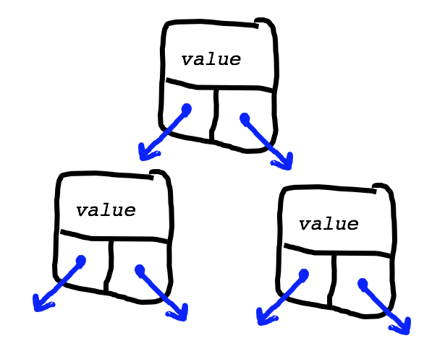
What is the best way to store a heap?
Binary Heaps
5
8
10
12
11
14
13
22
43
We could use a node-based solution, but…

Slide 16
It turns out that an array works great for storing a binary heap!
We will put the root at index 1 instead of index 0 (this makes the math work out just a bit nicer).
Binary Heaps
5
8
10
12
11
14
13
 | 5 | 10 | 8 | 12 | 11 | 14 | 13 | 22 | 43
[0] | [1] | [2] | [3] | [4] | [5] | [6] | [7] | [8] | [9] | [10] | [11]
22
43

Slide 17
The array representation makes determining parents and children a matter of simple arithmetic:
For an element at position i:
  left child is at 2i
  right child is at 2i+1
  parent is at ⌊i/2⌋
  heapSize: the number of elements in the heap.
Binary Heaps
5
8
10
12
11
14
13
22
43
 | 5 | 10 | 8 | 12 | 11 | 14 | 13 | 22 | 43
[0] | [1] | [2] | [3] | [4] | [5] | [6] | [7] | [8] | [9] | [10] | [11]

Slide 18
Remember that there are three important priority queue operations:
peek(): return an element of h with the smallest key.
enqueue(k,e): insert an element e with key k into the heap.
dequeue(): removes the smallest element from h.
We can accomplish this with a heap!
We will just look at keys for now -- just know that we will also store a value with the key.
Heap Operations
5
8
10
12
11
14
13
22
43

Slide 19
peek():
Heap Operations: peek()
5
8
Just return the root!
return heap[1]
10
O(1) yay!
12
11
14
13
22
43
 | 5 | 10 | 8 | 12 | 11 | 14 | 13 | 22 | 43
[0] | [1] | [2] | [3] | [4] | [5] | [6] | [7] | [8] | [9] | [10] | [11]

Slide 20
enqueue(k)
How might we go about inserting into a binary heap?
                enqueue(9)
Heap Operations: enqueue(k)
5
8
10
12
11
14
13
 | 5 | 10 | 8 | 12 | 11 | 14 | 13 | 22 | 43
[0] | [1] | [2] | [3] | [4] | [5] | [6] | [7] | [8] | [9] | [10] | [11]
22
43

Slide 21
Heap Operations: enqueue(k)
Insert item at element array[heap.size()+1] (this probably destroys the heap property)
Perform a “bubble up,” or “up-heap” operation:
  Compare the added element with its parent — if in correct order, stop
  If not, swap and repeat step 2.
See animation at: http://www.cs.usfca.edu/~galles/visualization/Heap.html
Heap Operations: enqueue(k)
5
8
10
12
11
14
13
22
43

Slide 22
Heap Operations: enqueue(9)
5
8
10
 | 5 | 10 | 8 | 12 | 11 | 14 | 13 | 22 | 43
[0] | [1] | [2] | [3] | [4] | [5] | [6] | [7] | [8] | [9] | [10] | [11]
12
11
14
13
43
Start by inserting the key at the first empty position. This is always at index heap.size()+1.
22

Slide 23
Heap Operations: enqueue(9)
5
8
10
 | 5 | 10 | 8 | 12 | 11 | 14 | 13 | 22 | 43 | 9
[0] | [1] | [2] | [3] | [4] | [5] | [6] | [7] | [8] | [9] | [10] | [11]
12
11
14
13
43
9
Start by inserting the key at the first empty position. This is always at index heap.size()+1.
22

Slide 24
Heap Operations: enqueue(9)
5
8
10
 | 5 | 10 | 8 | 12 | 11 | 14 | 13 | 22 | 43 | 9
[0] | [1] | [2] | [3] | [4] | [5] | [6] | [7] | [8] | [9] | [10] | [11]
12
11
14
13
22
43
9
Look at parent of index 10, and compare: do we meet the heap property requirement?
No -- we must swap.

Slide 25
Heap Operations: enqueue(9)
5
8
10
 | 5 | 10 | 8 | 12 | 11 | 14 | 13 | 22 | 43 | 9
[0] | [1] | [2] | [3] | [4] | [5] | [6] | [7] | [8] | [9] | [10] | [11]
12
11
14
13
22
43
9

Slide 26
Heap Operations: enqueue(9)
5
8
10
 | 5 | 10 | 8 | 12 | 9 | 14 | 13 | 22 | 43 | 11
[0] | [1] | [2] | [3] | [4] | [5] | [6] | [7] | [8] | [9] | [10] | [11]
12
9
14
13
22
43
11

Slide 27
Heap Operations: enqueue(9)
5
8
10
 | 5 | 10 | 8 | 12 | 9 | 14 | 13 | 22 | 43 | 11
[0] | [1] | [2] | [3] | [4] | [5] | [6] | [7] | [8] | [9] | [10] | [11]
12
9
14
13
22
43
11
Look at parent of index 5, and compare: do we meet the heap property requirement?
No -- we must swap. This "bubbling up" won't ever be a problem if the heap is "already a heap" (i.e., already meets heap property for all nodes)

Slide 28
Heap Operations: enqueue(9)
5
8
10
 | 5 | 10 | 8 | 12 | 9 | 14 | 13 | 22 | 43 | 11
[0] | [1] | [2] | [3] | [4] | [5] | [6] | [7] | [8] | [9] | [10] | [11]
12
9
14
13
22
43
11

Slide 29
Heap Operations: enqueue(9)
5
8
9
 | 5 | 9 | 8 | 12 | 10 | 14 | 13 | 22 | 43 | 11
[0] | [1] | [2] | [3] | [4] | [5] | [6] | [7] | [8] | [9] | [10] | [11]
12
10
14
13
22
43
11

Slide 30
Heap Operations: enqueue(9)
No swap necessary between index 2 and its parent.
We're done bubbling up!
5
8
9
 | 5 | 9 | 8 | 12 | 10 | 14 | 13 | 22 | 43 | 11
[0] | [1] | [2] | [3] | [4] | [5] | [6] | [7] | [8] | [9] | [10] | [11]
12
10
14
13
Complexity?
O(log n) - yay!
22
43
11
Average complexity for random inserts: O(1), see: http://ieeexplore.ieee.org/xpls/abs_all.jsp?arnumber=6312854

Slide 31
How might we go about removing the minimum?
                dequeue()
Heap Operations: dequeue()
5
8
9
12
10
14
11
 | 5 | 9 | 8 | 12 | 10 | 14 | 11 | 22 | 43 | 13
[0] | [1] | [2] | [3] | [4] | [5] | [6] | [7] | [8] | [9] | [10] | [11]
22
43
13

Slide 32
We are removing the root, and we need to retain a complete tree: replace root with last element.
“bubble-down” or “down-heap” the new root:
  Compare the root with its children, if in correct order, stop.
  If not, swap with smallest child, and repeat step 2.
  Be careful to check whether the children exist (if right exists, left must…)
Heap Operations: dequeue()
5
8
9
12
10
14
11
22
43
13

Slide 33
Heap Operations: dequeue()
5
8
9
 | 5 | 9 | 8 | 12 | 10 | 14 | 11 | 22 | 43 | 13
[0] | [1] | [2] | [3] | [4] | [5] | [6] | [7] | [8] | [9] | [10] | [11]
12
10
14
11
22
43
13

Slide 34
Heap Operations: dequeue()
Remove root (will return at the end)
5
8
9
 | 5 | 9 | 8 | 12 | 10 | 14 | 11 | 22 | 43 | 13
[0] | [1] | [2] | [3] | [4] | [5] | [6] | [7] | [8] | [9] | [10] | [11]
12
10
14
11
22
43
13

Slide 35
Heap Operations: dequeue()
Move last element (at heap[heap.size()]) to the root (this may be unintuitive!) to begin bubble-down
8
9
 | 5 | 9 | 8 | 12 | 10 | 14 | 11 | 22 | 43 | 13
[0] | [1] | [2] | [3] | [4] | [5] | [6] | [7] | [8] | [9] | [10] | [11]
12
10
14
11
Don't forget to decrease heap size!
22
43
13

Slide 36
Heap Operations: dequeue()
Compare children of root with root: swap root with the smaller one (why?)
13
8
9
 | 13 | 9 | 8 | 12 | 10 | 14 | 11 | 22 | 43
[0] | [1] | [2] | [3] | [4] | [5] | [6] | [7] | [8] | [9] | [10] | [11]
12
10
14
11
22
43

Slide 37
Heap Operations: dequeue()
Keep swapping new element if necessary. In this case: compare 13 to 11 and 14, and swap with smallest (11).
8
9
13
 | 8 | 9 | 13 | 12 | 10 | 14 | 11 | 22 | 43
[0] | [1] | [2] | [3] | [4] | [5] | [6] | [7] | [8] | [9] | [10] | [11]
12
10
14
11
22
43

Slide 38
Heap Operations: dequeue()
13 has now bubbled down until it has no more children, so we are done!
8
9
11
 | 8 | 9 | 11 | 12 | 10 | 14 | 13 | 22 | 43
[0] | [1] | [2] | [3] | [4] | [5] | [6] | [7] | [8] | [9] | [10] | [11]
12
10
14
13
Complexity?
O(log n) - yay!
22
43

Slide 39
Heaps in Real Life
Heapsort (see extra slides)
Google Maps -- finding the shortest path between places
All priority queue situations
Kernel process scheduling
Event simulation
Huffman coding

Slide 40
What is the best method for building a heap from scratch (buildHeap())
14, 9, 13, 43, 10, 8, 11, 22, 12
Heap Operations: building a heap from scratch
We could insert each in turn.
An insertion takes O(log n), and we have to insert n elements
Big O?
O(n log n)

Slide 41
There is a better way: heapify()
Insert all elements into a binary tree in original order (O(n))
Starting from the lowest completely filled level at the first node with children (e.g., at position n/2), down-heap each element (also O(n) to heapify the whole tree).
for (int i=heapSize/2;i>0;i--){
              downHeap(i);
}
Heap Operations: building a heap from scratch

Slide 42
14, 9, 13, 43, 10, 8, 11, 22, 12
Heap Operations: building a heap from scratch
14
9
13
 | 14 | 9 | 13 | 43 | 10 | 8 | 11 | 22 | 12
[0] | [1] | [2] | [3] | [4] | [5] | [6] | [7] | [8] | [9] | [10] | [11]
first node with children!
43
10
8
11
loop down:
i=heapSize/2
heapSize==9,
i==4
22
12

Slide 43
Heap Operations: building a heap from scratch
14, 9, 13, 43, 10, 8, 11, 22, 12
14
9
13
 | 14 | 9 | 13 | 43 | 10 | 8 | 11 | 22 | 12
[0] | [1] | [2] | [3] | [4] | [5] | [6] | [7] | [8] | [9] | [10] | [11]
43
10
8
11
i==4
22
12

Slide 44
14, 9, 13, 43, 10, 8, 11, 22, 12
Heap Operations: building a heap from scratch
14
9
13
 | 14 | 9 | 13 | 12 | 10 | 8 | 11 | 22 | 43
[0] | [1] | [2] | [3] | [4] | [5] | [6] | [7] | [8] | [9] | [10] | [11]
12
10
8
11
i==3
22
43

Slide 45
Heap Operations: building a heap from scratch
14, 9, 13, 43, 10, 8, 11, 22, 12
14
no swap necessary
9
 | 14 | 9 | 8 | 12 | 10 | 13 | 11 | 22 | 43
[0] | [1] | [2] | [3] | [4] | [5] | [6] | [7] | [8] | [9] | [10] | [11]
8
12
10
13
11
i==2
22
43

Slide 46
14, 9, 13, 43, 10, 8, 11, 22, 12
Heap Operations: building a heap from scratch
14
9
 | 14 | 9 | 8 | 12 | 10 | 13 | 11 | 22 | 43
[0] | [1] | [2] | [3] | [4] | [5] | [6] | [7] | [8] | [9] | [10] | [11]
8
12
10
13
11
i==1
22
43

Slide 47
Heap Operations: building a heap from scratch
14, 9, 13, 43, 10, 8, 11, 22, 12
8
9
14
 | 8 | 9 | 14 | 12 | 10 | 13 | 11 | 22 | 43
[0] | [1] | [2] | [3] | [4] | [5] | [6] | [7] | [8] | [9] | [10] | [11]
12
10
13
11
must keep down-heaping
22
43

Slide 48
14, 9, 13, 43, 10, 8, 11, 22, 12
Heap Operations: building a heap from scratch
8
9
11
 | 8 | 9 | 11 | 12 | 10 | 13 | 14 | 22 | 43
[0] | [1] | [2] | [3] | [4] | [5] | [6] | [7] | [8] | [9] | [10] | [11]
12
10
13
14
Done!
We now have a proper min-heap.
Asymptotic complexity — not trivial to determine, but turns out to be O(n).
22
43

Slide 49
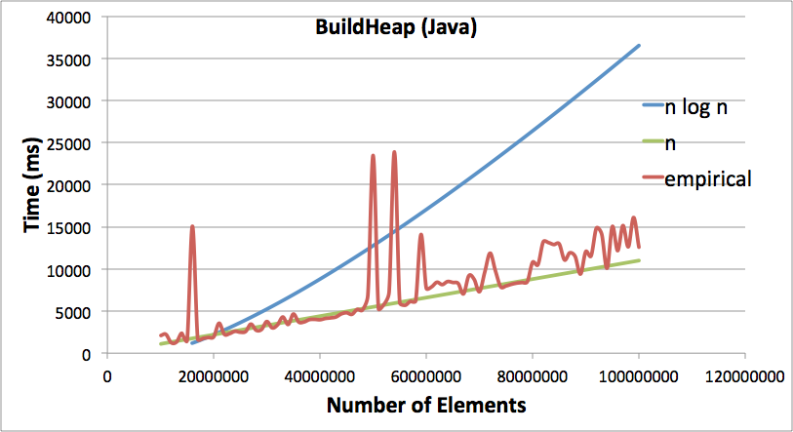
BuildHeap
Empirical Results
(Java)
Heap Operations: heaping: empirical

Slide 50
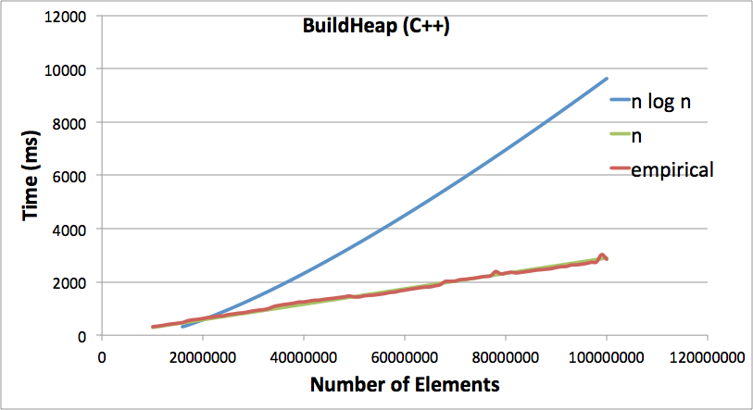
BuildHeap
Empirical Results
(C++)
Heap Operations: heaping: empirical

Slide 51
References and Advanced Reading
References:
  Priority Queues, Wikipedia: http://en.wikipedia.org/wiki/Priority_queue
  YouTube on Priority Queues: https://www.youtube.com/watch?v=gJc-J7K_P_w
  http://en.wikipedia.org/wiki/Binary_heap (excellent)
  http://www.cs.usfca.edu/~galles/visualization/Heap.html (excellent visualization)
  Another explanation online: http://www.cs.cmu.edu/~adamchik/15-121/lectures/Binary%20Heaps/heaps.html (excellent)
Advanced Reading:
  A great online explanation of asymptotic complexity of a heap: http://www.cs.umd.edu/~meesh/351/mount/lectures/lect14-heapsort-analysis-part.pdf
  YouTube video with more detail and math: https://www.youtube.com/watch?v=B7hVxCmfPtM (excellent, mostly max heaps)

Slide 52
Extra Slides

Slide 53
Extras: HeapSort
We can perform a full heap sort in place, in O(n log n) time.
  First, heapify an array (i.e., call build-heap on an unsorted array)
  Second, iterate over the array and perform dequeue(), but instead of returning the minimum elements, swap them with the last element (and also decrease heapSize)
  When the iteration is complete, the array will be sorted from low to high priority.
Notes:
Sequential programming: one instruction at a time, instructions follow each other, with the possibility of branching.

Slide 54
Extras: HeapSort — Heapify first
9
Unheaped:
5
11
8
12
10
14
 | 9 | 5 | 11 | 8 | 12 | 10 | 14 | 2 | 22 | 43
[0] | [1] | [2] | [3] | [4] | [5] | [6] | [7] | [8] | [9] | [10]
2
22
43
2
Heaped:
5
10
 | 2 | 5 | 10 | 8 | 12 | 11 | 14 | 9 | 22 | 43
[0] | [1] | [2] | [3] | [4] | [5] | [6] | [7] | [8] | [9] | [10]
8
12
11
14
9
22
43
Notes:
Sequential programming: one instruction at a time, instructions follow each other, with the possibility of branching.

Slide 55
Extras: HeapSort — Iterate and call dequeue(), swapping the root with the last element, then down-heaping.
43
heapSize
5
10
 | 43 | 5 | 10 | 8 | 12 | 11 | 14 | 9 | 22 | 2
[0] | [1] | [2] | [3] | [4] | [5] | [6] | [7] | [8] | [9] | [10]
8
12
11
14
2
9
22
Notes:
Sequential programming: one instruction at a time, instructions follow each other, with the possibility of branching.

Slide 56
Extras: HeapSort — Iterate and call dequeue(), swapping the root with the last element, then down-heaping.
5
heapSize
8
10
 | 5 | 8 | 10 | 9 | 12 | 11 | 14 | 43 | 22 | 2
[0] | [1] | [2] | [3] | [4] | [5] | [6] | [7] | [8] | [9] | [10]
9
12
11
14
2
43
22
Notes:
Sequential programming: one instruction at a time, instructions follow each other, with the possibility of branching.

Slide 57
Extras: HeapSort — Iterate and call dequeue(), swapping the root with the last element, then down-heaping.
22
heapSize
8
10
 | 22 | 8 | 10 | 9 | 12 | 11 | 14 | 43 | 5 | 2
[0] | [1] | [2] | [3] | [4] | [5] | [6] | [7] | [8] | [9] | [10]
9
12
11
14
2
43
5
Notes:
Sequential programming: one instruction at a time, instructions follow each other, with the possibility of branching.

Slide 58
Extras: HeapSort — Iterate and call dequeue(), swapping the root with the last element, then down-heaping.
8
heapSize
9
10
 | 8 | 9 | 10 | 22 | 12 | 11 | 14 | 43 | 5 | 2
[0] | [1] | [2] | [3] | [4] | [5] | [6] | [7] | [8] | [9] | [10]
22
12
11
14
2
43
5
Notes:
Sequential programming: one instruction at a time, instructions follow each other, with the possibility of branching.

Slide 59
Extras: HeapSort — Iterate and call dequeue(), swapping the root with the last element, then down-heaping.
43
heapSize
9
10
 | 43 | 9 | 10 | 22 | 12 | 11 | 14 | 8 | 5 | 2
[0] | [1] | [2] | [3] | [4] | [5] | [6] | [7] | [8] | [9] | [10]
22
12
11
14
2
8
5
Notes:
Sequential programming: one instruction at a time, instructions follow each other, with the possibility of branching.

Slide 60
Extras: HeapSort — Iterate and call dequeue(), swapping the root with the last element, then down-heaping.
9
heapSize
12
10
 | 9 | 12 | 10 | 22 | 43 | 11 | 14 | 8 | 5 | 2
[0] | [1] | [2] | [3] | [4] | [5] | [6] | [7] | [8] | [9] | [10]
22
43
11
14
2
8
5
Notes:
Sequential programming: one instruction at a time, instructions follow each other, with the possibility of branching.

Slide 61
Extras: HeapSort — Iterate and call dequeue(), swapping the root with the last element, then down-heaping.
14
heapSize
12
10
 | 14 | 12 | 10 | 22 | 43 | 11 | 9 | 8 | 5 | 2
[0] | [1] | [2] | [3] | [4] | [5] | [6] | [7] | [8] | [9] | [10]
22
43
11
9
2
8
5
Notes:
Sequential programming: one instruction at a time, instructions follow each other, with the possibility of branching.

Slide 62
Extras: HeapSort — Iterate and call dequeue(), swapping the root with the last element, then down-heaping.
10
heapSize
12
11
 | 10 | 12 | 11 | 22 | 43 | 14 | 9 | 8 | 5 | 2
[0] | [1] | [2] | [3] | [4] | [5] | [6] | [7] | [8] | [9] | [10]
22
43
14
9
2
8
5
Notes:
Sequential programming: one instruction at a time, instructions follow each other, with the possibility of branching.

Slide 63
Extras: HeapSort — Iterate and call dequeue(), swapping the root with the last element, then down-heaping.
43
heapSize
12
11
 | 43 | 12 | 11 | 22 | 10 | 14 | 9 | 8 | 5 | 2
[0] | [1] | [2] | [3] | [4] | [5] | [6] | [7] | [8] | [9] | [10]
22
10
14
9
2
8
5
Notes:
Sequential programming: one instruction at a time, instructions follow each other, with the possibility of branching.

Slide 64
Extras: HeapSort — Iterate and call dequeue(), swapping the root with the last element, then down-heaping.
11
heapSize
12
43
 | 11 | 12 | 43 | 22 | 10 | 14 | 9 | 8 | 5 | 2
[0] | [1] | [2] | [3] | [4] | [5] | [6] | [7] | [8] | [9] | [10]
22
10
14
9
2
8
5
Notes:
Sequential programming: one instruction at a time, instructions follow each other, with the possibility of branching.

Slide 65
Extras: HeapSort — Iterate and call dequeue(), swapping the root with the last element, then down-heaping.
22
heapSize
12
43
 | 22 | 12 | 43 | 11 | 10 | 14 | 9 | 8 | 5 | 2
[0] | [1] | [2] | [3] | [4] | [5] | [6] | [7] | [8] | [9] | [10]
11
10
14
9
2
8
5
Notes:
Sequential programming: one instruction at a time, instructions follow each other, with the possibility of branching.

Slide 66
Extras: HeapSort — Iterate and call dequeue(), swapping the root with the last element, then down-heaping.
12
heapSize
22
43
 | 12 | 22 | 43 | 11 | 10 | 14 | 9 | 8 | 5 | 2
[0] | [1] | [2] | [3] | [4] | [5] | [6] | [7] | [8] | [9] | [10]
11
10
14
9
2
8
5
Notes:
Sequential programming: one instruction at a time, instructions follow each other, with the possibility of branching.

Slide 67
Extras: HeapSort — Iterate and call dequeue(), swapping the root with the last element, then down-heaping.
43
heapSize
22
12
 | 43 | 22 | 12 | 11 | 10 | 14 | 9 | 8 | 5 | 2
[0] | [1] | [2] | [3] | [4] | [5] | [6] | [7] | [8] | [9] | [10]
11
10
14
9
2
8
5
Notes:
Sequential programming: one instruction at a time, instructions follow each other, with the possibility of branching.

Slide 68
Extras: HeapSort — Iterate and call dequeue(), swapping the root with the last element, then down-heaping.
22
heapSize
43
12
 | 43 | 22 | 12 | 11 | 10 | 14 | 9 | 8 | 5 | 2
[0] | [1] | [2] | [3] | [4] | [5] | [6] | [7] | [8] | [9] | [10]
11
10
14
9
2
8
5
Notes:
Sequential programming: one instruction at a time, instructions follow each other, with the possibility of branching.

Slide 69
Extras: HeapSort — Iterate and call dequeue(), swapping the root with the last element, then down-heaping.
                Done! (reverse-ordered)
43
heapSize
22
12
 | 43 | 22 | 12 | 11 | 10 | 14 | 9 | 8 | 5 | 2
[0] | [1] | [2] | [3] | [4] | [5] | [6] | [7] | [8] | [9] | [10]
11
10
14
9
2
8
5
Complexity: O(n log n)
Notes:
Sequential programming: one instruction at a time, instructions follow each other, with the possibility of branching.

Slide 70
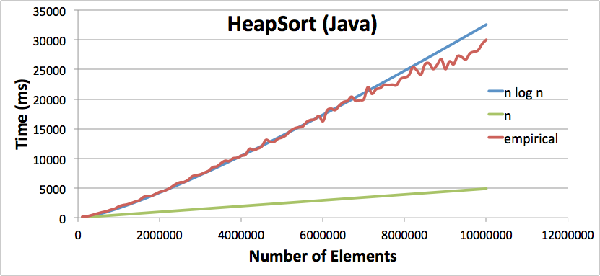
HeapSort
Empirical Results
(Java)
Notes:
Sequential programming: one instruction at a time, instructions follow each other, with the possibility of branching.

Slide 71
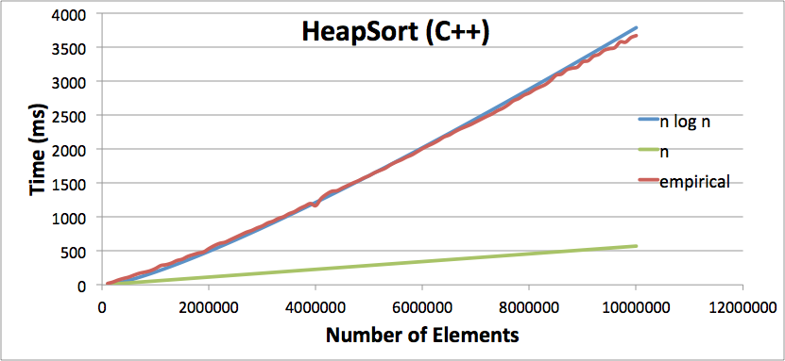
HeapSort
Empirical Results
(C++)
Notes:
Sequential programming: one instruction at a time, instructions follow each other, with the possibility of branching.

Slide 72
Extras: Why is buildheap() O(n)?
14
Consider a full binary heap data structure with n nodes.
Nodes at this level: 1, work done: c * (1) * log n
9
13
Nodes at this level: n/8, work done: c * n/8 * 2
43
10
15
19
Nodes at this level: n/4, work done: c * n/4 * 1
(possible swaps to bottom level)
50
45
12
17
31
18
22
40
Work at this level: none
Notes:
Sequential programming: one instruction at a time, instructions follow each other, with the possibility of branching.

Slide 73
Extras: Why is buildheap() O(n)?
14
Consider a full binary heap data structure with n nodes.
Total work done:
9
13
43
10
15
19
50
45
12
17
31
18
22
40
Notes:
Sequential programming: one instruction at a time, instructions follow each other, with the possibility of branching.

Slide 74
Extras: Why is buildheap() O(n)?
14
Consider a full binary heap data structure with n nodes.
Total work done:
9
13
43
10
15
19
Substitution:
Must do some math for lg(n):
50
45
12
17
31
18
22
40
Notes:
Sequential programming: one instruction at a time, instructions follow each other, with the possibility of branching.

Slide 75
Extras: Why is buildheap() O(n)?
14
Consider a full binary heap data structure with n nodes.
With substitution, and pulling out c*2^{k}:
9
13
43
10
15
19
Simplify a bit more:
50
45
12
17
31
18
22
40
Notes:
Sequential programming: one instruction at a time, instructions follow each other, with the possibility of branching.

Slide 76
Extras: Why is buildheap() O(n)?
14
Consider a full binary heap data structure with n nodes.
With substitution, and pulling out c*2^{k}:
9
13
43
10
15
19
50
45
12
17
31
18
22
40
Notes:
Sequential programming: one instruction at a time, instructions follow each other, with the possibility of branching.

Slide 77
Extras: Why is buildheap() O(n)?
14
Consider a full binary heap data structure with n nodes.
With substitution, and pulling out c*2^{k}:
9
13
43
10
15
19
Substitution:
50
45
12
17
31
18
22
40
Linear amount of work!
Notes:
Sequential programming: one instruction at a time, instructions follow each other, with the possibility of branching.

