Slide 1
Monday, May 15, 2017
CS 106B
Lecture 18: Trees
Programming Abstractions
Sprint 2017
Stanford University
Computer Science Department
Lecturer: Chris Gregg
reading:
Programming Abstractions in C++, Section 16.1

Slide 2
Today's Topics
Logistics
Introduction to Trees

Slide 3
Trees
We have already seen trees in the class in the form of decision trees!
cart
art
crt
cat
car
rt
at
ar
rt
ct
cr
at
ct
ca
ar
cr
ca
t
r
t
a
r
a
t
r
t
c
r
c
t
a
t
c
a
c
r
a
r
c
a
c

Slide 4
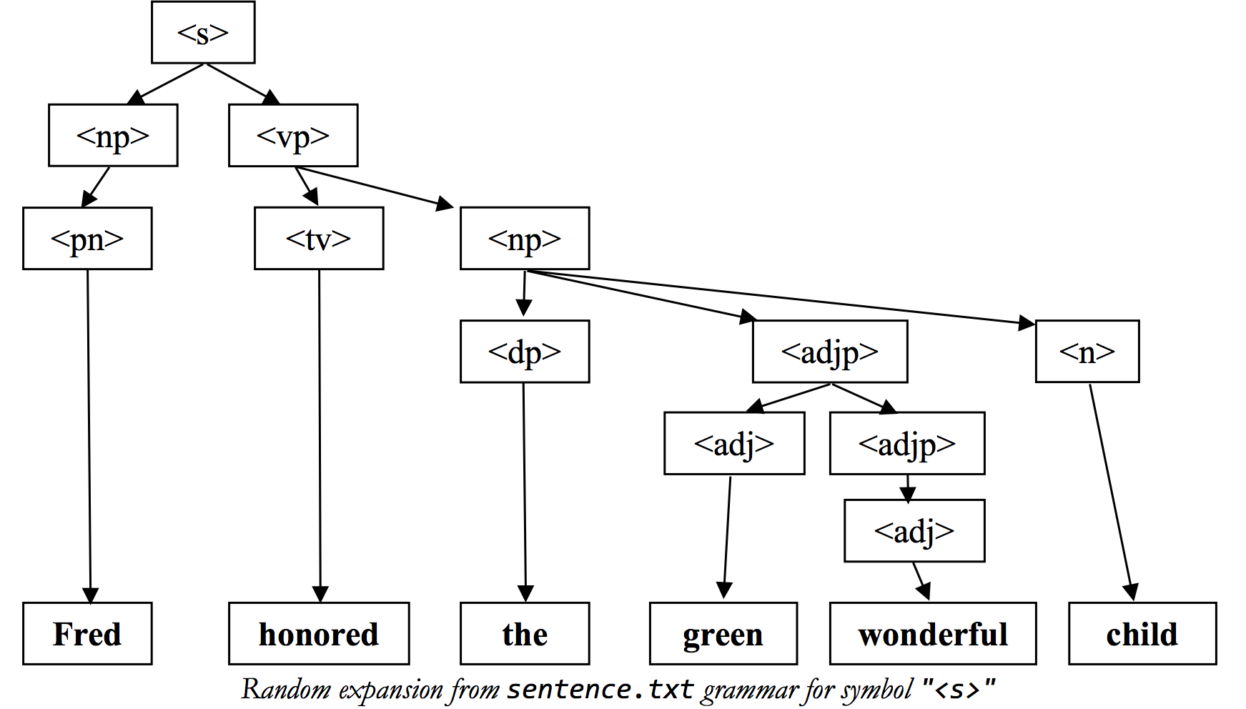
Trees
You've coded trees for recursive assignments!

Slide 5
Trees Can Describe Hierarchies
world
China
Honduras
USA
Shanghai
Tegucigalpa
Hunan
California
Ohio
Changsha
SF
LA
Kent

Slide 6
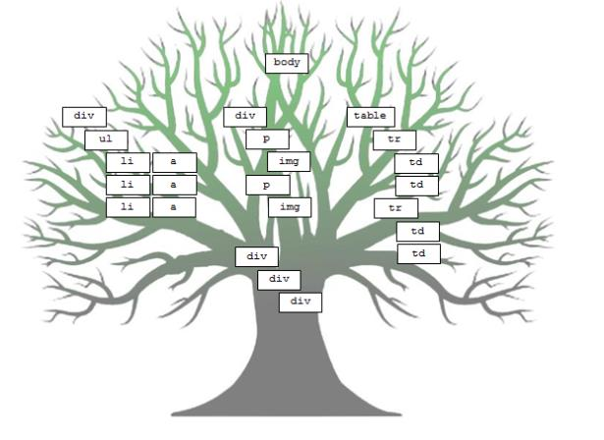
Trees Can Describe Websites (HTML)

Slide 7
Trees Can Describe Programs
* This is a figure in an academic paper written by a recent CS106 student!

Slide 8
What is a Tree (in Computer Science)?
A tree is a collection of nodes, which can be empty. If it is not empty, there is a “root” node, r, and zero or more non-empty subtrees, T1, T2, …, Tk, whose roots are connected by a directed edge from r.
Trees are inherently recursive
A is the root
A
B
C
D
E
F
G
H
I
J
K
L
M
N
O
P

Slide 9
What is a Tree (in Computer Science)?
A tree is a collection of nodes, which can be empty. If it is not empty, there is a “root” node, r, and zero or more non-empty subtrees, T1, T2, …, Tk, whose roots are connected by a directed edge from r.
Tree Terminology
A is the root
A
B
C
D
E
F
F is a
child of A
and a parent
of K,L,M
G
B is a
child of A
H
I
J
K
L
M
N
Note: there are
N nodes and
N-1 edges
O
P

Slide 10
What is a Tree (in Computer Science)?
A tree is a collection of nodes, which can be empty. If it is not empty, there is a “root” node, r, and zero or more non-empty subtrees, T1, T2, …, Tk, whose roots are connected by a directed edge from r.
Tree Terminology
A is the root
A
B
C
D
E
F
G
H
I
J
K
L
M
N
Nodes with no
children are
called leaves
O
P

Slide 11
What is a Tree (in Computer Science)?
A tree is a collection of nodes, which can be empty. If it is not empty, there is a “root” node, r, and zero or more non-empty subtrees, T1, T2, …, Tk, whose roots are connected by a directed edge from r.
Tree Terminology
A is the root
A
B
C
D
E
F
G
H
I
J
K
L
M
N
Nodes with the
same parent are
siblings.
O
P

Slide 12
Tree Terminology
We can define a
path from a parent
to its children.
The path A-E-J-O
has a length of three
(the number of edges)
A
E
F
G
I
J
K
L
M
N
O
P

Slide 13
Tree Terminology
The depth of a node
is the length from the
root. The depth of node
J is 2. The depth of the
root is 0.
The height of a node
is the longest path
from the node to a
leaf. The height of
node F is 1. The height
of all leaves is 0.
A
E
F
G
I
J
K
L
M
N
O
P

Slide 14
Tree Terminology
The height of a tree
is the height of the
root (in this case,
the height of the tree
is 3.
A
E
F
G
I
J
K
L
M
N
O
P

Slide 15


Tree Terminology
Trees can have only one parent, and cannot have cycles

Slide 16
Tree Terminology
Trees can have only one parent, and cannot have cycles
S
N
S
N
T
A
A
F
O

Slide 17
Tree Terminology
Trees can have only one parent, and cannot have cycles
S
N
S
N
Node A has two parents
T
A
A
Node A has two parents
F
O

Slide 18
Tree Terminology
Trees can have only one parent, and cannot have cycles
S
S
T
A
T
A
N
N

Slide 19
Tree Terminology
Trees can have only one parent, and cannot have cycles
S
S
T
A
T
A
N
N
not a tree: the red edges make a cycle

Slide 20
How can we build trees programmatically?

Slide 21
How can we build trees programmatically?
Binary Tree:
value

Slide 22
How can we build trees programmatically?
Binary Tree:
value
Linked List
value

Slide 23
How can we build trees programmatically?
Binary Tree:
value
Linked List
value

Slide 24
How can we build trees programmatically?
Binary Tree:
value
Linked List
value
value
value

Slide 25
How can we build trees programmatically?
Binary Tree:
value
Linked List
value
value
value

Slide 26
The Most Important Slide
Binary Tree:
struct Tree {
  string value;
  Tree *left;
  Tree *right;
};
value

Slide 27
We Can Have Ternary Trees (or any number, n)
Ternary Tree:
struct Tree {
  string value;
  Tree *left;
  Tree *middle;
  Tree *right;
};
value

Slide 28
We Can Have Ternary Trees (or any number, n)
N-ary Tree:
struct Tree {
  string value;
  Vector<Tree *> children;
};
value
 |  | ...

Slide 29
Trees can be defined as either structs or classes
struct Tree {
string value;
Tree * left;
Tree * right;
};
class Tree {
private:
  string value;
  Vector<Tree *> children;
};

Slide 30
Let's write some code to "traverse" the tree
struct Tree {
string value;
Tree * left;
Tree * right;
};
this
is
written
There are multiple ways to traverse the nodes in a binary tree:
Pre-order
In-order
Post-order
Level-order
a
correctly
sentence.

Slide 31
Let's write some code to "traverse" the tree
struct Tree {
string value;
Tree * left;
Tree * right;
};
this
is
written
There are multiple ways to traverse the nodes in a binary tree:
Pre-order
In-order
Post-order
Level-order
a
correctly
sentence.
Do something
Go left
Go right

Slide 32
Let's write some code to "traverse" the tree
struct Tree {
string value;
Tree * left;
Tree * right;
};
this
is
written
There are multiple ways to traverse the nodes in a binary tree:
Pre-order
In-order
Post-order
Level-order
a
correctly
sentence.
Go left
Do something
Go right

Slide 33
Let's write some code to "traverse" the tree
struct Tree {
string value;
Tree * left;
Tree * right;
};
this
is
written
There are multiple ways to traverse the nodes in a binary tree:
Pre-order
In-order
Post-order
Level-order
a
correctly
sentence.
Go left
Go right
Do something

Slide 34
Let's write some code to "traverse" the tree
struct Tree {
string value;
Tree * left;
Tree * right;
};
this
is
written
There are multiple ways to traverse the nodes in a binary tree:
Pre-order
In-order
Post-order
Level-order
a
correctly
sentence.
Hmm...can we do this recursively?
We want to print the levels: 0, 1, 2 from left-to-right order

Slide 35
Let's write some code to "traverse" the tree
struct Tree {
string value;
Tree * left;
Tree * right;
};
this
is
written
There are multiple ways to traverse the nodes in a binary tree:
Pre-order
In-order
Post-order
Level-order
a
correctly
sentence.
Not easy recursively...let's use a queue!
Enqueue root
While queue is not empty:
  dequeue node
  do something with node
  enqueue left child of node if it exists
  enqueue right child of node if it exists
should look familiar...word ladder?

Slide 36
Let's write some code
struct Tree {
string value;
Tree * left;
Tree * right;
};
this
is
written
void preOrder(Tree * tree) {
  if(tree == NULL) return;
  cout<< tree->value <<" ";
  preOrder(tree->left);
  preOrder(tree->right);
}
void inOrder(Tree * tree) {
  if(tree == NULL) return;
  inOrder(tree->left);
  cout<< tree->value <<" ";
  inOrder(tree->right);
}
void postOrder(Tree * tree) {
  if(tree == NULL) return;
  postOrder(tree->left);
  postOrder(tree->right);
  cout<< tree->value << " ";
}
a
correctly
sentence.
void levelOrder(Tree *tree) {
Queue<Tree *>treeQueue;
treeQueue.enqueue(tree);
while (!treeQueue.isEmpty()) {
Tree *node = treeQueue.dequeue();
cout << node->value << " ";
if (node->left != NULL) {
treeQueue.enqueue(node->left);
}
if (node->right != NULL) {
treeQueue.enqueue(node->right);
}
}
}

Slide 37
References and Advanced Reading
References:
  https://en.wikipedia.org/wiki/Tree_(data_structure)
  http://pages.cs.wisc.edu/~vernon/cs367/notes/8.TREES.html
Advanced Reading:
  http://www.cs.cmu.edu/~adamchik/15-121/lectures/Trees/trees.html
  Great set of tree-type questions:
    http://cslibrary.stanford.edu/110/BinaryTrees.html

