Slide 1
Wednesday, May 24, 2017
CS 106B
Lecture 23: Graphs II
Programming Abstractions
Spring 2017
Stanford University
Computer Science Department
Lecturer: Chris Gregg
reading:
Programming Abstractions in C++, Chapter 18

Slide 2
Today's Topics
Logistics
  Huffman Encoding: due Thursday, 12:00pm -- last change to use late credits
  Final Assignment YEAH hours tomorrow, 3:30pm, B03
  CS+Social Good Interest form
  How to Declare EE Lunch, Thursday, May 25th
Real Graphs:
  Internet routers and traceroute
Topological Sort
Minimum Spanning Trees
  Kruskal's algorithm

Slide 3
CS+Social Good Interest Form
https://goo.gl/mOcBEu
CS53SI: Discussions in Social Tech Interest Form
CS+Social Good is planning on organizing a course aiming on discussing the intersection of technology and social impact through speakers and student discussions. If you are interested in taking such a class, we would love to hear what kind of class you would like to take!
DESCRIPTION: This course introduces students to various intersections of social good and technology through a weekly discussion and speaker series. Students will be given a space to exchange ideas and experiences regarding a certain social issue. Invited speakers come from industry, academia, and non-profit organizations. They will share their career paths, what drove them to these fields, and advice for students. The topics examined will span a broad variety of social issues -- from race and class to mental health to sustainability -- and help students better understand how to kick off their journey in using computer science for social good.

Slide 4

How to Declare EE Lunch

Slide 5
Real Graphs!
There was a Tiny Feedback from the first graphs lecture that said,
        ❝I would give more examples of how graphs are used, or, in general, give a wider variety of examples of applications to the methods being used. I think it would be interesting to give examples of how certain topics can be used in cross-sections of CS and other majors/departments.❞
Let's dig a bit deeper into how the Internet is a real graph by analyzing internet routers, or:
How does a message get sent from your computer to another computer on the Internet, say in Australia?

Slide 6
The Internet: Computers connected through routers
your computer
computer in Australia

Slide 7
The Internet: Computers connected through routers
your computer
computer in Australia

Slide 8
The Internet: Let's simplify a bit
The destination computer has a name and an IP address, like this:
www.engineering.unsw.edu.au
IP address: 149.171.158.109
your computer
E
A
The first number denotes the "network address" and routers continually pass around information about how many "hops" they think it will take for them to get to all the networks. E.g., for router C:
B
D
F
C
computer in Australia
router | hops
A | 2
B | 1
C | -
D | 1
E | 2
F | 2

Slide 9
The Internet: Let's simplify a bit
Each router knows its neighbors, and it has a copy of its neighbors' tables. So, B would have the following tables:
your computer
E
A
B
router | hops
A | -
B | 1
C | 3
D | 2
E | 3
F | 3
D
A
F
C
router | hops
A | 2
B | 1
C | -
D | 1
E | 2
F | 2
router | hops
A | 2
B | 1
C | 1
D | -
E | 1
F | 1
C
D

Slide 10
The Internet: Let's simplify a bit
your computer
If B wants to connect to F, it connects through its neighbor that reports the shortest path to F. Which router would it choose?
E
A
B
router | hops
A | -
B | 1
C | 3
D | 2
E | 3
F | 3
D
A
F
C
router | hops
A | 2
B | 1
C | -
D | 1
E | 2
F | 2
router | hops
A | 2
B | 1
C | 1
D | -
E | 1
F | 1
C
D

Slide 11
The Internet: Let's simplify a bit
your computer
If B wants to connect to F, it connects through its neighbor that reports the shortest path to F. Which router would it choose? D.
E
A
B
router | hops
A | -
B | 1
C | 3
D | 2
E | 3
F | 3
D
A
F
C
router | hops
A | 2
B | 1
C | -
D | 1
E | 2
F | 2
router | hops
A | 2
B | 1
C | 1
D | -
E | 1
F | 1
C
D

Slide 12

Traceroute
We can use a program called "traceroute" to tell us the path between our computer and a different computer:
traceroute -I -e www.engineering.unsw.edu.au

Slide 13
Traceroute: Stanford Hops
traceroute -I -e www.engineering.unsw.edu.au
traceroute to www.engineering.unsw.edu.au (149.171.158.109), 64 hops max, 72 byte packets
1 csmx-west-rtr.sunet (171.67.64.2) 7.414 ms 9.155 ms 8.288 ms
2 gnat-2.sunet (172.24.70.12) 0.339 ms 1.532 ms 0.423 ms
3 csmx-west-rtr-vl3866.sunet (171.64.66.2) 38.916 ms 10.506 ms 8.402 ms
4 dca-rtr-vlan8.sunet (171.64.255.204) 0.530 ms 0.521 ms 0.713 ms
5 dc-svl-agg4--stanford-10ge.cenic.net (137.164.50.157) 1.554 ms 1.653 ms 2.828 ms
6 hpr-svl-hpr2--svl-agg4-10ge.cenic.net (137.164.26.249) 1.212 ms 1.161 ms 1.204 ms
7 aarnet-2-is-jmb-778.sttlwa.pacificwave.net (207.231.245.4) 17.994 ms 17.998 ms 18.319 ms
8 et-2-0-0.pe2.brwy.nsw.aarnet.net.au (113.197.15.98) 160.020 ms 160.234 ms 159.922 ms
9 et-3-3-0.pe1.brwy.nsw.aarnet.net.au (113.197.15.148) 160.285 ms 160.076 ms 160.118 ms
10 138.44.5.1 (138.44.5.1) 160.124 ms 160.138 ms 160.068 ms
11 ombcr1-te-1-5.gw.unsw.edu.au (149.171.255.106) 160.090 ms 160.381 ms 160.185 ms
12 r1dcdnex1-po-2.gw.unsw.edu.au (149.171.255.178) 160.909 ms 160.847 ms 160.921 ms
13 dcfw1-ae-1-3049.gw.unsw.edu.au (129.94.254.60) 160.592 ms 160.558 ms 160.949 ms
14 www.engineering.unsw.edu.au (149.171.158.109) 160.978 ms 161.184 ms 160.987 ms

Slide 14
Traceroute: CENIC
traceroute -I -e www.engineering.unsw.edu.au
traceroute to www.engineering.unsw.edu.au (149.171.158.109), 64 hops max, 72 byte packets
1 csmx-west-rtr.sunet (171.67.64.2) 7.414 ms 9.155 ms 8.288 ms
2 gnat-2.sunet (172.24.70.12) 0.339 ms 1.532 ms 0.423 ms
3 csmx-west-rtr-vl3866.sunet (171.64.66.2) 38.916 ms 10.506 ms 8.402 ms
4 dca-rtr-vlan8.sunet (171.64.255.204) 0.530 ms 0.521 ms 0.713 ms
5 dc-svl-agg4--stanford-10ge.cenic.net (137.164.50.157) 1.554 ms 1.653 ms 2.828 ms
6 hpr-svl-hpr2--svl-agg4-10ge.cenic.net (137.164.26.249) 1.212 ms 1.161 ms 1.204 ms
7 aarnet-2-is-jmb-778.sttlwa.pacificwave.net (207.231.245.4) 17.994 ms 17.998 ms 18.319 ms
8 et-2-0-0.pe2.brwy.nsw.aarnet.net.au (113.197.15.98) 160.020 ms 160.234 ms 159.922 ms
9 et-3-3-0.pe1.brwy.nsw.aarnet.net.au (113.197.15.148) 160.285 ms 160.076 ms 160.118 ms
10 138.44.5.1 (138.44.5.1) 160.124 ms 160.138 ms 160.068 ms
11 ombcr1-te-1-5.gw.unsw.edu.au (149.171.255.106) 160.090 ms 160.381 ms 160.185 ms
12 r1dcdnex1-po-2.gw.unsw.edu.au (149.171.255.178) 160.909 ms 160.847 ms 160.921 ms
13 dcfw1-ae-1-3049.gw.unsw.edu.au (129.94.254.60) 160.592 ms 160.558 ms 160.949 ms
14 www.engineering.unsw.edu.au (149.171.158.109) 160.978 ms 161.184 ms 160.987 ms
The Corporation for Education Network Initiatives in California (CENIC) is a nonprofit corporation formed in 1996 to provide high-performance, high-bandwidth networking services to California universities and research institutions (source: Wikipedia)

Slide 15
Traceroute: Pacificwave (Seattle)
traceroute -I -e www.engineering.unsw.edu.au
traceroute to www.engineering.unsw.edu.au (149.171.158.109), 64 hops max, 72 byte packets
1 csmx-west-rtr.sunet (171.67.64.2) 7.414 ms 9.155 ms 8.288 ms
2 gnat-2.sunet (172.24.70.12) 0.339 ms 1.532 ms 0.423 ms
3 csmx-west-rtr-vl3866.sunet (171.64.66.2) 38.916 ms 10.506 ms 8.402 ms
4 dca-rtr-vlan8.sunet (171.64.255.204) 0.530 ms 0.521 ms 0.713 ms
5 dc-svl-agg4--stanford-10ge.cenic.net (137.164.50.157) 1.554 ms 1.653 ms 2.828 ms
6 hpr-svl-hpr2--svl-agg4-10ge.cenic.net (137.164.26.249) 1.212 ms 1.161 ms 1.204 ms
7 aarnet-2-is-jmb-778.sttlwa.pacificwave.net (207.231.245.4) 17.994 ms 17.998 ms 18.319 ms
8 et-2-0-0.pe2.brwy.nsw.aarnet.net.au (113.197.15.98) 160.020 ms 160.234 ms 159.922 ms
9 et-3-3-0.pe1.brwy.nsw.aarnet.net.au (113.197.15.148) 160.285 ms 160.076 ms 160.118 ms
10 138.44.5.1 (138.44.5.1) 160.124 ms 160.138 ms 160.068 ms
11 ombcr1-te-1-5.gw.unsw.edu.au (149.171.255.106) 160.090 ms 160.381 ms 160.185 ms
12 r1dcdnex1-po-2.gw.unsw.edu.au (149.171.255.178) 160.909 ms 160.847 ms 160.921 ms
13 dcfw1-ae-1-3049.gw.unsw.edu.au (129.94.254.60) 160.592 ms 160.558 ms 160.949 ms
14 www.engineering.unsw.edu.au (149.171.158.109) 160.978 ms 161.184 ms 160.987 ms
Pass Internet traffic directly with other major national and international networks, including U.S. federal agencies and many Pacific Rim R&E networks (source: http://www.pnwgp.net/services/pacific-wave-peering-exchange/ )

Slide 16
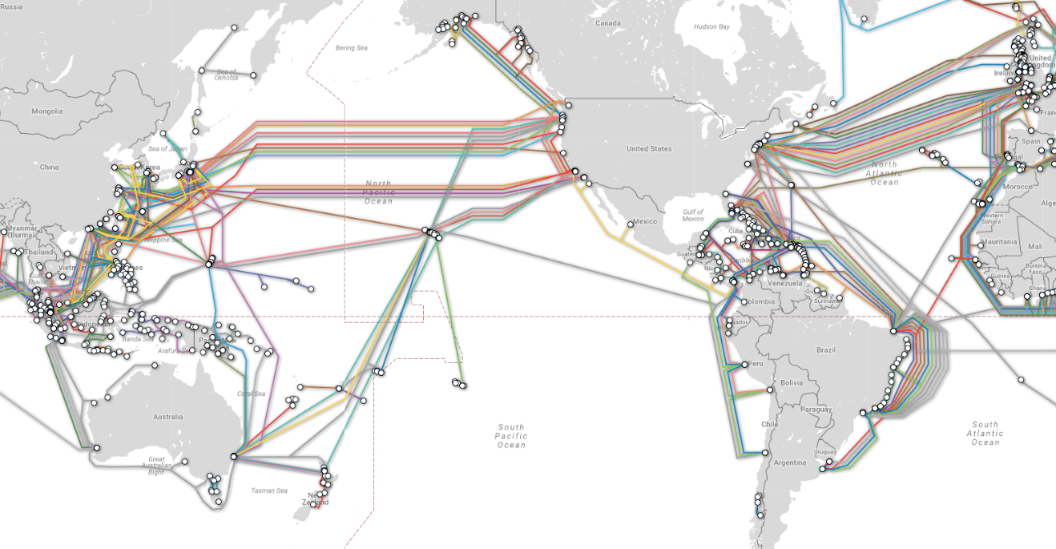
Traceroute: Oregon to Australia - underwater!
http://www.submarinecablemap.com

Slide 17
Traceroute: Australia
traceroute -I -e www.engineering.unsw.edu.au
traceroute to www.engineering.unsw.edu.au (149.171.158.109), 64 hops max, 72 byte packets
1 csmx-west-rtr.sunet (171.67.64.2) 7.414 ms 9.155 ms 8.288 ms
2 gnat-2.sunet (172.24.70.12) 0.339 ms 1.532 ms 0.423 ms
3 csmx-west-rtr-vl3866.sunet (171.64.66.2) 38.916 ms 10.506 ms 8.402 ms
4 dca-rtr-vlan8.sunet (171.64.255.204) 0.530 ms 0.521 ms 0.713 ms
5 dc-svl-agg4--stanford-10ge.cenic.net (137.164.50.157) 1.554 ms 1.653 ms 2.828 ms
6 hpr-svl-hpr2--svl-agg4-10ge.cenic.net (137.164.26.249) 1.212 ms 1.161 ms 1.204 ms
7 aarnet-2-is-jmb-778.sttlwa.pacificwave.net (207.231.245.4) 17.994 ms 17.998 ms 18.319 ms
8 et-2-0-0.pe2.brwy.nsw.aarnet.net.au (113.197.15.98) 160.020 ms 160.234 ms 159.922 ms
9 et-3-3-0.pe1.brwy.nsw.aarnet.net.au (113.197.15.148) 160.285 ms 160.076 ms 160.118 ms
10 138.44.5.1 (138.44.5.1) 160.124 ms 160.138 ms 160.068 ms
11 ombcr1-te-1-5.gw.unsw.edu.au (149.171.255.106) 160.090 ms 160.381 ms 160.185 ms
12 r1dcdnex1-po-2.gw.unsw.edu.au (149.171.255.178) 160.909 ms 160.847 ms 160.921 ms
13 dcfw1-ae-1-3049.gw.unsw.edu.au (129.94.254.60) 160.592 ms 160.558 ms 160.949 ms
14 www.engineering.unsw.edu.au (149.171.158.109) 160.978 ms 161.184 ms 160.987 ms

Slide 18
Traceroute: University of New South Wales
traceroute -I -e www.engineering.unsw.edu.au
traceroute to www.engineering.unsw.edu.au (149.171.158.109), 64 hops max, 72 byte packets
1 csmx-west-rtr.sunet (171.67.64.2) 7.414 ms 9.155 ms 8.288 ms
2 gnat-2.sunet (172.24.70.12) 0.339 ms 1.532 ms 0.423 ms
3 csmx-west-rtr-vl3866.sunet (171.64.66.2) 38.916 ms 10.506 ms 8.402 ms
4 dca-rtr-vlan8.sunet (171.64.255.204) 0.530 ms 0.521 ms 0.713 ms
5 dc-svl-agg4--stanford-10ge.cenic.net (137.164.50.157) 1.554 ms 1.653 ms 2.828 ms
6 hpr-svl-hpr2--svl-agg4-10ge.cenic.net (137.164.26.249) 1.212 ms 1.161 ms 1.204 ms
7 aarnet-2-is-jmb-778.sttlwa.pacificwave.net (207.231.245.4) 17.994 ms 17.998 ms 18.319 ms
8 et-2-0-0.pe2.brwy.nsw.aarnet.net.au (113.197.15.98) 160.020 ms 160.234 ms 159.922 ms
9 et-3-3-0.pe1.brwy.nsw.aarnet.net.au (113.197.15.148) 160.285 ms 160.076 ms 160.118 ms
10 138.44.5.1 (138.44.5.1) 160.124 ms 160.138 ms 160.068 ms
11 ombcr1-te-1-5.gw.unsw.edu.au (149.171.255.106) 160.090 ms 160.381 ms 160.185 ms
12 r1dcdnex1-po-2.gw.unsw.edu.au (149.171.255.178) 160.909 ms 160.847 ms 160.921 ms
13 dcfw1-ae-1-3049.gw.unsw.edu.au (129.94.254.60) 160.592 ms 160.558 ms 160.949 ms
14 www.engineering.unsw.edu.au (149.171.158.109) 160.978 ms 161.184 ms 160.987 ms
161 milliseconds to get to the final computer

Slide 19

Other Real Life Uses for Graphs
Amazon.com -- Product relationships are graph-based
What product might this be related to?

Slide 20
Other Real Life Uses for Graphs

Slide 21
Other Real Life Uses for Graphs
Web page searching (we will discuss this on Friday!)
Google Maps (your final assignment, Trailblazer!)

Slide 22
Other Real Life Uses for Graphs
Routing circuits:

Slide 23
Other Real Life Uses for Graphs
Scheduling work based on dependencies (e.g., when doing laundry, the washer must finish before the dryer, and before folding) -- this is called a "topological sort")
b
g
k
d
a
e
h
f
c

Slide 24
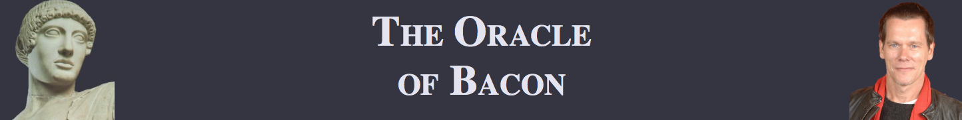
Other Real Life Uses for Graphs
The "Oracle of Bacon": https://oracleofbacon.org (we will cover graph searching on Friday)

Slide 25
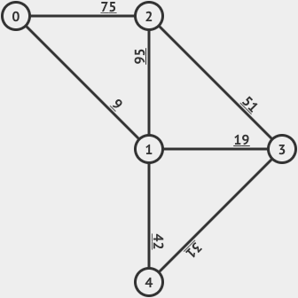
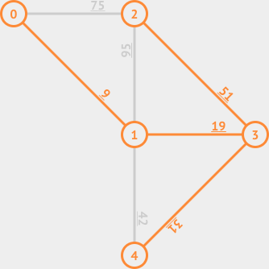
Other Real Life Uses for Graphs
Telecommunications: find the least expensive way to lay out a set of cables for a telephone or cable TV system ("a Minimum Spanning Tree")

Slide 26

Spanning Trees and Minimum Spanning Trees
Definition: A Spanning Tree (ST) of a connected undirected weighted graph G is a subgraph of G that is a tree and connects (spans) all vertices of G. A graph G can have multiple STs. A Minimum Spanning Tree (MST) of G is a ST of G that has the smallest total weight among the various STs. A graph G can have multiple MSTs but the MST weight is unique.
Minimum Spanning Tree

Slide 27
Kruskal's Algorithm to find a Minimum Spanning Tree
Kruskal's algorithm: Finds a MST in a given graph.
  function kruskal(graph):
  Remove all edges from the graph.
  Place all edges into a priority queue based on their weight (cost).
  While the priority queue is not empty:
  Dequeue an edge e from the priority queue.
  If e's endpoints aren't already connected to one another,
  add that edge into the graph.
  Otherwise, skip the edge.

Slide 28
Kruskal Example
In what order would Kruskal's algorithm visit the edges
in the graph below? What MST would it produce?
  function kruskal(graph):
  Remove all edges from the graph.
  Place all edges into a priority queue
  based on their weight (cost).
  While the priority queue is not empty:
  Dequeue an edge e from the priority queue.
  If e's endpoints aren't already connected,
  add that edge into the graph.
  Otherwise, skip the edge.
  pq = {a:1, b:2, c:3, d:4, e:5, f:6, g:7, h:8, i:9, j:10, k:11, l:12, m:13, n:14, o:15, p:16, q:17, r:18}
q:17
p:16
k:11
i:9
m:13
j:10
o:15
f:6
r:18
a:1
c:3
g:7
b:2
e:5
n:14
d:4
l:12
h:8

Slide 29
Kruskal Example
In what order would Kruskal's algorithm visit the edges
in the graph below? What MST would it produce?
  function kruskal(graph):
  Remove all edges from the graph.
  Place all edges into a priority queue
  based on their weight (cost).
  While the priority queue is not empty:
  Dequeue an edge e from the priority queue.
  If e's endpoints aren't already connected,
  add that edge into the graph.
  Otherwise, skip the edge.
  pq = {a:1, b:2, c:3, d:4, e:5, f:6, g:7, h:8, i:9, j:10, k:11, l:12, m:13, n:14, o:15, p:16, q:17, r:18}
q:17
p:16
k:11
i:9
m:13
j:10
o:15
f:6
r:18
a:1
c:3
g:7
b:2
e:5
n:14
d:4
l:12
h:8

Slide 30
Kruskal Example
In what order would Kruskal's algorithm visit the edges
in the graph below? What MST would it produce?
  function kruskal(graph):
  Remove all edges from the graph.
  Place all edges into a priority queue
  based on their weight (cost).
  While the priority queue is not empty:
  Dequeue an edge e from the priority queue.
  If e's endpoints aren't already connected,
  add that edge into the graph.
  Otherwise, skip the edge.
  pq = {b:2, c:3, d:4, e:5, f:6, g:7, h:8, i:9, j:10, k:11, l:12, m:13, n:14, o:15, p:16, q:17, r:18}
q:17
p:16
k:11
i:9
m:13
j:10
o:15
f:6
r:18
a:1
c:3
g:7
b:2
e:5
n:14
d:4
l:12
h:8

Slide 31
Kruskal Example
In what order would Kruskal's algorithm visit the edges
in the graph below? What MST would it produce?
  function kruskal(graph):
  Remove all edges from the graph.
  Place all edges into a priority queue
  based on their weight (cost).
  While the priority queue is not empty:
  Dequeue an edge e from the priority queue.
  If e's endpoints aren't already connected,
  add that edge into the graph.
  Otherwise, skip the edge.
  pq = {c:3, d:4, e:5, f:6, g:7, h:8, i:9, j:10, k:11, l:12, m:13, n:14, o:15, p:16, q:17, r:18}
q:17
p:16
k:11
i:9
m:13
j:10
o:15
f:6
r:18
a:1
c:3
g:7
b:2
e:5
n:14
d:4
l:12
h:8

Slide 32
Kruskal Example
In what order would Kruskal's algorithm visit the edges
in the graph below? What MST would it produce?
  function kruskal(graph):
  Remove all edges from the graph.
  Place all edges into a priority queue
  based on their weight (cost).
  While the priority queue is not empty:
  Dequeue an edge e from the priority queue.
  If e's endpoints aren't already connected,
  add that edge into the graph.
  Otherwise, skip the edge.
  pq = {d:4, e:5, f:6, g:7, h:8, i:9, j:10, k:11, l:12, m:13, n:14, o:15, p:16, q:17, r:18}
q:17
p:16
k:11
i:9
m:13
j:10
o:15
f:6
r:18
a:1
c:3
g:7
b:2
e:5
n:14
d:4
l:12
h:8

Slide 33
Kruskal Example
In what order would Kruskal's algorithm visit the edges
in the graph below? What MST would it produce?
  function kruskal(graph):
  Remove all edges from the graph.
  Place all edges into a priority queue
  based on their weight (cost).
  While the priority queue is not empty:
  Dequeue an edge e from the priority queue.
  If e's endpoints aren't already connected,
  add that edge into the graph.
  Otherwise, skip the edge.
  pq = {e:5, f:6, g:7, h:8, i:9, j:10, k:11, l:12, m:13, n:14, o:15, p:16, q:17, r:18}
q:17
p:16
k:11
i:9
m:13
j:10
o:15
f:6
r:18
a:1
c:3
g:7
b:2
e:5
n:14
d:4
l:12
h:8

Slide 34
Kruskal Example
In what order would Kruskal's algorithm visit the edges
in the graph below? What MST would it produce?
  function kruskal(graph):
  Remove all edges from the graph.
  Place all edges into a priority queue
  based on their weight (cost).
  While the priority queue is not empty:
  Dequeue an edge e from the priority queue.
  If e's endpoints aren't already connected,
  add that edge into the graph.
  Otherwise, skip the edge.
  pq = {f:6, g:7, h:8, i:9, j:10, k:11, l:12, m:13, n:14, o:15, p:16, q:17, r:18}
q:17
p:16
k:11
i:9
m:13
j:10
o:15
f:6
r:18
a:1
c:3
g:7
b:2
e:5
n:14
d:4
l:12
h:8

Slide 35
Kruskal Example
In what order would Kruskal's algorithm visit the edges
in the graph below? What MST would it produce?
  function kruskal(graph):
  Remove all edges from the graph.
  Place all edges into a priority queue
  based on their weight (cost).
  While the priority queue is not empty:
  Dequeue an edge e from the priority queue.
  If e's endpoints aren't already connected,
  add that edge into the graph.
  Otherwise, skip the edge.
  pq = {g:7, h:8, i:9, j:10, k:11, l:12, m:13, n:14, o:15, p:16, q:17, r:18}
q:17
p:16
k:11
i:9
m:13
j:10
o:15
f:6
r:18
a:1
c:3
g:7
b:2
e:5
n:14
d:4
l:12
h:8

Slide 36
Kruskal Example
In what order would Kruskal's algorithm visit the edges
in the graph below? What MST would it produce?
  function kruskal(graph):
  Remove all edges from the graph.
  Place all edges into a priority queue
  based on their weight (cost).
  While the priority queue is not empty:
  Dequeue an edge e from the priority queue.
  If e's endpoints aren't already connected,
  add that edge into the graph.
  Otherwise, skip the edge.
  pq = {h:8, i:9, j:10, k:11, l:12, m:13, n:14, o:15, p:16, q:17, r:18}
q:17
p:16
k:11
i:9
m:13
j:10
o:15
f:6
r:18
a:1
c:3
g:7
b:2
e:5
n:14
d:4
l:12
h:8

Slide 37
Kruskal Example
In what order would Kruskal's algorithm visit the edges
in the graph below? What MST would it produce?
  function kruskal(graph):
  Remove all edges from the graph.
  Place all edges into a priority queue
  based on their weight (cost).
  While the priority queue is not empty:
  Dequeue an edge e from the priority queue.
  If e's endpoints aren't already connected,
  add that edge into the graph.
  Otherwise, skip the edge.
  pq = {i:9, j:10, k:11, l:12, m:13, n:14, o:15, p:16, q:17, r:18}
q:17
p:16
k:11
i:9
m:13
j:10
o:15
f:6
r:18
a:1
c:3
g:7
b:2
e:5
n:14
d:4
l:12
h:8

Slide 38
Kruskal Example
In what order would Kruskal's algorithm visit the edges
in the graph below? What MST would it produce?
  function kruskal(graph):
  Remove all edges from the graph.
  Place all edges into a priority queue
  based on their weight (cost).
  While the priority queue is not empty:
  Dequeue an edge e from the priority queue.
  If e's endpoints aren't already connected,
  add that edge into the graph.
  Otherwise, skip the edge.
  pq = {j:10, k:11, l:12, m:13, n:14, o:15, p:16, q:17, r:18}
q:17
p:16
k:11
i:9
m:13
j:10
o:15
f:6
r:18
a:1
c:3
g:7
b:2
e:5
n:14
d:4
l:12
h:8

Slide 39
Kruskal Example
In what order would Kruskal's algorithm visit the edges
in the graph below? What MST would it produce?
  function kruskal(graph):
  Remove all edges from the graph.
  Place all edges into a priority queue
  based on their weight (cost).
  While the priority queue is not empty:
  Dequeue an edge e from the priority queue.
  If e's endpoints aren't already connected,
  add that edge into the graph.
  Otherwise, skip the edge.
  pq = {k:11, l:12, m:13, n:14, o:15, p:16, q:17, r:18}
q:17
p:16
k:11
i:9
m:13
j:10
o:15
f:6
r:18
a:1
c:3
g:7
b:2
e:5
n:14
d:4
l:12
h:8

Slide 40
Kruskal Example
In what order would Kruskal's algorithm visit the edges
in the graph below? What MST would it produce?
  function kruskal(graph):
  Remove all edges from the graph.
  Place all edges into a priority queue
  based on their weight (cost).
  While the priority queue is not empty:
  Dequeue an edge e from the priority queue.
  If e's endpoints aren't already connected,
  add that edge into the graph.
  Otherwise, skip the edge.
  pq = {l:12, m:13, n:14, o:15, p:16, q:17, r:18}
q:17
p:16
k:11
i:9
m:13
j:10
o:15
f:6
r:18
a:1
c:3
g:7
b:2
e:5
n:14
d:4
l:12
h:8

Slide 41
Kruskal Example
In what order would Kruskal's algorithm visit the edges
in the graph below? What MST would it produce?
  function kruskal(graph):
  Remove all edges from the graph.
  Place all edges into a priority queue
  based on their weight (cost).
  While the priority queue is not empty:
  Dequeue an edge e from the priority queue.
  If e's endpoints aren't already connected,
  add that edge into the graph.
  Otherwise, skip the edge.
  pq = {m:13, n:14, o:15, p:16, q:17, r:18}
q:17
p:16
k:11
i:9
m:13
j:10
o:15
f:6
r:18
a:1
c:3
g:7
b:2
e:5
n:14
d:4
l:12
h:8

Slide 42
Kruskal Example
In what order would Kruskal's algorithm visit the edges
in the graph below? What MST would it produce?
  function kruskal(graph):
  Remove all edges from the graph.
  Place all edges into a priority queue
  based on their weight (cost).
  While the priority queue is not empty:
  Dequeue an edge e from the priority queue.
  If e's endpoints aren't already connected,
  add that edge into the graph.
  Otherwise, skip the edge.
  pq = {n:14, o:15, p:16, q:17, r:18}
q:17
p:16
k:11
i:9
m:13
j:10
o:15
f:6
r:18
a:1
c:3
g:7
b:2
e:5
n:14
d:4
l:12
h:8

Slide 43
Kruskal Example
In what order would Kruskal's algorithm visit the edges
in the graph below? What MST would it produce?
  function kruskal(graph):
  Remove all edges from the graph.
  Place all edges into a priority queue
  based on their weight (cost).
  While the priority queue is not empty:
  Dequeue an edge e from the priority queue.
  If e's endpoints aren't already connected,
  add that edge into the graph.
  Otherwise, skip the edge.
  pq = {o:15, p:16, q:17, r:18}
q:17
p:16
k:11
i:9
m:13
j:10
o:15
f:6
r:18
a:1
c:3
g:7
b:2
e:5
n:14
d:4
l:12
h:8

Slide 44
Kruskal Example
In what order would Kruskal's algorithm visit the edges
in the graph below? What MST would it produce?
  function kruskal(graph):
  Remove all edges from the graph.
  Place all edges into a priority queue
  based on their weight (cost).
  While the priority queue is not empty:
  Dequeue an edge e from the priority queue.
  If e's endpoints aren't already connected,
  add that edge into the graph.
  Otherwise, skip the edge.
  pq = {p:16, q:17, r:18}
q:17
p:16
k:11
i:9
m:13
j:10
o:15
f:6
r:18
a:1
c:3
g:7
b:2
e:5
n:14
d:4
l:12
h:8

Slide 45
Kruskal Example
In what order would Kruskal's algorithm visit the edges
in the graph below? What MST would it produce?
  function kruskal(graph):
  Remove all edges from the graph.
  Place all edges into a priority queue
  based on their weight (cost).
  While the priority queue is not empty:
  Dequeue an edge e from the priority queue.
  If e's endpoints aren't already connected,
  add that edge into the graph.
  Otherwise, skip the edge.
  pq = {q:17, r:18}
q:17
p:16
k:11
i:9
m:13
j:10
o:15
f:6
r:18
a:1
c:3
g:7
b:2
e:5
n:14
d:4
l:12
h:8

Slide 46
Kruskal Example
In what order would Kruskal's algorithm visit the edges
in the graph below? What MST would it produce?
  function kruskal(graph):
  Remove all edges from the graph.
  Place all edges into a priority queue
  based on their weight (cost).
  While the priority queue is not empty:
  Dequeue an edge e from the priority queue.
  If e's endpoints aren't already connected,
  add that edge into the graph.
  Otherwise, skip the edge.
  pq = {r:18}
q:17
p:16
k:11
i:9
m:13
j:10
o:15
f:6
r:18
a:1
c:3
g:7
b:2
e:5
n:14
d:4
l:12
h:8

Slide 47
Kruskal Example
In what order would Kruskal's algorithm visit the edges
in the graph below? What MST would it produce?
  function kruskal(graph):
  Remove all edges from the graph.
  Place all edges into a priority queue
  based on their weight (cost).
  While the priority queue is not empty:
  Dequeue an edge e from the priority queue.
  If e's endpoints aren't already connected,
  add that edge into the graph.
  Otherwise, skip the edge.
  pq = {}
q:17
p:16
k:11
i:9
m:13
j:10
o:15
f:6
r:18
a:1
c:3
g:7
b:2
e:5
n:14
d:4
l:12
h:8

Slide 48
Kruskal Example
Kruskal's algorithm would output the following MST:
  {a, b, c, d, f, h, i, k, p}
The MST's total cost is:
  1+2+3+4+6+8+9+11+16 = 60
p:16
k:11
i:9
f:6
a:1
c:3
b:2
d:4
h:8

Slide 49
What data structures should we use to implement this algorithm?
  function kruskal(graph):
  Remove all edges from the graph.
  Place all edges into a priority queue
  based on their weight (cost).
  While the priority queue is not empty:
  Dequeue an edge e from the priority queue.
  If e's endpoints aren't already connected,
  add that edge into the graph.
  Otherwise, skip the edge.

Slide 50
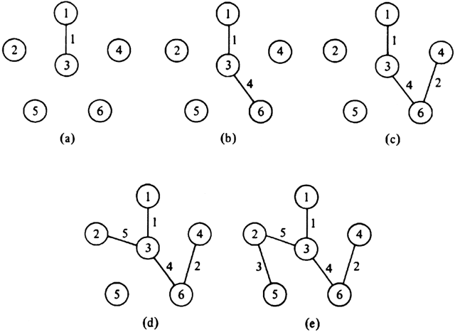

Need some way to identify which vertexes are "connected" to which other ones
  we call these "clusters" of vertices
Also need an efficient way
to figure out which cluster
a given vertex is in.
Also need to merge clusters
when adding an edge.

Slide 51
References and Advanced Reading
References:
  Minimum Spanning Tree visualization: https://visualgo.net/mst
  Kruskal's Algorithm: https://en.wikipedia.org/wiki/Kruskal's_algorithm
Advanced Reading:
  How Internet Routing works: https://web.stanford.edu/class/msande91si/www-spr04/readings/week1/InternetWhitepaper.htm
  http://www.explainthatstuff.com/internet.html

Slide 52
Extra Slides
Extra Slides

