Slide 1
Monday, June 5, 2017
CS 106B
Lecture 27: Inheritance and Polymorphism in C++
Programming Abstractions
Spring 2017
Stanford University
Computer Science Department
Lecturer: Chris Gregg
reading:
Programming Abstractions in C++, Chapter 19

Slide 2
Today's Topics
Logistics
  Final Exam prep online: http://web.stanford.edu/class/cs106b/handouts/final.html
  Final exam is on Friday, June 9th at 8:30am.
  Course evaluations now open on Axess
Inheritance and Polymorphism in C++

Slide 3
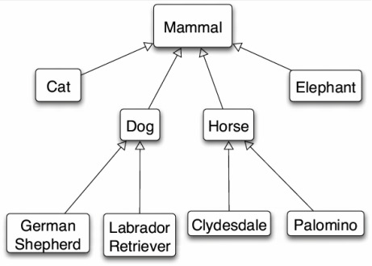
Inheritance in C++
inheritance: A way to form new classes based on existing classes, taking on their attributes/behavior.
a way to indicate that classes are related
a way to share code between two or more related classes (a hierarchy)
One class can extend another, absorbing its data/behavior.
  superclass (base class): Parent class that is being extended.
  subclass (derived class): Child class that inherits from the superclass.
    Subclass gets a copy of every field and method from superclass.
    Subclass can add its own behavior, and/or change inherited behavior.

Slide 4
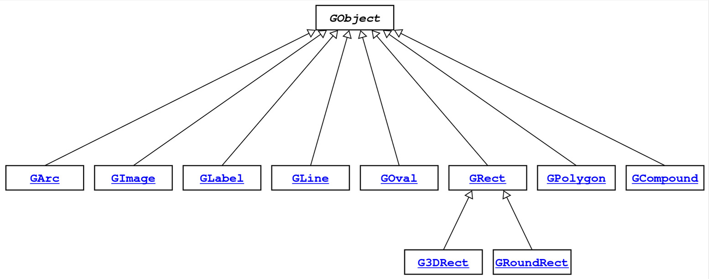
GObject Hierarchy
The Stanford C++ library contains a hierarchy of graphical objects based on a common base class named GObject.
GArc, GCompound, GImage, GLabel, GLine, GOval, GPolygon, GRect, G3DRect, GRoundRect, ...

Slide 5
GObject Members
GObject defines the state and behavior common to all shapes:
contains(x, y)
getColor(), setColor(color)
getHeight(), getWidth(), getLocation(), setLocation(x, y)
getX(), getY(), setX(x), setY(y), move(dx, dy)
setVisible(visible)
toString()
The subclasses add state and behavior unique to them:
GLabel:
get/setFont
get/setLabel
...
GLine:
get/setStartPoint
get/setEndPoint
...
GPolygon:
addEdge
addVertex
get/setFillColor
...

Slide 6
Example: Employees
Imagine a company with the following employee regulations:
All employees work 40 hours / week.
Employees make $40,000 per year plus $500 for each year worked,
  except for lawyers who get twice the usual pay,
  and programmers who get the same $40k base but $2000 for each year worked.
Employees have 2 weeks of paid vacation days per year,
  except for programmers who get an extra week (a total of 3).
Employees should use a yellow form to apply for leave,
  except for programmers who use a pink form.
Each type of employee has some unique behavior:
Lawyers know how to sue.
Programmers know how to write code.
Secretaries know how to take dictation.
Legal Secretaries know how to take dictation and how to file legal briefs.

Slide 7
Employee Class
// Employee.h
class Employee {
public:
Employee(string name, int years);
virtual int hours() const;
virtual string name() const;
virtual double salary() const;
virtual int vacationDays() const;
virtual string vacationForm() const;
virtual int years() const;
private:
string myName;
int myYears;
};
// Employee.cpp
Employee::Employee(string name, int years) {
myName = name;
myYears = years;
}
int Employee::hours() const {
return 40;
}
string Employee::name() const {
return myName;
}
double Employee::salary() const {
return 40000.0 + (500 * myYears);
}
int Employee::vacationDays() const {
return 10;
}
string Employee::vacationForm() const {
return "yellow";
}
int Employee::years() const {
return myYears;
}

Slide 8
Exercise: Employees
Exercise: Implement classes Lawyer and Programmer.
Lawyer
A Lawyer remembers what law school he/she went to.
Lawyers make twice as much salary as normal employees.
Lawyers know how to sue people (unique behavior).
Programmer
Programmers make the same base salary as normal employees, but they earn a bonus of $2k/year instead of $500/year.
Programmers fill out the pink form rather than yellow for vacations.
Programmers get 3 weeks of vacation rather than 2.
Programmers know how to write code (unique behavior).

Slide 9
Overriding
override: To replace a superclass's member function by writing a new version of that function in a subclass.
virtual function: One that is allowed to be overridden.
  Must be declared with virtual keyword in superclass.
// Employee.h
virtual string vacationForm();
// Employee.cpp
string Employee::vacationForm() {
return "yellow";
}
// Programmer.h
virtual string vacationForm();
// Programmer.cpp
string Programmer::vacationForm() {
return "pink"; // override!
}
If you "override" a non-virtual function, it actually just puts a second copy of that function in the subclass, which can be confusing later.
* Virtual has some subtleties. For example, destructors in inheritance hierarchies should always be declared virtual or else memory may not get cleaned up properly; ugh.

Slide 10
Calling the Superclass Constructor
SubclassName::SubclassName(params) : SuperclassName(params) {
statements;
}
To call a superclass constructor from subclass constructor, use an initialization list, with a colon after the constructor declaration.
Example:
Lawyer::Lawyer(string name, string lawSchool, int years) :
Employee(name, years) {
// calls Employee constructor first
mylawSchool = lawSchool;
}

Slide 11
Calling the Superclass Member
SuperclassName::memberName(params)
To call a superclass overridden member from subclass member.
Example:
double Lawyer::salary() { // paid twice as much
return Employee::salary() * 2;
}
Notes:
Subclass cannot access private members of the superclass.
You only need to use this syntax when the superclass's member has been overridden.
If you just want to call one member from another, even if that member came from the superclass, you don't need to write Superclass:: .

Slide 12
Lawyer.h
PDF: http://web.stanford.edu/class/cs106b//lectures/27-Inheritance/code/InheritancePolymorphismExamples.pdf
#pragma once
#include "Employee.h"
#include <string>
class Lawyer : public Employee {
// I now have an hours, name, salary, etc. method. yay!
public:
Lawyer(string name, string lawSchool, int years);
virtual double salary() const;
void sue(string person);
private:
string myLawSchool;
};
One typo: cross out line 195

Slide 13
Lawyer.cpp
#include "Lawyer.h"
// call the constructor of Employee superclass?
Lawyer::Lawyer(string name, string lawSchool, int years)
: Employee(name, years) {
myLawSchool = lawSchool;
}
// overriding: replace version from Employee class
double Lawyer::salary() const {
return Employee::salary() * 2;
}
void Lawyer::sue(string person) {
cout << "See you in court, " << person << endl;
}

Slide 14
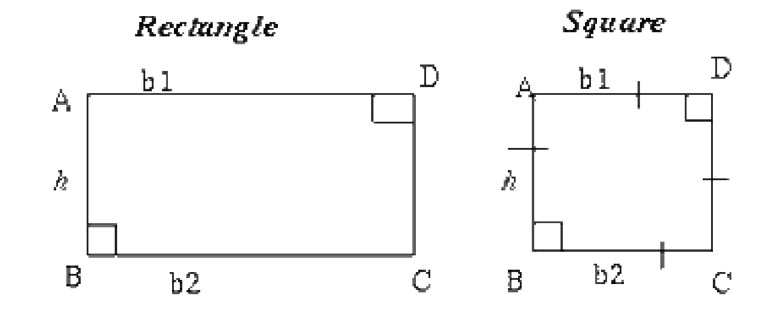
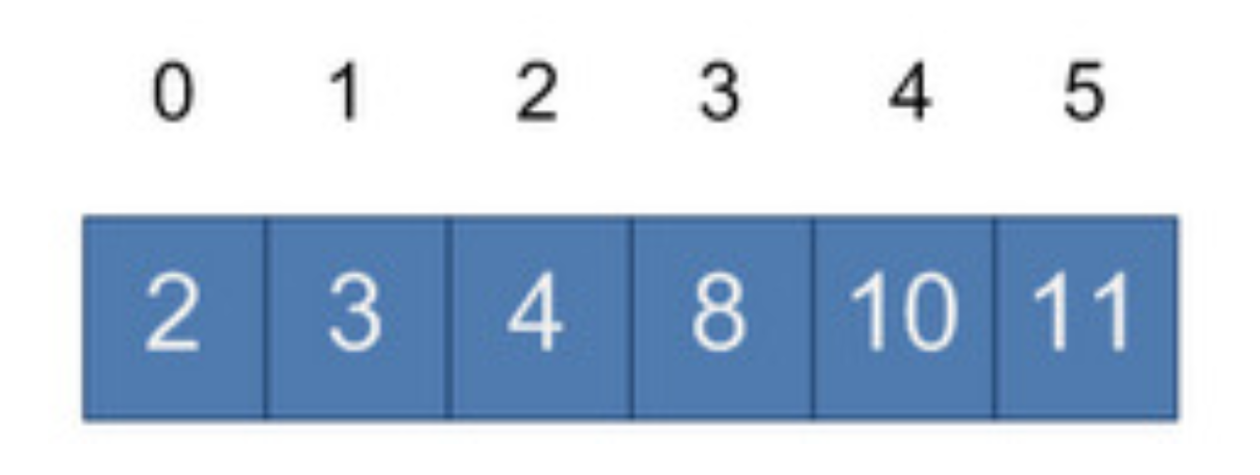
Perils of Inheritance (i.e., think before you inherit!)
Consider the following places you might use inheritance:
class Point3D extends Point2D and adds z-coordinate
class Square extends Rectangle (or vice versa?)
class SortedVector extends Vector, keeps it in sorted order
What's wrong with these examples? Is inheritance good here?
Point2D's distance() function is wrong for 3D points
Rectangle supports operations a Square shouldn't (e.g. setWidth)
SortedVector might confuse client; they call insert at an index, then check that index, and the element they inserted is elsewhere!

Slide 15
Private Inheritance
class Name : private SuperclassName { ...
private inheritance: Copies code from superclass but does not publicly advertise that your class extends that superclass.
Good for cases where you want to inherit another class's code, but you don't want outside clients to be able to randomly call it.
Example: Have Point3D privately extend Point2D and add z-coordinate functionality.
Example: Have SortedVector privately extend Vector and add only the public members it feels are appropriate (e.g., no insert).

Slide 16
Pure Virtual Functions
virtual returntype name(params) = 0;
pure virtual function: Declared in superclass's .h file and set to 0 (null). An absent function that has not been implemented.
Must be implemented by any subclass, or it cannot be used.
A way of forcing subclasses to add certain important behavior.
class Employee {
...
virtual void work() = 0; // every employee does
// some kind of work
};
FYI: In Java, this is called an abstract method.

Slide 17
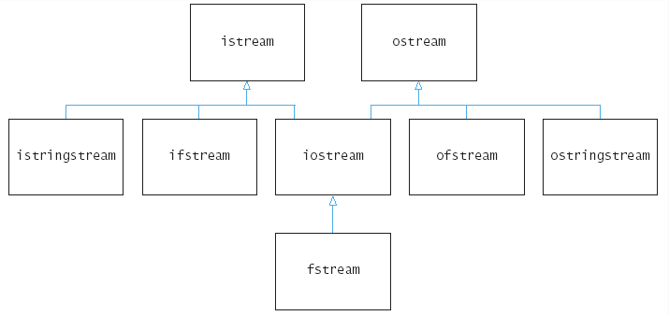
Multiple Inheritance
class Name : public Superclass1, public Superclass2, ...
multiple inheritance: When one subclass has multiple superclasses.
Forbidden in many OO languages (e.g. Java) but allowed in C++.
Convenient because it allows code sharing from multiple sources.
Can be confusing or buggy, e.g. when both superclasses define a member with the same name.
Example: The C++ I/O streams use multiple inheritance:

Slide 18
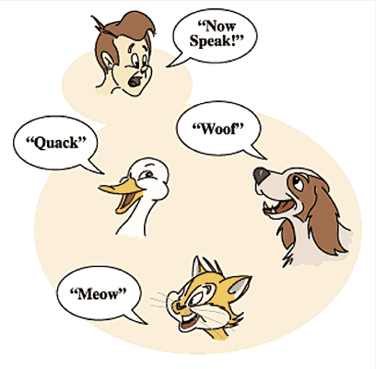
Polymorphism
polymorphism: Ability for the same code to be used with different types of objects and behave differently with each.
Templates provide compile-time polymorphism. Inheritance provides run-time polymorphism.
Idea: Client code can call a method on different kinds of objects, and the resulting behavior will be different.
Shape
draw()
erase()
Circle
Square
Triangle
draw()
erase()
draw()
erase()
draw()
erase()

Slide 19
Polymorphism and Pointers
A pointer of type T can point to any subclass of T.
Employee* edna = new Lawyer("Edna", "Harvard", 5);
Secretary* steve = new LegalSecretary("Steve", 2);
World* world = new WorldMap("map-stanford.txt");
When a member function is called on edna, it behaves as a Lawyer.
(This is because the employee functions are declared virtual.)
You can not call any Lawyer-only members on edna (e.g. sue).
You can not call any LegalSecretary-only members on steve (e.g. fileLegalBriefs).

Slide 20
Polymorphism Example
You can use the object's extra functionality by casting.
Employee* edna = new Lawyer("Edna", "Harvard", 5);
edna->vacationDays(); // ok
edna->sue("Stuart"); // compiler error
((Lawyer*) edna)->sue("Stuart"); // ok
You should not cast a pointer to something that it is not.
It will compile, but the code will crash (or behave unpredictably) when you try to run it
Employee* paul = new Programmer("Paul", 3);
paul->code(); // compiler error
((Programmer*) paul)->code(); // ok
((Lawyer*) paul)->sue("Marty"); // crash!

Slide 21
Polymorphism Mystery
class Sleet : public Snow {
public:
virtual void method2() {
cout << "Sleet 2" << endl;
Snow::method2();
}
virtual void method3() {
cout << "Sleet 3" << endl;
}
};
class Fog : public Sleet {
public:
virtual void method1() {
cout << "Fog 1" << endl;
}
virtual void method3() {
cout << "Fog 3" << endl;
}
};
class Snow {
public:
virtual void method2() {
cout << "Snow 2" << endl;
}
virtual void method3() {
cout << "Snow 3" << endl;
}
};
class Rain : public Snow {
public:
virtual void method1() {
cout << "Rain 1" << endl;
}
virtual void method2() {
cout << "Rain 2" << endl;
}
};

Slide 22
Diagramming classes
Draw a diagram of the classes from top (superclass) to bottom.
Snow
Snow 2
method2()
method3()
Snow 3
Rain
Sleet
Sleet 2 / Snow 2
Rain 1
method1()
method2()
(method3())
Rain 2
method2()
method3()
Sleet 3
Snow 3
Fog
Fog 1
method1()
method2()
method3()
Sleet 2 / Snow 2
Fog 3

Slide 23
Mystery Problem
Snow* var1 = new Sleet();
var1->method2(); // What's the output?
To find the behavior/output of calls like the one above:
Look at the variable's type.
If that type does not have that member: COMPILER ERROR.
Execute the member.
Since the member is virtual: behave like the object's type, not like the variable's type.

Slide 24
Example 1
variable
Q: What is the result of the following call?
Snow
Snow 2
method2()
method3()
Snow 3
Snow* var1 = new Sleet();
var1->method2();
object
Rain
Sleet
Sleet 2 / Snow 2
Rain 1
Snow 2
Rain 2
Sleet 2
Snow 2
COMPILER ERROR
method1()
method2()
(method3())
Rain 2
method2()
method3()
Sleet 3
Snow 3
Fog
Fog 1
method1()
method2()
method3()
Sleet 2 / Snow 2
Fog 3

Slide 25
Example 1
variable
Q: What is the result of the following call?
Snow
Snow 2
method2()
method3()
Snow 3
Snow* var1 = new Sleet();
var1->method2();
object
Rain
Sleet
Sleet 2 / Snow 2
Rain 1
Snow 2
Rain 2
Sleet 2
Snow 2
COMPILER ERROR
method1()
method2()
(method3())
Rain 2
method2()
method3()
Sleet 3
Snow 3
Fog
Fog 1
method1()
method2()
method3()
Sleet 2 / Snow 2
Fog 3

Slide 26
Example 2
variable
Q: What is the result of the following call?
Snow
Snow 2
method2()
method3()
Snow 3
Snow* var2 = new Rain();
var2->method1();
Rain
Sleet
Sleet 2 / Snow 2
object
Rain 1
Snow 1
Rain 1
Snow 1
Rain 1
COMPILER ERROR
method1()
method2()
(method3())
Rain 2
method2()
method3()
Sleet 3
Snow 3
Fog
Fog 1
method1()
method2()
method3()
Sleet 2 / Snow 2
Fog 3

Slide 27
Example 2
variable
Q: What is the result of the following call?
Snow
Snow 2
method2()
method3()
Snow 3
Snow* var2 = new Rain();
var2->method1();
Rain
Sleet
Sleet 2 / Snow 2
object
Rain 1
Snow 1
Rain 1
Snow 1
Rain 1
COMPILER ERROR
method1()
method2()
(method3())
Rain 2
method2()
method3()
Sleet 3
Snow 3
Fog
Fog 1
method1()
method2()
method3()
Sleet 2 / Snow 2
Fog 3

Slide 28
Example 3
variable
Q: What is the result of the following call?
Snow
Snow 2
method2()
method3()
Snow 3
Snow* var3 = new Rain();
var3->method2();
Rain
Sleet
Sleet 2 / Snow 2
object
Rain 1
Snow 2
Rain 2
Sleet 2
Snow 2
COMPILER ERROR
method1()
method2()
(method3())
Rain 2
method2()
method3()
Sleet 3
Snow 3
Fog
Fog 1
method1()
method2()
method3()
Sleet 2 / Snow 2
Fog 3

Slide 29
Example 3
variable
Q: What is the result of the following call?
Snow
Snow 2
method2()
method3()
Snow 3
Snow* var3 = new Rain();
var3->method2();
Rain
Sleet
Sleet 2 / Snow 2
object
Rain 1
Snow 2
Rain 2
Sleet 2
Snow 2
COMPILER ERROR
method1()
method2()
(method3())
Rain 2
method2()
method3()
Sleet 3
Snow 3
Fog
Fog 1
method1()
method2()
method3()
Sleet 2 / Snow 2
Fog 3

Slide 30
Mystery with type cast
Snow* var4 = new Rain();
((Rain *) var4->method1(); // What's the output?
If the mystery problem has a type cast, then:
Look at the cast type.
If that type does not have the method: COMPILER ERROR.
(Note: if the object's type was not equal to or a subclass of the cast type, the code would CRASH / have unpredictable behavior.)
Execute the member.
Since the member is virtual: behave like the object's type, not like the variable's type.

Slide 31
Example 4
Q: What is the result of the following call?
variable
Snow
Snow 2
Snow* var4 = new Rain();
((Rain *) var4)->method1();
method2()
method3()
Snow 3
Rain
Sleet
cast
object
Sleet 2 / Snow 2
Rain 1
Snow 1
Rain 1
Sleet 1
COMPILER ERROR
method1()
method2()
(method3())
Rain 2
method2()
method3()
Sleet 3
Snow 3
Fog
Fog 1
method1()
method2()
method3()
Sleet 2 / Snow 2
Fog 3

Slide 32
Example 4
Q: What is the result of the following call?
variable
Snow
Snow 2
Snow* var4 = new Rain();
((Rain *) var4)->method1();
method2()
method3()
Snow 3
Rain
Sleet
cast
object
Sleet 2 / Snow 2
Rain 1
Snow 1
Rain 1
Sleet 1
COMPILER ERROR
method1()
method2()
(method3())
Rain 2
method2()
method3()
Sleet 3
Snow 3
Fog
Fog 1
method1()
method2()
method3()
Sleet 2 / Snow 2
Fog 3

Slide 33
Example 5
Q: What is the result of the following call?
variable
Snow
Snow 2
Snow* var5 = new Fog();
((Sleet *) var5)->method1();
method2()
method3()
Snow 3
cast
Rain
Sleet
Sleet 2 / Snow 2
Rain 1
Snow 1
Sleet 1
Fog 1
COMPILER ERROR
method1()
method2()
(method3())
Rain 2
method2()
method3()
Sleet 3
Snow 3
Fog
object
Fog 1
method1()
method2()
method3()
Sleet 2 / Snow 2
Fog 3

Slide 34
Example 5
Q: What is the result of the following call?
variable
Snow
Snow 2
Snow* var5 = new Fog();
((Sleet *) var5)->method1();
method2()
method3()
Snow 3
cast
Rain
Sleet
Sleet 2 / Snow 2
Rain 1
Snow 1
Sleet 1
Fog 1
COMPILER ERROR
method1()
method2()
(method3())
Rain 2
method2()
method3()
Sleet 3
Snow 3
Fog
object
Fog 1
method1()
method2()
method3()
Sleet 2 / Snow 2
Fog 3

Slide 35
Example 6
Suppose we add the following method to base class Snow:
variable
Snow
virtual void method4() {
cout << "Snow 4" << endl;
method2();
}
Snow 2
method2()
method3()
Snow 3
object
Rain
Sleet
Sleet 2 / Snow 2
Rain 1
What is the output?
Snow* var6 = new Sleet();
var6->method4();
method1()
method2()
(method3())
Rain 2
method2()
method3()
Sleet 3
Snow 3
Answer?
Snow 4
Sleet 2
Snow 2
Fog
(Sleet's method2 is used because method 4 and method2 are virtual)
Fog 1
method1()
method2()
method3()
Sleet 2 / Snow 2
Fog 3

Slide 36
Example 7
What is the output of the following call?
variable
Snow
Snow* var7 = new Sleet();
((Rain*) var7)->method1();
Snow 2
method2()
method3()
Snow 3
Snow 1
Sleet 1
Fog 1
COMPILER ERROR
CRASH / UNDEFINED
object
cast
Rain
Sleet
Sleet 2 / Snow 2
Rain 1
method1()
method2()
(method3())
Rain 2
method2()
method3()
Sleet 3
Snow 3
Fog
Fog 1
method1()
method2()
method3()
Sleet 2 / Snow 2
Fog 3

Slide 37
References and Advanced Reading
References:
  C++ Inheritance: https://www.tutorialspoint.com/cplusplus/cpp_inheritance.htm
  C++ Polymorphism: https://www.tutorialspoint.com/cplusplus/cpp_polymorphism.htm
Advanced Reading:
  http://stackoverflow.com/questions/5854581/polymorphism-in-c
  https://www.codingunit.com/cplusplus-tutorial-polymorphism-and-abstract-base-class

