Slide 1
Friday, April 14, 2017
CS 106B
Lecture 6: Sets and Maps
b
c
a
d
Set:
m
i
h
e
k
n
g
Programming Abstractions
Spring 2017
Stanford University
Computer Science Department
Lecturer: Chris Gregg
reading:
Programming Abstractions in C++, Chapter 5.4-5.6
a
A
b
B
c
C
Map:
d
D
e
E
f
F

Slide 2

Today's Topics
Logistics:
  Tiny Feedback: some responses!
    Not enough motivation for why we care about ADTs: good point!
    More interactive classes: I'll see what I can do!
    KEY pages ( )
    Late credits change: up to two calendar days equals one late credit. You get three automatic late credits per quarter.
the "const" qualifier
Postfix refresher
Structs (details will come later!)
Sets
Maps

Slide 3
const
When we pass variables by reference into a function, we do so for a couple of reasons:
  We don't want to make copies of big objects
    As it turns out (thanks to the person who put a note on sayat.me/chrisgregg who reminded me to mention this), C++ has new functionality that allows us to return big objects in some cases without lots of copying (but the Stanford libraries don't have that functionality yet)
    and / or
    We need to modify an object in place (we will do this a great deal with recursion)

Slide 4
const
What if we want to pass a variable by reference, but we know we won't modify it?
  We could just have self-control and not modify it.
  Or, we could make the compiler keep us honest. To do this, we use the keyword const

Slide 5
const
const allows a programmer to tell the compiler that the object passed cannot be changed in the function. E.g.,
  void printLifeGrid(Grid<char> const &lifeGrid);
There is no need for the printLifeGrid() function to change the lifeGrid, but we would rather pass the grid by reference to avoid big copies.

Slide 6
const
We use const to tell the compiler to give us an error if we do try to modify a const-declared variable in a function.
This also tells someone reading our code that we are guaranteeing that the object will be the same when the function ends as when it began.

Slide 7
Postfix (RPN) Refresher
What does the following postfix (RPN) computation equal?
10 3 5 * 9 4 - / +
Feel free to use our stack algorithm:
Read the input and push numbers onto a stack until you reach an operator.
When you see an operator, apply the operator to the two numbers that are popped from the stack.
Push the resulting value back onto the stack.
When the input is complete, the value left on the stack is the result.
Answer: 13
How would our stack-based RPN know that we had made an error, e.g.,
10 3 5 * - + 9 4 -
Answer: the stack is empty when we try to pop two operands

Slide 8
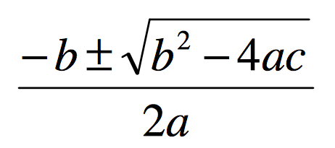
Brief Introduction to Structs
Recall that in C++, we can only return one value from a function. We have overcome this in the past by using references:
/*
* Solves a quadratic equation ax^2 + bx + c = 0,
* storing the results in output parameters root1 and root2.
* Assumes that the given equation has two real roots.
*/
void quadratic(double a, double b, double c,
double& root1, double& root2) {
double d = sqrt(b * b - 4 * a * c);
root1 = (-b + d) / (2 * a);
root2 = (-b - d) / (2 * a);
}

Slide 9
Brief Introduction to Structs
There is another way we can return variables by packaging them up in a type called a "struct"
Structs are a way to define a new type for us to use.
Once we define a struct, we can use that type anywhere we would normally use another type (e.g., an int, double, string, etc.)
new type name
struct Roots {
double root1;
double root2;
};
struct variables, referred to with dot notation
don't forget the semicolon

Slide 10

Brief Introduction to Structs
Let's re-write our quadratic equation solver to use the Roots struct.

Slide 11
Brief Introduction to Structs
Let's re-write our quadratic equation solver to use the Roots struct.
struct Roots {
double root1;
double root2;
};
/*
* Solves a quadratic equation ax^2 + bx + c = 0,
* storing the results in output parameters root1 and root2.
* Assumes that the given equation has two real roots.
*/
Roots quadratic(double a, double b, double c) {
Roots roots;
double d = sqrt(b * b - 4 * a * c);
roots.root1 = (-b + d) / (2 * a);
roots.root2 = (-b - d) / (2 * a);
return roots;
}

Slide 12
Sets and Maps
Sets
Maps
Collection of elements with no duplicates.
Collection of key/value pairs
The key is used to find its associated value.
"the"
"he"
"if"
"by"
"down"
"of"
"them"
"Chris"
"867-5309"
"to"
"from"
"in"
"Jenny"
"866-2233"
"Mehran"
"685-6232"
"Anton"
"488-0312"

Slide 13
Sets
set: a collection of elements with no duplicates.
Operations include add, contains, and remove, and they are all fast
Sets do not have indexes
set.contains("to")
"the"
"he"
true
"if"
"by"
"down"
"of"
"them"
set.contains("be")
"to"
"from"
"in"
false

Slide 14
Sets: Simple Example
Set<string> friends;
friends.add("chris");
friends.add("anton");
cout << friends.contains("voldemort") << endl;
for(string person : friends) {
cout << person << endl;
}

Slide 15
Set Essentials
int set.size() Returns the number of elements in the set.
void set.add(value) Adds the new value to the set (ignores it if the value is already in the set)
bool set.contains(value) Returns true if the value is in the set, false otherwise.
void set.remove(value) Removes the value if present in the set. Does not return the value.
bool set.isEmpty() Returns true if the set is empty, false otherwise.
Sets also have other helpful methods. See the online docs for more.

Slide 16
Looping Over a Set
for(type currElem : set) {
// process elements one at a time
}
can't use a normal for loop and get each element [i]
for(int i=0; i < set.size(); i++) {
// does not work, no index!
cout << set[i];
}

Slide 17
Types of Sets
Set
HashSet
Iterate over elements in sorted order
Really fast!
O(log n) per retrieval
Implemented using a "binary search tree"
Iterate over elements in unsorted (jumbled) order
Really, ridiculously fast!
O(1) per retrieval
Implemented using a "hash table"

Slide 18
Set Operands
Sets can be compared, combined, etc.
s1 == s2 true if the sets contain exactly the same elements
s1 != s2 true if the sets don't contain the same elements
s1 + s2 returns the union of s1 and s2 (all elements in both)
s1 * s2 returns intersection of s1 and s2 (elements must be in both)
s1 - s2 returns difference of s1, s2 (elements in s1 but not s2)

Slide 19
Count Unique Words

Slide 20
Maps
map: A collection of pairs (k, v), sometimes called key/value pairs, where v can be found quickly if you know k.
a.k.a. dictionary, associative array, hash
a generalization of an array, where the "indexes" need not be ints.
"Chris"
"867-5309"
"Jenny"
"866-2233"
"Mehran"
"685-6232"
"Anton"
"488-0312"

Slide 21
Using Maps
A map allows you to get from one half of a pair to the other.
store an association from "Jenny" to "867-5309"
// key value
// m["Jenny"] = "867-5309"; or
m.put("Jenny", "867-5309");
Map
What is Jenny's number?
// string ph = m["Jenny"] or
string ph = m.get("Jenny")
"206-685-2181"
Map

Slide 22
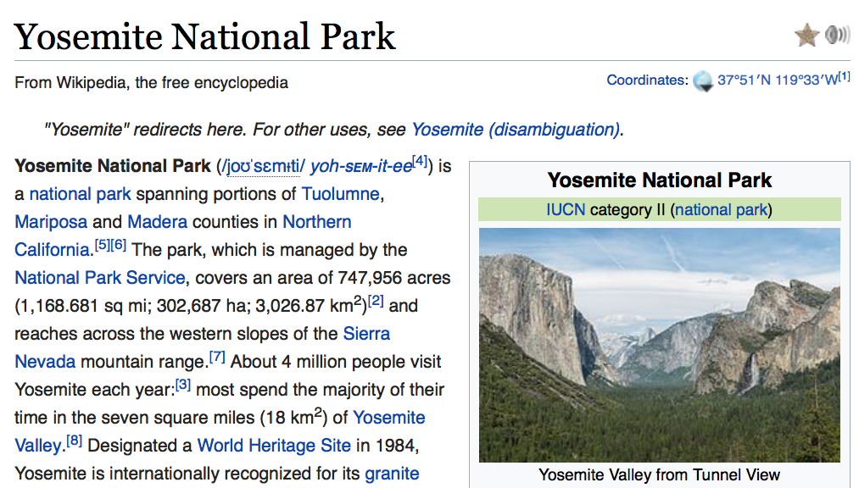
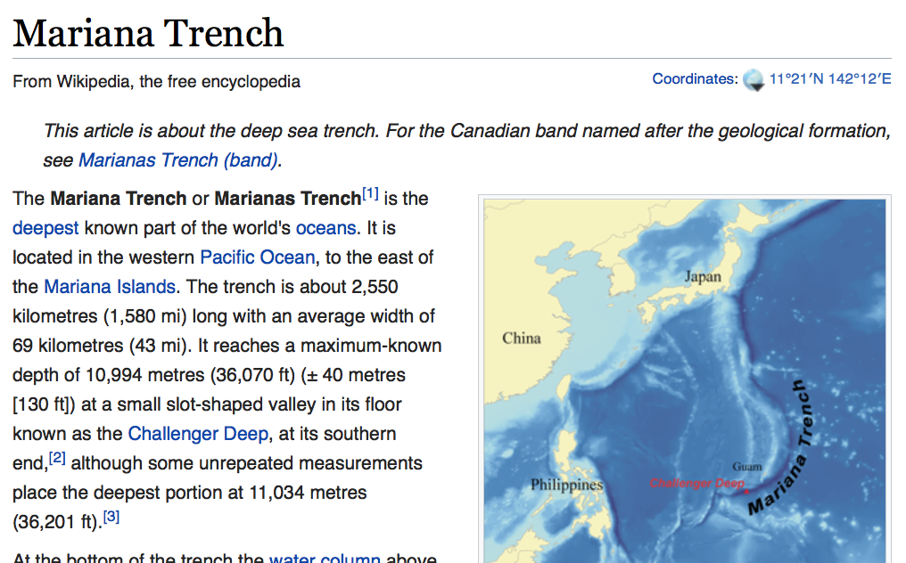
Maps are Everywhere
key = title, value = article
key:
"Yosemite National Park"
value:
key:
"Mariana Trench"
value:

Slide 23
Creating Maps
Requires 2 type parameters: one for keys, one for values.
// maps from string keys to integer values
Map<string, int> votes;
// maps from double keys to Vector<int> values
Map<string, Vector<string>> friendMap;

Slide 24
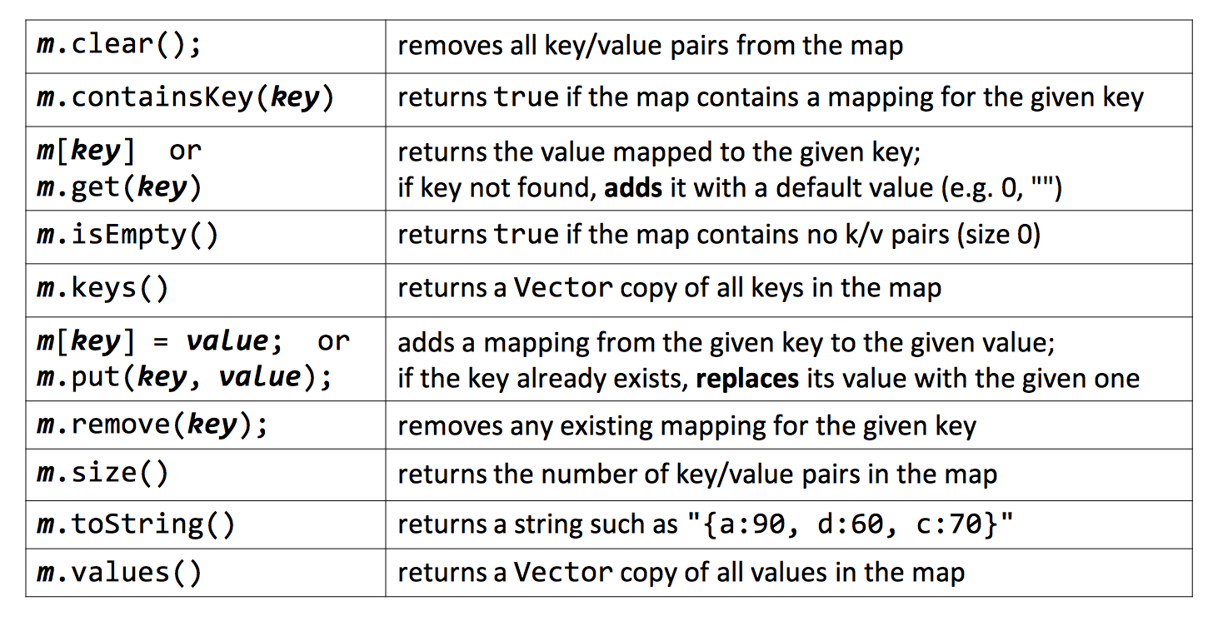
Map Methods

Slide 25
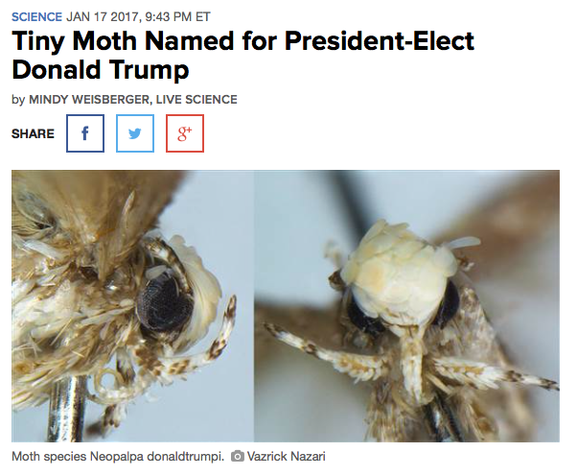
Map Example
Map<string, string> wiki;
// adds name / text pair to dataset
wiki.put(“Neopalpa donaldtrumpi”, articleHTML);

Slide 26
Map Example
Map<string, string> wiki;
// adds name / text pair to dataset
wiki.put(“Neopalpa donaldtrumpi”, articleHTML);
// returns corresponding articleHTML
cout << wiki.get(“Yosemite National Park”);

Slide 27
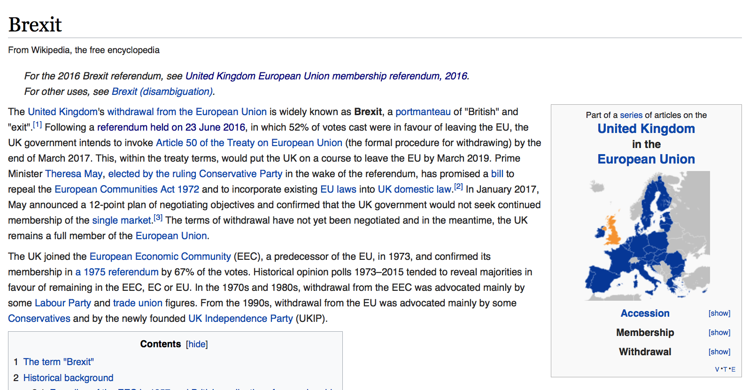
Map Example
Map<string, string> wiki;
// adds name / text pair to dataset
wiki.put(“Neopalpa donaldtrumpi”, articleHTML);
// returns corresponding articleHTML
cout << wiki.get(“Yosemite National Park”);
// removes the article
wiki.remove(“Britain in the E.U.”);

Slide 28
Types of Maps
Map
HashMap
Iterate over elements in sorted order
Really fast!
O(log n) per retrieval
Implemented using a "binary search tree"
Iterate over elements in unsorted (jumbled) order
Really, ridiculously fast!
O(1) per retrieval
Implemented using a "hash table"

Slide 29
Map Example: Tallying Votes
count votes:
// (M)ilk, (S)tokes, (R)ogers
"MMMRMSSMSSMMMMMRRMMMMRRRMMM"
17
key: | "M" | "S" | "R"
value: | 17 | 7 | 3
"M"
"S"
7
3
"R"
*In 1976 Harvey Milk became the first openly gay elected official in the US

Slide 30
Tallying Words

Slide 31
Looping Over a Map
Map<string, double> gpa = load();
for (string name : gpa) {
cout << name << "'s GPA is ";
cout << gpa[name] << endl;
}
*The order is unpredictable in a HashMap

Slide 32
Recap
Structs
  Used to define a type that holds multiple other types.
  Useful for returning more than one value, or keeping things together (e.g., a coordinate could be an x,y and it is nice to keep them together:
  struct coordinate {
  double x,y;
  }
Uses dot notation to access elements.
Sets:
  Container that holds non-duplicate elements
  O(log n) behavior per element access (HashSet: O(1), but unordered)
Map:
  Container that relates keys to values.
  Needs two types when defining: Map<keyType, valueType>
  O(log n) behavior per element access (HashMap: O(1), but unordered)

Slide 33
References and Advanced Reading
References:
  Stanford Set reference: http://stanford.edu/~stepp/cppdoc/Set-class.html
  Stanford Map reference: stanford.edu/~stepp/cppdoc/Map-class.html
  const: http://www.cprogramming.com/tutorial/const_correctness.html
Advanced Reading:
  Hashing: https://en.wikipedia.org/wiki/Hash_table
  Relational Databases: https://en.wikipedia.org/wiki/Relational_database (especially idecies)
  const: http://duramecho.com/ComputerInformation/WhyHowCppConst.html

Slide 34
Extra Slides

