Slide 1
Monday, April 17th, 2017
CS 106B
Lecture 7: Introduction to Recursion
Programming Abstractions
Spring 2017
Stanford University
Computer Science Department
Lecturer: Chris Gregg
reading:
Programming Abstractions in C++, Chapter 5.4-5.6

Slide 2
Today's Topics
Logistics:
  Tiny Feedback:
Writing a simple program all by yourself
Serafini Due Thursday, April 20th, noon
  One submission of two files (wordLadder, Ngrams)
Recursion!

Slide 3
Tiny Feedback
  Sometimes, if the majority of the class understands something, Chris will skip the explanation. However, there are people that are silent in the lecture or watching that are not saying "yeah, I understand". It would be useful to explain every single thing no matter how much positive feedback you hear. — Sometimes not tenable in lecture. Please ask on Piazza, email, etc.
  The explanation of struct was really rushed and could be expanded upon. — We will explain structs more later :) There isn't much to the part I already described.
  Some of the slides have too much writing on them and it's hard to digest it all. — Slides serve a dual purpose, as in-class material and for reference. When slides have too much on them, I will explain the basics, and expect that you will go back and look at them later. Don't try to read the slides all at once in class!
  More logistics and Less logistics. — I try to only spend a few of the precious minutes in class on logistics.

Slide 4
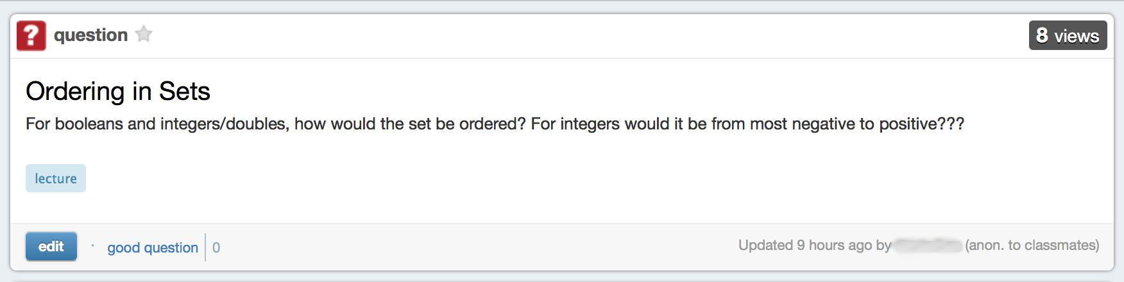

Today's Topics
There was a question on Piazza:
This is a great opportunity to write a quick program to test this yourself! Let's see how we might do that!

Slide 5
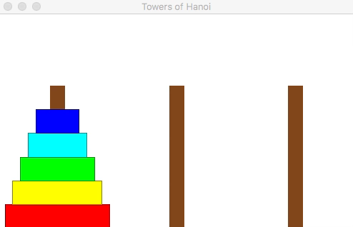
A Little Demo
The Towers of Hanoi Puzzle
This can be solved by recursion!

Slide 6
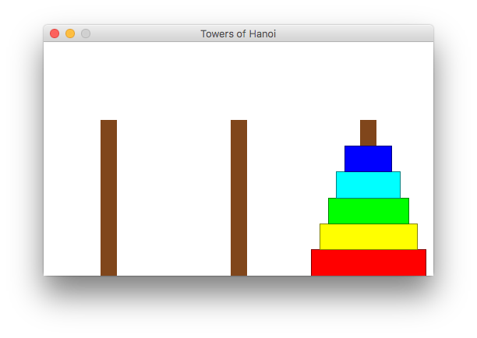
A Little Demo
By the end of today, we will be able to write this program, and you may talk about the algorithm in section

Slide 7
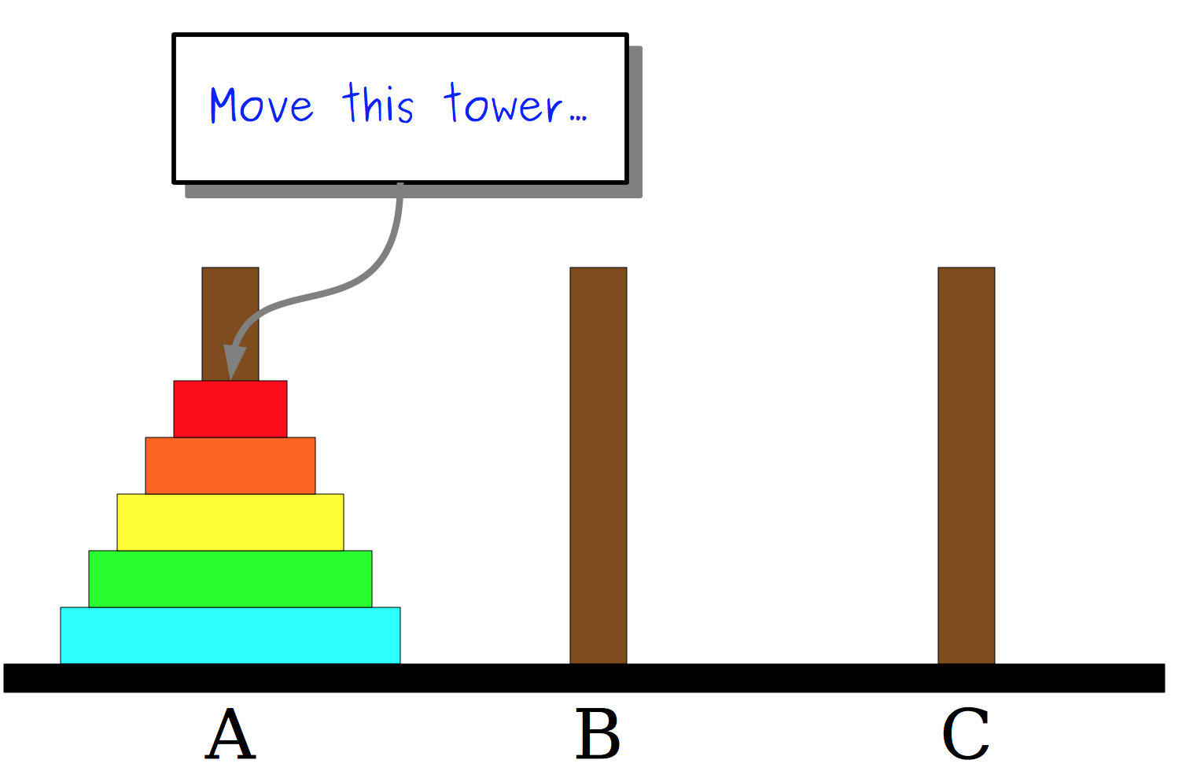
Towers of Hanoi
Here is the way the game is played:

Slide 8
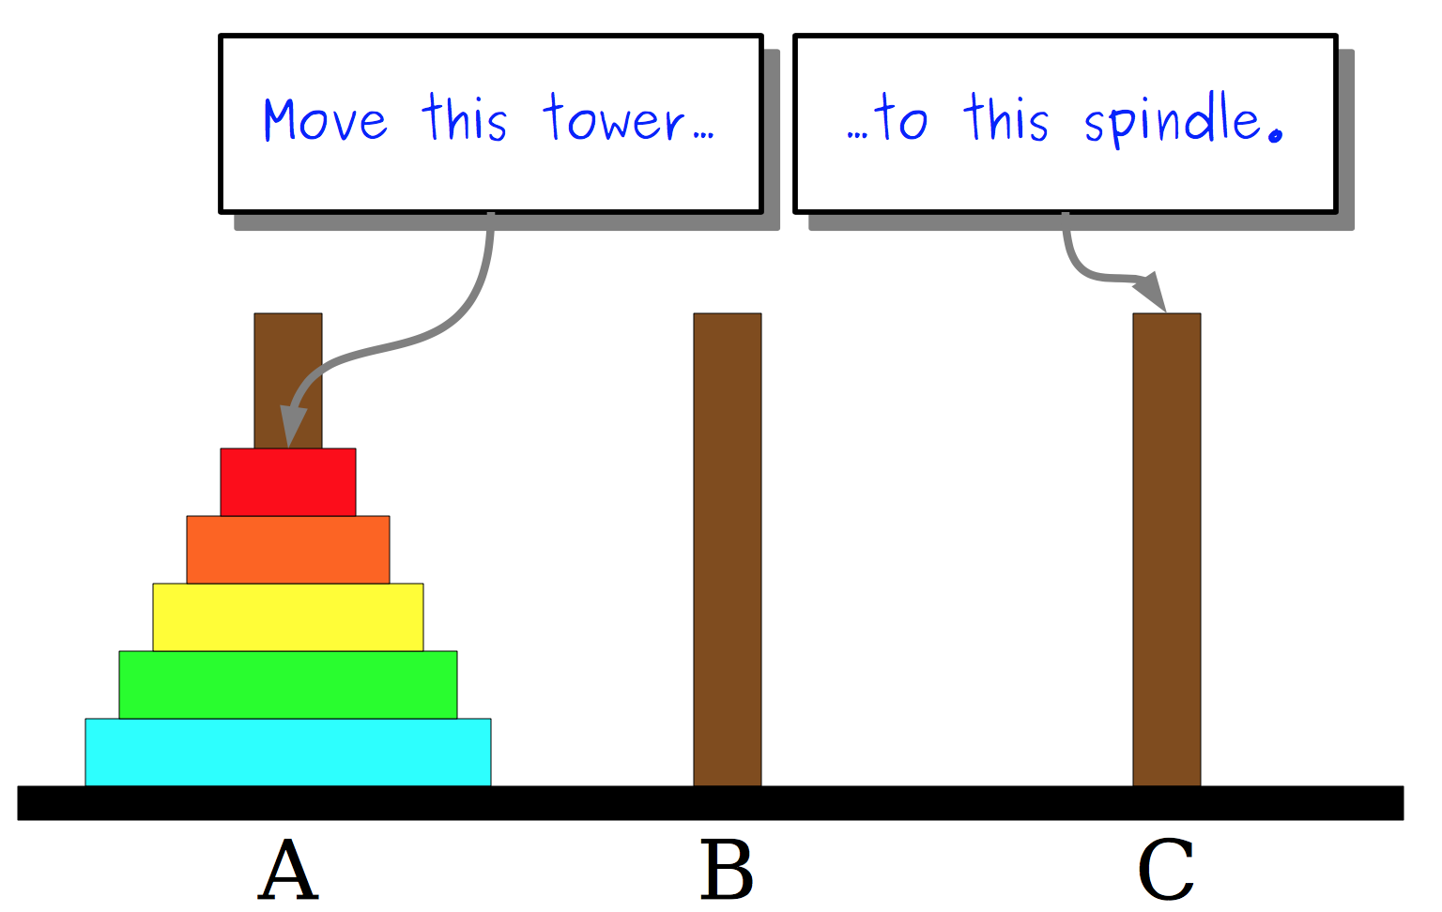
Towers of Hanoi
Here is the way the game is played:

Slide 9
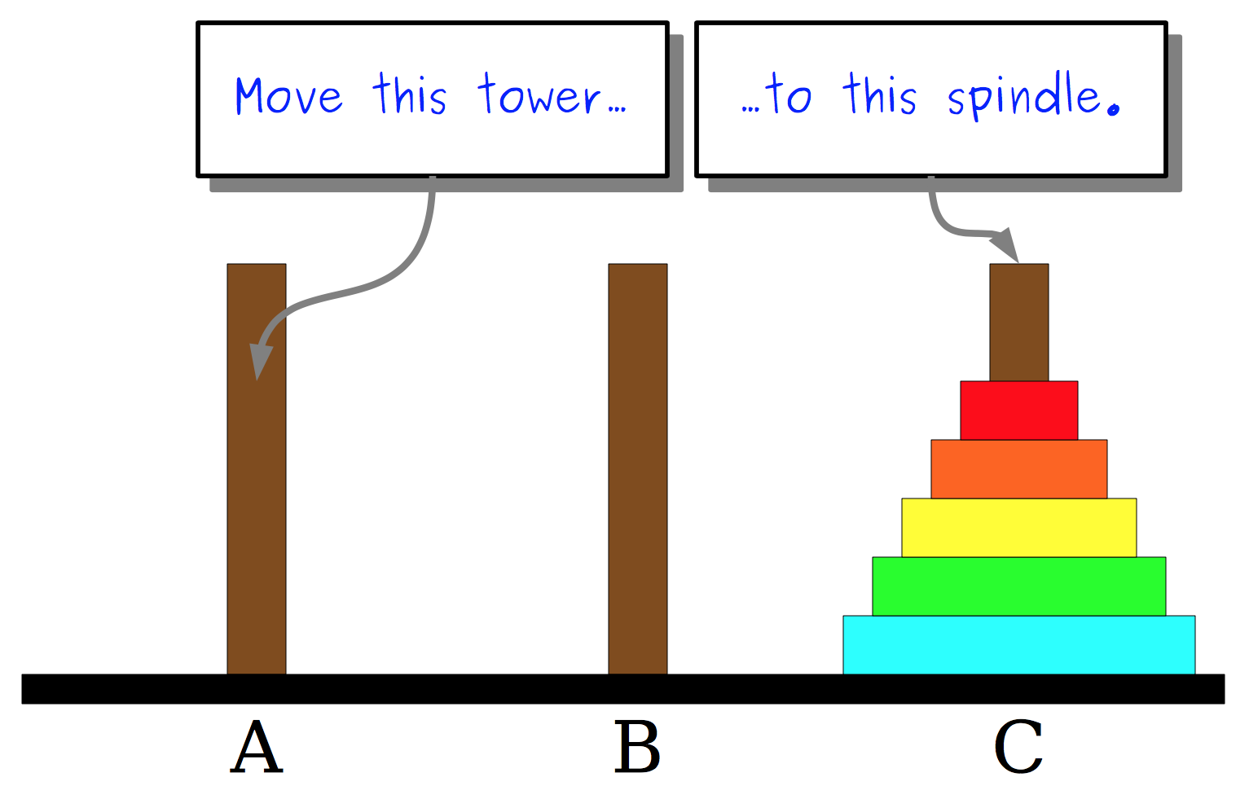
Towers of Hanoi
Here is the way the game is played:

Slide 10
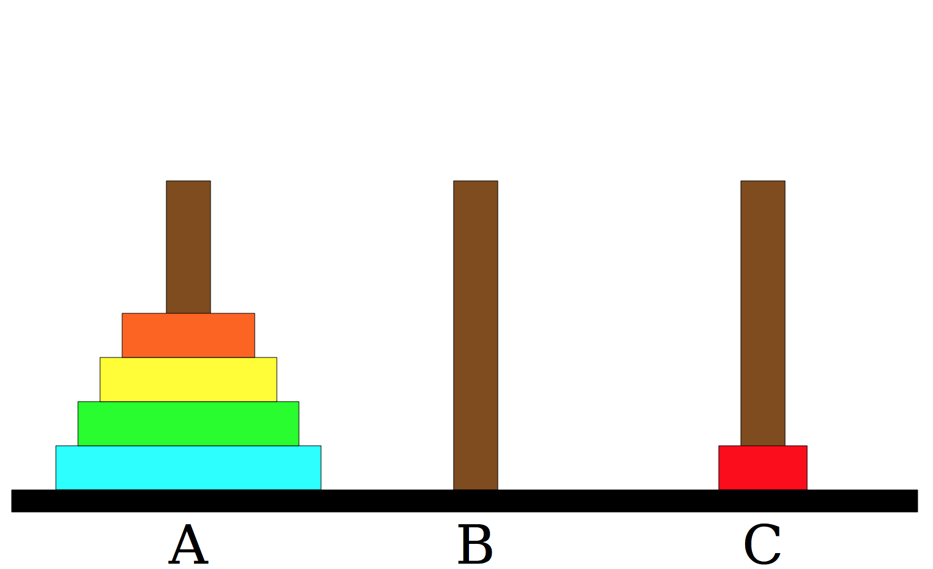
Towers of Hanoi
Here is the way the game is played:

Slide 11
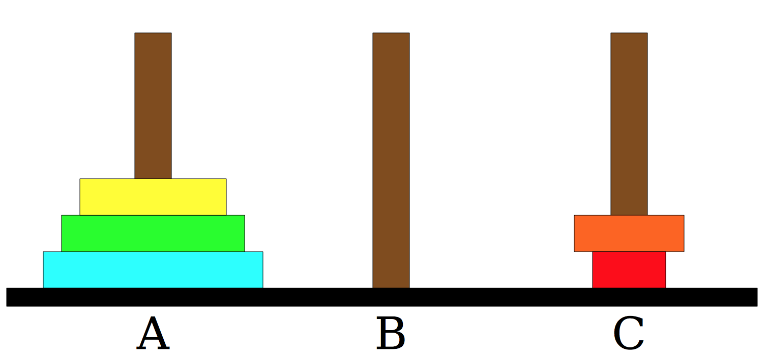
Towers of Hanoi
Here is the way the game is played:

Slide 12

Towers of Hanoi
Here is the way the game is played:
Illegal move!

Slide 13
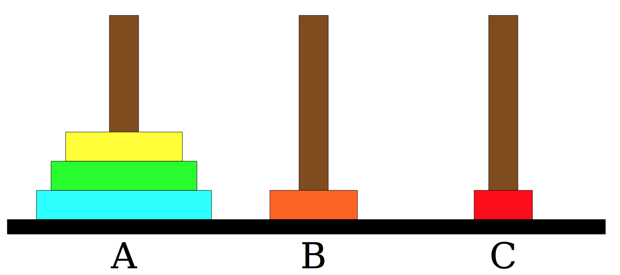
Towers of Hanoi
Here is the way the game is played:

Slide 14
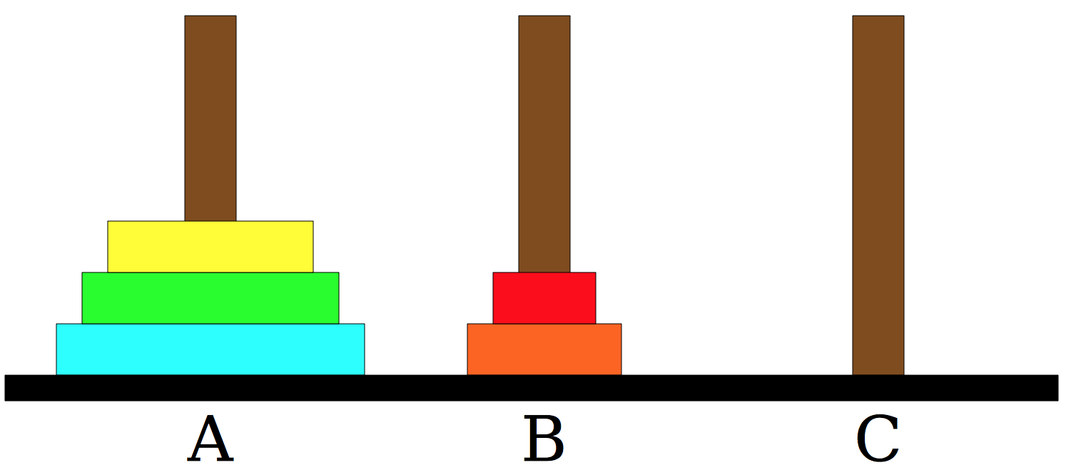
Towers of Hanoi
Here is the way the game is played:

Slide 15
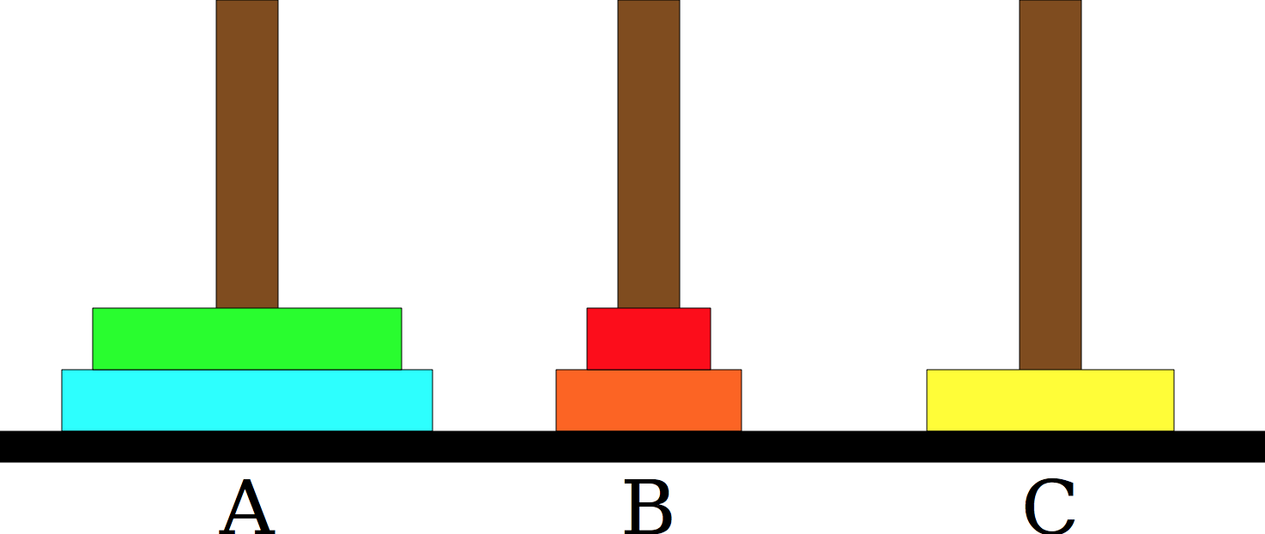
Towers of Hanoi
Here is the way the game is played:
etc.

Slide 16
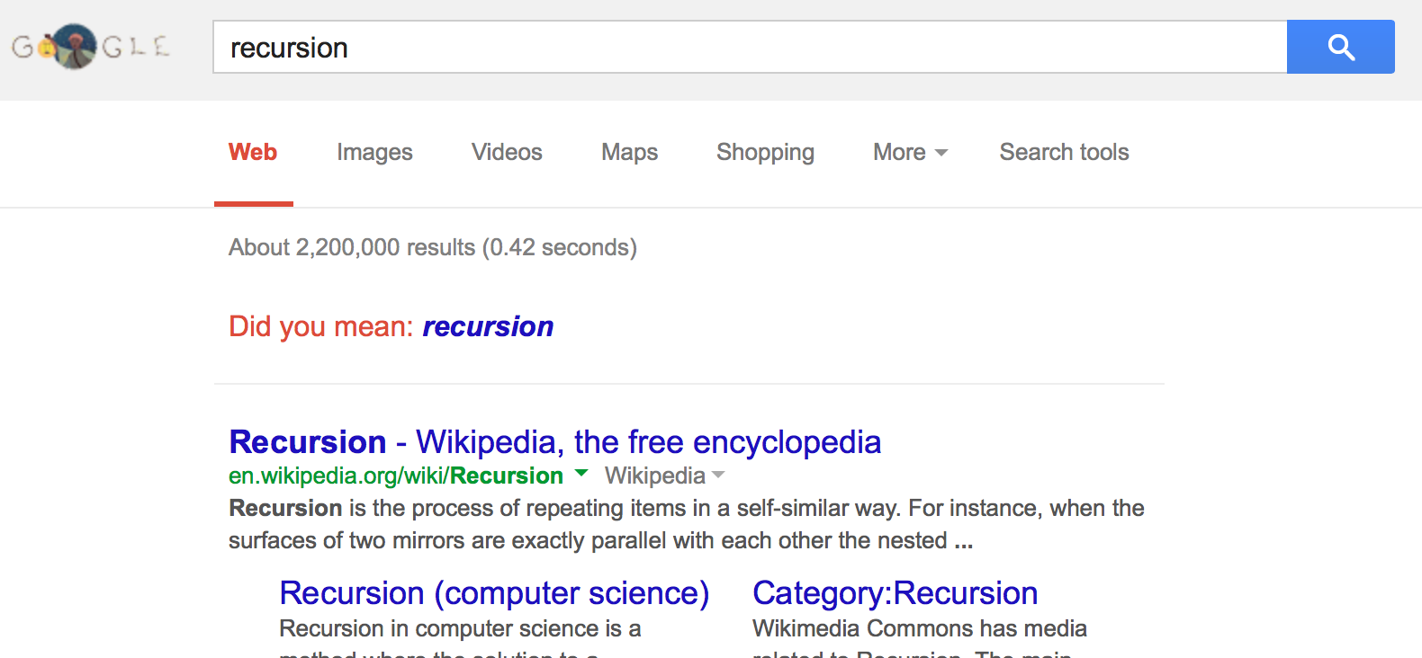
What is Recursion?

Slide 17
What is Recursion?
Recursion:
A problem solving technique in which problems are solved by reducing them to smaller problems of the same form.

Slide 18
Why Recursion?
Great style
Powerful tool
Master of control flow

Slide 19
Pedagogy
Many simple examples

Slide 20
Recursion In Programming
In programming, recursion simply means that a function will call itself:
int main() {
main();
return 0;
}
SEG FAULT!
(this is a terrible example, and will crash!)
main() isn't supposed to call itself, but if we do write this program, what happens?
Let's try it...
We'll get back to programming in a minute...

Slide 21
Recursion
How to solve a jigsaw puzzle recursively (“solve the puzzle”)
  Is the puzzle finished? If so, stop.
  Find a correct puzzle piece and place it.
  Solve the puzzle
Recursion In Real Life
ridiculously hard puzzle

Slide 22
Let's recurse on you.
How many students total are directly behind you in your "column" of the classroom?
Recursion In Real Life
Rules:
You can see only the people directly in front and behind you. So, you can't just look back and count.
You are allowed to ask questions of the people in front / behind you.
How can we solve this problem recursively?

Slide 23
Answer:
The first person looks behind them, and sees if there is a person there. If not, the person responds "0".
If there is a person, repeat step 1, and wait for a response.
Once a person receives a response, they add 1 for the person behind them, and they respond to the person that asked them.
Recursion In Real Life

Slide 24
int numStudentsBehind(Student curr) {
if (noOneBehind(curr)) {
return 0;
} else {
Student personBehind = curr.getBehind();
return numStudentsBehind(personBehind) + 1
}
}
In C++:
Recursive call!

Slide 25
The structure of recursive functions is typically like the following:
recursiveFunction() {
if (test for simple case) {
Compute the solution without recursion
} else {
Break the problem into subproblems of the same form
Call recursiveFunction() on each subproblem
Reassamble the results of the subproblems
}
}
In C++:

Slide 26
Every recursive algorithm involves at least two cases:
base case: The simple case; an occurrence that can be answered directly; the case that recursive calls reduce to.
recursive case: a more complex occurrence of the problem that cannot be directly answered, but can be described in terms of smaller occurrences of the same problem.
In C++:

Slide 27
int numStudentsBehind(Student curr) {
if (noOneBehind(curr)) {
return 0;
} else {
Student personBehind = curr.getBehind();
return numStudentsBehind(personBehind) + 1
}
}
In C++:
Base case

Slide 28
int numStudentsBehind(Student curr) {
if (noOneBehind(curr)) {
return 0;
} else {
Student personBehind = curr.getBehind();
return numStudentsBehind(personBehind) + 1
}
}
In C++:
Base case
Recursive case

Slide 29
int numStudentsBehind(Student curr) {
if (noOneBehind(curr)) {
return 0;
} else {
Student personBehind = curr.getBehind();
return numStudentsBehind(personBehind) + 1
}
}
In C++:
Recursive call

Slide 30

Three Musts of Recursion
1. Your code must have a case for all valid inputs
2. You must have a base case that makes no recursive calls
3. When you make a recursive call it should be to a simpler instance and make forward progress towards the base case.

Slide 31
There is a "recursive leap of faith"

Slide 32
More Examples!
The power() function:
Write a recursive function that takes in a number (x) and an exponent (n) and returns the result of x^{n}

Slide 33
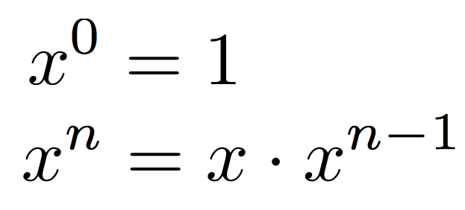
Powers

Slide 34
Powers
Let's code it

Slide 35
Powers
Each previous call waits for the next call to finish (just like any function).
cout << power(5, 3) << endl;
// first call: power (5, 3)
int power(int x, int exp) {
if (exp == 0) {
return 1;
} else {
return x * power(x, exp - 1);
}
}
// first call: power (5, 3)
int power(int x, int exp) {
if (exp == 0) {
return 1;
} else {
return x * power(x, exp - 1);
}
}
// second call: power (5, 2)
int power(int x, int exp) {
if (exp == 0) {
return 1;
} else {
return x * power(x, exp - 1);
}
}
// third call: power (5, 1)
int power(int x, int exp) {
if (exp == 0) {
return 1;
} else {
return x * power(x, exp - 1);
}
}
// fourth call: power (5, 0)
int power(int x, int exp) {
if (exp == 0) {
return 1;
} else {
return x * power(x, exp - 1);
}
}

Slide 36
Powers
Each previous call waits for the next call to finish (just like any function).
cout << power(5, 3) << endl;
// first call: power (5, 3)
int power(int x, int exp) {
if (exp == 0) {
return 1;
} else {
return x * power(x, exp - 1);
}
}
// first call: power (5, 3)
int power(int x, int exp) {
if (exp == 0) {
return 1;
} else {
return x * power(x, exp - 1);
}
}
// second call: power (5, 2)
int power(int x, int exp) {
if (exp == 0) {
return 1;
} else {
return x * power(x, exp - 1);
}
}
// third call: power (5, 1)
int power(int x, int exp) {
if (exp == 0) {
return 1;
} else {
return x * power(x, exp - 1);
}
}
// fourth call: power (5, 0)
int power(int x, int exp) {
if (exp == 0) {
return 1;
} else {
return x * power(x, exp - 1);
}
}
This call returns 1

Slide 37
Powers
Each previous call waits for the next call to finish (just like any function).
cout << power(5, 3) << endl;
// first call: power (5, 3)
int power(int x, int exp) {
if (exp == 0) {
return 1;
} else {
return x * power(x, exp - 1);
}
}
// first call: power (5, 3)
int power(int x, int exp) {
if (exp == 0) {
return 1;
} else {
return x * power(x, exp - 1);
}
}
// second call: power (5, 2)
int power(int x, int exp) {
if (exp == 0) {
return 1;
} else {
return x * power(x, exp - 1);
}
}
// third call: power (5, 1)
int power(int x, int exp) {
if (exp == 0) {
return 1;
} else {
return x * power(x, exp - 1);
}
}
equals 1 from call
this entire statement returns 5 * 1

Slide 38
Powers
Each previous call waits for the next call to finish (just like any function).
cout << power(5, 3) << endl;
// first call: power (5, 3)
int power(int x, int exp) {
if (exp == 0) {
return 1;
} else {
return x * power(x, exp - 1);
}
}
// first call: power (5, 3)
int power(int x, int exp) {
if (exp == 0) {
return 1;
} else {
return x * power(x, exp - 1);
}
}
// second call: power (5, 2)
int power(int x, int exp) {
if (exp == 0) {
return 1;
} else {
return x * power(x, exp - 1);
}
}
equals 5 from call
this entire statement returns 5 * 5

Slide 39
Powers
Each previous call waits for the next call to finish (just like any function).
cout << power(5, 3) << endl;
// first call: power (5, 3)
int power(int x, int exp) {
if (exp == 0) {
return 1;
} else {
return x * power(x, exp - 1);
}
}
// first call: power (5, 3)
int power(int x, int exp) {
if (exp == 0) {
return 1;
} else {
return x * power(x, exp - 1);
}
}
equals 25 from call
this entire statement returns 5 * 25
the original function call was to this one, so it returns 125, which is 5³

Slide 40
Faster Method!
int power(int x, int exp) {
if(exp == 0) {
// base case
return 1;
} else {
if (exp % 2 == 1) {
// if exp is odd
return x * power(x, exp - 1);
} else {
// else, if exp is even
int y = power(x, exp / 2);
return y * y;
}
}
}
Exponentiation by squaring
Big O???
O(log n) -- yay!

Slide 41
Mystery Recursion: Trace this function
int mystery(int n) {
if (n < 10) {
return n;
} else {
int a = n/10;
int b = n % 10;
return mystery(a + b);
}
}
What is the result of mystery(648)?
8
9
54
72
648

Slide 42
Mystery Recursion: Trace this function
int mystery(int n) { // n = 648
if (n < 10) {
return n;
} else {
int a = n/10; // a = 64
int b = n % 10; // b = 8
return mystery(a + b); // mystery(72);
}
}

Slide 43
Mystery Recursion: Trace this function
int mystery(int n) { // n = 648
if (n < 10) {
return n;
} else {
int a = n/10; // a = 64
int b = n % 10; // b = 8
return mystery(a + b); // mystery(72);
}
}
int mystery(int n) { // n = 72
if (n < 10) {
return n;
} else {
int a = n/10; // a = 7
int b = n % 10; // b = 2
return mystery(a + b); // mystery(9);
}
}

Slide 44
Mystery Recursion: Trace this function
int mystery(int n) { // n = 648
if (n < 10) {
return n;
} else {
int a = n/10; // a = 64
int b = n % 10; // b = 8
return mystery(a + b); // mystery(72);
}
}
int mystery(int n) { // n = 72
if (n < 10) {
return n;
} else {
int a = n/10; // a = 7
int b = n % 10; // b = 2
return mystery(a + b); // mystery(9);
}
}
int mystery(int n) { // n = 9
if (n < 10) {
return n; // return 9;
} else {
int a = n/10;
int b = n % 10;
return mystery(a + b);
}
}

Slide 45
Mystery Recursion: Trace this function
int mystery(int n) { // n = 648
if (n < 10) {
return n;
} else {
int a = n/10; // a = 64
int b = n % 10; // b = 8
return mystery(a + b); // mystery(72);
}
}
int mystery(int n) { // n = 72
if (n < 10) {
return n;
} else {
int a = n/10; // a = 7
int b = n % 10; // b = 2
return mystery(a + b); // mystery(9);
}
}
returns 9

Slide 46
Mystery Recursion: Trace this function
int mystery(int n) { // n = 648
if (n < 10) {
return n;
} else {
int a = n/10; // a = 64
int b = n % 10; // b = 8
return mystery(a + b); // mystery(72);
}
}
What is the result of mystery(648)?
8
9
54
72
648
returns 9

Slide 47
More Examples! isPalendrome(string s)
Write a recursive function isPalindrome accepts a string and returns true if it reads the same forwards as backwards.
isPalindrome("madam") → true
isPalindrome("racecar") → true
isPalindrome("step on no pets") → true
isPalindrome("Java") → false
isPalindrome("byebye") →false

Slide 48
Three Musts of Recursion
1. Your code must have a case for all valid inputs
2. You must have a base case that makes no recursive calls
3. When you make a recursive call it should be to a simpler instance and make forward progress towards the base case.

Slide 49
isPalendrome
// Returns true if the given string reads the same
// forwards as backwards.
// Trivially true for empty or 1-letter strings.
bool isPalindrome(const string& s) {
if (s.length() < 2) { // base case
return true;
} else { // recursive case
if (s[0] != s[s.length() - 1]) {
return false;
}
string middle = s.substr(1, s.length() - 2);
return isPalindrome(middle);
}
}

Slide 50
Flashback to 106A: Hailstone
// Couts the sequence of numbers from n to one
// produced by the Hailstone (aka Collatz) procedure
void hailstone(int n) {
cout << n << endl;
if(n == 1) {
return;
} else {
if(n % 2 == 0) {
// n is even so we repeat with n/2
hailstone(n / 2);
} else {
// n is odd so we repeat with 3 * n + 1
hailstone(3 * n + 1);
}
}
}

Slide 51
Flashback to 106A: Hailstone
// Couts the sequence of numbers from n to one
// produced by the Hailstone (aka Collatz) procedure
void hailstone(int n) {
cout << n << endl;
if(n == 1) {
return;
} else {
if(n % 2 == 0) {
// n is even so we repeat with n/2
hailstone(n / 2);
} else {
// n is odd so we repeat with 3 * n + 1
hailstone(3 * n + 1);
}
}
}
3. When you make a recursive call it should be to a simpler instance and make forward progress towards the base case.
Is this simpler???

Slide 52
Flashback to 106A: Hailstone
hailstone(int n)
Hailstone has been checked for values up to 5 x 10¹⁸
but no one has proved that it always reaches 1!
There is a cash prize for proving it!
The prize is $1400.

Slide 53
Flashback to 106A: Hailstone
Print the sequences of numbers that you take to get from N until 1, using the Hailstone (Collatz) production rules:
If n == 1, you are done.
If n is even your next number is n / 2.
If n is odd your next number is 3*n + 1.

Slide 54
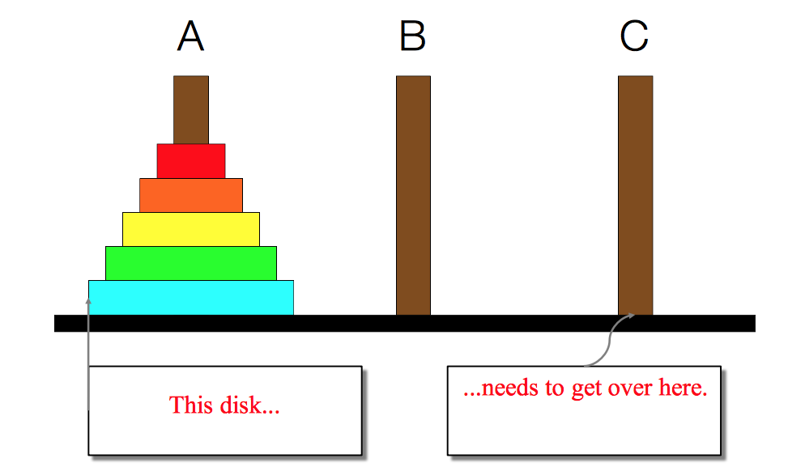
Back to Towers of Hanoi
This is a hard problem to solve iteratively, but can be done recursively (though the recursive insight is not trivial to figure out)

Slide 55
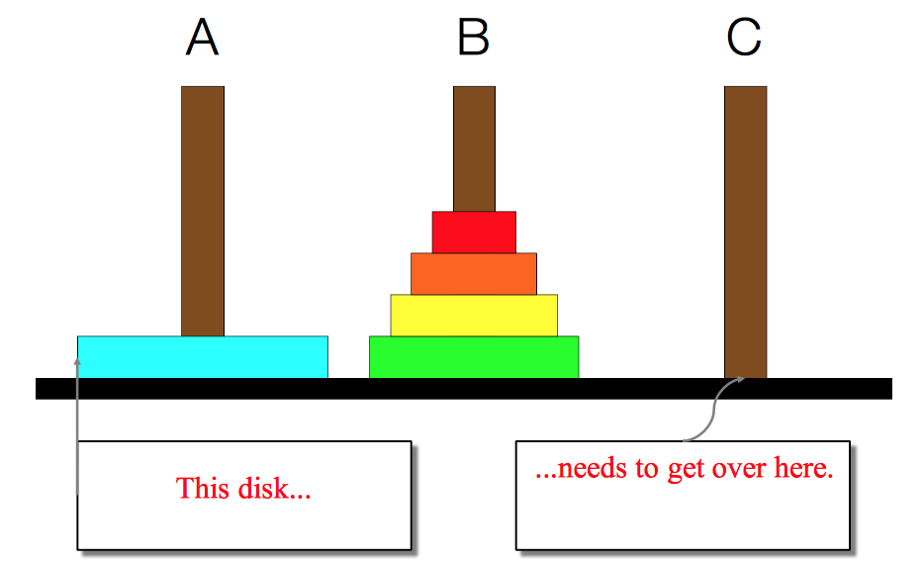
Back to Towers of Hanoi

Slide 56
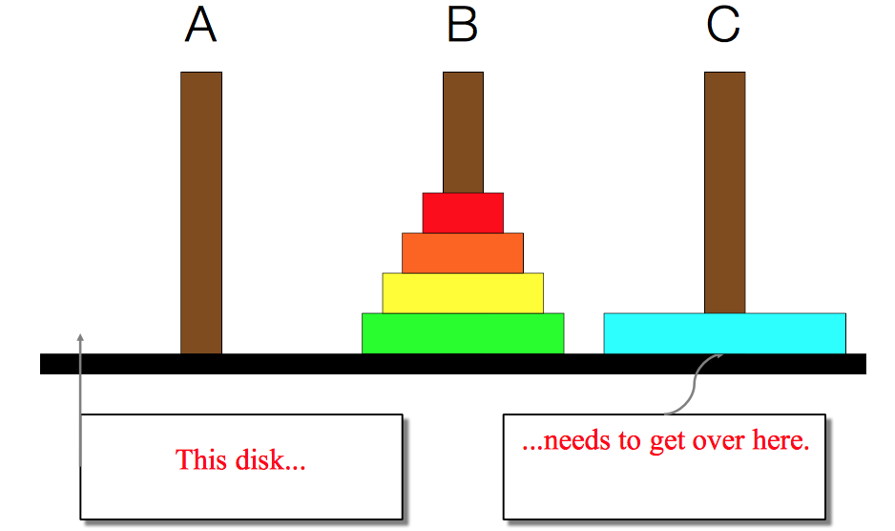
Back to Towers of Hanoi

Slide 57
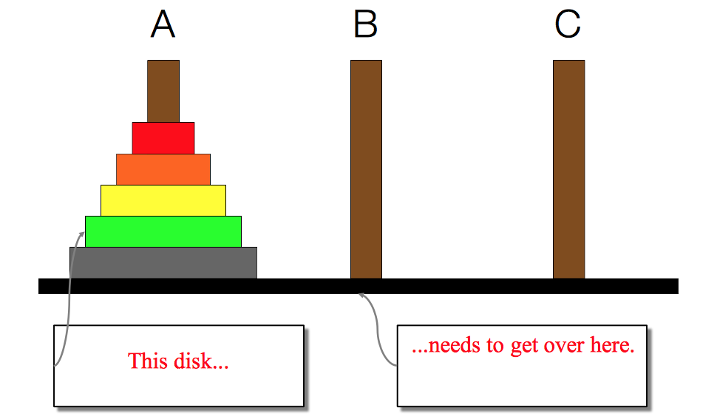
Back to Towers of Hanoi

Slide 58
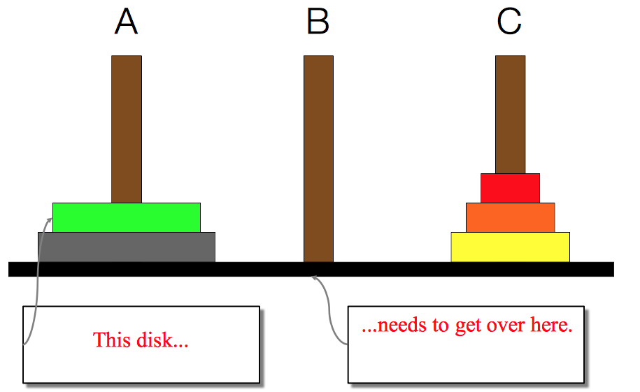
Back to Towers of Hanoi

Slide 59
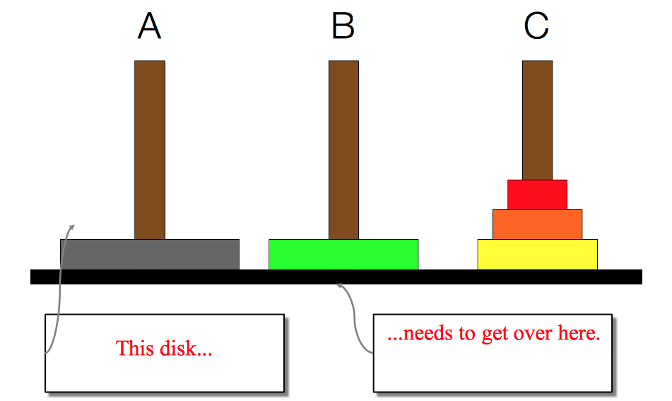
Back to Towers of Hanoi

Slide 60
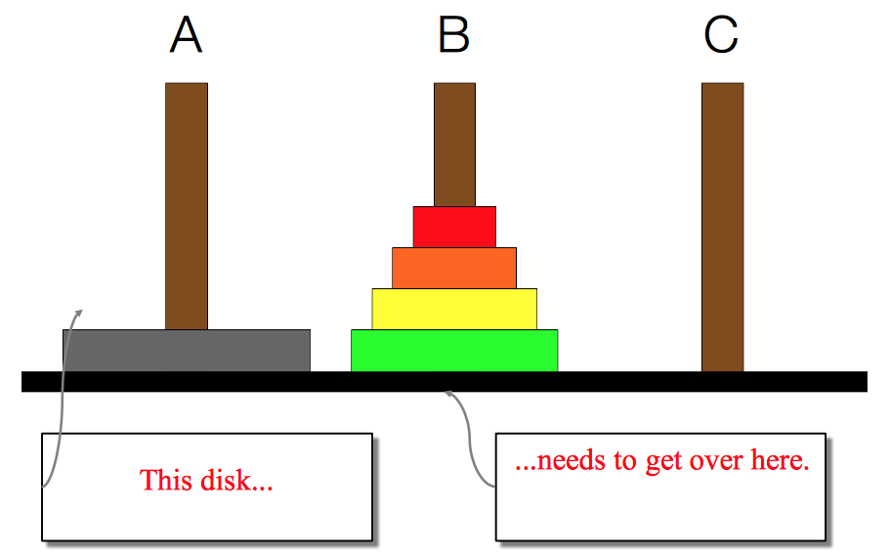
Back to Towers of Hanoi

Slide 61
Back to Towers of Hanoi
We need to find a very simple case that we can solve directly in order for the recursion to work.
If the tower has size one, we can just move that single disk from the source to the destination.
If the tower has more than one, we have to use the auxiliary spindle.

Slide 62
Back to Towers of Hanoi
We can break the entire process down into very simple steps -- not necessarily easy to think of steps, but simple ones!

Slide 63
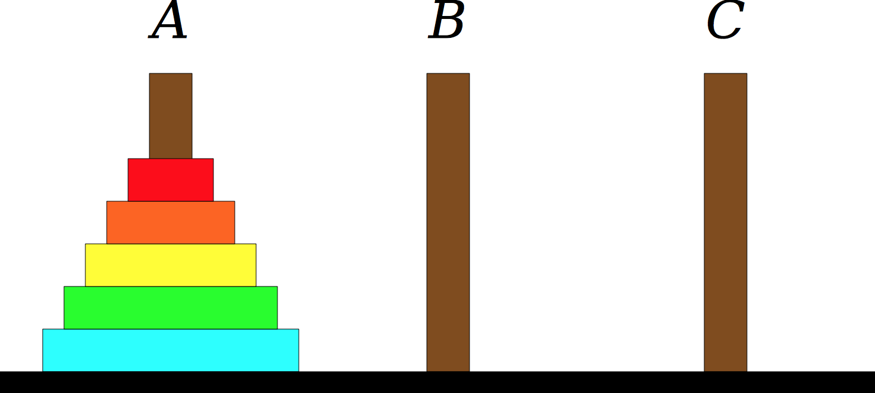
Back to Towers of Hanoi

Slide 64
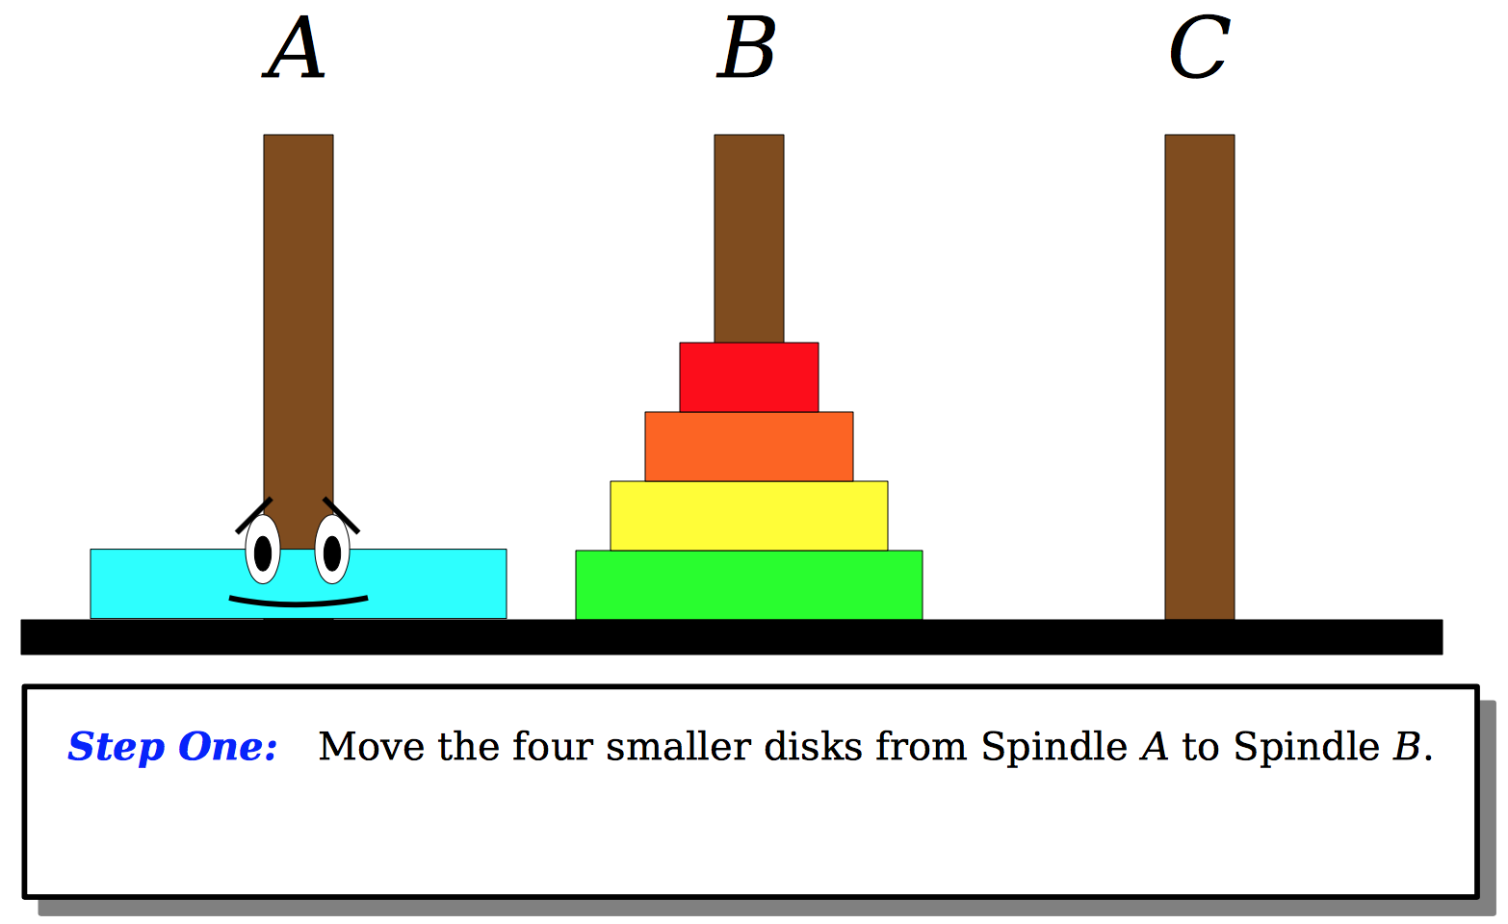
Back to Towers of Hanoi

Slide 65
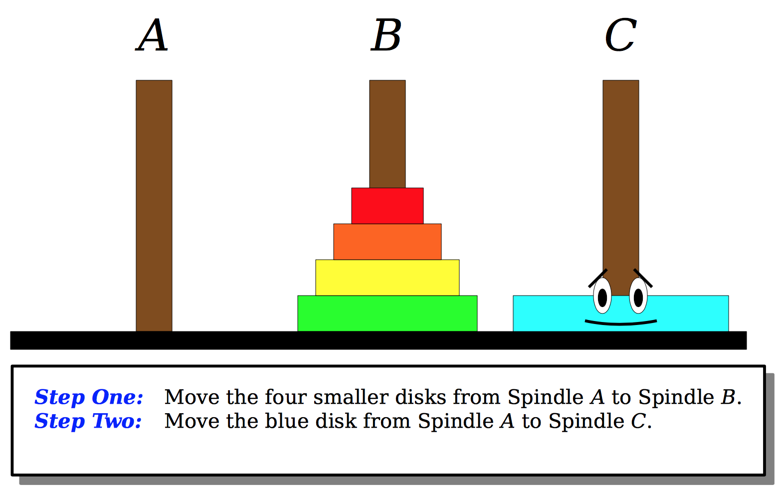
Back to Towers of Hanoi

Slide 66
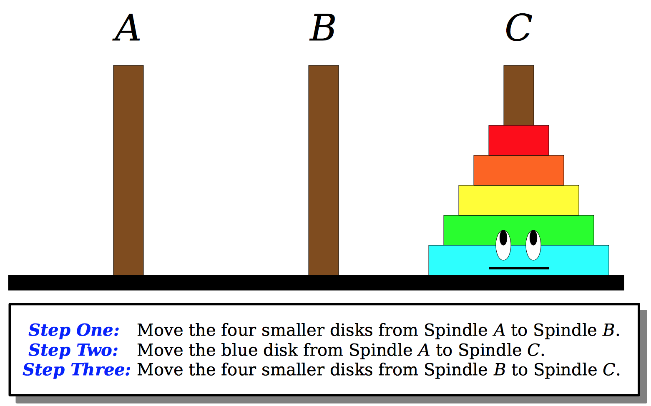
Back to Towers of Hanoi

Slide 67
Back to Towers of Hanoi
Repeat these steps at each stage!

Slide 68
Back to Towers of Hanoi

Slide 69
Recap
Recursion
  Break a problem into smaller subproblems of the same form, and call the same function again on that smaller form.
  Super powerful programming tool
  Not always the perfect choice, but often a good one
  Some beautiful problems are solved recursively
Three Musts for Recursion:
  Your code must have a case for all valid inputs
  You must have a base case that makes no recursive calls
  When you make a recursive call it should be to a simpler instance and make forward progress towards the base case.

Slide 70
References and Advanced Reading
References:
  http://www.cs.utah.edu/~germain/PPS/Topics/recursion.html
  Why is iteration generally better than recursion? http://stackoverflow.com/a/3093/561677
Advanced Reading:
  Tail recursion: http://stackoverflow.com/questions/33923/what-is-tail-recursion
  Interesting story on the history of recursion in programming languages: http://goo.gl/P6Einb

Slide 71
Extra Slides

Slide 72
Converting Decimal to Binary
Recursion is about solving a small piece of a large problem.
– What is 69743 in binary?
  • Do we know anything about its representation in binary?
– Case analysis:
• What is/are easy numbers to print in binary?
• Can we express a larger number in terms of a smaller number(s)?

Slide 73
Converting Decimal to Binary
Suppose we are examining some arbitrary integer N.
– if N's binary representation is 10010101011
– (N / 2)'s binary representation is 1001010101
– (N % 2)'s binary representation is 1
– What can we infer from this relationship?

Slide 74
Converting Decimal to Binary
// Prints the given integer's binary representation.
// Precondition: n >= 0
void printBinary(int n) {
if (n < 2) {
// base case; same as base 10
cout << n;
} else {
// recursive case; break number apart
printBinary(n / 2);
printBinary(n % 2);
}
}

