Slide 1

Wednesday, April 19, 2017
CS 106B
Lecture 8: Fractals
Programming Abstractions
Spring 2017
Stanford University
Computer Science Department
Lecturer: Chris Gregg
reading:
Programming Abstractions in C++, Chapter 5.4-5.6

Slide 2
Today's Topics
Logistics:
  ADTs Due Thursday April 20th, noon
  Towers of Hanoi video featuring Keith Schwartz: https://www.youtube.com/watch?v=2SUvWfNJSsM
Tiny Feedback
Assignment 3: Recursion
  Fractals
  Grammar Solver
A more detailed recursion example
Fractals

Slide 3
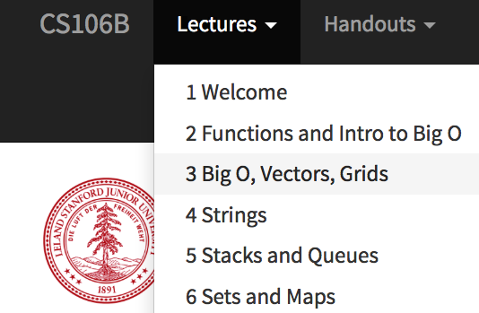
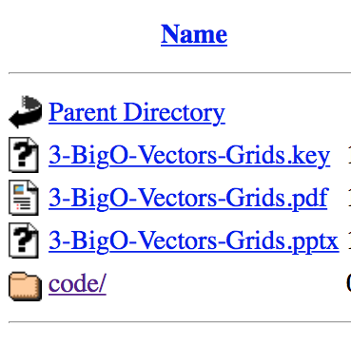
Tiny Feedback
    Could you please upload the .ppt of the classes and not only the .pdf?
      We've already been doing this! See the Lectures drop-down on the course web page:

Slide 4
Assignment 3: Recursion
      Fractals and Graphics
      Grammar Solver

Slide 5
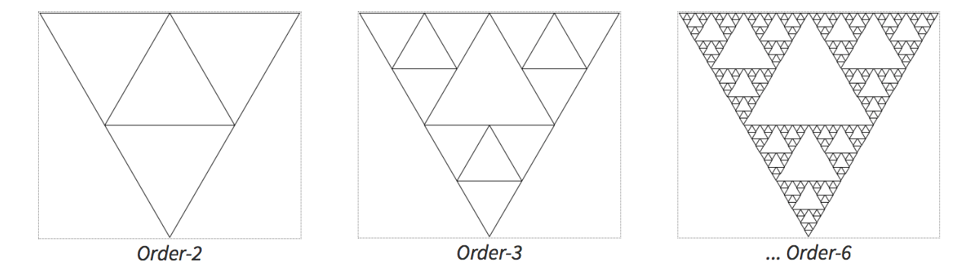
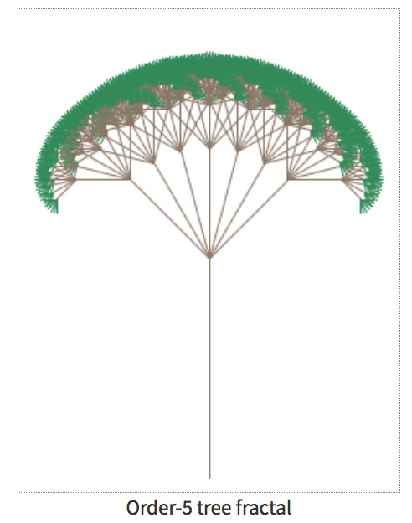
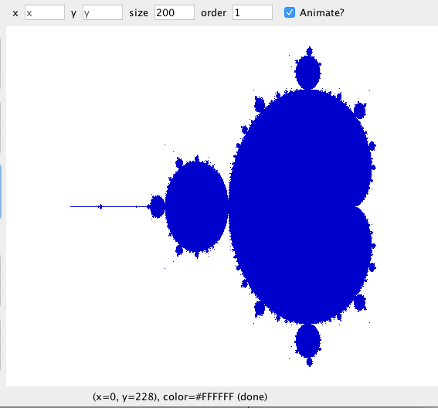
Assignment 3A: Fractals and Graphics
part 1
Sierpinski
part 3
mandelbrot
part 2
tree fractal

Slide 6
Assignment 3B: Grammar Solver
write a function for generating random sentences from a grammar.
example describing a small subset of the English language. Non-terminal names such as <s>, <np> and <tv> are short for linguistic elements such as sentences, noun phrases, and transitive verbs:
<s>::=<np> <vp>
<np>::=<dp> <adjp> <n>|<pn>
<dp>::=the|a
<adjp>::=<adj>|<adj> <adjp>
<adj>::=big|fat|green|wonderful|faulty|subliminal|pretentious
<n>::=dog|cat|man|university|father|mother|child|television
<pn>::=John|Jane|Sally|Spot|Fred|Elmo
<vp>::=<tv> <np>|<iv>
<tv>::=hit|honored|kissed|helped
<iv>::=died|collapsed|laughed|wept

Slide 7

Three Musts of Recursion
1. Your code must have a case for all valid inputs
2. You must have a base case that makes no recursive calls
3. When you make a recursive call it should be to a simpler instance and make forward progress towards the base case.

Slide 8
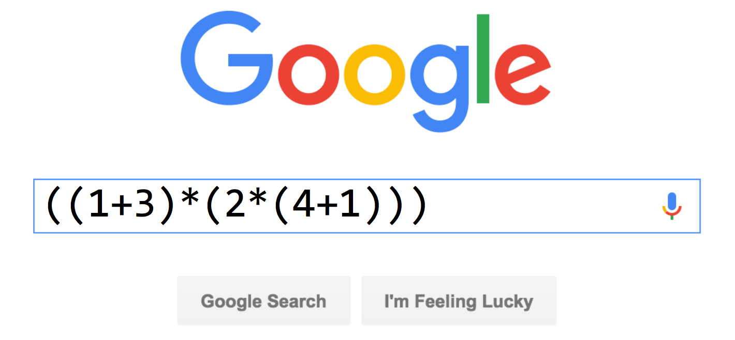
Recursion Example

Slide 9
Recursion Example
((1*17)+(2*(3+(4*9))))
95

Slide 10
Challenge
Implement a function which evaluates an expression string:
"((1+3)*(2*(4+1)))"
"(7+6)"
"(((4*(1+2))+6)*7)"
(only needs to implement * or +)

Slide 11
Anatomy of an Expression
An expression is always one of these three things
number
expression (expression + expression)
(expression * expression)

Slide 12
Anatomy of an Expression
((1*3)+(4*2)
left expression
right expression
joining operator

Slide 13
Anatomy of an Expression
op
left exp
right exp
((1*3)+(4*2)
left expression
right expression
joining operator

Slide 14
Anatomy of an Expression
How do we evaluate ((1*17)+(2*(3+(4*9))))?
95
((1 * 17) + (2 * (3 + (4 * 9))))
17
78
(1 * 17)
(2 * (3 + (4 * 9)))
39
1
17
2
(3 + (4 * 9))
36
3
(4 * 9)
4
9

Slide 15
Is it Recursive? Yes!
((1*3)+(4+2))
The big instance of this problem is:
((1*3)+(4+2))
The smaller instances are:
(1*3)
and
(4+2)

Slide 16
Task
Write this function:
int evaluate(string exp);
"((1*3)+(4+2))" // returns 9
Using these library functions:
stringIsInteger(exp)
stringToInteger(exp)
//returns ‘+’
char op = getOperator(exp);
//returns “(1*3)”
string left = getLeftExp(exp);
//returns “(4+2)”
string right = getRightExp(exp);
And these exp helper functions:

Slide 17
Solution (Pseudocode)
"((1*3)+(4+2))"
int evaluate(expression):
if expression is a number, return expression
Otherwise, break up expression by its operator:
  leftResult = evaluate(leftExpression)
  rightResult = evaluate(rightExpression)
  return leftResult operator rightResult

Slide 18
Solution
int evaluate(string exp) {
if (stringIsInteger(exp)) {
return stringToInteger(exp);
} else {
char op = getOperator(exp);
string left = getLeftExp(exp);
string right = getRightExp(exp);
int leftResult = evaluate(left);
int rightResult = evaluate(right);
if (op == '+') {
return leftResult + rightResult;
} else if (op == '*') {
return leftResult * rightResult;
}
}
}
exp = "((1*3)+(4*5)+2)"
op = '+'
left = "(1*3)"
right = "((4*5)+2)"
leftResult = 3
rightResult = 22

Slide 19
Helper Methods
Here is the key function behind the helper methods:
int getOppIndex(string exp){
int parens = 0;
// ignore first left paren
for (int i = 1; i < exp.length(); i++) {
char c = exp[i];
if (c == '(') {
parens++;
} else if (c == ')') {
parens--;
}
if (parens == 0 && (c == '+' || c == '*')) {
return i;
}
}
}

Slide 20
By the way...
We could also have solved this with a stack!

Slide 21
Today
Recursion you can see

Slide 22
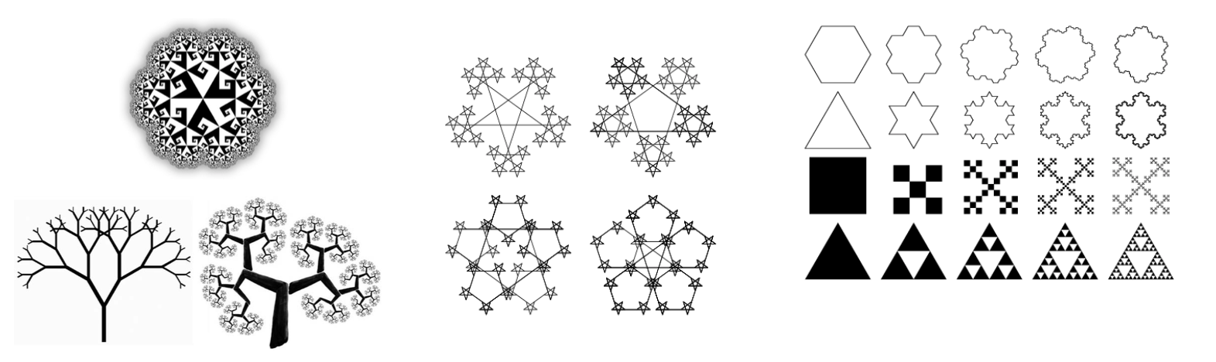
Fractal
fractal: A recurring graphical pattern. Smaller instances of the same shape or pattern occur within the pattern itself.

Slide 23
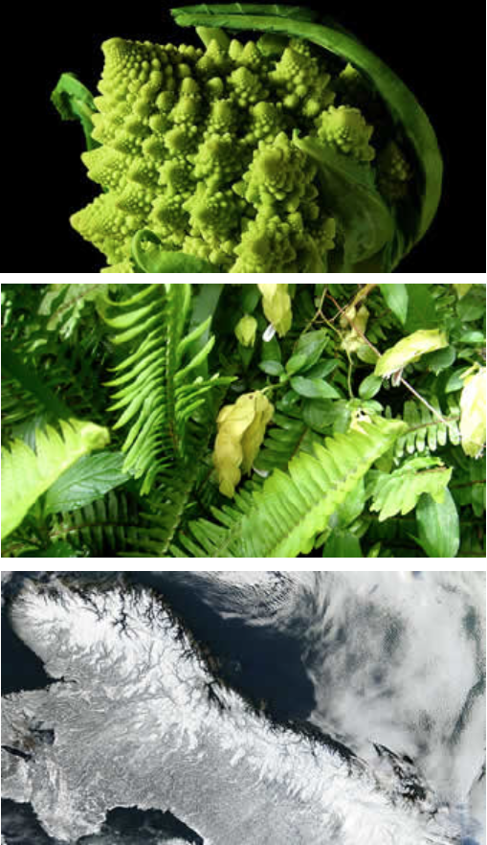
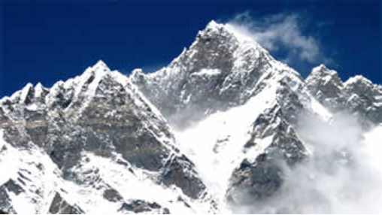
Fractal
Many natural phenomena generate fractal patterns:
earthquake fault lines
animal color patterns
clouds
mountain ranges
snowflakes
crystals
DNA
...

Slide 24
The Cantor Fractal

Slide 25
Cantor Fractal
Parts of a cantor set image ... are Cantor set images

Slide 26
Cantor Fractal
Start
End
Another cantor set
Also a cantor set

Slide 27
Levels of Cantor
6 levels

Slide 28
Levels of Cantor
5 levels

Slide 29
Levels of Cantor
1 level

Slide 30
How to Draw a Level 1 Cantor

Slide 31
How to Draw a Level n Cantor
1
Draw a line from start to finish.
2
Draw a Cantor of size n-1
2
Draw a Cantor of size n-1

Slide 32
Graphics in C++ with the Stanford Libs: GPoint
x=0
y=0
GWindow w;
GPoint a(100, 100);
cout << a.getX() << endl;
GPoint a

Slide 33
Graphics in C++ with the Stanford Libs: GPoint
x=0
y=0
GPoint b
GWindow w;
GPoint a(100, 100);
GPoint b(20, 20);
w.drawLine(a, b);
GPoint a

Slide 34
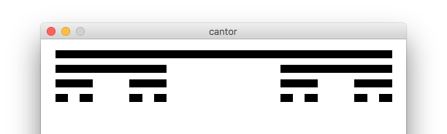

Cantor Fractal

Slide 35
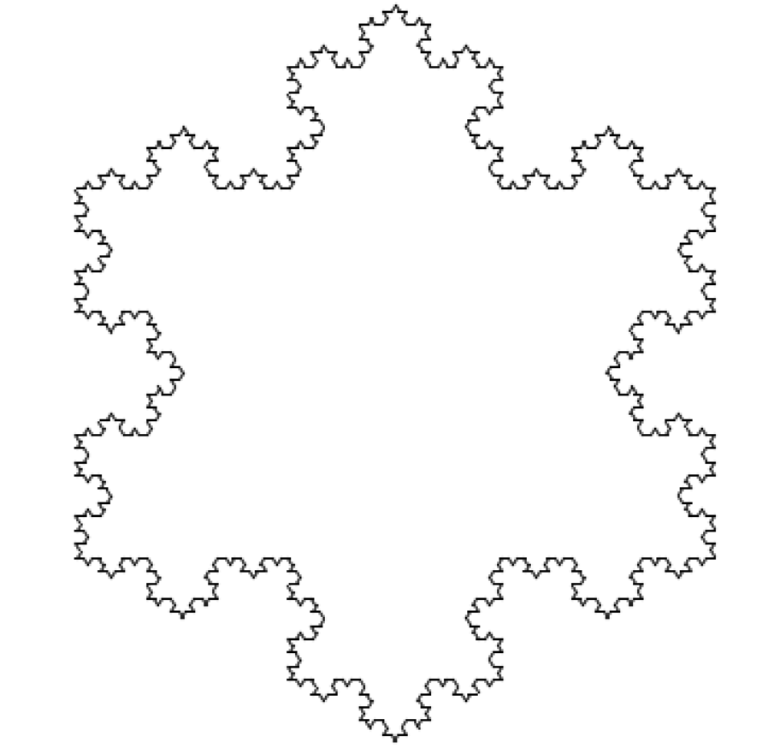
Snoflake Fractal

Slide 36
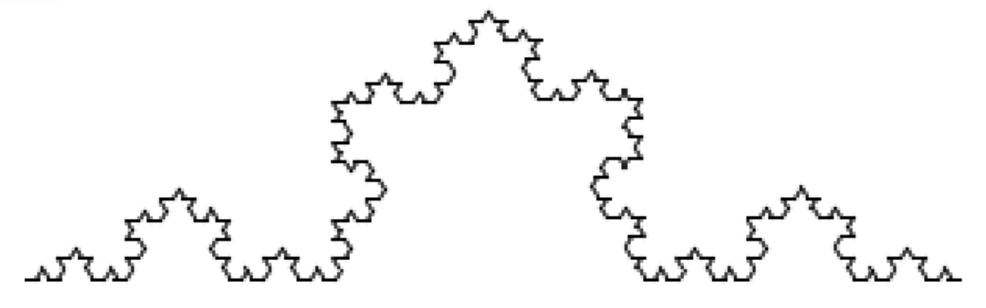
Snowflake Fractal

Slide 37
Depth 1 Snowflake Line

Slide 38
Depth 2 Snowflake Line

Slide 39
Depth 3 Snowflake Line (in progress)

Slide 40
Depth 3 Snowflake Line (in progress)

Slide 41
Depth 3 Snowflake Line (in progress)

Slide 42
Depth 3 Snowflake Line (in progress)

Slide 43
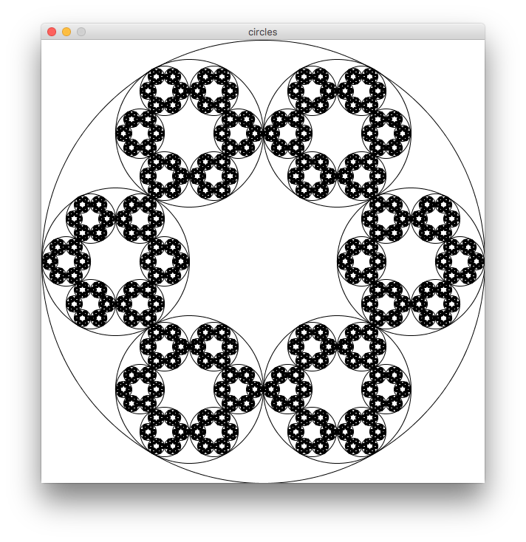
Another Example On the Website

Slide 44
Recap
Fractals
  Fractals are self-referential, and that makes for nice recursion problems!
  Break the problem into a smaller, self-similar part, and don't forget your base case!

Slide 45
References and Advanced Reading
References:
  http://www.cs.utah.edu/~germain/PPS/Topics/recursion.html
  Why is iteration generally better than recursion? http://stackoverflow.com/a/3093/561677
Advanced Reading:
  Tail recursion: http://stackoverflow.com/questions/33923/what-is-tail-recursion
  Interesting story on the history of recursion in programming languages: http://goo.gl/P6Einb

Slide 46
Extra Slides

