Slide 1
Tuesday, July 11, 2017
CS 106B
Lecture 9: Recursive Backtracking 1: Decision Trees
Programming Abstractions
Summer 2017
Stanford University
Computer Science Department
Lecturer: Chris Gregg
reading:
Programming Abstractions in C++, Chapter 8.2-8.3

Slide 2
Today's Topics
Logistics:
  Assignment 3: Fractals and Recursion: Due next Tuesday
  Pair programming? What is it?
Recursion and Decision Trees
  Folders and Directories
  Reducible Words
Recursive Backtracking: Exhaustive Search
  Permutations

Slide 3
Assignment 3: Recursion
      Fractals and Graphics
      Grammar Solver

Slide 4
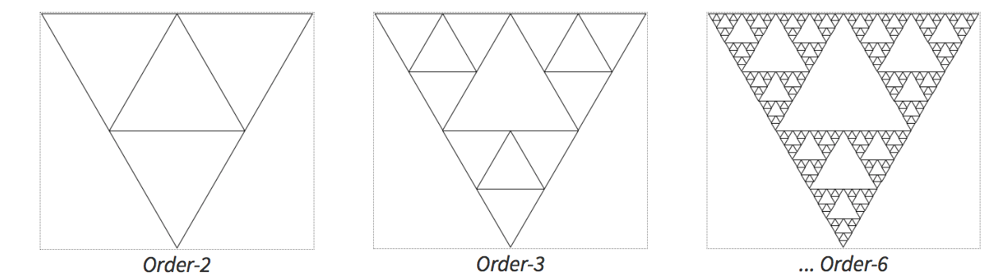
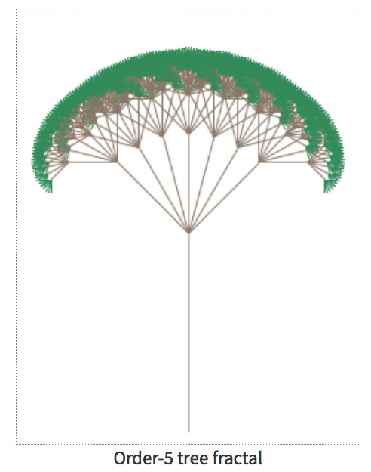
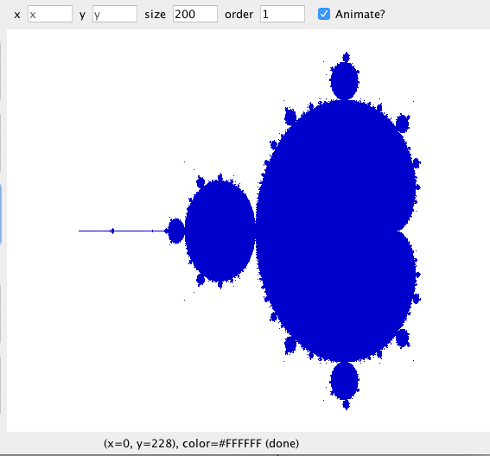
Assignment 3A: Fractals and Graphics
part 1
Sierpinski
part 3
mandelbrot
part 2
tree fractal

Slide 5
Assignment 3B: Grammar Solver
write a function for generating random sentences from a grammar.
example describing a small subset of the English language. Non-terminal names such as <s>, <np> and <tv> are short for linguistic elements such as sentences, noun phrases, and transitive verbs:
<s>::=<np> <vp>
<np>::=<dp> <adjp> <n>|<pn>
<dp>::=the|a
<adjp>::=<adj>|<adj> <adjp>
<adj>::=big|fat|green|wonderful|faulty|subliminal|pretentious
<n>::=dog|cat|man|university|father|mother|child|television
<pn>::=John|Jane|Sally|Spot|Fred|Elmo
<vp>::=<tv> <np>|<iv>
<tv>::=hit|honored|kissed|helped
<iv>::=died|collapsed|laughed|wept

Slide 6
Pair Programming — what is it?
This is the first assignment where you are allowed to work with a partner from your section. But what is "pair programming"?
Pair programming means that two people work together on an assignment, completely.
Pair programmers must never be working on the assignment independently, and should both be looking at the same screen, with one of the students typing (they should take turns).
Students may ask conceptual questions in the LaIR and on Piazza independently, but if you are in a pair you must get help on the code together.
If one student has taken the course before, there can be no overlapping code from that student's prior work.

Slide 7
More Recursion!
So far, you might be thinking to yourself: why do I need recursion, when I can solve lots of problems using simple loops?
Example: A factorial is a recursively defined number:
  n! = n * (n-1)!, where 1! = 1
4!
= 4 * 3!
= 4 * 3 * 2!
= 3 * 2 * 1!
= 3 * 2 * 1
= 24

Slide 8
More Recursion!
Let's write the factorial function recursively
  n! = n * (n-1)!, where 1! = 1
long factorial(long n) {
}

Slide 9
More Recursion!
Let's write the factorial function recursively
  n! = n * (n-1)!, where 1! = 1
long factorial(long n) {
// base case
if (n == 1) {
return 1;
}
// recursive case
return n * factorial(n-1);
}

Slide 10
More Recursion!
But wait...we could have just written this iteratively, using a loop!
  n! = n * (n-1)!, where 1! = 1
long factorial(long n) {
}

Slide 11
More Recursion!
But wait...we could have just written this iteratively, using a loop!
  n! = n * (n-1)!, where 1! = 1
long factorial(long n) {
long answer = 1;
while (n > 1) {
answer *= n;
n--;
}
return answer;
}

Slide 12
More Recursion!
These relatively easy recursive problems may have beautiful solutions, but there isn't anything special about solving the problem recursively.
Today, we will discuss problems that deal with "iterative branching" -- and it is these problems that demonstrate the power of a recursive solution.
Let's go!

Slide 13
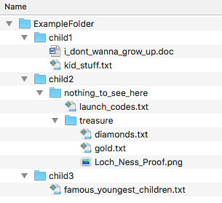
Recursion and Decision Trees
The following is a graphical depiction of the files in a folder on my computer:
The top-level folder is called "ExampleFolder", and it has three children folders, called "child1", "child2", and "child3".
child1 has two files, "i_dont_wanna_grow_up.doc" and "kid_stuff.txt"
etc.

Slide 14
Recursion and Decision Trees
Let's re-draw that structure a bit, into a "tree" format.

Slide 15
Recursion and Decision Trees
If we flip it over...there is a root at the bottom and leaves where there are no more branches.

Slide 16
Recursion and Decision Trees
Flipped back, this is what we call a tree in computer science.

Slide 17
A folder is just a recursive container!
A folder is a tree!

Slide 18
A folder is just a recursive container!
All children are also complete trees!

Slide 19
A folder is just a recursive container!
All children are also complete trees!

Slide 20
A folder is just a recursive container!
All children are also complete trees!

Slide 21
A folder is just a recursive container!
All children are also complete trees!

Slide 22

Let's write a program to output all files in a folder
All children are also complete trees!

Slide 23
Another Example: Reducible Words
Here is a word puzzle: "Is there a nine-letter English word that can be reduced to a single-letter word one letter at at time by removing letters, leaving a legal word at each step?

Slide 24
Another Example: Reducible Words
4-letter example:
cart ☞ art ☞ at ☞ a
can you think of a nine letter word?

Slide 25
Another Example: Reducible Words
startling
startling ☞ starling ☞ staring ☞ string ☞sting ☞sing ☞sin ☞in ☞i
is there really just one nine-letter word with this property?

Slide 26
All Reducible 9-letter words
can we do this iteratively?
it would be very messy!

Slide 27
All Reducible 9-letter words
can we do this recursively?
yes!
what is the decision tree?

Slide 28
Reducability Decision Tree
cart
art
crt
cat
car

Slide 29
Reducability Decision Tree
cart
art
crt
cat
car
rt
at
ar

Slide 30
Reducability Decision Tree
cart
art
crt
cat
car
rt
at
ar
rt
ct
cr
at
ct
ca
ar
cr
ca

Slide 31
Reducability Decision Tree
cart
art
crt
cat
car
rt
at
ar
rt
ct
cr
at
ct
ca
ar
cr
ca
t
r
t
a
r
a
t
r
t
c
r
c
t
a
t
c
a
c
r
a
r
c
a
c

Slide 32
Reducability Decision Tree
cart
art
crt
cat
car
rt
at
ar
rt
ct
cr
at
ct
ca
ar
cr
ca
t
r
t
a
r
a
t
r
t
c
r
c
t
a
t
c
a
c
r
a
r
c
a
c

Slide 33
Reducability Decision Tree
cart
art
crt
cat
car
rt
at
ar
rt
ct
cr
at
ct
ca
ar
cr
ca
t
r
t
a
r
a
t
r
t
c
r
c
t
a
t
c
a
c
r
a
r
c
a
c

Slide 34
Decision Tree Search Template
bool search(currentState) {
if (isSolution(currentState)) {
return true;
} else {
for (option : moves from currentState) {
nextState = takeOption(curr, option);
if (search(nextState)) {
return true;
}
}
return false;
}
}

Slide 35
Reducible Word
Let's define a reducible word as a word that can be reduced down to one letter by removing one character at a time, leaving a word at each step.
Base case:
  A one letter word in the dictionary.
Recursive Step:
  Any multi-letter word is reducible if you can remove a letter (legal move) to form a shrinkable word.

Slide 36
How the algorithm works
cart
art
crt
cat
car
rt
at
ar
rt
ct
cr
at
ct
ca
ar
cr
ca
t
r
t
a
r
a
t
r
t
c
r
c
t
a
t
c
a
c
r
a
r
c
a
c
art: is a word

Slide 37
How the algorithm works
cart
art
crt
cat
car
rt
at
ar
rt
ct
cr
at
ct
ca
ar
cr
ca
t
r
t
a
r
a
t
r
t
c
r
c
t
a
t
c
a
c
r
a
r
c
a
c
rt: not a word

Slide 38
How the algorithm works
cart
art
crt
cat
car
rt
at
ar
rt
ct
cr
at
ct
ca
ar
cr
ca
t
r
t
a
r
a
t
r
t
c
r
c
t
a
t
c
a
c
r
a
r
c
a
c
at: is a word

Slide 39
How the algorithm works
cart
art
crt
cat
car
rt
at
ar
rt
ct
cr
at
ct
ca
ar
cr
ca
t
r
t
a
r
a
t
r
t
c
r
c
t
a
t
c
a
c
r
a
r
c
a
c
t: not a word

Slide 40
How the algorithm works
cart
art
crt
cat
car
rt
at
ar
rt
ct
cr
at
ct
ca
ar
cr
ca
t
r
t
a
r
a
t
r
t
c
r
c
t
a
t
c
a
c
r
a
r
c
a
c
a: is a word
there is a solution!

Slide 41
How the algorithm works
cart
art
crt
cat
car
rt
at
ar
rt
ct
cr
at
ct
ca
ar
cr
ca
t
r
t
a
r
a
t
r
t
c
r
c
t
a
t
c
a
c
r
a
r
c
a
c
a: is a word
there is a solution!

Slide 42
How the algorithm works
cart
art
crt
cat
car
rt
at
ar
rt
ct
cr
at
ct
ca
ar
cr
ca
t
r
t
a
r
a
t
r
t
c
r
c
t
a
t
c
a
c
r
a
r
c
a
c
a: is a word
there is a solution!

Slide 43
How the algorithm works
cart
art
crt
cat
car
rt
at
ar
rt
ct
cr
at
ct
ca
ar
cr
ca
t
r
t
a
r
a
t
r
t
c
r
c
t
a
t
c
a
c
r
a
r
c
a
c
a: is a word
there is a solution!

Slide 44
Reducible Word
Is there really just one nine-letter word?

Slide 45

Recursive Backtracking: Templates
There are basically five different problems you might see that will require recursive backtracking:
Determine whether a solution exists
Find a solution
Find the best solution
Count the number of solutions
Print/find all the solutions

Slide 46
Jumble
Since 1954, the JUMBLE has been a staple in newspapers.
The basic idea is to unscramble the anagrams for the words on the left, and then use the letters in the circles as another anagram to unscramble to answer the pun in the comic.
As a kid, I played the puzzle every day, but some days I just couldn't descramble the words. Six letter words have 6! == 720 combinations, which can be tricky!
I figured I would write a computer program to print out all the permutations!

Slide 47
Jumble
Since 1954, the JUMBLE has been a staple in newspapers.
The basic idea is to unscramble the anagrams for the words on the left, and then use the letters in the circles as another anagram to unscramble to answer the pun in the comic.
As a kid, I played the puzzle every day, but some days I just couldn't descramble the words. Six letter words have 6! == 720 combinations, which can be tricky!
I figured I would write a computer program to print out all the permutations!
dinky
AGILE
encore
DEVOUT
ADDITION
DIAINODT

Slide 48

Permutations
My original function to print out all permutations of four letters:
void permute4(string s) {
for (int i = 0; i < 4; i++) {
for (int j = 0; j < 4 ; j++) {
if (j == i) {
continue; // ignore
}
for (int k = 0; k < 4; k++) {
if (k == j || k == i) {
continue; // ignore
}
for (int w = 0; w < 4; w++) {
if (w == k || w == j || w == i) {
continue; // ignore
}
cout << s[i] << s[j] << s[k] << s[w] << endl;
}
}
}
}
}

Slide 49

Permutations
I also had a permute5() function…
void permute5(string s) {
for (int i = 0; i < 5; i++) {
for (int j = 0; j < 5 ; j++) {
if (j == i) {
continue; // ignore
}
for (int k = 0; k < 5; k++) {
if (k == j || k == i) {
continue; // ignore
}
for (int w = 0; w < 5; w++) {
if (w == k || w == j || w == i) {
continue; // ignore
}
for (int x = 0; x < 5; x++) {
if (x == k || x == j || x == i || x == w) {
continue;
}
cout << " " << s[i] << s[j] << s[k] << s[w] << s[x] << endl;
}
}
}
}
}
}

Slide 50

Permutations
And a permute6() function…
void permute6(string s) {
for (int i = 0; i < 5; i++) {
for (int j = 0; j < 5 ; j++) {
if (j == i) {
continue; // ignore
}
for (int k = 0; k < 5; k++) {
if (k == j || k == i) {
continue; // ignore
}
for (int w = 0; w < 5; w++) {
if (w == k || w == j || w == i) {
continue; // ignore
}
for (int x = 0; x < 5; x++) {
if (x == k || x == j || x == i || x == w) {
continue;
}
for (int y = 0; y < 6; y++) {
if (y == k || y == j || y == i || y == w || y == x) {
continue;
}
cout << " " << s[i] << s[j] << s[k] << s[w] << s[x] << s[y] << endl;
}
}
}
}
}
}
}
What has been seen
cannot be un-seen
This is not tenable!

Slide 51
Tree Framework — Permutations
Permutations do not lend themselves well to iterative looping because we are really rearranging the letters, which doesn't follow an iterative pattern.
Instead, we can look at a recursive method to do the rearranging, called an exhaustive algorithm. We want to investigate all possible solutions. We don't need to know how many letters there are in advance!
In pseudocode:
  If you have no more characters left to rearrange, print current permutation
  for (every possible choice among the characters left to rearrange) {
  Make a choice and add that character to the permutation so far
  Use recursion to rearrange the remaining letters
  }
In English:
  The permutation starts with zero characters, as we have all the letters in the original string to arrange. The base case is that there are no more letters to arrange.
  Take one letter from the letters left, add it to the current permutation, and recursively continue the process, decreasing the characters left by one.

Slide 52

Tree Framework — Permutations
The algorithm in C++:
void permute(string soFar, string rest) {
if (rest == "") {
cout << soFar << endl;
} else {
for (int i = 0; i < rest.length(); i++) {
string remaining = rest.substr(0, i) + rest.substr(i+1);
permute(soFar + rest[i], remaining);
}
}
}
Example call:
  recPermute("","abcd");

Slide 53
Tree Framework — Permutations
soFar: ""
rest: "abcd"
"a"
"bcd"
"b"
"acd"
"c"
"abd"
"d"
"abc"
ab
cd
ac
bd
ad
bc
ba
cd
bc
ad
bd
ac
ca
bd
cb
ad
cd
ab
da
bc
db
ac
dc
ab
abc
d
abd
c
acb
d
acd
b
adb
c
adc
b
bac
d
bad
c
bca
d
bcd
a
bda
c
bdc
a
cab
d
cad
b
cba
d
cbd
a
cda
b
cdb
a
dab
c
dac
b
dba
c
dbc
a
dca
b
dcb
a
abcd
abdc
acbd
acdb
adbc
adcb
bacd
badc
bcad
bcda
bdac
bdca
cabd
cadb
cbad
cbda
cdab
cdba
dabc
dacb
dbac
dbca
dcab
dcba
This is a tree!
Exhaustive
Works for any length string
N! different results
Can think of this as a "call tree" or a "decision tree"

Slide 54

Tree Framework — Helper functions
Here is the algorithm again:
void permute(string soFar, string rest) {
if (rest == "") {
cout << soFar << endl;
} else {
for (int i = 0; i < rest.length(); i++) {
string remaining = rest.substr(0, i) + rest.substr(i+1);
permute(soFar + rest[i], remaining);
}
}
}
Some might argue that this isn't a particularly good function, because it requires the user to always start the algorithm with the empty string for the soFar parameter. It's ugly, and it exposes our internal parameter.
What we really want is a permute(string s) function that is cleaner.
We can overload the permute() function with one parameter and have a cleaner permute function that calls the original one with two parameters.

Slide 55

Tree Framework — Helper functions
The cleaner interface:
void permute(string soFar, string rest) {
if (rest == "") {
cout << soFar << endl;
} else {
for (int i = 0; i < rest.length(); i++) {
string remaining = rest.substr(0, i) + rest.substr(i+1);
permute(soFar + rest[i], remaining);
}
}
}
void permute(string s) {
permute("", s);
}
Now, a user only has to call permute("tuvedo"), which hides the helper recursion parameter.

Slide 56
References and Advanced Reading
References:
  Understanding permutations: http://stackoverflow.com/questions/7537791/understanding-recursion-to-generate-permutations
  Maze algorithms: https://en.wikipedia.org/wiki/Maze_solving_algorithm
Advanced Reading:
  Exhaustive recursive backtracking: https://see.stanford.edu/materials/icspacs106b/h19-recbacktrackexamples.pdf
  Backtracking: https://en.wikipedia.org/wiki/Backtracking

Slide 57
Extra Slides

