Slide 1

Wednesday, April 18, 2018
CS 106B
Lecture 8: Fractals
Programming Abstractions
Spring 2018
Stanford University
Computer Science Department
Nick Troccoli
reading:
Programming Abstractions in C++, Chapter 5.4-5.6

Slide 2
Today's Topics
Logistics:
  Serafini Due Thursday April 19th, noon
  Towers of Hanoi video: https://www.youtube.com/watch?v=2SUvWfNJSsM
Assignment 3: Recursion —posted at 12PM tomorrow, due next Thursday.
                Fractals
                Grammar Solver
                YEAH Hours: Thurs. 4/19 4:30PM-5:20PM in Skilling Auditorium
Recursion example: expressions
Fractals

Slide 3

Three Musts of Recursion
1. Your code must have a case for all valid inputs
2. You must have a base case that makes no recursive calls
3. When you make a recursive call it should be to a simpler instance and make forward progress towards the base case.

Slide 4
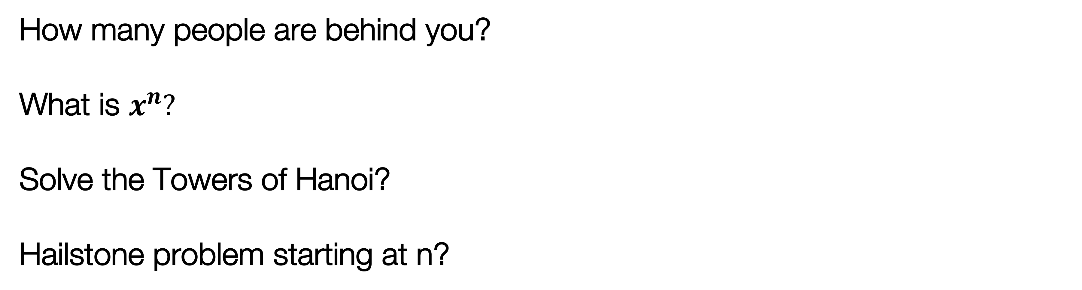
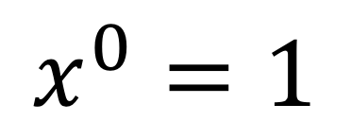
An Observation
The base case represents the simplest possible instance of the problem you are solving.
How many people are behind you?
What is $x^{n}?$
Solve the Towers of Hanoi?
Hailstone problem starting at n?
There is no one behind me ☺
$$x^{0}=1$$
Towers of Hanoi with 1 ring
n = 1

Slide 5
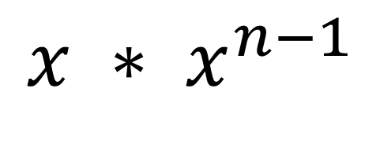
An Observation
The recursive case represents how you can break down the problem into smaller instances of the same problem.
How many people are behind you?
What is $x^{n}?$
Solve the Towers of Hanoi?
Hailstone problem starting at n?
1 + # behind the person behind me
$$x ∗ x^{n−1}$$
N-1 disks to aux, 1 disk to target, N-1 disks to target
Even? Hailstone (n/2). Odd? Hailstone(3n+1)

Slide 6
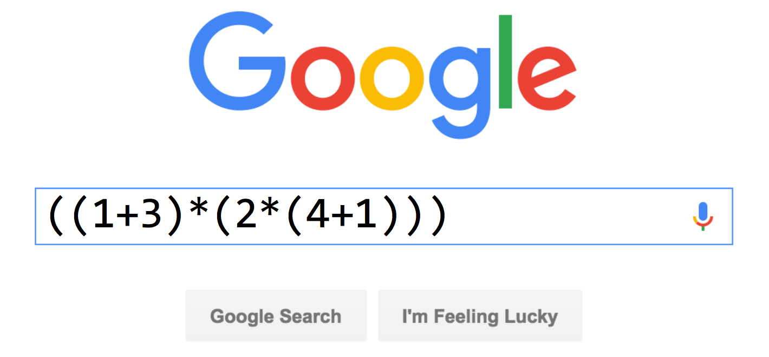
Recursion Example

Slide 7
Recursion Example
((1*17)+(2*(3+(4*9))))
95

Slide 8
Challenge
Implement a function which evaluates an expression string:
"((1+3)*(2*(4+1)))"
"(7+6)"
"(((4*(1+2))+6)*7)"
(only needs to implement * or +)
Notes:
What is the simplest possible instance of this problem?
How can this problem be solved with smaller instances of the same problem?

Slide 9
Anatomy of an Expression
An expression is always one of these three things
number
expression (expression + expression)
(expression * expression)

Slide 10
Anatomy of an Expression
((1*3)+(4*2))
left expression
right expression
joining operator

Slide 11
Anatomy of an Expression
How do we evaluate ((1*17)+(2*(3+(4*9))))?
95
((1 * 17) + (2 * (3 + (4 * 9))))
17
78
(1 * 17)
(2 * (3 + (4 * 9)))
39
1
17
2
(3 + (4 * 9))
36
3
(4 * 9)
4
9

Slide 12
Is it Recursive? Yes!
((1*3)+(4+2))
The big instance of this problem is:
((1*3)+(4+2))
The smaller instances are:
3
and
2

Slide 13
Task
Write this function:
int evaluate(string exp);
"((1*3)+(4+2))" // returns 9
Using these library functions:
stringIsInteger(exp)
stringToInteger(exp)
//returns ‘+’
char op = getOperator(exp);
//returns “(1*3)”
string left = getLeftExp(exp);
//returns “(4+2)”
string right = getRightExp(exp);
And these exp helper functions:

Slide 14
Solution (Pseudocode)
"((1*3)+(4+2))"
int evaluate(expression):
if expression is a number, return expression
Otherwise, break up expression by its operator:
  leftResult = evaluate(leftExpression)
  rightResult = evaluate(rightExpression)
  return leftResult operator rightResult

Slide 15
Solution
int evaluate(string exp) {
if (stringIsInteger(exp)) {
return stringToInteger(exp);
} else {
char op = getOperator(exp);
string left = getLeftExp(exp);
string right = getRightExp(exp);
int leftResult = evaluate(left);
int rightResult = evaluate(right);
if (op == '+') {
return leftResult + rightResult;
} else {
return leftResult * rightResult;
}
}
}
exp = "((1*3)+((4*5)+2))"
op = '+'
left = "(1*3)"
right = "((4*5)+2)"
leftResult = 3
rightResult = 22

Slide 16
Helper Methods
Here is the key function behind the helper methods:
int getOppIndex(string exp){
int parens = 0;
// ignore first left paren
for (int i = 1; i < exp.length(); i++) {
char c = exp[i];
if (c == '(') {
parens++;
} else if (c == ')') {
parens--;
}
if (parens == 0 && (c == '+' || c == '*')) {
return i;
}
}
return -1;
}

Slide 17
Today
Recursion you can see

Slide 18
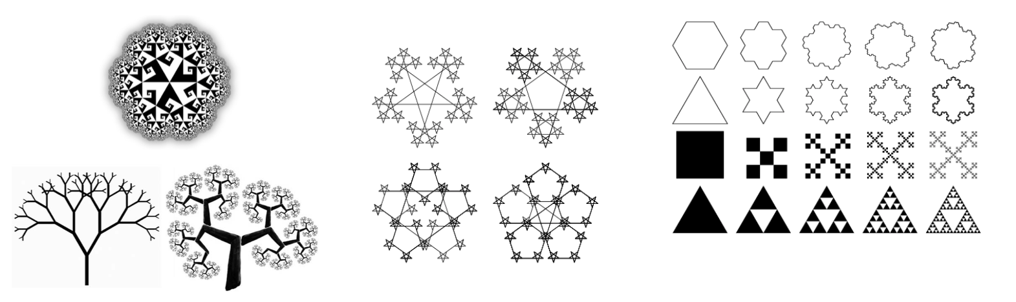
Fractal
fractal: A recurring graphical pattern. Smaller instances of the same shape or pattern occur within the pattern itself.

Slide 19
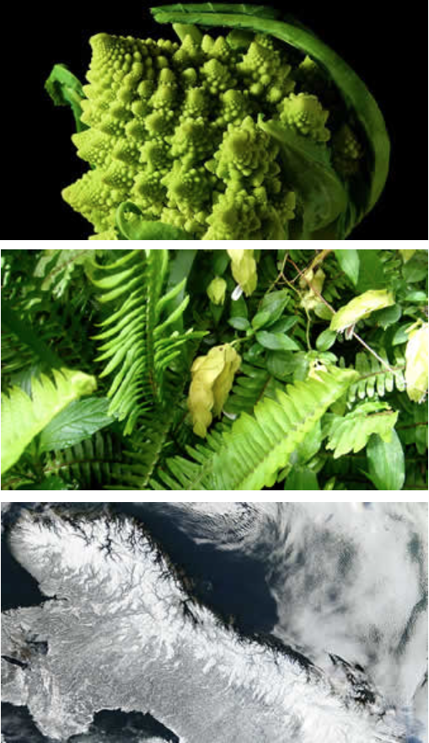

Fractal
Many natural phenomena generate fractal patterns:
earthquake fault lines
animal color patterns
clouds
mountain ranges
snowflakes
crystals
DNA
...

Slide 20
The Cantor Fractal

Slide 21
Cantor Fractal
Parts of a cantor set image ... are Cantor set images

Slide 22
Cantor Fractal
Start
End
Another cantor set
Also a cantor set

Slide 23
Levels of Cantor
6 levels

Slide 24
Levels of Cantor
5 levels

Slide 25
Levels of Cantor
1 level

Slide 26
How to Draw a Level 1 Cantor

Slide 27
How to Draw a Level n Cantor
1
Draw a line from start to finish.
2
Draw a Cantor of size n-1
2
Draw a Cantor of size n-1

Slide 28
Graphics in C++ with the Stanford Libs: GPoint
x=0
y=0
GWindow w;
GPoint a(100, 100);
cout << a.getX() << endl;
GPoint a

Slide 29
Graphics in C++ with the Stanford Libs: GPoint
x=0
y=0
GPoint b
GWindow w;
GPoint a(100, 100);
GPoint b(20, 20);
w.drawLine(a, b);
GPoint a

Slide 30
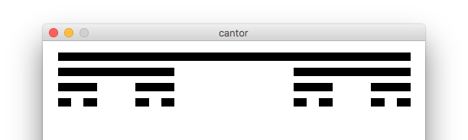

Cantor Fractal

Slide 31
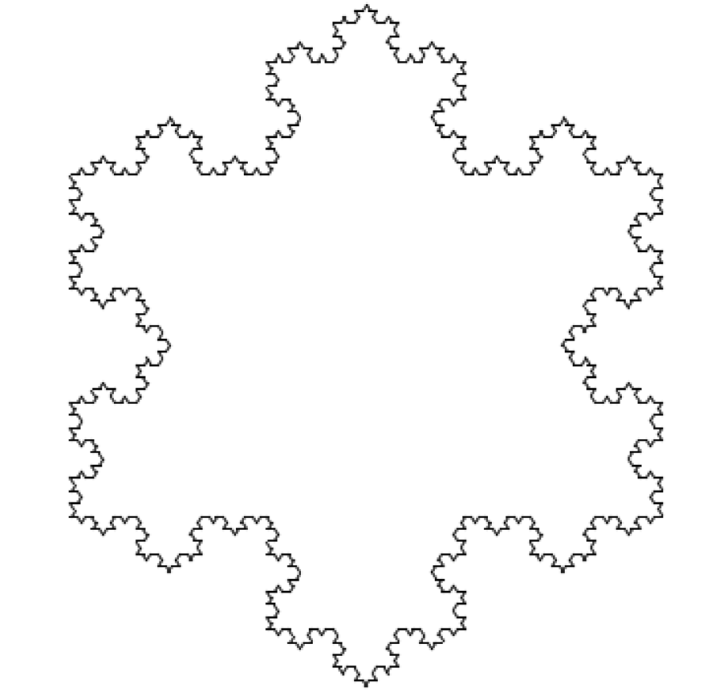
Snoflake Fractal

Slide 32
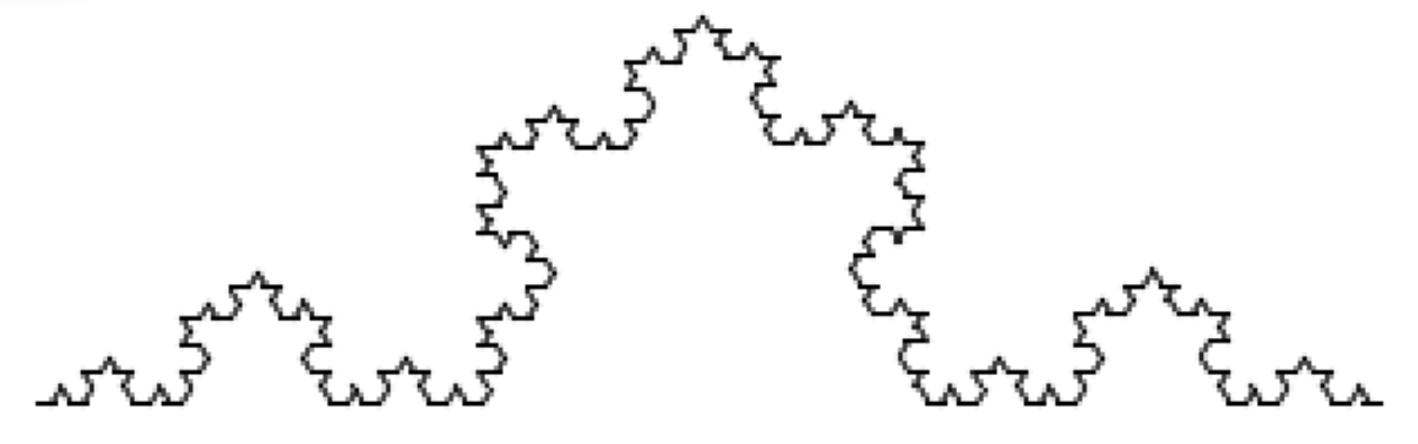
Snowflake Fractal

Slide 33
Depth 1 Snowflake Line

Slide 34
Depth 2 Snowflake Line

Slide 35
Depth 3 Snowflake Line (in progress)

Slide 36
Depth 3 Snowflake Line (in progress)

Slide 37
Depth 3 Snowflake Line (in progress)

Slide 38
Depth 3 Snowflake Line (in progress)

Slide 39
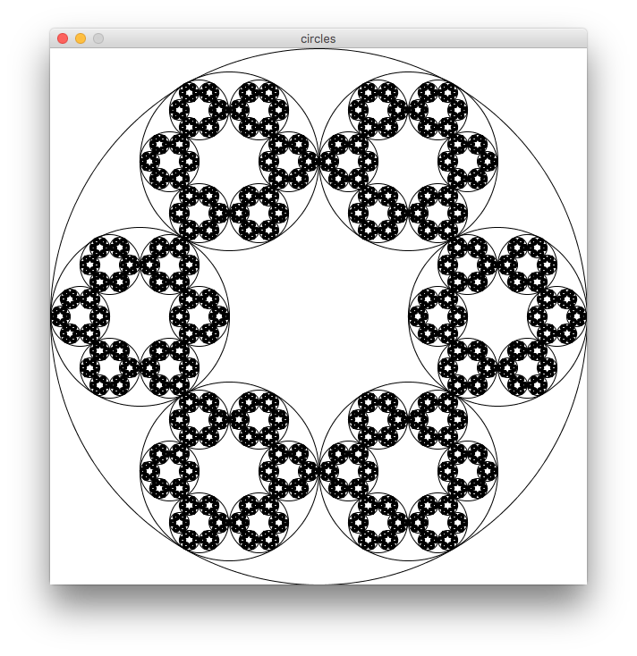
Another Example On the Website

Slide 40
Recap
Fractals
  Fractals are self-referential, and that makes for nice recursion problems!
  Break the problem into a smaller, self-similar part, and don't forget your base case!

Slide 41
References and Advanced Reading
References:
  http://www.cs.utah.edu/~germain/PPS/Topics/recursion.html
  Why is iteration generally better than recursion? http://stackoverflow.com/a/3093/561677
Advanced Reading:
  Tail recursion: http://stackoverflow.com/questions/33923/what-is-tail-recursion
  Interesting story on the history of recursion in programming languages: http://goo.gl/P6Einb

