Slide 1
Friday, May 18, 2018
CS 106B
Lecture 21: Graphs
6
5
4
1
Programming Abstractions
Spring 2018
Stanford University
Computer Science Department
Lecturer: Chris Gregg
reading:
Programming Abstractions in C++, Chapter 18
2
3

Slide 2
Today's Topics
Logistics
  YEAH hours video: posted.
  You must use your remaining late credits before the last assignment.
  Today's handout: http://web.stanford.edu/class/cs106b//lectures/22-Graphs/handout.pdf
Introduction to Graphs
  The wild west of the node world
  First Graph
  Who is your lover?

Slide 3

Intro to Graphs: Who do You Love?
And how does Facebook know?

Slide 4


Tree Definition
Only One Parent
No Cycles

Slide 6
Graph Definition
A graph is a mathematical structure
for representing relationships using nodes and edges.
*Just like a tree without the rules

Slide 7

We can have a family tree?

Slide 8
Family Tree
Tywin
Jamie
Tyrion
Cersi

Slide 9
Not a Tree
Tywin
Jamie
Tyrion
Cersi
Joffrey

Slide 10
Not a Tree
Tywin
Jamie
Tyrion
Cersi
Joffrey

Slide 11
graph
We can have a family tree?

Slide 12
Graphs Don’t Have Roots
Catelyn
Tywin
Tyrion
Jamie
Cersi
The High Sparrow
Joffrey

Slide 13
Simple Graph
struct Node{
  string value;
  Vector<Edge *> edges;
};
struct Edge{
  Node * start;
  Node * end;
};
struct Graph{
  Set<Node *> nodes;
  Set<Edge *> edges;
};

Slide 14
Simple Graph
struct Node{
  string value;
  Vector<Edge *> edges;
};
struct Edge{
  Node * start;
  Node * end;
};
We allow for more interesting edges
struct Graph{
  Set<Node *> nodes;
  Set<Edge *> edges;
};

Slide 15
Simple Graph
struct Node{
  string value;
  Vector<Edge *> edges;
};
struct Edge{
  Node * start;
  Node * end;
  double weight;
};
struct Graph{
  Set<Node *> nodes;
  Set<Edge *> edges;
};
We allow for more interesting edges

Slide 16
Simple Graph
A graph consists of a set of nodes connected by edges.

Slide 17
Simple Graph
A graph consists of a set of nodes connected by edges.

Slide 18
Graph Nodes
A graph consists of a set of nodes connected by edges.
Nodes

Slide 19
Nodes are Also Called Vertices
A graph consists of a set of nodes connected by edges.
Vertices

Slide 20
Graph Edges
A graph consists of a set of nodes connected by edges.
Edges

Slide 21

Directed Graph

Slide 22
Undirected Graph
CAN
MAN
RAN
MAT
CAT
SAT
RAT

Slide 23
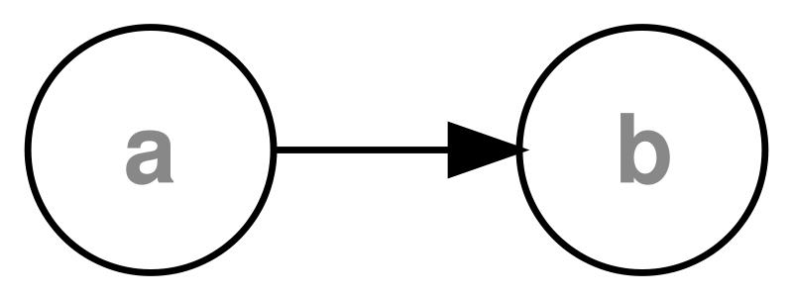
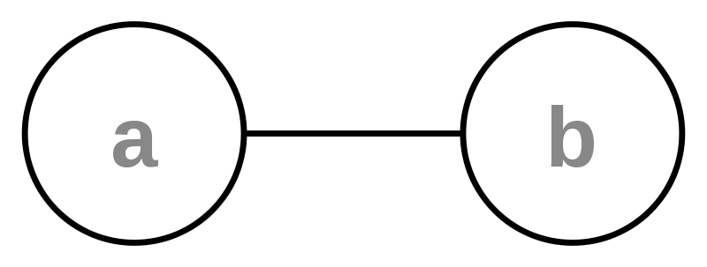
Directed vs Undirected

Slide 24
Weighted graphs
weight: Cost associated with a given edge.
example: graph of airline flights, weighted by miles between cities:
849
PVD
1843
ORD
SFO
142
802
LGA
1743
337
1387
HNL
2555
1099
LAX
1233
DFW
1120
MIA

Slide 25
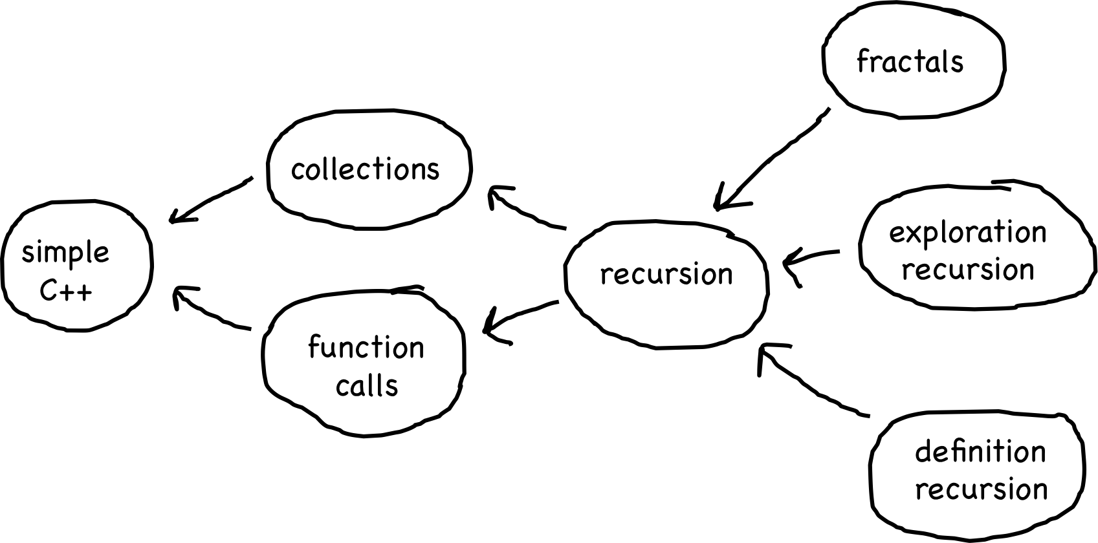
Prerequisite Graph

Slide 26
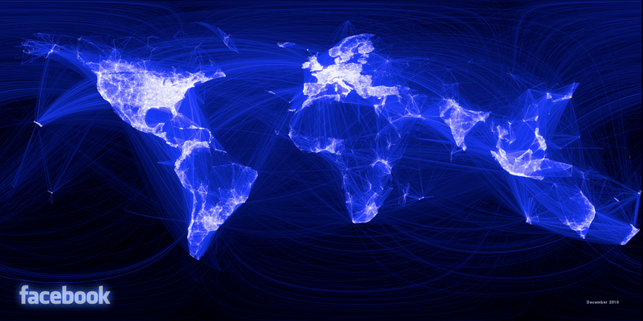
Social Network

Slide 27
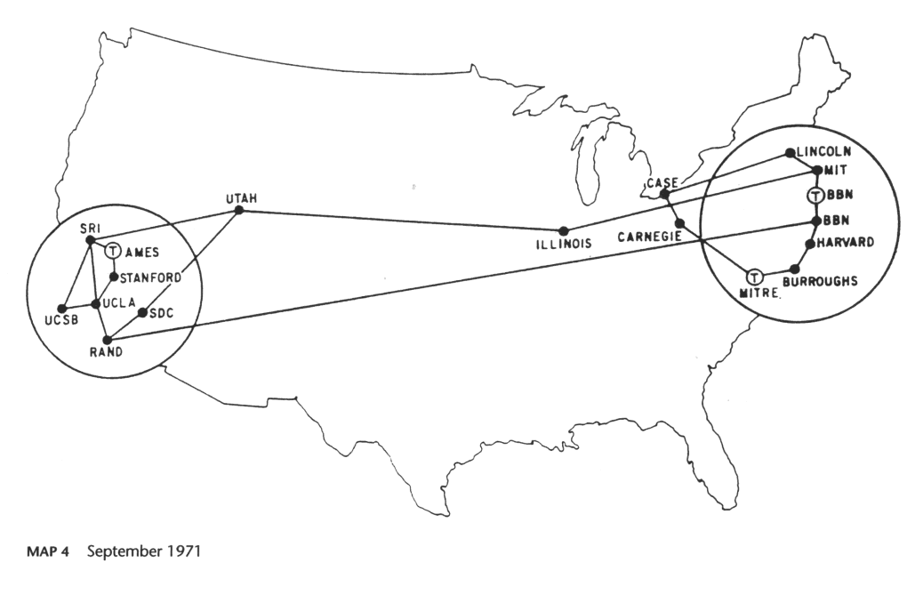
The Internet

Slide 28
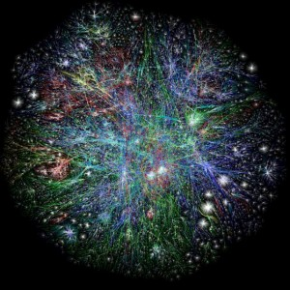
The Internet
10 to 20 billion

Slide 29
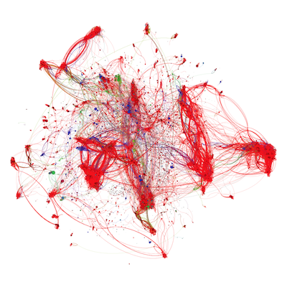
CS Assignments
50,000 unique implementations of logistic regression in CS229

Slide 30
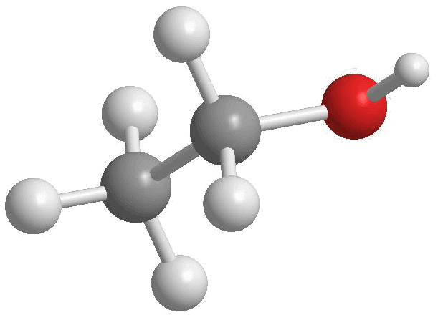
Chemical Bonds
http://4.bp.blogspot.com/-xCtBJ8lKHqA/Tjm0BONWBRI/AAAAAAAAAK4/-mHrbAUOHHg/s1600/Ethanol2.gif

Slide 31
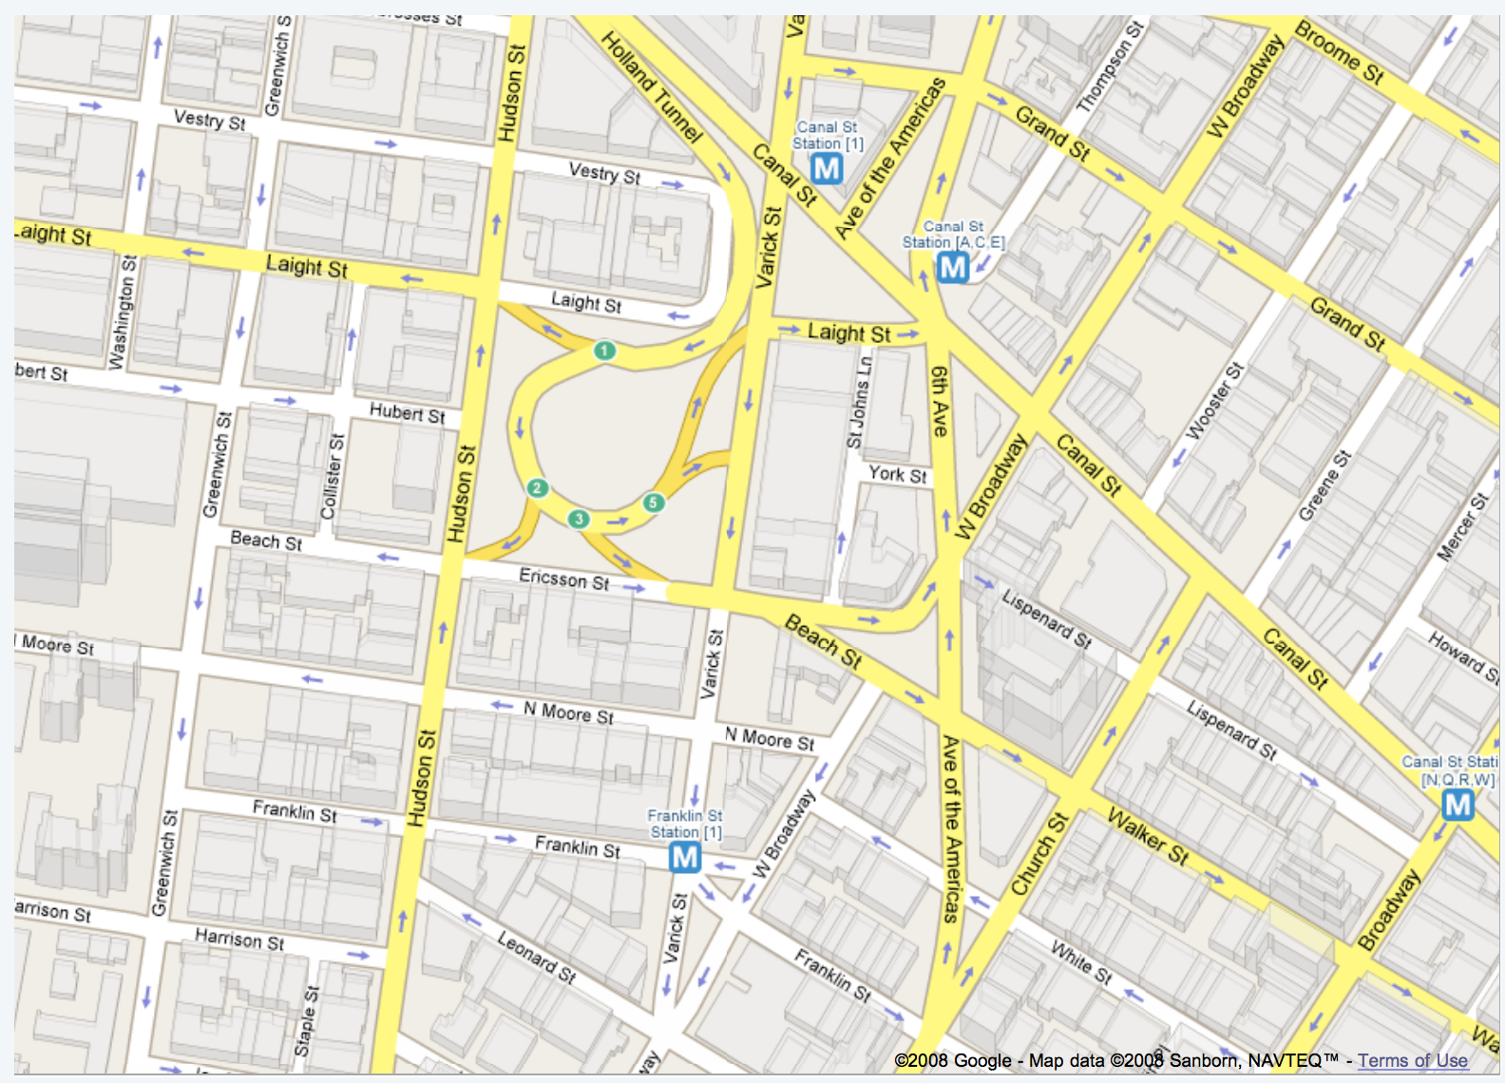
Road Map

Slide 32
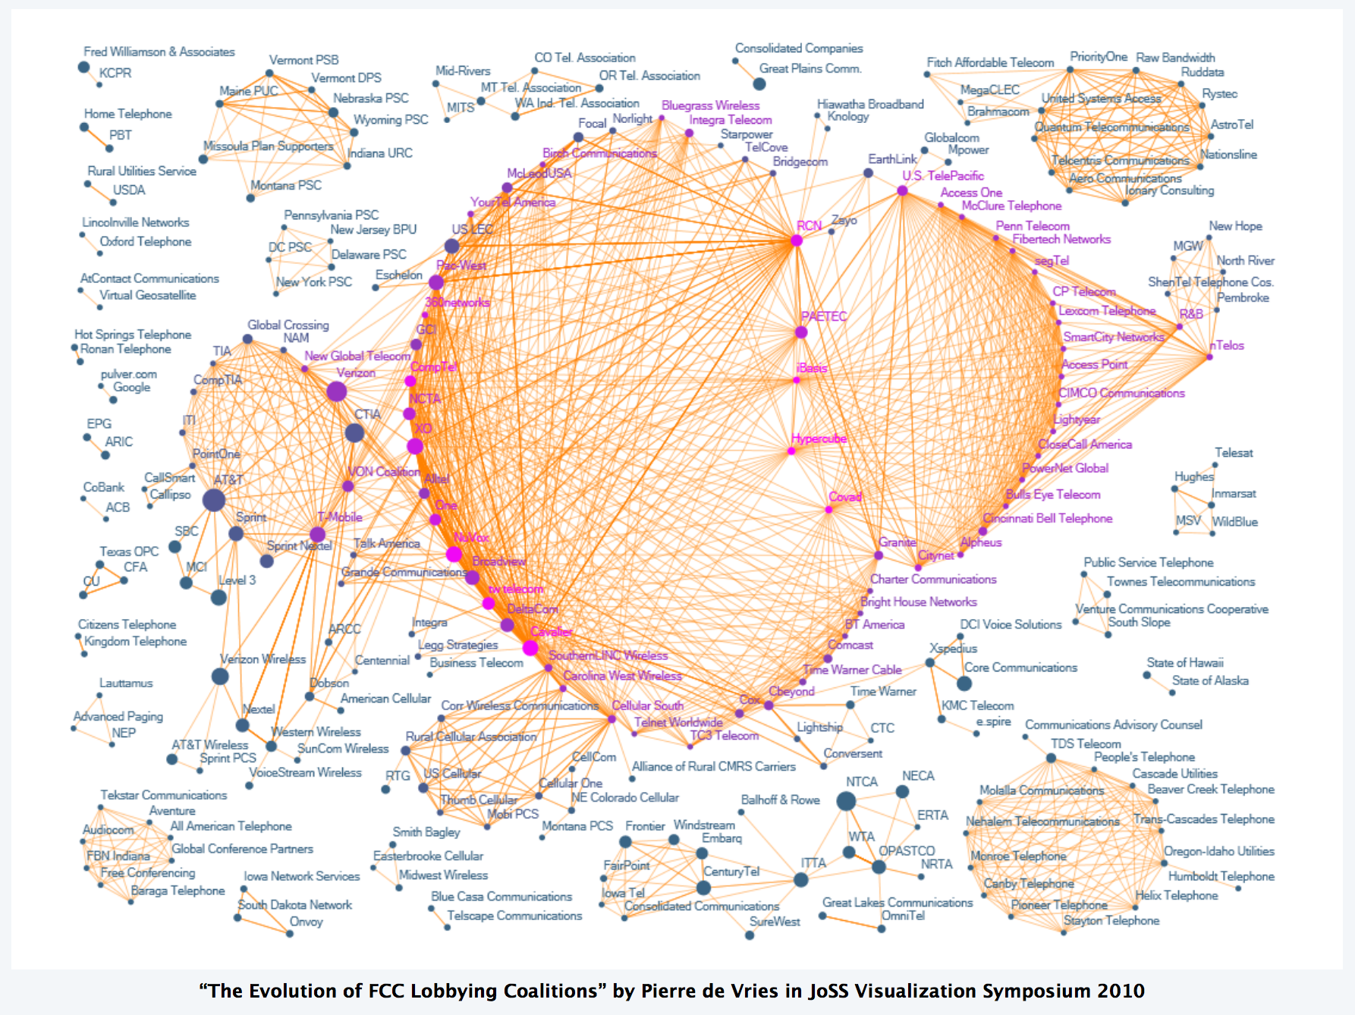
Corruption

Slide 33
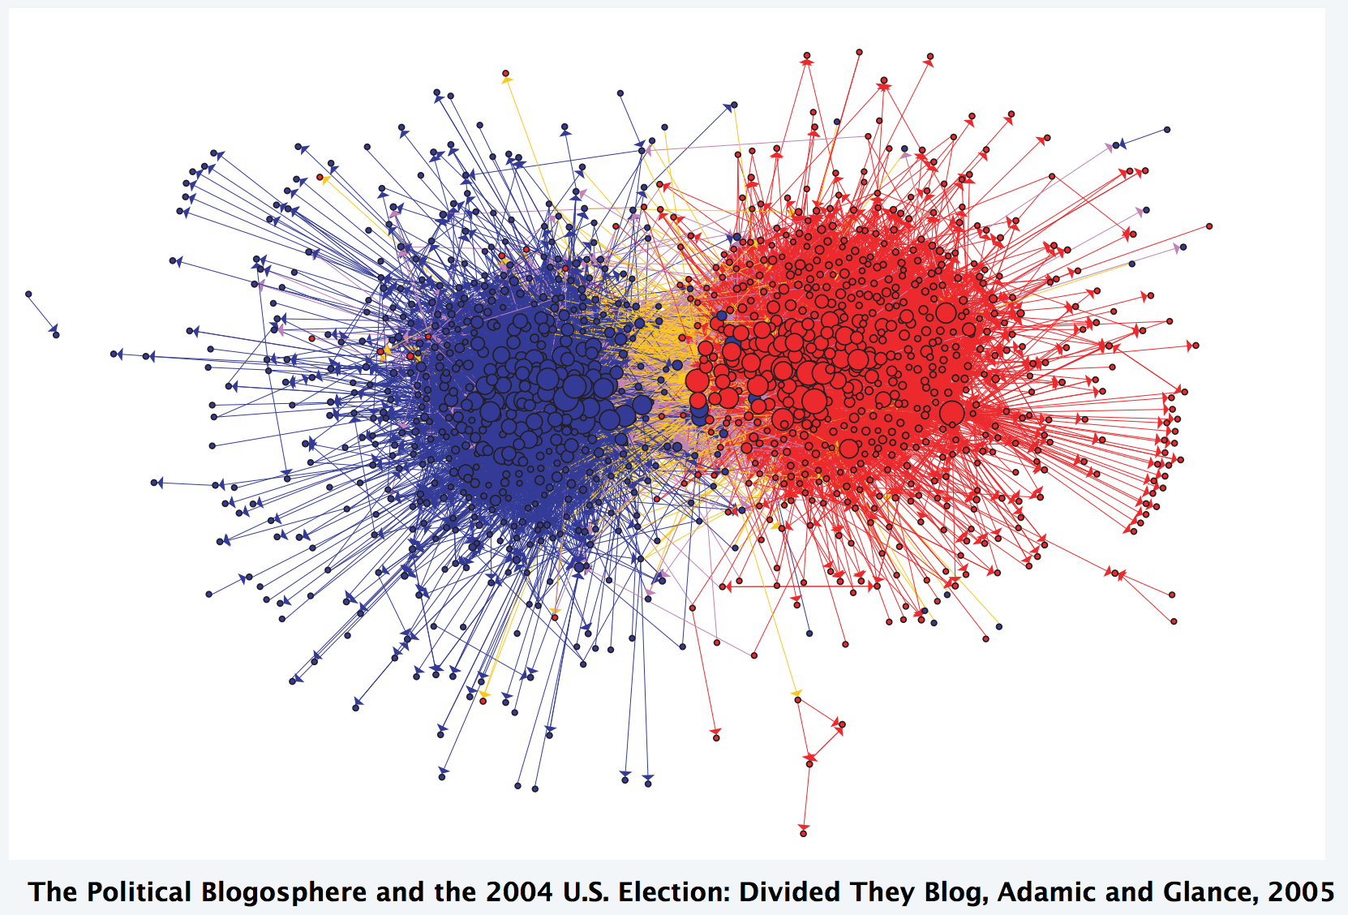
Partisanship

Slide 34
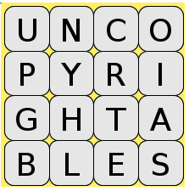
Boggle

Slide 35
Boggle

Slide 36
Boggle

Slide 37
Some terms:

Slide 38
Paths
path: A path from vertex a to b is a sequence of edges that can be followed starting from a to reach b.
  can be represented as vertices visited, or edges taken
  example, one path from V to Z: {b, h} or {V, X, Z}
  What are two paths from U to Y?
path length: Number of vertices
or edges contained in the path.
neighbor or adjacent: Two vertices
connected directly by an edge.
  example: V and X
V
a
b
U
d
X
Z
h
c
e
W
g
f
Y

Slide 39
Loops and cycles
cycle: A path that begins and ends at the same node.
  example: {b, g, f, c, a} or {V, X, Y, W, U, V}.
  example: {c, d, a} or {U, W, V, U}.
  acyclic graph: One that does
  not contain any cycles.
loop: An edge directly from
a node to itself.
  Many graphs don't allow loops.
V
a
b
U
d
X
Z
h
c
e
X
f
(loop)
W
g
e
f
W
Y

Slide 40
Reachability, connectedness
reachable: Vertex b is reachable from vertex a
if a path exists from a to b.
connected: A graph is connected if every
vertex is reachable from every other.
complete: If every vertex has a direct
edge to every other.
V
a
b
U
d
X
Z
h
c
e
W
g
f
Y
a
b
a
b
d
c
c
d
e

Slide 41
Stanford BasicGraph
The Stanford C++ library includes a BasicGraph class.
  Based on an older library class named Graph
You can construct a graph and add vertices/edges:
  #include "basicgraph.h"
  ...
  BasicGraph graph;
  graph.addVertex("a");
  graph.addVertex("b");
  graph.addVertex("c");
  graph.addVertex("d");
  graph.addEdge("a", "c");
  graph.addEdge("b", "c");
  graph.addEdge("c", "b");
  graph.addEdge("b", "d");
  graph.addEdge("c", "d");
a
b
c
d

Slide 42
BasicGraph members
#include "basicgraph.h" // a directed, weighted graph
g.addEdge(v1, v2); | adds an edge between two vertexes
g.addVertex(name); | adds a vertex to the graph
g.clear(); | removes all vertexes/edges from the graph
g.getEdgeSet() g.getEdgeSet(v) | returns all edges, or all edges that start at v, as a Set of pointers
g.getNeighbors(v) | returns a set of all vertices that v has an edge to
g.getVertex(name) | returns pointer to vertex with the given name
g.getVertexSet() | returns a set of all vertexes
g.isNeighbor(v1, v2) | returns true if there is an edge from vertex v1 to v2
g.isEmpty() | returns true if queue contains no vertexes/edges
g.removeEdge(v1, v2); | removes an edge from the graph
g.removeVertex(name); | removes a vertex from the graph
g.size() | returns the number of vertexes in the graph
g.toString() | returns a string such as "{a, b, c, a -> b}"

Slide 43
BasicGraph members
#include "basicgraph.h" // a directed, weighted graph
g.addEdge(v1, v2); | adds an edge between two vertexes
g.addVertex(name); | adds a vertex to the graph
g.clear(); | removes all vertexes/edges from the graph
g.getEdgeSet() g.getEdgeSet(v) | returns all edges, or all edges that start at v, as a Set of pointers
g.getNeighbors(v) | returns a set of all vertices that v has an edge to
g.getVertex(name) | returns pointer to vertex with the given name
g.getVertexSet() | returns a set of all vertexes
g.isNeighbor(v1, v2) | returns true if there is an edge from vertex v1 to v2
g.isEmpty() | returns true if queue contains no vertexes/edges
g.removeEdge(v1, v2); | removes an edge from the graph
g.removeVertex(name); | removes a vertex from the graph
g.size() | returns the number of vertexes in the graph
g.toString() | returns a string such as "{a, b, c, a -> b}"

Slide 44
Using BasicGraph
The graph stores a struct of information about each vertex/edge:
  struct Vertex { struct Edge {
  string name; Vertex* start;
  Set<Edge*> edges; Vertex* finish;
  double cost; double weight;
  // other stuff // other stuff
  }; };
You can use these to help implement graph algorithms:
  Vertex * vertC = graph.getVertex("c");
  Edge * edgeAC = graph.getEdge("a", "c");
a
b
3
c
d

Slide 45

Our First Graph
A
C
B

Slide 46
There are other representations…

Slide 47
… this is the one we are going to use.

Slide 48
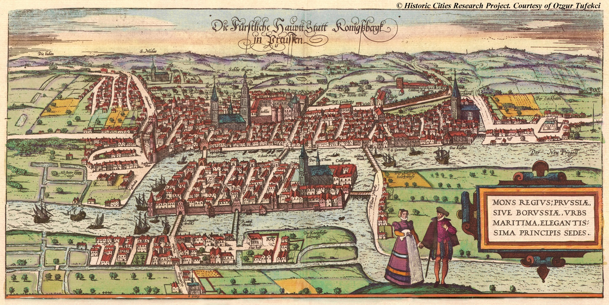
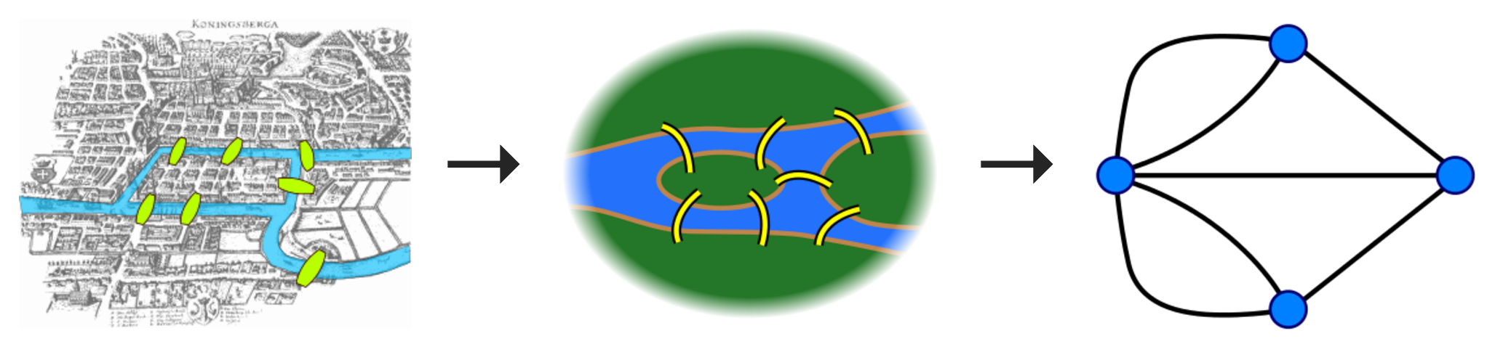
Algorithms

Slide 49
Who Do You Love
And how does Facebook know?

Slide 50
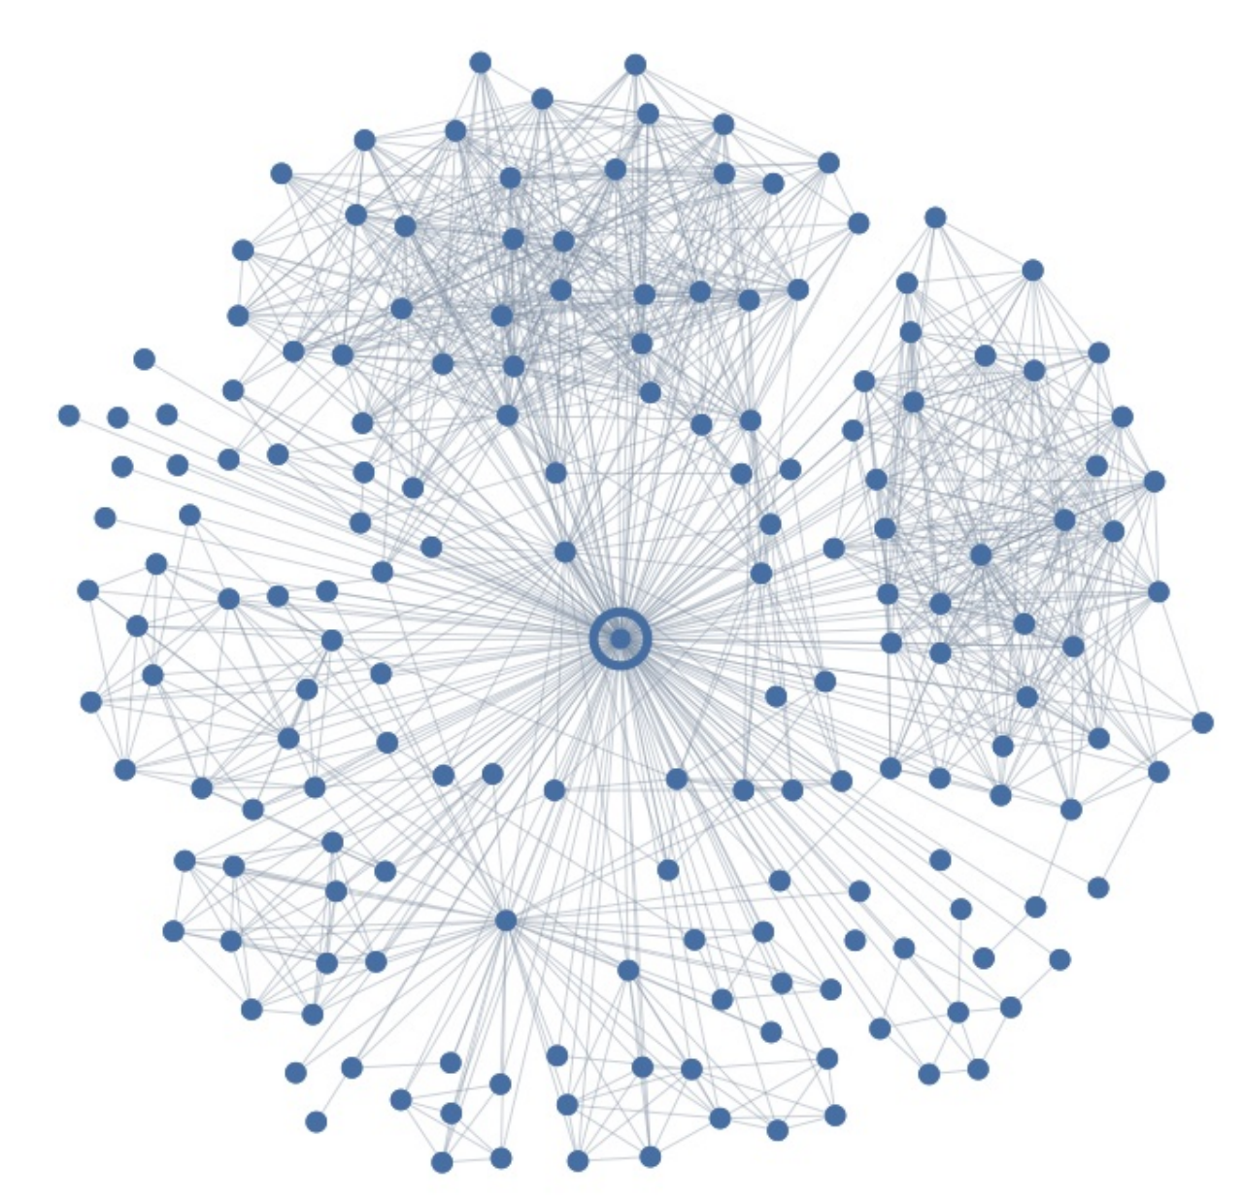
Ego Graph

Slide 51
Maybe I Love These People?

Slide 52
But I Actually Love This Person
Your significant other
376

Slide 53
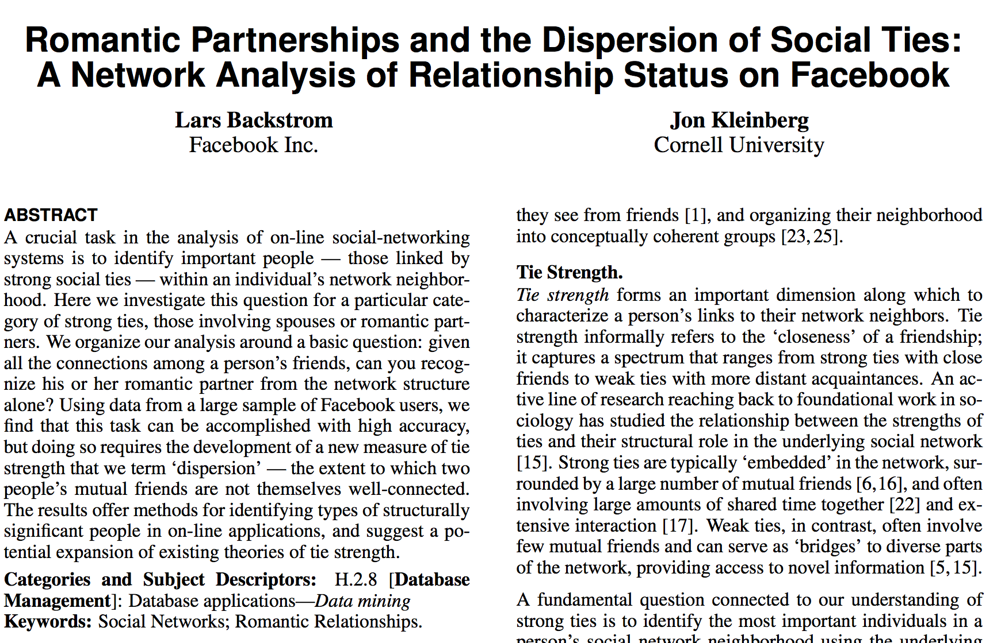
Romance and Dispersion
October 2013
http://arxiv.org/pdf/1310.6753v1.pdf

Slide 54
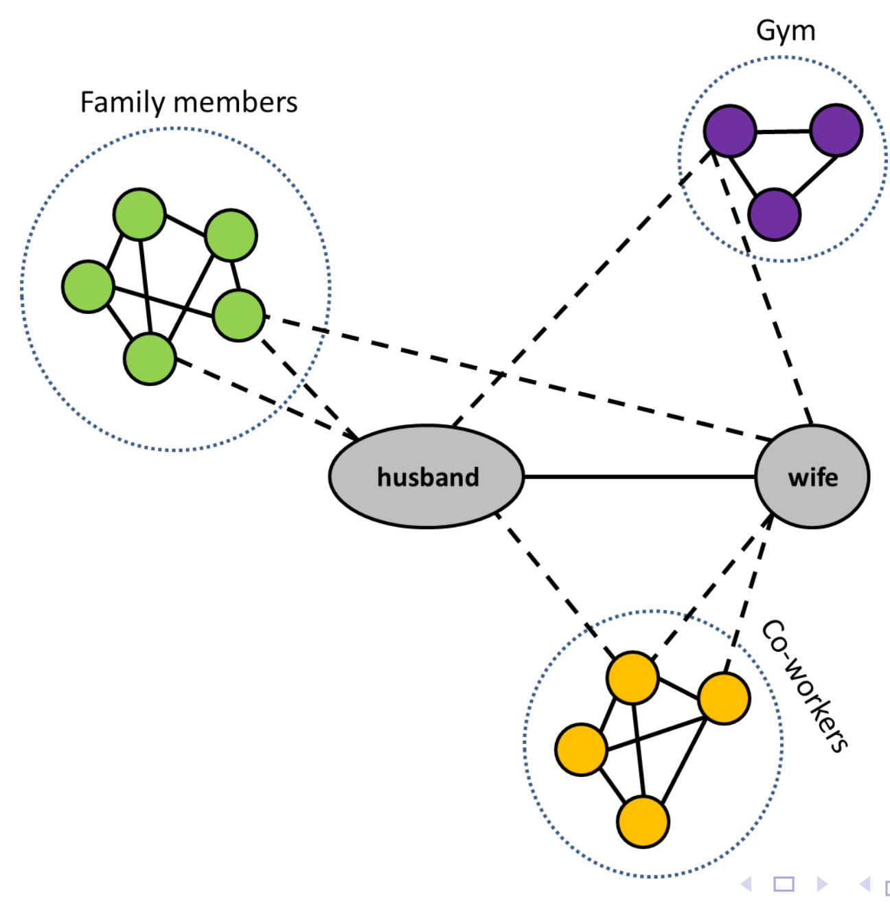
Dispersion Insight
Dispersion: The extent to which two people’s
mutual friends are not directly connected

Slide 55
Dispersion
Mutual
Friends
You
Testee
Dispersion: The extent to which two people’s
mutual friends are not directly connected

Slide 56
Dispersion
Mutual
Friends
You
Testee
Dispersion: The extent to which two people’s
mutual friends are not directly connected

Slide 57
Dispersion
Mutual
Friends
Dispersion: 0
You
Testee
Dispersion: The extent to which two people’s
mutual friends are not directly connected

Slide 58
Dispersion
Mutual
Friends
Dispersion: 1
You
Testee
Dispersion: The extent to which two people’s
mutual friends are not directly connected

Slide 59
Dispersion
Mutual
Friends
Dispersion: 2
You
Testee
Dispersion: The extent to which two people’s
mutual friends are not directly connected

Slide 60
Dispersion
Mutual
Friends
Dispersion: 3
You
Testee
Dispersion: The extent to which two people’s
mutual friends are not directly connected

Slide 61
Dispersion
Mutual
Friends
Dispersion: 4
You
Testee
Dispersion: The extent to which two people’s
mutual friends are not directly connected

Slide 62
Dispersion
Mutual
Friends
Dispersion: 5
You
Testee
Dispersion: The extent to which two people’s
mutual friends are not directly connected

Slide 63
Dispersion
Mutual
Friends
Dispersion: 5
You
Testee
Dispersion: The extent to which two people’s
mutual friends are not directly connected

Slide 64
Dispersion
Mutual
Friends
Dispersion: 5
You
Testee
The higher the dispersion between two people, the more likely they are lovers!
Dispersion: The extent to which two people’s
mutual friends are not directly connected

Slide 65
Who Do You Love?
Your significant other
376

Slide 66
References and Advanced Reading
References:
Wikipedia on graphs: https://en.wikipedia.org/wiki/Graph_(discrete_mathematics)
Wolfram Graph theory: http://mathworld.wolfram.com/Graph.html
Advanced Reading:
Facebook graph API: https://developers.facebook.com/docs/graph-api
Different graph lecture: https://www.youtube.com/watch?v=ylWAB6CMYiY

Slide 67
Extra Slides
Extra Slides

