Slide 1
Wednesday, May 30, 2018
CS 106B
Lecture 25: Graphs II
Programming Abstractions
Spring 2018
Stanford University
Computer Science Department
Lecturer: Chris Gregg
reading:
Programming Abstractions in C++, Chapter 18

Slide 2
Today's Topics
Logistics:
  Final review session will be early next week.
  If you need accommodations for the final exam, let Chris and Nick know now.
  The Final will be using BlueBook — you'll need 3 hours of battery life, or find an outlet (we will try to provide enough outlets for those who need it)
Real Graphs:
  Internet routers and traceroute
Topological Sort
Minimum Spanning Trees
  Kruskal's algorithm

Slide 3
Real Graphs!
I received some feedback from last quarter that said,
        ❝I would give more examples of how graphs are used, or, in general, give a wider variety of examples of applications to the methods being used. I think it would be interesting to give examples of how certain topics can be used in cross-sections of CS and other majors/departments.❞
Let's dig a bit deeper into how the Internet is a real graph by analyzing internet routers, or:
How does a message get sent from your computer to another computer on the Internet, say in Australia?

Slide 4
The Internet: Computers connected through routers
your computer
computer in Australia

Slide 5
The Internet: Computers connected through routers
your computer
computer in Australia

Slide 6
The Internet: Let's simplify a bit
The destination computer has a name and an IP address, like this:
www.engineering.unsw.edu.au
IP address: 149.171.158.109
your computer
E
A
The first number denotes the "network address" and routers continually pass around information about how many "hops" they think it will take for them to get to all the networks. E.g., for router C:
B
D
F
C
computer in Australia
router | hops
A | 2
B | 1
C | -
D | 1
E | 2
F | 2

Slide 7
The Internet: Let's simplify a bit
Each router knows its neighbors, and it has a copy of its neighbors' tables. So, B would have the following tables:
your computer
E
A
B
router | hops
A | -
B | 1
C | 3
D | 2
E | 3
F | 3
D
A
F
C
router | hops
A | 2
B | 1
C | -
D | 1
E | 2
F | 2
router | hops
A | 2
B | 1
C | 1
D | -
E | 1
F | 1
C
D

Slide 8
The Internet: Let's simplify a bit
your computer
If B wants to connect to F, it connects through its neighbor that reports the shortest path to F. Which router would it choose?
E
A
B
router | hops
A | -
B | 1
C | 3
D | 2
E | 3
F | 3
D
A
F
C
router | hops
A | 2
B | 1
C | -
D | 1
E | 2
F | 2
router | hops
A | 2
B | 1
C | 1
D | -
E | 1
F | 1
C
D

Slide 9
The Internet: Let's simplify a bit
your computer
If B wants to connect to F, it connects through its neighbor that reports the shortest path to F. Which router would it choose? D.
E
A
B
router | hops
A | -
B | 1
C | 3
D | 2
E | 3
F | 3
D
A
F
C
router | hops
A | 2
B | 1
C | -
D | 1
E | 2
F | 2
router | hops
A | 2
B | 1
C | 1
D | -
E | 1
F | 1
C
D

Slide 10

Traceroute
We can use a program called "traceroute" to tell us the path between our computer and a different computer:
traceroute -I -e www.engineering.unsw.edu.au

Slide 11
Traceroute: Stanford Hops
traceroute -I -e www.engineering.unsw.edu.au
traceroute to www.engineering.unsw.edu.au (149.171.158.109), 64 hops max, 72 byte packets
1 csmx-west-rtr.sunet (171.67.64.2) 5.965 ms 11.205 ms 14.180 ms
2 gnat-1.sunet (172.24.70.11) 0.328 ms 0.312 ms 0.289 ms
3 csmx-west-rtr.sunet (171.64.66.2) 15.702 ms 33.031 ms 10.003 ms
4 dc-svl-rtr-vl8.sunet (171.64.255.204) 0.595 ms 0.552 ms 0.547 ms
5 dc-svl-agg4--stanford-100ge.cenic.net (137.164.23.144) 1.618 ms 1.154 ms 1.672 ms
6 hpr-svl-hpr2--svl-agg4-10ge.cenic.net (137.164.26.249) 1.056 ms 1.016 ms 0.929 ms
7 aarnet-2-is-jmb-778.sttlwa.pacificwave.net (207.231.245.4) 17.803 ms 17.714 ms 17.978 ms
8 et-2-0-0.pe1.a.hnl.aarnet.net.au (113.197.15.200) 69.984 ms 69.888 ms 70.004 ms
9 et-2-1-0.pe1.sxt.bkvl.nsw.aarnet.net.au (113.197.15.98) 162.935 ms 163.033 ms 162.977 ms
10 et-3-3-0.pe1.brwy.nsw.aarnet.net.au (113.197.15.148) 163.819 ms 163.083 ms 163.111 ms
11 138.44.5.1 (138.44.5.1) 163.124 ms 163.236 ms 163.254 ms
12 libcr1-te-1-5.gw.unsw.edu.au (149.171.255.102) 163.448 ms 163.355 ms 163.307 ms
13 libdcdnex1-po-1.gw.unsw.edu.au (149.171.255.174) 163.544 ms 163.250 ms 163.344 ms
14 srdh4it2r26blfx1-ext.gw.unsw.edu.au (129.94.0.31) 164.605 ms 164.288 ms 164.461 ms
15 bfw1-ae-1-3053.gw.unsw.edu.au (129.94.254.76) 164.065 ms 164.066 ms 164.267 ms
16 engplws008.eng.unsw.edu.au (149.171.158.109) 164.326 ms 164.538 ms 164.462 ms

Slide 12
Traceroute: CENIC
traceroute -I -e www.engineering.unsw.edu.au
traceroute to www.engineering.unsw.edu.au (149.171.158.109), 64 hops max, 72 byte packets
1 csmx-west-rtr.sunet (171.67.64.2) 5.965 ms 11.205 ms 14.180 ms
2 gnat-1.sunet (172.24.70.11) 0.328 ms 0.312 ms 0.289 ms
3 csmx-west-rtr.sunet (171.64.66.2) 15.702 ms 33.031 ms 10.003 ms
4 dc-svl-rtr-vl8.sunet (171.64.255.204) 0.595 ms 0.552 ms 0.547 ms
5 dc-svl-agg4--stanford-100ge.cenic.net (137.164.23.144) 1.618 ms 1.154 ms 1.672 ms
6 hpr-svl-hpr2--svl-agg4-10ge.cenic.net (137.164.26.249) 1.056 ms 1.016 ms 0.929 ms
7 aarnet-2-is-jmb-778.sttlwa.pacificwave.net (207.231.245.4) 17.803 ms 17.714 ms 17.978 ms
8 et-2-0-0.pe1.a.hnl.aarnet.net.au (113.197.15.200) 69.984 ms 69.888 ms 70.004 ms
9 et-2-1-0.pe1.sxt.bkvl.nsw.aarnet.net.au (113.197.15.98) 162.935 ms 163.033 ms 162.977 ms
10 et-3-3-0.pe1.brwy.nsw.aarnet.net.au (113.197.15.148) 163.819 ms 163.083 ms 163.111 ms
11 138.44.5.1 (138.44.5.1) 163.124 ms 163.236 ms 163.254 ms
12 libcr1-te-1-5.gw.unsw.edu.au (149.171.255.102) 163.448 ms 163.355 ms 163.307 ms
13 libdcdnex1-po-1.gw.unsw.edu.au (149.171.255.174) 163.544 ms 163.250 ms 163.344 ms
14 srdh4it2r26blfx1-ext.gw.unsw.edu.au (129.94.0.31) 164.605 ms 164.288 ms 164.461 ms
15 bfw1-ae-1-3053.gw.unsw.edu.au (129.94.254.76) 164.065 ms 164.066 ms 164.267 ms
16 engplws008.eng.unsw.edu.au (149.171.158.109) 164.326 ms 164.538 ms 164.462 ms
The Corporation for Education Network Initiatives in California (CENIC) is a nonprofit corporation formed in 1996 to provide high-performance, high-bandwidth networking services to California universities and research institutions (source: Wikipedia)

Slide 13
Traceroute: Pacificwave (Seattle)
traceroute -I -e www.engineering.unsw.edu.au
traceroute to www.engineering.unsw.edu.au (149.171.158.109), 64 hops max, 72 byte packets
1 csmx-west-rtr.sunet (171.67.64.2) 5.965 ms 11.205 ms 14.180 ms
2 gnat-1.sunet (172.24.70.11) 0.328 ms 0.312 ms 0.289 ms
3 csmx-west-rtr.sunet (171.64.66.2) 15.702 ms 33.031 ms 10.003 ms
4 dc-svl-rtr-vl8.sunet (171.64.255.204) 0.595 ms 0.552 ms 0.547 ms
5 dc-svl-agg4--stanford-100ge.cenic.net (137.164.23.144) 1.618 ms 1.154 ms 1.672 ms
6 hpr-svl-hpr2--svl-agg4-10ge.cenic.net (137.164.26.249) 1.056 ms 1.016 ms 0.929 ms
7 aarnet-2-is-jmb-778.sttlwa.pacificwave.net (207.231.245.4) 17.803 ms 17.714 ms 17.978 ms
8 et-2-0-0.pe1.a.hnl.aarnet.net.au (113.197.15.200) 69.984 ms 69.888 ms 70.004 ms
9 et-2-1-0.pe1.sxt.bkvl.nsw.aarnet.net.au (113.197.15.98) 162.935 ms 163.033 ms 162.977 ms
10 et-3-3-0.pe1.brwy.nsw.aarnet.net.au (113.197.15.148) 163.819 ms 163.083 ms 163.111 ms
11 138.44.5.1 (138.44.5.1) 163.124 ms 163.236 ms 163.254 ms
12 libcr1-te-1-5.gw.unsw.edu.au (149.171.255.102) 163.448 ms 163.355 ms 163.307 ms
13 libdcdnex1-po-1.gw.unsw.edu.au (149.171.255.174) 163.544 ms 163.250 ms 163.344 ms
14 srdh4it2r26blfx1-ext.gw.unsw.edu.au (129.94.0.31) 164.605 ms 164.288 ms 164.461 ms
15 bfw1-ae-1-3053.gw.unsw.edu.au (129.94.254.76) 164.065 ms 164.066 ms 164.267 ms
16 engplws008.eng.unsw.edu.au (149.171.158.109) 164.326 ms 164.538 ms 164.462 ms
Pass Internet traffic directly with other major national and international networks, including U.S. federal agencies and many Pacific Rim R&E networks (source: http://www.pnwgp.net/services/pacific-wave-peering-exchange/ )

Slide 14
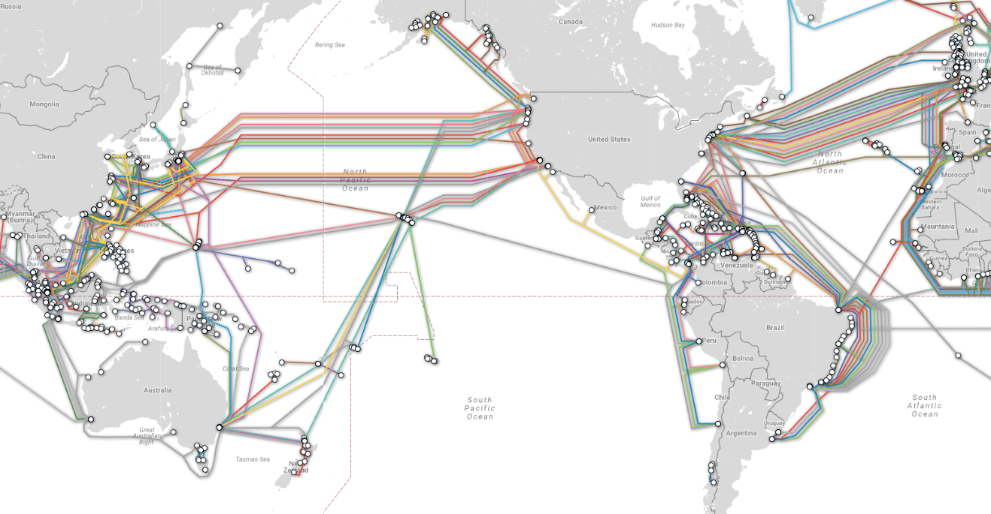
Traceroute: Oregon to Australia - underwater!
http://www.submarinecablemap.com

Slide 15
Traceroute: Australia
traceroute -I -e www.engineering.unsw.edu.au
traceroute to www.engineering.unsw.edu.au (149.171.158.109), 64 hops max, 72 byte packets
1 csmx-west-rtr.sunet (171.67.64.2) 5.965 ms 11.205 ms 14.180 ms
2 gnat-1.sunet (172.24.70.11) 0.328 ms 0.312 ms 0.289 ms
3 csmx-west-rtr.sunet (171.64.66.2) 15.702 ms 33.031 ms 10.003 ms
4 dc-svl-rtr-vl8.sunet (171.64.255.204) 0.595 ms 0.552 ms 0.547 ms
5 dc-svl-agg4--stanford-100ge.cenic.net (137.164.23.144) 1.618 ms 1.154 ms 1.672 ms
6 hpr-svl-hpr2--svl-agg4-10ge.cenic.net (137.164.26.249) 1.056 ms 1.016 ms 0.929 ms
7 aarnet-2-is-jmb-778.sttlwa.pacificwave.net (207.231.245.4) 17.803 ms 17.714 ms 17.978 ms
8 et-2-0-0.pe1.a.hnl.aarnet.net.au (113.197.15.200) 69.984 ms 69.888 ms 70.004 ms
9 et-2-1-0.pe1.sxt.bkvl.nsw.aarnet.net.au (113.197.15.98) 162.935 ms 163.033 ms 162.977 ms
10 et-3-3-0.pe1.brwy.nsw.aarnet.net.au (113.197.15.148) 163.819 ms 163.083 ms 163.111 ms
11 138.44.5.1 (138.44.5.1) 163.124 ms 163.236 ms 163.254 ms
12 libcr1-te-1-5.gw.unsw.edu.au (149.171.255.102) 163.448 ms 163.355 ms 163.307 ms
13 libdcdnex1-po-1.gw.unsw.edu.au (149.171.255.174) 163.544 ms 163.250 ms 163.344 ms
14 srdh4it2r26blfx1-ext.gw.unsw.edu.au (129.94.0.31) 164.605 ms 164.288 ms 164.461 ms
15 bfw1-ae-1-3053.gw.unsw.edu.au (129.94.254.76) 164.065 ms 164.066 ms 164.267 ms
16 engplws008.eng.unsw.edu.au (149.171.158.109) 164.326 ms 164.538 ms 164.462 ms

Slide 16
Traceroute: University of New South Wales
traceroute -I -e www.engineering.unsw.edu.au
traceroute to www.engineering.unsw.edu.au (149.171.158.109), 64 hops max, 72 byte packets
1 csmx-west-rtr.sunet (171.67.64.2) 5.965 ms 11.205 ms 14.180 ms
2 gnat-1.sunet (172.24.70.11) 0.328 ms 0.312 ms 0.289 ms
3 csmx-west-rtr.sunet (171.64.66.2) 15.702 ms 33.031 ms 10.003 ms
4 dc-svl-rtr-vl8.sunet (171.64.255.204) 0.595 ms 0.552 ms 0.547 ms
5 dc-svl-agg4--stanford-100ge.cenic.net (137.164.23.144) 1.618 ms 1.154 ms 1.672 ms
6 hpr-svl-hpr2--svl-agg4-10ge.cenic.net (137.164.26.249) 1.056 ms 1.016 ms 0.929 ms
7 aarnet-2-is-jmb-778.sttlwa.pacificwave.net (207.231.245.4) 17.803 ms 17.714 ms 17.978 ms
8 et-2-0-0.pe1.a.hnl.aarnet.net.au (113.197.15.200) 69.984 ms 69.888 ms 70.004 ms
9 et-2-1-0.pe1.sxt.bkvl.nsw.aarnet.net.au (113.197.15.98) 162.935 ms 163.033 ms 162.977 ms
10 et-3-3-0.pe1.brwy.nsw.aarnet.net.au (113.197.15.148) 163.819 ms 163.083 ms 163.111 ms
11 138.44.5.1 (138.44.5.1) 163.124 ms 163.236 ms 163.254 ms
12 libcr1-te-1-5.gw.unsw.edu.au (149.171.255.102) 163.448 ms 163.355 ms 163.307 ms
13 libdcdnex1-po-1.gw.unsw.edu.au (149.171.255.174) 163.544 ms 163.250 ms 163.344 ms
14 srdh4it2r26blfx1-ext.gw.unsw.edu.au (129.94.0.31) 164.605 ms 164.288 ms 164.461 ms
15 bfw1-ae-1-3053.gw.unsw.edu.au (129.94.254.76) 164.065 ms 164.066 ms 164.267 ms
16 engplws008.eng.unsw.edu.au (149.171.158.109) 164.326 ms 164.538 ms 164.462 ms
161 milliseconds to get to the final computer

Slide 17

Other Real Life Uses for Graphs
Amazon.com -- Product relationships are graph-based
What product might this be related to?

Slide 18
Other Real Life Uses for Graphs

Slide 19
Other Real Life Uses for Graphs
Web page searching (discussed last week -- Wikipedia path to Philosophy)
Google Maps (Trailblazer!)

Slide 20
Other Real Life Uses for Graphs
Routing circuits:

Slide 21
Other Real Life Uses for Graphs
Scheduling work based on dependencies (e.g., when doing laundry, the washer must finish before the dryer, and before folding) -- this is called a "topological sort")
b
g
k
d
a
e
h
f
c

Slide 22
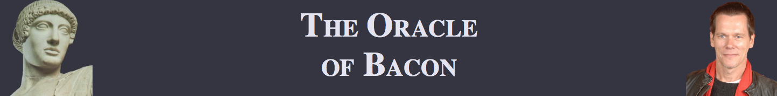
Other Real Life Uses for Graphs
The "Oracle of Bacon": https://oracleofbacon.org (just graph searching!)

Slide 23
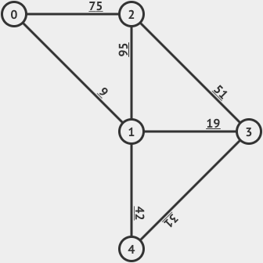
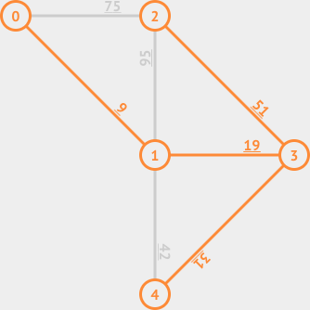
Other Real Life Uses for Graphs
Telecommunications: find the least expensive way to lay out a set of cables for a telephone or cable TV system ("a Minimum Spanning Tree")

Slide 24

Spanning Trees and Minimum Spanning Trees
Definition: A Spanning Tree (ST) of a connected undirected weighted graph G is a subgraph of G that is a tree and connects (spans) all vertices of G. A graph G can have multiple STs. A Minimum Spanning Tree (MST) of G is a ST of G that has the smallest total weight among the various STs. A graph G can have multiple MSTs but the MST weight is unique.
Minimum Spanning Tree

Slide 25
Kruskal's Algorithm to find a Minimum Spanning Tree
Kruskal's algorithm: Finds a MST in a given graph.
  function kruskal(graph):
  Remove all edges from the graph.
  Place all edges into a priority queue based on their weight (cost).
  While the priority queue is not empty:
  Dequeue an edge e from the priority queue.
  If e's endpoints aren't already connected to one another,
  add that edge into the graph.
  Otherwise, skip the edge.

Slide 26
Kruskal Example
In what order would Kruskal's algorithm visit the edges
in the graph below? What MST would it produce?
  function kruskal(graph):
  Remove all edges from the graph.
  Place all edges into a priority queue
  based on their weight (cost).
  While the priority queue is not empty:
  Dequeue an edge e from the priority queue.
  If e's endpoints aren't already connected,
  add that edge into the graph.
  Otherwise, skip the edge.
  pq = {a:1, b:2, c:3, d:4, e:5, f:6, g:7, h:8, i:9, j:10, k:11, l:12, m:13, n:14, o:15, p:16, q:17, r:18}
q:17
p:16
k:11
i:9
m:13
j:10
o:15
f:6
r:18
a:1
c:3
g:7
b:2
e:5
n:14
d:4
l:12
h:8

Slide 27
Kruskal Example
In what order would Kruskal's algorithm visit the edges
in the graph below? What MST would it produce?
  function kruskal(graph):
  Remove all edges from the graph.
  Place all edges into a priority queue
  based on their weight (cost).
  While the priority queue is not empty:
  Dequeue an edge e from the priority queue.
  If e's endpoints aren't already connected,
  add that edge into the graph.
  Otherwise, skip the edge.
  pq = {a:1, b:2, c:3, d:4, e:5, f:6, g:7, h:8, i:9, j:10, k:11, l:12, m:13, n:14, o:15, p:16, q:17, r:18}
q:17
p:16
k:11
i:9
m:13
j:10
o:15
f:6
r:18
a:1
c:3
g:7
b:2
e:5
n:14
d:4
l:12
h:8

Slide 28
Kruskal Example
In what order would Kruskal's algorithm visit the edges
in the graph below? What MST would it produce?
  function kruskal(graph):
  Remove all edges from the graph.
  Place all edges into a priority queue
  based on their weight (cost).
  While the priority queue is not empty:
  Dequeue an edge e from the priority queue.
  If e's endpoints aren't already connected,
  add that edge into the graph.
  Otherwise, skip the edge.
  pq = {b:2, c:3, d:4, e:5, f:6, g:7, h:8, i:9, j:10, k:11, l:12, m:13, n:14, o:15, p:16, q:17, r:18}
q:17
p:16
k:11
i:9
m:13
j:10
o:15
f:6
r:18
a:1
c:3
g:7
b:2
e:5
n:14
d:4
l:12
h:8

Slide 29
Kruskal Example
In what order would Kruskal's algorithm visit the edges
in the graph below? What MST would it produce?
  function kruskal(graph):
  Remove all edges from the graph.
  Place all edges into a priority queue
  based on their weight (cost).
  While the priority queue is not empty:
  Dequeue an edge e from the priority queue.
  If e's endpoints aren't already connected,
  add that edge into the graph.
  Otherwise, skip the edge.
  pq = {c:3, d:4, e:5, f:6, g:7, h:8, i:9, j:10, k:11, l:12, m:13, n:14, o:15, p:16, q:17, r:18}
q:17
p:16
k:11
i:9
m:13
j:10
o:15
f:6
r:18
a:1
c:3
g:7
b:2
e:5
n:14
d:4
l:12
h:8

Slide 30
Kruskal Example
In what order would Kruskal's algorithm visit the edges
in the graph below? What MST would it produce?
  function kruskal(graph):
  Remove all edges from the graph.
  Place all edges into a priority queue
  based on their weight (cost).
  While the priority queue is not empty:
  Dequeue an edge e from the priority queue.
  If e's endpoints aren't already connected,
  add that edge into the graph.
  Otherwise, skip the edge.
  pq = {d:4, e:5, f:6, g:7, h:8, i:9, j:10, k:11, l:12, m:13, n:14, o:15, p:16, q:17, r:18}
q:17
p:16
k:11
i:9
m:13
j:10
o:15
f:6
r:18
a:1
c:3
g:7
b:2
e:5
n:14
d:4
l:12
h:8

Slide 31
Kruskal Example
In what order would Kruskal's algorithm visit the edges
in the graph below? What MST would it produce?
  function kruskal(graph):
  Remove all edges from the graph.
  Place all edges into a priority queue
  based on their weight (cost).
  While the priority queue is not empty:
  Dequeue an edge e from the priority queue.
  If e's endpoints aren't already connected,
  add that edge into the graph.
  Otherwise, skip the edge.
  pq = {e:5, f:6, g:7, h:8, i:9, j:10, k:11, l:12, m:13, n:14, o:15, p:16, q:17, r:18}
q:17
p:16
k:11
i:9
m:13
j:10
o:15
f:6
r:18
a:1
c:3
g:7
b:2
e:5
n:14
d:4
l:12
h:8

Slide 32
Kruskal Example
In what order would Kruskal's algorithm visit the edges
in the graph below? What MST would it produce?
  function kruskal(graph):
  Remove all edges from the graph.
  Place all edges into a priority queue
  based on their weight (cost).
  While the priority queue is not empty:
  Dequeue an edge e from the priority queue.
  If e's endpoints aren't already connected,
  add that edge into the graph.
  Otherwise, skip the edge.
  pq = {f:6, g:7, h:8, i:9, j:10, k:11, l:12, m:13, n:14, o:15, p:16, q:17, r:18}
q:17
p:16
k:11
i:9
m:13
j:10
o:15
f:6
r:18
a:1
c:3
g:7
b:2
e:5
n:14
d:4
l:12
h:8

Slide 33
Kruskal Example
In what order would Kruskal's algorithm visit the edges
in the graph below? What MST would it produce?
  function kruskal(graph):
  Remove all edges from the graph.
  Place all edges into a priority queue
  based on their weight (cost).
  While the priority queue is not empty:
  Dequeue an edge e from the priority queue.
  If e's endpoints aren't already connected,
  add that edge into the graph.
  Otherwise, skip the edge.
  pq = {g:7, h:8, i:9, j:10, k:11, l:12, m:13, n:14, o:15, p:16, q:17, r:18}
q:17
p:16
k:11
i:9
m:13
j:10
o:15
f:6
r:18
a:1
c:3
g:7
b:2
e:5
n:14
d:4
l:12
h:8

Slide 34
Kruskal Example
In what order would Kruskal's algorithm visit the edges
in the graph below? What MST would it produce?
  function kruskal(graph):
  Remove all edges from the graph.
  Place all edges into a priority queue
  based on their weight (cost).
  While the priority queue is not empty:
  Dequeue an edge e from the priority queue.
  If e's endpoints aren't already connected,
  add that edge into the graph.
  Otherwise, skip the edge.
  pq = {h:8, i:9, j:10, k:11, l:12, m:13, n:14, o:15, p:16, q:17, r:18}
q:17
p:16
k:11
i:9
m:13
j:10
o:15
f:6
r:18
a:1
c:3
g:7
b:2
e:5
n:14
d:4
l:12
h:8

Slide 35
Kruskal Example
In what order would Kruskal's algorithm visit the edges
in the graph below? What MST would it produce?
  function kruskal(graph):
  Remove all edges from the graph.
  Place all edges into a priority queue
  based on their weight (cost).
  While the priority queue is not empty:
  Dequeue an edge e from the priority queue.
  If e's endpoints aren't already connected,
  add that edge into the graph.
  Otherwise, skip the edge.
  pq = {i:9, j:10, k:11, l:12, m:13, n:14, o:15, p:16, q:17, r:18}
q:17
p:16
k:11
i:9
m:13
j:10
o:15
f:6
r:18
a:1
c:3
g:7
b:2
e:5
n:14
d:4
l:12
h:8

Slide 36
Kruskal Example
In what order would Kruskal's algorithm visit the edges
in the graph below? What MST would it produce?
  function kruskal(graph):
  Remove all edges from the graph.
  Place all edges into a priority queue
  based on their weight (cost).
  While the priority queue is not empty:
  Dequeue an edge e from the priority queue.
  If e's endpoints aren't already connected,
  add that edge into the graph.
  Otherwise, skip the edge.
  pq = {j:10, k:11, l:12, m:13, n:14, o:15, p:16, q:17, r:18}
q:17
p:16
k:11
i:9
m:13
j:10
o:15
f:6
r:18
a:1
c:3
g:7
b:2
e:5
n:14
d:4
l:12
h:8

Slide 37
Kruskal Example
In what order would Kruskal's algorithm visit the edges
in the graph below? What MST would it produce?
  function kruskal(graph):
  Remove all edges from the graph.
  Place all edges into a priority queue
  based on their weight (cost).
  While the priority queue is not empty:
  Dequeue an edge e from the priority queue.
  If e's endpoints aren't already connected,
  add that edge into the graph.
  Otherwise, skip the edge.
  pq = {k:11, l:12, m:13, n:14, o:15, p:16, q:17, r:18}
q:17
p:16
k:11
i:9
m:13
j:10
o:15
f:6
r:18
a:1
c:3
g:7
b:2
e:5
n:14
d:4
l:12
h:8

Slide 38
Kruskal Example
In what order would Kruskal's algorithm visit the edges
in the graph below? What MST would it produce?
  function kruskal(graph):
  Remove all edges from the graph.
  Place all edges into a priority queue
  based on their weight (cost).
  While the priority queue is not empty:
  Dequeue an edge e from the priority queue.
  If e's endpoints aren't already connected,
  add that edge into the graph.
  Otherwise, skip the edge.
  pq = {l:12, m:13, n:14, o:15, p:16, q:17, r:18}
q:17
p:16
k:11
i:9
m:13
j:10
o:15
f:6
r:18
a:1
c:3
g:7
b:2
e:5
n:14
d:4
l:12
h:8

Slide 39
Kruskal Example
In what order would Kruskal's algorithm visit the edges
in the graph below? What MST would it produce?
  function kruskal(graph):
  Remove all edges from the graph.
  Place all edges into a priority queue
  based on their weight (cost).
  While the priority queue is not empty:
  Dequeue an edge e from the priority queue.
  If e's endpoints aren't already connected,
  add that edge into the graph.
  Otherwise, skip the edge.
  pq = {m:13, n:14, o:15, p:16, q:17, r:18}
q:17
p:16
k:11
i:9
m:13
j:10
o:15
f:6
r:18
a:1
c:3
g:7
b:2
e:5
n:14
d:4
l:12
h:8

Slide 40
Kruskal Example
In what order would Kruskal's algorithm visit the edges
in the graph below? What MST would it produce?
  function kruskal(graph):
  Remove all edges from the graph.
  Place all edges into a priority queue
  based on their weight (cost).
  While the priority queue is not empty:
  Dequeue an edge e from the priority queue.
  If e's endpoints aren't already connected,
  add that edge into the graph.
  Otherwise, skip the edge.
  pq = {n:14, o:15, p:16, q:17, r:18}
q:17
p:16
k:11
i:9
m:13
j:10
o:15
f:6
r:18
a:1
c:3
g:7
b:2
e:5
n:14
d:4
l:12
h:8

Slide 41
Kruskal Example
In what order would Kruskal's algorithm visit the edges
in the graph below? What MST would it produce?
  function kruskal(graph):
  Remove all edges from the graph.
  Place all edges into a priority queue
  based on their weight (cost).
  While the priority queue is not empty:
  Dequeue an edge e from the priority queue.
  If e's endpoints aren't already connected,
  add that edge into the graph.
  Otherwise, skip the edge.
  pq = {o:15, p:16, q:17, r:18}
q:17
p:16
k:11
i:9
m:13
j:10
o:15
f:6
r:18
a:1
c:3
g:7
b:2
e:5
n:14
d:4
l:12
h:8

Slide 42
Kruskal Example
In what order would Kruskal's algorithm visit the edges
in the graph below? What MST would it produce?
  function kruskal(graph):
  Remove all edges from the graph.
  Place all edges into a priority queue
  based on their weight (cost).
  While the priority queue is not empty:
  Dequeue an edge e from the priority queue.
  If e's endpoints aren't already connected,
  add that edge into the graph.
  Otherwise, skip the edge.
  pq = {p:16, q:17, r:18}
q:17
p:16
k:11
i:9
m:13
j:10
o:15
f:6
r:18
a:1
c:3
g:7
b:2
e:5
n:14
d:4
l:12
h:8

Slide 43
Kruskal Example
In what order would Kruskal's algorithm visit the edges
in the graph below? What MST would it produce?
  function kruskal(graph):
  Remove all edges from the graph.
  Place all edges into a priority queue
  based on their weight (cost).
  While the priority queue is not empty:
  Dequeue an edge e from the priority queue.
  If e's endpoints aren't already connected,
  add that edge into the graph.
  Otherwise, skip the edge.
  pq = {q:17, r:18}
q:17
p:16
k:11
i:9
m:13
j:10
o:15
f:6
r:18
a:1
c:3
g:7
b:2
e:5
n:14
d:4
l:12
h:8

Slide 44
Kruskal Example
In what order would Kruskal's algorithm visit the edges
in the graph below? What MST would it produce?
  function kruskal(graph):
  Remove all edges from the graph.
  Place all edges into a priority queue
  based on their weight (cost).
  While the priority queue is not empty:
  Dequeue an edge e from the priority queue.
  If e's endpoints aren't already connected,
  add that edge into the graph.
  Otherwise, skip the edge.
  pq = {r:18}
q:17
p:16
k:11
i:9
m:13
j:10
o:15
f:6
r:18
a:1
c:3
g:7
b:2
e:5
n:14
d:4
l:12
h:8

Slide 45
Kruskal Example
In what order would Kruskal's algorithm visit the edges
in the graph below? What MST would it produce?
  function kruskal(graph):
  Remove all edges from the graph.
  Place all edges into a priority queue
  based on their weight (cost).
  While the priority queue is not empty:
  Dequeue an edge e from the priority queue.
  If e's endpoints aren't already connected,
  add that edge into the graph.
  Otherwise, skip the edge.
  pq = {}
q:17
p:16
k:11
i:9
m:13
j:10
o:15
f:6
r:18
a:1
c:3
g:7
b:2
e:5
n:14
d:4
l:12
h:8

Slide 46
Kruskal Example
Kruskal's algorithm would output the following MST:
  {a, b, c, d, f, h, i, k, p}
The MST's total cost is:
  1+2+3+4+6+8+9+11+16 = 60
p:16
k:11
i:9
f:6
a:1
c:3
b:2
d:4
h:8

Slide 47
What data structures should we use to implement this algorithm?
  function kruskal(graph):
  Remove all edges from the graph.
  Place all edges into a priority queue
  based on their weight (cost).
  While the priority queue is not empty:
  Dequeue an edge e from the priority queue.
  If e's endpoints aren't already connected,
  add that edge into the graph.
  Otherwise, skip the edge.

Slide 48
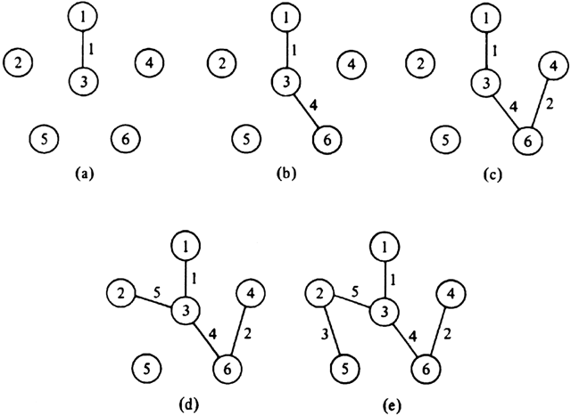

Need some way to identify which vertexes are "connected" to which other ones
  we call these "clusters" of vertices
Also need an efficient way
to figure out which cluster
a given vertex is in.
Also need to merge clusters
when adding an edge.

Slide 49
References and Advanced Reading
References:
  Minimum Spanning Tree visualization: https://visualgo.net/mst
  Kruskal's Algorithm: https://en.wikipedia.org/wiki/Kruskal's_algorithm
Advanced Reading:
  How Internet Routing works: https://web.stanford.edu/class/msande91si/www-spr04/readings/week1/InternetWhitepaper.htm
  http://www.explainthatstuff.com/internet.html

