Slide 1
Monday, June 4, 2018
CS 106B
Lecture 27: Inheritance and Polymorphism in C++
Programming Abstractions
Spring 2018
Stanford University
Computer Science Department
Lecturer: Chris Gregg
reading:
Programming Abstractions in C++, Chapter 19

Slide 2
Today's Topics
Logistics
  Final Exam prep online: http://web.stanford.edu/class/cs106b/handouts/final.html
  Final Review Session: Wednesday, June 6th, 7:30-9pm, STLC-111.
  Peer office hours: Thursday 1-3pm, STLC-118.
  If you are expecting an alternate exam, you should have received an email over the weekend.
  Final exam is on Friday, June 8th at 8:30am.
Hash Map Example
Inheritance and Polymorphism in C++
  PDF for code: http://web.stanford.edu/class/cs106b//lectures/27-Inheritance/code/InheritancePolymorphismExamples.pdf

Slide 3
Hash Map Example
Let's simulate the behavior of a hash map that hashes ints (keys) to chars (values).
We will assume that the hash table starts with a capacity of 5 elements, and that it uses linked list chaining to resolve collisions. We will also assume that the key/value pairs are inserted at the head of each linked list.
We will use a hash / compression function defined as follows:
int hash(int key, int numBuckets) {
return key % 7 % numBuckets;
}
We will rehash when the load factor (number of keys / number of buckets) is greater than or equal to 0.8.

Slide 4
Hash Map Example
int hash(int key, int numBuckets) {
return key % 7 % numBuckets;
}
Initial table:
Operations:
map.put(6,'x');
map.put(12,'b');
map.put(25,'c');
map.put(50,'r');
map.put(85,'z');
map.remove(12);
map.put(11,'p');
map.put(44,'q');
Index | Value
0 | nullptr
1 | nullptr
2 | nullptr
3 | nullptr
4 | nullptr

Slide 5
Hash Map Example
int hash(int key, int numBuckets) {
return key % 7 % numBuckets;
}
Initial table:
Operations:
map.put(6,'x');
map.put(12,'b');
map.put(25,'c');
map.put(50,'r');
map.put(85,'z');
map.remove(12);
map.put(11,'p');
map.put(44,'q');
Index | Value
0 | nullptr
1 | 6,'x'
2 | nullptr
3 | nullptr
4 | nullptr
hash(6,5) == 1
Load factor:
1 / 5 == 0.2

Slide 6
Hash Map Example
int hash(int key, int numBuckets) {
return key % 7 % numBuckets;
}
Initial table:
Operations:
map.put(6,'x');
map.put(12,'b');
map.put(25,'c');
map.put(50,'r');
map.put(85,'z');
map.remove(12);
map.put(11,'p');
map.put(44,'q');
Index | Value
0 | 12,'b'
1 | 6,'x'
2 | nullptr
3 | nullptr
4 | nullptr
hash(12,5) == 0
Load factor:
2 / 5 == 0.4

Slide 7
Hash Map Example
int hash(int key, int numBuckets) {
return key % 7 % numBuckets;
}
Initial table:
Operations:
map.put(6,'x');
map.put(12,'b');
map.put(25,'c');
map.put(50,'r');
map.put(85,'z');
map.remove(12);
map.put(11,'p');
map.put(44,'q');
Index | Value
0 | 12,'b'
1 | 6,'x'
2 | nullptr
3 | nullptr
4 | 25,'c'
hash(25,5) == 4
Load factor:
3 / 5 == 0.6

Slide 8
Hash Map Example
int hash(int key, int numBuckets) {
return key % 7 % numBuckets;
}
Initial table:
Operations:
map.put(6,'x');
map.put(12,'b');
map.put(25,'c');
map.put(50,'r');
map.put(85,'z');
map.remove(12);
map.put(11,'p');
map.put(44,'q');
Index | Value
0 | 12,'b'
1 | 50,'r' -> 6,'x'
2 | nullptr
3 | nullptr
4 | 25,'c'
hash(50,5) == 1
Load factor:
4 / 5 == 0.8
must rehash!

Slide 9
Hash Map Example
int hash(int key, int numBuckets) {
return key % 7 % numBuckets;
}
To rehash:
Walk each bucket's linked list and rehash each key/value pair into new table with double the capacity.
Index | Value
0 | 12,'b'
1 | 50,'r' -> 6,'x'
2 | nullptr
3 | nullptr
4 | 25,'c'
Index | Value
0 | nullptr
1 | nullptr
2 | nullptr
3 | nullptr
4 | nullptr
5 | 12,'b'
6 | nullptr
7 | nullptr
8 | nullptr
9 | nullptr
hash(12,10) == 5

Slide 10
Hash Map Example
int hash(int key, int numBuckets) {
return key % 7 % numBuckets;
}
To rehash:
Walk each bucket's linked list and rehash each key/value pair into new table with double the capacity.
Index | Value
0 | 12,'b'
1 | 50,'r' -> 6,'x'
2 | nullptr
3 | nullptr
4 | 25,'c'
Index | Value
0 | nullptr
1 | 50,'r'
2 | nullptr
3 | nullptr
4 | nullptr
5 | 12,'b'
6 | nullptr
7 | nullptr
8 | nullptr
9 | nullptr
hash(50,10) == 1

Slide 11
Hash Map Example
int hash(int key, int numBuckets) {
return key % 7 % numBuckets;
}
To rehash:
Walk each bucket's linked list and rehash each key/value pair into new table with double the capacity.
Index | Value
0 | 12,'b'
1 | 50,'r' -> 6,'x'
2 | nullptr
3 | nullptr
4 | 25,'c'
Index | Value
0 | nullptr
1 | 50,'r'
2 | nullptr
3 | nullptr
4 | nullptr
5 | 12,'b'
6 | 6,'x'
7 | nullptr
8 | nullptr
9 | nullptr
hash(6,10) == 6

Slide 12
Hash Map Example
int hash(int key, int numBuckets) {
return key % 7 % numBuckets;
}
To rehash:
Walk each bucket's linked list and rehash each key/value pair into new table with double the capacity.
Index | Value
0 | 12,'b'
1 | 50,'r' -> 6,'x'
2 | nullptr
3 | nullptr
4 | 25,'c'
Index | Value
0 | nullptr
1 | 50,'r'
2 | nullptr
3 | nullptr
4 | 25,'c'
5 | 12,'b'
6 | 6,'x'
7 | nullptr
8 | nullptr
9 | nullptr
hash(25,10) == 1
Load factor:
4 / 10 == 0.4

Slide 13
Hash Map Example
int hash(int key, int numBuckets) {
return key % 7 % numBuckets;
}
Operations:
map.put(6,'x');
map.put(12,'b');
map.put(25,'c');
map.put(50,'r');
map.put(85,'z');
map.remove(12);
map.put(11,'p');
map.put(44,'q');
Index | Value
0 | nullptr
1 | 85,'z' -> 50,'r'
2 | nullptr
3 | nullptr
4 | 25,'c'
5 | 12,'b'
6 | 6,'x'
7 | nullptr
8 | nullptr
9 | nullptr
hash(85,10) == 1
Load factor:
5 / 10 == 0.5

Slide 14
Hash Map Example
int hash(int key, int numBuckets) {
return key % 7 % numBuckets;
}
Operations:
map.put(6,'x');
map.put(12,'b');
map.put(25,'c');
map.put(50,'r');
map.put(85,'z');
map.remove(12);
map.put(11,'p');
map.put(44,'q');
Index | Value
0 | nullptr
1 | 85,'z' -> 50,'r'
2 | nullptr
3 | nullptr
4 | 25,'c'
5 | 12,'b'
6 | 6,'x'
7 | nullptr
8 | nullptr
9 | nullptr
Remove by hashing, and walking to find key.
hash(12,10) == 5

Slide 15
Hash Map Example
int hash(int key, int numBuckets) {
return key % 7 % numBuckets;
}
Operations:
map.put(6,'x');
map.put(12,'b');
map.put(25,'c');
map.put(50,'r');
map.put(85,'z');
map.remove(12);
map.put(11,'p');
map.put(44,'q');
Index | Value
0 | nullptr
1 | 85,'z' -> 50,'r'
2 | nullptr
3 | nullptr
4 | 11,'p' -> 25,'c'
5 | nullptr
6 | 6,'x'
7 | nullptr
8 | nullptr
9 | nullptr
hash(11,10) == 4
Load factor:
6 / 10 == 0.6

Slide 16
Hash Map Example
int hash(int key, int numBuckets) {
return key % 7 % numBuckets;
}
Operations:
map.put(6,'x');
map.put(12,'b');
map.put(25,'c');
map.put(50,'r');
map.put(85,'z');
map.remove(12);
map.put(11,'p');
map.put(44,'q');
Index | Value
0 | nullptr
1 | 85,'z' -> 50,'r'
2 | 44,'q'
3 | nullptr
4 | 11,'p' -> 25,'c'
5 | nullptr
6 | 6,'x'
7 | nullptr
8 | nullptr
9 | nullptr
hash(44,10) == 2
Load factor:
7 / 10 == 0.7

Slide 17
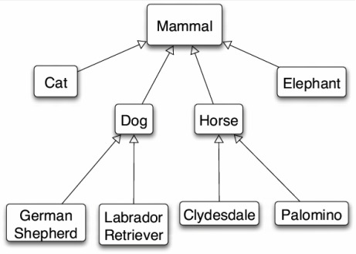
Inheritance in C++
inheritance: A way to form new classes based on existing classes, taking on their attributes/behavior.
a way to indicate that classes are related
a way to share code between two or more related classes (a hierarchy)
One class can extend another, absorbing its data/behavior.
  superclass (base class): Parent class that is being extended.
  subclass (derived class): Child class that inherits from the superclass.
    Subclass gets a copy of every field and method from superclass.
    Subclass can add its own behavior, and/or change inherited behavior.

Slide 18
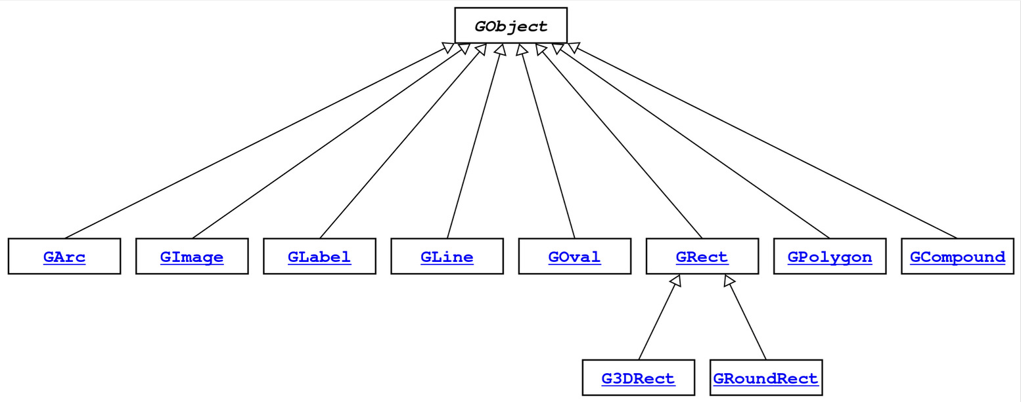
GObject Hierarchy
The Stanford C++ library contains a hierarchy of graphical objects based on a common base class named GObject.
GArc, GCompound, GImage, GLabel, GLine, GOval, GPolygon, GRect, G3DRect, GRoundRect, ...

Slide 19
GObject Members
GObject defines the state and behavior common to all shapes:
contains(x, y)
getColor(), setColor(color)
getHeight(), getWidth(), getLocation(), setLocation(x, y)
getX(), getY(), setX(x), setY(y), move(dx, dy)
setVisible(visible)
toString()
The subclasses add state and behavior unique to them:
GLabel:
get/setFont
get/setLabel
...
GLine:
get/setStartPoint
get/setEndPoint
...
GPolygon:
addEdge
addVertex
get/setFillColor
...

Slide 20
Example: Employees
Imagine a company with the following employee regulations:
All employees work 40 hours / week.
Employees make $40,000 per year plus $500 for each year worked,
  except for lawyers who get twice the usual pay,
  and programmers who get the same $40k base but $2000 for each year worked.
Employees have 2 weeks of paid vacation days per year,
  except for programmers who get an extra week (a total of 3).
Employees should use a yellow form to apply for leave,
  except for programmers who use a pink form.
Each type of employee has some unique behavior:
Lawyers know how to sue.
Programmers know how to write code.
Assistants know how to take dictation.
Legal Assistants know how to take dictation and how to file legal briefs.

Slide 21
Employee Class
// Employee.h
class Employee {
public:
Employee(string name, int years);
virtual int hours() const;
virtual string name() const;
virtual double salary() const;
virtual int vacationDays() const;
virtual string vacationForm() const;
virtual int years() const;
private:
string myName;
int myYears;
};
// Employee.cpp
Employee::Employee(string name, int years) {
myName = name;
myYears = years;
}
int Employee::hours() const {
return 40;
}
string Employee::name() const {
return myName;
}
double Employee::salary() const {
return 40000.0 + (500 * myYears);
}
int Employee::vacationDays() const {
return 10;
}
string Employee::vacationForm() const {
return "yellow";
}
int Employee::years() const {
return myYears;
}

Slide 22
Exercise: Employees
Exercise: Implement classes Lawyer and Programmer.
Lawyer
A Lawyer remembers what law school he/she went to.
Lawyers make twice as much salary as normal employees.
Lawyers know how to sue people (unique behavior).
Programmer
Programmers make the same base salary as normal employees, but they earn a bonus of $2k/year instead of $500/year.
Programmers fill out the pink form rather than yellow for vacations.
Programmers get 3 weeks of vacation rather than 2.
Programmers know how to write code (unique behavior).

Slide 23
Overriding
override: To replace a superclass's member function by writing a new version of that function in a subclass.
virtual function: One that is allowed to be overridden.
  Must be declared with virtual keyword in superclass.
// Employee.h
virtual string vacationForm();
// Employee.cpp
string Employee::vacationForm() {
return "yellow";
}
// Programmer.h
virtual string vacationForm();
// Programmer.cpp
string Programmer::vacationForm() {
return "pink"; // override!
}
If you "override" a non-virtual function, it actually just puts a second copy of that function in the subclass, which can be confusing later.
* Virtual has some subtleties. For example, destructors in inheritance hierarchies should always be declared virtual or else memory may not get cleaned up properly; ugh.

Slide 24
Calling the Superclass Constructor
SubclassName::SubclassName(params) : SuperclassName(params) {
statements;
}
To call a superclass constructor from subclass constructor, use an initialization list, with a colon after the constructor declaration.
Example:
Lawyer::Lawyer(string name, string lawSchool, int years) :
Employee(name, years) {
// calls Employee constructor first
mylawSchool = lawSchool;
}

Slide 25
Calling the Superclass Member
SuperclassName::memberName(params)
To call a superclass overridden member from subclass member.
Example:
double Lawyer::salary() { // paid twice as much
return Employee::salary() * 2;
}
Notes:
Subclass cannot access private members of the superclass.
You only need to use this syntax when the superclass's member has been overridden.
If you just want to call one member from another, even if that member came from the superclass, you don't need to write Superclass:: .

Slide 26
Lawyer.h
#pragma once
#include "Employee.h"
#include <string>
class Lawyer : public Employee {
// I now have an hours, name, salary, etc. method. yay!
public:
Lawyer(string name, string lawSchool, int years);
virtual double salary() const;
void sue(string person);
private:
string myLawSchool;
};

Slide 27
Lawyer.cpp
#include "Lawyer.h"
// call the constructor of Employee superclass?
Lawyer::Lawyer(string name, string lawSchool, int years)
: Employee(name, years) {
myLawSchool = lawSchool;
}
// overriding: replace version from Employee class
double Lawyer::salary() const {
return Employee::salary() * 2;
}
void Lawyer::sue(string person) {
cout << "See you in court, " << person << endl;
}

Slide 28
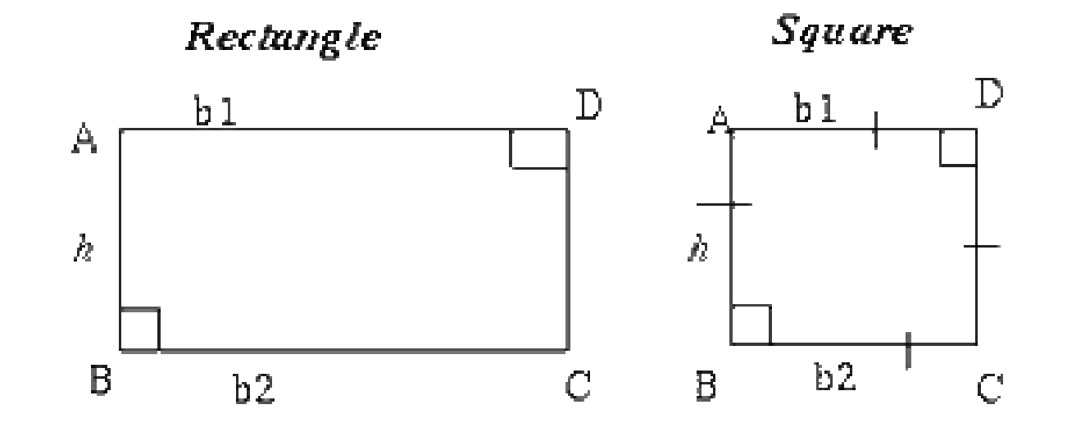
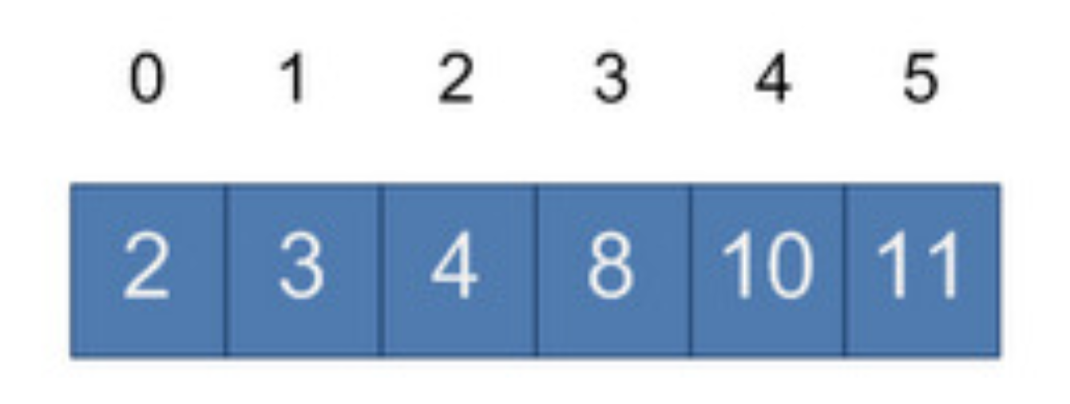
Perils of Inheritance (i.e., think before you inherit!)
Consider the following places you might use inheritance:
class Point3D extends Point2D and adds z-coordinate
class Square extends Rectangle (or vice versa?)
class SortedVector extends Vector, keeps it in sorted order
What's wrong with these examples? Is inheritance good here?
Point2D's distance() function is wrong for 3D points
Rectangle supports operations a Square shouldn't (e.g. setWidth)
SortedVector might confuse client; they call insert at an index, then check that index, and the element they inserted is elsewhere!

Slide 29
Private Inheritance
class Name : private SuperclassName { ...
private inheritance: Copies code from superclass but does not publicly advertise that your class extends that superclass.
Good for cases where you want to inherit another class's code, but you don't want outside clients to be able to randomly call it.
Example: Have Point3D privately extend Point2D and add z-coordinate functionality.
Example: Have SortedVector privately extend Vector and add only the public members it feels are appropriate (e.g., no insert).

Slide 30
Pure Virtual Functions
virtual returntype name(params) = 0;
pure virtual function: Declared in superclass's .h file and set to 0 (nullptr). An absent function that has not been implemented.
Must be implemented by any subclass, or it cannot be used.
A way of forcing subclasses to add certain important behavior.
class Employee {
...
virtual void work() = 0; // every employee does
// some kind of work
};
FYI: In Java, this is called an abstract method.

Slide 31
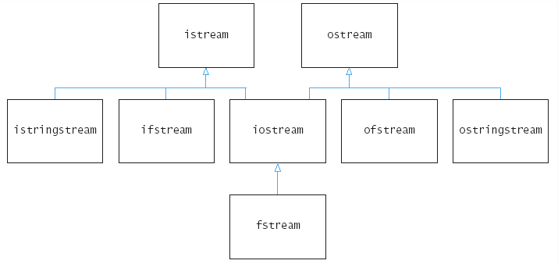
Multiple Inheritance
class Name : public Superclass1, public Superclass2, ...
multiple inheritance: When one subclass has multiple superclasses.
Forbidden in many OO languages (e.g. Java) but allowed in C++.
Convenient because it allows code sharing from multiple sources.
Can be confusing or buggy, e.g. when both superclasses define a member with the same name.
Example: The C++ I/O streams use multiple inheritance:

Slide 32
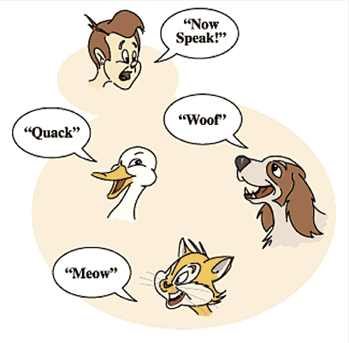
Polymorphism
polymorphism: Ability for the same code to be used with different types of objects and behave differently with each.
Templates provide compile-time polymorphism. Inheritance provides run-time polymorphism.
Idea: Client code can call a method on different kinds of objects, and the resulting behavior will be different.
Shape
draw()
erase()
Circle
Square
Triangle
draw()
erase()
draw()
erase()
draw()
erase()

Slide 33
Polymorphism and Pointers
A pointer of type T can point to any subclass of T.
Employee* edna = new Lawyer("Edna", "Harvard", 5);
Assistant* steve = new LegalAssistant("Steve", 2);
World* world = new WorldMap("map-stanford.txt");
When a member function is called on edna, it behaves as a Lawyer.
(This is because the employee functions are declared virtual.)
You can not call any Lawyer-only members on edna (e.g. sue).
You can not call any LegalAssistant-only members on steve (e.g. fileLegalBriefs).

Slide 34
But why?
A pointer of type T can point to any subclass of T.
Employee* tom = new Lawyer("Cori", "Stanford", 5);
Pointer of type Employee
Subclass of Employee
COMPILE TIME: Determine whether the function exists according to the type T (e.g. sue does not exists in Employee) since the compiler doesn't know what the type of the object might be (it may be Lawyer, Programmer, etc.)
RUN TIME: Run the function according to the actual object type (since we know the type of the object)
Notes:
You may say “Yeah, I know that, but why?”
The reason for that isn’t really important for final, but knowing the reason will help you remember this stuff better.
At compile time, the compiler will determine whether the function exists according to the type T (e.g. sue does not exists in Employee) since the compiler have no idea what the type of the object may be, for example, you can assign a Programmer object to tom and compiler won’t know at compile time
But at run time, things become different, since at that time we know the type of the object, we run the function according to the actual object type.

Slide 35
Polymorphism Example
You can use the object's extra functionality by casting.
Employee* edna = new Lawyer("Edna", "Harvard", 5);
edna->vacationDays(); // ok
edna->sue("Stuart"); // compiler error
((Lawyer*) edna)->sue("Stuart"); // ok
You should not cast a pointer to something that it is not.
It will compile, but the code will crash (or behave unpredictably) when you try to run it
Employee* angela = new Programmer("Angela", 3);
angela->code(); // compiler error
((Programmer*) angela)->code(); // ok
((Lawyer*) angela)->sue("Marty"); // crash!

Slide 36
Polymorphism Mystery
class Sleet : public Snow {
public:
virtual void method2() {
cout << "Sleet 2" << endl;
Snow::method2();
}
virtual void method3() {
cout << "Sleet 3" << endl;
}
};
class Fog : public Sleet {
public:
virtual void method1() {
cout << "Fog 1" << endl;
}
virtual void method3() {
cout << "Fog 3" << endl;
}
};
class Snow {
public:
virtual void method2() {
cout << "Snow 2" << endl;
}
virtual void method3() {
cout << "Snow 3" << endl;
}
};
class Rain : public Snow {
public:
virtual void method1() {
cout << "Rain 1" << endl;
}
virtual void method2() {
cout << "Rain 2" << endl;
}
};

Slide 37
Diagramming classes
Draw a diagram of the classes from top (superclass) to bottom.
Snow
Snow 2
method2()
method3()
Snow 3
Rain
Sleet
Sleet 2 / Snow 2
Rain 1
method1()
method2()
(method3())
Rain 2
method2()
method3()
Sleet 3
Snow 3
Fog
Fog 1
method1()
method2()
method3()
Sleet 2 / Snow 2
Fog 3

Slide 38
Mystery Problem
Snow* var1 = new Sleet();
var1->method2(); // What's the output?
To find the behavior/output of calls like the one above:
Look at the variable's type.
If that type does not have that member: COMPILER ERROR.
Execute the member.
Since the member is virtual: behave like the object's type, not like the variable's type.

Slide 39
Example 1
variable
Q: What is the result of the following call?
Snow
Snow 2
method2()
method3()
Snow 3
Snow* var1 = new Sleet();
var1->method2();
object
Rain
Sleet
Sleet 2 / Snow 2
Rain 1
Snow 2
Rain 2
Sleet 2
Snow 2
COMPILER ERROR
method1()
method2()
(method3())
Rain 2
method2()
method3()
Sleet 3
Snow 3
Fog
Fog 1
method1()
method2()
method3()
Sleet 2 / Snow 2
Fog 3

Slide 40
Example 1
variable
Q: What is the result of the following call?
Snow
Snow 2
method2()
method3()
Snow 3
Snow* var1 = new Sleet();
var1->method2();
object
Rain
Sleet
Sleet 2 / Snow 2
Rain 1
Snow 2
Rain 2
Sleet 2
Snow 2
COMPILER ERROR
method1()
method2()
(method3())
Rain 2
method2()
method3()
Sleet 3
Snow 3
Fog
Fog 1
method1()
method2()
method3()
Sleet 2 / Snow 2
Fog 3

Slide 41
Example 2
variable
Q: What is the result of the following call?
Snow
Snow 2
method2()
method3()
Snow 3
Snow* var2 = new Rain();
var2->method1();
Rain
Sleet
Sleet 2 / Snow 2
object
Rain 1
Snow 1
Rain 1
Snow 1
Rain 1
COMPILER ERROR
method1()
method2()
(method3())
Rain 2
method2()
method3()
Sleet 3
Snow 3
Fog
Fog 1
method1()
method2()
method3()
Sleet 2 / Snow 2
Fog 3

Slide 42
Example 2
variable
Q: What is the result of the following call?
Snow
Snow 2
method2()
method3()
Snow 3
Snow* var2 = new Rain();
var2->method1();
Rain
Sleet
Sleet 2 / Snow 2
object
Rain 1
Snow 1
Rain 1
Snow 1
Rain 1
COMPILER ERROR
method1()
method2()
(method3())
Rain 2
method2()
method3()
Sleet 3
Snow 3
Fog
Fog 1
method1()
method2()
method3()
Sleet 2 / Snow 2
Fog 3

Slide 43
Example 3
variable
Q: What is the result of the following call?
Snow
Snow 2
method2()
method3()
Snow 3
Snow* var3 = new Rain();
var3->method2();
Rain
Sleet
Sleet 2 / Snow 2
object
Rain 1
Snow 2
Rain 2
Sleet 2
Snow 2
COMPILER ERROR
method1()
method2()
(method3())
Rain 2
method2()
method3()
Sleet 3
Snow 3
Fog
Fog 1
method1()
method2()
method3()
Sleet 2 / Snow 2
Fog 3

Slide 44
Example 3
variable
Q: What is the result of the following call?
Snow
Snow 2
method2()
method3()
Snow 3
Snow* var3 = new Rain();
var3->method2();
Rain
Sleet
Sleet 2 / Snow 2
object
Rain 1
Snow 2
Rain 2
Sleet 2
Snow 2
COMPILER ERROR
method1()
method2()
(method3())
Rain 2
method2()
method3()
Sleet 3
Snow 3
Fog
Fog 1
method1()
method2()
method3()
Sleet 2 / Snow 2
Fog 3

Slide 45
Mystery with type cast
Snow* var4 = new Rain();
((Rain *) var4->method1(); // What's the output?
If the mystery problem has a type cast, then:
Look at the cast type.
If that type does not have the method: COMPILER ERROR.
(Note: if the object's type was not equal to or a subclass of the cast type, the code would CRASH / have unpredictable behavior.)
Execute the member.
Since the member is virtual: behave like the object's type, not like the variable's type.

Slide 46
Example 4
Q: What is the result of the following call?
variable
Snow
Snow 2
Snow* var4 = new Rain();
((Rain *) var4)->method1();
method2()
method3()
Snow 3
Rain
Sleet
cast
object
Sleet 2 / Snow 2
Rain 1
Snow 1
Rain 1
Sleet 1
COMPILER ERROR
method1()
method2()
(method3())
Rain 2
method2()
method3()
Sleet 3
Snow 3
Fog
Fog 1
method1()
method2()
method3()
Sleet 2 / Snow 2
Fog 3

Slide 47
Example 4
Q: What is the result of the following call?
variable
Snow
Snow 2
Snow* var4 = new Rain();
((Rain *) var4)->method1();
method2()
method3()
Snow 3
Rain
Sleet
cast
object
Sleet 2 / Snow 2
Rain 1
Snow 1
Rain 1
Sleet 1
COMPILER ERROR
method1()
method2()
(method3())
Rain 2
method2()
method3()
Sleet 3
Snow 3
Fog
Fog 1
method1()
method2()
method3()
Sleet 2 / Snow 2
Fog 3

Slide 48
Example 5
Q: What is the result of the following call?
variable
Snow
Snow 2
Snow* var5 = new Fog();
((Sleet *) var5)->method1();
method2()
method3()
Snow 3
cast
Rain
Sleet
Sleet 2 / Snow 2
Rain 1
Snow 1
Sleet 1
Fog 1
COMPILER ERROR
method1()
method2()
(method3())
Rain 2
method2()
method3()
Sleet 3
Snow 3
Fog
object
Fog 1
method1()
method2()
method3()
Sleet 2 / Snow 2
Fog 3

Slide 49
Example 5
Q: What is the result of the following call?
variable
Snow
Snow 2
Snow* var5 = new Fog();
((Sleet *) var5)->method1();
method2()
method3()
Snow 3
cast
Rain
Sleet
Sleet 2 / Snow 2
Rain 1
Snow 1
Sleet 1
Fog 1
COMPILER ERROR
method1()
method2()
(method3())
Rain 2
method2()
method3()
Sleet 3
Snow 3
Fog
object
Fog 1
method1()
method2()
method3()
Sleet 2 / Snow 2
Fog 3

Slide 50
Example 6
Suppose we add the following method to base class Snow:
variable
Snow
virtual void method4() {
cout << "Snow 4" << endl;
method2();
}
Snow 2
method2()
method3()
Snow 3
object
Rain
Sleet
Sleet 2 / Snow 2
Rain 1
What is the output?
Snow* var6 = new Sleet();
var6->method4();
method1()
method2()
(method3())
Rain 2
method2()
method3()
Sleet 3
Snow 3
Answer?
Snow 4
Sleet 2
Snow 2
Fog
(Sleet's method2 is used because method 4 and method2 are virtual)
Fog 1
method1()
method2()
method3()
Sleet 2 / Snow 2
Fog 3

Slide 51
Example 7
What is the output of the following call?
variable
Snow
Snow* var7 = new Sleet();
((Rain*) var7)->method1();
Snow 2
method2()
method3()
Snow 3
Snow 1
Sleet 1
Fog 1
COMPILER ERROR
CRASH / UNDEFINED
object
cast
Rain
Sleet
Sleet 2 / Snow 2
Rain 1
method1()
method2()
(method3())
Rain 2
method2()
method3()
Sleet 3
Snow 3
Fog
Fog 1
method1()
method2()
method3()
Sleet 2 / Snow 2
Fog 3

Slide 52
Example 7
What is the output of the following call?
variable
Snow
Snow* var7 = new Sleet();
((Rain*) var7)->method1();
Snow 2
method2()
method3()
Snow 3
Snow 1
Sleet 1
Fog 1
COMPILER ERROR
CRASH / UNDEFINED
object
cast
Rain
Sleet
Sleet 2 / Snow 2
Rain 1
method1()
method2()
(method3())
Rain 2
method2()
method3()
Sleet 3
Snow 3
Fog
Fog 1
method1()
method2()
method3()
Sleet 2 / Snow 2
Fog 3

Slide 53
References and Advanced Reading
References:
  C++ Inheritance: https://www.tutorialspoint.com/cplusplus/cpp_inheritance.htm
  C++ Polymorphism: https://www.tutorialspoint.com/cplusplus/cpp_polymorphism.htm
Advanced Reading:
  http://stackoverflow.com/questions/5854581/polymorphism-in-c
  https://www.codingunit.com/cplusplus-tutorial-polymorphism-and-abstract-base-class

