Slide 1
Wednesday, June 6, 2018
CS 106B
Lecture 28: Conclusion
Programming Abstractions
Spring 2018
Stanford University
Computer Science Department
Lecturer: Chris Gregg

Slide 2
Today's Topics
Logistics
  Final Exam Friday, 8:30am. We will have some power strips, but make sure you have a full battery on your laptop!
Where we have been
Where you are going
  How to Prepare for CS107

Slide 3
Where We Have Been
CS 106B

Slide 4
Where We Have Been: Game of Life

Slide 5
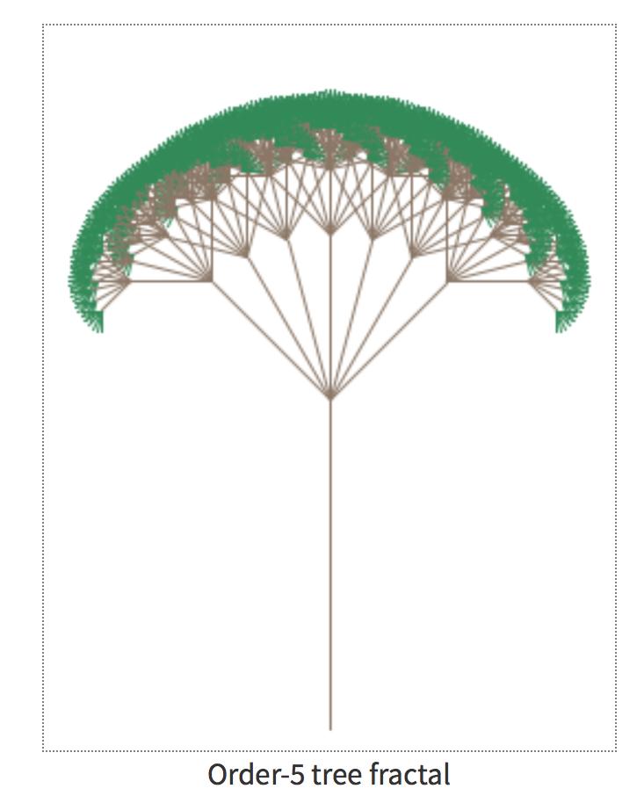
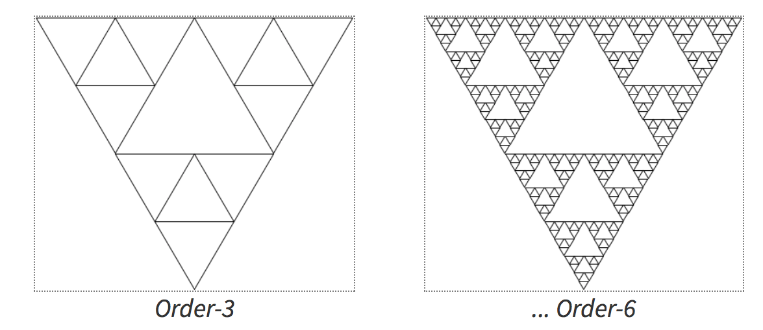
Where We Have Been: Fractals

Slide 6
Where We Have Been: Backtracking

Slide 7
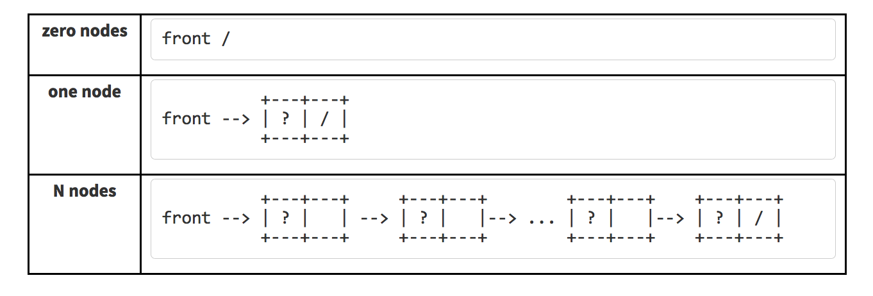
Where We Have Been: Linked Lists and Heaps

Slide 8
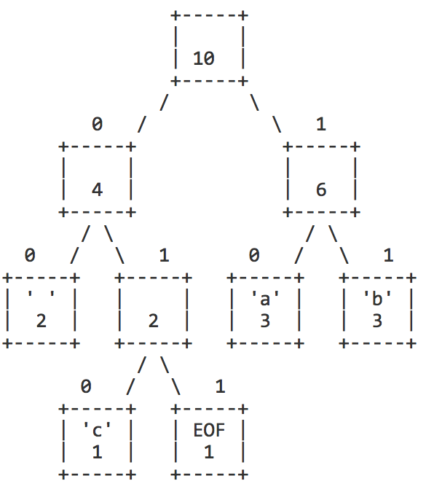
Where We Have Been: Binary Trees
Huffman!

Slide 9
Where We Have Been: Graphs

Slide 10
Where We Have Been: Sorting
So many ways to sort things!
We learned:
Insertion sort
Selection Sort
Merge Sort
Quicksort
Other sorts:
Shell Sort
Heap Sort
Tim Sort
Radix Sort
Bubble Sort
Trying to achieve O(n log n)

Slide 11
Where We Have Been: C++
For many of you, a new language!
Highlights:
Object oriented language with classes
Fast (except our wonky graphics...)
Extremely robust (too much sometimes)
Widely used in industry and for making games
Differences you probably saw from other languages:
Mutable strings
Input / Output streams
Operator overloading
Pointers
Memory Management: new, delete
Inheritance and Polymorphism

Slide 12
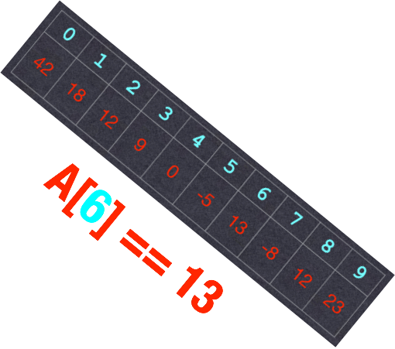
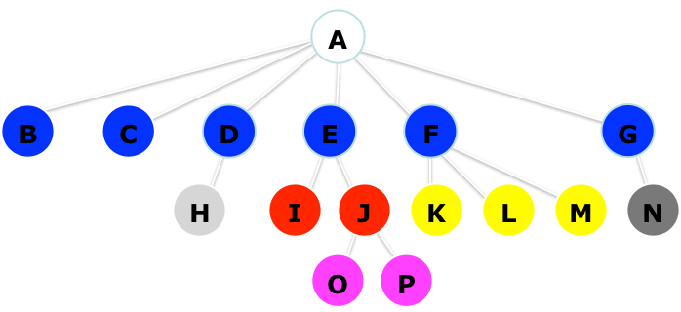
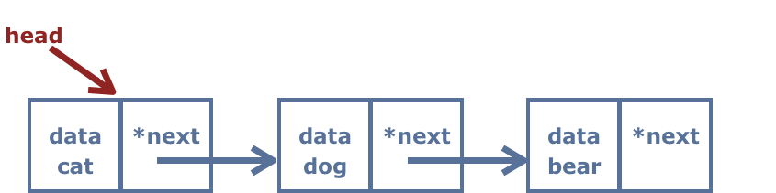
Why Data Structures are Important
One reason we care about data structures is, quite simply, time. Let’s say we have a program that does the following (and times the results):
- Creates four “list-like” containers for data.
- Adds 100,000 elements to each container – specifically, the even integers between 0 and 198,998 (sound familiar?).
- Searches for 100,000 elements (all integers 0-100,000)
- Attempts to delete 100,000 elements (integers from 0-100,000)
What are the results?
The Importance of Data Structures

Slide 13
The Importance of Data Structures
Structure | Overall(s)
Unsorted Vector
Linked List
Hash Table
Binary Tree
Sorted Vector

Slide 14
Results:
The Importance of Data Structures
Processor: 2.8GHz Intel Core i7 (Macbook Pro)
Compiler: clang++
Structure | Overall(s)
Unsorted Vector | 15.057
Linked List | 92.202
Hash Table | 0.145
Binary Tree | 0.164
Sorted Vector | 1.563
A factor of 103x
A factor of 636x!
Note: In general, for this test, we used optimized library data structures (from the "standard template library") where appropriate. The Stanford libraries are not optimized.
Overall, the Hash Table "won" — but (as we shall see!) while this is generally a great data structure, there are trade-offs to using it.

Slide 15
Full Results
Structure | Overall(s) | Insert(s) | Search(s) | Delete(s)
Unsorted Vector | 15.057 | 0.007 | 10.307 | 4.740
Linked List | 92.202 | 0.025 | 46.436 | 45.729
Hash Table | 0.145 | 0.135 | 0.002 | 0.008
Binary Tree | 0.164 | 0.133 | 0.010 | 0.0208
Sorted Vector | 1.563 | 0.024 | 0.006 | 1.534
Why are there such discrepancies??
Bottom line:
Some structures carry more information simply because of their design.
Manipulating structures takes time
Notes:
Sequential programming: one instruction at a time, instructions follow each other, with the possibility of branching.

Slide 16
Where to from here?

Slide 17
CS Core
CS 106B
Programming Abstractions
CS 103
Mathematical Foundations
of Computing
CS 107
Computer Organization
and Systems
CS 109
Introduction to Probability
for Computer Scientists
CS 110
Principles of
Computer Systems
CS 161
Design and Analysis
of Algorithms

Slide 18

CS Core
CS 106B
Programming Abstractions
CS 103
Mathematical Foundations
of Computing
CS 107
Computer Organization
and Systems
CS 109
Introduction to Probability
for Computer Scientists
CS 110
Principles of
Computer Systems
CS 161
Design and Analysis
of Algorithms

Slide 19

CS Core
CS 106B
Programming Abstractions
CS 103
Mathematical Foundations
of Computing
CS 107
Computer Organization
and Systems
CS 109
Introduction to Probability
for Computer Scientists
CS 110
Principles of
Computer Systems
CS 161
Design and Analysis
of Algorithms

Slide 20
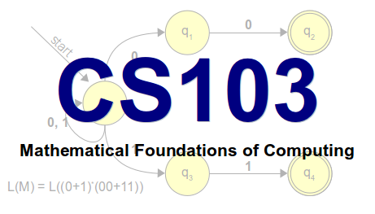
CS 103
Can computers solve all problems?
Spoiler alert: no!
Why are some problems harder than others?
We can do find in an unsorted array in O(N), and we can sort an unsorted array in O(NlogN). Is sorting just inherently a harder problem, or are there better O(N) sorting algorithm yet to be discovered?
How can we be certain about this?

Slide 21
CS107 (kind of like CS106C)
How do we encode text, numbers,
programs, etc. using just 0s and 1s?
Where does memory come from?
How is it managed?
How do compilers, debuggers, etc. work?

Slide 22
CS107 is not
CS107 is not a litmus test for whether you can be a computer scientist.
  You can be a great computer scientist without enjoying low-level systems programming.
CS107 is not indicative of what programming is “really like.”
  CS107 does a lot of low-level programming. You don't have to do low-level programming to be a good computer scientist.

Slide 23
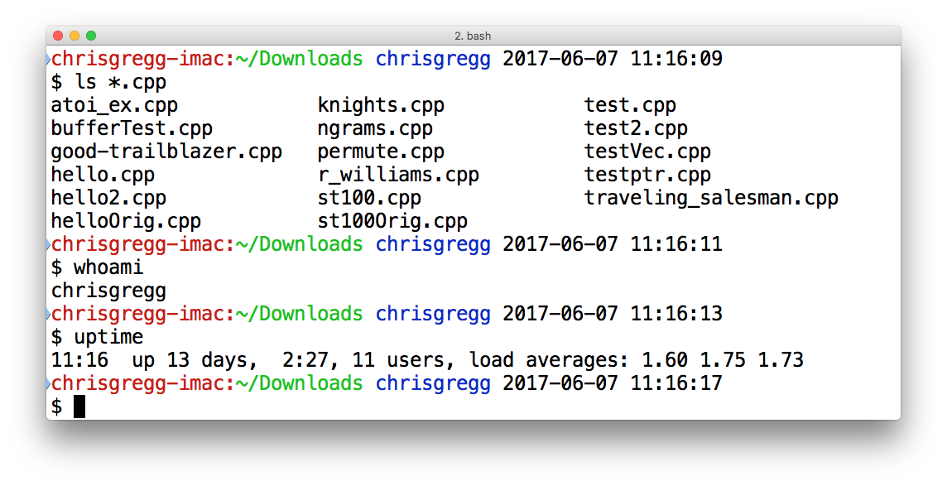
How to Prepare for cs107
You are prepared! cs106b is a great preparation!
However...you may want to learn a few things before class
  Terminal
/afs/ir/users/c/g/cgregg/cowsay/bin/cowsay Moooo
ls /afs/ir/users/c/g/cgregg/cowsay/share/cows
/afs/ir/users/c/g/cgregg/cowsay/bin/cowsay -f stegosaurus rowr

Slide 24
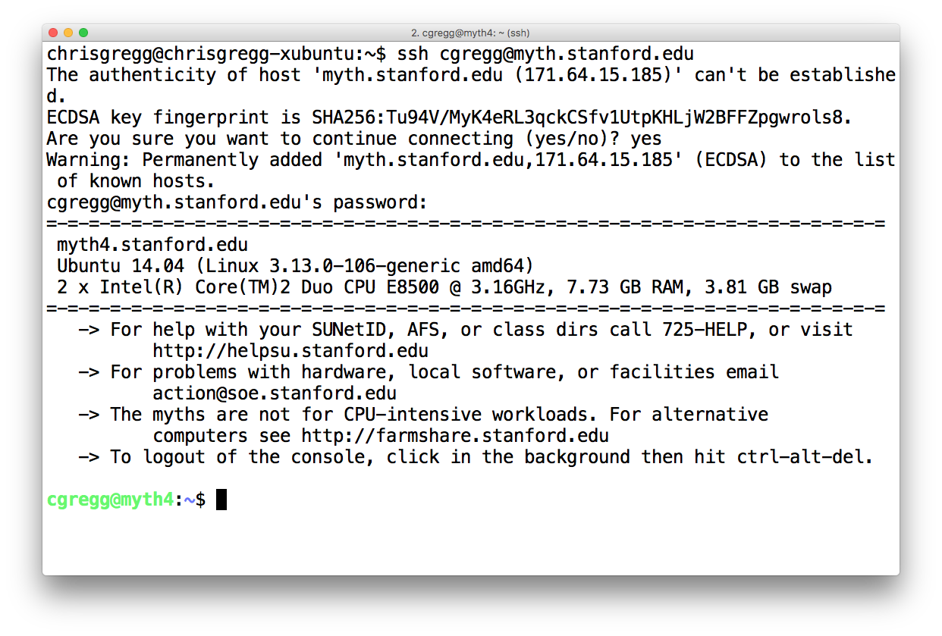
How to Prepare for cs107
How to log into Myth: Open Terminal (on Mac / Linux), use MobaXTerm on Windows. Then:
Substitute your SUNet id

Slide 25
How to Prepare for cs107
How to log into Myth: Open Terminal (on Mac / Linux), use MobaXTerm on Windows. Then:
Only need to answer this once.

Slide 26
How to Prepare for cs107
How to log into Myth: Open Terminal (on Mac / Linux), use MobaXTerm on Windows. Then:
Password won't show up when you type it.

Slide 27
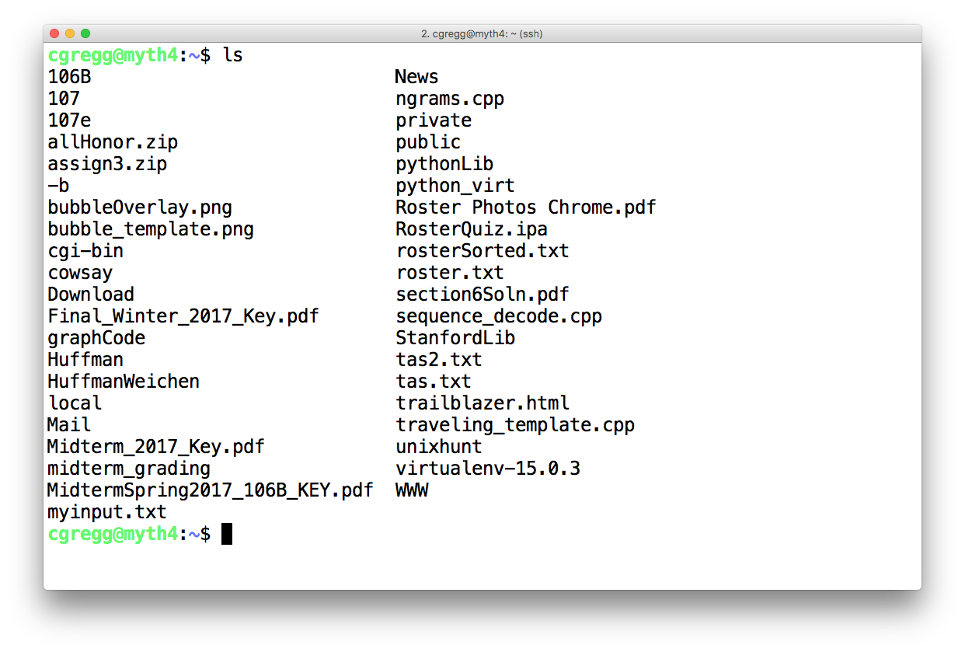
How to Prepare for cs107
How to log into Myth: Open Terminal (on Mac / Linux), use MobaXTerm on Windows. Then:
ls command "lists files"

Slide 28
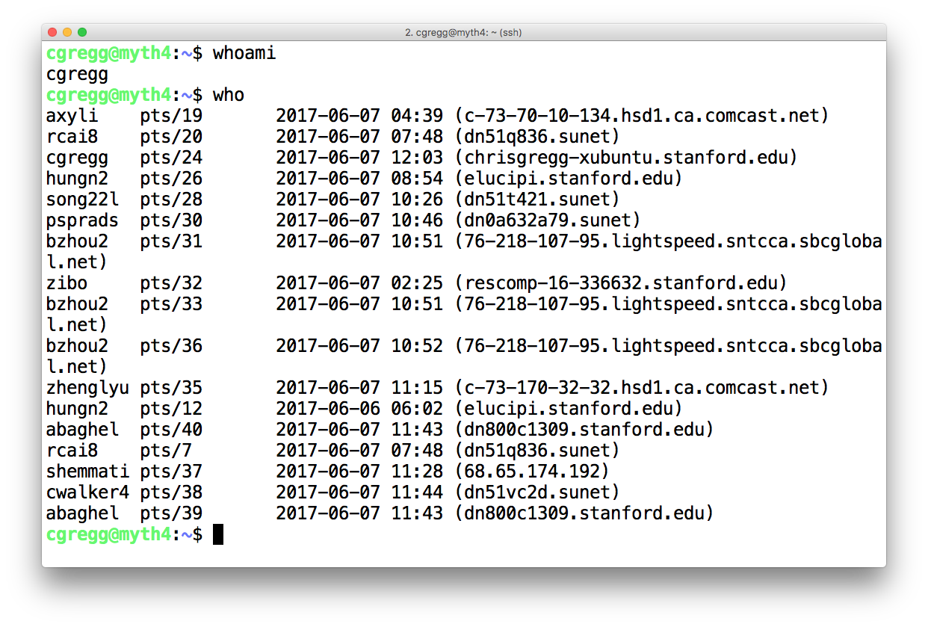
How to Prepare for cs107
How to log into Myth: Open Terminal (on Mac / Linux), use MobaXTerm on Windows. Then:
some other commands

Slide 29
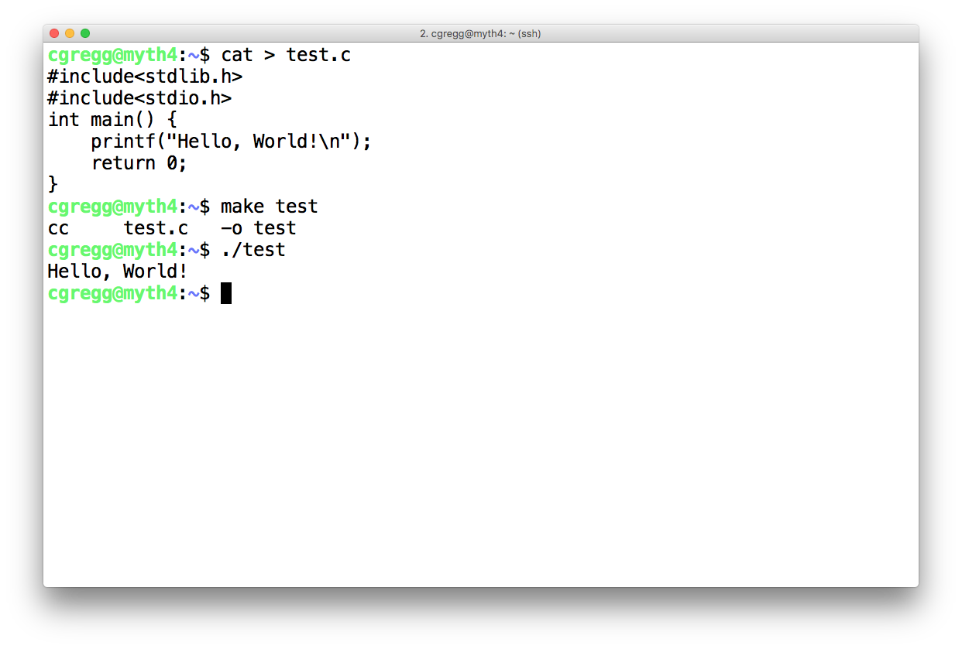
How to Prepare for cs107
Your first C program!
Type "ctrl-D" to exit
"make" compiles your program
./test runs your program
But what if you want an actual editor...

Slide 30
How to Prepare for cs107
  Lots of choices:
    vi / vim
    emacs
    nano
    Sublime Text from your own computer (slower, must transfer files)

Slide 31
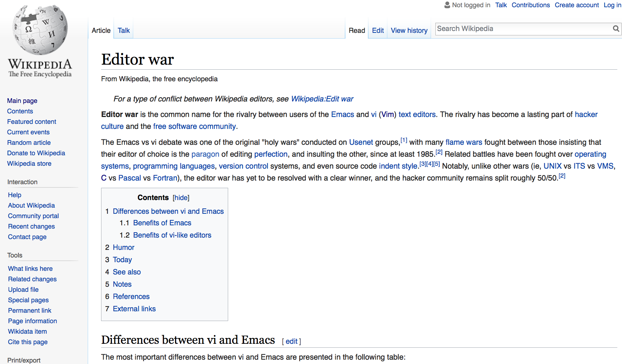
How to Prepare for cs107

Slide 32
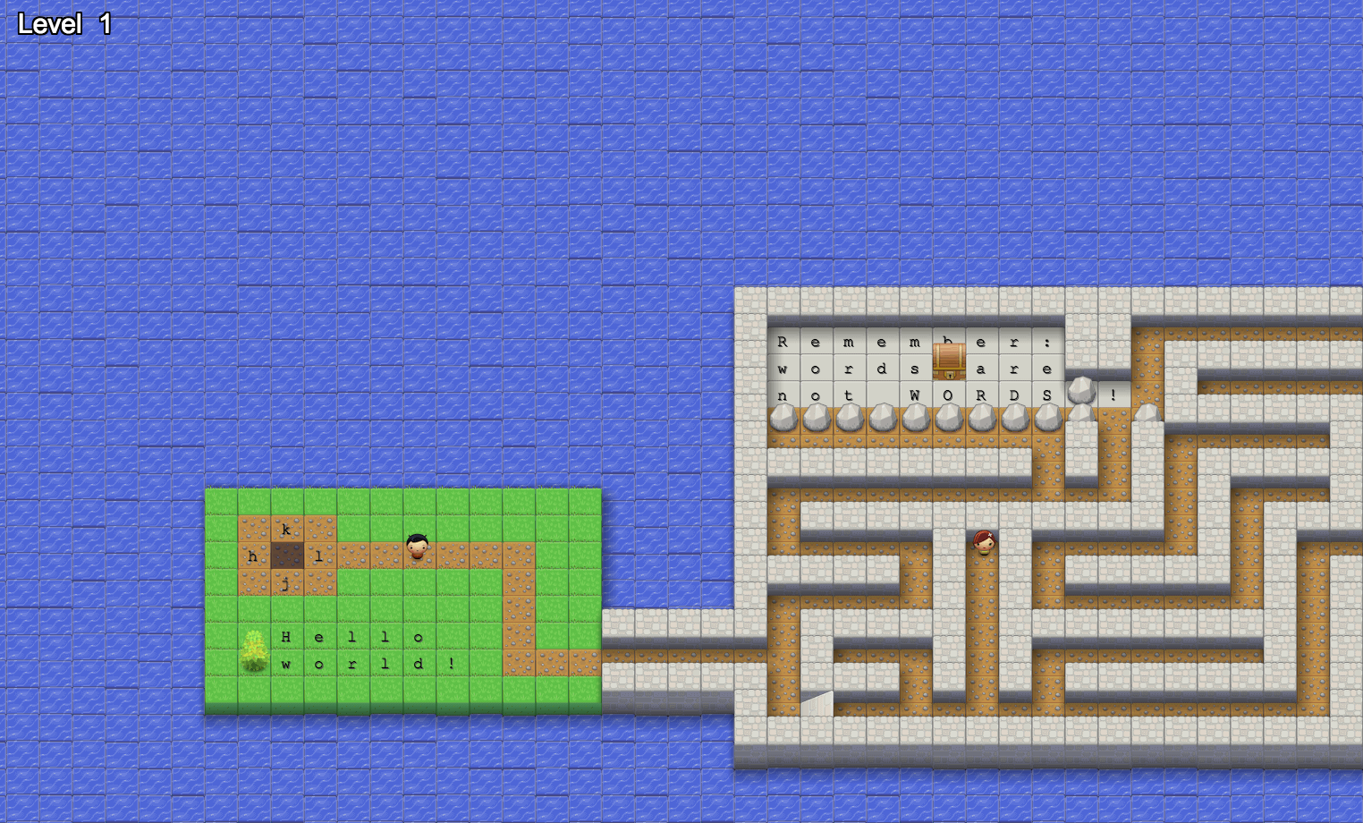
How to Prepare for cs107
  Vim Adventures: https://vim-adventures.com/

Slide 33
How to Prepare for cs107
  You might want to learn more about pointers, and pointers-to-pointers... https://www.tutorialspoint.com/cprogramming/c_pointer_to_pointer.htm
#include <stdio.h>
int main () {
int var;
int *ptr;
int **pptr;
var = 3000;
/* take the address of var */
ptr = &var;
/* take the address of ptr using address of operator & */
pptr = &ptr;
/* take the value using pptr */
printf("Value of var = %d\n", var );
printf("Value available at *ptr = %d\n", *ptr );
printf("Value available at **pptr = %d\n", **pptr);
return 0;
}

Slide 34
How to Prepare for cs107
  What is this "printf()" function??
  It is the "cout" for C
Let's talk about some C differences...

Slide 35
You will find C to be similar in feel to C++ (C++ is based on C, after all)
Things that are the same:
  built-in data types: int, char, float, double, long, unsigned int
  array indexing (using brackets, e.g., v[4])
  function declarations
  modularity between .h and .c files
  flow: while, if, for, etc.
How to Prepare for cs107
Going from C++ to C: “C has the speed and efficiency of assembly language combined with readability of assembly language.”

Slide 36
Things that are different:
  There isn’t a “string” type. Strings are null terminated arrays of chars.
  There are no classes, no objects, and no constructors/destructors.
  Memory management is more involved than in C++
    To allocate memory, C uses “malloc()” (so can C++, but normally we use new())
      You must provide a size to malloc, generally using “sizeof()”
    To free memory, C uses “free()”
    You cannot pass by reference in C (although you can pass pointers)
    C does not have a bool type: 0 means false, everything else is true.
How to Prepare for cs107
Going from C++ to C

Slide 37
There is no string class in C. Let me repeat: there is no string class in C.
Strings are simply arrays of characters, with the final character of the array set aside for the NULL character.
You must be careful to avoid buffer overflows when dealing with char strings.
How to Prepare for cs107
C strings: null terminated char arrays

Slide 38
Things that are the same but that you might not have learned about yet:
  There are entities called “void pointers” which can point to any type
  You often need to cast variables to different types
  “Pointer arithmetic” is often used instead of bracket notation
How to Prepare for cs107
Going from C++ to C

Slide 39
malloc() and free(), and sizeof(): used for memory management instead of new and delete
malloc() is used to reserve memory from the heap. You must pass it the size in bytes of the amount of memory you want. How do you know the size in bytes? You use sizeof():
sizeof(int) returns the size of an integer. On our machines, this is 4 bytes, or 32-bits.
How to Prepare for cs107
Going from C++ to C

Slide 40
malloc() returns a pointer to memory, e.g.,
/* an array of 10 ints from the heap */
int *int_ptr;
int_ptr = malloc(sizeof(int)*10);
malloc() returns NULL if the system runs out of memory.
How to Prepare for cs107
Going from C++ to C

Slide 41
How to Prepare for cs107
Going from C++ to C
  free() simply frees the previously allocated memory:
  /* an array of 10 ints from the heap */
  int *int_ptr;
  int_ptr = malloc(sizeof(int)*10);
  free(int_ptr);

Slide 42
Pointer arithmetic is really important in C, and you have to understand it.
How to Prepare for cs107
Going from C++ to C
int main() {
/* an array of 10 ints */
int *int_ptr;
int_ptr = (int *)malloc(sizeof(int)*10);
int i;
for(i=0;i<10;i++) {
*(int_ptr+i)=i*10;
}
for(i=0;i<5;i++) {
printf("%d\n",*(int_ptr+i*2));
}
free(int_ptr);
  return 0;
  }
What will this print out?
Oops — we’d better take a detour into
printf() land.

Slide 43
printf() writes a formatted string to the standard output. The format can include format specifiers that begin with % and additional arguments are inserted into the string, replacing their formatters.
How to Prepare for cs107
printf() — the way to print to stdout in C
Example: print the int variable, d:
int i = 22;
printf("This is i: %d\n",i);
output:
This is i: 22

Slide 44
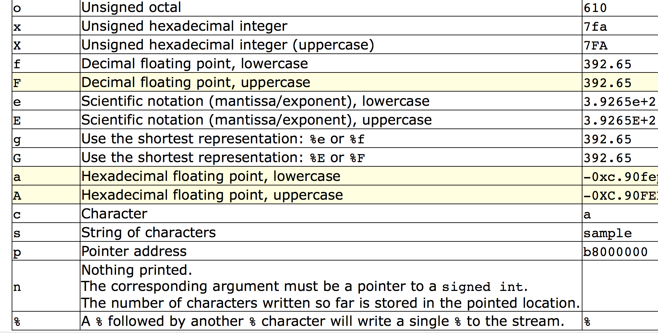
How to Prepare for cs107
printf() — the way to print to stdout in C
lots of specifiers

Slide 45
How to Prepare for cs107
printf() — more examples
#include <stdio.h>
int main()
{
printf ("Characters: %c %c \n", 'a', 65);
printf ("Decimals: %d %ld\n", 1977, 650000L);
printf ("Preceding with blanks: %10d \n", 1977);
printf ("Preceding with zeros: %010d \n", 1977);
printf ("Radices: %d %x %o %#x %#o \n", 100, 100, 100, 100, 100);
printf ("floats: %4.2f %+.0e %E \n", 3.1416, 3.1416, 3.1416);
printf ("Width trick: %*d \n", 5, 10);
printf ("%s \n", "A string");
return 0;
}
Characters: a A
Decimals: 1977 650000
Preceding with blanks: 1977
Preceding with zeros: 0000001977
Radices: 100 64 144 0x64 0144
floats: 3.14 +3e+000 3.141600E+000
Width trick: 10
A string

Slide 46
Pointer arithmetic is really important in C, and you have to understand it.
How to Prepare for cs107
Going from C++ to C (back to our example)
int main() {
/* an array of 10 ints */
int *int_ptr;
int_ptr = (int *)malloc(sizeof(int)*10);
int i;
for(i=0;i<10;i++) {
*(int_ptr+i)=i*10;
}
for(i=0;i<5;i++) {
printf("%d\n",*(int_ptr+i*2));
}
free(int_ptr);
  return 0;
  }
What will this print out?
0
20
40
60
80

Slide 47
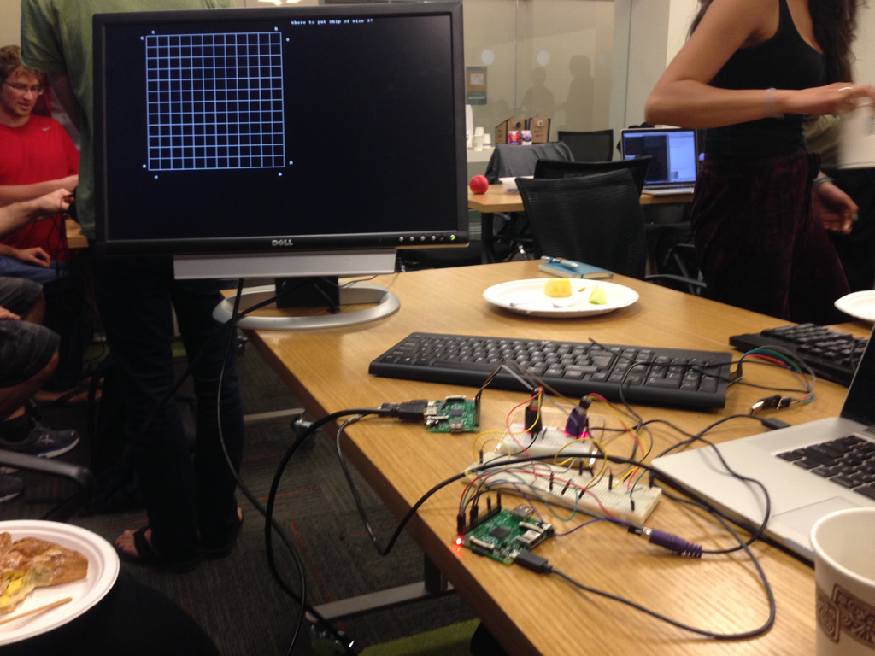
CS107E
CS107E
Computer Systems from the Ground Up

Slide 48


CS109
Foundations of
probability
Narrative driven
Intro to
Machine Learning

Slide 49



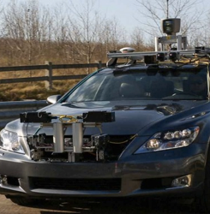

Computer Science Affects Every Field

Slide 50
Courses Aren't Necessary!
Things to learn on your own:
A new language. Good candidates?
  Python: used everywhere, easy to learn, easy to write quick programs. Best online resource: https://www.reddit.com/r/Python/ (see right side-bar)
  Haskell: a "functional" programming language. Best online resource: Learn You a Haskell for Great Good
iOS / Android Programming: Why not learn how to program your phone?
  Best iOS resource: https://www.raywenderlich.com
  Good tutorials link: http://equallysimple.com/best-android-development-video-tutorials/
  Want to code for all phones (and the web, and the desktop?) Check out React Native: https://facebook.github.io/react-native/
Hardware: Raspberry Pi, Arduino, FPGA: Hardware is awesome!
  Raspberry Pi resources: https://www.reddit.com/r/raspberry_pi/
  Arduino Resources: https://www.reddit.com/r/arduino/
  FPGA resources: http://www.embedded.com/design/prototyping-and-development/4006429/FPGA-programming-step-by-step
GPU and Multicore Programming: hard, but your code can fly
  Your GPU might have hundreds of individual processors. Resources: http://gpgpu.org

Slide 51
Python

Slide 52

It is the Time and Place for CS

Slide 53
It is the Time and Place for CS
Thank You

Slide 54
It is the Time and Place for CS
Congrats (in advance)

Slide 55
References and Advanced Reading
References:
  https://en.wikipedia.org/wiki/Theory_of_computation
  https://explorecourses.stanford.edu/search;jsessionid=1xnekjf0f94bc1gql4to9qrgzp?view=catalog&academicYear=&page=0&q=CS&filter-departmentcode-CS=on&filter-coursestatus-Active=on&filter-term-Autumn=on
  https://www.theguardian.com/technology/self-driving-cars

