Slide 1
Wednesday, August 16, 2017
CS 106B
Lecture 28: Different Languages
Programming Abstractions
Summer 2017
Stanford University
Computer Science Department
Lecturer: Chris Gregg
reading:
Programming Abstractions in C++, Chapter 19

Slide 2
Today's Topics
Logistics
  Final Exam prep online: http://web.stanford.edu/class/cs106b/handouts/final.html
  Mini-review session on Inheritance: STLC 111, 7:30pm, Wednesday
  Final Review Session: STLC 111, 6:30-7:30pm, Thursday August 17th
  Final exam is on Saturday, August 19th at 8:30am — I need a good list of students who will need power strip access; please fill out the survey on Piazza: https://piazza.com/class/j44l3eyaz006uz
Different Languages You Might Like
  PDF for code: http://web.stanford.edu/class/cs106b/lectures/28-DifferentLanguages/code/handout.pdf
  Fun Languages
  Python
  Javascript and D3
  Haskell
  COBOL
  Obfuscated C
  Quines

Slide 3
Different Languages
There are literally hundreds of programming languages.
You probably have never heard of most of them, and you will almost certainly never program in most of them.
https://en.wikipedia.org/wiki/List_of_programming_languages

Slide 4
Some fun examples
There are also a number of "Esoteric Programming Languages," which can be fun:
https://en.wikipedia.org/wiki/Esoteric_programming_language

Slide 5
Some fun examples: LOLCODE
HAI 1.0
CAN HAS STDIO?
I HAS A VAR
IM IN YR LOOP
UP VAR!!1
VISIBLE VAR
IZ VAR BIGGER THAN 10? KTHX
IM OUTTA YR LOOP
KTHXBYE
https://en.wikipedia.org/wiki/LOLCODE

Slide 6
Some fun examples: Piet
A "Hello World" program in Piet
Piet is a language designed by David Morgan-Mar, whose programs are bitmaps that look like abstract art. The compilation is guided by a "pointer" that moves around the image, from one continuous coloured region to the next. Procedures are carried through when the pointer exits a region.
Source: https://en.wikipedia.org/wiki/Esoteric_programming_language#Piet

Slide 7
Some fun examples: Whitespace
S S S T S S T S S S L
T L
S S S S S T T S S T S T L
T L
S S S S S T T S T T S S L
T L
S S S S S T T S T T S S L
T L
S S S S S T T S T T T T L
T L
S S S S S T S T T S S L
T L
S S S S S T S S S S S L
T L
S S S S S T T T S T T T L
T L
S S S S S T T S T T T T L
T L
S S S S S T T T S S T S L
T L
S S S S S T T S T T S S L
T L
S S S S S T T S S T S S L
T L
S S S S S T S S S S T L
T L
S S L
L
L
A "Hello World" program in Whitespace
This is a commented Whitespace program that simply prints "Hello, world!", where each Space, Tab, or Linefeed character is preceded by the identifying comment "S", "T", or "L", respectively:
Source: https://en.wikipedia.org/wiki/Whitespace_(programming_language)

Slide 8
Python
Python is an extremely readable programming language (it looks like psuedocode), and is really simple to learn (though it takes a long time to learn it really well!)
In Python, whitespace matters, but that means that curly braces aren't necessary:
for i in range(10):
print("Hello " + str(i))
One cool feature of Python is that it has a "REPL" that you can simply open up and type on. Let's try it!

Slide 9
Python
Python has some neat built-in functionality, such as arbitrary length integers:
>>> 2 ** 2 ** 2 ** 2 ** 2
The "**" means exponent. How many digits is this going to be?

Slide 10
Python
Python has some neat built-in functionality, such as arbitrary length integers:
The "**" means exponent. How many digits is this going to be?
>>> len(str(2 ** 2 ** 2 ** 2 ** 2))
19729

Slide 11
Python
Python has built-in lists, dictionaries (hash tables), sets, queues, psuedo-random number generators, etc., and it is also object oriented and has classes.
You can return multiple values in Python:
import math
def quadEqSolver(a,b,c):
inner = math.sqrt(b * b - 4 * a * c)
return (-b + inner) / (2 * a), (-b - inner) / (2 * a)

Slide 12
FizzBuzz
A famous easy coding interview question is "FizzBuzz," defined as follows:
Write a program that prints the numbers from 1 to 100.
But for multiples of three print “Fizz” instead of the
number and for the multiples of five print “Buzz”. For
numbers which are multiples of both three and five
print “FizzBuzz”.
We can write this relatively easily in most languages, so we'll do it in the different languages we look at today.

Slide 13
C++ FizzBuzz
#include <iostream>
using namespace std;
int main ()
{
for(int i = 1; i <= 100; i++)
{
if(i % 3 == 0 && i % 5 == 0) {
cout << "FizzBuzz" << endl;
} else if(i % 3 == 0) {
cout << "Fizz" << endl;
} else if(i % 5 == 0) {
cout << "Buzz" << endl;
} else {
cout << i << endl;
}
}
return 0;
}
Output:
1
2
Fizz
4
Buzz
Fizz
7
8
Fizz
Buzz
11
Fizz
13
14
FizzBuzz
16
17
Fizz
etc.

Slide 14
Python FizzBuzz
Output:
$ python fizzBuzz.py
1
2
Fizz
4
Buzz
Fizz
7
8
Fizz
Buzz
11
Fizz
13
14
FizzBuzz
16
17
Fizz
for i in range(1,100):
if i % 3 == 0 and i % 5 == 0:
print("FizzBuzz")
elif i % 3 == 0:
print("Fizz")
elif i % 5 == 0:
print("Buzz")
else:
print(i)
etc.

Slide 15
Python
If you are going to learn one more language, learn Python — you won't be disappointed!
>>> import this
>>> import antigravity

Slide 16

JavaScript and D3
JavaScript has become the "language of the Web"
It is not the best language, but it is a pretty good one (but, give the Author, Brendan Each, a break — he created it in 10 days!)
JavaScript and Java are completely different languages, although they both share "C-like syntax". So, for loops look very familiar:
for (var i=0; i < 10; i++) {
console.log("Hello " + i);
}
You already have JavaScript installed and ready to go — it's built into the browser. Let's play!

Slide 17
JavaScript FizzBuzz
function fizzBuzz() {
for(var i = 1; i <= 100; i++)
{
if(i % 3 == 0 && i % 5 == 0) {
console.log("FizzBuzz");
} else if(i % 3 == 0) {
console.log("Fizz");
} else if(i % 5 == 0) {
console.log("Buzz");
} else {
console.log(i);
}
}
}
Looks a lot like C++!
JavaScript syntax is basically the same, but the model is much different!

Slide 18
JavaScript FizzBuzz, output to Web Page
FizzBuzz.html:
fizzBuzz_web.js:
<!DOCTYPE html>
<html>
<head>
<script type="text/javascript"
src="fizzBuzz_web.js"></script>
</head>
<body onload=fizzBuzz()>
<div id="fizzBuzzOutput">
This is the default text.
</div>
</body>
</html>
function fizzBuzz() {
fb_div = document.getElementById('fizzBuzzOutput');
// clear current contents
fb_div.innerHTML = ""
for(var i = 1; i <= 100; i++)
{
if(i % 3 == 0 && i % 5 == 0) {
fb_div.innerHTML += "FizzBuzz<br>";
} else if(i % 3 == 0) {
fb_div.innerHTML += "Fizz<br>";
} else if(i % 5 == 0) {
fb_div.innerHTML += "Buzz<br>";
} else {
fb_div.innerHTML += i + "<br>";
}
}
return 0;
}

Slide 19
JavaScript FizzBuzz, output to Web Page
FizzBuzz.html:
fizzBuzz_web.js:
<!DOCTYPE html>
<html>
<head>
<script type="text/javascript"
src="fizzBuzz_web.js"></script>
</head>
<body onload=fizzBuzz()>
<div id="fizzBuzzOutput">
This is the default text.
</div>
</body>
</html>
function fizzBuzz() {
fb_div = document.getElementById('fizzBuzzOutput');
// clear current contents
fb_div.innerHTML = ""
for(var i = 1; i <= 100; i++)
{
if(i % 3 == 0 && i % 5 == 0) {
fb_div.innerHTML += "FizzBuzz<br>";
} else if(i % 3 == 0) {
fb_div.innerHTML += "Fizz<br>";
} else if(i % 5 == 0) {
fb_div.innerHTML += "Buzz<br>";
} else {
fb_div.innerHTML += i + "<br>";
}
}
return 0;
}
One problem…we want our websites to be responsive, and we don't like loops!

Slide 20
JavaScript FizzBuzz, output to Web Page
fizzBuzz_web_noLoop.js:
function fizzBuzz() {
fb_div = document.getElementById('fizzBuzzOutput');
// clear current contents
fb_div.innerHTML = ""
var i = 1;
var timer = setInterval(function() {
if(i % 3 == 0 && i % 5 == 0) {
fb_div.innerHTML += "FizzBuzz<br>";
} else if(i % 3 == 0) {
fb_div.innerHTML += "Fizz<br>";
} else if(i % 5 == 0) {
fb_div.innerHTML += "Buzz<br>";
} else {
fb_div.innerHTML += i + "<br>";
}
i++;
if (i == 100) {
// stop the timer
clearInterval(timer);
}
},1);
return 0;
}
Set a timer for each iteration
Fires every millisecond

Slide 21
JavaScript FizzBuzz, output to Web Page
fizzBuzz_web_noLoop.js:
function fizzBuzz() {
fb_div = document.getElementById('fizzBuzzOutput');
// clear current contents
fb_div.innerHTML = ""
var i = 1;
var timer = setInterval(function() {
if(i % 3 == 0 && i % 5 == 0) {
fb_div.innerHTML += "FizzBuzz<br>";
} else if(i % 3 == 0) {
fb_div.innerHTML += "Fizz<br>";
} else if(i % 5 == 0) {
fb_div.innerHTML += "Buzz<br>";
} else {
fb_div.innerHTML += i + "<br>";
}
i++;
if (i == 100) {
// stop the timer
clearInterval(timer);
}
},1);
return 0;
}
This is called an "anonymous function", and it is what gets called every time the timer fires.
It takes some getting used to!

Slide 22
JavaScript FizzBuzz, output to Web Page
fizzBuzz_web_noLoop.js:
function fizzBuzz() {
fb_div = document.getElementById('fizzBuzzOutput');
// clear current contents
fb_div.innerHTML = ""
var i = 1;
var timer = setInterval(function() {
if(i % 3 == 0 && i % 5 == 0) {
fb_div.innerHTML += "FizzBuzz<br>";
} else if(i % 3 == 0) {
fb_div.innerHTML += "Fizz<br>";
} else if(i % 5 == 0) {
fb_div.innerHTML += "Buzz<br>";
} else {
fb_div.innerHTML += i + "<br>";
}
i++;
if (i == 100) {
// stop the timer
clearInterval(timer);
}
},1);
return 0;
}
Increment i to keep track of the iteration count

Slide 23
JavaScript FizzBuzz, output to Web Page
fizzBuzz_web_noLoop.js:
function fizzBuzz() {
fb_div = document.getElementById('fizzBuzzOutput');
// clear current contents
fb_div.innerHTML = ""
var i = 1;
var timer = setInterval(function() {
if(i % 3 == 0 && i % 5 == 0) {
fb_div.innerHTML += "FizzBuzz<br>";
} else if(i % 3 == 0) {
fb_div.innerHTML += "Fizz<br>";
} else if(i % 5 == 0) {
fb_div.innerHTML += "Buzz<br>";
} else {
fb_div.innerHTML += i + "<br>";
}
i++;
if (i == 100) {
// stop the timer
clearInterval(timer);
}
},1);
return 0;
}
Stop the timer after we reach 100

Slide 24
D3.js
If you are taking cs193c this quarter, you already know a bit about JavaScript, and HTML. There are a ton of JavaScript libraries online. One of my favorites is a JavaScript library that can make dynamic data visualizations really easily.
Let's look at some examples!
http://christopheviau.com/d3list/gallery.html
https://github.com/d3/d3/wiki/Gallery

Slide 25
eclipse.js
Yesterday, I wrote a little D3 animation to show the path of the Solar Eclipse that is happening next week.
I found the data online at https://eclipse.gsfc.nasa.gov/SEpath/SEpath2001/SE2017Aug21Tpath.html
I did a bit of work to make the data readable for my program (latitude and longitude for the center of the path and the northern and southern limits), and then grabbed a map.
The hardest part was translating the lat/long values onto the map, and it isn't perfect, but the math wasn't too hard.
http://stanford.edu/~cgregg/eclipse/

Slide 26
Haskell
Haskell is a completely different way of programming than you are used to (though not as different as some of the esoteric languages)
Haskell is a "purely functional" programming language, meaning that all computation is the result of evaluating mathematical functions. There is no concept of "mutable" data in Haskell, and all functions only depend on their arguments and no other information.
The book Learn You a Haskell for Great Good! is a terrific way to learn the language!
LYaHfGG

Slide 27
Haskell Example (from LYaHfGG)
sample.hs:
doubleMe x = x + x
doubleUs x y = x*2 + y*2
doubleSmallNumber x = if x > 100
then x
else x*2
Functions are defined simply. If statements look a little different, too.

Slide 28
Haskell Example (from LYaHfGG)
doubleMe x = x + x
doubleUs x y = x*2 + y*2
doubleSmallNumber x = if x > 100
then x
else x*2
Sample functions (sample.hs)
$ ghci
GHCi, version 8.0.2: http://www.haskell.org/ghc/ :? for help
Prelude> :set prompt "ghci> "
ghci> :l sample.hs
[1 of 1] Compiling Main ( sample.hs, interpreted )
Ok, modules loaded: Main.
ghci> doubleMe 4
8
ghci> doubleMe 8.2
16.4
ghci> doubleUs 5 4
18
ghci> doubleSmallNumber 12
24
ghci> doubleSmallNumber 120
120
ghci>
Testing the functions

Slide 29
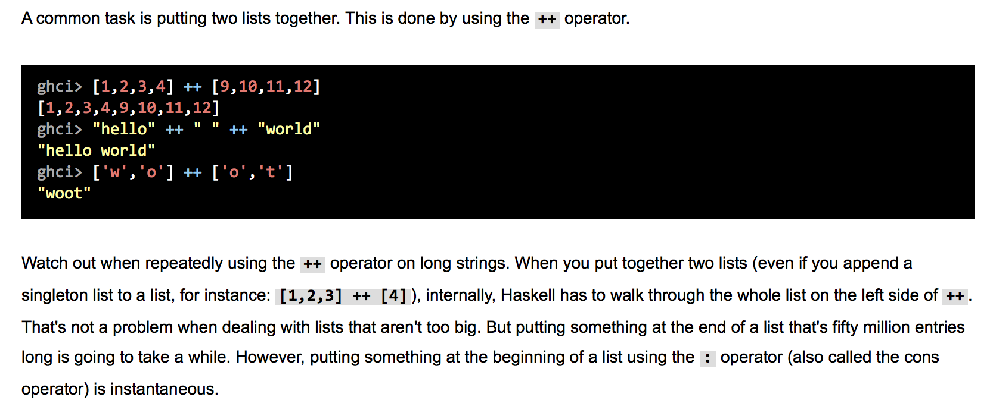
Lists in Haskell (from LYaHfGG)

Slide 30
Lists in Haskell (from LYaHfGG)
How do you think Haskell stores its lists?

Slide 31
Lists in Haskell (from LYaHfGG)
How do you think Haskell stores its lists?
As linked lists!

Slide 32
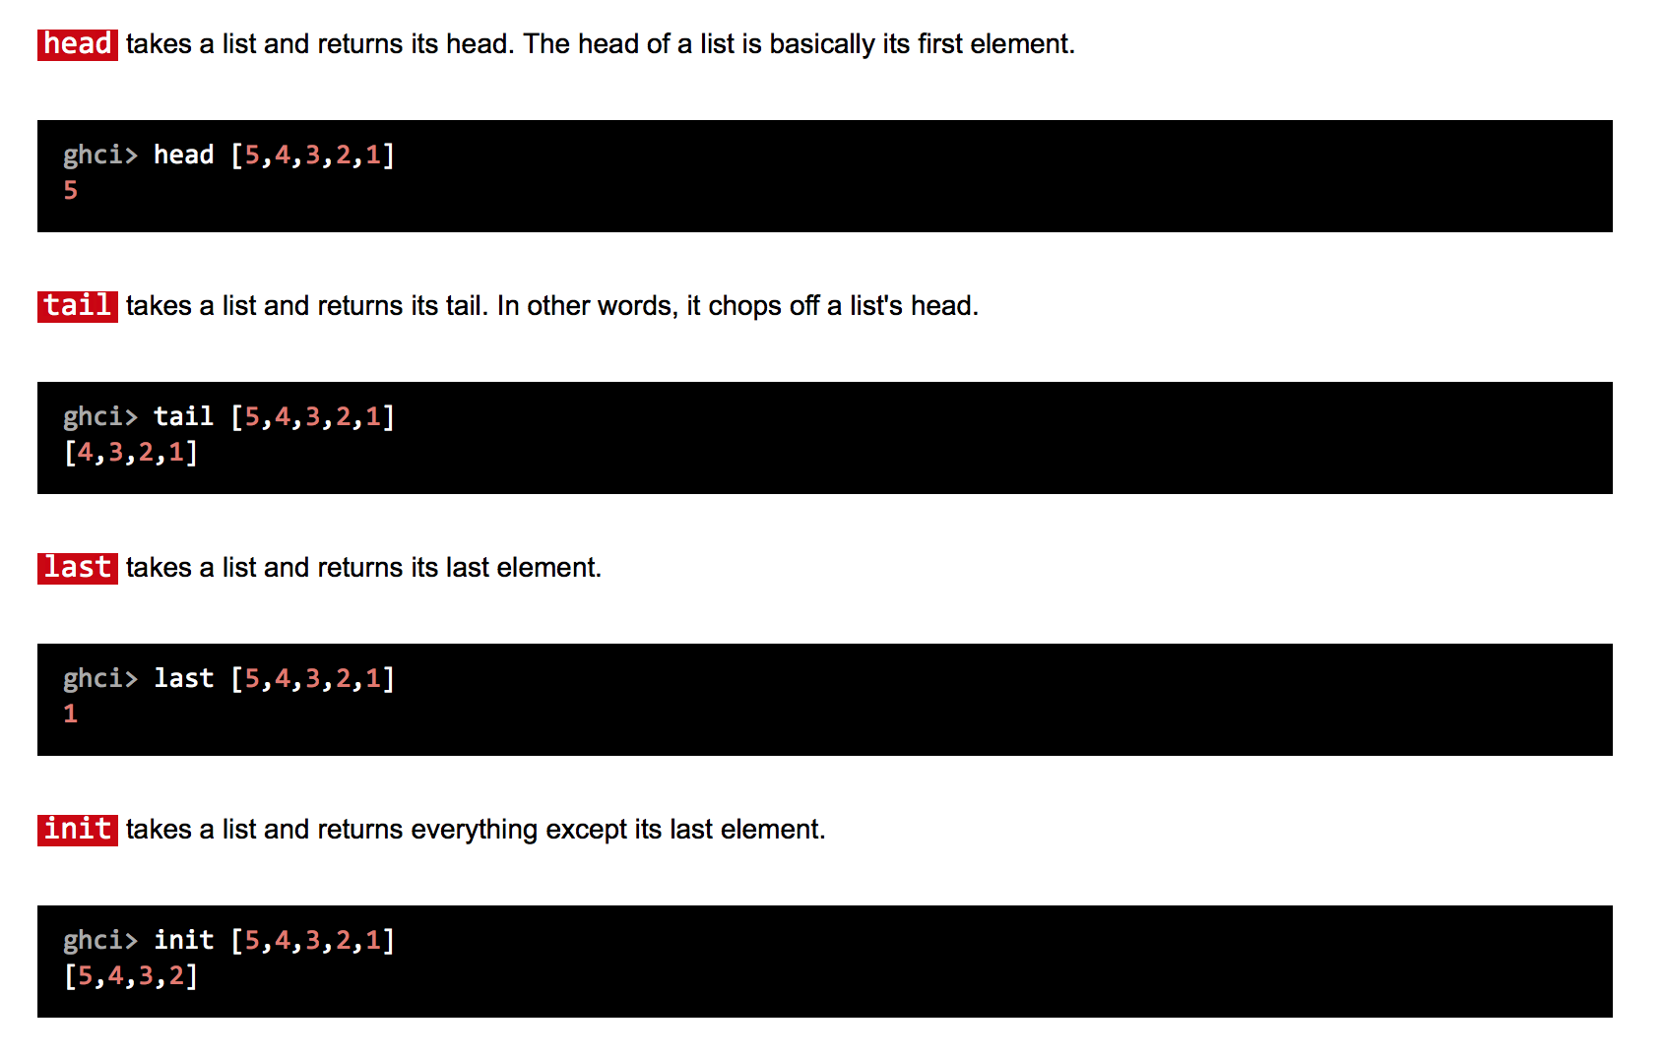
Lists operations in Haskell (from LYaHfGG)

Slide 33
Haskell FizzBuzz
module Main where
main :: IO ()
main = printAll $ map fizzBuzz [1..100]
where
printAll [] = return ()
printAll (x:xs) = putStrLn x >> printAll xs
fizzBuzz :: Integer -> String
fizzBuzz n | n `mod` 15 == 0 = "FizzBuzz"
| n `mod` 5 == 0 = "Fizz"
| n `mod` 3 == 0 = "Buzz"
| otherwise = show n
Doesn't look like C++!
Haskell takes some getting used to…

Slide 34
COBOL
Someone asked if we could talk a bit about COBOL. I had to look up how to run COBOL programs, but it isn't too difficult:
IDENTIFICATION DIVISION.
PROGRAM-ID. HELLO-WORLD.
*> SIMPLE HELLO WORLD PROGRAM
PROCEDURE DIVISION.
DISPLAY 'HELLO, WORLD!'.
STOP RUN.
It is really old-school: all UPPERCASE letters
It was made to be "readable", but it reminds me of this:
https://www.youtube.com/watch?v=PT_DnxmyuhA

Slide 35
COBOL FizzBuzz
IDENTIFICATION DIVISION.
PROGRAM-ID. FIZZ-BUZZ.
DATA DIVISION.
WORKING-STORAGE SECTION.
01 CT PIC 999 VALUE 1.
01 FZ PIC 999 VALUE 1.
01 BZ PIC 999 VALUE 1.
PROCEDURE DIVISION.
FIZZ-BUZZ-MAIN SECTION.
PERFORM 100 TIMES
IF FZ = 3
THEN IF BZ = 5
THEN DISPLAY "FizzBuzz"
COMPUTE BZ = 0
ELSE DISPLAY "Fizz"
END-IF
COMPUTE FZ = 0
ELSE IF BZ = 5
THEN DISPLAY "Buzz"
COMPUTE BZ = 0
ELSE
DISPLAY CT
END-IF
END-IF
ADD 1 TO CT
ADD 1 TO FZ
ADD 1 TO BZ
END-PERFORM
STOP RUN.

Slide 36
Grace Hopper: Creator of COBOL
The Harvard Mark I, one of the first computers in the world
Rear Admiral, U.S. Navy
The first "bug" in the computer
Hopper on Letterman: https://www.youtube.com/watch?v=1-vcErOPofQ

Slide 37
Obfucsated C
http://www.ioccc.org
# include<stdio.h>// .IOCCC Fluid- #
# include <unistd.h> //2012 _Sim!_ #
# include<complex.h> //|||| ,____. IOCCC- #
# define h for( x=011; 2012/* #
# */-1>x ++;)b[ x]//-' winner #
# define f(p,e) for(/* #
# */p=a; e,p<r; p+=5)// #
# define z(e,i) f(p,p/* #
## */[i]=e)f(q,w=cabs (d=*p- *q)/2- 1)if(0 <(x=1- w))p[i]+=w*/// ##
double complex a [ 97687] ,*p,*q ,*r=a, w=0,d; int x,y;char b/* ##
## */[6856]="\x1b[2J" "\x1b" "[1;1H ", *o= b, *t; int main (){/** ##
## */for( ;0<(x= getc ( stdin) );)w=x >10?32< x?4[/* ##
## */*r++ =w,r]= w+1,*r =r[5]= x==35, r+=9:0 ,w-I/* ##
## */:(x= w+2);; for(;; puts(o ),o=b+ 4){z(p [1]*/* ##
## */9,2) w;z(G, 3)(d*( 3-p[2] -q[2]) *P+p[4 ]*V-/* ##
## */q[4] *V)/p[ 2];h=0 ;f(p,( t=b+10 +(x=*p *I)+/* ##
## */80*( y=*p/2 ),*p+=p [4]+=p [3]/10 *!p[1]) )x=0/* ##
## */ <=x &&x<79 &&0<=y&&y<23?1[1 [*t|=8 ,t]|=4,t+=80]=1/* ##
## */, *t |=2:0; h=" '`-.|//,\\" "|\\_" "\\/\x23\n"[x/** ##
## */%80- 9?x[b] :16];;usleep( 12321) ;}return 0;}/* ##
#### ####
###############################################################################
**###########################################################################*/
https://www.youtube.com/watch?v=QMYfkOtYYlg

Slide 38
Quines
A quine is a non-empty computer program which takes no input and produces a copy of its own source code as its only output.
https://en.wikipedia.org/wiki/Quine_(computing)
https://github.com/mame/quine-relay

Slide 39
LOLCODE FizzBuzz
HAI
CAN HAS STDIO?
I HAS A VAR IZ 0
IM IN YR LOOP
UPZ VAR!!1
IZ VAR BIGR THAN 100?
GTFO.
KTHX
IZ VAR LEFTOVAR 15 LIEK 0?
VISIBLE "FIZZBUZZ"
KTHX
ORLY?
IZ VAR LEFTOVAR 5 LIEK 0?
VISIBLE "BUZZ"
KTHX
ORLY?
IZ VAR LEFTOVAR 3 LIEK 0?
VISIBLE "FIZZ"
KTHX
NOWAI
VISIBLE VAR
KTHX
KTHX
KTHXBYE

Slide 40
References and Advanced Reading
References:
  C++ Inheritance: https://www.tutorialspoint.com/cplusplus/cpp_inheritance.htm
  C++ Polymorphism: https://www.tutorialspoint.com/cplusplus/cpp_polymorphism.htm
Advanced Reading:
  http://stackoverflow.com/questions/5854581/polymorphism-in-c
  https://www.codingunit.com/cplusplus-tutorial-polymorphism-and-abstract-base-class

