Slide 1
Programming Abstractions in C++
CS106B
Instructors:
Cynthia Bailey
Chris Gregg

Slide 2
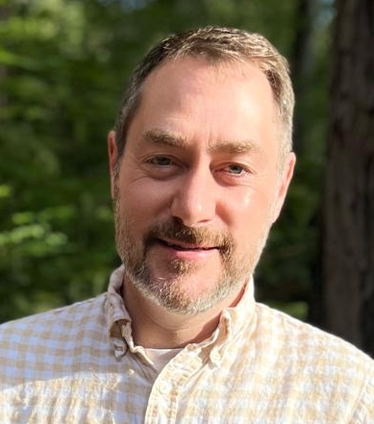
Meet your instructors:
Chris Gregg
  Undergraduate degree in Electrical Engineering (Johns Hopkins), Master’s in Education (Harvard), Ph.D. in Computer Engineering (University of Virginia).
  After undergrad school, I joined the Navy as a Cryptologist. I was on active duty for about seven years, and then in the reserves for another 15 years. I deployed all over the world, and lived in Australia for two years.
  After my active duty service, I became a high school physics teacher, and did that for about seven years in Massachusetts and in Santa Cruz.
  Eventually, I got my Ph.D. and decided to keep teaching, first at Tufts University, and then at Stanford. This is my eighth year at Stanford.
  I love to tinker — my espresso machine is connected to the internet. stop by my office some time to see my typewriter projects.

Slide 3
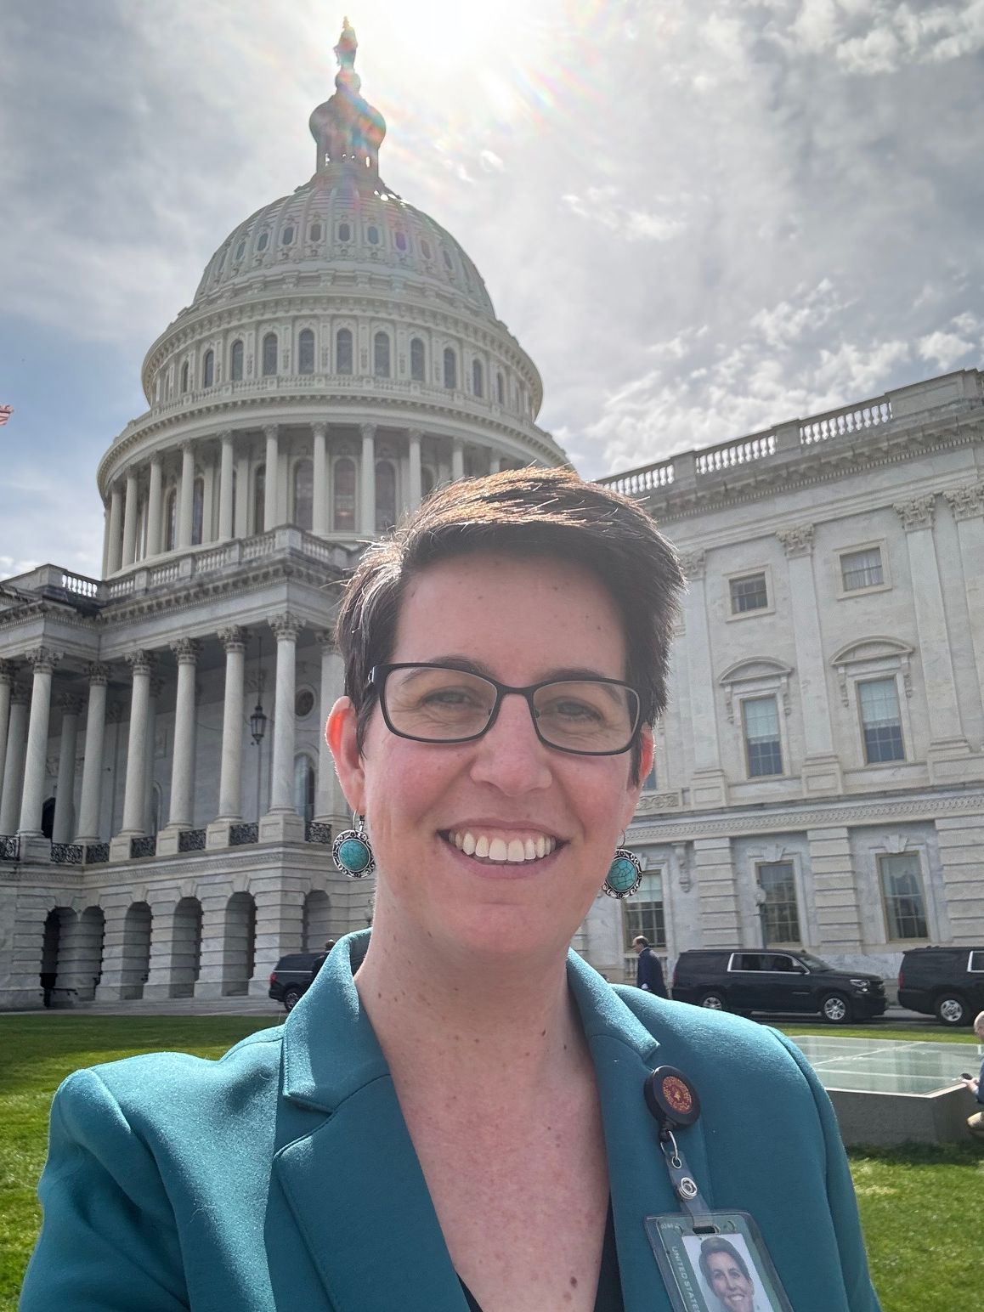
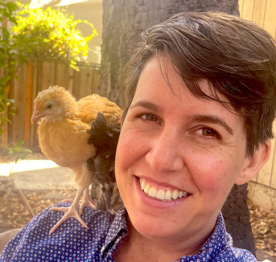
Meet your instructors:
Cynthia Bailey
  This year my partner and I are the new RFs in J-Ro House in Sequoia.
  Last year I was on leave from Stanford, living in DC and advising the U.S. Senate on AI legislation. I met with stakeholders like NATO officials, CEOs, artists, and academics, and wrote bills relating to AI/tech.
  I’ve been teaching at Stanford for over 10 years, primarily CS106B and CS103. I also teach seminars “AI Governance” and “Race & Gender in Silicon Valley.”
  For both undergrad and PhD, I studied CS at UC San Diego, focus on supercomputing and machine learning.
  I’ve worked as a software engineer or consultant at startups, NASA, and law firms.
  Hobbies: Family, biking, hiking, cooking, “like a cat lady, but for chickens”

Slide 4
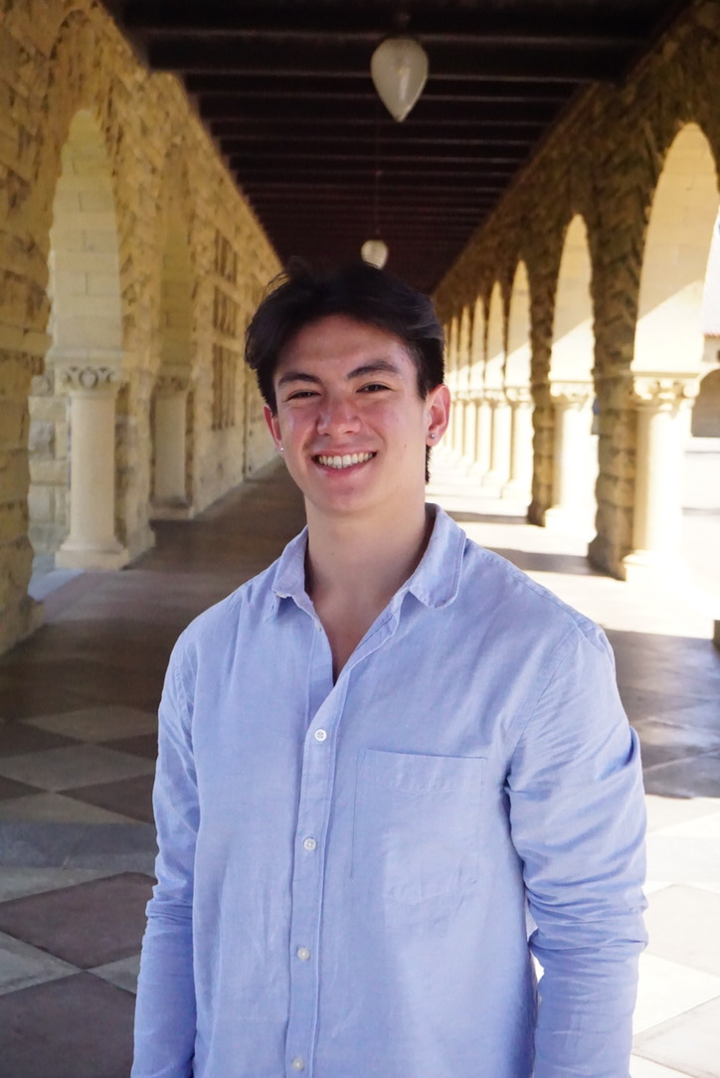
Meet your Head TA:
Jonathan Coronado
  Stanford BS '24, Currently MS '25
  I took CS106B Winter 2021!
  Teaching
  SL since Fall '22, first time head TA!
  Here to help you succeed in 106B! Please do not hesitate to reach out to me at jonathan.coronado@stanford.edu with anything you need!
  Software Engineering
  Most recently Backend Engineer at DoorDash, AWS before that
  Away from Keyboard
  Running, crosswords, lifting, the seahawks!

Slide 5
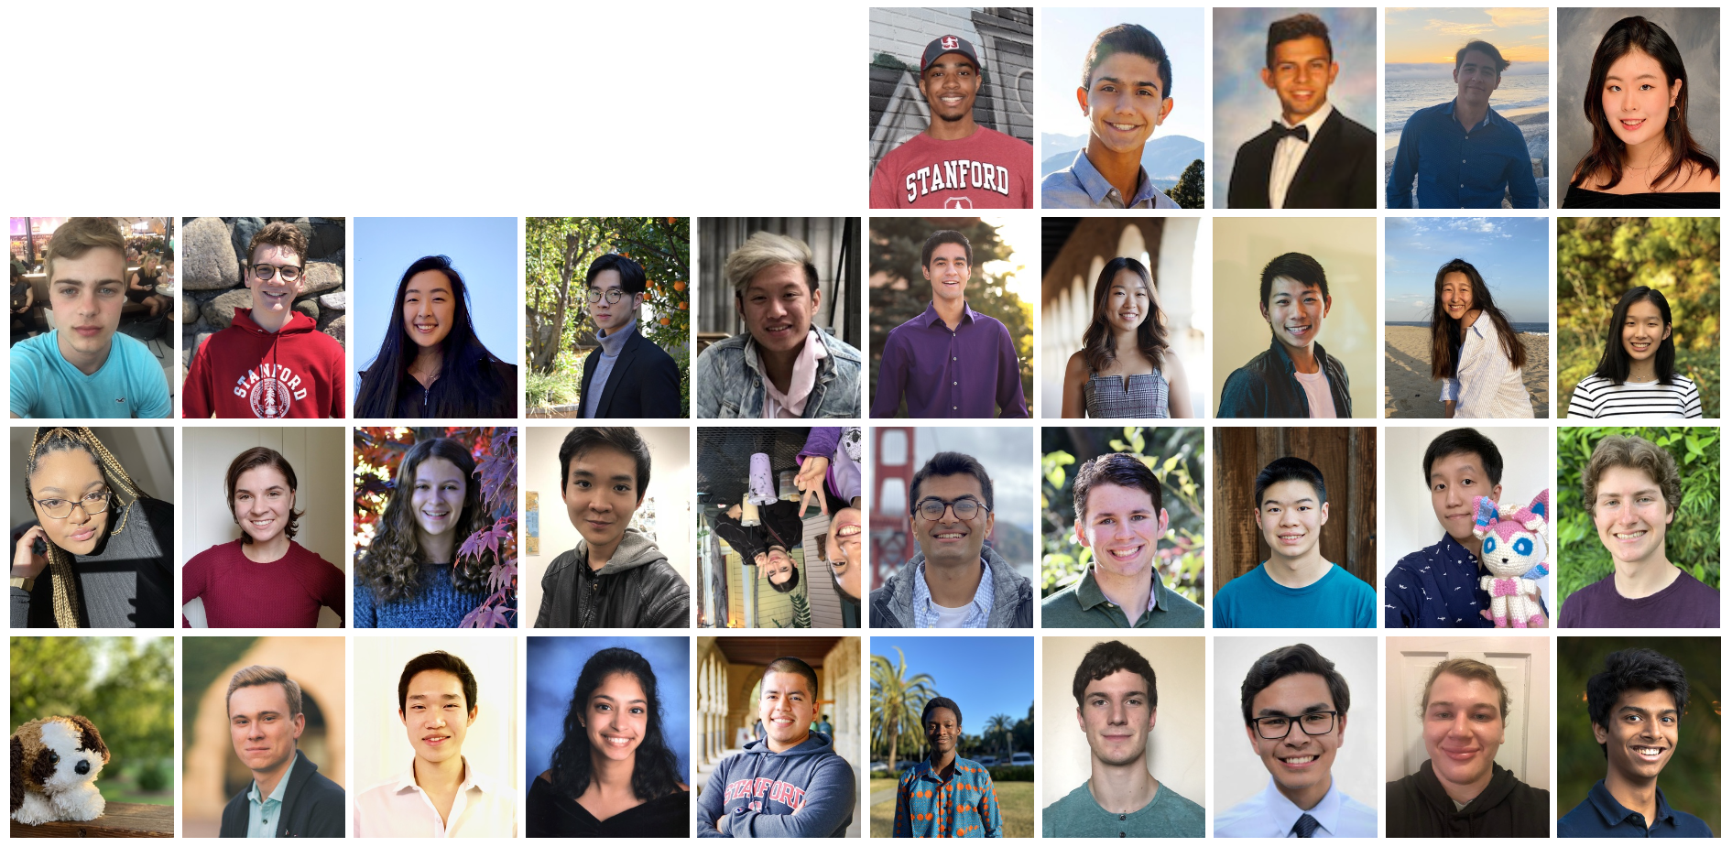
Discussion Section, Section Leaders (“SLs”)
  Section Leaders are helpful undergraduate assistants
  Your personal trainer in 106B
  Meet with the same SL each week
  (consider being one in the future!)

Slide 6
Course Logistics
Quick overview of how to earn the grade you want in CS106B

Slide 7
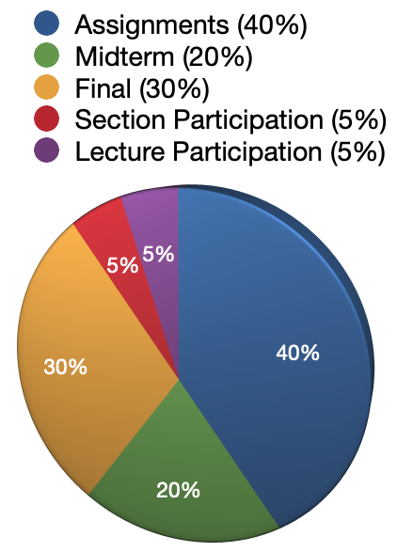
Course Grade Overview
  Your course grade will be calculated as follows:
  40% assignments
  20% Midterm
  30% Final
  5% Section participation
  5% Lecture participation
  (Details and caveats on next slide.)

Slide 8
Course Grade Overview
  The assignments are the most important part of the course, and weighted accordingly.
  We also want section discussions to be robust, so we are including a section participation component.
    To get an “A” in the class, you may only miss one section.
  Midterm: Tuesday, October 29th, 7-9pm PST
  Final: Monday, December 9th, 8:30am-11:30am, PST Note:
    You must pass the final exam in order to pass the course.
  Important: If you are an undergraduate, you must take the course for 5 units. We will not assign grades to undergraduates who take the course for fewer than 5 units.

Slide 9
CS106L: Standard C++ Programming
  1 unit
  T/Th 4:30-5:50pm, Thornton 110
  Course Info: cs106l.stanford.edu
  Covers additional topics on C++ features not included in CS106B, where our focus is on the algorithms used to manage large datasets—which apply regardless of programming language used—and not as much on the details of C++ syntax.
    Templates, streams, lambdas, operator overloading, R-values, and more!
  Questions? Reach out to Fabio and Jacob!
  (fabioi@stanford.edu & jtrb@stanford.edu)

Slide 10
CS106B Course Culture
How to succeed in this longstanding community at stanford

Slide 11
Community norms and expectations
  Celebrate discovery and growth. No gatekeeping, shaming, or comparisons based on who knew what coming in.
    Example of things we’re not going to do: audience “questions” in lecture that are just showing off that you know some jargon.
  Shed “zero-sum” and scarcity attitudes. There are plenty of tech jobs.
    Others gaining strength in the power of coding doesn’t take power away from you. Be helpful and encouraging, try to feel as genuinely happy when others around you succeed as when you succeed.
  Do your own work. We take this very seriously, because that’s how you grow.
    Nobody gets good at yoga by watching videos. You have to get on the mat, and sometimes you have to sweat. No shortcuts. We do enforce, but it can’t only be about enforcement—you need to decide within yourself to hold the line on integrity.

Slide 12
Programming Abstractions in C++
What are “programming abstractions”?

Slide 13
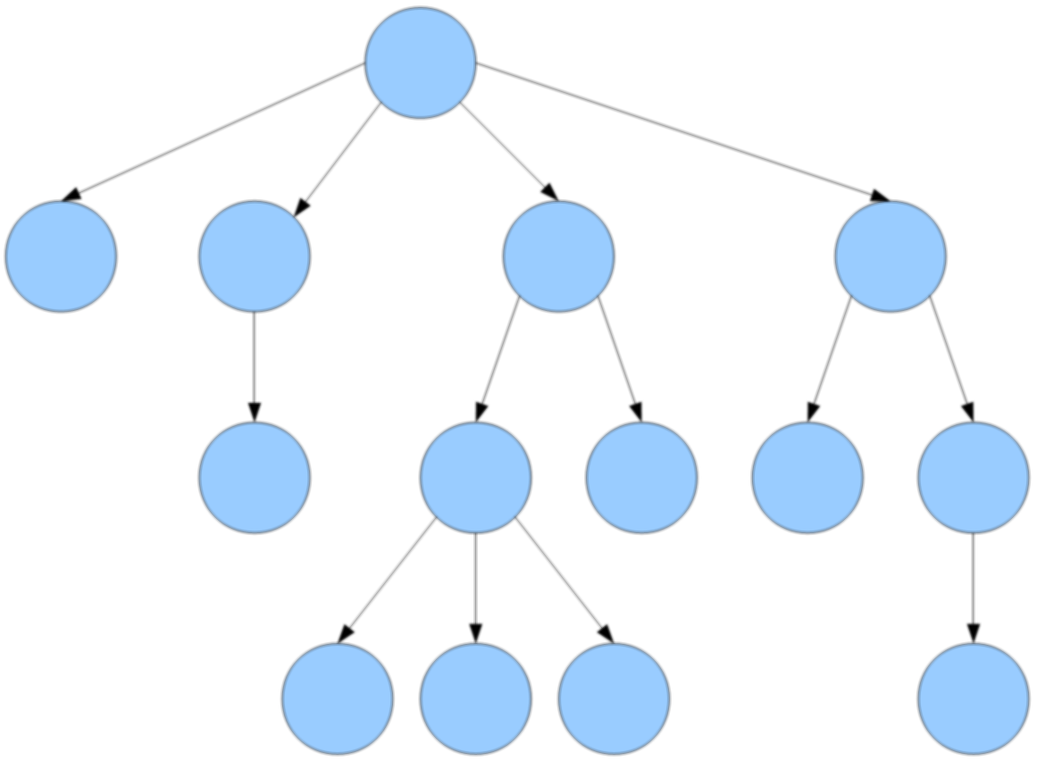
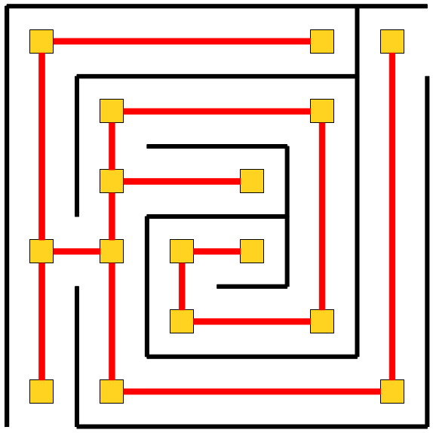
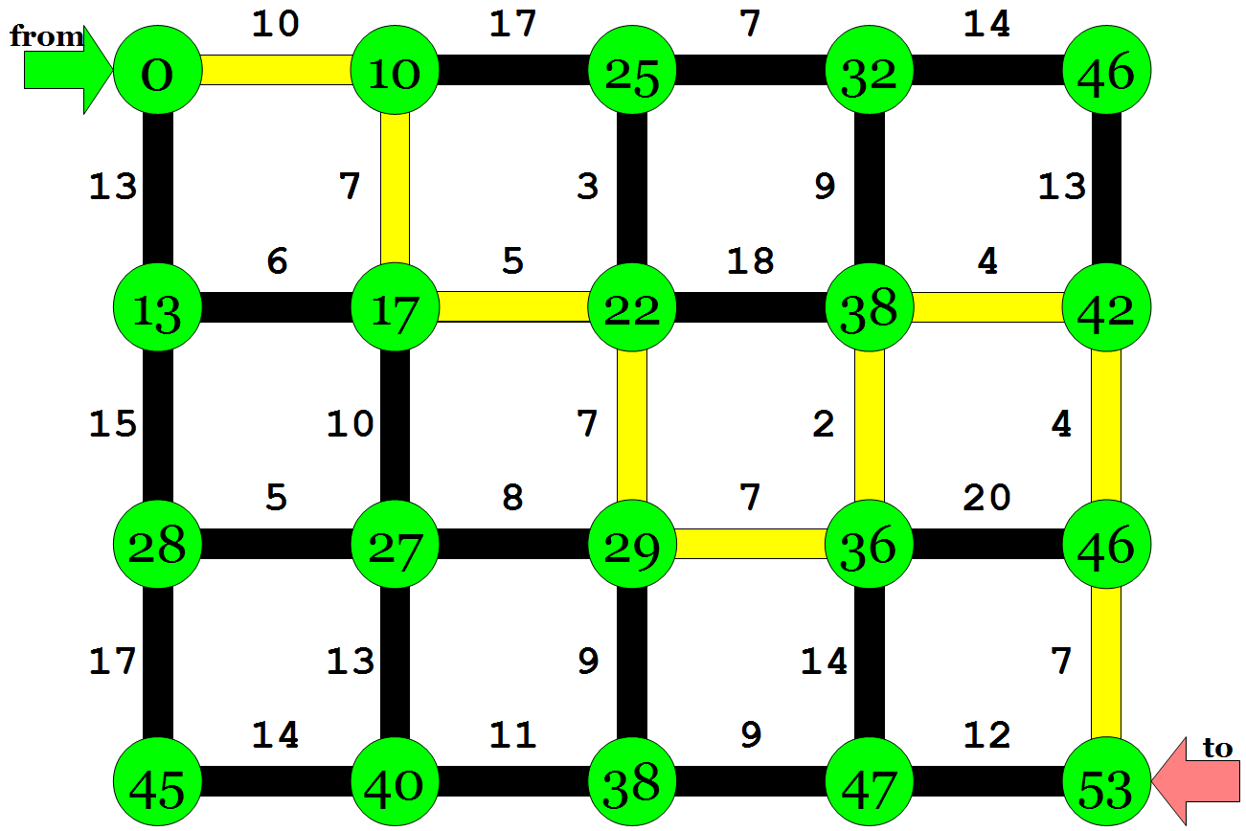

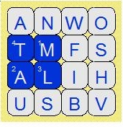
What is CS 106B?
CS 106B: Programming Abstractions
  solving big(ger) problems and processing big(ger) data
  learning to manage complex data structures
  algorithmic analysis and algorithmic techniques such as recursion
  programming style and software development practices
  familiarity with the C++ programming language
Prerequisite: CS 106A or equivalent
http://cs106b.stanford.edu/

Slide 14

What is this class about?
What do we mean by “abstractions”?
Colatina, Carlos Nemer
This file is licensed under the Creative Commons Attribution 3.0 Unported license.

Slide 15

http://www.publicdomainpictures.net/pictures/10000/velka/1-1265899974oKJ9.jpg

Slide 16
http://www.publicdomainpictures.net/pictures/10000/velka/1-1265899974oKJ9.jpg

Slide 17
Sentence
Subject
Verb Phrase
Object
Noun
Adverb
Verb
Possessive
Noun
CS106B
totally
rocks
my
socks

Slide 18
CS106B
totally
rocks
my
socks

Slide 19
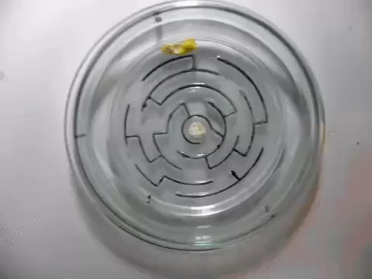

Slide 20
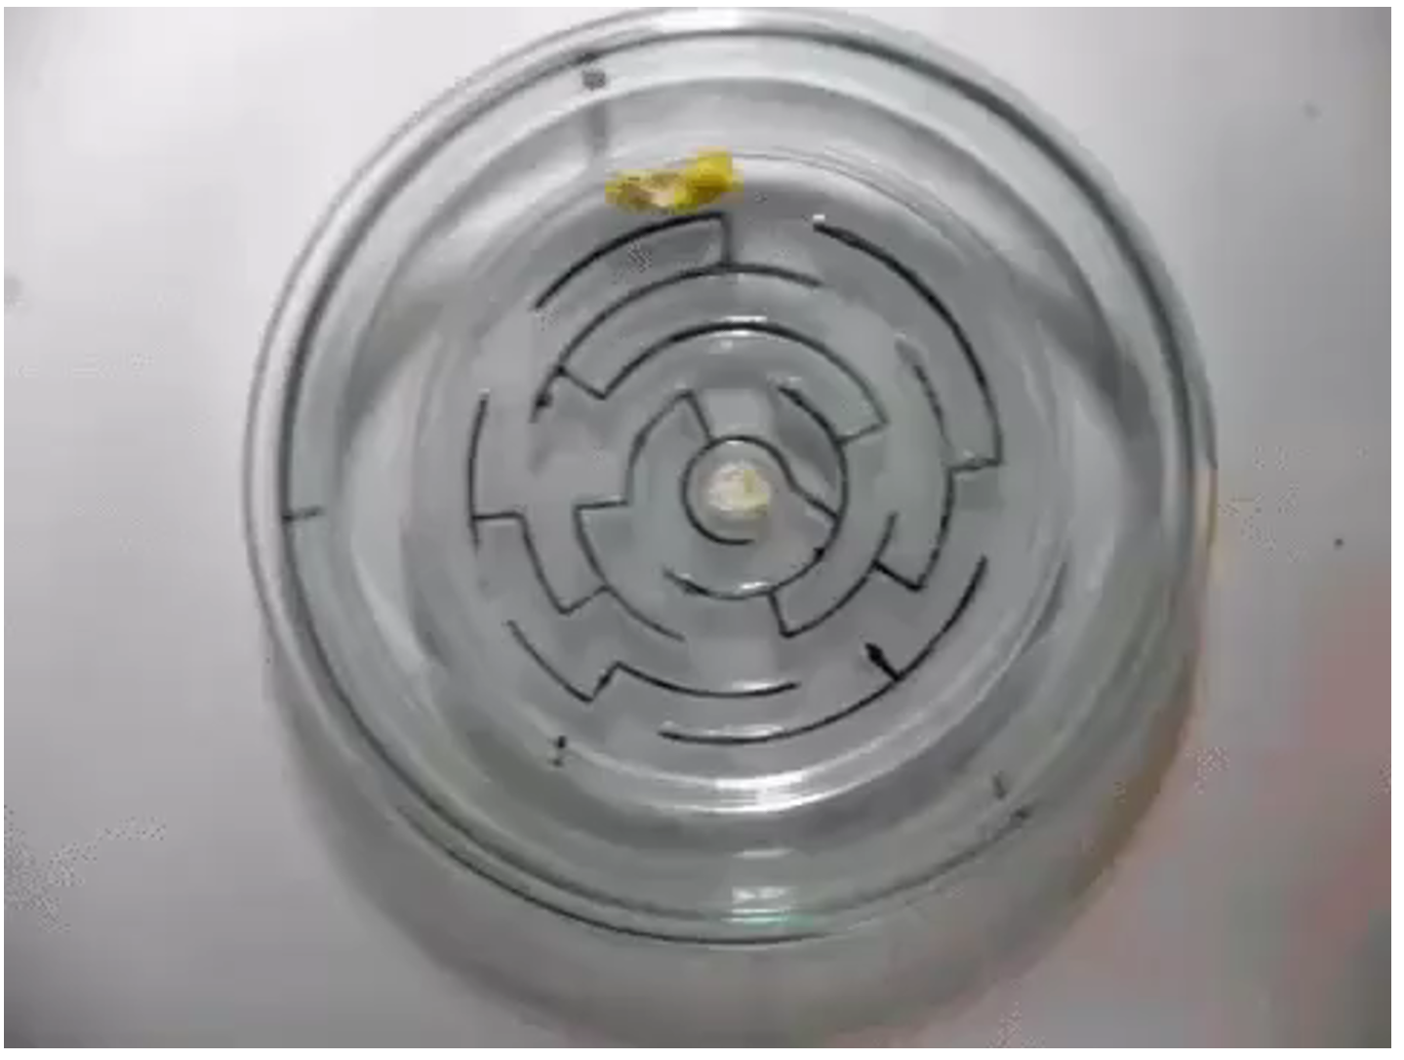

Slide 22

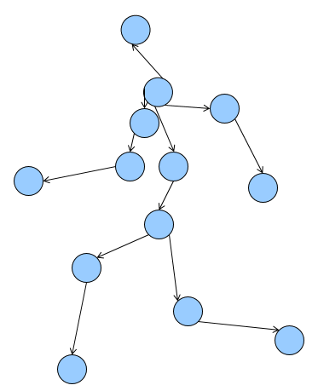
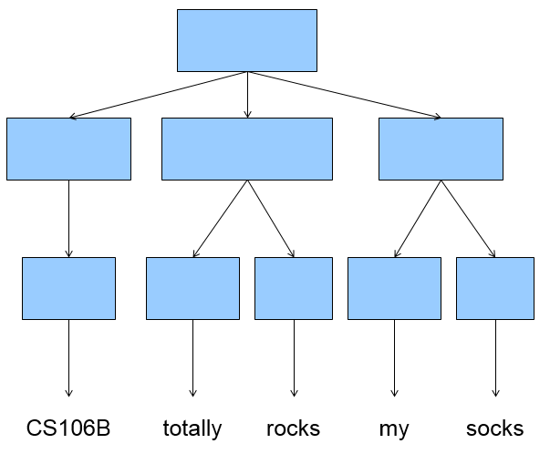
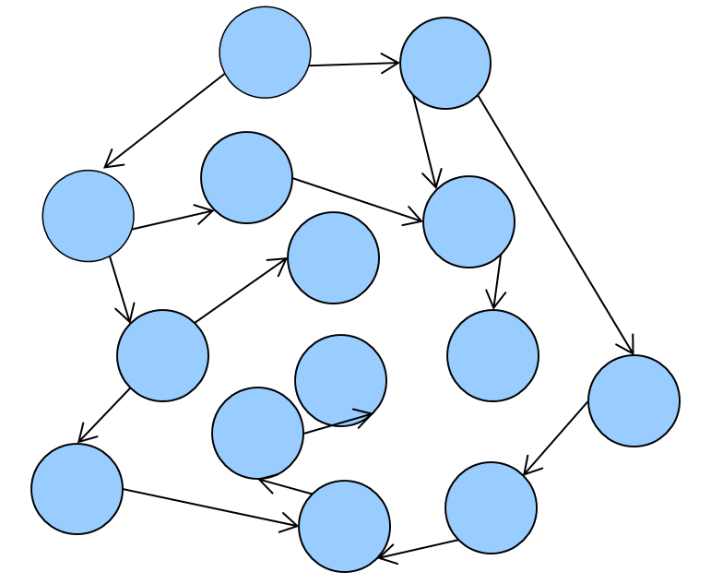
In CS106B, you’ll learn to:
Identify common underlying structures
Apply known algorithmic tools that solve diverse problems that share that structure

Slide 23
Building a vocabulary of abstractions
makes it possible to represent and solve a huge variety of problems using known tools.

Slide 24
After this course…
you’ll have what is effectively a superpower.
Spend some time thinking about how you’ll use it.

Slide 25
Welcome to C++
Let’s start coding!!

Slide 26
First C++ program (1.1)
helloWorld
/*
* hello.cpp
* This program prints a welcome message
* to the user.
*/
#include <iostream>
#include "console.h"
using namespace std;
int main() {
cout << "Hello, world!" << endl;
return 0;
}
Include statements are like imports in Java/Python. More on this in a moment.
Every C++ program has a main function. The program starts at main and executes its statements in sequence.
At program end, main returns 0 to indicate successful completion. A non-zero return value is an error code, but we won’t use this method of error reporting in this class so we will always return zero.

Slide 27
C++ variables and types (1.5-1.8)
C++
Python
  The C++ compiler is rather picky about types when it comes to variables.
  Types exist in languages like Python (see the two code examples at right), but you don’t need to say much about them in the code. They just happen.
  The first time you introduce a variable in C++, you need to announce its type to the compiler (what kind of data it will hold).
    After that, just use the variable name (don’t repeat the type).
    You won’t be able to change the type of data later! C++ variables can only do one thing.
int x = 42 + 7 * -5;
double pi = 3.14159;
char letter = 'Q';
bool done = true;
x = x – 3;
x = 42 + 7 * -5
pi = 3.14159
letter = 'Q'
done = True
x = x - 3

Slide 28
More C++ syntax examples (1.5-1.8)
for (int i = 0; i < 10; i++) { // for loops
if (i % 2 == 0) { // if statements
x += i;
} /* two comment styles */
}
while (letter != 'Q' && !done) { // while loops, logic
x = x / 2;
if (x == 42) { return 0; }
}
binky(pi, 17); // function call
winky("this is a string"); // string usage

Slide 29
Some C++ logistical details (2.2)
#include <libraryname> // standard C++ library
#include "libraryname.h" // local project library
  Attaches a library for use in your program
  Note the differences (common bugs):
  <> vs " "
  .h vs no .h
using namespace name;
  Mostly, just don’t worry about what this actually does/means! Copy & paste the std line below into the top of your programs.
  Brings a group of features into global scope so your program can directly refer to them
  Many C++ standard library features are in namespace std so we write:
    using namespace std;
    “std” is short for “standard”

