Slide 1
Programming Abstractions
CS106B
Cynthia Bailey
Chris Gregg

Slide 2

Today’s Topics
pollev.com/cs106b
  Recursion!
    Functions calling functions
  Next time:
    More recursion! It’s Recursion Week!
    Like Shark Week, but more nerdy
  For important announcements, be sure to see the weekly announcements post on the Ed Q&A board! https://edstem.org
  Also on Ed: live lecture Q&A with Chris & Jonathan

Slide 3
Quick Course Overview
  Week 1: C++
  Week 2: ADTs, how to use them
  Weeks 3-4: Recursion ← YOU ARE HERE
  Weeks 5-10: ADTs, behind the scenes!
    actually implement them yourself

Slide 4
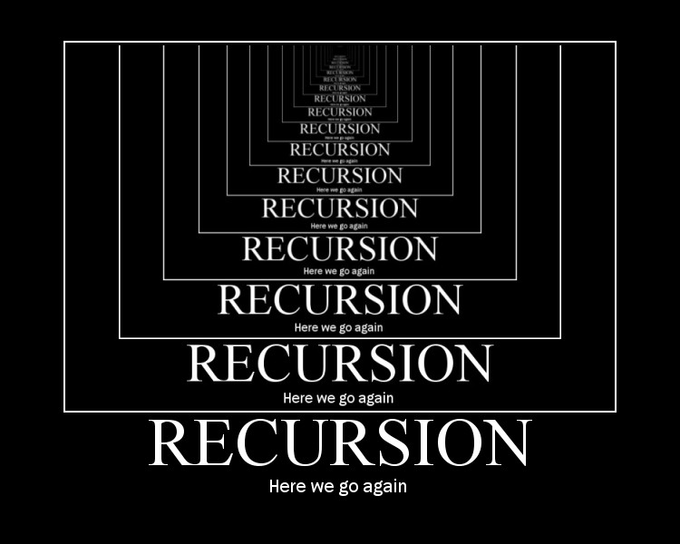
Recursion!
The exclamation point isn’t there only because this is so exciting; it also relates to our first recursion example….

Slide 5
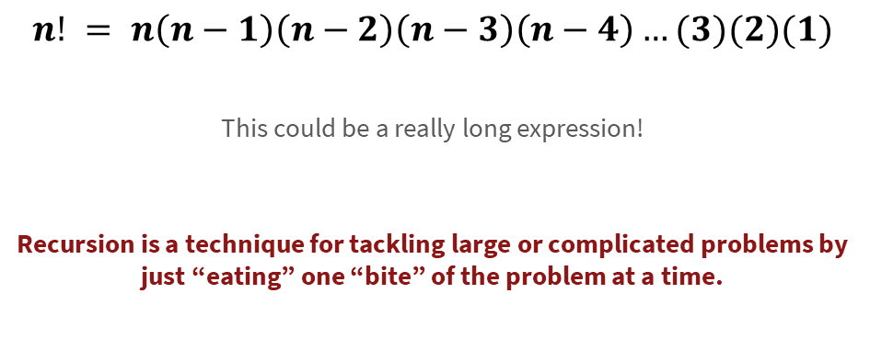
Factorial!
$$n! = n\left(n−1\right)\left(n−2\right)\left(n−3\right)\left(n−4\right)…(3)(2)(1)$$
  This could be a really long expression!
  Recursion is a technique for tackling large or complicated problems by just “eating” one “bite” of the problem at a time.

Slide 6
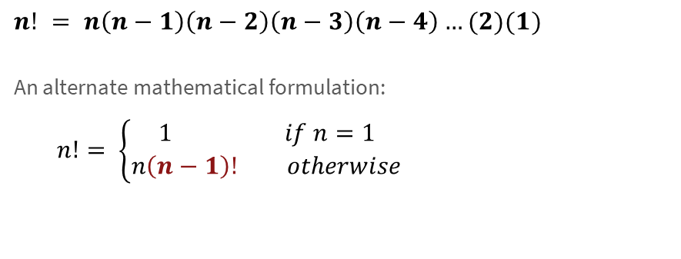
Factorial!
$$n! = n\left(n−1\right)\left(n−2\right)\left(n−3\right)\left(n−4\right)…(2)(1)$$
  An alternate mathematical formulation:
  $n!= \left\{\begin{matrix}1 if n=1 \\ n\left(n−1\right)! otherwise\end{matrix}\right.$
Translated to code
int factorial(int n) {
if (n == 1) {
return 1;
} else {
return n * factorial(n - 1);
}
}

Slide 7
Factorial!
$$n! = n\left(n−1\right)\left(n−2\right)\left(n−3\right)\left(n−4\right)…(2)(1)$$
  An alternate mathematical formulation:
  $n!= \left\{\begin{matrix}1 if n=1 \\ n\left(n−1\right)! otherwise\end{matrix}\right.$
Debugging tip: when reading your own code, mentally assume the recursive call works perfectly, and reason from there.
Translated to code
int factorial(int n) {
if (n == 1) {
return 1;
} else {
return n * factorial_teacher_solution(n-1);
}
}

Slide 8
Basic Recursive Function Design Pattern
Always two parts:
Base case:
  This problem is so tiny, it’s hardly a problem anymore! Just give answer.
Recursive case:
  This problem is still a bit large, let’s (1) bite off just one piece, and (2) delegate the remaining work to recursion.

Slide 9
The recursive function pattern
Recursive case:
  This problem is still a bit large, let’s (1) bite off just one piece, and (2) delegate the remaining work to recursion.
int factorial(int n) {
if (n == 1) { // Easy! Return trivial answer
return 1;
} else { // Not easy enough to finish yet!
return n * factorial(n - 1);
}
}
Do one of the many, many multiplications required for factorial.

Slide 10
The recursive function pattern
Recursive case:
  This problem is still a bit large, let’s (1) bite off just one piece, and (2) delegate the remaining work to recursion.
int factorial(int n) {
if (n == 1) { // Easy! Return trivial answer
return 1;
} else { // Not easy enough to finish yet!
return n * factorial(n - 1);
}
}
Do one of the many, many multiplications required for factorial.
Delegate all the other multiplications to the recursive call.

Slide 11
Digging deeper in the recursion
Looking at how recursion works “under the hood”

Slide 12
Factorial!
int factorial(int n) {
cout << n << endl; // **Added for this question**
if (n == 1) { // Easy! Return trivial answer
return 1;
} else { // Not easy enough to finish yet!
return n * factorial(n - 1);
}
}
What is the third thing printed when we call factorial(4)?
1
2
3
4
Other/none/more
pollev.com/cs106b

Slide 13
How does this look in memory?
A little background…
A computer’s memory is like a giant Vector/array, and like a Vector, we start counting at index 0.
We typically draw memory vertically (rather than horizontally like a Vector), with index 0 at the bottom.
A typical laptop’s memory has billions of these indexed slots (one byte each)
8,000,000,000
…
0
* Take CS107 to learn much more!!

Slide 14
How does this look in memory?
A little background…
Broadly speaking, we divide memory into regions:
  Text: the program’s own code (needs to be in memory so it can run!)
  Heap: we’ll learn about this later in CS106B!
  Stack: this is where local variables for each function are stored.
Stack
Heap
Text
0
* Take CS107 to learn much more!!

Slide 15
How does this look in memory?
Memory
Recursive code
main()
4
int factorial(int n) {
cout << n << endl;
if (n == 1) return 1;
else return n * factorial(n – 1);
}
void myfunction(){
int x = 4;
int xfac = 0;
xfac = factorial(x);
}
myfunction()x:
xfac:
0
factorial() n:
4
Text, Heap
0

Slide 16
pollev.com/cs106b
Memory
Memory
Memory
(A)
(B)
(C)
main()
main()
main()
4
4
4
myfunction()x:
xfac:
myfunction()x:
xfac:
myfunction()x:
xfac:
0
0
0
factorial() n:
factorial() n:
factorial()n:
4
3
3, 4
factorial() n:
3
Text, Heap
Text, Heap
Text, Heap
(D) Other/none of the above

Slide 17
Fun fact:
The “stack” part of memory is a stack
Function call = push a stack frame
Function return = pop a stack frame
* Take CS107 to learn much more!!

Slide 18
The “stack” part of memory is a stack
Recursive code
main()
int factorial(int n) {
cout << n << endl;
if (n == 1) return 1;
else return n * factorial(n – 1);
}
void myfunction(){
int x = 4;
int xfac = 0;
xfac = factorial(x);
}
4
myfunction()x:
xfac:
0
factorial() n:
4
Text, Heap

Slide 19
The “stack” part of memory is a stack
Recursive code
main()
int factorial(int n) {
cout << n << endl;
if (n == 1) return 1;
else return n * factorial(n – 1);
}
void myfunction(){
int x = 4;
int xfac = 0;
xfac = factorial(x);
}
4
myfunction()x:
xfac:
0
factorial() n:
4
factorial() n:
3
Text, Heap

Slide 20
The “stack” part of memory is a stack
Recursive code
Answer: 3rd thing printed is 2
main()
int factorial(int n) {
cout << n << endl;
if (n == 1) return 1;
else return n * factorial(n – 1);
}
void myfunction(){
int x = 4;
int xfac = 0;
xfac = factorial(x);
}
4
myfunction()x:
xfac:
0
factorial() n:
4
factorial() n:
3
factorial() n:
2
Text, Heap

Slide 21
The “stack” part of memory is a stack
Recursive code
main()
int factorial(int n) {
cout << n << endl;
if (n == 1) return 1;
else return n * factorial(n – 1);
}
void myfunction(){
int x = 4;
int xfac = 0;
xfac = factorial(x);
}
4
myfunction()x:
xfac:
0
factorial() n:
4
factorial() n:
3
factorial() n:
2
factorial() n:
1
Text, Heap

Slide 22
Factorial!
Recursive code
int factorial(int n) {
cout << n << endl;
if (n == 1) return 1;
else return n * factorial(n – 1);
}
void myfunction(){
int x = 4;
int xfac = 0;
xfac = factorial(x);
}
What is the fourth value ever returned when we call factorial(4)?
4
6
10
24
Other/none/more than one
pollev.com/cs106b

Slide 23
The “stack” part of memory is a stack
Recursive code
main()
int factorial(int n) {
cout << n << endl;
if (n == 1) return 1;
else return n * factorial(n – 1);
}
void myfunction(){
int x = 4;
int xfac = 0;
xfac = factorial(x);
}
4
myfunction()x:
xfac:
0
factorial() n:
4
factorial() n:
3
factorial() n:
2
factorial() n:
1
Return 1
Text, Heap

Slide 24
The “stack” part of memory is a stack
Recursive code
main()
int factorial(int n) {
cout << n << endl;
if (n == 1) return 1;
else return n * factorial(n – 1);
}
void myfunction(){
int x = 4;
int xfac = 0;
xfac = factorial(x);
}
4
myfunction()x:
xfac:
0
factorial() n:
4
factorial() n:
3
factorial() n:
2
Return 2
Text, Heap

Slide 25
The “stack” part of memory is a stack
Recursive code
main()
int factorial(int n) {
cout << n << endl;
if (n == 1) return 1;
else return n * factorial(n – 1);
}
void myfunction(){
int x = 4;
int xfac = 0;
xfac = factorial(x);
}
4
myfunction()x:
xfac:
0
factorial() n:
4
factorial() n:
Return 6
3
Text, Heap

Slide 26
The “stack” part of memory is a stack
Recursive code
main()
int factorial(int n) {
cout << n << endl;
if (n == 1) return 1;
else return n * factorial(n – 1);
}
void myfunction(){
int x = 4;
int xfac = 0;
xfac = factorial(x);
}
4
myfunction()x:
xfac:
0
factorial() n:
4
Return 24
Answer: 4th thing returned is 24
Text, Heap

Slide 27
Factorial!
Iterative version
Recursive version
int factorial(int n) {
int f = 1;
while (n > 1) {
f = f * n;
n = n – 1;
}
return f;
}
int factorial(int n) {
if (n == 1) return 1;
else return n * factorial(n – 1);
}
NOTE: sometimes iterative can be much faster because it doesn’t have to push and pop stack frames. Method calls have overhead in terms of space and time (to set up and tear down).

Slide 28
The Fibonacci Sequence
*Math nerd rejoicing intensifies*

Slide 29
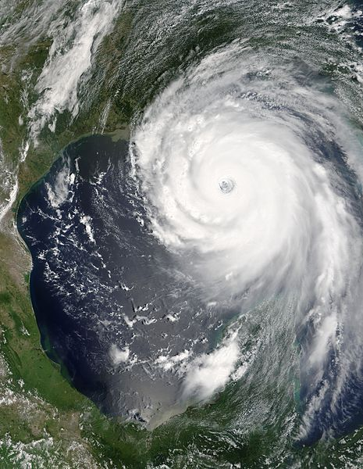
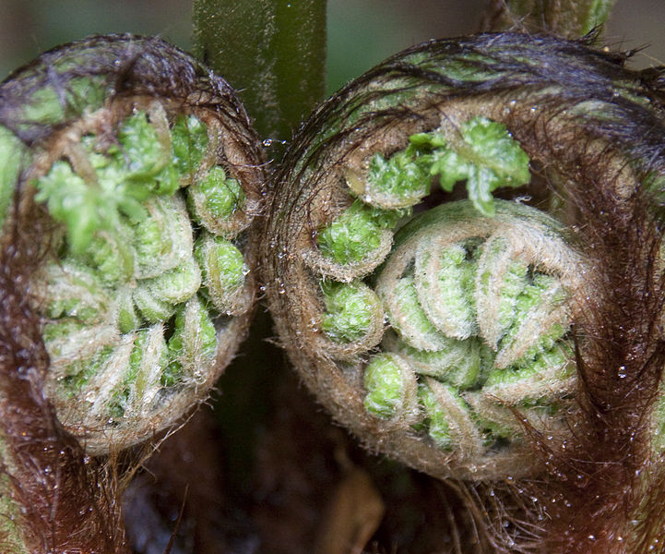
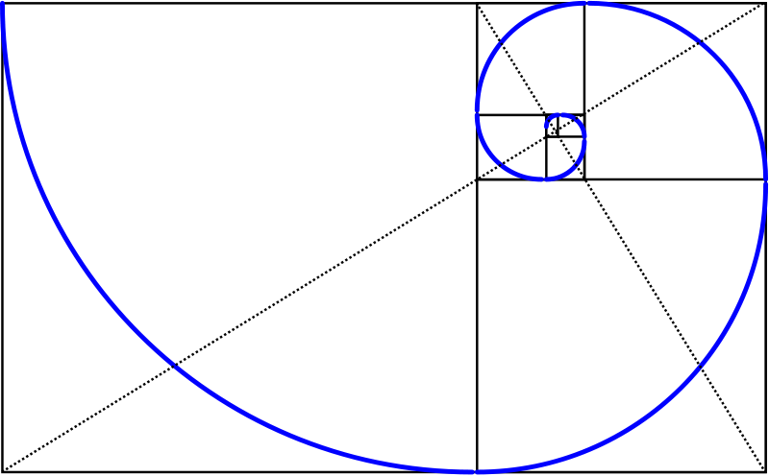
Fibonacci in nature
These files are, respectively: public domain (hurricane) and licensed under the Creative Commons Attribution 2.0 Generic license (fibonacci and fern).

Slide 30
Fibonacci
0 | 1 | 2 | 3 | 4 | 5 | 6 | 7 | 8 | 9 | 10 | 11
0, | 1, | 1, | 2, | 3, | 5, | 8, | 13, | 21, | 34, | 55, | 89,
This image is licensed under the Creative Commons Attribution-Share Alike 3.0 Unported license. http://commons.wikimedia.org/wiki/File:Golden_spiral_in_rectangles.png

Slide 31
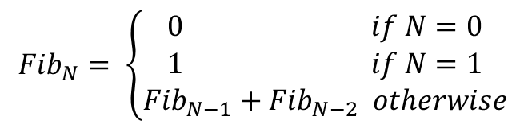
Fibonacci
0 | 1 | 2 | 3 | 4 | 5 | 6 | 7 | 8 | 9 | 10 | 11
0 | 1 | 1 | 2 | 3 | 5 | 8 | 13 | 21 | 34 | 55 | 89
$${Fib}_{N}= \left\{\begin{aligned}0 if N=0 \\ 1 if N=1 \\ {Fib}_{N−1}+{Fib}_{N−2} otherwise\end{aligned}\right.$$

Slide 32
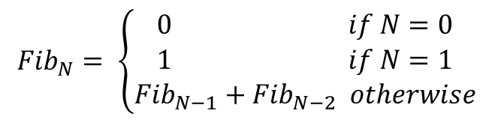
Basic Recursive Function Design Pattern
Always two parts:
Base case:
  This problem is so tiny, it’s hardly a problem anymore! Just give answer.
Recursive case:
  This problem is still a bit large, let’s (1) bite off just one piece, and (2) delegate the remaining work to recursion.
$${Fib}_{N}= \left\{\begin{aligned}0 if N=0 \\ 1 if N=1 \\ {Fib}_{N−1}+{Fib}_{N−2} otherwise\end{aligned}\right.$$

Slide 33
Fibonacci
N=5
N=4
N=3
N=3
N=2
N=2
N=1
N=2
N=1
N=1
N=0
N=1
N=0
int fib(int n)
{
if (n == 0) {
return 0;
} else if (n == 1) {
return 1;
} else {
return fib(n – 1) + fib(n – 2);
}
}
Observation: work is duplicated throughout the call tree
  fib(2) is calculated 3 separate times when calculating fib(5)!
  15 function calls in total for fib(5)!
N=1
N=0

Slide 34
Fibonacci
N=5
N=4
N=3
fib(2) is calculated 3 separate times when calculating fib(5)!
N=3
N=2
N=2
N=1
N=2
N=1
N=1
N=0
N=1
N=0
N=1
N=0
How many times would we calculate fib(2) while calculating fib(6)? See if you can just “read” it off the chart above.
4 times
5 times
6 times
Other/none/more
pollev.com/cs106b

Slide 35
Fibonacci
N=5
N=3
N=4
N=3
N=2
N=2
N=1
N | fib(N) | # of calls to fib(2)
2 | 1 | 1
3 | 2 | 1
4 | 3 | 2
5 | 5 | 3
6 | 8
7 | 13
8 | 21
9 | 34
10 | 55
N=2
N=1
N=1
N=0
N=1
N=0
N=1
N=0
5
8
13
21
34

Slide 36
Efficiency of naïve Fibonacci implementation
When we added 1 to the input N, the number of times we had to calculate fib(2) nearly doubled (~1.6* times)
  Ouch!
Goal: predict how much time it will take to compute for arbitrary input N.
Calculation: “approximately” (1.6)^{N}
* This ~1.6 number is called the “Golden Ratio” in math—cool!

