Slide 1
Programming Abstractions
CS106B
Cynthia Bailey
Chris Gregg

Slide 2

Today’s Topics
pollev.com/cs106b
  Recursion!
    Algorithm performance analysis with Big-O
  Next time:
    More recursion! It’s Recursion Week!
    Like Shark Week, but more nerdy
  For important announcements, be sure to see the weekly announcements post on the Ed Q&A board! https://edstem.org
  Also on Ed: live lecture Q&A with Chris & Jonathan

Slide 3
Binary Search
An elegant solution to the problem of too much data

Slide 4

Current issue in computer science: we have loads of data! Once we have all this data, how do we find anything?

Slide 5
The context:
  You have a collection of numbers
    Say product IDs for items in stock in a store
    We’re going to store our collection of numbers in a Vector
    We’re going to keep them in sorted order
  It’s important to be able to find out whether you have a particular number in your collection or not
    A customer asks, “Do you have item 8 in stock?” (Yes.)
    A customer asks, “Do you have item 55 in stock?” (No.)
  Key question: How long does this take?
0 | 1 | 2 | 3 | 4 | 5 | 6 | 7 | 8 | 9 | 10
2 | 7 | 8 | 13 | 25 | 29 | 33 | 51 | 89 | 90 | 95

Slide 6
Does this list of numbers contain X?
Context: we have a collection of numbers in a Vector, in sorted order.
0 | 1 | 2 | 3 | 4 | 5 | 6 | 7 | 8 | 9 | 10
2 | 7 | 8 | 13 | 25 | 29 | 33 | 51 | 89 | 90 | 95
  Basic approach: Start at the front and proceed forward until you find:
    X (answer Yes)
    A number greater than X (answer No)
    End of the list (answer No)
  Key observation: each time you compare against the contents of a cell of the Vector and it’s not X, you rule out *1* of the N cells in the Vector

Slide 7
Does this list of numbers contain X?
Context: we have a collection of numbers in a Vector, in sorted order.
0 | 1 | 2 | 3 | 4 | 5 | 6 | 7 | 8 | 9 | 10
2 | 7 | 8 | 13 | 25 | 29 | 33 | 51 | 89 | 90 | 95
  Efficiency Hack: Jump to the middle of the Vector and look there to find:
    X (answer Yes)
    A number greater than X (rule out entire second half of Vector)
    A number less than X (rule out entire first half of Vector)
  Key observation: with *one* comparison, you ruled out *N/2* of the N cells in the Vector!
0 | 1 | 2 | 3 | 4 | 5 | 6 | 7 | 8 | 9 | 10
2 | 7 | 8 | 13 | 25 | 29 | 33 | 51 | 89 | 90 | 95
0 | 1 | 2 | 3 | 4 | 5 | 6 | 7 | 8 | 9 | 10
2 | 7 | 8 | 13 | 25 | 29 | 33 | 51 | 89 | 90 | 95

Slide 8
Does this list of numbers contain X?
Context: we have a collection of numbers in a Vector, in sorted order.
0 | 1 | 2 | 3 | 4 | 5 | 6 | 7 | 8 | 9 | 10
2 | 7 | 8 | 13 | 25 | 29 | 33 | 51 | 89 | 90 | 95
  Efficiency Hack: Jump to the middle of the Vector and look there to find:
    X (answer Yes)
    A number greater than X (rule out entire second half of Vector)
    A number less than X (rule out entire first half of Vector)
  Key observation: with *one* comparison, you ruled out *N/2* of the N cells in the Vector!
Now we could do our Basic Approach, but in half the time.
Thanks, Efficiency Hack!!
0 | 1 | 2 | 3 | 4 | 5 | 6 | 7 | 8 | 9 | 10
2 | 7 | 8 | 13 | 25 | 29 | 33 | 51 | 89 | 90 | 95
0 | 1 | 2 | 3 | 4 | 5 | 6 | 7 | 8 | 9 | 10
2 | 7 | 8 | 13 | 25 | 29 | 33 | 51 | 89 | 90 | 95
…but I have an even better idea...

Slide 9
Does this list of numbers contain X?
Context: we have a collection of numbers in a Vector, in sorted order.
0 | 1 | 2 | 3 | 4 | 5 | 6 | 7 | 8 | 9 | 10
2 | 7 | 8 | 13 | 25 | 29 | 33 | 51 | 89 | 90 | 95
  Extreme Efficiency Hack: Keep jumping to the middle!
    Let’s say our first jump to the middle found a number less than X, so we ruled out the whole first half:
    Now jump to the middle of the remaining second half:
  Key observation: we do one piece of work, then delegate the rest. Recursion!!
0 | 1 | 2 | 3 | 4 | 5 | 6 | 7 | 8 | 9 | 10
2 | 7 | 8 | 13 | 25 | 29 | 33 | 51 | 89 | 90 | 95
0 | 1 | 2 | 3 | 4 | 5 | 6 | 7 | 8 | 9 | 10
2 | 7 | 8 | 13 | 25 | 29 | 33 | 51 | 89 | 90 | 95

Slide 10
Basic Recursive Function Design Pattern
Always two parts:
Base case:
  This problem is so tiny, it’s hardly a problem anymore! Just give answer.
Recursive case:
  This problem is still a bit large, let’s (1) bite off just one piece, and (2) delegate the remaining work to recursion.

Slide 11
Binary Search pseudocode
We’ll write the real C++ code together on Friday, but here’s the outline/pseudocode of how it works:
bool binarySearch(Vector<int>& data, int key)
{
if (data.size() == 0) {
return false;
}
if (key == data[midpoint]) {
return true;
} else if (key < data[midpoint]) {
return binarySearch(data[first half only], key);
} else {
return binarySearch(data[second half only], key);
}
}

Slide 12
Binary Search pseudocode
We’ll write the real C++ code together on Friday, but here’s the outline/pseudocode of how it works:
bool binarySearch(Vector<int>& data, int key)
{
if (data.size() == 0) {
return false;
}
if (key == data[midpoint]) {
return true;
} else if (key < data[midpoint]) {
return binarySearch(data[first half only], key);
} else {
return binarySearch(data[second half only], key);
}
}
Base case: we shrank the search problem so tiny it no longer exists!
Recursive case:
Do one piece of work (comparison)
Delegate the rest of the work

Slide 13
Big-O Performance Analysis
A way to compare the number of steps to run these functions

Slide 14
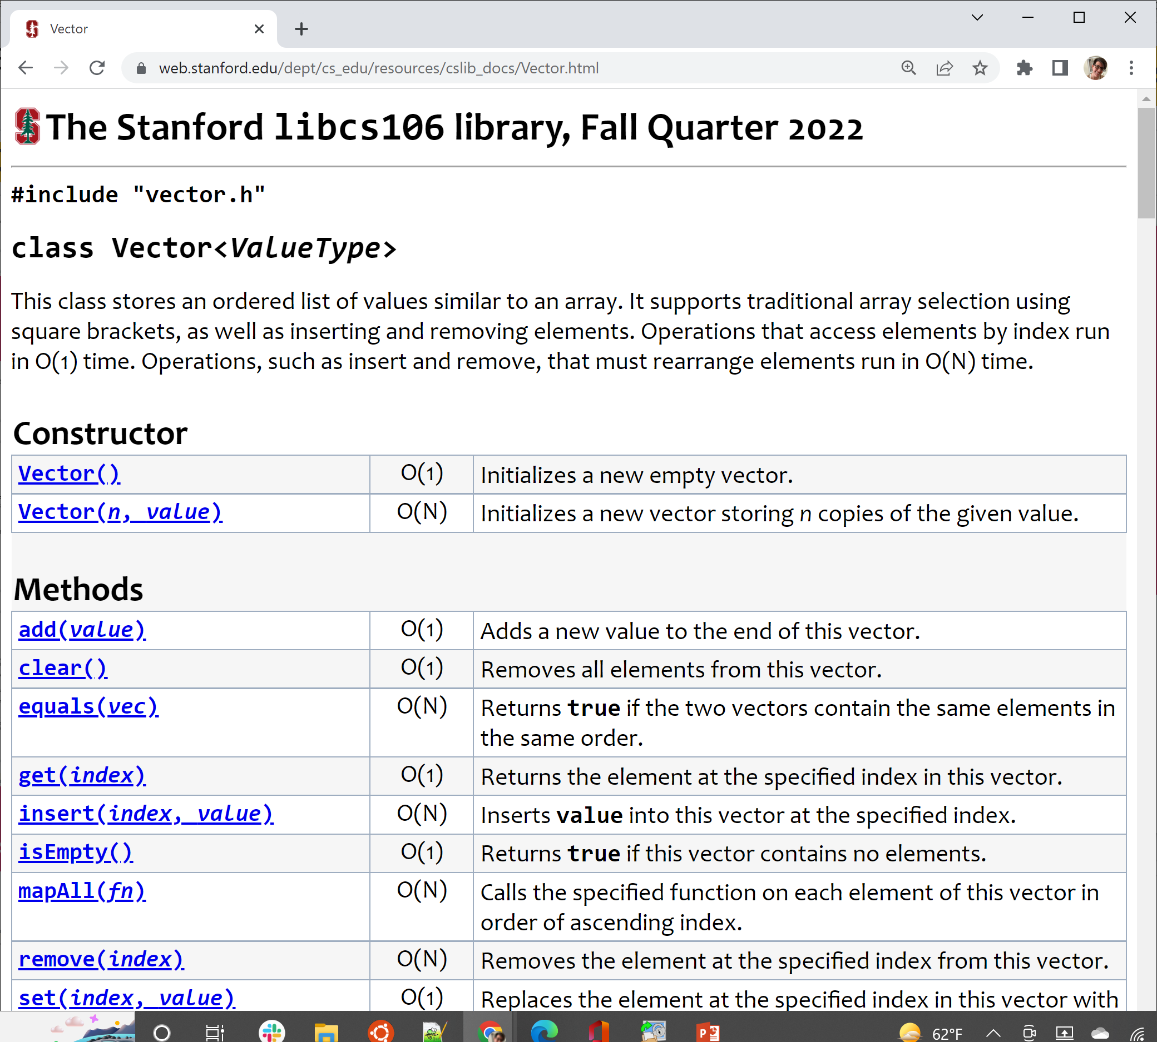
Big-O analysis in computer science

Slide 15
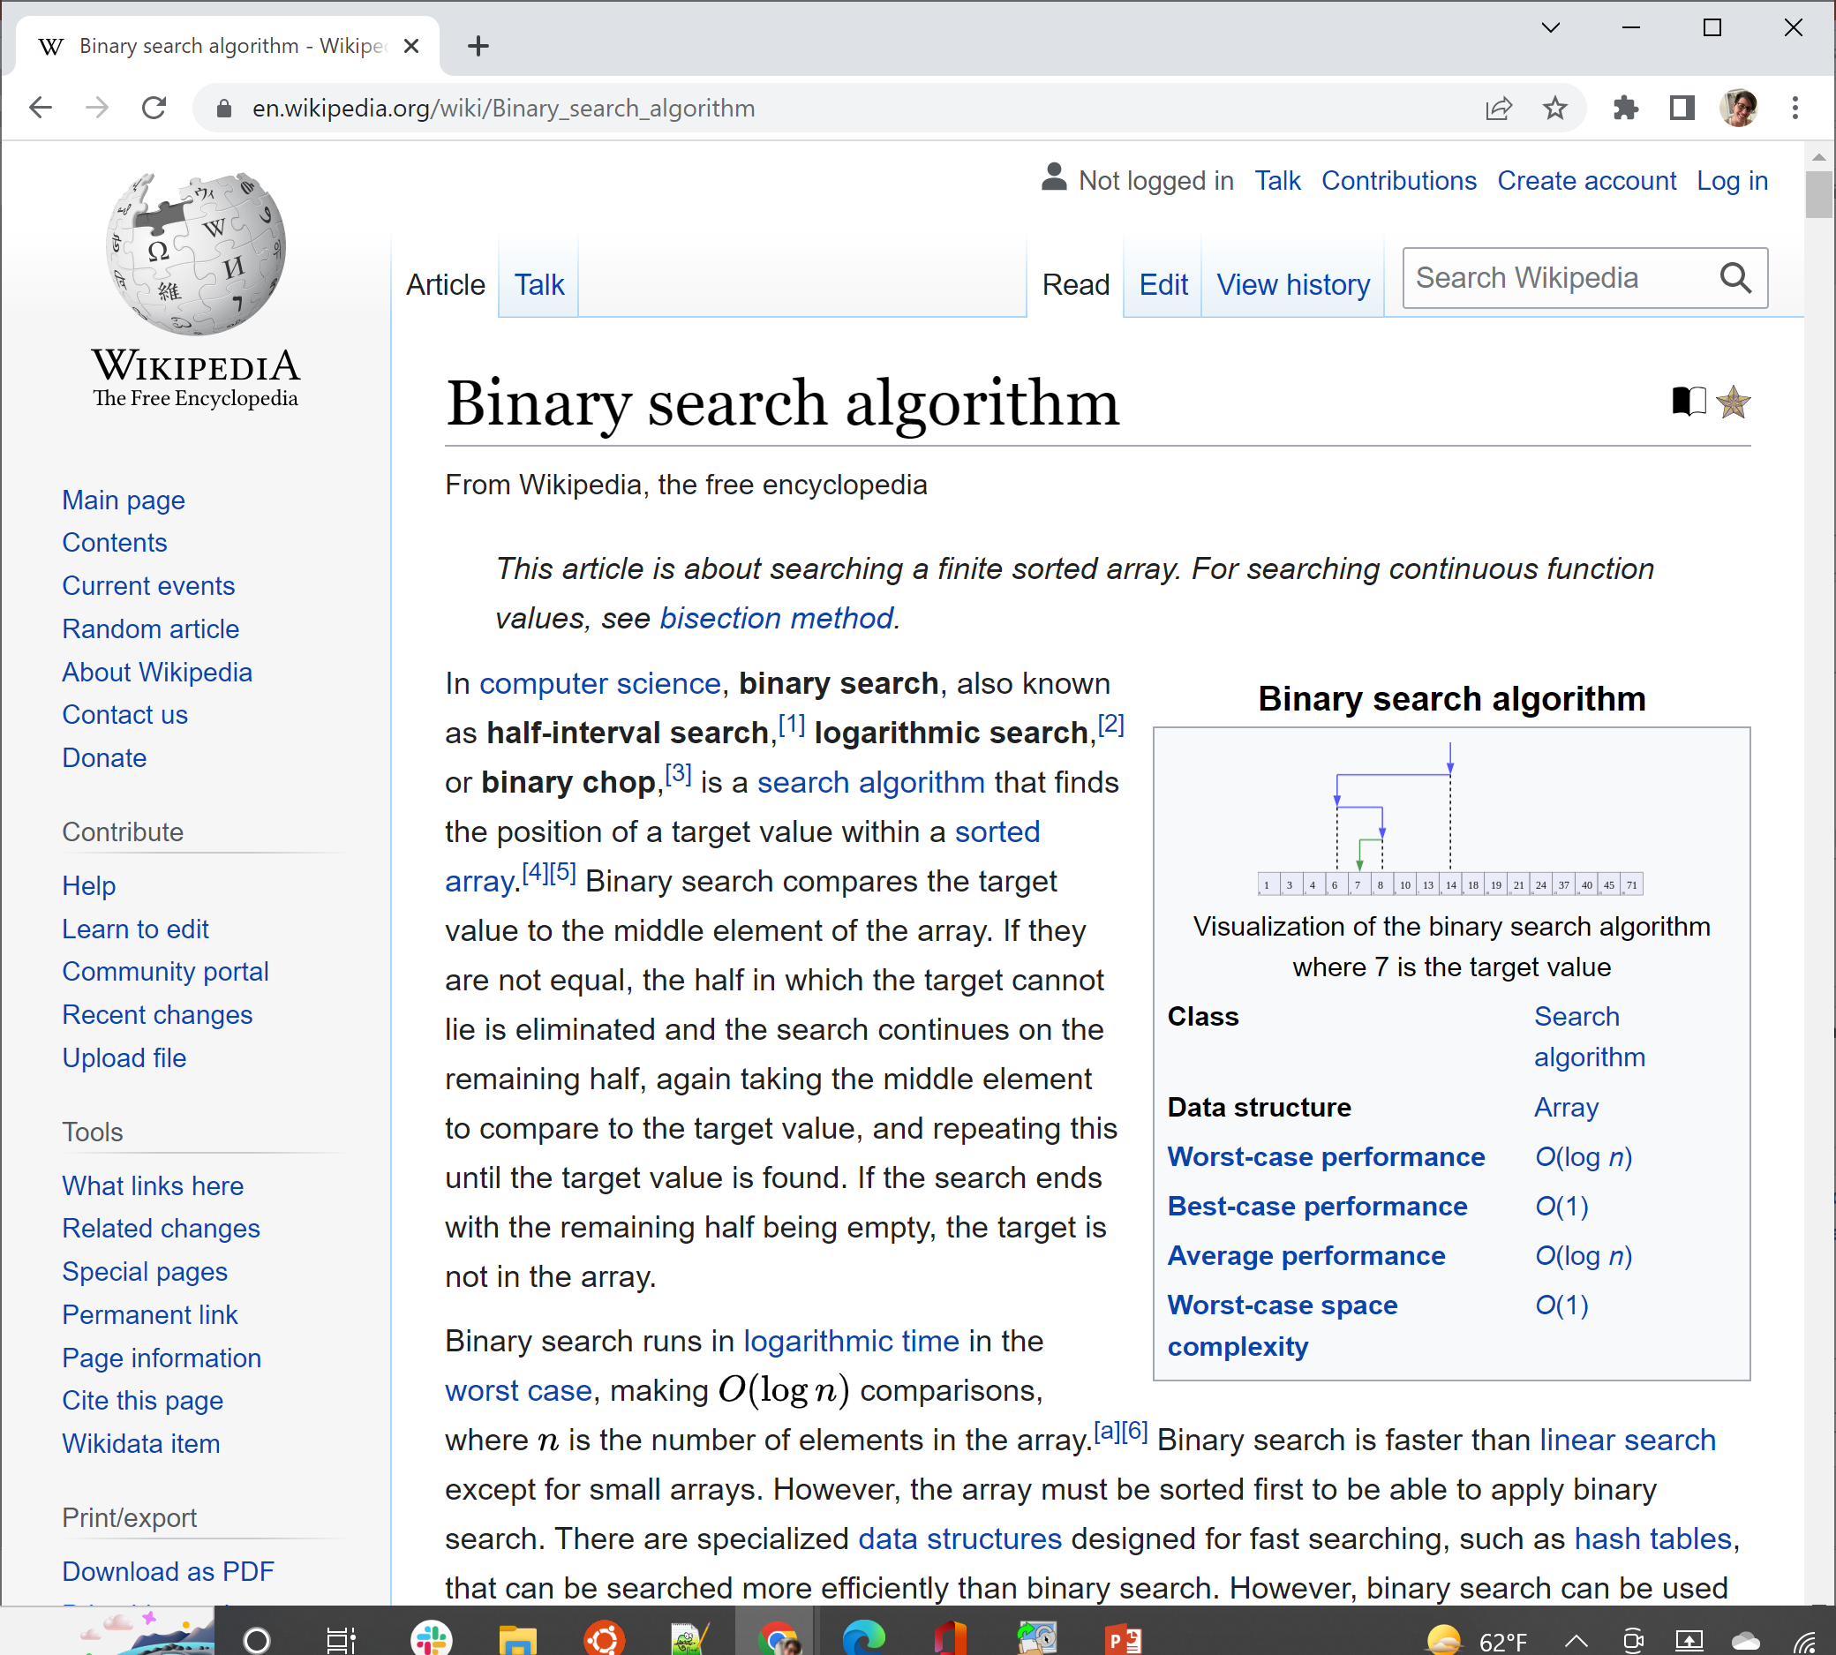
Big-O analysis in computer science

Slide 16
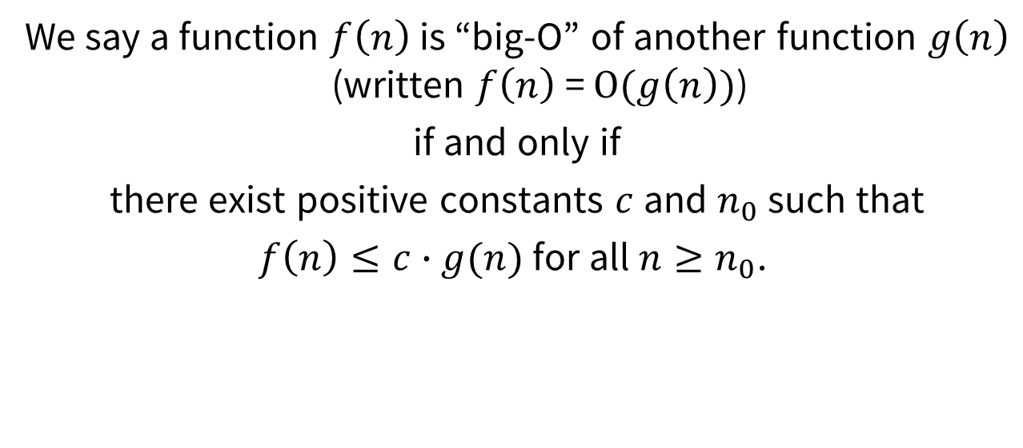
Formal definition of big-O
We say a function $f\left(n\right)$ is “big-O” of another function $g\left(n\right)$ (written $f\left(n\right)$ = $O(g\left(n\right))$)
if and only if
there exist positive constants $c$ and $n_{0}$ such that
$f\left(n\right)≤c∙g(n)$ for all $n≥n_{0}$.
c says “we don’t care about constant coefficients”
n₀ says “we only care about performance on big data sets”

Slide 17
Before we start, let’s get introduced

Slide 18
Before we start, let’s get introduced
Lets say I want to meet each of you today with a handshake and you tell me your name…
How many introductions need to happen?
There are N people in the room including me
But do I need to shake hands with myself, or tell myself my name?
N-1 introductions
 | 😊 | 😊 | 😊 | 😊 | 😊 | 😊 | 😊 | 😊 | Me
Me

Slide 19
Putting this in Big-O terms
Big-O is a way of categorizing amount of work to be done in general terms, with a focus on:
  Rate of growth as a function of the problem size N
  What that rate looks like on the horizon (i.e., for large N)
Therefore, we don’t really care about an insignificant ±1
 | 😊 | 😊 | 😊 | 😊 | 😊 | 😊 | 😊 | 😊 |  |  |  |  |  |  |  |  | 😊 | 😊 | 😊 | 😊 | 😊 | 😊 | 😊 | 😊 | 😊 | Me

Slide 20
Putting this in Big-O terms
For the first handshake problem, the rate N is important and the -1 constant is not, so N – 1 introductions becomes:
O( N ) → O(N)
Similarly, if we said that each introduction takes 3 seconds, the amount of time is 3(N – 1) = 3N – 3, but we disregard the constant 3s:
O( N ) → O(N)
-1
3
- 3

Slide 21
Before we start, let’s get introduced
What if I not only want you to be introduced to me, but to each other? (Note: I don’t need to tell anyone my name, and nobody needs to tell themselves their own name, so subtract those out.)
Now how many introductions?
N²
 | 😊 | 😊 | 😊 | 😊 | 😊 | 😊 | 😊 | 😊 | Me
😊
😊
😊
😊
😊
😊
😊
😊
Me
N

Slide 22
Before we start, let’s get introduced
What if I not only want you to be introduced to me, but to each other? (Note: I don’t need to tell anyone my name, and nobody needs to tell themselves their own name, so subtract those out.)
Now how many introductions?
(N - 1)² = N² - 2N + 1
N²
N

Slide 23
Putting this in Big-O terms
For the second handshake problem, the introductions was N² - N:
O( N² ) → O(N²)
But wait, didn’t we just say that a term of +/- N was important?
For Big-O, we only care about the largest term of the polynomial
- 2N + 1

Slide 24
Big-O and Binary Search
Spoiler: Fast!!

Slide 25
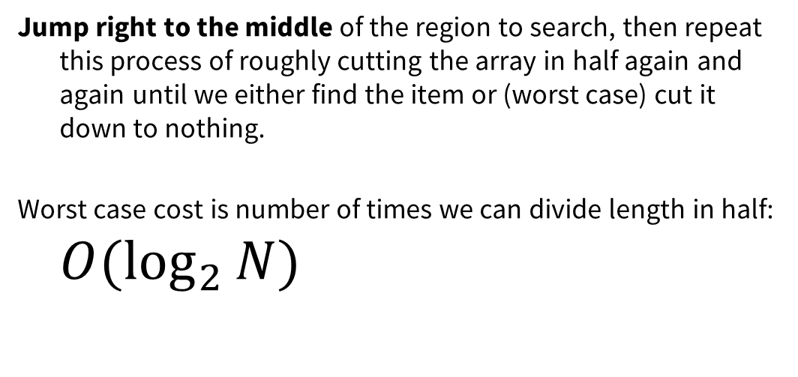
Binary search
2 | 7 | 8 | 13 | 25 | 29 | 33 | 51 | 89 | 90 | 95
Jump right to the middle of the region to search, then repeat this process of roughly cutting the array in half again and again until we either find the item or (worst case) cut it down to nothing.
Worst case cost is number of times we can divide length in half: $O(\log_{2}{N})$

Slide 26
Putting it all together

Slide 27
Binary search
Handshake #1
Handshake #2
MANY important optimization and other problems
log₂n | n | n log₂n | n² | 2^{n}
2 | 4 | 8 | 16 | 16
3 | 8 | 24 | 64 | 256
4 | 16 | 64 | 256 | 65,536
5 | 32 | 160 | 1,024 | 4,294,967,296
6 | 64
7 | 128
8 | 256
9 | 512
10 | 1,024
30 | 2,700,000,000
Naïve Recursive Fibonacci
(O(1.6^{n}))

Slide 28
log₂n | n | n log₂n | n² | 2^{n}
2 | 4 | 8 | 16 | 16
3 | 8 | 24 | 64 | 256
4 | 16 | 64 | 256 | 65,536
5 | 32 | 160 | 1,024 | 4,294,967,296
6 | 64
7 | 128
8 | 256
9 | 512
10 | 1,024
30 | 2,700,000,000
2.4s
Easy!

Slide 29
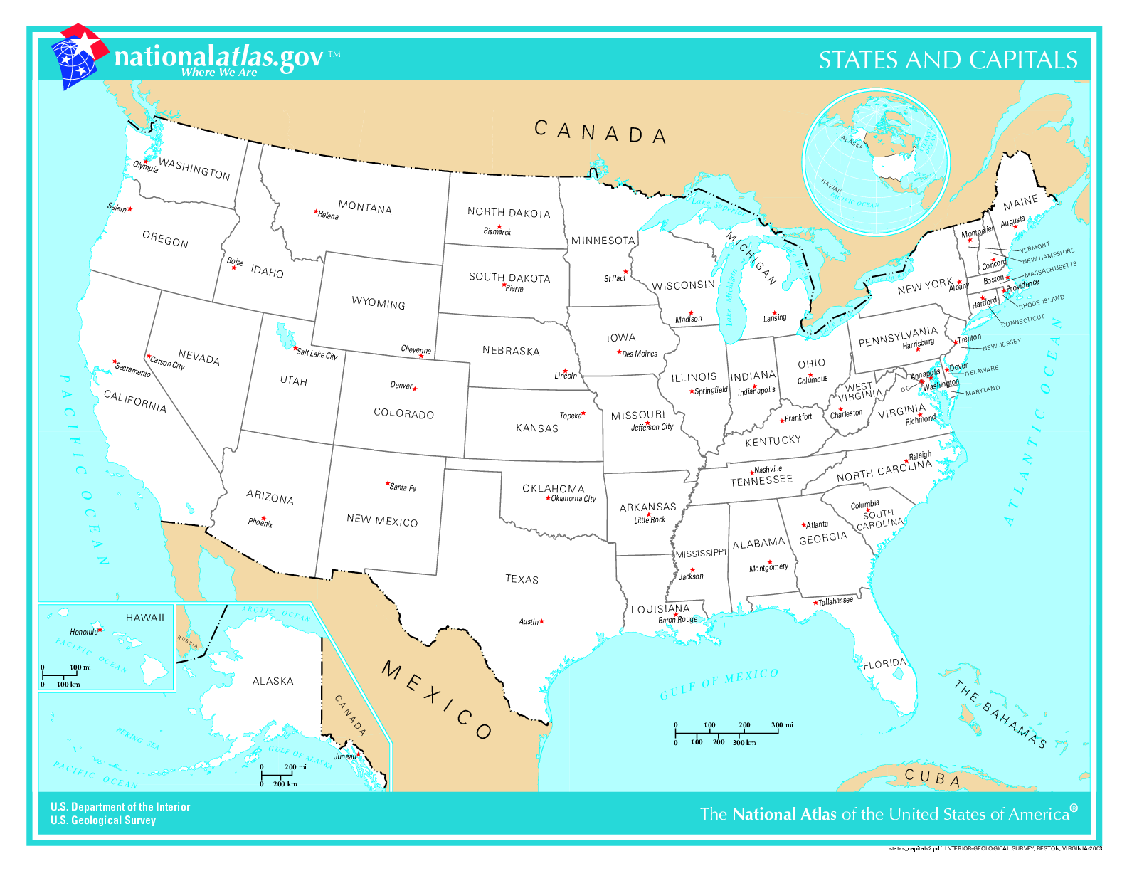
Traveling Salesperson Problem:
We have a bunch of cities to visit. In what order should we visit them to minimize total travel distance?

Slide 30
Traveling Salesperson Problem:
We have a bunch of cities to visit. In what order should we visit them to minimize total travel distance?

Slide 31
Exhaustively try all orderings: O(n!)
Use current best known algorithm: O(n²2^{n})
Maybe we could invent an algorithm that fits in our rightmost column: O(2^{n})

Slide 32
So let’s say we come up with a way to solve Traveling Salesperson Problem in O(2^{n}).
It would take 4 days to solve Traveling Salesperson Problem on 50 state capitals.

Slide 33

Two tiny little updates
Imagine we approve statehood for US territory Puerto Rico
  Add San Juan, the capital city
Also add Washington, DC
Now 52 capital cities instead of 50
This work has been released into the public domain by its author, Madden. This applies worldwide.

Slide 34
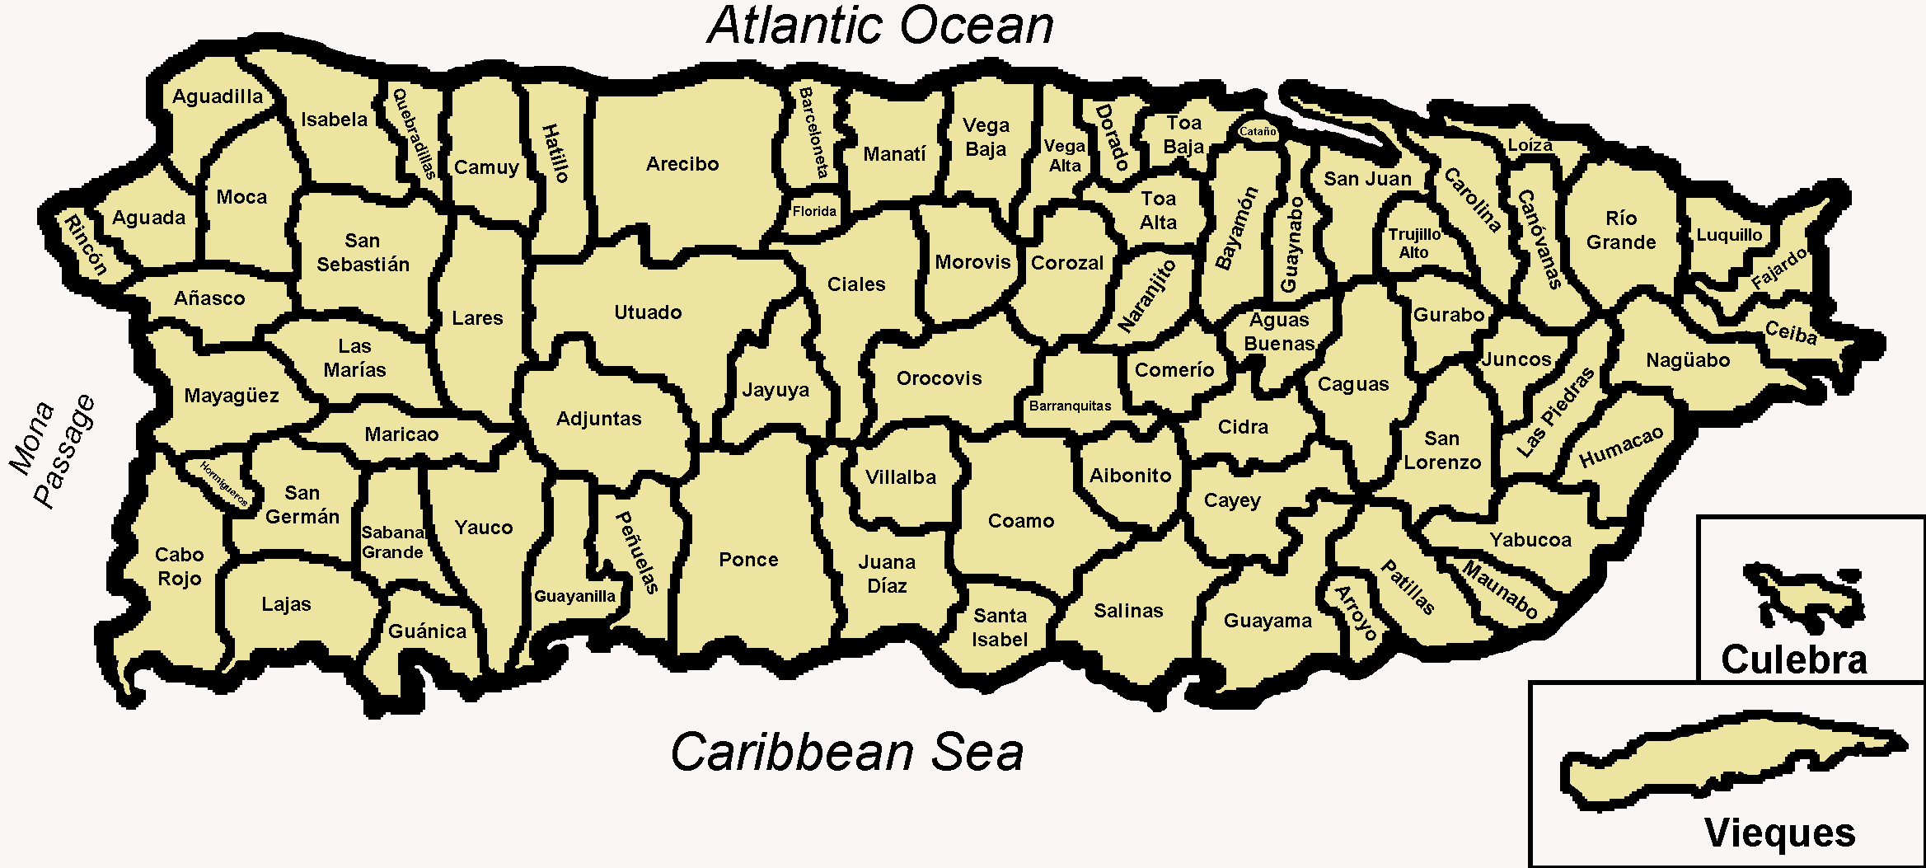
For 50 state capitals: ~4 days
With the O(2^{n}) algorithm we invented, it would take ~__?__ days to solve Traveling Salesperson problem on 50 state capitals + 2 (DC and San Juan)
6 days
8 days
10 days
> 10 days
pollev.com/cs106b

Slide 35
With the O(2^{n}) algorithm we invented, it would take ~16 days to solve Traveling Salesperson problem on 50 state capitals + 2 (DC and San Juan)

Slide 36
Sacramento is not exactly the most interesting or important city in California (sorry, Sacramento).
What if we add the 12 biggest non-capital cities in the United States to our map?

Slide 37
With the O(2^{n}) algorithm we invented,
It would take 194 YEARS to solve Traveling Salesman problem on 64 cities (state capitals + DC + San Juan + 12 biggest non-capital cities)

Slide 38
log₂n | n | n log₂n | n² | 2^{n}
2 | 4 | 8 | 16 | 16
3 | 8 | 24 | 64 | 256
4 | 16 | 64 | 256 | 65,536
5 | 32 | 160 | 1,024 | 4,294,967,296
6 | 64 | 384 | 4,096 | 1.84 x 10¹⁹
7 | 128
8 | 256
9 | 512
10 | 1,024
30 | 2,700,000,000
194 YEARS

Slide 39
log₂n | n | n log₂n | n² | 2^{n}
2 | 4 | 8 | 16 | 16
3 | 8 | 24 | 64 | 256
4 | 16 | 64 | 256 | 65,536
5 | 32 | 160 | 1,024 | 4,294,967,296
6 | 64 | 384 | 4,096 | 1.84 x 10¹⁹
7 | 128 | 896 | 16,384 | 3.40 x 10³⁸
8 | 256
9 | 512
10 | 1,024
30 | 2,700,000,000
3.59E+21 YEARS

Slide 40
log₂n | n | n log₂n | n² | 2^{n}
2 | 4 | 8 | 16 | 16
3 | 8 | 24 | 64 | 256
4 | 16 | 64 | 256 | 65,536
5 | 32 | 160 | 1,024 | 4,294,967,296
6 | 64 | 384 | 4,096 | 1.84 x 10¹⁹
7 | 128 | 896 | 16,384 | 3.40 x 10³⁸
8 | 256
9 | 512
10 | 1,024
30 | 2,700,000,000
3,590,000,000,000,000,000,000 YEARS

Slide 41
log₂n | n | n log₂n | n² | 2^{n}
2 | 4 | 8 | 16 | 16
3 | 8 | 24 | 64 | 256
4 | 16 | 64 | 256 | 65,536
5 | 32 | 160 | 1,024 | 4,294,967,296
6 | 64 | 384 | 4,096 | 1.84 x 10¹⁹
7 | 128 | 896 | 16,384 | 3.40 x 10³⁸
8 | 256 | 2,048 | 65,536 | 1.16 x 10⁷⁷
9 | 512
10 | 1,024
30 | 2,700,000,000
For comparison: there are about 10E+80 atoms in the universe. No big deal.

Slide 42
log₂n | n | n log₂n | n² | 2^{n}
2 | 4 | 8 | 16 | 16
3 | 8 | 24 | 64 | 256
4 | 16 | 64 | 256 | 65,536
5 | 32 | 160 | 1,024 | 4,294,967,296
6 | 64 | 384 | 4,096 | 1.84 x 10¹⁹
7 | 128 | 896 | 16,384 | 3.40 x 10³⁸
8 | 256 | 2,048 | 65,536 | 1.16 x 10⁷⁷
9 | 512 | 4,608 | 262,144 | 1.34 x 10¹⁵⁴
10 | 1,024
30 | 2,700,000,000
1.42E+137 YEARS

Slide 43
log₂n | n | n log₂n | n² | 2^{n}
2 | 4 | 8 | 16 | 16
3 | 8 | 24 | 64 | 256
4 | 16 | 64 | 256 | 65,536
5 | 32 | 160 | 1,024 | 4,294,967,296
6 | 64 | 384 | 4,096 | 1.84 x 10¹⁹
7 | 128 | 896 | 16,384 | 3.40 x 10³⁸
8 | 256 | 2,048 | 65,536 | 1.16 x 10⁷⁷
9 | 512 | 4,608 | 262,144 | 1.34 x 10¹⁵⁴
10 | 1,024 | 10,240 (.000003s) | 1,048,576 (.0003s) | 1.80 x 10³⁰⁸
30 | 2,700,000,000 | 84,591,843,105 (28s) | 7,290,000,000,000,000,000 (77 years)
LOL

Slide 44
log₂n | n | n log₂n | n² | 2^{n}
2 | 4 | 8 | 16 | 16
3 | 8 | 24 | 64 | 256
4 | 16 | 64 | 256 | 65,536
5 | 32 | 160 | 1,024 | 4,294,967,296
6 | 64 | 384 | 4,096 | 1.84 x 10¹⁹
7 | 128 | 896 | 16,384 | 3.40 x 10³⁸
8 | 256 | 2,048 | 65,536 | 1.16 x 10⁷⁷
9 | 512 | 4,608 | 262,144 | 1.34 x 10¹⁵⁴
10 | 1,024 | 10,240 (.000003s) | 1,048,576 (.0003s) | 1.80 x 10³⁰⁸
31 | 2,700,000,000 | 84,591,843,105 (28s) | 7,290,000,000,000,000,000 (77 years) | 1.962227 x 10^{812,780,998}

Slide 45
log₂n | n | n log₂n | n² | 2^{n}
2 | 4 | 8 | 16 | 16
3 | 8 | 24 | 64 | 256
4 | 16 | 64 | 256 | 65,536
5 | 32 | 160 | 1,024 | 4,294,967,296
6 | 64 | 384 | 4,096 | 1.84 x 10¹⁹
7 | 128 | 896 | 16,384 | 3.40 x 10³⁸
8 | 256 | 2,048 | 65,536 | 1.16 x 10⁷⁷
9 | 512 | 4,608 | 262,144 | 1.34 x 10¹⁵⁴
10 | 1,024 | 10,240 (.000003s) | 1,048,576 (.0003s) | 1.80 x 10³⁰⁸
30 | 2,700,000,000 | 84,591,843,105 (28s) | 7,290,000,000,000,000,000 (77 years) | 1.962227 x 10^{812,780,998}
2^{n} is clearly infeasible, but look at log₂n—only a tiny fraction of a second!

Slide 46
In Conclusion
NOT worth doing: Optimization of your code that just trims a bit
    Like that +/-1 handshake—we don’t need to worry ourselves about it!
    Just write clean, easy-to-read code!!!!!
COULD BE worth doing: Optimization of your code that changes Big-O
    If performance of a particular function is important, focus on this!
    (but if performance of the function is not very important, for example it will only run on small inputs, just focus on writing clean, easy-to-read code!!)
  (Also remember that efficiency is not necessarily a virtue—first and foremost focus on correctness, both technical correctness and ethical/moral correctness)

