Slide 1
Programming Abstractions
CS106B
Cynthia Bailey
Chris Gregg

Slide 2

Today’s Topics
pollev.com/cs106b
  First advanced data structure implementation!
    More practice with classes + dynamic memory
    Good skills to practice for A5 homework that goes out tomorrow!
  Apply to be a section leader! Applications due Saturday Nov 2.
    Next quarter too busy to start? Fun fact: you can apply now and interview, and if accepted, defer to Spring!
  For important announcements, be sure to see the weekly announcements post on the Ed Q&A board! https://edstem.org
  Also on Ed: live lecture Q&A with Chris & Jonathan

Slide 3
Today’s Agenda:
Previously:
  Stack implementation using dynamically-allocated array
    Pointers, new and delete
    Array doubling when capacity is exceeded
    Inserting and deleting elements from an array
  Big-O analysis
  Priority Queue ADT
  Two “starter” implementations that build on our array skills
    Sorted array
    Unsorted array
    Performance analysis
  Binary heap data structure implementation
    What are binary heaps?
    How do we do enqueue in a heap?

Slide 4
Recall what we saw with Vector insert()
_elems:
_size: 10
_capacity: 13
0 | 1 | 2 | 3 | 4 | 5 | 6 | 7 | 8 | 9 | 10 | 11 | 12
2 | 7 | 8 | 13 | 25 | 29 | 33 | 51 | 89 | 90
  Because memory is contiguous, all elements must scoot over to make room for an inserted element
    For example, insert 10

Slide 5
Recall what we saw with Vector insert()
_elems:
_size: 10
_capacity: 13
0 | 1 | 2 | 3 | 4 | 5 | 6 | 7 | 8 | 9 | 10 | 11 | 12
2 | 7 | 8
13
25
29
33
51
89
90
  Because memory is contiguous, all elements must scoot over to make room for an inserted element
    For example, insert 10
10

Slide 6
Recall what we saw with Vector insert()
_elems:
_size: 11
_capacity: 13
0 | 1 | 2 | 3 | 4 | 5 | 6 | 7 | 8 | 9 | 10 | 11 | 12
2 | 7 | 8 | 10 | 13 | 25 | 29 | 33 | 51 | 89 | 90
  Because memory is contiguous, all elements must scoot over to make room for an inserted element
    For example, insert 10

Slide 7


Priority Queue ADT
  Purpose: we need to access items in order of priority
  Requirements
    The next item to access or remove is the highest-priority item
    New items may be added at any time
  Common use case or analogy: Hospital Emergency Department
    Patients are served in order of urgency of their condition, not first-come first serve
Longer wait
Next to be served
Low priority
High priority

Slide 8
Today’s Agenda:
  Priority Queue ADT
  Two “starter” implementations that build on our array skills
    Sorted array
    Unsorted array
    Performance analysis
  Binary heap data structure implementation
    What are binary heaps?
    How do we do enqueue in a heap?
    Homework: dequeue in a heap

Slide 9
Contents of one element of a Priority Queue
  Individual elements of our priority queue will have two pieces to them:
    An integer indicating the priority of this element
      We will use smaller number means higher priority, but could be done either way
    A “payload” of whatever the actual element data is
      Varies based on application, but we’ll use a string for the patient name
0
6 | "SooMin"
0
13 | "Diego"
0
15 | "Muhammad"
0
22 | "Sasha"
Priority
Payload

Slide 10
Two priority queue implementation options
0 |  | 1 |  | 2 |  | 3 |  | 4
22 | "Sasha" | 6 | "SooMin" | 15 | "Muhammad" | 13 | "Diego"
Unsorted array
  Enqueue: add new element at the end of the array
  Dequeue: search for highest-priority item, then remove it
Sorted array
  Enqueue: add new element where it goes in priority-sorted order
  Dequeue: take the last element of the array
0 |  | 1 |  | 2 |  | 3 |  | 4
22 | "Sasha" | 15 | "Muhammad" | 13 | "Diego" | 6 | "SooMin"

Slide 11
Unsorted array
Enqueue
Add new element
at the end of the array
  Dequeue
  Search for highest-priority item, then remove it
Sorted array
Enqueue
  Add new element where it goes in priority-sorted order
  Dequeue
  Take the last element of the array

Slide 12
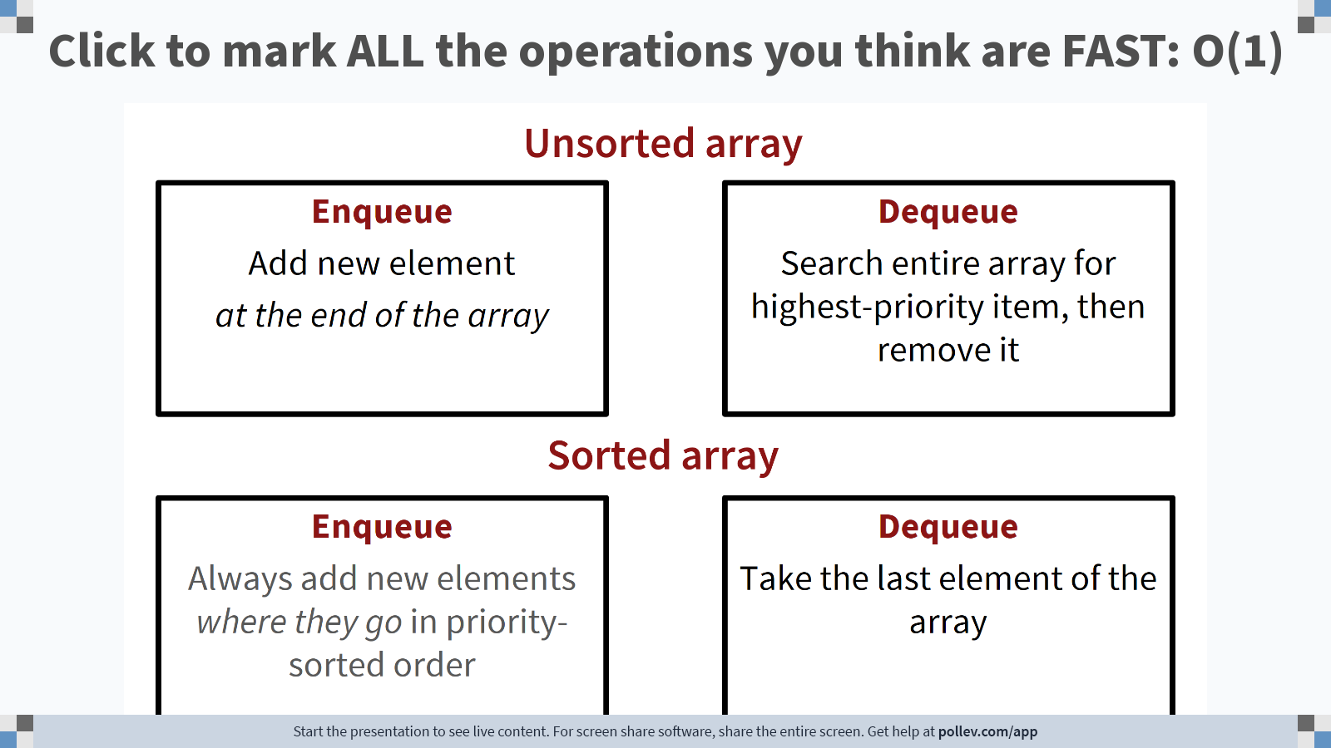
Notes:
Poll Title: Do not modify the notes in this section to avoid tampering with the Poll Everywhere activity.
More info at polleverywhere.com/support
Click to mark ALL the operations you think are FAST: O(1)
https://www.polleverywhere.com/clickable_images/ArIFPKTb0LQyA5sBnS0vd

Slide 13
Unsorted array
O(N)—search whole array, and items may have to scoot over
O(1)
Enqueue
Add new element
at the end of the array
  Dequeue
  Search for highest-priority item, then remove it
Sorted array
Enqueue
  Add new element where it goes in priority-sorted order
  Dequeue
  Take the last element of the array
O(1)
O(N)—items may have to scoot over

Slide 14

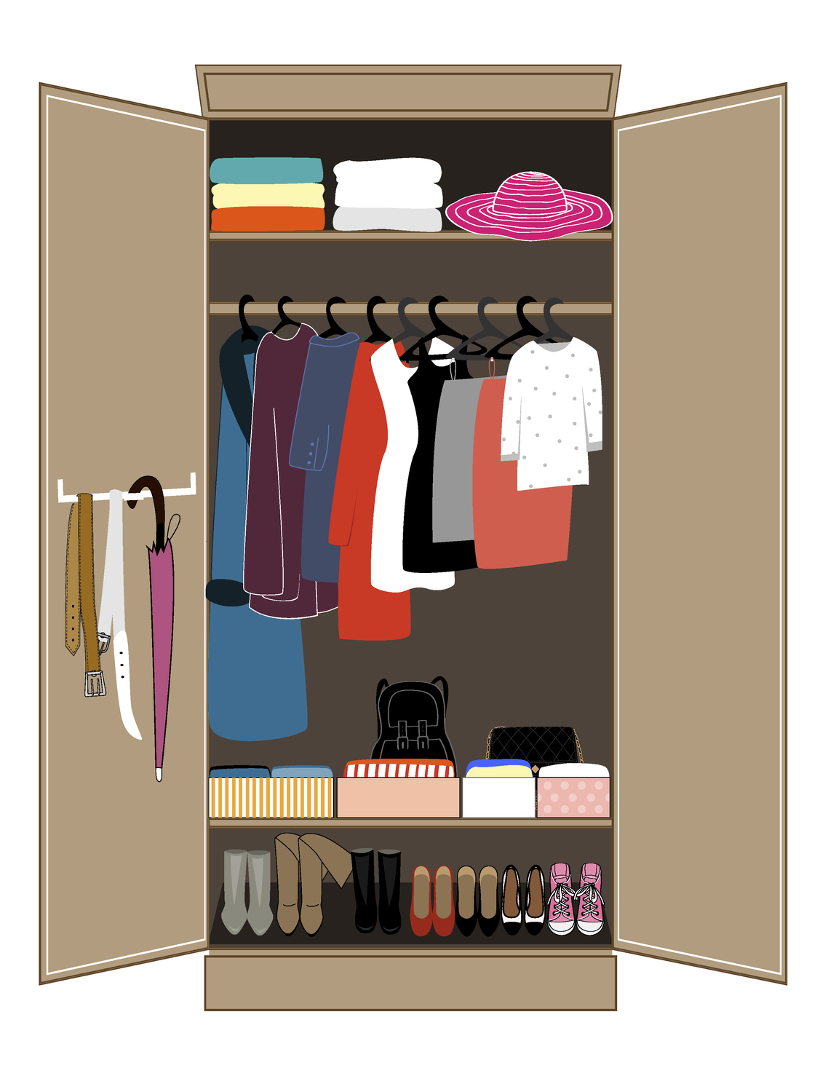
Unsorted array
O(N)—search whole array, and items may have to scoot over
O(1)
Enqueue
Add new element
at the end of the array
  Dequeue
  Search for highest-priority item, then remove it
Sorted array
Enqueue
  Add new element where it goes in priority-sorted order
  Dequeue
  Take the last element of the array
O(1)
O(N)—items may have to scoot over

Slide 15
Entirely unsorted is too chaotic, but entirely sorted is too difficult to maintain
O(1)
Is there a “just-right” compromise with the
best of both?
O(1)

Slide 16
Entirely unsorted is too chaotic, but entirely sorted is too difficult to maintain
O(log₂N)
Is there a “just-right” compromise with the
best of both?
O(log₂N)

Slide 17
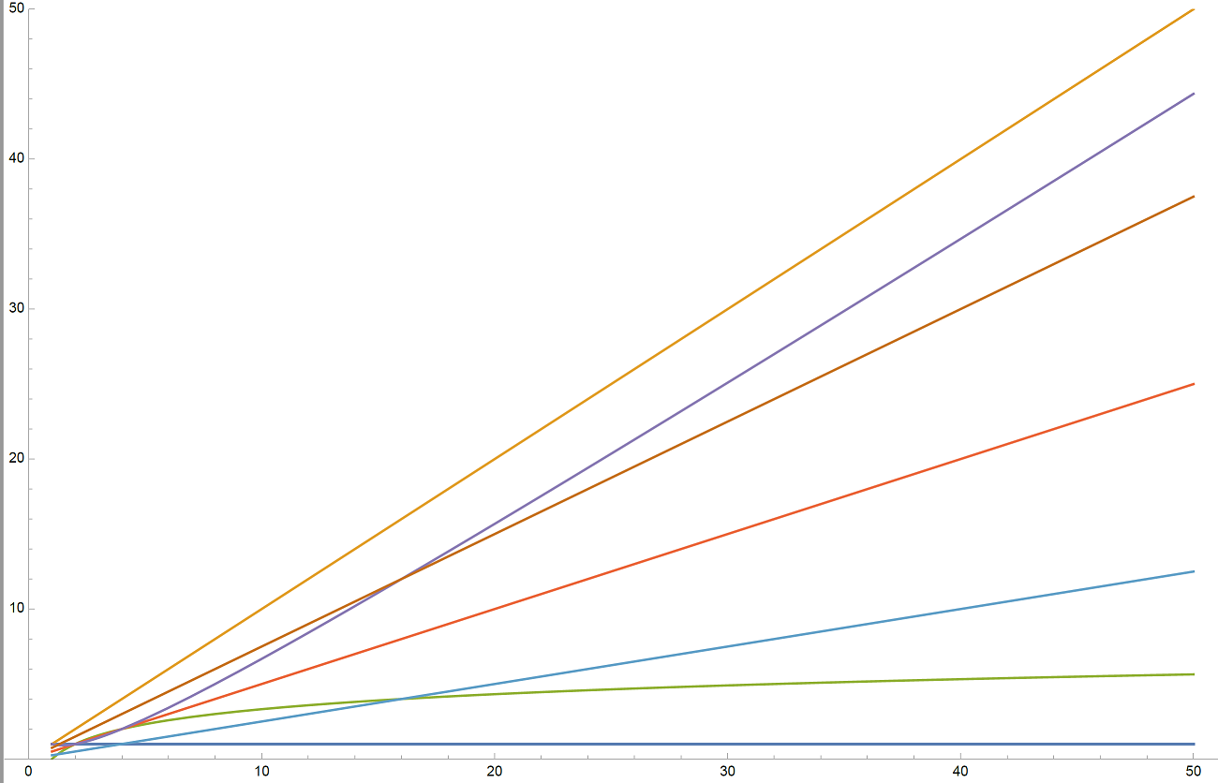
Aside: what does O(log₂N) look like?
O(N)
The top line is O(N).
The bottom line is O(1).
Which of the 5 middle lines is O(log₂N)?
(A)
(B)
(C)
(D)
(E)
O(1)

Slide 18
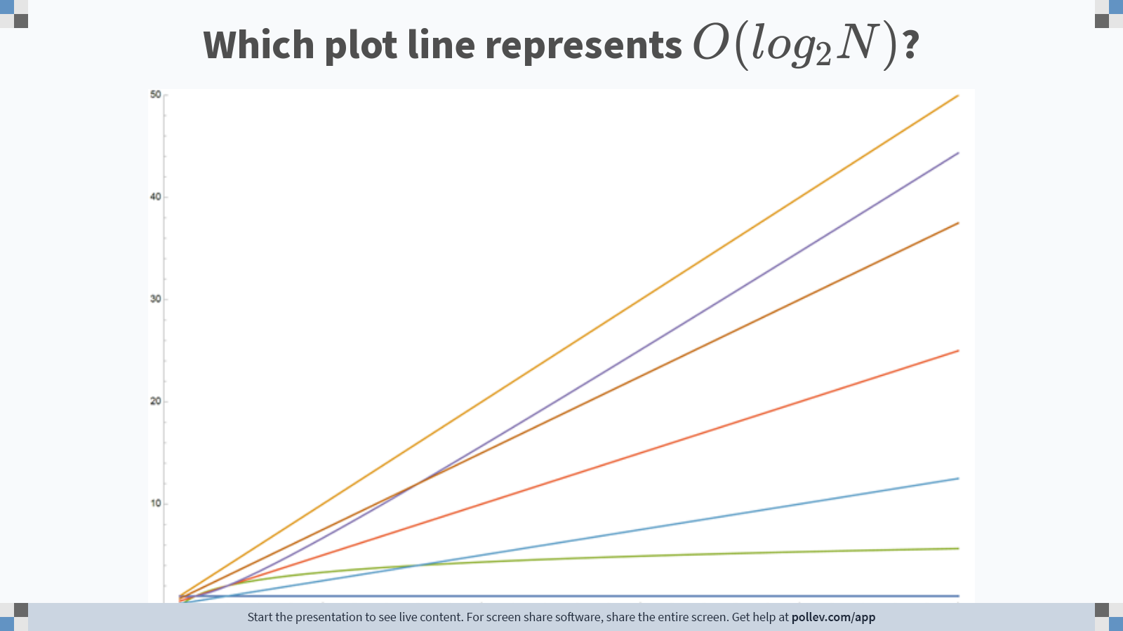
Notes:
Poll Title: Do not modify the notes in this section to avoid tampering with the Poll Everywhere activity.
More info at polleverywhere.com/support
Which plot line represents $$O(log_2N)$$?
https://www.polleverywhere.com/clickable_images/lqAqmBmGKIy0sUAqQ00VM

Slide 19
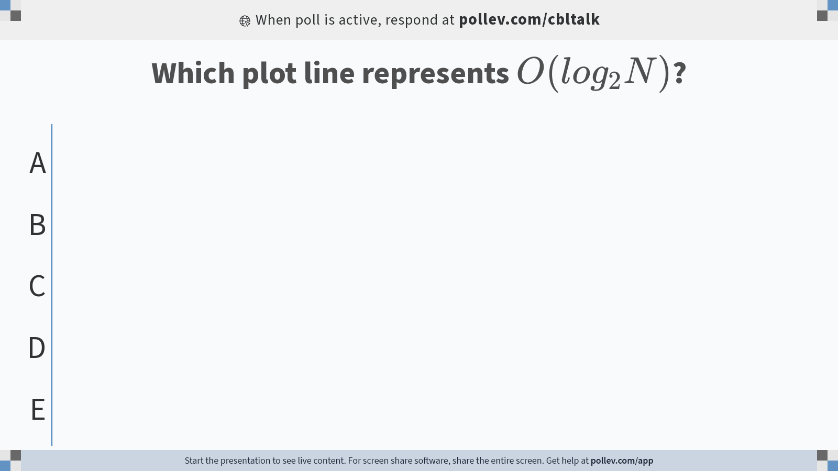
Notes:
Poll Title: Do not modify the notes in this section to avoid tampering with the Poll Everywhere activity.
More info at polleverywhere.com/support
Which plot line represents $$O(log_2N)$$?
https://www.polleverywhere.com/multiple_choice_polls/BV5sPdFsuEHY1fnqSth8l?state=opened&flow=Default&onscreen=persist

Slide 20
Today’s Agenda:
  Priority Queue ADT
  Two “starter” implementations that build on our array skills
    Sorted array
    Unsorted array
    Performance analysis
  Binary heap data structure implementation
    What are binary heaps?
    How do we do enqueue in a heap?
    Homework: dequeue in a heap

Slide 21
Binary heap for our priority queue
Binary heaps store things partially-sorted.
The partial sorting will still be stored in an array, but it’s best to imagine it as what we call a binary “tree”
    One root node at the top
    Each node has at most 2 children, “left” and “right”
Here’s what it might look like:
6 | "SooMin"
Root node
Root’s left child
13 | "Diego"
22 | "Sasha"
Root’s right child
15 | "Muhammad"

Slide 22
Binary Heaps
Binary heaps have a few special restrictions, in addition to being a binary tree:
  Must be complete
    No “gaps”—nodes are filled in left-to-right on each level (row) of the tree
  Ordering of priorities must obey heap property
    A parent’s priority is always ≤ both its children’s priority (min-heap)

Slide 23
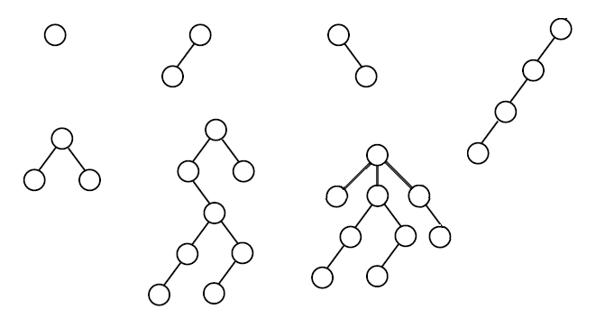
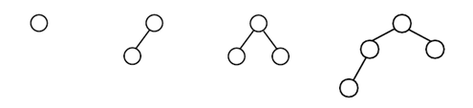
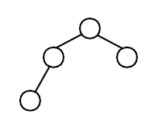
How many of these are valid binary heaps?
  Must be a valid binary tree
  Must be complete
  Ordering of priorities must obey heap property
For the next few slides, we’ll focus on the priority, so for simplicity we’ll leave the payload off the diagrams.
3
8
3
5
8
3
8
6
10
22
14
11
21
2
2
19
27
5
4
6
6
4

Slide 24
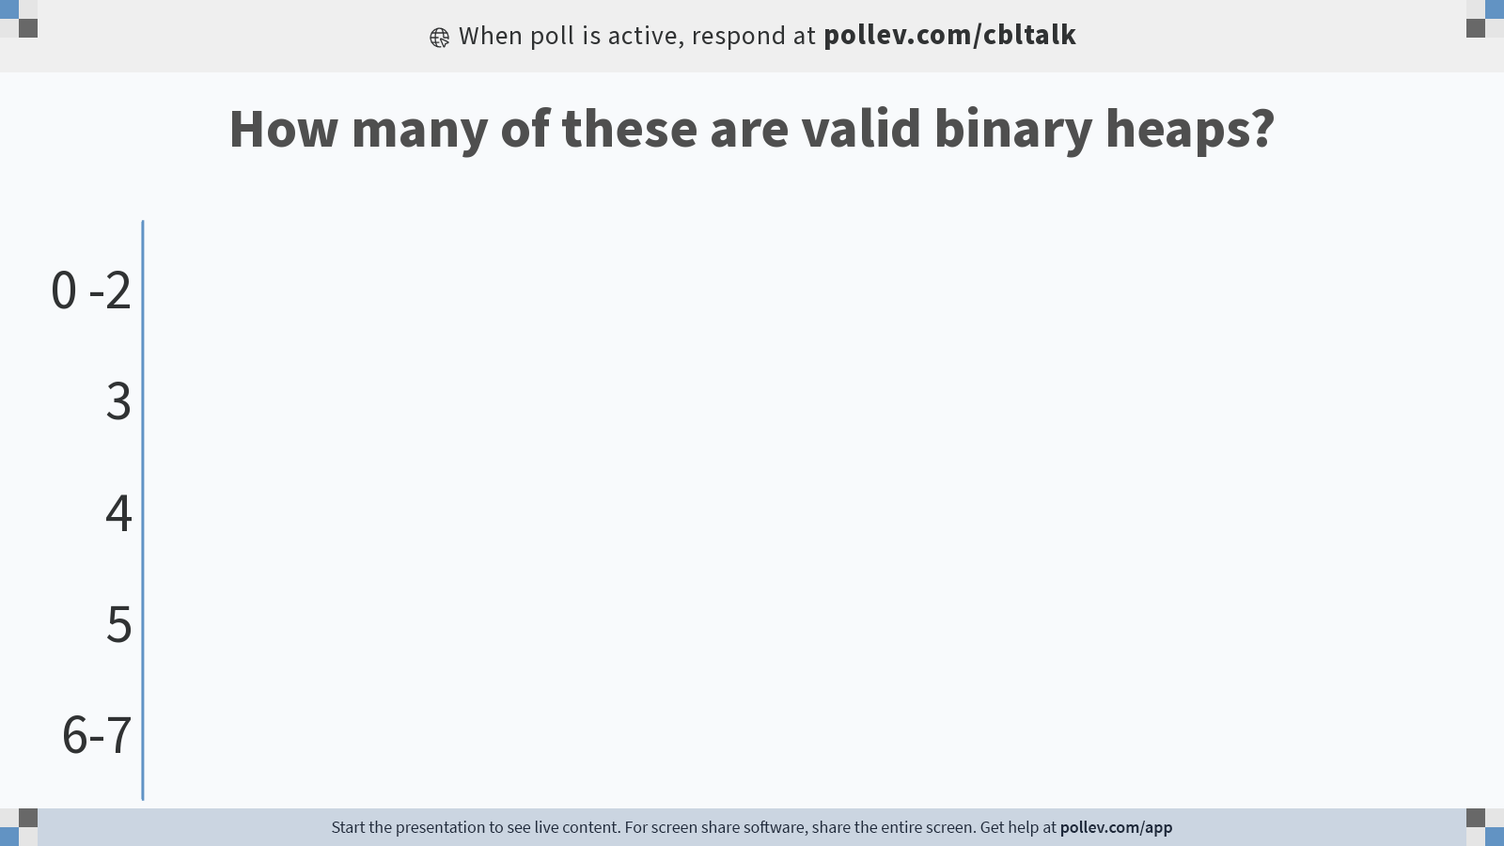
Notes:
Poll Title: Do not modify the notes in this section to avoid tampering with the Poll Everywhere activity.
More info at polleverywhere.com/support
How many of these are valid binary heaps?
https://www.polleverywhere.com/multiple_choice_polls/iGg19Z4dOwKRpftLqUVK0?state=opened&flow=Default&onscreen=persist

Slide 25
Implementing binary heap in an array
Because of the special constraint that they must be complete, binary heaps fit nicely into an array
  We fill the array by reading out the tree nodes top to bottom, left to right
5
6
10
19
14
11
21
_size = 9 _capacity = 15 _elements =
0 | 1 | 2 | 3 | 4 | 5 | 6 | 7 | 8 | 9 | 10 | 11 | 12 | 13 | 14
5 | 6 | 10 | 19 | 14 | 11 | 21 | 22 | 27 | ? | ? | ? | ? | ? | ?
22
27

Slide 26
Implementing binary heap in an array
Because of the special constraint that they must be complete, binary heaps fit nicely into an array
  We fill the array by reading out the tree nodes top to bottom, left to right
5
6
10
Let’s hop into the code now!
19
14
11
21
_size = 9 _capacity = 15 _elements =
0 | 1 | 2 | 3 | 4 | 5 | 6 | 7 | 8 | 9 | 10 | 11 | 12 | 13 | 14
5 | 6 | 10 | 19 | 14 | 11 | 21 | 22 | 27 | ? | ? | ? | ? | ? | ?
22
27

Slide 27
Navigating in the heap array
5
6
10
0 | 1 | 2 | 3 | 4 | 5 | 6 | 7 | 8
5 | 6 | 10 | 19 | 14 | 11 | 21 | 22 | 27
19
14
11
21
22
27
  The parent of the node found in array index i is found where?
    In array index i / 2
    In array index i – 2
    In array index (i – 1) / 2
    In array index 2i
    Somewhere else
    For now, assume that the node in array index i has a parent, i.e., i > 0
    Extra time? Think about a formula for the index of the left and right child of index i
Notes:
Left: 2i + 1
Right: 2i + 2

Slide 28
Fact summary: Binary heap in an array
  For tree of height h, required array length is 2^h - 1
  For a node in array index i:
    Parent is at array index: (i – 1)/2
    Left child is at array index: 2i + 1
    Right child is at array index: 2i + 2
    These all assume the parent/child exists
5
6
10
19
14
11
21
22
27
0 | 1 | 2 | 3 | 4 | 5 | 6 | 7 | 8
5 | 6 | 10 | 19 | 14 | 11 | 21 | 22 | 27
Take a photo of this slide for reference!

Slide 29
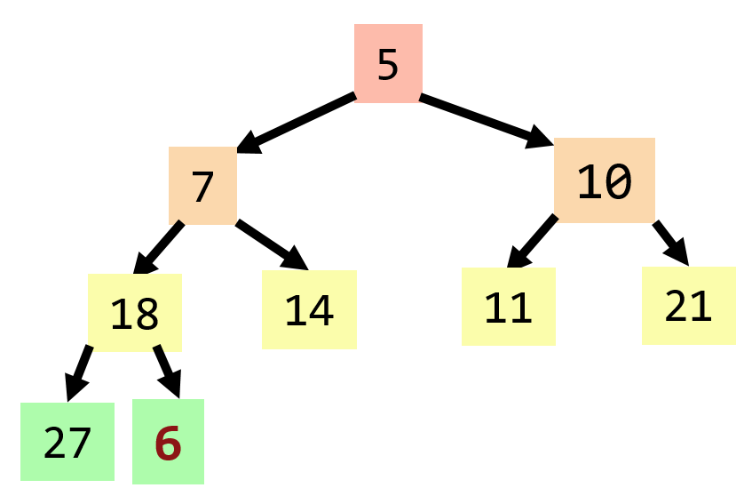
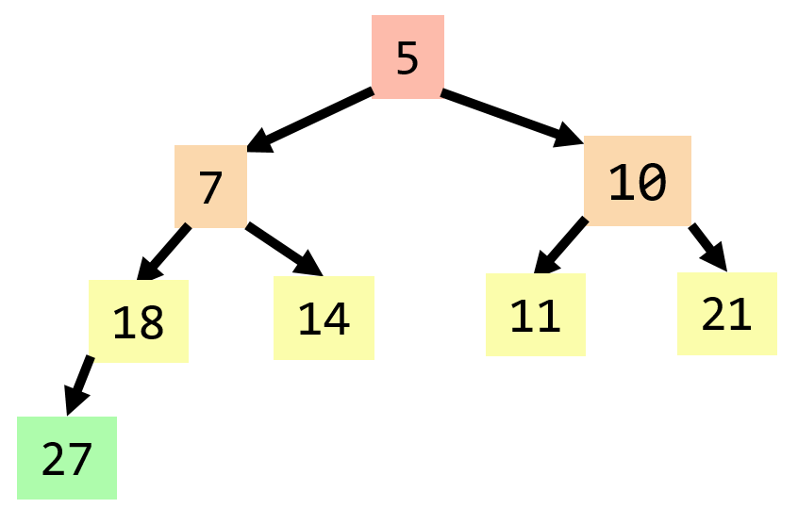
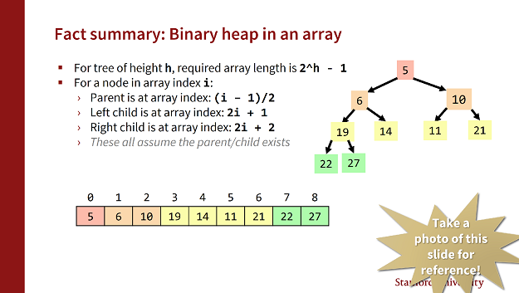
Binary heap enqueue algorithm (append + “bubble up”)
_size = 8, _capacity = 15
0 | 1 | 2 | 3 | 4 | 5 | 6 | 7 | 8 | … | 14
5 | 7 | 10 | 18 | 14 | 11 | 21 | 27 | ? | … | ?
_size = 9, _capacity = 15
0 | 1 | 2 | 3 | 4 | 5 | 6 | 7 | 8 | … | 14
5 | 7 | 10 | 18 | 14 | 11 | 21 | 27 | 6 | … | ?
Parent of index 8 is (8-1)/2 = 3.
We can tell by looking at this tree visualization that the 6 doesn’t go here—but remember in the code all you have is the array. How do we tell there?

Slide 30
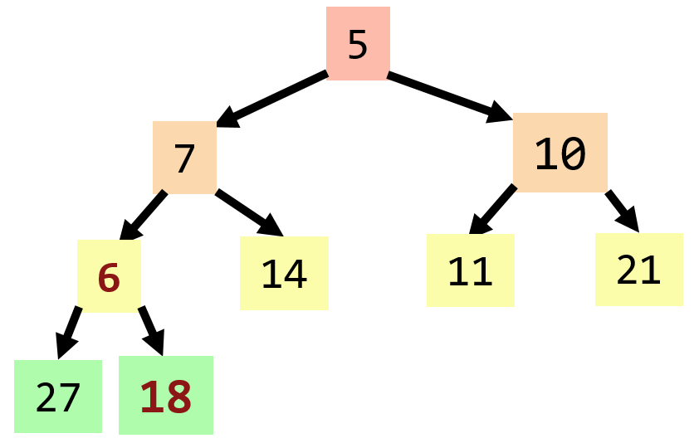
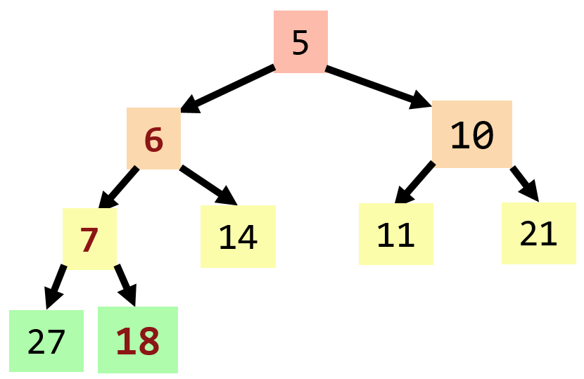
Binary heap enqueue algorithm (append + “bubble up”)
_size = 9, _capacity = 15
0 | 1 | 2 | 3 | 4 | 5 | 6 | 7 | 8 | … | 14
5 | 7 | 10 | 18 | 14 | 11 | 21 | 27 | 6 | … | ?
_size = 9, _capacity = 15
0 | 1 | 2 | 3 | 4 | 5 | 6 | 7 | 8 | … | 14
5 | 7 | 10 | 6 | 14 | 11 | 21 | 27 | 18 | … | ?
_size = 9, _capacity = 15
0 | 1 | 2 | 3 | 4 | 5 | 6 | 7 | 8 | … | 14
5 | 6 | 10 | 7 | 14 | 11 | 21 | 27 | 18 | … | ?

Slide 31
Binary heap enqueue algorithm (append + “bubble up”)
_size = 9, _capacity = 15
0 | 1 | 2 | 3 | 4 | 5 | 6 | 7 | 8 | … | 14
5 | 7 | 10 | 18 | 14 | 11 | 21 | 27 | 6 | … | ?
_size = 9, _capacity = 15
0 | 1 | 2 | 3 | 4 | 5 | 6 | 7 | 8 | … | 14
5 | 7 | 10 | 6 | 14 | 11 | 21 | 27 | 18 | … | ?
_size = 9, _capacity = 15
0 | 1 | 2 | 3 | 4 | 5 | 6 | 7 | 8 | … | 14
5 | 6 | 10 | 7 | 14 | 11 | 21 | 27 | 18 | … | ?
Let’s hop into the code now!

Slide 32
Checking our test case
Inserted values: {5, 8, 9, 7, 1, 10, 3, 4, 6, 2}
1
2
3
5
4
10
9
8
6
7
_size = 10, _capacity = 10
0 | 1 | 2 | 3 | 4 | 5 | 6 | 7 | 8 | 9
1 | 2 | 3 | 5 | 4 | 10 | 9 | 8 | 6 | 7

Slide 33
Dequeue algorithm
5
6
10
19
14
11
21
22
27
Remove the highest-priority item
Move the “last” element (array-index-wise) into its place
“Bubble down” swaps until it is correctly placed
    Important: of the two children, swap with the higher priority (smaller number) child

Slide 34
Entirely unsorted is too chaotic, but entirely sorted is too difficult to maintain
O(log₂N)
Is there a “just-right” compromise with the
best of both?
O(log₂N)

Slide 35
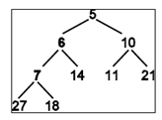
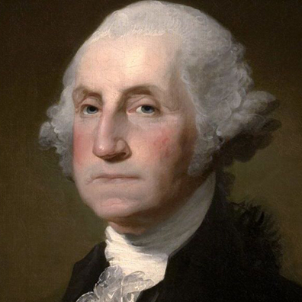
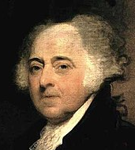

Binary heap dequeue (delete min)
Size=9, Capacity=15
0 | 1 | 2 | 3 | 4 | 5 | 6 | 7 | 8 | 9 | … | 14
5 | 6 | 10 | 7 | 14 | 11 | 21 | 27 | 18 | … | … | …
18
?
6
18

Slide 36
Dequeue and “trickle-down” algorithm summary
1. Remove the min element (the one in the root node—index 0) and that’s the value you’re going to return
  There’s now a “gap”—so the heap no longer follows the structural requirement that it be “complete”
2. Promote the last element into the root node (index 0) position
  We have now immediately restored the “complete” property, but…
  …we have likely broken the “heap ordering” property!
3. “Trickle down” the new root element until the heap ordering property is restored
  Pick the smaller value of the left and right children of this element, and swap downward with that smaller one (i.e., you might trickle-down left, and you might trickle-down right, depending on which is smaller!)
  Repeat step 3 as needed (until it is smaller than both left and right children)

Slide 37
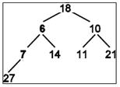
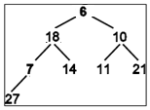
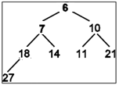
Binary heap dequeue (delete min + “trickle down”)
Size=9, Capacity=15
0 | 1 | 2 | 3 | 4 | 5 | 6 | 7 | 8 | 9 | … | 14
5 | 6 | 10 | 7 | 14 | 11 | 21 | 27 | 18 | ? | … | ?
Size=8, Capacity=15
0 | 1 | 2 | 3 | 4 | 5 | 6 | 7 | 8 | 9 | … | 14
18 | 6 | 10 | 7 | 14 | 11 | 21 | 27 | 18 | ? | … | ?
Size=8, Capacity=15
0 | 1 | 2 | 3 | 4 | 5 | 6 | 7 | 8 | 9 | … | 14
6 | 18 | 10 | 7 | 14 | 11 | 21 | 27 | 18 | ? | … | ?
Size=8, Capacity=15
0 | 1 | 2 | 3 | 4 | 5 | 6 | 7 | 8 | 9 | … | 14
6 | 7 | 10 | 18 | 14 | 11 | 21 | 27 | 18 | ? | … | ?

