Slide 1




Programming Abstractions
CS106B
Cynthia Bailey
Chris Gregg

Slide 2
Graphs
What are graphs? What are they good for?

Slide 3
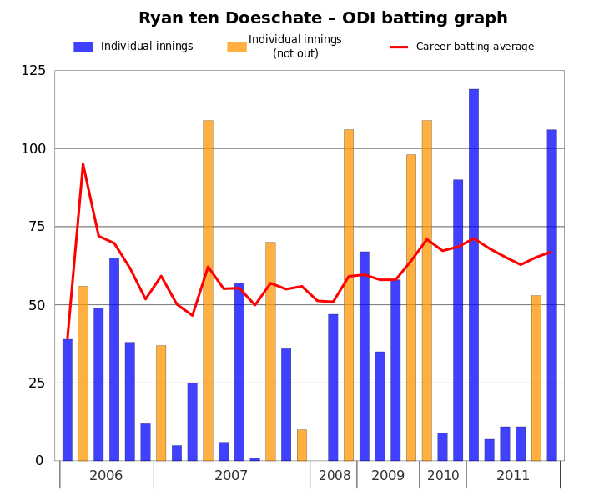
Graph
This file is licensed under the Creative Commons Attribution 3.0 Unported license. Jfd34 http://commons.wikimedia.org/wiki/File:Ryan_ten_Doeschate_ODI_batting_graph.svg

Slide 4
Graphs in Computer Science
A graph is a mathematical structure for representing relationships
  A set V of nodes (or vertices)
  A set E of edges (or arcs) connecting a pair of vertices
Slide by Keith Schwarz

Slide 5
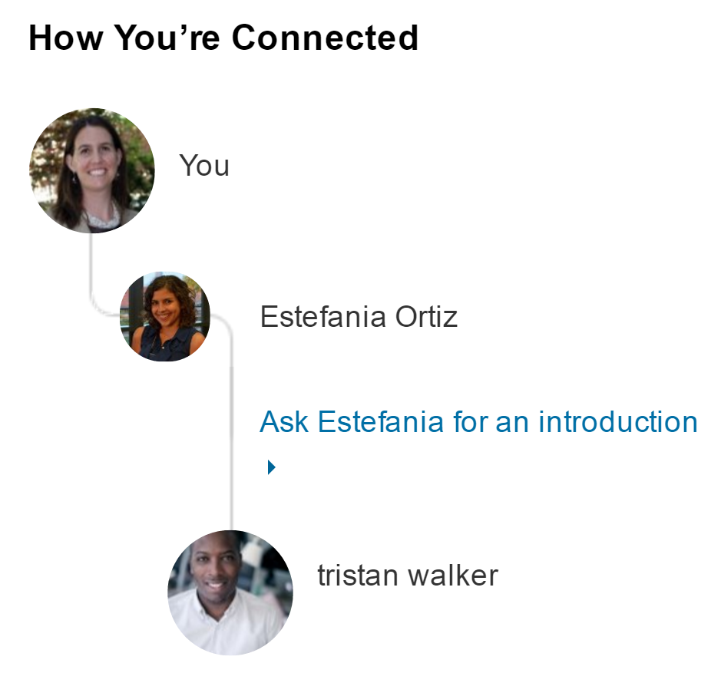

A Social Network

Slide 6
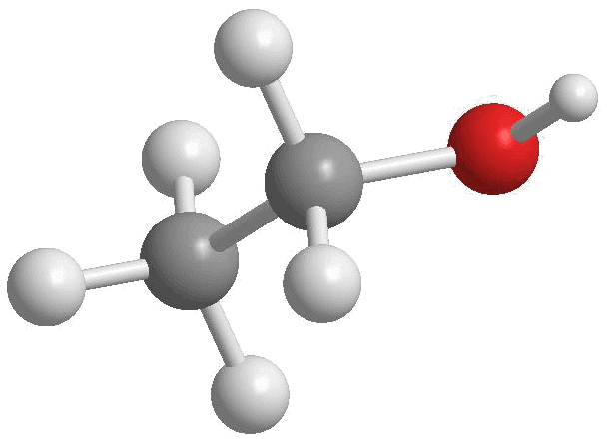
Chemical Bonds
Slide by Keith Schwarz
http://4.bp.blogspot.com/-xCtBJ8lKHqA/Tjm0BONWBRI/AAAAAAAAAK4/-mHrbAUOHHg/s1600/Ethanol2.gif

Slide 7
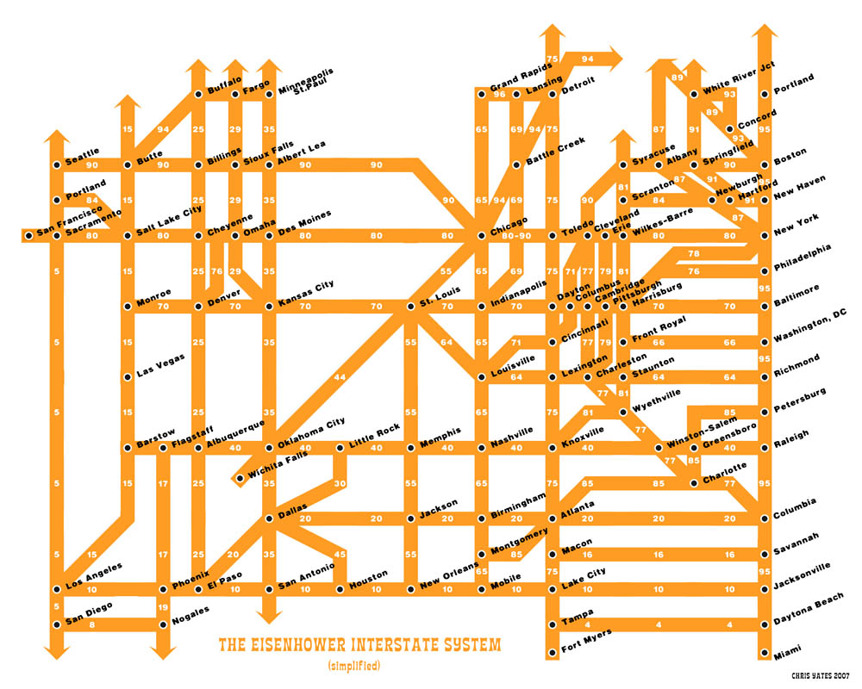
Slide by Keith Schwarz
http://strangemaps.files.wordpress.com/2007/02/fullinterstatemap-web.jpg

Slide 8
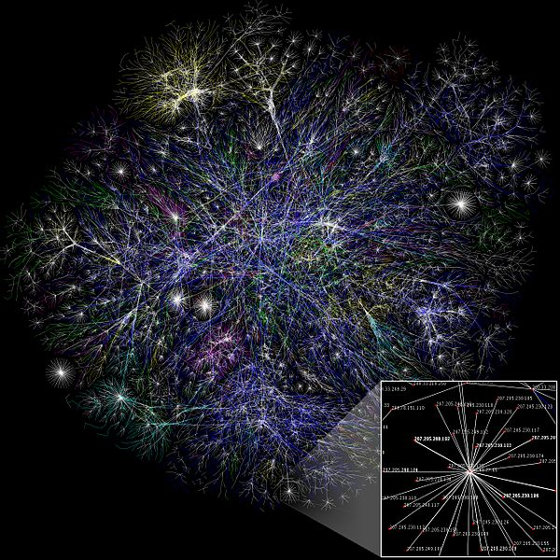
Internet
This file is licensed under the Creative Commons Attribution 2.5 Generic license. The Opte Project http://commons.wikimedia.org/wiki/File:Internet_map_1024.jpg

Slide 9
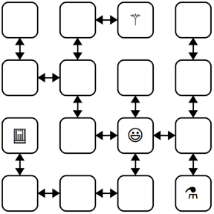
You’ve seen Graphs already
The linked-list Labyrinth assignment is a graph!

Slide 10
Graph Terminology

Slide 11
Graphs: basic types
  Directedness:
    A graph may be directed—an edge from A to B only allow you to go from A to B, not B to A,
    or undirected—an edge between A and B allows travel in both directions, and/or “direction” doesn’t really apply.
  Weights:
    A graph may be weighted—an edge from A to B has a number representing a length, cost, bandwidth, or strength of that connection)
    or unweighted—all edges are equal.
3

Slide 12


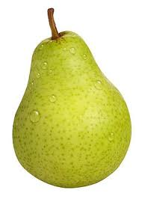
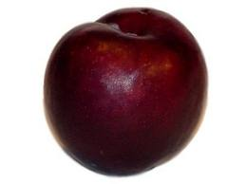
Graphs
Diagrams each show a graph with four vertices: Apple, Banana, Pear, Plum. Each answer choice has different edge sets.
A: no edges
B: Apple to Plum directed, Apple to banana undirected
C: Apple and Banana point to each other. Two edges point from Plum to Pear
All of the following are valid graphs:
A graph could be a single node
An example of a directed graph with 4 nodes
Graphs don’t have to be connected (notice this one has two separated parts)

Slide 13
Graph terminology: Paths
path: A path from vertex a to b is a sequence of edges that can be followed starting from a to reach b.
neighbor or adjacent: Two vertices connected directly by an edge.
reachable: Vertex a is reachable from b if a path exists from a to b.
connected: A graph is connected if every vertex is reachable from every other.
cycle: A path that begins and ends at the same node.

Slide 14
Representing Graphs
Ways we could implement a Graph class

Slide 15
Adjacency Matrix

Slide 16
Representing Graphs: Adjacency matrix
We can represent a graph as a Grid<bool> (unweighted)
 | 0 | 1 | 1 | 0 | 0 | 0
 | 0 | 0 | 0 | 1 | 1 | 0
 | 1 | 1 | 0 | 1 | 0 | 0
 | 0 | 1 | 0 | 0 | 0 | 0
 | 0 | 0 | 0 | 1 | 0 | 1
 | 0 | 0 | 1 | 1 | 0 | 0

Slide 17
Representing Graphs: Adjacency matrix
We can represent a graph as a Grid<bool> (unweighted)
 | 0 | 1 | 1 | 0 | 0 | 0
 | 0 | 0 | 0 | 1 | 1 | 0
 | 1 | 1 | 0 | 1 | 0 | 0
 | 0 | 1 | 0 | 0 | 0 | 0
 | 0 | 0 | 0 | 1 | 0 | 1
 | 0 | 0 | 1 | 1 | 0 | 0
Your Turn: what aspect of the picture does this 0/false correspond to?
Your Turn: which edge in the picture does this 1/true correspond to?

Slide 18
Representing Graphs: Adjacency matrix
 | 0 | 5 | 1 | 0 | 0 | 0
 | 0 | 0 | 0 | 2 | 5 | 0
 | 4 | 1 | 0 | 3 | 0 | 0
 | 0 | 2 | 0 | 0 | 0 | 0
 | 0 | 0 | 0 | 2 | 0 | 7
 | 0 | 0 | 1 | 6 | 0 | 0
We can represent a graph as a Grid<int> (weighted)
5
5
2
2
1
7
1
3
4
6
1

Slide 19
Adjacency List

Slide 20
Representing Graphs: Adjacency list
We can represent a graph as a map from nodes to the set of nodes each node is connected to.
Map<Node*, Set<Node*>>
Node
Connected To
Slide by Keith Schwarz

Slide 21
Representing Graphs: Adjacency list
We can represent a graph as a map from nodes to the set of nodes each node is connected to.
Map<Node*, Set<Edge*>>
Node
Connected To
5
4
5
2
5
2
4
1
3
5
2
2
1
7
3
2
7
4
6
1
6
1
Slide by Keith Schwarz

Slide 22
Graph representations
We just saw:
Adjacency matrix
    Bool: unweighted
    Int: weighted
  Adjacency list
    Without a weight field: unweighted
    With a weight field: weighted
  These aren’t the only options
    You saw with Labyrinth homework assignment that linked nodes also work!

Slide 23
Your Turn: choosing an implementation
Which implementation would you choose for the following circumstances:
    Nodes = Facebook accounts (about 3 billion of them)
    Edges = the two accounts are “Friends” with each other
  Answer each of the following:
    Should your graph be weighted or unweighted?
    Should your graph be directed or undirected?
    Should you use Adjacency Matrix or Adjacency List? (or something else)
    And explain (to your neighbors) why ☺
  Now repeat the exercise for Instagram
    Nodes again represent accounts, and edges capture “following”

Slide 24
Graph representation efficiency considerations
Adjacency matrix implemented as an NxN Grid<bool> takes up how much space in memory?
    O(N²)
  Approximately what percentage of all N2 entries in the Grid are 0/false?
    Pretty close to 100%!
  This is a common phenomenon called a “sparse matrix”—there’s no specific numeric cutoff to count as one, it just means generally a matrix with few entries that are actually “used” in a useful way
  As an engineer, it helps to know when designing your setup whether a given NxN matrix is expected to be sparse or not, and if so, you can make design decisions to reduce waste!

Slide 25
Quick Sampling of Classic Graph Theory Problems

Slide 26
Hamiltonian Cycle
Sadly, has nothing to do with the musical Hamilton. Named after Sir William Rowan Hamilton.

Slide 27
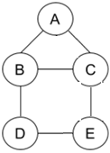
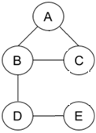
Hamiltonian Cycle
A Hamiltonian Cycle is a path that starts and ends at the same node, and visits every node exactly once (except that start/end node, which is of course visited twice).
✅
There are several different ways to do a Hamiltonian Cycle in this graph. (ex: A, B, D, E, C, A)
It’s not possible to do a Hamiltonian Cycle
in this graph.

Slide 28
Hamiltonian Cycle
A Hamiltonian Cycle is a path that starts and ends at the same node, and visits every node exactly once (except that start/end node, which is of course visited twice).
  The concept of a Hamiltonian Cycle is pretty simple!
And yet, there is no known algorithm for detecting if a graph contains a Hamiltonian Cycle that is faster than O(2^{N}) ☹ ☹
    Using CS106B skills, it’s not very hard to write a recursive depth-first search / backtracking function to find a Hamiltonian Path in a graph. But the function unfortunately will be very slow.

Slide 29
Problem from
“Good Will Hunting” Movie
Or, How Hollywood thinks you prove you are a math savant

Slide 30
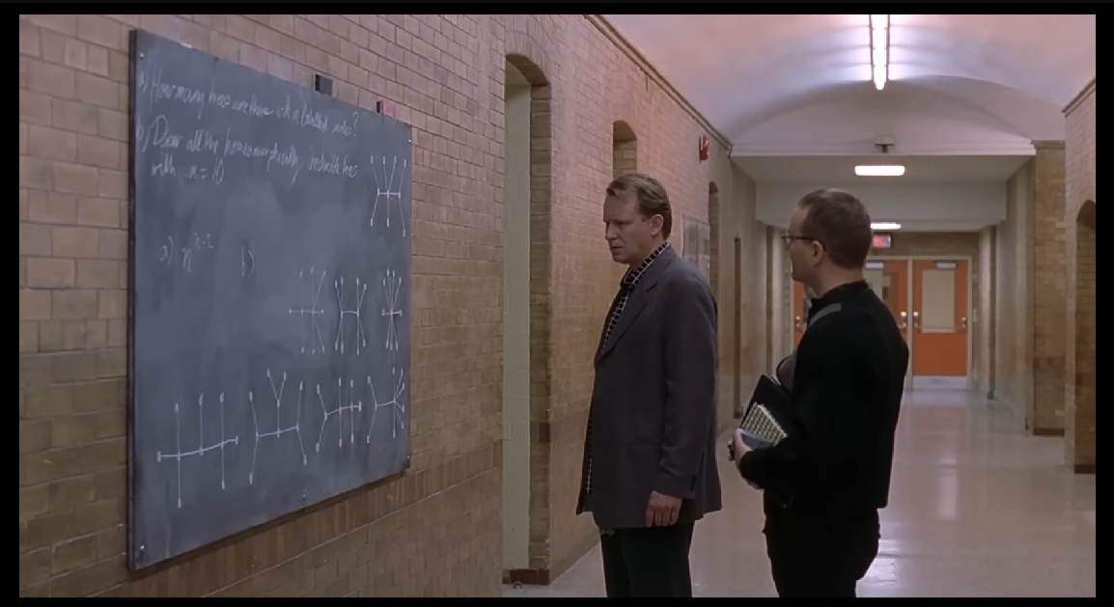
“Draw all the homeomorphically irreducible trees with n=10.”

Slide 31
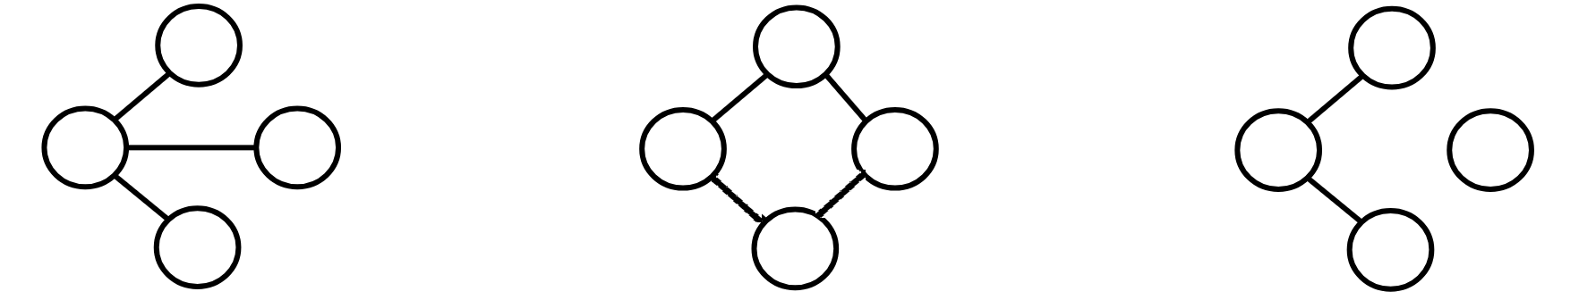
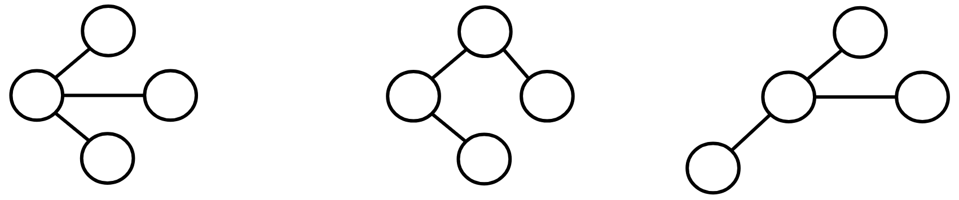
“Draw all the homeomorphically irreducible trees with n=10.”
“n = 10” means it has 10 nodes
“trees” means an undirected graph with no “loops” (no way to go from a node and get back to itself without reusing edges), and there aren’t any parts of the graph that are totally disconnected from the rest
“homeomorphically irreducible” means that for this problem, nodes that lie between exactly 2 other nodes are useless in terms of branching structure—they in effect just act as a blip on a longer edge—and are therefore banned. Also we ignore superficial changes in the drawing.
Yes: (for n=4)
No:
No:
Yes: (for n=4)
Legal, but same underlying structure as the first, so it doesn’t count as a new one
No:
No:

Slide 32
“Draw all the homeomorphically irreducible trees with n=10.”
How many can you find?
“n = 10” means it has 10 nodes
“trees” means an undirected graph with no “loops” (no way to go from a node and get back to itself without reusing edges), and there aren’t any parts of the graph that are totally disconnected from the rest
“homeomorphically irreducible” means that for this problem, nodes that lie between exactly 2 other nodes are useless in terms of tree structure—they in effect just act as a blip on a longer edge—and are therefore banned. Also we ignore superficial changes in the drawing.
Yes: (for n=4)
No:
No:
Extra challenge: can we predict the number of such trees for arbitrary n?
Yes: (for n=4)
Legal, but same underlying structure as the first, so it doesn’t count as a new one
No:
No:

Slide 33
Breadth-First Search
We’ve seen BFS before this quarter!

Slide 34
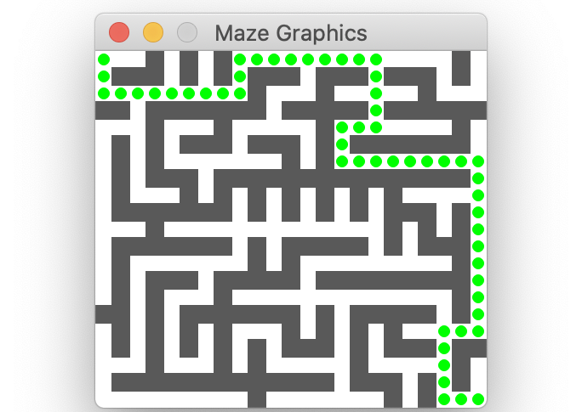
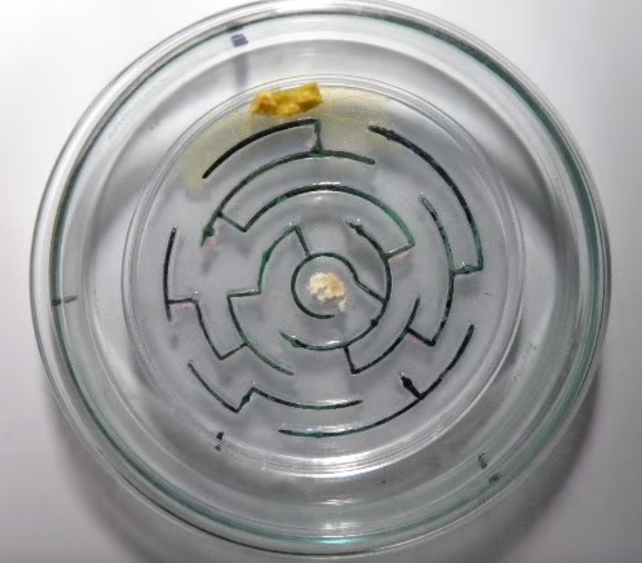
BFS in this class so far
Assignments
Slime Mold
A
B
C
D
E
F
Trees

Slide 35
Generic BFS algorithm pseudocode
Make an empty queue to store places we want to visit in the future
Enqueue the starting location
While the queue is not empty (and/or until you reach a desired destination):
    Dequeue a location
    Mark that location as visited
    Enqueue all the neighbors of that location

Slide 36
Breadth-First Search in a Graph
Graph algorithms

Slide 37
Breadth-First Search
BFS is useful for finding the shortest path between two nodes (in an unweighted, or equally-weighted graph).
A
B
C
D
E
F
G
H
I
J
K
L

Slide 38
Breadth-First Search
BFS is useful for finding the shortest path between two nodes (in an unweighted, or equally-weighted graph).
A
B
C
D
Example: What is the shortest way to go from F to G?
One way (not the shortest): F → E → I → G 3 edges
E
F
G
H
I
J
K
L

Slide 39
Breadth-First Search
BFS is useful for finding the shortest path between two nodes (in an unweighted, or equally-weighted graph).
A
B
C
D
Example: What is the shortest way to go from F to G?
One way (not the shortest): F → E → I → G 3 edges
Shortest way:
F → K → G 2 edges
E
F
G
H
I
J
K
L

Slide 40
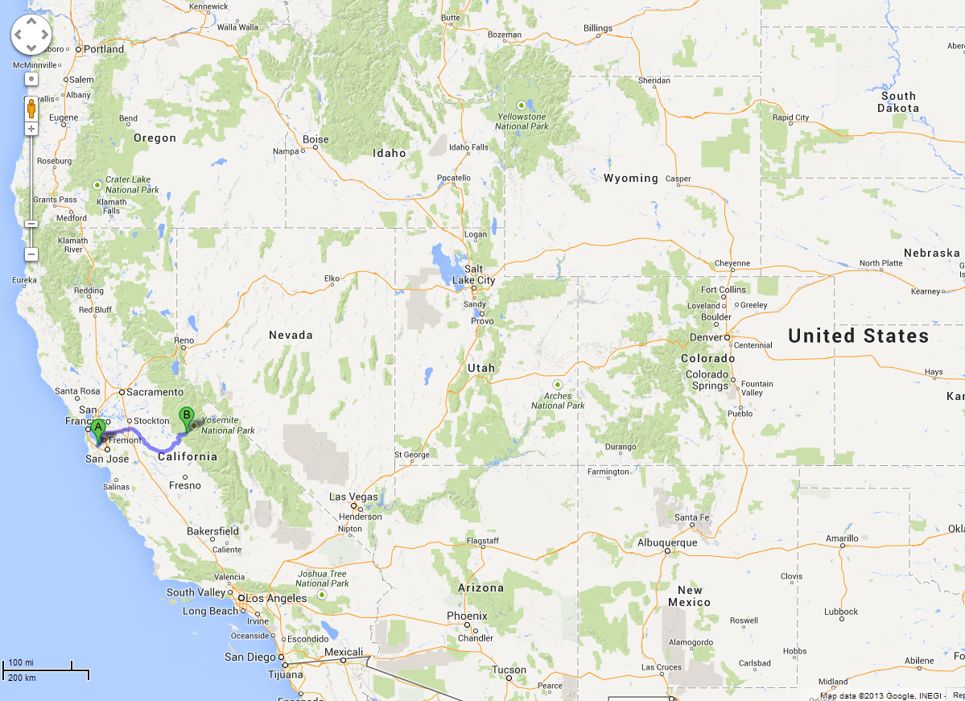
BFS is useful for finding the shortest path between two nodes.
Map Example:
What is the shortest way to go from Yosemite to Palo Alto?

Slide 41
A BFS algorithm for graphs with a special property…
A
B
C
D
A
B
C
D
TO START:
Color all nodes GREY to mean UNVISITED
Queue is empty
E
F
G
H
E
F
G
H
I
J
K
I
J
K
L
L

Slide 42
A BFS algorithm for graphs with a special property…
A
B
C
D
A
B
C
D
TO START:
Color all nodes GREY to mean UNVISITED
Queue is empty
Enqueue the desired start node, change its color to mark it VISITED
E
F
G
H
E
F
G
H
I
J
K
I
J
K
L
L
F

Slide 43
A BFS algorithm for graphs with a special property…
A
B
C
D
A
B
C
D
LOOP PROCEDURE:
Dequeue a node
Set current node’s UNVISITED neighbors’ parent pointers to current node, then enqueue them (and mark them visited when we enqueue)
F
E
F
G
H
E
F
G
H
I
J
K
I
J
K
L
L

Slide 44
Breadth-First Search
A
B
C
D
A
B
C
D
F
E
F
G
H
E
F
G
H
I
J
K
I
J
K
L
L

Slide 45
Breadth-First Search
A
B
C
D
A
B
C
D
F
E
F
G
H
E
F
G
H
I
J
K
I
J
K
L
L

Slide 46
Breadth-First Search
A
B
C
D
A
B
C
D
F
E
F
G
H
E
F
G
H
I
J
K
I
J
K
L
L
A
B
D
E
K

Slide 47
Breadth-First Search
A
A
B
C
D
A
B
C
D
E
F
G
H
E
F
G
H
I
J
K
I
J
K
L
L
B
D
E
K

Slide 48
Breadth-First Search
A
A
B
C
D
A
B
C
D
E
F
G
H
E
F
G
H
I
J
K
I
J
K
L
L
B
D
E
K

Slide 49
Breadth-First Search
A
A
B
C
D
A
B
C
D
E
F
G
H
E
F
G
H
I
J
K
I
J
K
L
L
B
D
E
K

Slide 50
Breadth-First Search
B
A
B
C
D
A
B
C
D
E
F
G
H
E
F
G
H
I
J
K
I
J
K
L
L
D
E
K

Slide 51
Breadth-First Search
B
A
B
C
D
A
B
C
D
E
F
G
H
E
F
G
H
I
J
K
I
J
K
L
L
D
E
K

Slide 52
Breadth-First Search
B
A
B
C
D
A
B
C
D
E
F
G
H
E
F
G
H
I
J
K
I
J
K
L
L
D
E
K
C
H

Slide 53
Breadth-First Search
D
A
B
C
D
A
B
C
D
E
F
G
H
E
F
G
H
I
J
K
I
J
K
L
L
E
K
C
H

Slide 54
Breadth-First Search
D
A
B
C
D
A
B
C
D
E
F
G
H
E
F
G
H
I
J
K
I
J
K
L
L
E
K
C
H

Slide 55
Breadth-First Search
D
A
B
C
D
A
B
C
D
E
F
G
H
E
F
G
H
I
J
K
I
J
K
L
L
E
K
C
H

Slide 56
Breadth-First Search
A
B
C
D
A
B
C
D
E
E
F
G
H
E
F
G
H
I
J
K
I
J
K
L
L
K
C
H

Slide 57
Breadth-First Search
A
B
C
D
A
B
C
D
E
E
F
G
H
E
F
G
H
I
J
K
I
J
K
L
L
K
C
H

Slide 58
Breadth-First Search
A
B
C
D
A
B
C
D
E
E
F
G
H
E
F
G
H
I
J
K
I
J
K
L
L
K
C
H
I

Slide 59
Breadth-First Search
A
B
C
D
A
B
C
D
E
F
G
H
E
F
G
H
K
I
J
K
I
J
K
L
L
C
H
I

Slide 60
Breadth-First Search
A
B
C
D
A
B
C
D
E
F
G
H
E
F
G
H
K
I
J
K
I
J
K
L
L
C
H
I

Slide 61
Breadth-First Search
A
B
C
D
A
B
C
D
E
F
G
H
E
F
G
H
K
I
J
K
I
J
K
L
L
C
H
I
G

Slide 62
Breadth-First Search
C
A
B
C
D
A
B
C
D
E
F
G
H
E
F
G
H
I
J
K
I
J
K
L
L
H
I
G

Slide 63
Breadth-First Search
C
A
B
C
D
A
B
C
D
E
F
G
H
E
F
G
H
I
J
K
I
J
K
L
L
H
I
G

Slide 64
Breadth-First Search
A
B
C
D
A
B
C
D
H
E
F
G
H
E
F
G
H
I
J
K
I
J
K
L
L
I
G

Slide 65
Breadth-First Search
A
B
C
D
A
B
C
D
H
E
F
G
H
E
F
G
H
I
J
K
I
J
K
L
L
I
G

Slide 66
Breadth-First Search
A
B
C
D
A
B
C
D
E
F
G
H
E
F
G
H
I
J
K
I
J
K
L
L
I
G

Slide 67
Breadth-First Search
A
B
C
D
A
B
C
D
E
F
G
H
E
F
G
H
I
I
J
K
I
J
K
L
L
G

Slide 68
Breadth-First Search
A
B
C
D
A
B
C
D
E
F
G
H
E
F
G
H
I
I
J
K
I
J
K
L
L
G

Slide 69
Breadth-First Search
A
B
C
D
A
B
C
D
E
F
G
H
E
F
G
H
I
I
J
K
I
J
K
L
L
G
L

Slide 70
Breadth-First Search
A
B
C
D
A
B
C
D
G
E
F
G
H
E
F
G
H
I
J
K
I
J
K
L
L
L

Slide 71
Breadth-First Search
A
B
C
D
A
B
C
D
G
E
F
G
H
E
F
G
H
I
J
K
I
J
K
L
L
L

Slide 72
Breadth-First Search
A
B
C
D
A
B
C
D
E
F
G
H
E
F
G
H
I
J
K
I
J
K
L
L
L

Slide 73
Breadth-First Search
A
B
C
D
A
B
C
D
E
F
G
H
E
F
G
H
I
J
K
I
J
K
L
L
L

Slide 74
Breadth-First Search
A
B
C
D
A
B
C
D
E
F
G
H
E
F
G
H
I
J
K
I
J
K
L
L
L
J

Slide 75
Breadth-First Search
A
B
C
D
A
B
C
D
E
F
G
H
E
F
G
H
J
I
J
K
I
J
K
L
L

Slide 76
Breadth-First Search
A
B
C
D
A
B
C
D
E
F
G
H
E
F
G
H
J
I
J
K
I
J
K
L
L

Slide 77
Breadth-First Search
Done!
Now we know that to go from Yoesmite (F) to Palo Alto (J), we should go:
F->E->I->L->J
(4 edges)
(note we follow the parent pointers backwards)
A
B
C
D
A
B
C
D
E
F
G
H
E
F
G
H
J
I
J
K
I
J
K
L
L

Slide 78
Breadth-First Search
A
B
C
D
A
B
C
D
THINGS TO NOTICE:
We used a queue
What’s left is a kind of subset of the edges, in the form of ‘parent’ pointers
If you follow the parent pointers from the desired end point, you will get back to the start point, and it will be the shortest way to do that
E
F
G
H
E
F
G
H
I
J
K
I
J
K
L
L

Slide 79
Quick question about efficiency…
Let’s say that you have an extended family with somebody living in every major city in the western U.S.

Slide 80
Quick question about efficiency…
You’re all in Yosemite for a family reunion, and you’ve been tasked with making custom Yosemite-to-home-city driving directions for everyone.

Slide 81
Quick question about efficiency…
You’re all in Yosemite for a family reunion, and you’ve been tasked with making custom Yosemite-to-home-city driving directions for everyone.
You’ve already run the BFS algorithm and calculated the shortest path for yourself to return home from the reunion (Yosemite to Palo Alto)
The Big-O cost of doing that for yourself works out to O(E log₂V)
    Where V is the number of nodes/cities, and E is the number of edges/road segments

Slide 82
Quick question about efficiency…
You’re all in Yosemite for a family reunion, and you’ve been tasked with making custom Yosemite-to-home-city driving directions for everyone.
You’ve already run the BFS algorithm and calculated the shortest path for yourself to return home from the reunion (Yosemite to Palo Alto)
O(E log₂V) was the Big-O cost of doing that for yourself
    Where V is the number of nodes/cities, and E is the number of edges/road segments
Your Turn: How long will it take you, in total, to calculate the shortest paths for you and all of your relatives?
O(VE log₂V)
O(E log₂V²)
O(V log₂E)
O(E log₂V)
Something else

Slide 83
Breadth-First Search
A
B
C
D
A
B
C
D
THINGS TO NOTICE:
We used a queue
What’s left is a kind of subset of the edges, in the form of ‘parent’ pointers
If you follow the parent pointers from the desired end point, you will get back to the start point, and it will be the shortest way to do that
E
F
G
H
E
F
G
H
I
J
K
I
J
K
And you have that info not only for the node you were interested in, but as a side effect also for every node in the graph!
L
L

Slide 84
Quick question about efficiency…
You’re all in Yosemite for a family reunion, and you’ve been tasked with making custom Yosemite-to-home-city driving directions for everyone.
You’ve already run the BFS algorithm and calculated the shortest path for yourself to return home from the reunion (Yosemite to Palo Alto)
O(E log₂V) was the Big-O cost of doing that for yourself
    Where V is the number of nodes/cities, and E is the number of edges/road segments
Your Turn: How long will it take you, in total, to use BFS to calculate the shortest paths for you and all of your relatives?
O(VE log₂V)
O(E log₂V²)
O(V log₂E)
O(E log₂V)
Something else
No additional work for BFS to determine the shortest paths for all your relatives, vs just for yourself!

Slide 85
Dijkstra’s Shortest Paths
(Like Breadth-first Search, but takes into account weight/distance between nodes)

Slide 86
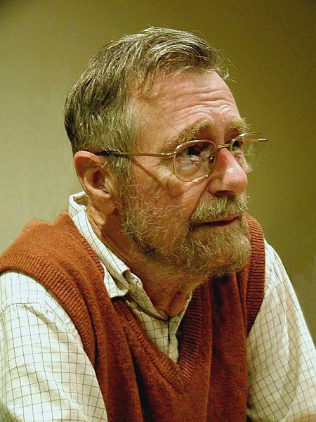
Edsger Dijkstra
1930-2002
THE multiprogramming system (operating system)
  Layers of abstraction!!
Complier for a language that can do recursion
Dining Philosopher’s Problem (resource contention and deadlock)
Dijkstra’s algorithm
“Goto considered harmful” (title given to his letter)
This file is licensed under the Creative Commons Attribution-Share Alike 3.0 Unported license. http://en.wikipedia.org/wiki/File:Edsger_Wybe_Dijkstra.jpg

Slide 87
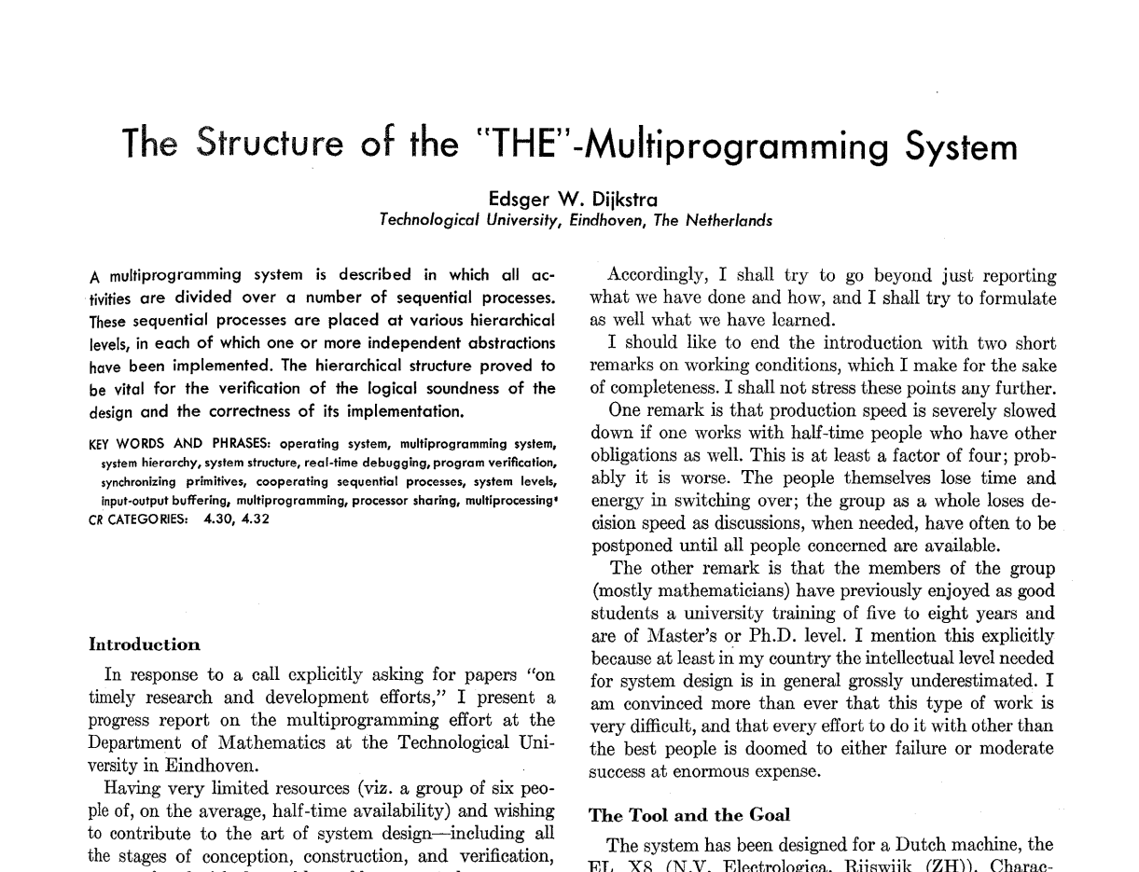

Slide 88
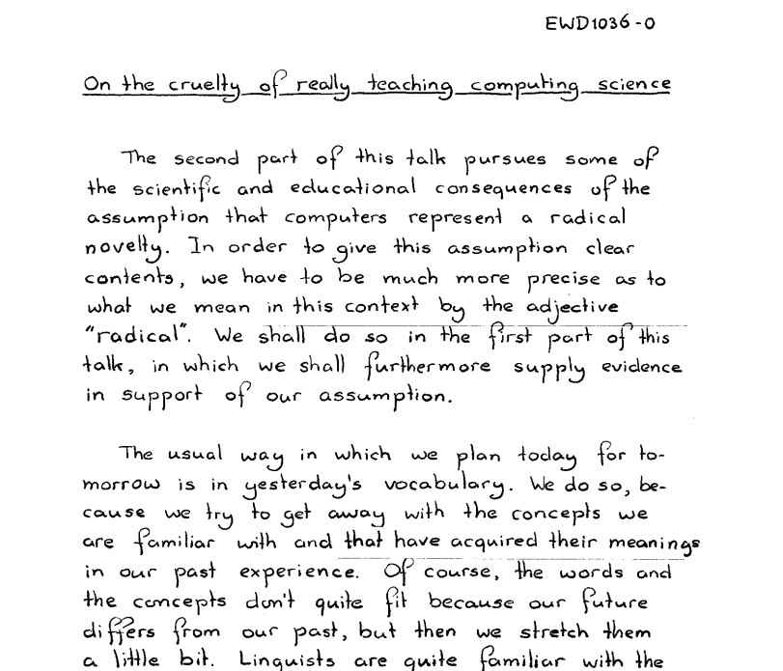

Slide 89
Mark all nodes as gray.
Mark the initial node s as yellow and at candidate distance 0.
Enqueue s into the priority queue with priority 0.
While not all nodes have been visited:
  Dequeue the lowest-cost node u from the priority queue.
  Color u green. The candidate distance d that is currently stored for node u is the length of the shortest path from s to u.
  If u is the destination node t, you have found the shortest path from s to t and are done.
  For each node v connected to u by an edge of length L:
    If v is gray:
      Color v yellow.
      Mark v's distance as d + L.
      Set v's parent to be u.
      Enqueue v into the priority queue with priority d + L.
    If v is yellow and the candidate distance to v is greater than d + L:
      Update v's candidate distance to be d + L.
      Update v's parent to be u.
      Update v's priority in the priority queue to d + L.
Dijkstra's
Algorithm

