Slide 1
Programming Abstractions
CS106B
Cynthia Bailey
Chris Gregg

Slide 2

Today’s Topics
pollev.com/cs106b
  Previously:
  Graphs
    Terminology
    Basics
    A couple samples of classic Graph Theory problems (Hamiltonian Path and the Good Will Hunting movie problem)
  Today:
  Another classic graph problem: shortest paths
    BFS
    Dijkstra’s algorithm
  For important announcements, be sure to see the weekly announcements post on the Ed Q&A board! https://edstem.org
  Also on Ed: live lecture Q&A with Chris & Jonathan

Slide 3
Breadth-First Search
We’ve seen BFS before this quarter!

Slide 4
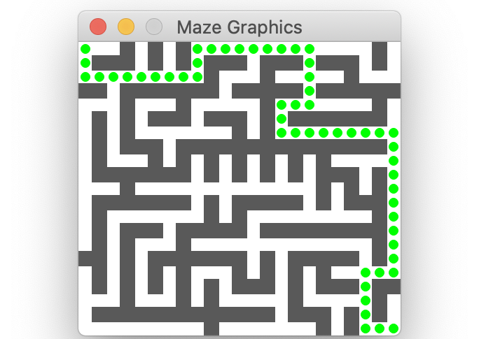
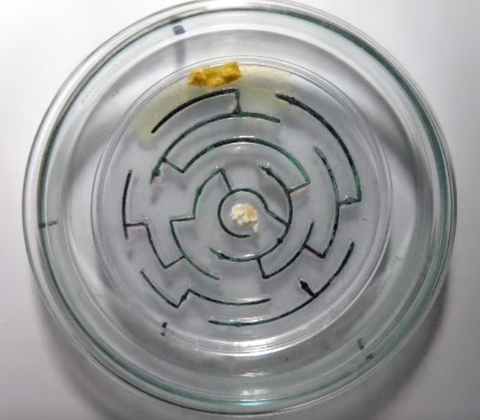
BFS in this class so far
Assignments
Slime Mold
A
B
C
D
E
F
Trees

Slide 5
Generic BFS algorithm pseudocode
Make an empty queue to store places we want to visit in the future
Enqueue the starting location
While the queue is not empty (and/or until you reach a desired destination):
    Dequeue a location
    Mark that location as visited
    Enqueue all the neighbors of that location

Slide 6
Breadth-First Search in a Graph
Graph algorithms

Slide 7
Breadth-First Search
BFS is useful for finding the shortest path between two nodes (in an unweighted, or equally-weighted graph).
A
B
C
D
E
F
G
H
I
J
K
L

Slide 8
Breadth-First Search
BFS is useful for finding the shortest path between two nodes (in an unweighted, or equally-weighted graph).
A
B
C
D
Example: What is the shortest way to go from F to G?
One way (not the shortest): F → E → I → G 3 edges
E
F
G
H
I
J
K
L

Slide 9
Breadth-First Search
BFS is useful for finding the shortest path between two nodes (in an unweighted, or equally-weighted graph).
A
B
C
D
Example: What is the shortest way to go from F to G?
One way (not the shortest): F → E → I → G 3 edges
Shortest way:
F → K → G 2 edges
E
F
G
H
I
J
K
L

Slide 10
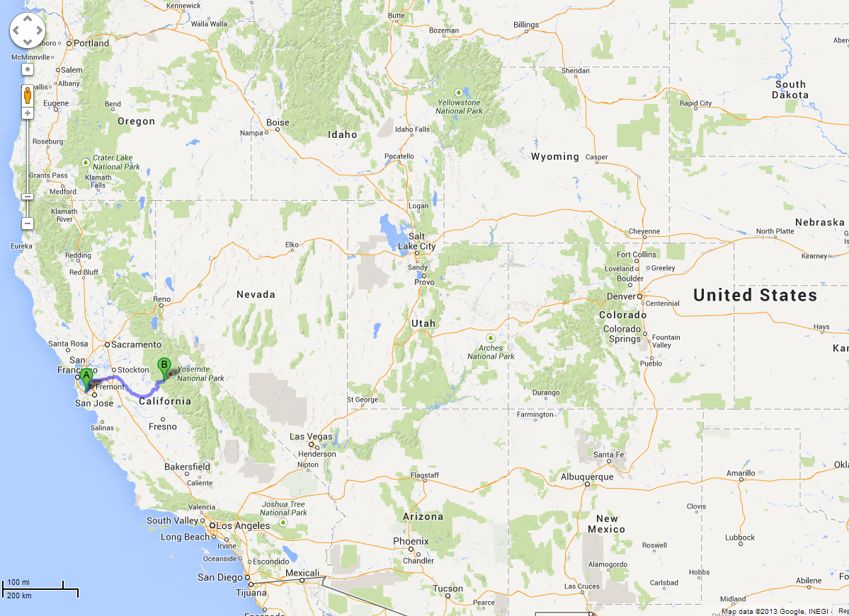
BFS is useful for finding the shortest path between two nodes.
Map Example:
What is the shortest way to go from Yosemite to Palo Alto?

Slide 11
A BFS algorithm for graphs with a special property…
A
B
C
D
A
B
C
D
TO START:
Color all nodes GREY to mean UNVISITED
Queue is empty
E
F
G
H
E
F
G
H
I
J
K
I
J
K
L
L

Slide 12
A BFS algorithm for graphs with a special property…
A
B
C
D
A
B
C
D
TO START:
Color all nodes GREY to mean UNVISITED
Queue is empty
Enqueue the desired start node, change its color to mark it VISITED
E
F
G
H
E
F
G
H
I
J
K
I
J
K
L
L
F

Slide 13
A BFS algorithm for graphs with a special property…
A
B
C
D
A
B
C
D
LOOP PROCEDURE:
Dequeue a node
Set current node’s UNVISITED neighbors’ parent pointers to current node, then enqueue them (and mark them visited when we enqueue)
F
E
F
G
H
E
F
G
H
I
J
K
I
J
K
L
L

Slide 14
Breadth-First Search
A
B
C
D
A
B
C
D
F
E
F
G
H
E
F
G
H
I
J
K
I
J
K
L
L

Slide 15
Breadth-First Search
A
B
C
D
A
B
C
D
F
E
F
G
H
E
F
G
H
I
J
K
I
J
K
L
L

Slide 16
Breadth-First Search
A
B
C
D
A
B
C
D
F
E
F
G
H
E
F
G
H
I
J
K
I
J
K
L
L
A
B
D
E
K

Slide 17
Breadth-First Search
A
A
B
C
D
A
B
C
D
E
F
G
H
E
F
G
H
I
J
K
I
J
K
L
L
B
D
E
K

Slide 18
Breadth-First Search
A
A
B
C
D
A
B
C
D
E
F
G
H
E
F
G
H
I
J
K
I
J
K
L
L
B
D
E
K

Slide 19
Breadth-First Search
A
A
B
C
D
A
B
C
D
E
F
G
H
E
F
G
H
I
J
K
I
J
K
L
L
B
D
E
K

Slide 20
Breadth-First Search
B
A
B
C
D
A
B
C
D
E
F
G
H
E
F
G
H
I
J
K
I
J
K
L
L
D
E
K

Slide 21
Breadth-First Search
B
A
B
C
D
A
B
C
D
E
F
G
H
E
F
G
H
I
J
K
I
J
K
L
L
D
E
K

Slide 22
Breadth-First Search
B
A
B
C
D
A
B
C
D
E
F
G
H
E
F
G
H
I
J
K
I
J
K
L
L
D
E
K
C
H

Slide 23
Breadth-First Search
D
A
B
C
D
A
B
C
D
E
F
G
H
E
F
G
H
I
J
K
I
J
K
L
L
E
K
C
H

Slide 24
Breadth-First Search
D
A
B
C
D
A
B
C
D
E
F
G
H
E
F
G
H
I
J
K
I
J
K
L
L
E
K
C
H

Slide 25
Breadth-First Search
D
A
B
C
D
A
B
C
D
E
F
G
H
E
F
G
H
I
J
K
I
J
K
L
L
E
K
C
H

Slide 26
Breadth-First Search
A
B
C
D
A
B
C
D
E
E
F
G
H
E
F
G
H
I
J
K
I
J
K
L
L
K
C
H

Slide 27
Breadth-First Search
A
B
C
D
A
B
C
D
E
E
F
G
H
E
F
G
H
I
J
K
I
J
K
L
L
K
C
H

Slide 28
Breadth-First Search
A
B
C
D
A
B
C
D
E
E
F
G
H
E
F
G
H
I
J
K
I
J
K
L
L
K
C
H
I

Slide 29
Breadth-First Search
A
B
C
D
A
B
C
D
E
F
G
H
E
F
G
H
K
I
J
K
I
J
K
L
L
C
H
I

Slide 30
Breadth-First Search
A
B
C
D
A
B
C
D
E
F
G
H
E
F
G
H
K
I
J
K
I
J
K
L
L
C
H
I

Slide 31
Breadth-First Search
A
B
C
D
A
B
C
D
E
F
G
H
E
F
G
H
K
I
J
K
I
J
K
L
L
C
H
I
G

Slide 32
Breadth-First Search
C
A
B
C
D
A
B
C
D
E
F
G
H
E
F
G
H
I
J
K
I
J
K
L
L
H
I
G

Slide 33
Breadth-First Search
C
A
B
C
D
A
B
C
D
E
F
G
H
E
F
G
H
I
J
K
I
J
K
L
L
H
I
G

Slide 34
Breadth-First Search
A
B
C
D
A
B
C
D
H
E
F
G
H
E
F
G
H
I
J
K
I
J
K
L
L
I
G

Slide 35
Breadth-First Search
A
B
C
D
A
B
C
D
H
E
F
G
H
E
F
G
H
I
J
K
I
J
K
L
L
I
G

Slide 36
Breadth-First Search
A
B
C
D
A
B
C
D
E
F
G
H
E
F
G
H
I
J
K
I
J
K
L
L
I
G

Slide 37
Breadth-First Search
A
B
C
D
A
B
C
D
E
F
G
H
E
F
G
H
I
I
J
K
I
J
K
L
L
G

Slide 38
Breadth-First Search
A
B
C
D
A
B
C
D
E
F
G
H
E
F
G
H
I
I
J
K
I
J
K
L
L
G

Slide 39
Breadth-First Search
A
B
C
D
A
B
C
D
E
F
G
H
E
F
G
H
I
I
J
K
I
J
K
L
L
G
L

Slide 40
Breadth-First Search
A
B
C
D
A
B
C
D
G
E
F
G
H
E
F
G
H
I
J
K
I
J
K
L
L
L

Slide 41
Breadth-First Search
A
B
C
D
A
B
C
D
G
E
F
G
H
E
F
G
H
I
J
K
I
J
K
L
L
L

Slide 42
Breadth-First Search
A
B
C
D
A
B
C
D
E
F
G
H
E
F
G
H
I
J
K
I
J
K
L
L
L

Slide 43
Breadth-First Search
A
B
C
D
A
B
C
D
E
F
G
H
E
F
G
H
I
J
K
I
J
K
L
L
L

Slide 44
Breadth-First Search
A
B
C
D
A
B
C
D
E
F
G
H
E
F
G
H
I
J
K
I
J
K
L
L
L
J

Slide 45
Breadth-First Search
A
B
C
D
A
B
C
D
E
F
G
H
E
F
G
H
J
I
J
K
I
J
K
L
L

Slide 46
Breadth-First Search
A
B
C
D
A
B
C
D
E
F
G
H
E
F
G
H
J
I
J
K
I
J
K
L
L

Slide 47
Breadth-First Search
Done!
Now we know that to go from Yoesmite (F) to Palo Alto (J), we should go:
F->E->I->L->J
(4 edges)
(note we follow the parent pointers backwards)
A
B
C
D
A
B
C
D
E
F
G
H
E
F
G
H
J
I
J
K
I
J
K
L
L

Slide 48
Breadth-First Search
A
B
C
D
A
B
C
D
THINGS TO NOTICE:
We used a queue
What’s left is a kind of subset of the edges, in the form of ‘parent’ pointers
If you follow the parent pointers from the desired end point, you will get back to the start point, and it will be the shortest way to do that
E
F
G
H
E
F
G
H
I
J
K
I
J
K
L
L

Slide 49
Quick question about efficiency…
Let’s say that you have an extended family with somebody living in every major city in the western U.S.

Slide 50
Quick question about efficiency…
You’re all in Yosemite for a family reunion, and you’ve been tasked with making custom Yosemite-to-home-city driving directions for everyone.

Slide 51
Quick question about efficiency…
You’re all in Yosemite for a family reunion, and you’ve been tasked with making custom Yosemite-to-home-city driving directions for everyone.
You’ve already run the BFS algorithm and calculated the shortest path for yourself to return home from the reunion (Yosemite to Palo Alto)
The Big-O cost of doing that for yourself works out to O(E log₂V)
    Where V is the number of nodes/cities, and E is the number of edges/road segments

Slide 52
Quick question about efficiency…
You’re all in Yosemite for a family reunion, and you’ve been tasked with making custom Yosemite-to-home-city driving directions for everyone.
You’ve already run the BFS algorithm and calculated the shortest path for yourself to return home from the reunion (Yosemite to Palo Alto)
O(E log₂V) was the Big-O cost of doing that for yourself
    Where V is the number of nodes/cities, and E is the number of edges/road segments
Your Turn: How long will it take you, in total, to calculate the shortest paths for you and all of your relatives?
O(VE log₂V)
O(E log₂V²)
O(V log₂E)
O(E log₂V)
Something else

Slide 53
Breadth-First Search
A
B
C
D
A
B
C
D
THINGS TO NOTICE:
We used a queue
What’s left is a kind of subset of the edges, in the form of ‘parent’ pointers
If you follow the parent pointers from the desired end point, you will get back to the start point, and it will be the shortest way to do that
E
F
G
H
E
F
G
H
I
J
K
I
J
K
And you have that info not only for the node you were interested in, but as a side effect also for every node in the graph!
L
L

Slide 54
Quick question about efficiency…
You’re all in Yosemite for a family reunion, and you’ve been tasked with making custom Yosemite-to-home-city driving directions for everyone.
You’ve already run the BFS algorithm and calculated the shortest path for yourself to return home from the reunion (Yosemite to Palo Alto)
O(E log₂V) was the Big-O cost of doing that for yourself
    Where V is the number of nodes/cities, and E is the number of edges/road segments
Your Turn: How long will it take you, in total, to use BFS to calculate the shortest paths for you and all of your relatives?
O(VE log₂V)
O(E log₂V²)
O(V log₂E)
O(E log₂V)
Something else
No additional work for BFS to determine the shortest paths for all your relatives, vs just for yourself!

Slide 55
Dijkstra’s Shortest Paths
(Like Breadth-first Search, but takes into account weight/distance between nodes)

Slide 56
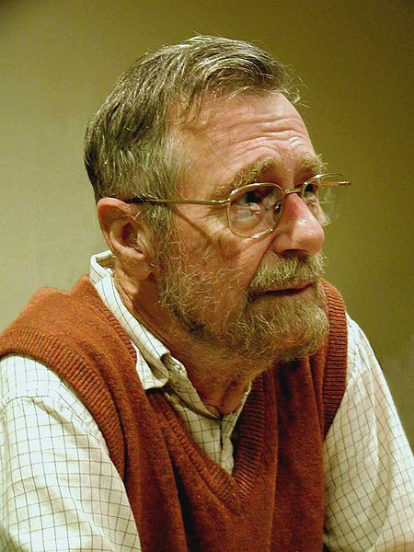
Edsger Dijkstra
1930-2002
THE multiprogramming system (operating system)
  Layers of abstraction!!
Complier for a language that can do recursion
Dining Philosopher’s Problem (resource contention and deadlock)
Dijkstra’s algorithm
“Goto considered harmful” (title given to his letter)
This file is licensed under the Creative Commons Attribution-Share Alike 3.0 Unported license. http://en.wikipedia.org/wiki/File:Edsger_Wybe_Dijkstra.jpg

Slide 57


Slide 58
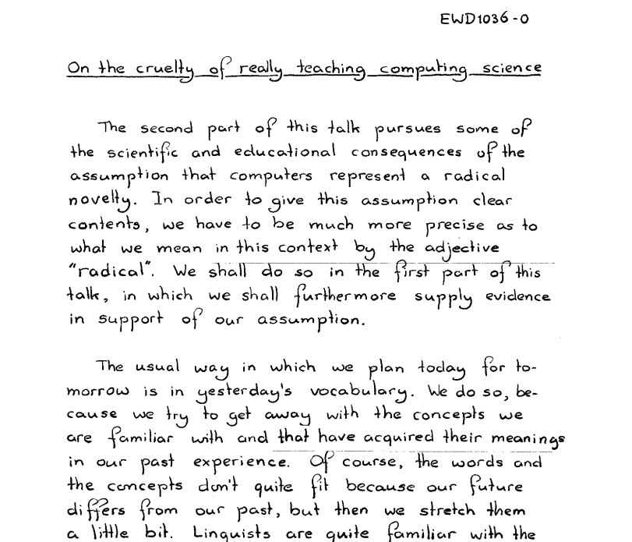

Slide 59
Mark all nodes as gray.
Mark the initial node s as yellow and at candidate distance 0.
Enqueue s into the priority queue with priority 0.
While not all nodes have been visited:
  Dequeue the lowest-cost node u from the priority queue.
  Color u green. The candidate distance d that is currently stored for node u is the length of the shortest path from s to u.
  If u is the destination node t, you have found the shortest path from s to t and are done.
  For each node v connected to u by an edge of length L:
    If v is gray:
      Color v yellow.
      Mark v's distance as d + L.
      Set v's parent to be u.
      Enqueue v into the priority queue with priority d + L.
    If v is yellow and the candidate distance to v is greater than d + L:
      Update v's candidate distance to be d + L.
      Update v's parent to be u.
      Update v's priority in the priority queue to d + L.
Dijkstra's
Algorithm

