Slide 1
Programming Abstractions in C++
CS106X
Cynthia Lee

Slide 2
Today’s Topics
Introductions
Course structure and procedures
What is this class? What do we mean by “abstractions”?
Introduce the C++ language from the Java programmer’s perspective (but it’s ok if you’re not a Java programmer!)
    Functions
    Strings
    Streams
Next lecture:
  Strings and streams, continued
  Data structures: Grid

Slide 3

Introductions
Cynthia Lee
Welcome to CS106X!
cbl@cs.stanford.edu

Slide 4

Who Am I? Cynthia Lee
Research:
  PhD @ UCSD: market-based resource allocation in large-scale systems
  Recently: computer science education
Teaching:
  2 years at Stanford, 3 years at UCSD
  Courses: CS2 C++, CS1 Java, CS1 Matlab, CS2 Java, theory of computation, discrete mathematics, data structures, probability and statistics for CS, computer organization and systems with IA32, computer architecture, technical interviews prep
Software engineer:
  iPhone educational games
  Document clustering and classification
When I’m not working:
  Biking, climbing, hiking

Slide 5
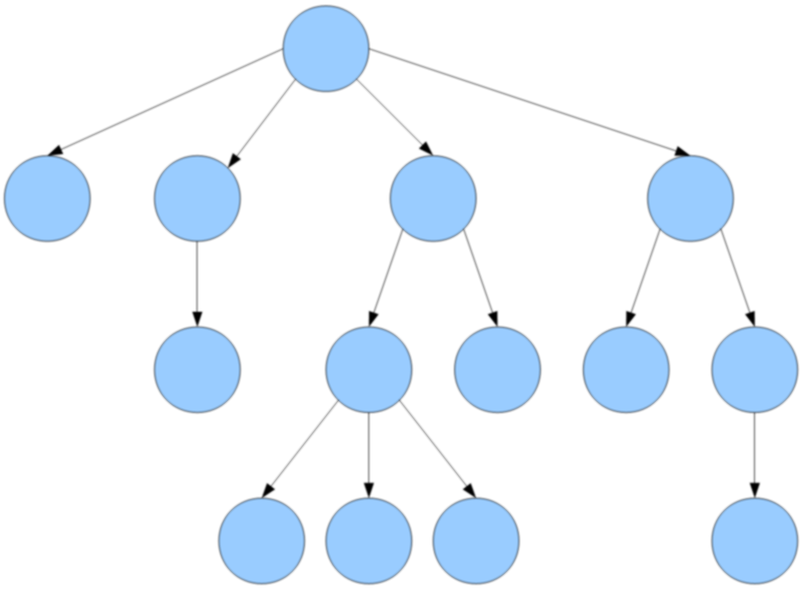
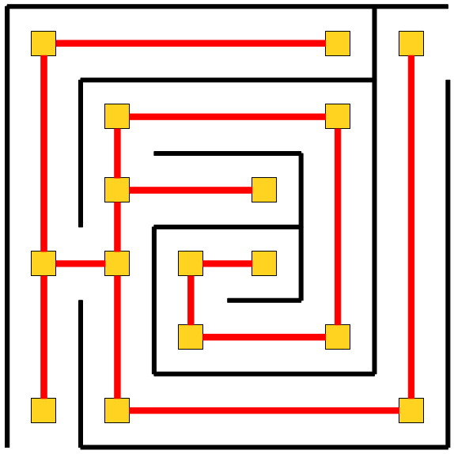
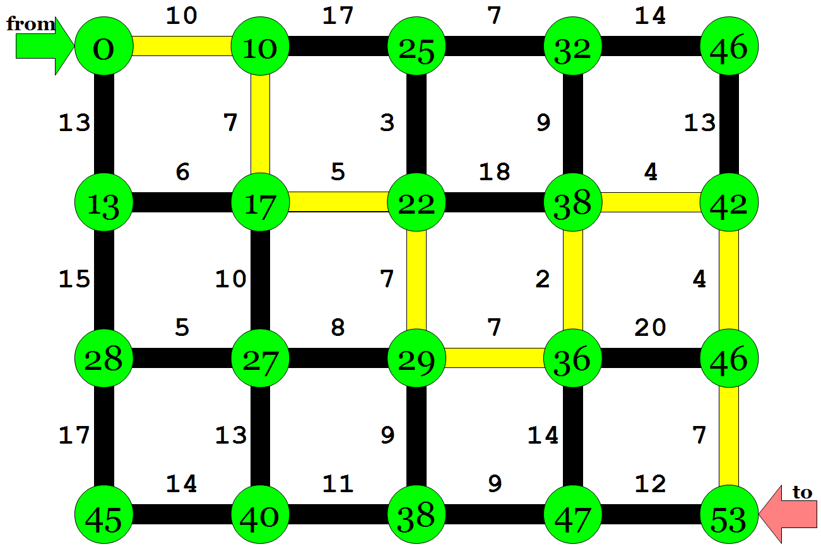

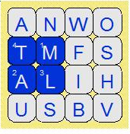
What is CS 106X?
CS 106X: Programming Abstractions
  solving big problems and processing big data
  learning to manage complex data structures
  algorithmic analysis and algorithmic techniques such as recursion
  programming style and software development practices
  familiarity with the C++ programming language
Prerequisite: CS 106A or equivalent
http://cs106x.stanford.edu/

Slide 6
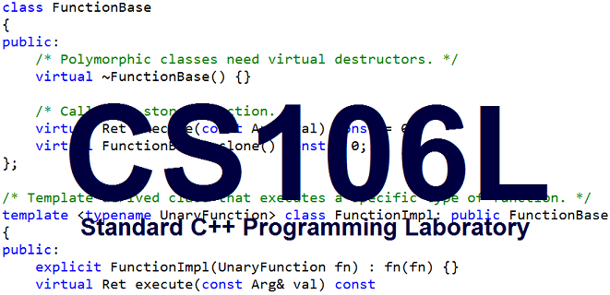
Possible addition to your repertoire: CS 106L
a one-unit course to learn and practice C++ programming in depth
  Instructor: Cristian Cibils Bernardes
  Tu/Th 1:30-2:20, Lathrop Library (there is no enrollment cap)
  Take it this quarter if it fits, or it will be offered again in Spring

Slide 7
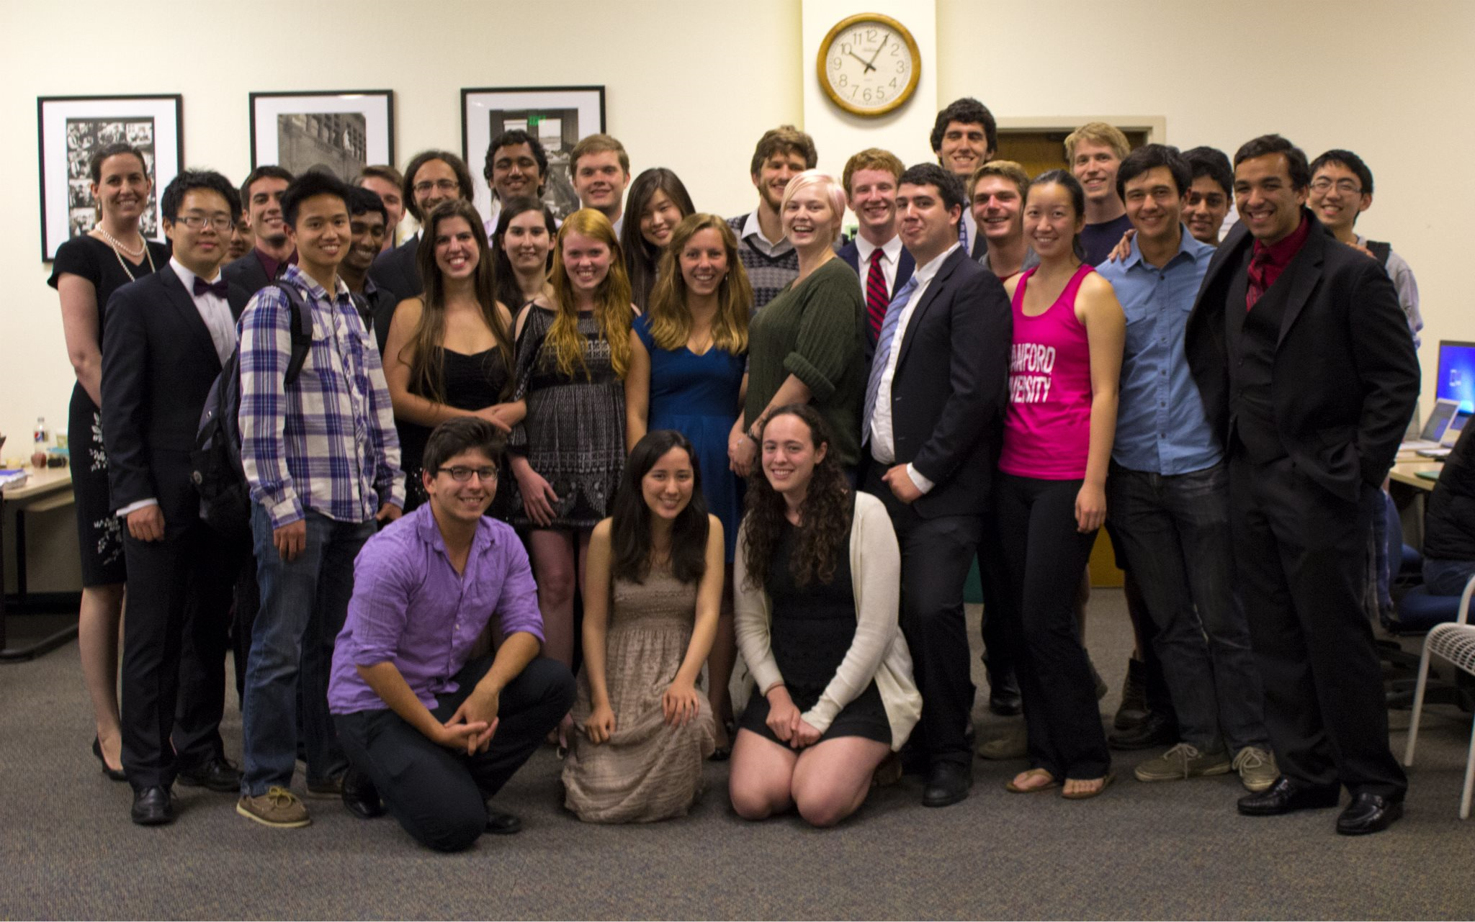
Discussion Section, SLs
section leaders: Helpful undergraduate assistants who will:
  run your discussion section each week
  grade your homework assignments and exams
  help you when you have questions
  ... and much more

Slide 8
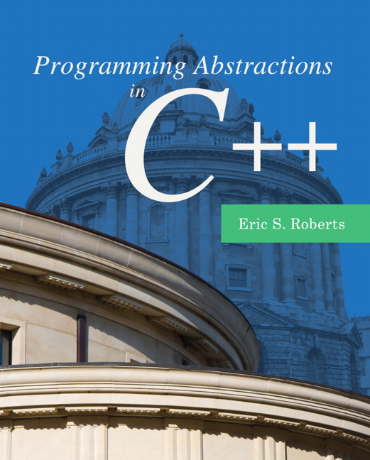
Textbook
Programming Abstractions in C++, by Eric Roberts
  Written here at Stanford
  Tailored to this course
  A valuable reference
  Usable on open-book exams
  Available on reserve at library
  Either buy a copy,
  or have access to one when you need it
  A PDF of it exists on the class web site, though note that PDF is not usable on exams

Slide 9
Late Days
late day: allows you to submit a homework 1 Lecture Day late
Week | Sun | Mon | Tue | Wed | Thu | Fri | Sat
1
2 |  |  |  | due | 1 day late | 1 day late | 2 days late
3 | 2 days late | 2 days late | 3 days late | 3 days late

Slide 10

What is this class about?
What do we mean by “abstractions”?
Colatina, Carlos Nemer
This file is licensed under the Creative Commons Attribution 3.0 Unported license.

Slide 11

http://www.publicdomainpictures.net/pictures/10000/velka/1-1265899974oKJ9.jpg

Slide 12
http://www.publicdomainpictures.net/pictures/10000/velka/1-1265899974oKJ9.jpg

Slide 13
Sentence
Subject
Verb Phrase
Object
Noun
Adverb
Verb
Possessive
Noun
CS106X
totally
rocks
my
socks

Slide 14
CS106X
totally
rocks
my
socks

Slide 15
http://www.publicdomainpictures.net/pictures/10000/velka/1-1265899974oKJ9.jpg

Slide 16
Building a vocabulary of abstractions
makes it possible to represent and solve a huge variety of problems using known tools.

Slide 17
A first C++ program (Error)
firstprogram.cpp
#include <iostream>
#include "console.h"
using namespace std;
int main(){
cout << "|-5| = "
<< absoluteValue(-5) << endl;
return 0;
}
int absoluteValue(int n) {
if (n<0){
return -n;
}
return n;
}
You don’t know what automata is, do you? SOON!
Notes:
-- firstprogram.cpp : unlike java, filename doesn’t have to match class! In fact, don’t need a class!
-- instead of "import" we have "#include" – note some have "" some have <> -- .h extension means "header" interface information as opposed to .cpp for implementation code
-- "using namespace" just don’t worry about why and use it (saves having to do ::)
-- main returns type int, just return zero if everything went ok (ignore why)
-- we use cout instead of System.out.println(), endl puts a newline

