Slide 1
Programming Abstractions
CS106X
Cynthia Lee

Slide 2
Today’s Topics
Introducing C++ from the Java Programmer’s Perspective
  firstprogram.cpp
    Function prototypes
    <iostream> and cout
    "simpio.h" and getLine()
  Absolute value example
    C++ strings and streams

Slide 3
C++ from the Java Programmer’s Perspective
(But it’s ok if you don’t know java!)

Slide 4
A first C++ program (Error)
firstprogram.cpp
#include <iostream>
#include "console.h"
using namespace std;
int main(){
cout << "|-5| = "
<< absoluteValue(-5) << endl;
return 0;
}
int absoluteValue(int n) {
if (n<0){
return -n;
}
return n;
}
You don’t know what automata is, do you? SOON!
Notes:
-- firstprogram.cpp : unlike java, filename doesn’t have to match class! In fact, don’t need a class!
-- instead of "import" we have "#include" – note some have "" some have <> -- .h extension means "header" interface information as opposed to .cpp for implementation code
-- "using namespace" just don’t worry about why and use it (saves having to do ::)
-- main returns type int, just return zero if everything went ok (ignore why)
-- we use cout instead of System.out.println(), endl puts a newline

Slide 5
A first C++ program (Fixed #1)
firstprogram.cpp
#include <iostream>
#include "console.h"
using namespace std;
int absoluteValue(int n) {
if (n<0){
return -n;
}
return n;
}
int main(){
cout << "|-5| = "
<< absoluteValue(-5) << endl;
return 0;
}
You don’t know what automata is, do you? SOON!
Notes:
-- firstprogram.cpp : unlike java, filename doesn’t have to match class! In fact, don’t need a class!
-- instead of "import" we have "#include" – note some have "" some have <> -- .h extension means "header" interface information as opposed to .cpp for implementation code
-- "using namespace" just don’t worry about why and use it (saves having to do ::)
-- main returns type int, just return zero if everything went ok (ignore why)
-- we use cout instead of System.out.println(), endl puts a newline

Slide 6
A first C++ program (Fixed #2)
firstprogram.cpp
#include <iostream>
#include "console.h"
using namespace std;
int absoluteValue(int n);
int main(){
cout << "|-5| = "
<< absoluteValue(-5) << endl;
return 0;
}
int absoluteValue(int n) {
if (n<0){
return -n;
}
return n;
}
You don’t know what automata is, do you? SOON!
Notes:
-- firstprogram.cpp : unlike java, filename doesn’t have to match class! In fact, don’t need a class!
-- instead of "import" we have "#include" – note some have "" some have <> -- .h extension means "header" interface information as opposed to .cpp for implementation code
-- "using namespace" just don’t worry about why and use it (saves having to do ::)
-- main returns type int, just return zero if everything went ok (ignore why)
-- we use cout instead of System.out.println(), endl puts a newline

Slide 7
Design Question: Why does C++ have the function prototype syntax?
In other words, why not just have a rule that you must set up the ordering so you define your functions before using them, as in the "FIXED 1" example?
  C++ could have done that, but such a rule would be too cumbersome for programmers to follow.
  C++ could have done that, but good programming style dictates "top-down" approach that logically puts main() first and helper functions it calls to follow.
  C++ could not have done that, because sometimes there is no way to order the functions so that all functions are defined before being used.
  Other/none/more than one of the above

Slide 8
Design Question: Why does C++ have the function prototype syntax?
(A) and (B) The rationales behind choices (A) and (B) (previous slide) are correct
    May or may not have been enough to compel the language designers to introduce the function prototype feature
(C) is true—there are cases where you simply cannot rearrange the ordering of functions to avoid all cases of use before definition
    e.g., mutual recursion

Slide 9
Which came first, the chicken or the egg?
(this code is just for fun, for now—we’ll cover recursion in depth in a few weeks!)
#include<iostream>
#include "console.h"
using namespace std;
void go(int n);
void stanford(int n);
int main(){
int n = 5;
go(n);
return 0;
}
void go(int n) {
if (n == 0) return;
cout << "Go!" << endl;
stanford(n-1);
}
void stanford(int n) {
cout << "Stanford!" << endl;
go(n);
}

Slide 10
Go Stanford Modifications Code Demo:
What did we just see?
  You can read in input with:
    cin (<iostream>)
    getInteger(), getLine(), etc (“simpio.h”)
  You can use getLine() as a way of pausing the program to wait for you to hit Enter before exiting (so you can see what happened!)
    (depending on operating system and Qt configuration, may not be necessary)
  cin and cout use the >> and << operators, respectively
    Remember: the arrows point in the way the data is “flowing”
    These aren’t like HTML tags <b> or Java/C++ parentheses () or curly braces {} in that they don’t need to “match”

Slide 11
Parameters
int main(){
int n = -5;
absoluteValue(n);
cout << "|-5| = " << n << endl;
return 0;
}
void absoluteValue(int n) {
if (n<0){
n = -n;
}
}
What is printed?
|-5| = 5
|-5| = -5
Other/none/more than one of the above
You don’t know what automata is, do you? SOON!
Notes:
-- firstprogram.cpp : unlike java, filename doesn’t have to match class! In fact, don’t need a class!
-- instead of "import" we have "#include" – note some have "" some have <> -- .h extension means "header" interface information as opposed to .cpp for implementation code
-- "using namespace" just don’t worry about why and use it (saves having to do ::)
-- main returns type int, just return zero if everything went ok (ignore why)
-- we use cout instead of System.out.println(), endl puts a newline

Slide 12
"Pass by reference"
int main(){
int n = -5;
absoluteValue(n);
cout << "|-5| = " << n << endl;
return 0;
}
void absoluteValue(int& n) {
if (n<0){
n = -n;
}
}
What is printed?
|-5| = 5
|-5| = -5
Other/none/more than one of the above
You don’t know what automata is, do you? SOON!
Notes:
-- firstprogram.cpp : unlike java, filename doesn’t have to match class! In fact, don’t need a class!
-- instead of "import" we have "#include" – note some have "" some have <> -- .h extension means "header" interface information as opposed to .cpp for implementation code
-- "using namespace" just don’t worry about why and use it (saves having to do ::)
-- main returns type int, just return zero if everything went ok (ignore why)
-- we use cout instead of System.out.println(), endl puts a newline

Slide 13
"Pass by value" (default behavior of parameters)
int main(){
int n = -5;
absoluteValue(n);
cout << "|-5| = " << n << endl;
return 0;
}
void absoluteValue(int n) {
if (n<0){
n = -n;
}
}
What is printed?
|-5| = 5
|-5| = -5
Other/none/more than one of the above
You don’t know what automata is, do you? SOON!
Notes:
-- firstprogram.cpp : unlike java, filename doesn’t have to match class! In fact, don’t need a class!
-- instead of "import" we have "#include" – note some have "" some have <> -- .h extension means "header" interface information as opposed to .cpp for implementation code
-- "using namespace" just don’t worry about why and use it (saves having to do ::)
-- main returns type int, just return zero if everything went ok (ignore why)
-- we use cout instead of System.out.println(), endl puts a newline

Slide 14
Often used when you would want to return several values from a function (but there is only one return value allowed)
#include "random.h"
void pickLotto(int& first, int& second, int& third);
int main(){
int first, second, third;
pickLotto(first, second, third);
cout << first << " " << second << " " << third << endl;
return 0;
}
void pickLotto(int& first, int& second, int& third) {
first = randomInteger(0,10);
second = randomInteger(0,10);
third = randomInteger(0,10);
}
You don’t know what automata is, do you? SOON!
Notes:
-- firstprogram.cpp : unlike java, filename doesn’t have to match class! In fact, don’t need a class!
-- instead of "import" we have "#include" – note some have "" some have <> -- .h extension means "header" interface information as opposed to .cpp for implementation code
-- "using namespace" just don’t worry about why and use it (saves having to do ::)
-- main returns type int, just return zero if everything went ok (ignore why)
-- we use cout instead of System.out.println(), endl puts a newline

Slide 15
Pass by reference
benefits of reference parameters:
  a useful way to be able to 'return' more than one value
  often used with large structures and objects, to avoid making bulky copies when passing (more on this in next lectures)
downsides of reference parameters:
  hard to tell from call whether it is ref; can't tell if it will be changed
    foo(a, b, c); // will foo change a, b, or c?? :-/
  can't pass a literal value to a ref parameter
    grow(39); // error

Slide 16
Strings in C++
String literal vs string class
Concatenation
String class methods

Slide 17
Using cout and strings
int main(){
int n = absoluteValue(-5);
string s = "|-5|";
s += " = ";
cout << s << n << endl;
return 0;
}
int absoluteValue(int n) {
if (n<0){
n = -n;
}
return n;
}
This prints |-5| = 5
The + operator concatenates strings, and += works in the way you’d expect.
You don’t know what automata is, do you? SOON!
Notes:
-- firstprogram.cpp : unlike java, filename doesn’t have to match class! In fact, don’t need a class!
-- instead of "import" we have "#include" – note some have "" some have <> -- .h extension means "header" interface information as opposed to .cpp for implementation code
-- "using namespace" just don’t worry about why and use it (saves having to do ::)
-- main returns type int, just return zero if everything went ok (ignore why)
-- we use cout instead of System.out.println(), endl puts a newline

Slide 18
Using cout and strings
int main(){
int n = absoluteValue(-5);
string s = "|-5|" + " = ";
cout << s << n << endl;
return 0;
}
int absoluteValue(int n) {
if (n<0){
n = -n;
}
return n;
}
But SURPRISE!…this one doesn’t work.
You don’t know what automata is, do you? SOON!
Notes:
-- firstprogram.cpp : unlike java, filename doesn’t have to match class! In fact, don’t need a class!
-- instead of "import" we have "#include" – note some have "" some have <> -- .h extension means "header" interface information as opposed to .cpp for implementation code
-- "using namespace" just don’t worry about why and use it (saves having to do ::)
-- main returns type int, just return zero if everything went ok (ignore why)
-- we use cout instead of System.out.println(), endl puts a newline

Slide 19
C++ string objects and string literals
In this class, we will interact with two types of strings:
    String literals are just hard-coded string values:
      "hello!" "1234" "#nailedit"
      They have no methods that do things for us
      Think of them like integer literals: you can’t do "4.add(5);" //no
    String objects are objects with lots of helpful methods and operators:
      string s;
      string piece = s.substr(0,3);
      s.append(t); //or, equivalently: s+= t;

Slide 20
String object member functions (3.2)
Member function name | Description
s.append(str) | add text to the end of a string
s.compare(str) | return -1, 0, or 1 depending on relative ordering
s.erase(index, length) | delete text from a string starting at given index
s.find(str) s.rfind(str) | first or last index where the start of str appears in this string (returns string::npos if not found)
s.insert(index, str) | add text into a string at a given index
s.length() or s.size() | number of characters in this string
s.replace(index, len, str) | replaces len chars at given index with new text
s.substr(start, length) or s.substr(start) | the next length characters beginning at start (inclusive); if length omitted, grabs till end of string
  string name = "Donald Knuth";
  if (name.find("Knu") != string::npos) {
  name.erase(7, 5); // "Donald"
  }

Slide 21
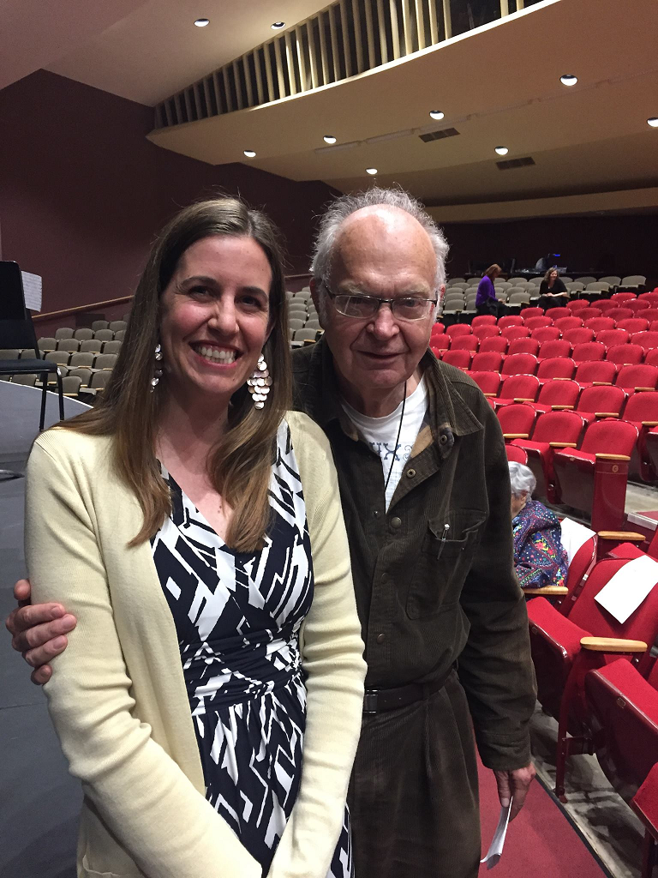
Aside: Donald Knuth
Emeritus (i.e., retired) faculty in our dept.
Legend of computer science
If you’re lucky, you’ll still see him around campus from time to time

Slide 22
Recap: C++ string objects and string literals
Even though they are different types, you can mix them as long as there is a string object around to be the "brains" of the operation:
    Yes:
      string s;
      s = "hello!" //string knows how to convert literal
      s = s + "1234"; //string has + defined as concatenation
      char ch = ‘A’; //a single ASCII character with ‘ not "
      s += ch; //string knows how to interact with char
      s += ‘A’; //and char literal
    No:
      "hello!" + " " + "bye!"; //literal not 'smart' enough to
      //do concat with +
      "hello!".substr(0); //literal has no methods

Slide 23
Practice: C++ strings
How many of these lines would NOT compile?
0
1
2
3
More than 3
When discussing:
Make sure you are not only on how many but which
Talk about the "why" for each
int main(){
string s = "hello,";
s += "dolly!";
s += s + "why," + "hello,dolly!";
s.append("hello");
s.append("dolly!");
cout << s + '5' << endl;
cout << "hello" + '5' << endl;
return 0;
}
You don’t know what automata is, do you? SOON!
Notes:
-- firstprogram.cpp : unlike java, filename doesn’t have to match class! In fact, don’t need a class!
-- instead of "import" we have "#include" – note some have "" some have <> -- .h extension means "header" interface information as opposed to .cpp for implementation code
-- "using namespace" just don’t worry about why and use it (saves having to do ::)
-- main returns type int, just return zero if everything went ok (ignore why)
-- we use cout instead of System.out.println(), endl puts a newline

Slide 24
Stanford library (3.7)
#include "strlib.h"
  Unlike the previous ones, these take the string as a parameter.
  if (startsWith(name, "Mr.")) {
  name += integerToString(age) + " years old";
  }
Function name | Description
endsWith(str, suffix) startsWith(str, prefix) | returns true if the given string begins or ends with the given prefix/suffix text
integerToString(int) realToString(double) stringToInteger(str) stringToReal(str) | returns a conversion between numbers and strings
equalsIgnoreCase(s1, s2) | true if s1 and s2 have same chars, ignoring casing
toLowerCase(str) toUpperCase(str) | returns an upper/lowercase version of a string
trim(str) | returns string with surrounding whitespace removed

