Slide 1
Programming Abstractions
CS106X
Cynthia Lee

Slide 2
Today’s Topics
Introducing C++ from the Java Programmer’s Perspective
  Absolute value example, continued
    C++ strings and streams
  ADTs: Abstract Data Types
  Introduction: What are ADTs?
  Queen safety example
    Grid data structure
    Passing objects by reference
      const reference parameters
    Loop over “neighbors” in a grid

Slide 3
Strings in C++
String literal vs string class
Concatenation
String class methods

Slide 4
Using cout and strings
int main(){
int n = absoluteValue(-5);
string s = "|-5|";
s += " = ";
cout << s << n << endl;
return 0;
}
int absoluteValue(int n) {
if (n<0){
n = -n;
}
return n;
}
This prints |-5| = 5
The + operator concatenates strings, and += works in the way you’d expect.
You don’t know what automata is, do you? SOON!
Notes:
-- firstprogram.cpp : unlike java, filename doesn’t have to match class! In fact, don’t need a class!
-- instead of "import" we have "#include" – note some have "" some have <> -- .h extension means "header" interface information as opposed to .cpp for implementation code
-- "using namespace" just don’t worry about why and use it (saves having to do ::)
-- main returns type int, just return zero if everything went ok (ignore why)
-- we use cout instead of System.out.println(), endl puts a newline

Slide 5
Using cout and strings
int main(){
int n = absoluteValue(-5);
string s = "|-5|" + " = ";
cout << s << n << endl;
return 0;
}
int absoluteValue(int n) {
if (n<0){
n = -n;
}
return n;
}
But SURPRISE!…this one doesn’t work.
You don’t know what automata is, do you? SOON!
Notes:
-- firstprogram.cpp : unlike java, filename doesn’t have to match class! In fact, don’t need a class!
-- instead of "import" we have "#include" – note some have "" some have <> -- .h extension means "header" interface information as opposed to .cpp for implementation code
-- "using namespace" just don’t worry about why and use it (saves having to do ::)
-- main returns type int, just return zero if everything went ok (ignore why)
-- we use cout instead of System.out.println(), endl puts a newline

Slide 6
C++ string objects and string literals
In this class, we will interact with two types of strings:
    String literals are just hard-coded string values:
      "hello!" "1234" "#nailedit"
      They have no methods that do things for us
      Think of them like integer literals: you can’t do "4.add(5);" //no
    String objects are objects with lots of helpful methods and operators:
      string s;
      string piece = s.substr(0,3);
      s.append(t); //or, equivalently: s+= t;

Slide 7
String object member functions (3.2)
Member function name | Description
s.append(str) | add text to the end of a string
s.compare(str) | return -1, 0, or 1 depending on relative ordering
s.erase(index, length) | delete text from a string starting at given index
s.find(str) s.rfind(str) | first or last index where the start of str appears in this string (returns string::npos if not found)
s.insert(index, str) | add text into a string at a given index
s.length() or s.size() | number of characters in this string
s.replace(index, len, str) | replaces len chars at given index with new text
s.substr(start, length) or s.substr(start) | the next length characters beginning at start (inclusive); if length omitted, grabs till end of string
  string name = "Donald Knuth";
  if (name.find("Knu") != string::npos) {
  name.erase(7, 5); // "Donald"
  }

Slide 8
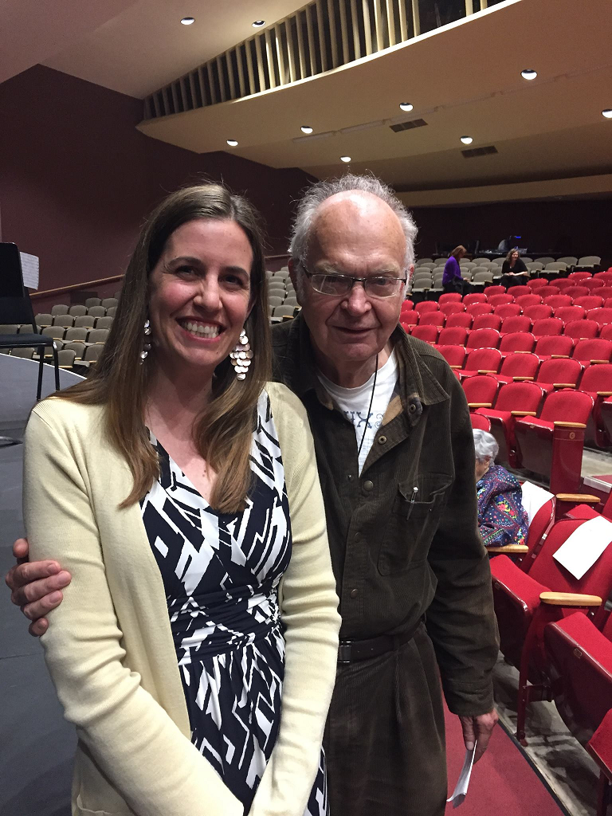
Aside: Donald Knuth
Emeritus (i.e., retired) faculty in our dept.
Legend of computer science
If you’re lucky, you’ll still see him around campus from time to time

Slide 9
Recap: C++ string objects and string literals
Even though they are different types, you can mix them as long as there is a string object around to be the "brains" of the operation:
    Yes:
      string s;
      s = "hello!" //string knows how to convert literal
      s = s + "1234"; //string has + defined as concatenation
      char ch = ‘A’; //a single ASCII character with ‘ not "
      s += ch; //string knows how to interact with char
      s += ‘A’; //and char literal
    No:
      "hello!" + " " + "bye!"; //literal not 'smart' enough to
      //do concat with +
      "hello!".substr(0); //literal has no methods

Slide 10
Practice: C++ strings
How many of these lines would NOT compile?
0
1
2
3
More than 3
When discussing:
Make sure you agree not only on how many but which
Talk about the "why" for each
int main(){
string s = "hello,";
s += "dolly!";
s += s + "why," + "hello,dolly!";
s.append("hello");
s.append("dolly!");
cout << s + '5' << endl;
cout << "hello" + '5' << endl;
return 0;
}
You don’t know what automata is, do you? SOON!
Notes:
-- firstprogram.cpp : unlike java, filename doesn’t have to match class! In fact, don’t need a class!
-- instead of "import" we have "#include" – note some have "" some have <> -- .h extension means "header" interface information as opposed to .cpp for implementation code
-- "using namespace" just don’t worry about why and use it (saves having to do ::)
-- main returns type int, just return zero if everything went ok (ignore why)
-- we use cout instead of System.out.println(), endl puts a newline

Slide 11
Stanford library (3.7)
#include "strlib.h"
  Unlike the previous ones, these take the string as a parameter.
  if (startsWith(name, "Mr.")) {
  name += integerToString(age) + " years old";
  }
Function name | Description
endsWith(str, suffix) startsWith(str, prefix) | returns true if the given string begins or ends with the given prefix/suffix text
integerToString(int) realToString(double) stringToInteger(str) stringToReal(str) | returns a conversion between numbers and strings
equalsIgnoreCase(s1, s2) | true if s1 and s2 have same chars, ignoring casing
toLowerCase(str) toUpperCase(str) | returns an upper/lowercase version of a string
trim(str) | returns string with surrounding whitespace removed

Slide 12
ADTs
Vector, Grid, stack

Slide 13
ADTs
Programming language independent models of common containers
They encompass not only the nature of the data, but ways of accessing it
They form a rich vocabulary of nouns and verbs, often drawing on analogies to make their use intuitive, and to give code written in them a certain literary quality

Slide 14
"Hope" is the thing with feathers
BY Emily DickensON
“Hope” is the thing with feathers -
That perches in the soul -
And sings the tune without the words -
And never stops - at all -
And sweetest - in the Gale - is heard -
And sore must be the storm -
That could abash the little Bird
That kept so many warm -
I’ve heard it in the chillest land -
And on the strangest Sea -
Yet - never - in Extremity,
It asked a crumb - of me.

Slide 15
Vector
ADT abstraction similar to an array
Many languages have a version of this
    (remember, ADTs are conceptual abstractions that are language-independent)
In C++ we declare one like this:
This syntax is called template syntax
    Vectors can hold many things, but they all have to be the same type
    The type goes in the < > after the class name Vector
      Vector<int> assignment3Scores;
      Vector<double> measurementsData;
      Vector<Vector<int>> allAssignmentScores;
Vector<string> lines;

Slide 16
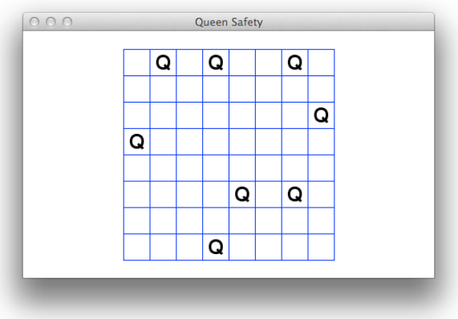
Code example: Queen safety
Download full code from the website to see an example of what we consider good coding style for your assignment!

Slide 17
Handy loop idiom: iterating over “neighbors” in a Grid
static bool isSafe(Grid<bool>& board, int row, int col) {
for (int drow = -1; drow <= 1; drow++) {
for (int dcol = -1; dcol <= 1; dcol++) {
if (!isDirectionSafe(board, row, col, drow, dcol)) {
return false;
}
}
}
return true;
}
R -1 C -1 | R -1 C +0 | R -1 C +1
R +0 C -1 | R +0 C +0 | R +0 C +1
R +1 C -1 | R +1 C +0 | R +1 C +1
These nested for loops generate all the pairs in the cross product {-1,0,1} x {-1,0,1}, and we can add these as offsets to a (row,col) coordinate to generate all the neighbors (note: often want to test for and exclude the (0,0) offset, which is “self” not a neighbor)

Slide 18
QT Creator
A few warnings & tips

Slide 19
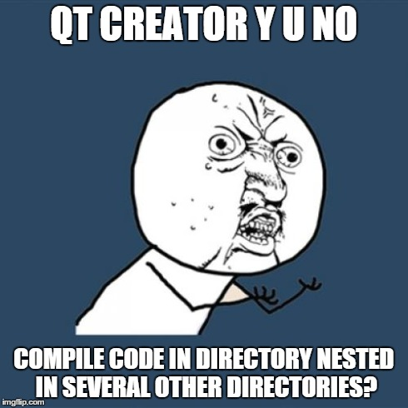
If your code doesn’t compile and gives an error about unknown function Main() (note capital M):
There is more than one reason this could arise, but the most common by far is that QT lost its ability to find the path to our Stanford library includes (which define a fake Main()), because you put your code in a directory/folder that is deeply nested on your drive.
For example, C:\Documents and Settings\Documents\classes\Stanford\2015\Summer\CS106B\assignments\C++\Assignment1\...
You need to move the assignment directory closer to C:\ (or on mac, the root directory)

Slide 20
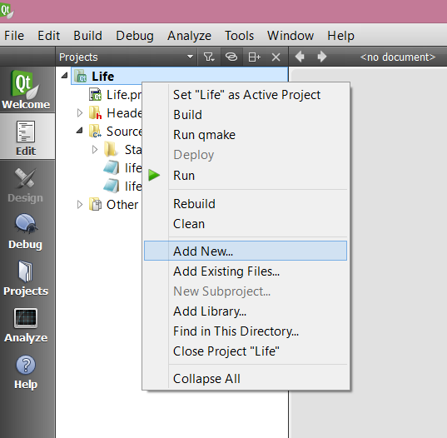
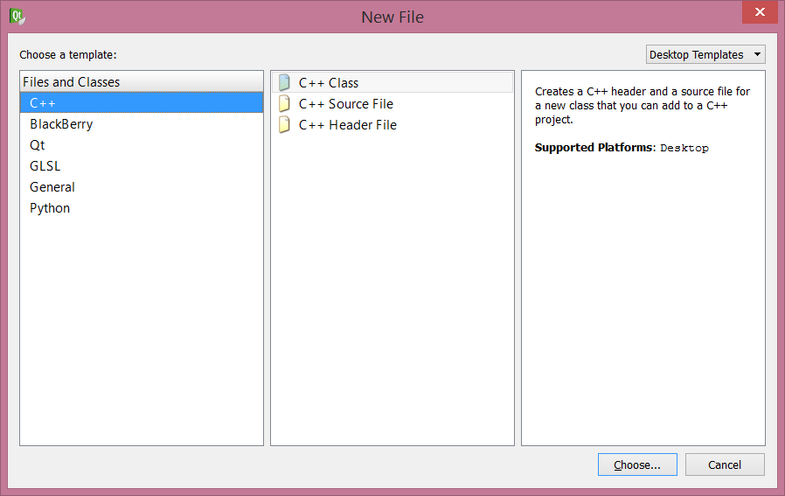
If your code doesn’t compile and gives you “multiple definition” errors for all the functions you have:
This can arise if you add new files to your code inside QT creator using its handy “Add New…” feature.
NOT HANDY! Do not use this feature. It breaks the .pro file.

Slide 21
If it’s too late and you already used the “Add New” feature
QUIT: Close QT Creator
CLEAN UP BROKEN FILES: Delete the .pro and .pro.user files in your code directory; delete the entire build directory (this is an automatically created directory that appears alongside the directory where your code is, it’s name is something like “build-simple-project-Desktop_Qt_5_2_0_MinGW_32bit-Debug”)
GRAB REPLACEMENT: Download/unzip the assignment bundle again, and get a fresh copy of the project file (the one that ends in .pro) and put it in place of the one you deleted.
ALL BETTER! Re-open QT Creator (it will make a new .pro.user)

