Slide 1
Programming Abstractions
CS106B
Cynthia Lee

Slide 2
Recursion!
The exclamation point isn’t there only because this is so exciting, it also relates to one of our recursion examples….

Slide 3
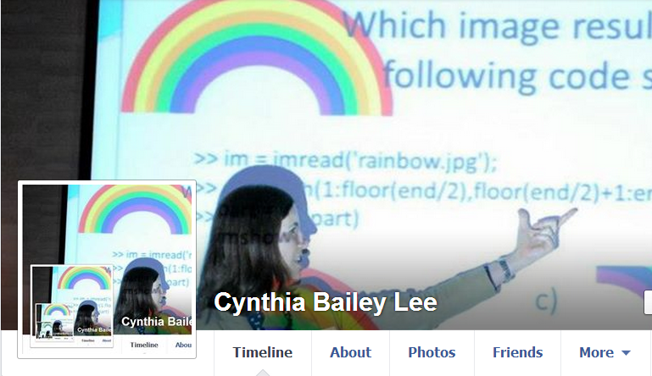
Recursion

Slide 4
Factorial!
Recursive mathematical definition
n! =
  if n is 1, then n! = 1
  if n > 1, then n! = n * (n – 1)!
  (0!=1 but for simplicity we’ll just consider the domain n>0 for today)
Recursive code

Slide 5
Designing a recursive algorithm
Recursion is a way of taking a big problem and repeatedly breaking it into smaller and smaller pieces until it is so small that it can be so easily solved that it almost doesn't even need solving.
There are two parts of a recursive algorithm:
    base case: where we identify that the problem is so small that we trivially solve it and return that result
    recursive case: where we see that the problem is still a bit too big for our taste, so we chop it into smaller bits and call our self (the function we are in now) on the smaller bits to find out the answer to the problem we face

Slide 6
Factorial!
Recursive definition
n! =
  if n is 1, then n! = 1
  if n > 1, then n! = n * (n – 1)!
Recursive code
long factorial ( int n ) {
if (n==1) return 1;
else return n*factorial(n-1);
}

Slide 7
Factorial!
Recursive definition
n! =
  if n is 1, then n! = 1
  if n > 1, then n! = n * (n – 1)!
Recursive code: imagining more concrete examaples
long factorialOf6 () {
return 6 * factorialOf5();
}
long factorialOf5() {
return 120;
}

Slide 8
Factorial!
Recursive definition
n! =
  if n is 1, then n! = 1
  if n > 1, then n! = n * (n – 1)!
Recursive code: imagining more concrete examaples
long factorial ( int n ) {
if (n==1) return 1;
else {
int nminus1fact = pretendIJustMagicallyKnowFactorialOfThis(n-1);
return n*nminus1fact;
}
}

Slide 9
Factorial!
Recursive definition
n! =
  if n is 1, then n! = 1
  if n > 1, then n! = n * (n – 1)!
Recursive code
long factorial ( int n ) {
if (n==1) return 1;
else {
int nminus1fact = factorial(n-1);
return n*nminus1fact;
}
}

Slide 10
Factorial!
Recursive definition
n! =
  if n is 1, then n! = 1
  if n > 1, then n! = n * (n – 1)!
Recursive code
long factorial ( int n ) {
if (n==1) return 1;
else return n*factorial(n-1);
}

Slide 11
Factorial!
Recursive definition
Recursive code
n! =
  if n is 1, then n! = 1
  if n > 1, then n! = n * (n – 1)!
long factorial ( int n ) {
if (n==1) return 1;
else return n*factorial(n–1);
}
Pro tip: the recursive “leap of faith”
This concept has become part of the mythology of Stanford’s CS106B/X classes. It speaks to the idea that recursion will start to make sense to you when you just trust that the recursive part works.
One way of tricking your brain into summoning this trust is imagining that the recursive call instead calls some different (non-recursive) function that calculates the same thing, like we did at first for factorial().

Slide 12
Digging deeper in the recursion
I know I just told you about the recursive leap of faith and that, for algorithm design purposes, you should mentally flatten the recursion. But before we put that tip into practice, it helps to orient ourselves to the full complexity.

Slide 13
Factorial!
Recursive definition
Recursive code
n! =
  if n is 1, then n! = 1
  if n > 1, then n! = n * (n – 1)!
long factorial ( int n ) {
cout << n << endl; //added code
if (n==1) return 1;
else return n*factorial(n–1);
}
What is the third thing printed when we call factorial(10)?
2
3
7
8
Other/none/more

Slide 14
How does this look in memory?
Memory
Stack
Heap
0

Slide 15
How does this look in memory?
Memory
Recursive code
main()
long factorial ( int n ) {
cout << n << endl;
if (n==1) return 1;
else return n*factorial(n–1);
}
void myfunction(){
int x = 10;
long xfac = 0;
xfac = factorial(x);
}
myfunction() x:
xfac:
10
0
factorial() n:
10
0
Heap

Slide 16
Memory
Memory
Memory
(A)
(B)
(C)
main()
main()
main()
myfunction() x:
xfac:
10
myfunction() x:
xfac:
10
myfunction() x:
xfac:
10
0
0
0
factorial() n:
10
factorial() n:
9
factorial() n:
9
10
factorial() n:
9
Heap
Heap
Heap
(D) Other/none of the above

Slide 17
The “stack” part of memory is a stack
Function call = push
Return = pop

Slide 18
The “stack” part of memory is a stack
main()
Recursive code
myfunction() x:
xfac:
long factorial ( int n ) {
cout << n << endl;
if (n==1) return 1;
else return n*factorial(n–1);
}
void myfunction(){
int x = 4; //smaller test case
long xfac = 0;
xfac = factorial(x);
}
4
0
factorial() n:
4
Heap

Slide 19
The “stack” part of memory is a stack
main()
Recursive code
myfunction() x:
xfac:
long factorial ( int n ) {
cout << n << endl;
if (n==1) return 1;
else return n*factorial(n–1);
}
void myfunction(){
int x = 4;
long xfac = 0;
xfac = factorial(x);
}
4
0
factorial() n:
4
factorial() n:
3
Heap

Slide 20
The “stack” part of memory is a stack
main()
Recursive code
myfunction() x:
xfac:
long factorial ( int n ) {
cout << n << endl;
if (n==1) return 1;
else return n*factorial(n–1);
}
void myfunction(){
int x = 4;
long xfac = 0;
xfac = factorial(x);
}
4
0
factorial() n:
4
factorial() n:
3
factorial() n:
2
Heap

Slide 21
The “stack” part of memory is a stack
main()
Recursive code
myfunction() x:
xfac:
long factorial ( int n ) {
cout << n << endl;
if (n==1) return 1;
else return n*factorial(n–1);
}
void myfunction(){
int x = 4;
long xfac = 0;
xfac = factorial(x);
}
4
0
factorial() n:
4
factorial() n:
3
factorial() n:
2
factorial() n:
1
Heap

Slide 22
Factorial!
Recursive definition
Recursive code
n! =
  if n is 1, then n! = 1
  if n > 1, then n! = n * (n – 1)!
long factorial ( int n ) {
cout << n << endl;
if (n==1) return 1;
else return n*factorial(n–1);
}
What is the fourth value ever returned when we call factorial(10)?
4
6
10
24
Other/none/more than one

Slide 23
The “stack” part of memory is a stack
main()
Recursive code
myfunction() x:
xfac:
4
long factorial ( int n ) {
cout << n << endl;
if (n==1) return 1;
else return n*factorial(n–1);
}
void myfunction(){
int x = 4;
long xfac = 0;
xfac = factorial(x);
}
0
factorial() n:
4
factorial() n:
3
factorial() n:
2
factorial() n:
1
Return 1
Heap

Slide 24
The “stack” part of memory is a stack
main()
Recursive code
myfunction() x:
xfac:
4
long factorial ( int n ) {
cout << n << endl;
if (n==1) return 1;
else return n*factorial(n–1);
}
void myfunction(){
int x = 4;
long xfac = 0;
xfac = factorial(x);
}
0
factorial() n:
4
factorial() n:
3
factorial() n:
2
Return 2
Heap

Slide 25
The “stack” part of memory is a stack
main()
Recursive code
myfunction() x:
xfac:
4
long factorial ( int n ) {
cout << n << endl;
if (n==1) return 1;
else return n*factorial(n–1);
}
void myfunction(){
int x = 4;
long xfac = 0;
xfac = factorial(x);
}
0
factorial() n:
4
factorial() n:
3
Return 6
Heap

Slide 26
The “stack” part of memory is a stack
main()
Recursive code
myfunction() x:
xfac:
4
long factorial ( int n ) {
cout << n << endl;
if (n==1) return 1;
else return n*factorial(n–1);
}
void myfunction(){
int x = 4;
long xfac = 0;
xfac = factorial(x);
}
0
factorial() n:
4
Return 24
Heap

Slide 27
Factorial!
Iterative version
Recursive version
long factorial(int n)
{
long f = 1;
while ( n > 1 ) {
f = f * n;
n = n – 1;
}
return f;
}
long factorial ( int n ) {
cout << n << endl;
if (n==1) return 1;
else return n*factorial(n–1);
}
NOTE: sometimes iterative can be much faster because it doesn’t have to push and pop stack frames. Function calls have overhead in terms of space and time to set up and tear down.

Slide 28
Announcement: Recursive art contest!
  Go to http://recursivedrawing.com/
  Make recursive art
    Win prizes!
  Come to my office hours and see my Wall of Fame of past recursive art submissions!
  Submission deadline:
    Wednesday of Week 4 (October 14)
  Submission procedure:
    Email me: cbl@stanford.edu

Slide 29
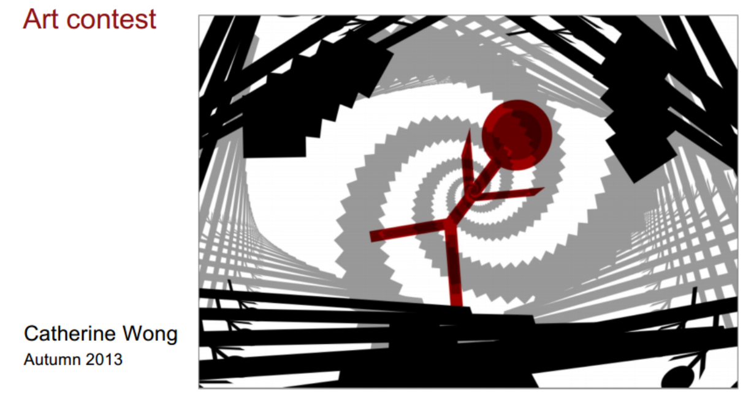

Slide 30
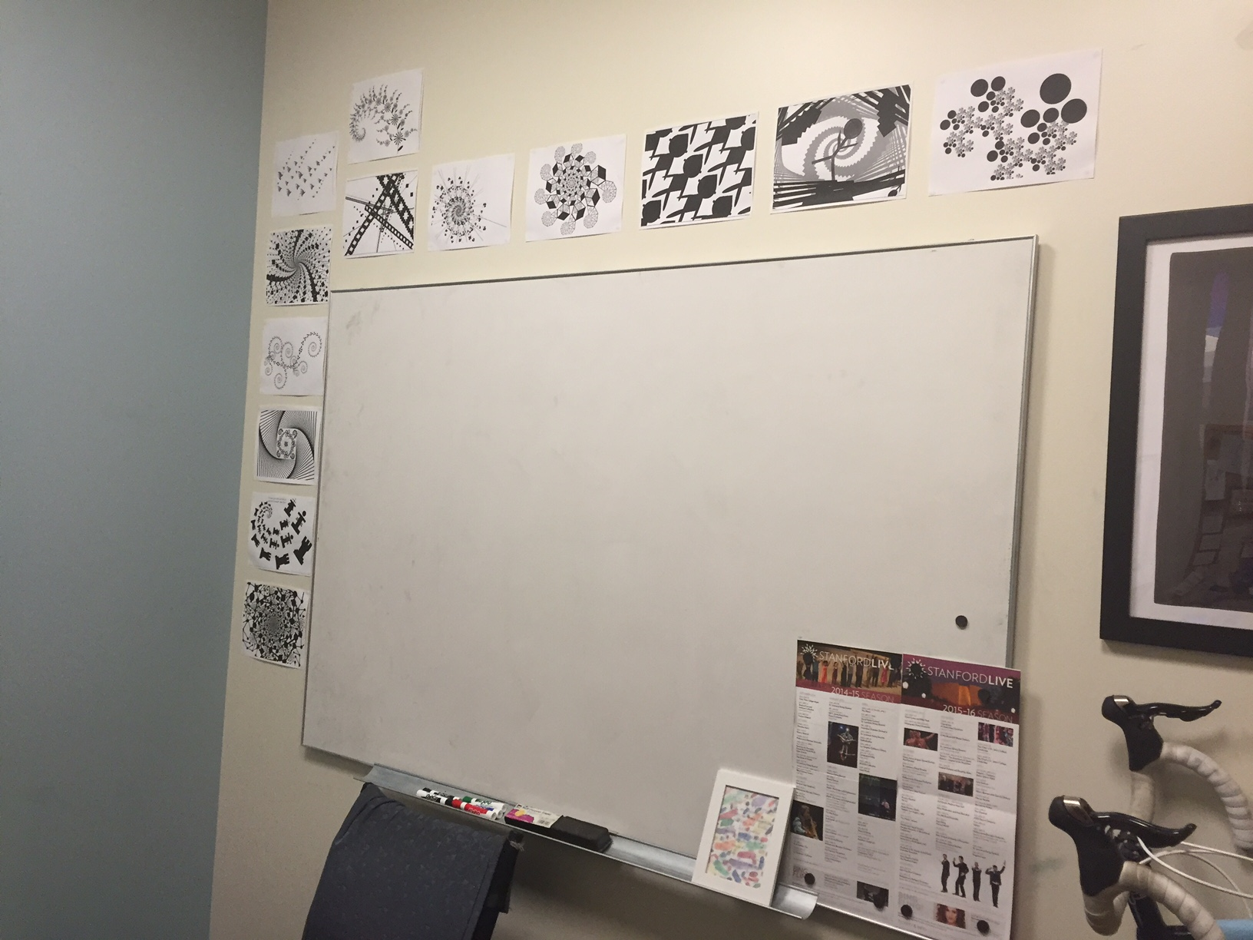
Wall of Fame

Slide 31
Classic CS problem: searching

Slide 32
Imagine storing sorted data in an array
How long does it take us to find a number we are looking for?
0 | 1 | 2 | 3 | 4 | 5 | 6 | 7 | 8 | 9 | 10
2 | 7 | 8 | 13 | 25 | 29 | 33 | 51 | 89 | 90 | 95

Slide 33
Imagine storing sorted data in an array
How long does it take us to find a number we are looking for?
If you start at the front and proceed forward, each item you examine rules out 1 item
0 | 1 | 2 | 3 | 4 | 5 | 6 | 7 | 8 | 9 | 10
2 | 7 | 8 | 13 | 25 | 29 | 33 | 51 | 89 | 90 | 95

Slide 34
Imagine storing sorted data in an array
0 | 1 | 2 | 3 | 4 | 5 | 6 | 7 | 8 | 9 | 10
2 | 7 | 8 | 13 | 25 | 29 | 33 | 51 | 89 | 90 | 95
If instead we jump right to the middle, one of three things can happen:
  The middle one happens to be the number we were looking for, yay!
  We realize we went too far
  We realize we didn’t go far enough

Slide 35
Imagine storing sorted data in an array
0 | 1 | 2 | 3 | 4 | 5 | 6 | 7 | 8 | 9 | 10
2 | 7 | 8 | 13 | 25 | 29 | 33 | 51 | 89 | 90 | 95
If instead we jump right to the middle, one of three things can happen:
  The middle one happens to be the number we were looking for, yay!
  We realize we went too far
  We realize we didn’t go far enough
  Ruling out HALF the options in one step is so much faster than only ruling out one!

Slide 36
Binary search
0 | 1 | 2 | 3 | 4 | 5 | 6 | 7 | 8 | 9 | 10
2 | 7 | 8 | 13 | 25 | 29 | 33 | 51 | 89 | 90 | 95
Let’s say the answer was 3, “we didn’t go far enough”
We ruled out the entire first half, and now only have the second half to search
We could start at the front of the second half and proceed forward…

Slide 37
Binary search
0 | 1 | 2 | 3 | 4 | 5 | 6 | 7 | 8 | 9 | 10
2 | 7 | 8 | 13 | 25 | 29 | 33 | 51 | 89 | 90 | 95
Let’s say the answer was 3, “we didn’t go far enough”
We ruled out the entire first half, and now only have the second half to search
We could start at the front of the second half and proceed forward…but why do that when we know we have a better way?
Jump right to the middle of the region to search

Slide 38
Binary search
0 | 1 | 2 | 3 | 4 | 5 | 6 | 7 | 8 | 9 | 10
2 | 7 | 8 | 13 | 25 | 29 | 33 | 51 | 89 | 90 | 95
Let’s say the answer was 3, “we didn’t go far enough”
We ruled out the entire first half, and now only have the second half to search
We could start at the front of the second half and proceed forward…but why do that when we know we have a better way?
Jump right to the middle of the region to search
RECURSION!!

Slide 39
Designing a recursive algorithm
Recursion is a way of taking a big problem and repeatedly breaking it into smaller and smaller pieces until it is so small that it can be so easily solved that it almost doesn't even need solving.
There are two parts of a recursive algorithm:
    base case: where we identify that the problem is so small that we trivially solve it and return that result
    recursive case: where we see that the problem is still a bit too big for our taste, so we chop it into smaller bits and call our self (the function we are in now) on the smaller bits to find out the answer to the problem we face

Slide 40
To write a recursive function, we need base case(s) and recursive call(s)
What would be a good base case for our Binary Search function?
Only three items remain: save yourself an unnecessary function call that would trivially divide them into halves of size 1, and just check all three.
Only two items remain: can’t divide into two halves with a middle, so just check the two.
Only one item remains: just check it.
No items remain: obviously we didn’t find it.
More than one

Slide 41
Binary Search
bool binarySearch(Vector<int>& data, int key){
return binarySearch(data, key, 0, data.size()-1);
}
bool binarySearch(Vector<int>& data, int key,
int start, int end){
//to be continued…
}

