Slide 1
Programming Abstractions
CS106X
Cynthia Lee

Slide 2
Today’s topics:
  Previous lectures:
    Introduction to recursion with Factorial
    Mechanics of recursion: looking at the stack frames
    Classic, widely-used CS algorithm example: Binary Search
    Visual example: Boxy “snowflake” fractal
  Today:
    New patterns of recursion application: adding loops
      Loops + recursion for generating permutations
      Loops + recursion for recursive backtracking

Slide 3
Announcement: Recursive art contest!
  Go to http://recursivedrawing.com/
  Make recursive art
    Win prizes!
  Come to my office hours and see my Wall of Fame of past recursive art submissions!
  Submission deadline:
    Wednesday of Week 4 (October 14)
  Submission procedure:
    Email me: cbl@stanford.edu

Slide 4
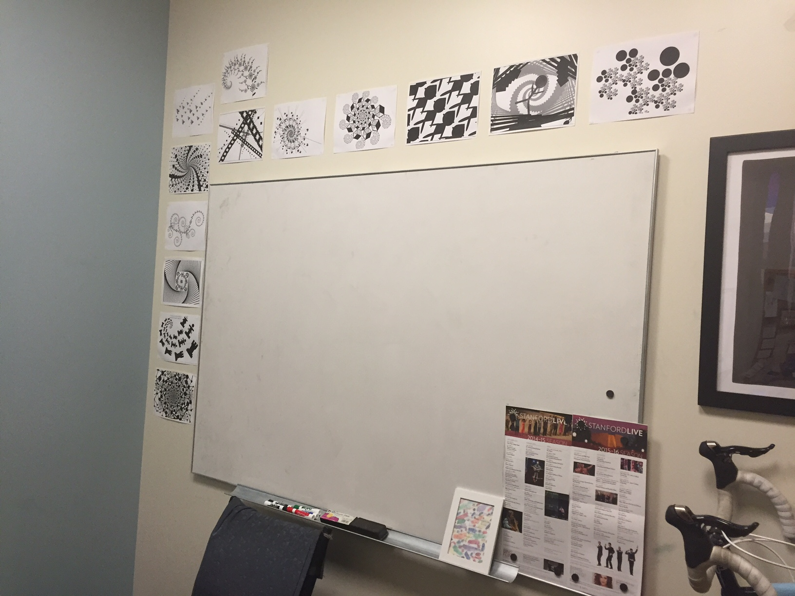
Wall of Fame

Slide 5
Backtracking
Maze solving

Slide 6
Backtracking
A particular behavior in recursive code where you tentatively explore many options, and recover to the nearest junction when you hit a “dead end”
The easiest way to understand this is probably to see literal exploration and dead ends

Slide 7
Maze-solving
 |  |  | Θ

Slide 8
Maze-solving
Thinking through the pseudo-code:
  From position Θ, what does it mean for a step North to be a good idea?
 |  |  | Θ

Slide 9
Maze-solving
Thinking through the pseudo-code:
  From position Θ, what does it mean for a step South to be a good idea?
  It means that from position one-step-South-of-Θ, there exists some step that is a good idea…
  …Recursion!
 |  |  | Θ

Slide 10
Backtracking template
bool recursiveFunction(){
    Base case test for success: return true
    Base case test for failure: return false
    Loop over several options for “what to do next”:
      Tentatively “do” one option
      if (recursiveFunction()) return true
      That tentative idea didn’t work, so “undo” that option
    None of the options we tried in the loop worked, so return false

Slide 11
SolveMaze code
Adapted from the textbook by Eric Roberts
bool solveMaze(Maze & maze, Point start) {
if (maze.isOutside(start)) return true;
if (maze.isMarked(start)) return false;
maze.markSquare(start);
pause(200);
for (Direction dir = NORTH; dir <= WEST; dir++) {
if (!maze.wallExists(start, dir)) {
if (solveMaze(maze, adjacentPoint(start, dir))) {
return true;
}
}
}
maze.unmarkSquare(start);
return false;
}
enum Direction =
{NORTH, EAST, SOUTH, WEST};

Slide 12
Maze-solving
//order of for loop:
enum Direction =
{NORTH, EAST, SOUTH, WEST};
 |  | x1
 |  | x2 | Θ
 |  |  |  | x3
In what order do we visit these spaces?
x1, x2, x3
x2, x3, x1
x1, x3, x2
We don’t visit all three
Other/none/more

Slide 13
The stack
Stack
 |  |  | Θ
What is the deepest the Stack gets (number of stack frames) during the solving of this maze?
Less than 5
5-10
11-20
More than 20
Other/none/more
Heap
0

Slide 14
Contrast: Recursive maze-solving vs. Word ladder
With word ladder, you did breadth-first search
This problem uses depth-first search
Both are possible for maze-solving!
The contrast between these approaches is a theme that you’ll see again and again in your CS career

