Slide 1
Programming Abstractions
CS106X
Cynthia Lee

Slide 2
Topics du Jour:
  Last time:
    Performance of Fibonacci recursive code
    Look at growth of various functions
      Traveling Salesperson problem
      Problem sizes up to number of Facebook accounts
  This time: Big-O performance analysis
    Formal mathematical definition
    Applying the formal definition (graphs)
    Simplifying Big-O expressions
    Analyzing algorithms/code
      Just a bit for now, but we’ll be applying this to all our algorithms as we encounter them from now on

Slide 3
Big-O
Extracting time cost from example code

Slide 4
Translating code to a f(n) model of the performance
 | Statements | Cost
1 | double findAvg ( Vector<int>& grades ){
2 | double sum = 0; | 1
3 | int count = 0; | 1
4 | while ( count < grades.size() ) { | n + 1
5 | sum += grades[count]; | n
6 | count++; | n
7 | }
8 | if ( grades.size() > 0 ) | 1
9 | return sum / grades.size();
10 | else | 1
11 | return 0.0;
12 | }
ALL |  | 3n+5
Do we really care about the +5?
Or the 3 for that matter?

Slide 5
log₂n | n | n log₂n | n² | 2^{n}
2 | 4 | 8 | 16 | 16
3 | 8 | 24 | 64 | 256
4 | 16 | 64 | 256 | 65,536
5 | 32 | 160 | 1,024 | 4,294,967,296
6 | 64 | 384 | 4,096 | 1.84 x 10¹⁹
7 | 128 | 896 | 16,384 | 3.40 x 10³⁸
8 | 256 | 2,048 | 65,536 | 1.16 x 10⁷⁷
9 | 512 | 4,608 | 262,144 | 1.34 x 10¹⁵⁴
10 | 1,024 | 10,240 (.000003s) | 1,048,576 (.0003s) | 1.80 x 10³⁰⁸
30 | 1,300,000,000 | 39000000000 (13s) | 1690000000000000000 (18 years) | 2.3 x 10^{391,338,994}

Slide 6
Definition of Big-O
We say a function f(n) is “big-O” of another function g(n), and write “f(n) is O(g(n))” iff there exist positive constants c and n₀ such that for all n ≥ n₀, f(n) ≤ c g(n).
$$∃c,n_{0}>0, s.t. ∀n≥n_{0}, f(n)≤c∙g(n)$$

Slide 7
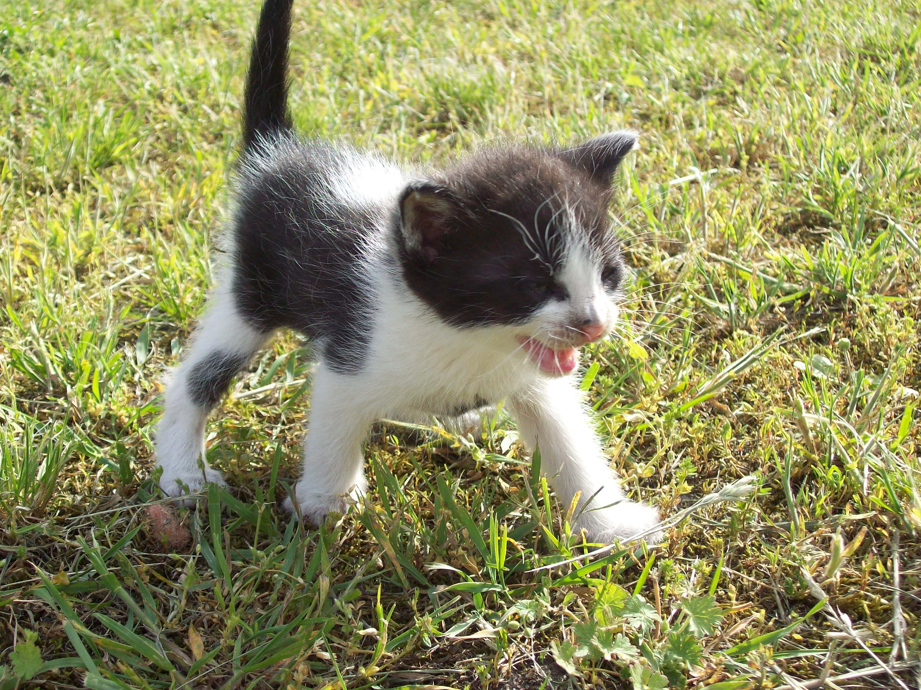
Image has been put in the public domain by its author. http://commons.wikimedia.org/wiki/File:Kitten_(06)_by_Ron.jpg

Slide 8
Definition of Big-O
We say a function f(n) is “big-O” of another function g(n), and write “f(n) is O(g(n))” iff there exist positive constants c and n₀ such that for all n ≥ n₀, f(n) ≤ c g(n).
What you need to know:
O(X) describes an “upper bound”—the algorithm will perform no worse than X (maybe better than X)
We ignore constant factors in saying that
We ignore behavior for “small” n
$$∃c,n_{0}>0, s.t. ∀n≥n_{0}, f(n)≤c∙g(n)$$

Slide 9
Translating code to a f(n) model of the performance
 | Statements | Cost
1 | double findAvg ( Vector<int>& grades ){
2 | double sum = 0; | 1
3 | int count = 0; | 1
4 | while ( count < grades.size() ) { | n + 1
5 | sum += grades[count]; | n
6 | count++; | n
7 | }
8 | if ( grades.size() > 0 ) | 1
9 | return sum / grades.size();
10 | else | 1
11 | return 0.0;
12 | }
ALL |  | 3n+5
Do we really care about the +5?
Or the 3 for that matter?

Slide 10
Big-O
Interpreting graphs

Slide 11
f₂ is O(f₁)
“f(n) is O(g(n))” iff
$$∃c,n_{0}>0, s.t. ∀n≥n_{0}, f(n)≤c∙g(n)$$
TRUE
FALSE
Why or why not?
f₁
f₂

Slide 12
f₁ is O(f₂)
“f(n) is O(g(n))” iff
$$∃c,n_{0}>0, s.t. ∀n≥n_{0}, f(n)≤c∙g(n)$$
TRUE
FALSE
Why or why not?
f₁
f₂

Slide 13
f(n) is O(g(n)), if there are positive constants c and n₀ such that f(n) ≤ c * g(n) for all n ≥ n₀.
f₂ = O(f₁) because f₁ is above f₂—an “upper bound”
But also true: f₁ = O(f₂)
  We can move f₂ above f₁ by multiplying by c
f₁
f₂

Slide 14
f₃ is O(f₁)
“f(n) is O(g(n))” iff
$$∃c,n_{0}>0, s.t. ∀n≥n_{0}, f(n)≤c∙g(n)$$
f₃
TRUE
FALSE
The constant c cannot rescue us here “because calculus.”
f₁
f₂

Slide 15
Announcements:
  Assignments 3&4 are traditionally thought of as one assignment, but I separated out the deadlines because it’s a lot to manage.
  Assignment 3 went out Friday (recursion warm-ups)
    Due this Friday
    As of last Wednesday, you have all necessary topics
  Assignment 4 goes out tomorrow (Boggle)
    Due next Wednesday
    As of this Wednesday, you will have all necessary topics
    Suggestion: read the chapter about classes and objects NOW, so you can really hit the ground running Wednesday
  I will be out of town for the rest of the week
    CS106B’s Marty Stepp will be lecturing Wednesday and Friday
    No instructor office hours this week—use Piazza to reach me

Slide 16
Simplifying Big-O Expressions
We always report Big-O analyses in simplified form and generally give the tightest bound we can
Some examples:
Let f(n) = 3 log₂n + 4 nlog₂n + n………..f(n) is O( ).
Let f(n) = 546 + 34n + 2n²……………..…..f(n) is O( ).
Let f(n) = 2^{n} + 14n² + 4n³……………..…...f(n) is O( ).
Let f(n) = 100……………………....…..…...f(n) is O( ).

Slide 17
Big-O
Applying to algorithms

Slide 18
Applying Big-O to Algorithms
Some familiar examples:
Binary search…….…………..is O( ) where n is .
Fauxtoshop edge detection...is O( ) where n is .
0 | 1 | 2 | 3 | 4 | 5 | 6 | 7 | 8 | 9 | 10
2 | 7 | 8 | 13 | 25 | 29 | 33 | 51 | 89 | 90 | 95
R -1 C -1 | R -1 C +0 | R -1 C +1
R +0 C -1 | R +0 C +0 | R +0 C +1
R +1 C -1 | R +1 C +0 | R +1 C +1

Slide 19
Applying Big-O to Algorithms
Some code examples:
    for (int i = data.size() - 1; i >= 0; i -= 3){
    for (int j = 0; j < data.size(); j += 3){
    cout << data[i] << data[j] << endl;
    }
    }
is O( ) where n is data.size().

Slide 20
Applying Big-O to Algorithms
Some code examples:
    for (int i = 0; i < data.size(); i += (data.size() / 5)) {
    cout << data[i] << endl;
    }
is O( ) where n is data.size().

