Slide 1
Programming Abstractions
CS106X
Cynthia Lee

Slide 2
Topics:
  Last week, with Marty Stepp:
    Making your own class
    Arrays in C++
  This week: Memory and Pointers
    Revisit some topics from last week
    Deeper look at what a pointer is
      Hexadecimal!
    Dynamic Memory allocation
    Linked nodes
    Linked List data structure
    (if we have time) Binary tree data structure

Slide 3
Arrays
(revisit from last week)

Slide 4
Arrays (11.3)
  type* name = new type[length];
    A dynamically allocated array.
    The variable that refers to the array is a pointer.
    The memory allocated for the array must be manually released,
    or else the program will have a memory leak. (>_<)
  Another array creation syntax that we will not use*:
  type name[length];
    A fixed array; initialized at declaration; can never be resized.
    Stored in a different place in memory; the first syntax uses the stack and the second uses the heap. (discussed later)
* For 106X, I would like you to know this syntax and be able to diagram what it does, but Marty Stepp was right in that we won’t generally be using it in code you write (for style/design reasons).
Notes:
DRAW DIAGRAM ON WHITEBOARD to contrast two approaches.

Slide 5
Arrays on the stack and heap
Memory
main()
myfunction()
x:
y:
void myfunction() {
int x = 5;
int y;
int arr[2];
arr[1] = 3;
int *heapArr = new int[2];
// bad -- memory leak coming!
}
What happens when myfunction() returns?
arr:
heapArr:
0x0

Slide 6
ArrayList
(revisit from last week)

Slide 7
Freeing array memory
  delete[] name;
    Releases the memory associated with the given array
    Must be done for all arrays created with new
      Or else the program has a memory leak. (No garbage collector like Java)
      Leaked memory will be released when the program exits, but for long-running programs, memory leaks are bad and will eventually exhaust your RAM
  int* a = new int[3];
  a[0] = 42;
  a[1] = -5;
  a[2] = 17;
  ...
  delete[] a;
Notes:
New and delete, always in pairs!

Slide 8
Destructor (12.3)
// ClassName.h // ClassName.cpp
~ClassName(); ClassName::~ClassName() { ...
destructor: Called when the object is deleted by the program.
  (when the object goes out of {} scope; opposite of a constructor)
  Useful if your object needs to do anything important as it dies:
    saving any temporary resources inside the object
    freeing any dynamically allocated memory used by the object's members
    …
  Does our ArrayList need a destructor? If so, what should it do?

Slide 9
Destructor solution
// in ArrayList.cpp
ArrayList::ArrayList() {
myElements = new int[10]();
mySize = 0;
myCapacity = 10;
}
void ArrayList::~ArrayList() {
delete[] myElements;
}

Slide 10
Running out of space
What if the client wants to add more than 10 elements?
  list.add(75); // add an 11th element
  Answer: Resize the array to one twice as large.
    Make sure to free the memory used by the old array!
index | 0 | 1 | 2 | 3 | 4 | 5 | 6 | 7 | 8 | 9
value | 3 | 8 | 9 | 7 | 5 | 12 | 4 | 8 | 1 | 6
size | 10 | capacity |  | 10
index | 0 | 1 | 2 | 3 | 4 | 5 | 6 | 7 | 8 | 9 | 10 | 11 | 12 | 13 | 14 | 15 | 16 | 17 | 18 | 19
value | 3 | 8 | 9 | 7 | 5 | 12 | 4 | 8 | 1 | 6 | 75 | 0 | 0 | 0 | 0 | 0 | 0 | 0 | 0 | 0
size | 11 | capacity |  |  |  | 20

Slide 11
Resize solution
// in ArrayList.cpp
void ArrayList::checkResize() {
if (mySize == myCapacity) {
// create bigger array and copy data over
int* bigger = new int[2 * capacity]();
for (int i = 0; i < myCapacity; i++) {
bigger[i] = myElements[i];
}
delete[] myElements;
myElements = bigger;
myCapacity *= 2;
}
}

Slide 12
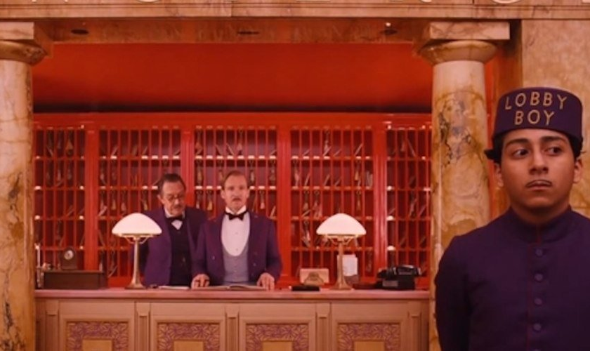
Heap memory works like a hotel registration desk
(Congratulations Golden Globe winner Grand Budapest Hotel)

Slide 13

Only a creepy killer would access a hotel room that isn’t theirs (either never was, or was but checked out already)
(Another great film about unusual people who work at hotels)

Slide 14
Pointers
Taking a deeper look at the syntax of that array on the heap

Slide 15
Memory addresses: the basics
Stack
When you declare a variable, it is necessarily stored somewhere in memory
You can ask for any variable's memory address with the & operator
Memory addresses are usually written as hexadecimal (base-16 or “hex”) numbers
  Ex: 0x28F620
    Prefix “0x” is a visual cue that this is a hex number (not really part of the number)
    0x28F620
12
Heap
0x0

Slide 16
Examples of the & operator
  int x = 42;
  int y;
  int a[4] = {91, -3, 85, 17};
  double d1 = 3.0;
  double d2 = 3.2;
  cout << x << endl; // 42
  cout << &x << endl; // 0x7f8e20
  cout << y << endl; // 17
  cout << &y << endl;
  cout << a << endl; // 0x7f8e24
  cout << &a[0] << endl; // 0x7f8e28
  cout << &a[1] << endl; // 0x7f8e2c
  cout << &a[2] << endl;
  cout << &d << endl; // 0x7f8e30
Notes:
Paste this code into QTCreator!
Things to notice about this example:
y’s address is less than x’s address (at least on my laptop), because QT’s compiler likes to allocated stack frame space in order and notice that as the stack grows, it grows DOWN towards memory address zero.
What prints out when we print y could be anything! y was allocated space on the stack but was never initialized. Whatever happened to be left over from whoever used that space last is what we will find there. (Note that the Stanford library Vector<int> Grid<int> etc will initialize the int’s to 0 for you. THIS IS NOT NORMAL IN C++ and is a feature of the Stanford library ADTs.)
Arrays in C++ are just a pointer to the first element of the array. So “cout << a” gives the same thing as “cout << &(a[0])”. IMPORTANT CONSEQUENCE OF THIS IS THAT C++ ALLOWS YOU TO WRITE PAST THE END OF AN ARRAY, because arrays don’t “know” how long they are, they only know where they start! So you could do a[500] = 22; and write 22 to some who-knows-where place in memory and really mess up your program.
Variables of type double are allocated more space than variables of type int. You can see the “gap” between memory addresses is bigger between double and the next variable’s address than would be for int.

Slide 17
Pointer arithmetic
Surprise! operators +, -, ++, -- work on pointers
  Incrementing a T* (pointer to type T) by 1 moves the pointer forward in memory to the next T

Slide 18
When we add 1 to a pointer, how much does the address change?
Thinking about what we just learned…
  int x = 42;
  int y;
  int a[4] = {91, -3, 85, 17};
  double d1 = 3.0;
  ...
  int* pi = &x;
  double* pd = &d1;
  cout << pi << endl;
  pi++;
  cout << pi << endl;
  cout << pd << endl;
  pd++;
  cout << pd << endl;
You can’t do ++ on a pointer to int
pi++ adds 1 and pd++ adds 1, of course!
pi++ adds 4 and pd++ adds 4
Other/none/more than one
This is why the language has you specify double* and int* rather than just having a generic* type (although it does have one of those too—void*).

Slide 19
Data types in C++
Each unique memory address describes one byte of memory space (1byte = 8bits, or 8 1’s and 0’s)
    We say memory is “byte addressable”
int addresses are 4 apart (32bits)
double addresses are 8 apart (64bits)
The above is true on this system--may differ on other systems
    Of course C++ doesn't impose a standard, because that would be safe and convenient, and that’s not how we roll....
  Bonus question: do int* and double* take up the (A) SAME or (B) DIFFERENT amounts of space?

Slide 20
2nd look: Arrays on the stack and heap
Memory
main()
myfunction()
x:
y:
void myfunction() {
int x = 5;
int y;
int arr[2];
arr[1] = 3;
int *heapArr = new int[2];
// bad -- memory leak coming!
}
arr:
heapArr:
0x0

Slide 21
Arrays are actually pointers
Surprise!
  If you have a pointer p (see declaration of p below), you can use p[k] syntax to access memory k slots away from p (according to the size of the type pointed to)
    p[k] is equivalent to *(p+k)
  (An array variable is really just a pointer to the array's first element, and so pointers and array variables work the same for indexing.)
  ...
  int a[4] = {91, -3, 85, 17};
  ...
  int* p = a;
  p[1] = 5;
  p++;
  cout << *p << endl;
  *(p + 2) = 26;
  cout << p[2] << endl;
  cout << a[2] << endl;
What prints here?
26, 26
26, 85
85, 26
85, 85

Slide 22

In the news: Heartbleed
Last spring, security experts warned that users of thousands of major websites needed to change their passwords due to potential exposure caused by the “Heartbleed” vulnerability
Heartbleed exploited a buffer overrun bug in OpenSSL
    SSL is the layer that secures web interactions, i.e., it’s what make the “s” in “https://” mean something

Slide 23
In the news: Heartbleed
The protocol allows you to send “heartbeat” messages, which basically say:
    Are you still there? If you are, repeat this word back to me: “hello” [0x0005 bytes].
    Each char is one byte, so 5 letters
Unfortunately, the software also let you send messages like this:
    Are you still there? If you are, repeat this word back to me: “hello” [0xFFFF bytes].
    That’s 65535 bytes—much more than the length of “hello”!
    So the software would continue for-looping past the end of the “hello” array, sending information back
    Which causes an error, right? RIGHT?? Turns out, no.

Slide 24


Software engineering tip:
Initialize pointers always! If not to a useful value, then at least to NULL. NULL initialization forces your program to crash (this is a good thing, really!) if you try to use the pointer without assigning it a proper value
Common error:
Prevention:
int* foo;
…never initialized…
*foo = 555;
int* foo = NULL;
…
*foo = 555;
Stack
    0x28F620
Heap
Image is in the public domain: http://en.wikipedia.org/wiki/File:Operation_Upshot-Knothole_-_Badger_001.jpg

