Slide 1
Programming Abstractions
CS106X
Cynthia Lee

Slide 2
Topics:
  Priority Queue
    Linked List implementation
    Heap data structure implementation
  TODAY’S TOPICS NOT ON THE MIDTERM

Slide 3
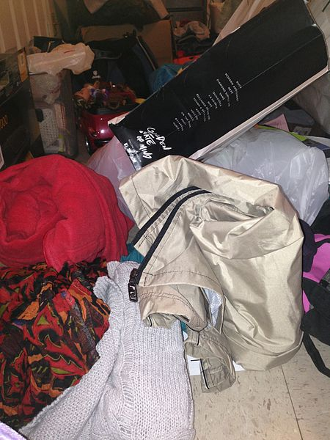
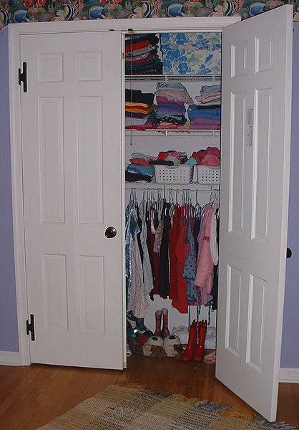
Some priority queue implementation options
data | next
75
data | next
8
data | next
20 | NULL
head
Unsorted linked list
  Insert new element in front: O(1)
  Remove by searching list: O(N)
Sorted linked list
  Always insert in sorted order: O(N)
  Remove from front: O(1)
data | next
8
data | next
20
data | next
75 | NULL
head

Slide 4
We want the best of both
Priority queue implementations
Fast add AND fast remove/peek
We will investigate trees as a way to get the best of both worlds
+
=
Fast add
Fast remove/peek

Slide 5
Binary Heaps

Slide 6
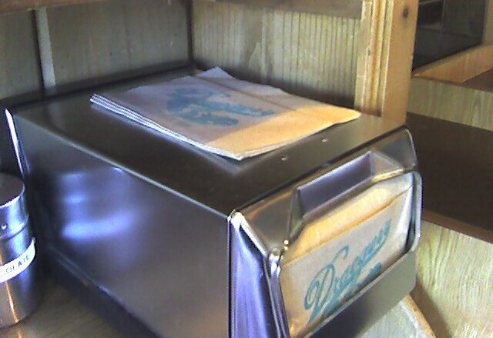
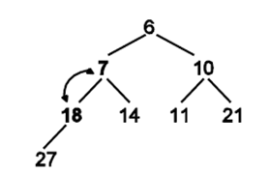
Heap: not to be confused with the Heap!
Although the Stack section of memory is a Stack like the ADT, the Heap section of memory has nothing to do with the Heap structure.
Probably just happened to reuse the same word
Source: http://www.flickr.com/photos/35237093334@N01/409465578/
Author: http://www.flickr.com/people/35237093334@N01 Peter Kazanjy]
Stack
=
Stack ADT
Heap data structure
Heap
≠
0x0

Slide 7
Binary trees

Slide 8
A binary tree
“In computer science, a binary tree is a tree data structure in which each node has at most two child nodes, usually distinguished as "left" and "right".” (Thanks, Wikipedia!)

Slide 9
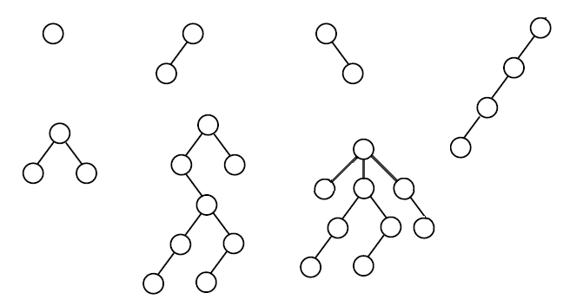
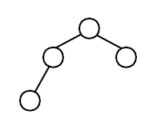
How many of these are valid binary trees?
“In computer science, a binary tree is a tree data structure in which each node has at most two child nodes, usually distinguished as "left" and "right".” (Thanks, Wikipedia!)

Slide 10
A node struct for binary trees
data:
left:
right:
Similar to a linked list node, it contains a pointer to data, and a pointer to the nearby elements
A binary node tree has two child pointers, left and right
    struct TreeNode {
    int data;
    TreeNode* left;
    TreeNode* right;
    };
data:
left:
right:
data:
left:
right:

Slide 11
Heaps!

Slide 12
Binary Heaps*
Binary heaps are one kind of binary tree
They have a few special restrictions, in addition to the usual binary tree:
  Must be complete
    No “gaps”—nodes are filled in left-to-right on each level (row) of the tree
  Ordering of data must obey heap property
    Min-heap version: a parent’s data is always ≤ both its children’s data
    Max-heap version: a parent’s data is always ≥ both its children’s data
* There are other kinds of heaps as well. For example, binomial heap is extra credit on your assignment.

Slide 13
How many of these could be valid binary heaps?
0-1
2
3
4
5-8

Slide 14
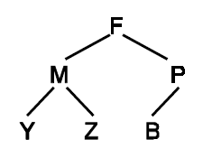
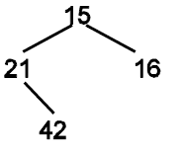
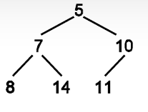
How many of these are valid min-binary-heaps?

Slide 15
Binary heap in an array

Slide 16
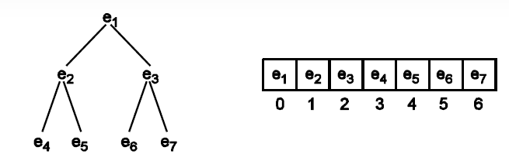
Binary heap in an array
data:
left:
right:
We actually do NOT typically use a node object to implement heaps
Because they have the special added constraint that they must be complete, they fit nicely into an array

Slide 17
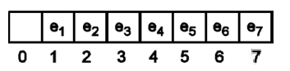
Two approaches:
Binary heap in an array
data:
left:
right:
Wait, but the homework handout starts storing the elements at array index 1!
    Either way is ok for the assignment.
    You should understand both ways, so we’re teaching both ways (one in handout and one in lecture)
0-based
OR
1-based

Slide 18
Heap in an array
For (0-baesd) tree of height h, array length is 2^{h}-1
For a node in array index i:
  Parent is at array index:
    i – 2
    i / 2
    (i – 1)/2
    2i

Slide 19
Fact summary:
Binary heap in an array
0-based:
1-based:
For tree of height h, array length is 2^{h}-1
For a node in array index i:
  Parent is at array index: (i – 1)/2
  Left child is at array index: 2i + 1
  Right child is at array index: 2i + 2
For tree of height h, array length is 2^{h}
For a node in array index i:
  Parent is at array index: i /2
  Left child is at array index: 2i
  Right child is at array index: 2i + 1

Slide 20
Binary heap insert and delete

Slide 21
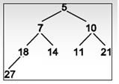
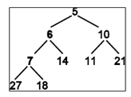
Binary heap insert + “bubble up”
Size=8, Capacity=15
0 | 1 | 2 | 3 | 4 | 5 | 6 | 7 | 8 | 9 | … | 14
5 | 7 | 10 | 18 | 14 | 11 | 21 | 27 | ? | ? | … | ?
Size=9, Capacity=15
0 | 1 | 2 | 3 | 4 | 5 | 6 | 7 | 8 | 9 | … | 14
5 | 6 | 10 | 7 | 14 | 11 | 21 | 27 | 18 | ? | … | ?

Slide 22
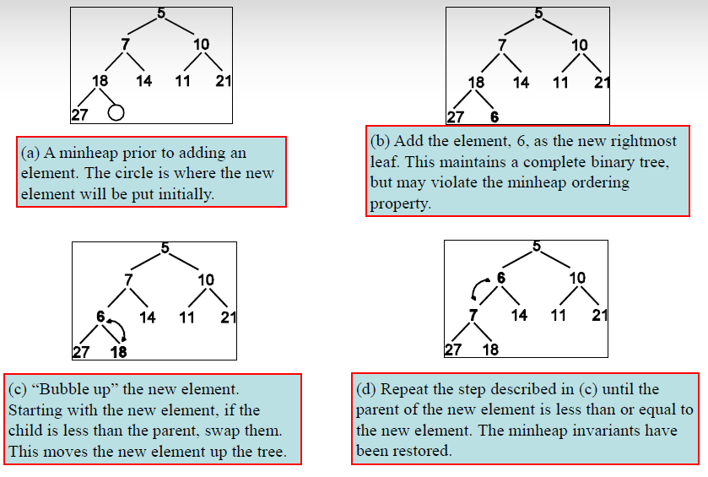
[Binary heap insert reference page]

Slide 23
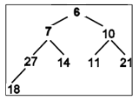
Binary heap delete + “trickle down”
Size=9, Capacity=15
0 | 1 | 2 | 3 | 4 | 5 | 6 | 7 | 8 | 9 | … | 14
5 | 6 | 10 | 7 | 14 | 11 | 21 | 27 | 18 | ? | … | ?
Size=8, Capacity=15
0 | 1 | 2 | 3 | 4 | 5 | 6 | 7 | 8 | 9 | … | 14
6 | 7 | 10 | 27 | 14 | 11 | 21 | 18 | ? | ? | … | ?

Slide 24
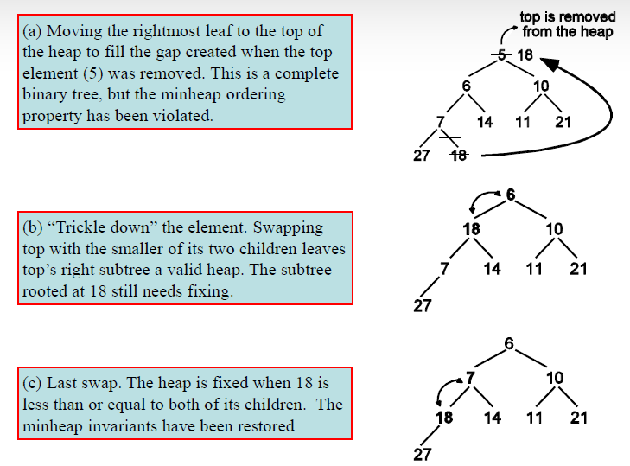
[Binary heap delete + “trickle-down” reference page]

