Slide 1
Programming Abstractions
CS106X
Cynthia Lee

Slide 2
Topics:
  Finish up heap data structure implementation
    Enqueue (“bubble up”)
    Dequeue (“trickle down”)
  Binary Search Tree (BST)
    Starting with a dream: binary search in a linked list?
    How our dream provided the inspiration for the BST
      Note: we do NOT actually construct BSTs using this method
    BST insert
    Big-O analysis of BST
    (if we have time) BST balance issues

Slide 3
Binary heap insert and delete

Slide 4
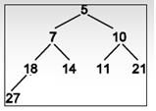
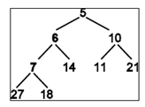
Binary heap insert + “bubble up”
Size=8, Capacity=15
0 | 1 | 2 | 3 | 4 | 5 | 6 | 7 | 8 | 9 | … | 14
5 | 7 | 10 | 18 | 14 | 11 | 21 | 27 | ? | ? | … | ?
Size=9, Capacity=15
0 | 1 | 2 | 3 | 4 | 5 | 6 | 7 | 8 | 9 | … | 14
5 | 6 | 10 | 7 | 14 | 11 | 21 | 27 | 18 | ? | … | ?

Slide 5
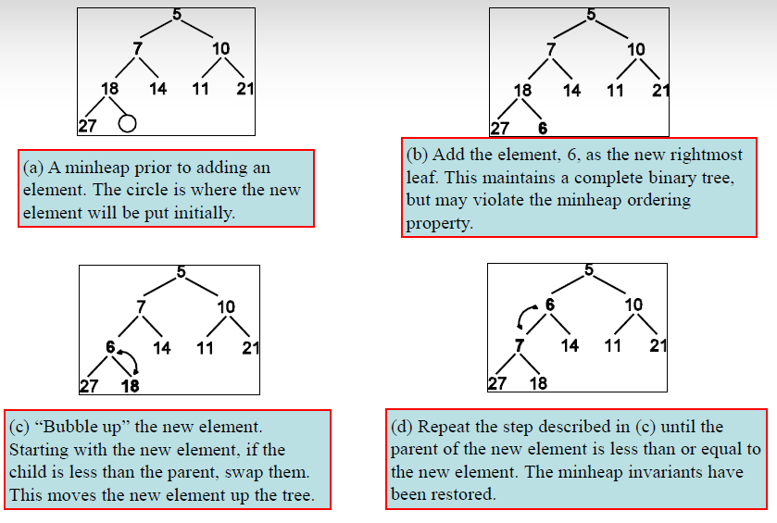
[Binary heap insert reference page]

Slide 6
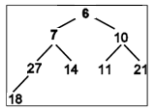
Binary heap delete + “trickle down”
Size=9, Capacity=15
0 | 1 | 2 | 3 | 4 | 5 | 6 | 7 | 8 | 9 | … | 14
5 | 6 | 10 | 7 | 14 | 11 | 21 | 27 | 18 | ? | … | ?
Size=8, Capacity=15
0 | 1 | 2 | 3 | 4 | 5 | 6 | 7 | 8 | 9 | … | 14
6 | 7 | 10 | 27 | 14 | 11 | 21 | 18 | ? | ? | … | ?

Slide 7
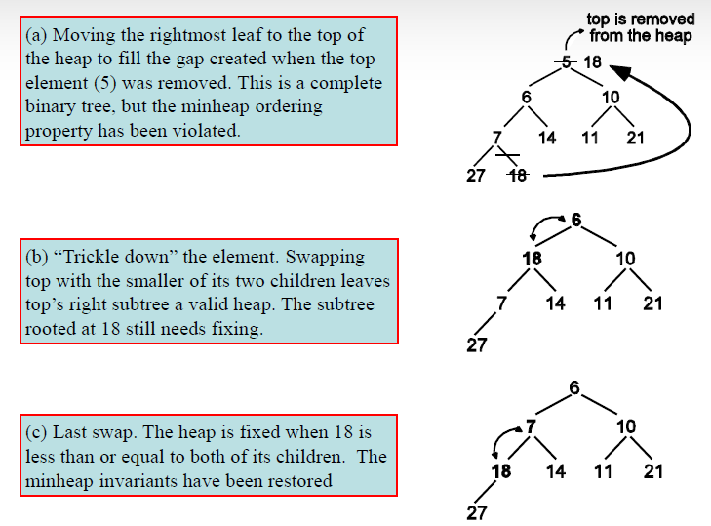
[Binary heap delete + “trickle-down” reference page]

Slide 8
Binary Search Trees
Implementing the Map interface with Binary Search Trees

Slide 9
Implementing Map interface with a Binary Search Tree (BST)
  Often we think of a hash table as the go-to implementation of the Map interface
    Will talk about this on Thursday!
  Binary Search Trees are another option
    C++’s Standard Template Library (STL) uses a Red-Black tree (a type of BST) for their map
    Stanford library also uses a BST
      Use hash-map.h to get a hashing version

Slide 10
Binary Search in a Linked List?
Exploring a good idea, finding way to make it work

Slide 11
Imagine storing sorted data in an array
0 | 1 | 2 | 3 | 4 | 5 | 6 | 7 | 8 | 9 | 10
2 | 7 | 8 | 13 | 25 | 29 | 33 | 51 | 89 | 90 | 95
How long does it take us to find?
    Binary search!
    O(logn): awesome!
  But slow to insert
    Scoot everyone over to make space
    O(n): not terrible, but pretty bad compared to log(n) or O(1)
    In contrast, linked list stores its nodes scattered all over the heap, so it doesn’t have to scoot things over

Slide 12
Q. Can we do binary search on a linked list to implement a quick insert?
No.
The nodes are spread all over the heap, and we must follow “next” pointers one at a time to navigate.
Therefore cannot jump right to the middle.
Therefore cannot do binary search.
Find is O(N): not terrible, but pretty bad compared to O(logn) or O(1)
Binary Search Tree can be thought of as a linked list that has pointers to the middle, again and again (recursively), to form a tree structure

Slide 13
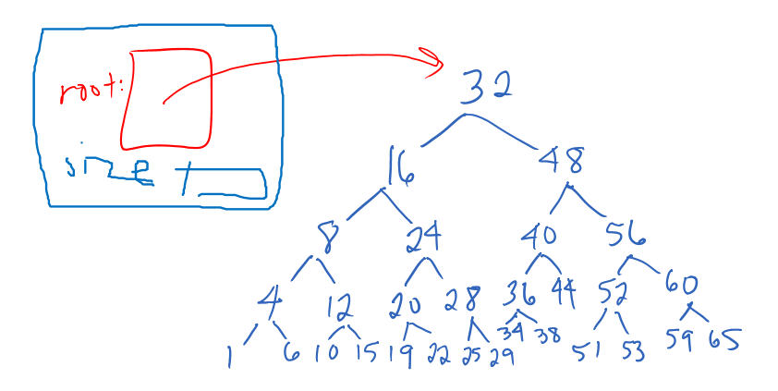
An Idealized Binary Search Tree

Slide 14
TreeMap
An implementation of the Map interface

Slide 15
tree-map.h
template <typename Key, typename Value>
class TreeMap {
public:
TreeMap();
~TreeMap();
bool isEmpty() const { return size() == 0; }
int size() const { return count; }
bool containsKey(const Key& key) const;
void put(const Key& key, const Value& value);
Value get(const Key& key) const;
Value& operator[](const Key& key);
...

Slide 16
tree-map.h
...
private:
struct node {
Key key;
Value value;
node *left, *right;
};
int count;
node *root;
};

Slide 17
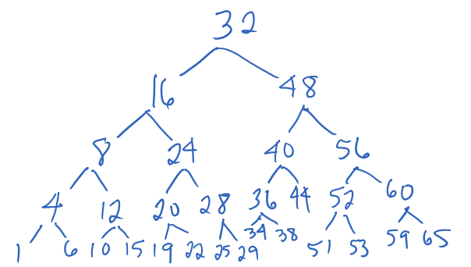
BST put()
Example: insert 2
Pretty simple!
If key > node’s key
    Go right!
  If key < node’s key
    Go left!
  If equal, do update of value—no duplicate keys!
  If there is nothing currently in the direction you are going, that’s where you end up

Slide 18
BST put()
Insert: 22, 9, 34, 18, 3
How many of these result in the same tree structure as above?
22, 34, 9, 18, 3
22, 18, 9, 3, 34
22, 9, 3, 18, 34
None of these
1 of these
2 of these
All of these

Slide 19
What is the WORST CASE cost for doing containsKey() in BST?
O(1)
O(log n)
O(n)
O(n log n)
O(n²)

Slide 20
What is the worst case cost for doing containsKey() in BST if the BST is balanced?
O(logN)—awesome!
BSTs is that they are great when balanced
BST is bad when unbalanced
Balance depends on order of insert of elements

