Slide 1
Programming Abstractions
CS106X
Cynthia Lee

Slide 2
Topics Overview
  Recently:
  Priority Queue implementations:
    linked list
    heap
  Map interface implementation:
    Binary Search Tree (BST)
  While we’re doing trees, another kind of tree:
    Huffman coding trees (used for compression of files)
  Today: Hashing:
  Another Map interface implementation
    Background: Lookup tables
    Details: Hashing

Slide 3
Hashing
Implementing the Map interface with Hashing/Hash Tables
PART 1: Intuition behind the invention of the hash table

Slide 4
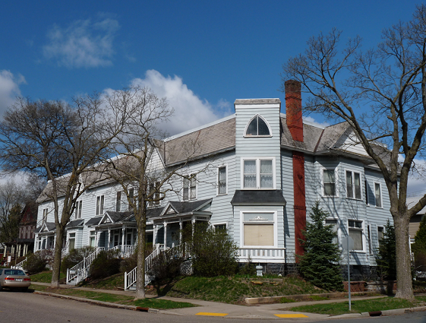
Imagine you want to look up your neighbors’ names, based on their house number
House numbers: 10565 through 90600
  (roughly 1000 houses—there are varying gaps in house numbers between houses)
  All the houses are on the same street, so we only need to lookup by house number
Names: string containing the name(s) living there
We will consider two data structure options: linked list, and array of strings
Image dedicated to public domain under Creative Commons license: http://commons.wikimedia.org/wiki/File:Salsbury_Row_House.jpg

Slide 5
Option #1: Linked list
head
10565, “Kyung Suk and Yong Han Lee”
10567, “Isaiah White”
90600, “Josie Spencer and Solange Clark”
…
Linked list:
  Struct has 3 fields: next pointer, int data (house number), and string data (name)
  Sort them by house number
  Add/remove: O(n)
  Find: O(n)

Slide 6
Option #2: Array of strings
Index (house number) | String value (name)
0 | “”
1 | “”
… | …
10565 | “Yong Han and Kyung Suk Lee”
10566 | “”
10567 | “Isaiah White”
… | …
90598 | “”
90599 | “”
90600 | “Josie Spencer and Solange Clark”
Array of strings:
  Index is house number, string is name
  Add/remove:
  Find:

Slide 7
Array of Strings
Array of strings:
Index (house number) | String value (name)
0 | “”
1 | “”
… | …
10565 | “Yong Han and Kyung Suk Lee”
10566 | “”
10567 | “Isaiah White”
… | …
90598 | “”
90599 | “”
90600 | “Josie Spencer and Solange Clark”
Array of strings:
  Index is house number, string is name(s)

Slide 8
Array of Strings
Array of strings:
Index (house number) | String value (name)
0 | “”
1 | “”
… | …
10565 | “Yong Han and Kyung Suk Lee”
10566 | “”
10567 | “Isaiah White”
… | …
90598 | “”
90599 | “”
90600 | “Josie Spencer and Solange Clark”
Array of strings:
  Index is house number, string is name(s)
  Add/remove: ____
    Ex.: if somebody moves into the vacant house at 90598, how long would it take to update?
  Find: ____
    Ex.: you want to find the name of the resident at 12475, if any
O(1), O(1)
O(logn), O(logn)
O(n), O(n)
Other/none/combination

Slide 9
Array of Strings
Array of strings:
Index (house number) | String value (name)
0 | “”
1 | “”
… | …
10565 | “Yong Han and Kyung Suk Lee”
10566 | “”
10567 | “Isaiah White”
… | …
90598 | “”
90599 | “”
90600 | “Josie Spencer and Solange Clark”
Wow, excellent performance on both!!
Only way to do better than O(1) is a time machine that can go back in time and make it take zero/negative time!
Everything is awesome (?)
Discuss: Can you identify 1-2 specific areas of waste in this approach?
  Bonus: can you think of a simple fix for at least one of the areas of waste?

Slide 10
One quick fix:
Array of strings:
Index (house number) | String value (name)
0 | “”
1 | “”
… | …
10565 | “Yong Han and Kyung Suk Lee”
10566 | “”
10567 | “Isaiah White”
… | …
90598 | “”
90599 | “”
90600 | “Josie Spencer and Solange Clark”
/* When accessing the array, use array[hash(houseNum)]
* rather than array[houseNum]
*/
int hash(int houseNumber){
return houseNumber-10565;
}
This solves the problem of the enormous gap from 0 to 10565
  So our array size could be ~80,000 entries instead of 90,600
  Doesn’t solve the problem of gaps between houses
    How could we do that? A tricky problem…
  This approach only works for keys of type int

Slide 11
Hashing
Implementing the Map interface with Hashing/Hash Tables
PART 2: Getting the MAGICAL performance of our simple house numbers example on any key type, and with less waste

Slide 12
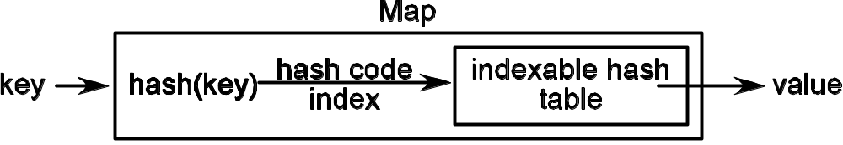
Hash Table is just a modified, more flexible array
Keys don’t have to be integers in the range [0-(size-1)]
    They don’t even have to be integers at all!
(Ideally) avoids big gaps like we had with house numbers array
Replicates the MAGICAL performance of our array of strings on ANY key/value!!
THANK YOU, HASH FUNCTION!! ♥ ♥ ♥
Not necessarily int
int in range [0-(size-1)]

Slide 13
hash() function
This is where the MAGIC happens!
    These are typically mathematically sophisticated functions
    They do their best to ensure a nice uniform distribution of elements across the available array (hash table)
    They use tricks like modulus (remainder) and prime numbers to do this
    A lot of art & science, beyond the scope of this class
    Fun times!

Slide 14
Hashing
Implementing the Map interface with Hashing/Hash Tables

Slide 15
Hash table inserts
Array index | Hashed data
0
1
2 | (A) "Annie", 3
3 | (B) "Annie", 3
4 | (C) "Annie", 3
5 | (D) "Annie", 3
6
7
8
Let’s pretend we have a profoundly not-mathematically-sophisticated hash function:
int hash(string key) {
return key.length();
}
Where does key="Annie" value=3 go?
  HashMap<string,int> mymap;
  mymap["Annie"] = 3;
See choices in table at right, or:
(E) Some other place

Slide 16
Hash table inserts
Array index | Hashed data
0
1
2
3
4
5 | "Annie", 3
6
7
8
Let’s pretend we have a profoundly not-mathematically-sophisticated hash function:
int hash(string key) {
return key.length();
}
Where does key="Michael", value=5 go?
  mymap["Michael"] = 5;

Slide 17
Hash table inserts
Array index | Hashed data
0
1
2
3
4
5 | "Annie", 3
6
7 | "Michael", 5
8
Let’s pretend we have a profoundly not-mathematically-sophisticated hash function:
int hash(string key) {
return key.length();
}
Where does key="Michael", value=5 go?
  mymap["Michael"] = 5;

Slide 18
Hash table inserts
Array index | Hashed data
0
1
2
3
4
5 | (A) "Annie", 3 7
6
7 | (B) "Michael", 5 "Annie", 7
8
Let’s pretend we have a profoundly not-mathematically-sophisticated hash function:
int hash(string key) {
return key.length();
}
Now insert key="Annie", value=7
mymap["Annie"] = 7;
See choices in table at right, or:
(C) Index 5 should store both
"Annie",3 and "Annie",7

Slide 19
Hash table inserts
Array index | Hashed data
0
1
2
3
4
5 | (A) "Annie", 7 "Maria", 8
6 | (B) "Maria", 8
7 | "Michael", 5
8 | (C) "Maria", 8
Let’s pretend we have a profoundly not-mathematically-sophisticated hash function:
int hash(string key) {
return key.length();
}
Now insert key="Maria", value=8
mymap["Maria"] = 8;
See choices in table at right, or:
(D) Index 5 should store both
"Annie",7 and "Maria",8

Slide 20
Uh-oh! Hash collisions
We can NOT overwrite the value the way we would if it really were the same key
Can you imagine how you would feel if you used Stanford library HashMap like this and it printed 8?!
mymap["Annie"] = 3;
mymap["Annie"] = 7;
cout << mymap["Annie"] << endl; //expect 7, not 3
mymap["Maria"] = 8;
cout << mymap["Annie"] << endl; //expect 7, not 8!!!

Slide 21
Uh-oh! Hash collisions
We may need to worry about hash collisions
Hash collision:
  Two keys a, b, a≠b, have the same hash code index (i.e. hash(a) == hash(b))
  Need a way of storing multiple values in a given “place” in the hash table, so all user’s data is preserved

Slide 22
Uh-oh! Hash collisions
Array index | Hashed data
0
1
2
3
4
5 | (A) "Annie", 7 "Maria", 8
6 | (B) "Maria", 8
7 | "Michael", 5
8 | (C) "Maria", 8
There are two main strategies for resolving this:
Put the item in the next bin (as in the (B) choice from our previous slide)—this is called “open addressing”
Make each bin be the head of a linked list, and elements can chain off each other as long as needed—this is called “closed addressing”

Slide 23
Map Interface: hash-map.h
…
private:
struct node {
Key key;
Value value;
node *next;
};
node **buckets;
int numBuckets;
int count;
int hash(const Key& key) const;
};

Slide 24
HashMap
0
NULL
NULL
NULL
NULL
NULL
…
private:
struct node {
Key key;
Value value;
node *next;
};
node **buckets;
int numBuckets;
int count;
int hash(const Key& key) const;
};
// Q: Can you draw the HashMap
// object in this memory diagram,
// including filling in values for
// all fields?
1
2
3
4
5
6
7

Slide 25
Hash key collisions & Big-O of HashMap
If there are no collisions, find/add/remove are all O(1)—just compute the key and go!
Two factors for ruining this magical land of instantaneous lookup:
  Too-small table (worst case = 1)
  Hash function doesn’t produce a good spread
  int awfulHashFunction(string input) {
  return 4;
  }
  Find/add/remove all O(n) worst case
// h/t http://xkcd.com/221/

Slide 26
The Birthday Problem
Commonly mentioned fact of probability theory:
In a group of n people, what are the odds that 2 people have the same birthday?
    (assume birthdays are uniformly distributed across 365 days, which is wrong in a few ways)
  For n ≥ 23, it is more likely than not
  For n ≥ 57, >99% chance
Moral of the story: hash tables almost certainly have at least one collision

