Slide 1
Programming Abstractions
CS106X
Cynthia Lee

Slide 2
Upcoming Topics
Graphs!
Basics
  What are they? How do we represent them?
Theorems
  What are some things we can prove about graphs?
Breadth-first search on a graph
  Spoiler: just a very, very small change to tree version
Dijkstra’s shortest paths algorithm
  Spoiler: just a very, very small change to BFS
A* shortest pathsalgorithm
  Spoiler: just a very, very small change to Dijkstra’s
Minimum Spanning Tree
  Kruskal’s algorithm

Slide 3
Graphs
What are graphs? What are they good for?

Slide 4
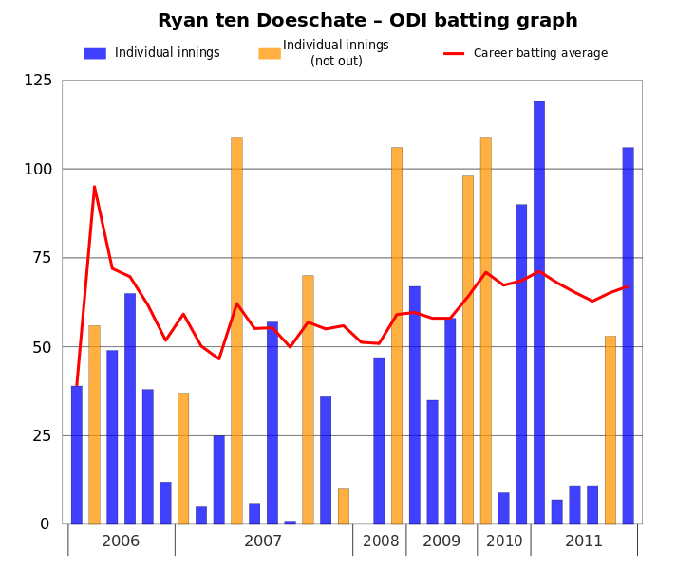
Graph
This file is licensed under the Creative Commons Attribution 3.0 Unported license. Jfd34 http://commons.wikimedia.org/wiki/File:Ryan_ten_Doeschate_ODI_batting_graph.svg

Slide 5
A Social Network
Slide by Keith Schwarz

Slide 6
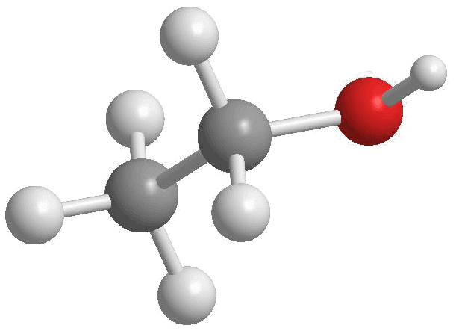
Chemical Bonds
Slide by Keith Schwarz
http://4.bp.blogspot.com/-xCtBJ8lKHqA/Tjm0BONWBRI/AAAAAAAAAK4/-mHrbAUOHHg/s1600/Ethanol2.gif

Slide 7
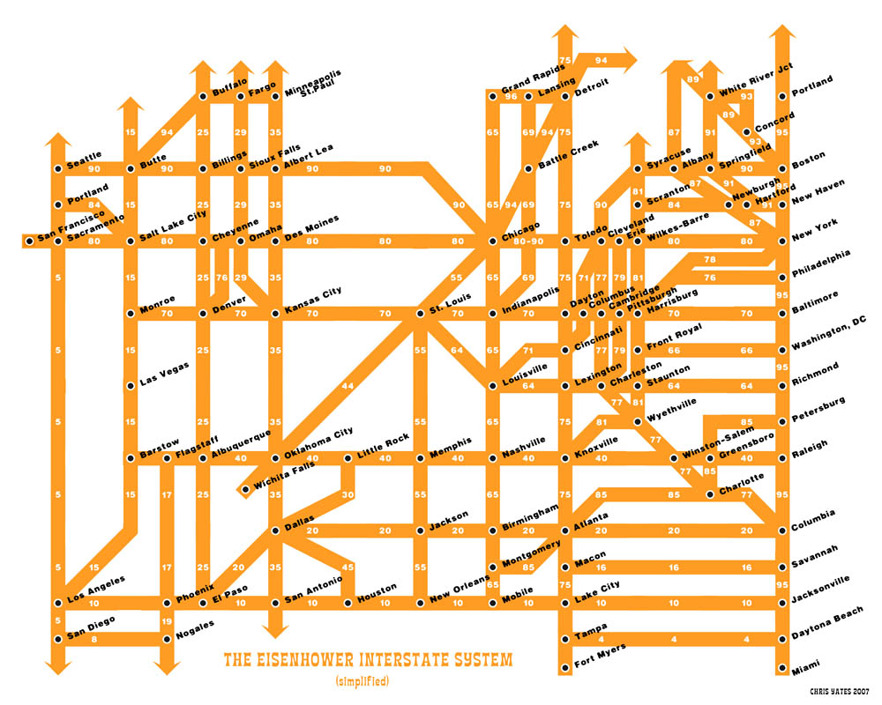
Slide by Keith Schwarz
http://strangemaps.files.wordpress.com/2007/02/fullinterstatemap-web.jpg

Slide 8
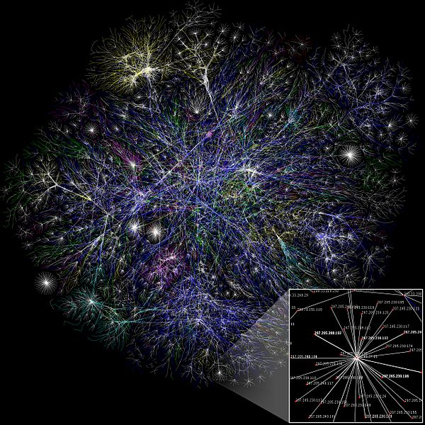
Internet
This file is licensed under the Creative Commons Attribution 2.5 Generic license. The Opte Project http://commons.wikimedia.org/wiki/File:Internet_map_1024.jpg

Slide 9
A graph is a mathematical structure for representing relationships
Consists of:
  A set V of vertices (or nodes)
    Often have an associated label
  A set E of edges (or arcs)
    Consist of two endpoint vertices
    Often have an associated cost or weight
  A graph may be directed (an edge from A to B only allow you to go from A to B, not B to A) or undirected (an edge between A and B allows travel in both directions)
  We talk about the number of vertices or edges as the size of the set, using the notation |V| and |E|

Slide 10
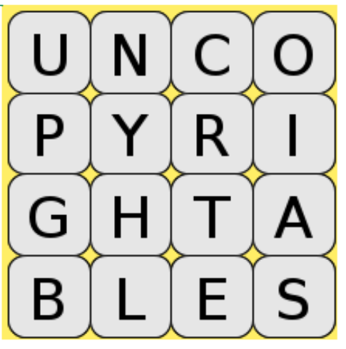
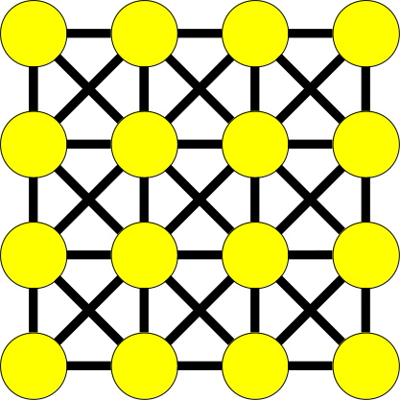
Boggle as a graph
Vertex = letter cube; Edge = connection to neighboring cube

Slide 11
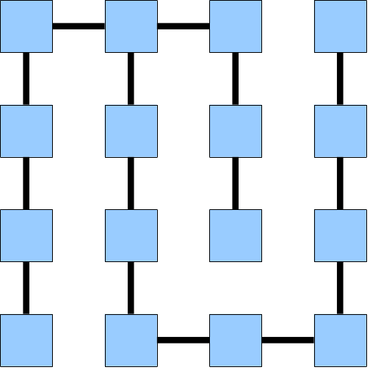
Maze as graph
If a maze is a graph, what is a vertex and what is an edge?

Slide 12
Graphs
How do we represent graphs in code?

Slide 13




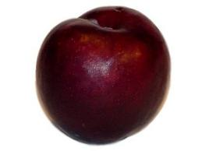
Graph terminology
Diagram shows a graph with four vertices:
Apple (outgoing edges to banana and blum)
Banana (with outgoing edge to self)
Pear (with outgoing edges to banana and plum)
Plum (with outgoing edge to banana)
This is a DIRECTED graph
This is an UNDIRECTED graph

Slide 14
Graph terminology
Diagrams each show a graph with four vertices: Apple, Banana, Pear, Plum. Each answer choice has different edge sets.
A: no edges
B: Apple to Plum directed, Apple to banana undirected
C: Apple and Banana point to each other. Two edges point from Plum to Pear
Which of the following is a correct graph?
A.
B.
C.
D. None of the above/other/more than one of the above

Slide 15
Paths
path: A path from vertex a to b is a sequence of edges that can be followed starting from a to reach b.
  can be represented as vertices visited, or edges taken
  example, one path from V to Z: {b, h} or {V, X, Z}
  What are two paths from U to Y?
path length: Number of vertices
or edges contained in the path.
neighbor or adjacent: Two vertices
connected directly by an edge.
  example: V and X
V
a
b
U
d
X
Z
h
c
e
W
g
f
Y

Slide 16
Reachability, connectedness
reachable: Vertex a is reachable from b
if a path exists from a to b.
connected: A graph is connected if every
vertex is reachable from every other.
complete: If every vertex has a direct
edge to every other.
V
a
b
U
d
X
Z
h
c
e
W
g
f
Y
a
b
a
b
d
c
c
d
e

Slide 17
Loops and cycles
cycle: A path that begins and ends at the same node.
  example: {V, X, Y, W, U, V}.
  example: {U, W, V, U}.
  acyclic graph: One that does
  not contain any cycles.
loop: An edge directly from
a node to itself.
  Many graphs don't allow loops.
V
a
b
U
d
X
Z
h
c
e
W
g
f
Y

Slide 18
Weighted graphs
weight: Cost associated with a given edge.
  Some graphs have weighted edges, and some are unweighted.
  Edges in an unweighted graph can be thought of as having equal weight (e.g. all 0, or all 1, etc.)
  Most graphs do not allow negative weights.
example: graph of airline flights, weighted by miles between cities:
849
PVD
1843
ORD
142
SFO
802
LGA
1743
337
1387
HNL
2555
1099
LAX
1233
DFW
1120
MIA

Slide 19
Representing Graphs: Adjacency Matrix
We can represent a graph as a Grid<bool> (unweighted)
or
Grid<int> (weighted)
 | 0 | 1 | 1 | 0 | 0 | 0
 | 1 | 0 | 1 | 1 | 1 | 0
 | 1 | 1 | 0 | 1 | 0 | 1
 | 0 | 1 | 1 | 0 | 1 | 1
 | 0 | 1 | 0 | 1 | 0 | 1
 | 0 | 0 | 1 | 1 | 1 | 0

Slide 20
Representing Graphs: adjacency list
We can represent a graph as a map from nodes to the set of nodes each node is connected to.
Map<Node*, Set<Node*>>
Node
Connected To
Slide by Keith Schwarz

Slide 21
Common ways of representing graphs
Adjacency list:
  Map<Node*, Set<Node*>>
Adjacency matrix:
  Grid<bool> unweighted
  Grid<int> weighted
How many of the following are true?
  Adjacency list can be used for directed graphs
  Adjacency list can be used for undirected graphs
  Adjacency matrix can be used for directed graphs
  Adjacency matrix can be used for undirected graphs
  (A) 0 (B) 1 (C) 2 (D) 3 (E) 4

Slide 22
Graphs
Theorems about graphs

Slide 23
Graphs lend themselves to fun theorems and proofs of said theorems!
Any graph with 6 vertices contains either a triangle (3 vertices with all pairs having an edge) or an empty triangle (3 vertices no two pairs having an edge)

Slide 24
Eulerian graphs
Let G be an undirected graph
A graph is Eulerian if it can
drawn without lifting the pen
and without repeating edges
Is this graph Eulerian?
Yes
No
Diagram shows a graph with four vertices, which are all fully connected with each other by undirected edges (6 edges in total).

Slide 25
Eulerian graphs
Diagram shows a graph with five vertices, four of which are all fully connected with each other by undirected edges (6 edges in total). The 5th vertex is connected to two of the remaining four vertices by an edge. (6 + 2 = 8 edges in total)
Let G be an undirected graph
A graph is Eulerian if it can
drawn without lifting the pen
and without repeating edges
What about this graph
Yes
No

Slide 26
Our second graph theorem
Definition: Degree of a vertex: number of edges adjacent to it
Euler’s theorem: a connected graph is Eulerian iff the number of vertices with odd degrees is either 0 or 2 (eg all vertices or all but two have even degrees)
Does it work for and ?

Slide 27
Breadth-First Search
Graph algorithms

Slide 28
Breadth-First Search
A
B
C
D
BFS is useful for finding the shortest path between two nodes.
Example:
What is the shortest way to go from F to G?
E
F
G
H
I
J
K
L

Slide 29
Breadth-First Search
A
B
C
D
BFS is useful for finding the shortest path between two nodes.
Example:
What is the shortest way to go from F to G?
Way 1: F->E->I->G
3 edges
E
F
G
H
I
J
K
L

Slide 30
Breadth-First Search
A
B
C
D
BFS is useful for finding the shortest path between two nodes.
Example:
What is the shortest way to go from F to G?
Way 2: F->K->G
2 edges
E
F
G
H
I
J
K
L

Slide 31
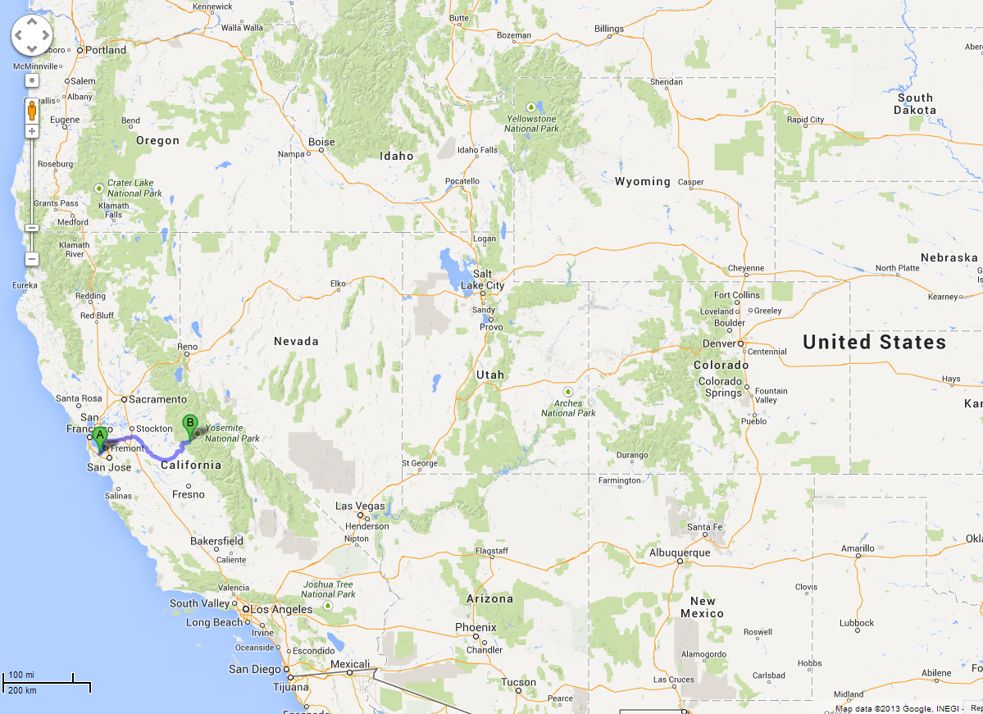
BFS is useful for finding the shortest path between two nodes.
Map Example:
What is the shortest way to go from Yoesmite (F) to Palo Alto (J)?

Slide 32
Breadth-First Search
A
B
C
D
A
B
C
D
TO START:
Color all nodes GREY
Queue is empty
Yoesmite
E
F
G
H
E
F
G
H
Palo Alto
I
J
K
I
J
K
L
L

Slide 33
Breadth-First Search
A
B
C
D
A
B
C
D
TO START (2):
Enqueue the desired start node
Note that anytime we enqueue a node, we mark it YELLOW
E
F
G
H
E
F
G
H
I
J
K
I
J
K
L
L
F

Slide 34
Breadth-First Search
A
B
C
D
A
B
C
D
LOOP PROCEDURE:
Dequeue a node
Mark current node GREEN
Set current node’s GREY neighbors’ parent pointers to current node, then enqueue them (remember: set them YELLOW)
F
E
F
G
H
E
F
G
H
I
J
K
I
J
K
L
L

Slide 35
Breadth-First Search
A
B
C
D
A
B
C
D
F
E
F
G
H
E
F
G
H
I
J
K
I
J
K
L
L

Slide 36
Breadth-First Search
A
B
C
D
A
B
C
D
F
E
F
G
H
E
F
G
H
I
J
K
I
J
K
L
L

Slide 37
Breadth-First Search
A
B
C
D
A
B
C
D
F
E
F
G
H
E
F
G
H
I
J
K
I
J
K
L
L
A
B
D
E
K

Slide 38
Breadth-First Search
A
A
B
C
D
A
B
C
D
E
F
G
H
E
F
G
H
I
J
K
I
J
K
L
L
B
D
E
K

Slide 39
Breadth-First Search
A
A
B
C
D
A
B
C
D
E
F
G
H
E
F
G
H
I
J
K
I
J
K
L
L
B
D
E
K

Slide 40
Breadth-First Search
A
A
B
C
D
A
B
C
D
E
F
G
H
E
F
G
H
I
J
K
I
J
K
L
L
B
D
E
K

Slide 41
Breadth-First Search
B
A
B
C
D
A
B
C
D
E
F
G
H
E
F
G
H
I
J
K
I
J
K
L
L
D
E
K

Slide 42
Breadth-First Search
B
A
B
C
D
A
B
C
D
E
F
G
H
E
F
G
H
I
J
K
I
J
K
L
L
D
E
K

Slide 43
Breadth-First Search
B
A
B
C
D
A
B
C
D
E
F
G
H
E
F
G
H
I
J
K
I
J
K
L
L
D
E
K
C
H

Slide 44
Breadth-First Search
D
A
B
C
D
A
B
C
D
E
F
G
H
E
F
G
H
I
J
K
I
J
K
L
L
E
K
C
H

Slide 45
Breadth-First Search
D
A
B
C
D
A
B
C
D
E
F
G
H
E
F
G
H
I
J
K
I
J
K
L
L
E
K
C
H

Slide 46
Breadth-First Search
D
A
B
C
D
A
B
C
D
E
F
G
H
E
F
G
H
I
J
K
I
J
K
L
L
E
K
C
H

Slide 47
Breadth-First Search
A
B
C
D
A
B
C
D
E
E
F
G
H
E
F
G
H
I
J
K
I
J
K
L
L
K
C
H

Slide 48
Breadth-First Search
A
B
C
D
A
B
C
D
E
E
F
G
H
E
F
G
H
I
J
K
I
J
K
L
L
K
C
H

Slide 49
Breadth-First Search
A
B
C
D
A
B
C
D
E
E
F
G
H
E
F
G
H
I
J
K
I
J
K
L
L
K
C
H
I

Slide 50
Breadth-First Search
A
B
C
D
A
B
C
D
E
F
G
H
E
F
G
H
K
I
J
K
I
J
K
L
L
C
H
I

Slide 51
Breadth-First Search
A
B
C
D
A
B
C
D
E
F
G
H
E
F
G
H
K
I
J
K
I
J
K
L
L
C
H
I

Slide 52
Breadth-First Search
You predict the next slide!
K’s neighbors F,G,H are yellow and in the queue and their parents are pointing to K
K’s neighbors G,H are yellow and in the queue and their parents are pointing to K
K’s neighbors G,H are yellow and in the queue
Other/none/more
A
B
C
D
A
B
C
D
E
F
G
H
E
F
G
H
K
I
J
K
I
J
K
L
L
C
H
I

Slide 53
Breadth-First Search
A
B
C
D
A
B
C
D
E
F
G
H
E
F
G
H
K
I
J
K
I
J
K
L
L
C
H
I
G

Slide 54
Breadth-First Search
A
B
C
D
A
B
C
D
E
F
G
H
E
F
G
H
K
I
J
K
I
J
K
L
L
C
H
I
G

Slide 55
Breadth-First Search
C
A
B
C
D
A
B
C
D
E
F
G
H
E
F
G
H
I
J
K
I
J
K
L
L
H
I
G

Slide 56
Breadth-First Search
C
A
B
C
D
A
B
C
D
E
F
G
H
E
F
G
H
I
J
K
I
J
K
L
L
H
I
G

Slide 57
Breadth-First Search
A
B
C
D
A
B
C
D
H
E
F
G
H
E
F
G
H
I
J
K
I
J
K
L
L
I
G

Slide 58
Breadth-First Search
A
B
C
D
A
B
C
D
H
E
F
G
H
E
F
G
H
I
J
K
I
J
K
L
L
I
G

Slide 59
Breadth-First Search
A
B
C
D
A
B
C
D
E
F
G
H
E
F
G
H
I
J
K
I
J
K
L
L
I
G

Slide 60
Breadth-First Search
A
B
C
D
A
B
C
D
E
F
G
H
E
F
G
H
I
I
J
K
I
J
K
L
L
G

Slide 61
Breadth-First Search
A
B
C
D
A
B
C
D
E
F
G
H
E
F
G
H
I
I
J
K
I
J
K
L
L
G

Slide 62
Breadth-First Search
A
B
C
D
A
B
C
D
E
F
G
H
E
F
G
H
I
I
J
K
I
J
K
L
L
G
L

Slide 63
Breadth-First Search
A
B
C
D
A
B
C
D
G
E
F
G
H
E
F
G
H
I
J
K
I
J
K
L
L
L

Slide 64
Breadth-First Search
A
B
C
D
A
B
C
D
G
E
F
G
H
E
F
G
H
I
J
K
I
J
K
L
L
L

Slide 65
Breadth-First Search
A
B
C
D
A
B
C
D
E
F
G
H
E
F
G
H
I
J
K
I
J
K
L
L
L

Slide 66
Breadth-First Search
A
B
C
D
A
B
C
D
E
F
G
H
E
F
G
H
I
J
K
I
J
K
L
L
L

Slide 67
Breadth-First Search
A
B
C
D
A
B
C
D
E
F
G
H
E
F
G
H
I
J
K
I
J
K
L
L
L
J

Slide 68
Breadth-First Search
A
B
C
D
A
B
C
D
E
F
G
H
E
F
G
H
J
I
J
K
I
J
K
L
L

Slide 69
Breadth-First Search
A
B
C
D
A
B
C
D
E
F
G
H
E
F
G
H
J
I
J
K
I
J
K
L
L

Slide 70
Breadth-First Search
Done!
Now we know that to go from Yoesmite (F) to Palo Alto (J), we should go:
F->E->I->L->J
(4 edges)
(note we follow the parent pointers backwards)
A
B
C
D
A
B
C
D
E
F
G
H
E
F
G
H
J
I
J
K
I
J
K
L
L

Slide 71
Breadth-First Search
A
B
C
D
A
B
C
D
THINGS TO NOTICE:
We used a queue
What’s left is a kind of subset of the edges, in the form of ‘parent’ pointers
If you follow the parent pointers from the desired end point, you will get back to the start point, and it will be the shortest way to do that
E
F
G
H
E
F
G
H
I
J
K
I
J
K
L
L

Slide 72
Quick question about efficiency…
Let’s say that you have an extended family with somebody in every city in the western U.S.

Slide 73
Quick question about efficiency…
You’re all going to fly to Yosemite for a family reunion, and then everyone will rent a car and drive home, and you’ve been tasked with making custom Yosemite-to-home driving directions for everyone.

Slide 74
Quick question about efficiency…
You calculated the shortest path for yourself to return home from the reunion (Yosemite to Palo Alto) and let’s just say that it took time X = O((|E| + |V|)log|V|)
      With respect to the number of cities |V|, and the number of edges or road segments |E|
How long will it take you, in total, to calculate the shortest path for you and all of your relatives?
O(|V|*X)
O(|E|*|V|* X)
X
Other/none/more

Slide 75
Breadth-First Search
A
B
C
D
A
B
C
D
THINGS TO NOTICE:
(4) We now have the answer to the question “What is the shortest path to you from F?” for every single node in the graph!!
E
F
G
H
E
F
G
H
I
J
K
I
J
K
L
L

