Slide 1
Programming Abstractions
CS106X
Cynthia Lee

Slide 2
Graphs Topics
Graphs!
Basics
  What are they? How do we represent them?
Theorems
  What are some things we can prove about graphs?
Breadth-first search on a graph
  Spoiler: just a very, very small change to tree version
Dijkstra’s shortest paths algorithm
  Spoiler: just a very, very small change to BFS
A* shortest paths algorithm
  Spoiler: just a very, very small change to Dijkstra’s
Minimum Spanning Tree
  Kruskal’s algorithm

Slide 3
Breadth-First Search
Graph algorithms

Slide 4
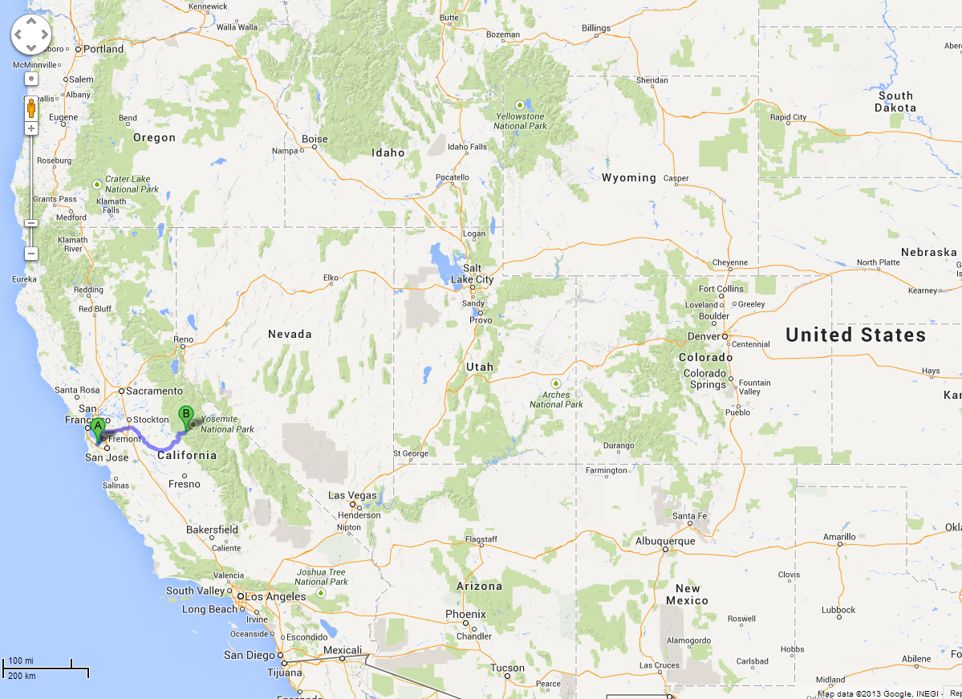
BFS is useful for finding the shortest path between two nodes.
Map Example:
What is the shortest way to go from Yoesmite (F) to Palo Alto (J)?

Slide 5
Breadth-First Search
A
B
C
D
A
B
C
D
TO START:
Color all nodes GREY
Queue is empty
Yoesmite
E
F
G
H
E
F
G
H
Palo Alto
I
J
K
I
J
K
L
L

Slide 6
Breadth-First Search
A
B
C
D
A
B
C
D
TO START (2):
Enqueue the desired start node
Note that anytime we enqueue a node, we mark it YELLOW
E
F
G
H
E
F
G
H
I
J
K
I
J
K
L
L
F

Slide 7
Breadth-First Search
A
B
C
D
A
B
C
D
LOOP PROCEDURE:
Dequeue a node
Mark current node GREEN
Set current node’s GREY neighbors’ parent pointers to current node, then enqueue them (remember: set them YELLOW)
F
E
F
G
H
E
F
G
H
I
J
K
I
J
K
L
L

Slide 8
Breadth-First Search
You predict the next slide!
K’s neighbors F,G,H are yellow and in the queue and their parents are pointing to K
K’s neighbors G,H are yellow and in the queue and their parents are pointing to K
K’s neighbors G,H are yellow and in the queue
Other/none/more
A
B
C
D
A
B
C
D
E
F
G
H
E
F
G
H
K
I
J
K
I
J
K
L
L
C
H
I

Slide 9
Breadth-First Search
A
B
C
D
A
B
C
D
E
F
G
H
E
F
G
H
K
I
J
K
I
J
K
L
L
C
H
I
G

Slide 10
Breadth-First Search
A
B
C
D
A
B
C
D
E
F
G
H
E
F
G
H
K
I
J
K
I
J
K
L
L
C
H
I
G

Slide 11
Breadth-First Search
C
A
B
C
D
A
B
C
D
E
F
G
H
E
F
G
H
I
J
K
I
J
K
L
L
H
I
G

Slide 12
Breadth-First Search
C
A
B
C
D
A
B
C
D
E
F
G
H
E
F
G
H
I
J
K
I
J
K
L
L
H
I
G

Slide 13
Breadth-First Search
A
B
C
D
A
B
C
D
H
E
F
G
H
E
F
G
H
I
J
K
I
J
K
L
L
I
G

Slide 14
Breadth-First Search
A
B
C
D
A
B
C
D
H
E
F
G
H
E
F
G
H
I
J
K
I
J
K
L
L
I
G

Slide 15
Breadth-First Search
A
B
C
D
A
B
C
D
E
F
G
H
E
F
G
H
I
J
K
I
J
K
L
L
I
G

Slide 16
Breadth-First Search
A
B
C
D
A
B
C
D
E
F
G
H
E
F
G
H
I
I
J
K
I
J
K
L
L
G

Slide 17
Breadth-First Search
A
B
C
D
A
B
C
D
E
F
G
H
E
F
G
H
I
I
J
K
I
J
K
L
L
G

Slide 18
Breadth-First Search
A
B
C
D
A
B
C
D
E
F
G
H
E
F
G
H
I
I
J
K
I
J
K
L
L
G
L

Slide 19
Breadth-First Search
A
B
C
D
A
B
C
D
G
E
F
G
H
E
F
G
H
I
J
K
I
J
K
L
L
L

Slide 20
Breadth-First Search
A
B
C
D
A
B
C
D
G
E
F
G
H
E
F
G
H
I
J
K
I
J
K
L
L
L

Slide 21
Breadth-First Search
A
B
C
D
A
B
C
D
E
F
G
H
E
F
G
H
I
J
K
I
J
K
L
L
L

Slide 22
Breadth-First Search
A
B
C
D
A
B
C
D
E
F
G
H
E
F
G
H
I
J
K
I
J
K
L
L
L

Slide 23
Breadth-First Search
A
B
C
D
A
B
C
D
E
F
G
H
E
F
G
H
I
J
K
I
J
K
L
L
L
J

Slide 24
Breadth-First Search
A
B
C
D
A
B
C
D
E
F
G
H
E
F
G
H
J
I
J
K
I
J
K
L
L

Slide 25
Breadth-First Search
A
B
C
D
A
B
C
D
E
F
G
H
E
F
G
H
J
I
J
K
I
J
K
L
L

Slide 26
Breadth-First Search
Done!
Now we know that to go from Yoesmite (F) to Palo Alto (J), we should go:
F->E->I->L->J
(4 edges)
(note we follow the parent pointers backwards)
A
B
C
D
A
B
C
D
E
F
G
H
E
F
G
H
J
I
J
K
I
J
K
L
L

Slide 27
Breadth-First Search
A
B
C
D
A
B
C
D
THINGS TO NOTICE:
We used a queue
What’s left is a tree-like structure of ‘parent pointers’
If you follow the parent pointers from the desired end point, you will get back to the start point, and it will be the shortest way to do that
E
F
G
H
E
F
G
H
I
J
K
I
J
K
L
L

Slide 28
Quick question about efficiency…
Let’s say that you have an extended family with somebody in every city in the western U.S.

Slide 29
Quick question about efficiency…
You’re all going to fly to Yosemite for a family reunion, and then everyone will rent a car and drive home, and you’ve been tasked with making custom Yosemite-to-home driving directions for everyone.

Slide 30
Quick question about efficiency…
You calculated the shortest path for yourself to return home from the reunion (Yosemite to Palo Alto) and let’s just say that it took time X = O((|E| + |V|)log|V|)
      With respect to the number of cities |V|, and the number of edges or road segments |E|
How long will it take you, in total, to calculate the shortest path for you and all of your relatives?
O(|V|*X)
O(|E|*|V|* X)
X
Other/none/more

Slide 31
Breadth-First Search
A
B
C
D
A
B
C
D
THINGS TO NOTICE:
(4) We now have the answer to the question “What is the shortest path to you from F?” for every single node in the graph!!
E
F
G
H
E
F
G
H
I
J
K
I
J
K
L
L

Slide 32
Dijkstra’s Shortest Paths
(Like Breadth-first Search, but takes into account weight/distance between nodes)

Slide 33
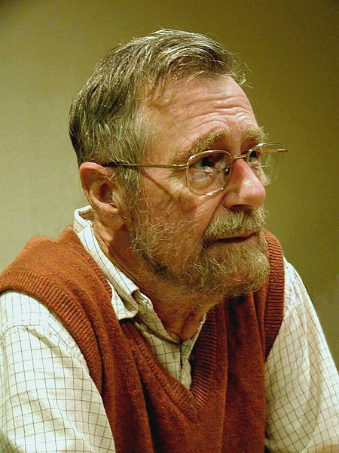
Edsger Dijkstra
1930-2002
THE multiprogramming system (operating system)
  Layers of abstraction!!
Complier for a language that can do recursion
Dining Philosopher’s Problem (resource contention and deadlock)
Dijkstra’s algorithm
“Goto considered harmful” (title given to his letter)
This file is licensed under the Creative Commons Attribution-Share Alike 3.0 Unported license. http://en.wikipedia.org/wiki/File:Edsger_Wybe_Dijkstra.jpg

Slide 34
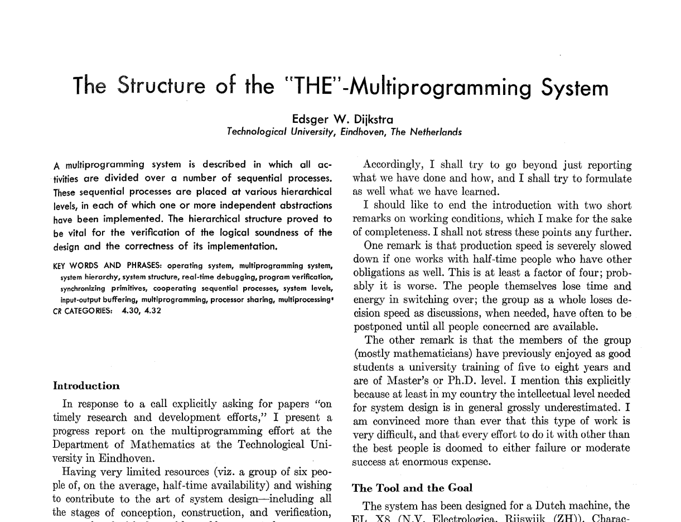

Slide 35
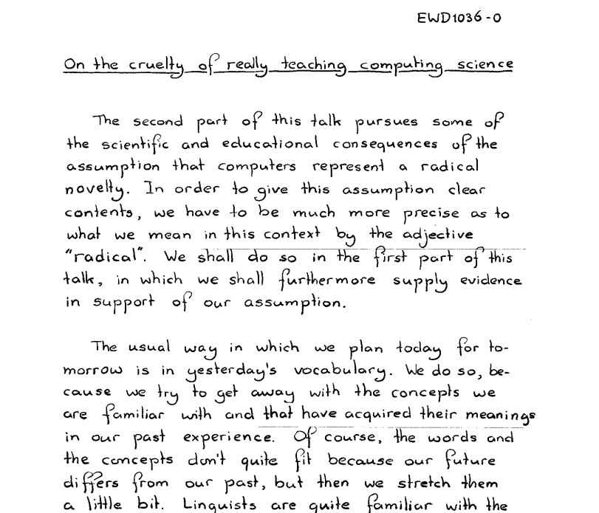

Slide 36
The Shortest Path Problem
Suppose that you have a graph representing different locations
Each edge has an associated cost (or weight, length, etc)
We'll assume costs are nonnegative*
Goal: Find the least-cost (or lowest-weight, lowest-length, etc) path from some node u to a node v
* else use the Bellman–Ford algorithm

Slide 37
A
A
B
B
C
6
3
C
3
1
1
D
D
E
E
F
1
7
F
9
4
7
G
G
H
H
I
2
5
I

Slide 38
Mark all nodes as gray.
Mark the initial node s as yellow and at candidate distance 0.
Enqueue s into the priority queue with priority 0.
While not all nodes have been visited:
  Dequeue the lowest-cost node u from the priority queue.
  Color u green. The candidate distance d that is currently stored for node u is the length of the shortest path from s to u.
  If u is the destination node t, you have found the shortest path from s to t and are done.
  For each node v connected to u by an edge of length L:
    If v is gray:
      Color v yellow.
      Mark v's distance as d + L.
      Set v's parent to be u.
      Enqueue v into the priority queue with priority d + L.
    If v is yellow and the candidate distance to v is greater than d + L:
      Update v's candidate distance to be d + L.
      Update v's parent to be u.
      Update v's priority in the priority queue to d + L.
Dijkstra's
Algorithm

Slide 39
A
A
0?
B
B
C
6
3
C
3
1
2
1
D
D
E
E
F
1
7
F
9
4
4
7
G
G
H
H
I
2
5
I

Slide 40
A
A
0?
B
B
C
6
3
C
A
0?
3
1
2
1
D
D
E
E
F
1
7
F
9
4
4
7
G
G
H
H
I
2
5
I

Slide 41
A
A
0?
B
B
C
6
3
C
A
0?
3
1
2
1
D
D
E
E
F
1
7
F
9
4
4
7
G
G
H
H
I
2
5
I

Slide 42
A
A
0?
B
B
C
6
3
C
3
1
2
1
D
D
E
E
F
1
7
F
9
4
4
7
G
G
H
H
I
2
5
I

Slide 43
A
A
0
B
B
C
6
3
C
3
1
2
1
D
D
E
E
F
1
7
F
9
4
4
7
G
G
H
H
I
2
5
I

Slide 44
A
A
0
B
B
6?
C
6
3
C
3
1
2
1
D
D
3?
E
E
F
1
7
F
9
4
4
7
G
G
H
H
I
2
5
I

Slide 45
A
A
0
B
B
6?
C
6
3
C
D
3?
3
1
2
1
B
6?
D
D
3?
E
E
F
1
7
F
9
4
4
7
G
G
H
H
I
2
5
I

Slide 46
A
A
0
B
B
6?
C
6
3
C
D
3?
3
1
2
1
B
6?
D
D
3?
E
E
F
1
7
F
9
4
4
7
G
G
H
H
I
2
5
I

Slide 47
A
A
0
B
B
6?
C
6
3
C
D
3?
3
1
2
1
B
6?
D
D
3?
E
E
F
1
7
F
9
4
4
7
G
G
H
H
I
2
5
I

Slide 48
A
A
0
B
B
6?
C
6
3
C
B
6?
3
1
2
1
D
D
3?
E
E
F
1
7
F
9
4
4
7
G
G
H
H
I
2
5
I

Slide 49
A
A
0
B
B
6?
C
6
3
C
B
6?
3
1
2
1
D
D
3
E
E
F
1
7
F
9
4
4
7
G
G
H
H
I
2
5
I

Slide 50
A
A
0
B
B
6?
C
6
3
C
B
6?
3
1
2
1
D
D
3
E
E
4?
F
1
7
F
9
4
4
7
G
G
12?
H
H
I
2
5
I

Slide 51
A
A
0
B
B
6?
C
6
3
C
3
1
2
1
B
6?
D
D
3
E
E
4?
F
1
7
F
9
4
4
7
G
G
12?
H
H
I
2
5
I

Slide 52
A
A
0
B
B
6?
C
6
3
C
E
4?
3
1
2
1
B
6?
D
D
3
E
E
4?
F
1
7
F
G
12?
9
4
4
7
G
G
12?
H
H
I
2
5
I

Slide 53
A
A
0
B
B
6?
C
6
3
C
E
4?
3
1
2
1
B
6?
D
D
3
E
E
4?
F
1
7
F
G
12?
9
4
4
7
G
G
12?
H
H
I
2
5
I

Slide 54
A
A
0
B
B
6?
C
6
3
C
E
4?
3
1
2
1
B
6?
D
D
3
E
E
4?
F
1
7
F
G
12?
9
4
4
7
G
G
12?
H
H
I
2
5
I

Slide 55
A
A
0
B
B
6?
C
6
3
C
B
6?
3
1
2
1
G
12?
D
D
3
E
E
4?
F
1
7
F
9
4
4
7
G
G
12?
H
H
I
2
5
I

Slide 56
A
A
0
B
B
6?
C
6
3
C
B
6?
3
1
2
1
G
12?
D
D
3
E
E
4
F
1
7
F
9
4
4
7
G
G
12?
H
H
I
2
5
I

Slide 57
A
A
0
B
B
6?
C
6
3
C
B
6?
3
1
2
1
G
12?
D
D
3
E
E
4
F
1
7
F
11?
9
4
4
7
G
G
12?
H
H
8?
I
2
5
I

Slide 58
A
A
0
B
B
6?
C
6
3
C
B
6?
3
1
2
1
D
D
3
E
E
4
F
1
7
F
11?
G
12?
9
4
4
7
G
G
12?
H
H
8?
I
2
5
I

Slide 59
A
A
0
B
B
6?
C
6
3
C
B
6?
3
1
2
1
H
8?
D
D
3
E
E
4
F
1
7
F
11?
F
11?
G
12?
9
4
4
7
G
G
12?
H
H
8?
I
2
5
I

Slide 60
A
A
0
B
B
6?
C
6
3
C
B
6?
3
1
2
1
H
8?
D
D
3
E
E
4
F
1
7
F
11?
F
11?
G
12?
9
4
4
7
G
G
12?
H
H
8?
I
2
5
I

Slide 61
A
A
0
B
B
5?
C
6
3
C
B
6?
3
1
2
1
H
8?
D
D
3
E
E
4
F
1
7
F
11?
F
11?
G
12?
9
4
4
7
G
G
12?
H
H
8?
I
2
5
I

Slide 62
A
A
0
B
B
5?
C
6
3
C
B
5?
3
1
2
1
H
8?
D
D
3
E
E
4
F
1
7
F
11?
F
11?
G
12?
9
4
4
7
G
G
12?
H
H
8?
I
2
5
I

Slide 63
A
A
0
B
B
5?
C
6
3
C
B
5?
3
1
2
1
H
8?
D
D
3
E
E
4
F
1
7
F
11?
F
11?
G
12?
9
4
4
7
G
G
12?
H
H
8?
I
2
5
I

Slide 64
A
A
0
B
B
5?
C
6
3
C
B
5?
3
1
2
1
H
8?
D
D
3
E
E
4
F
1
7
F
11?
F
11?
G
12?
9
4
4
7
G
G
12?
H
H
8?
I
2
5
I

Slide 65
A
A
0
B
B
5?
C
6
3
C
B
5?
3
1
2
1
H
8?
D
D
3
E
E
4
F
1
7
F
11?
F
11?
G
12?
9
4
4
7
G
G
12?
H
H
8?
I
2
5
I

Slide 66
A
A
0
B
B
5?
C
6
3
C
H
8?
3
1
2
1
F
11?
D
D
3
E
E
4
F
1
7
F
11?
G
12?
9
4
4
7
G
G
12?
H
H
8?
I
2
5
I

Slide 67
A
A
0
B
B
5
C
6
3
C
H
8?
3
1
2
1
F
11?
D
D
3
E
E
4
F
1
7
F
11?
G
12?
9
4
4
7
G
G
12?
H
H
8?
I
2
5
I

Slide 68
A
A
0
B
B
5
C
6
3
C
8?
H
8?
3
1
2
1
F
11?
D
D
3
E
E
4
F
1
7
F
11?
G
12?
9
4
4
7
G
G
12?
H
H
8?
I
2
5
I

Slide 69
A
A
0
B
B
5
C
6
3
C
8?
H
8?
3
1
2
1
D
D
3
E
E
4
F
1
7
F
11?
F
11?
G
12?
9
4
4
7
G
G
12?
H
H
8?
I
2
5
I

Slide 70
A
A
0
B
B
5
C
6
3
C
8?
H
8?
3
1
2
1
C
8?
D
D
3
E
E
4
F
1
7
F
11?
F
11?
G
12?
9
4
4
7
G
G
12?
H
H
8?
I
2
5
I

Slide 71
A
A
0
B
B
5
C
6
3
C
8?
H
8?
3
1
2
1
C
8?
D
D
3
E
E
4
F
1
7
F
11?
F
11?
G
12?
9
4
4
7
G
G
12?
H
H
8?
I
2
5
I

Slide 72
A
A
0
B
B
5
C
6
3
C
8?
H
8?
3
1
2
1
C
8?
D
D
3
E
E
4
F
1
7
F
11?
F
11?
G
12?
9
4
4
7
G
G
12?
H
H
8?
I
2
5
I

Slide 73
You predict the next queue state:
H,C,F,G,I
C,F,G,I
C,G,F,I
Other/none/ more
A
A
0
B
B
5
C
6
3
C
8?
H
8?
3
1
2
1
C
8?
D
D
3
E
E
4
F
1
7
F
11?
F
11?
G
12?
9
4
4
7
G
G
12?
H
H
8?
I
2
5
I

Slide 74
A
A
0
B
B
5
C
6
3
C
8?
C
8?
3
1
2
1
F
11?
D
D
3
E
E
4
F
1
7
F
11?
G
12?
9
4
4
7
G
G
12?
H
H
8?
I
2
5
I

Slide 75
A
A
0
B
B
5
C
6
3
C
8?
C
8?
3
1
2
1
F
11?
D
D
3
E
E
4
F
1
7
F
11?
G
12?
9
4
4
7
G
G
12?
H
H
8
I
2
5
I

Slide 76
A
A
0
B
B
5
C
6
3
C
8?
C
8?
3
1
2
1
F
11?
D
D
3
E
E
4
F
1
7
F
11?
G
12?
9
4
4
7
G
G
12?
H
H
8?
H
8
I
2
5
I
13?

Slide 77
A
A
0
B
B
5
C
6
3
C
8?
C
8?
3
1
2
1
F
11?
D
D
3
E
E
4
F
1
7
F
11?
G
12?
I
13?
9
4
4
7
G
G
12?
H
H
8?
H
8
I
2
5
I
13?

Slide 78
A
A
0
B
B
5
C
6
3
C
8?
C
8?
3
1
2
1
F
11?
D
D
3
E
E
4
F
1
7
F
11?
G
12?
I
13?
9
4
4
7
G
G
12?
H
H
8?
H
8
I
2
5
I
13?

Slide 79
A
A
0
B
B
5
C
6
3
C
8?
C
8?
3
1
2
1
F
11?
D
D
3
E
E
4
F
1
7
F
11?
G
12?
I
13?
9
4
4
7
G
G
10?
H
H
8?
H
8
I
2
5
I
13?

Slide 80
A
A
0
B
B
5
C
6
3
C
8?
C
8?
3
1
2
1
F
11?
D
D
3
E
E
4
F
1
7
F
11?
G
10?
I
13?
9
4
4
7
G
G
10?
H
H
8?
H
8
I
2
5
I
13?

Slide 81
A
A
0
B
B
5
C
6
3
C
8?
C
8?
3
1
2
1
F
11?
D
D
3
E
E
4
F
1
7
F
11?
G
10?
I
13?
9
4
4
7
G
G
10?
H
H
8?
H
8
I
2
5
I
13?

Slide 82
A
A
0
B
B
5
C
6
3
C
8?
C
8?
3
1
2
1
G
10?
D
D
3
E
E
4
F
1
7
F
11?
F
11?
I
13?
I
13?
9
4
4
7
G
G
10?
H
H
8?
H
8
I
2
5
I
13?

Slide 83
A
A
0
B
B
5
C
6
3
C
8?
C
8?
3
1
2
1
G
10?
D
D
3
E
E
4
F
1
7
F
11?
F
11?
I
13?
9
4
4
7
G
G
10?
H
H
8?
H
8
I
2
5
I
13?

Slide 84
A
A
0
B
B
5
C
6
3
C
8?
C
8?
3
1
2
1
G
10?
D
D
3
E
E
4
F
1
7
F
11?
F
11?
I
13?
9
4
4
7
G
G
10?
H
H
8?
H
8
I
2
5
I
13?

Slide 85
A
A
0
B
B
5
C
6
3
C
8?
C
8?
3
1
2
1
G
10?
D
D
3
E
E
4
F
1
7
F
11?
F
11?
I
13?
9
4
4
7
G
G
10?
H
H
8
I
2
5
I
13?

Slide 86
A
A
0
B
B
5
C
6
3
C
8?
C
8?
3
1
1
G
10?
D
D
3
E
E
4
F
1
7
F
11?
F
11?
I
13?
9
4
4
7
G
G
10?
H
H
8
I
2
5
I
13?

Slide 87
A
A
0
B
B
5
C
6
3
C
8?
G
10?
3
1
1
F
11?
D
D
3
E
E
4
F
1
7
F
11?
I
13?
9
4
4
7
G
G
10?
H
H
8
I
2
5
I
13?

Slide 88
A
A
0
B
B
5
C
6
3
C
8
G
10?
3
1
1
F
11?
D
D
3
E
E
4
F
1
7
F
11?
I
13?
9
4
4
7
G
G
10?
H
H
8
I
2
5
I
13?

Slide 89
A
A
0
B
B
5
C
6
3
C
8
G
10?
3
1
1
F
11?
D
D
3
E
E
4
F
1
7
F
11?
I
13?
9
4
4
7
G
G
10?
H
H
8
I
2
5
I
13?

Slide 90
A
A
0
B
B
5
C
6
3
C
8
G
10?
3
1
1
F
9?
D
D
3
E
E
4
F
1
7
F
9?
I
13?
9
4
4
7
G
G
10?
H
H
8
I
2
5
I
13?

Slide 91
A
A
0
B
B
5
C
6
3
C
8
G
10?
3
1
1
F
9?
D
D
3
E
E
4
F
1
7
F
9?
I
13?
9
4
4
7
G
G
10?
H
H
8
I
2
5
I
13?

Slide 92
A
A
0
B
B
5
C
6
3
C
8
F
9?
3
1
1
G
10?
D
D
3
E
E
4
F
1
7
F
9?
I
13?
9
4
4
7
G
G
10?
H
H
8
I
2
5
I
13?

Slide 93
A
A
0
B
B
5
C
6
3
C
8
F
9?
3
1
1
G
10?
D
D
3
E
E
4
F
1
7
F
9?
I
13?
9
4
4
7
G
G
10?
H
H
8
I
2
5
I
13?

Slide 94
A
A
0
B
B
5
C
6
3
C
8
F
9?
3
1
1
G
10?
D
D
3
E
E
4
F
1
7
F
9?
I
13?
9
4
4
7
G
G
10?
H
H
8
I
2
5
I
13?

Slide 95
A
A
0
B
B
5
C
6
3
C
8
F
9?
3
1
2
1
G
10?
D
D
3
E
E
4
F
1
7
F
9?
I
13?
9
4
4
7
G
G
10?
H
H
8
I
2
5
I
13?

Slide 96
A
A
0
B
B
5
C
6
3
C
8
F
9?
3
1
2
1
G
10?
D
D
3
E
E
4
F
1
7
F
9?
I
13?
9
4
4
7
G
G
10?
H
H
8
I
2
5
I
13?

Slide 97
A
A
0
B
B
5
C
6
3
C
8
G
10?
3
1
2
1
I
13?
D
D
3
E
E
4
F
1
7
F
9?
9
4
4
7
G
G
10?
H
H
8
I
2
5
I
13?

Slide 98
A
A
0
B
B
5
C
6
3
C
8
G
10?
3
1
2
1
I
13?
D
D
3
E
E
4
F
1
7
F
9
9
4
4
7
G
G
10?
H
H
8
I
2
5
I
13?

Slide 99
A
A
0
B
B
5
C
6
3
C
8
G
10?
3
1
2
1
I
13?
D
D
3
E
E
4
F
1
7
F
9
9
4
4
7
G
G
10?
H
H
8
I
2
5
I
13?

Slide 100
A
A
0
B
B
5
C
6
3
C
8
G
10?
3
1
2
1
I
13?
D
D
3
E
E
4
F
1
7
F
9
9
4
4
7
G
G
10?
H
H
8
I
2
5
I
13?

Slide 101
A
A
0
B
B
5
C
6
3
C
8
G
10?
3
1
2
1
I
13?
D
D
3
E
E
4
F
1
7
F
9
9
4
4
7
G
G
10?
H
H
8
I
2
5
I
13?

Slide 102
A
A
0
B
B
5
C
6
3
C
8
G
10?
3
1
2
1
I
13?
D
D
3
E
E
4
F
1
7
F
9
9
4
4
7
G
G
10?
H
H
8
I
2
5
I
13?

Slide 103
A
A
0
B
B
5
C
6
3
C
8
G
10?
3
1
2
1
I
13?
D
D
3
E
E
4
F
1
7
F
9
9
4
4
7
G
G
10?
H
H
8
I
2
5
I
13?

Slide 104
A
A
0
B
B
5
C
6
3
C
8
I
13?
3
1
2
1
D
D
3
E
E
4
F
1
7
F
9
9
4
4
7
G
G
10?
H
H
8
I
2
5
I
13?

Slide 105
A
A
0
B
B
5
C
6
3
C
8
I
13?
3
1
2
1
D
D
3
E
E
4
F
1
7
F
9
9
4
4
7
G
G
10
H
H
8
I
2
5
I
13?

Slide 106
A
A
0
B
B
5
C
6
3
C
8
I
13?
3
1
2
1
D
D
3
E
E
4
F
1
7
F
9
9
4
4
7
G
G
10
H
H
8
I
2
5
I
13?

Slide 107
A
A
0
B
B
5
C
6
3
C
8
I
13?
3
1
2
1
D
D
3
E
E
4
F
1
7
F
9
9
4
4
7
G
G
10
H
H
8
I
2
5
I
13?

Slide 108
A
A
0
B
B
5
C
6
3
C
8
3
1
2
1
D
D
3
E
E
4
F
1
7
F
9
9
4
4
7
G
G
10
H
H
8
I
2
5
I
13?

Slide 109
A
A
0
B
B
5
C
6
3
C
8
3
1
2
1
D
D
3
E
E
4
F
1
7
F
9
9
4
4
7
G
G
10
H
H
8
I
2
5
I
13

Slide 110
A
A
0
B
B
5
C
6
3
C
8
3
1
2
1
D
D
3
E
E
4
F
1
7
F
9
9
4
4
7
G
G
10
H
H
8
I
2
5
I
13

Slide 111
Dijkstra's Algorithm
Split nodes apart into three groups:
  Green nodes, where we already have the shortest path;
  Gray nodes, which we have never seen; and
  Yellow nodes that we still need to process.
Dijkstra's algorithm works as follows:
  Mark all nodes gray except the start node, which is yellow and has cost 0.
  Until no yellow nodes remain:
    Choose the yellow node with the lowest total cost.
    Mark that node green.
    Mark all its gray neighbors yellow and with the appropriate cost.
    Update the costs of all adjacent yellow nodes by considering the path through the current node.

Slide 112
An Important Note
The version of Dijkstra's algorithm I have just described is not the same as the version described in the course reader.
This version is more complex than the book's version, but is much faster.
THIS IS THE VERSION YOU MUST USE ON YOUR TRAILBLAZER ASSIGNMENT!

Slide 113
How Dijkstra's Works
Dijkstra's algorithm works by incrementally computing the shortest path to intermediary nodes in the graph in case they prove to be useful.
Most of these nodes are completely in the wrong direction.
No “big-picture” conception of how to get to the destination – the algorithm explores outward in all directions.
Could we give the algorithm a hint?

