Slide 1
Programming Abstractions
CS106X
Cynthia Lee

Slide 2
Graphs Topics
Graphs!
Basics
  What are they? How do we represent them?
Theorems
  What are some things we can prove about graphs?
Breadth-first search on a graph
  Spoiler: just a very, very small change to tree version
Dijkstra’s shortest paths algorithm
  Spoiler: just a very, very small change to BFS
A* shortest paths algorithm
  Spoiler: just a very, very small change to Dijkstra’s
Minimum Spanning Tree
  Kruskal’s algorithm

Slide 3
A* Solving Super Mario (video)
https://youtu.be/DlkMs4ZHHr8

Slide 4
Minimum Spanning Tree

Slide 5
B
D
F
1
7
3
3
Edges:
(A,B)=1
(A,C)=3
(B,C)=6
(B,D)=3
(C,E)=3
(D,E)=3
(D,F)=7
A
C
E
3
3
How many distinct minimum spanning trees are in this graph?
0-1
2-3
4-5
6-7
>7

Slide 6
Prim’s Algorithm

Slide 7
Prim’s algorithm
Arbitrarily choose start vertex
Add start vertex to MST
While vertices in MST < total vertices:
  Examine all edges that leave the current MST
  Choose the smallest one
  Add the end vertex of that edge to the MST

Slide 8
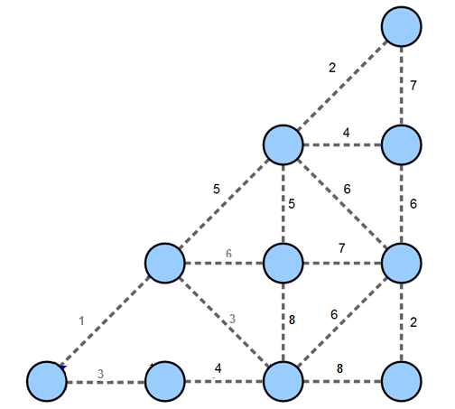
Prim’s algorithm

Slide 9
Kruskal’s Algorithm

Slide 10
Kruskal’s algorithm
Remove all edges from graph
Place all edges in a PQ based on length/weight
While !PQ.isEmpty():
  Dequeue edge
  If the edge connects previous disconnected nodes or groups of nodes, keep the edge
  Otherwise discard the edge

Slide 11
Kruskal’s algorithm

Slide 12
Kruskal’s algorithm
Remove all edges from graph
Place all edges in a PQ based on length/weight
While !PQ.isEmpty():
  Dequeue edge
  If the edge connects previous disconnected nodes or groups of nodes, keep the edge
  Otherwise discard the edge
Efficiency of this step is key

Slide 13
Cluster management questions
The assignment handout asks you to consider questions such as:
  How will you keep track of which nodes are in each cluster?
  How will you determine which cluster a node belongs to?
  How will you merge together two clusters?

Slide 14
Cluster management strategies
[watch lecture for whiteboard hints]

Slide 15
The Good Will Hunting Problem

Slide 16
Video Clip
https://www.youtube.com/watch?v=N7b0cLn-wHU

Slide 17
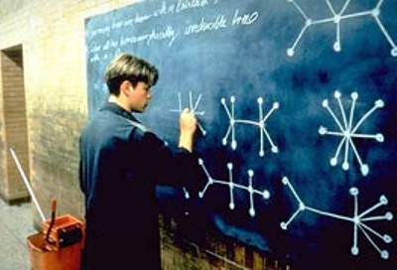
“Draw all the homeomorphically irreducible trees with n=10.”

Slide 18
“Draw all the homeomorphically irreducible trees with n=10.”
In this case “trees” simply means graphs with no cycles
“with n = 10” (i.e., has 10 nodes)
“homeomorphically irreducible”
  No nodes of degree 2 allowed in your solutions
    For this problem, nodes of degree 2 are useless in terms of tree structure—they just act as a blip on an edge—and are therefore banned
  Have to be actually different
    Ignore superficial changes in rotation or angles of drawing

