Slide 1
Programming Abstractions
CS106X
Cynthia Lee

Slide 2

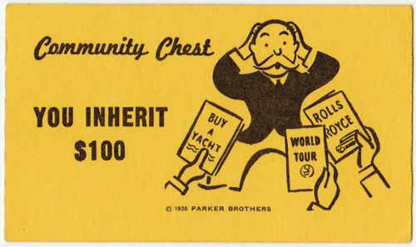
Inheritance Topics
Inheritance
  The basics
    Example: Stanford GObject class
  Polymorphism
    Example: Expression trees (final project)
This photograph was taken by Glenn Francis (User:Toglenn) and released under the license(s) stated below. You are free to use it as long as you credit me and follow the terms of the license. Attribution : © Glenn Francis, www.PacificProDigital.com (Email: glennfrancispacificprodigital.com)

Slide 3
Inheritance
What? Why? How?

Slide 4
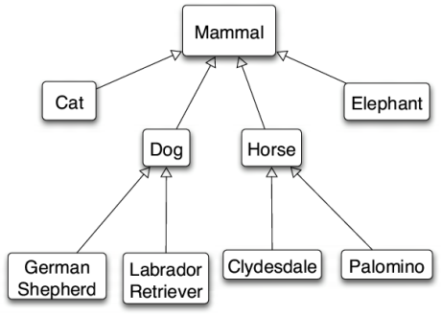
Inheritance: what?
is-a relationship: A hierarchical connection where one category can be treated as a specialized version of another.
  every rectangle is a shape
  every lion is an animal
  every lawyer is an employee
type hierarchy: A set of data types
connected by is-a relationships
that can share common code.
      Re-use!

Slide 5
Inheritance: why?
Remember the #1 rule of computer scientists:
    Computer scientists are super lazy
    …in a good way!
  We want to reuse code and work as much as possible
  You’ve already seen this going back to the very start of your CS education:
    Loops and Functions (instead of copy&paste to repeat code)
    Arrays (instead of copy&paste to make 100 named variables)
    Data structures (same idea as arrays but more expressive)
  Inheritance is another way of organizing smart reuse of code

Slide 6
Inheritance: how?
inheritance: A way to form new classes based on existing classes, taking on their attributes/behavior.
  a way to group related classes
  a way to share code between two or more classes
One class can extend another, absorbing its data/behavior.

Slide 7
Inheritance vocab
  superclass (base class): Parent class that is being extended.
  subclass (derived class): Child class that inherits from the superclass.
    Subclass gets a copy of every field and method from superclass.
    Subclass can add its own behavior, and/or change inherited behavior.

Slide 8

Inheritance Example
Stanford Library GObject family of classes

Slide 9
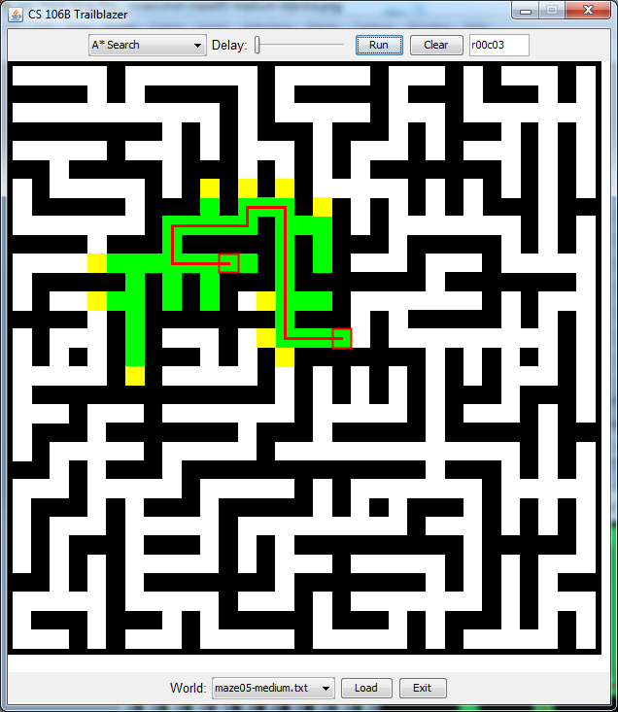
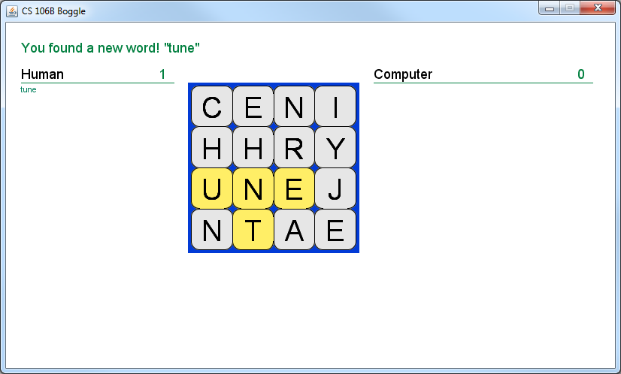
Behind the scenes…
We’ve always told you not to worry about the graphics parts of your assignments.
“Just call this BoggleGUI function…”
Now you can go ahead and take a look!

Slide 10

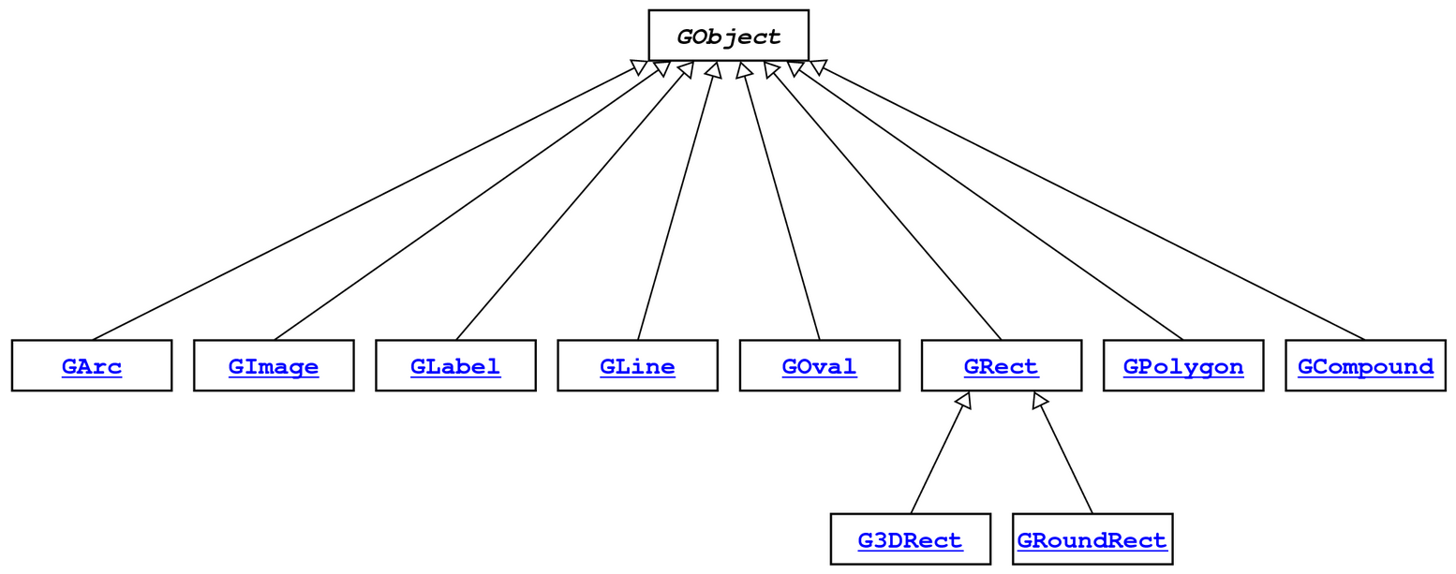
GObject hierarchy
The Stanford C++ library contains a hierarchy of graphical objects based on a common base class named GObject.
  GArc
  GImage
  GLabel
  GLine
  GOval
  GPolygon
  GRect
  G3DRect
  GRoundRect
hi

Slide 11
GObject hierarchy
Q: Rectangle is-a Polygon, right?
Why doesn’t it inherit from Polygon?
Think about it as we go through some details, and we’ll revisit the question later.
The Stanford C++ library contains a hierarchy of graphical objects based on a common base class named GObject.
  GArc
  GImage
  GLabel
  GLine
  GOval
  GPolygon
  GRect
  G3DRect
  GRoundRect
hi

Slide 12
Your turn: GObject design
How many of the following would you put in the base class (GObject), as opposed to a derived class?
    contains(x, y) – returns true if (x,y) lands on the item
    setFont(f) – sets the font for writing
    setColor(c)
    getFillColor()
    getWidth()
  0-1 (none or one of them)
  2
  3
  4-5 of them

Slide 13
GObject members
GObject defines the state and behavior common to all shapes:
  contains(x, y)
  get/setColor()
  getHeight(), getWidth()
  get/setLocation(), get/setX(), get/setY()
  move(dx, dy)
  setVisible(visible)
The subclasses add state and behavior unique to them:
  Glabel GLine GPolygon GOval
    get/setFont get/setStartPoint addEdge getSize
    get/setLabel get/setEndPoint addVertex get/setFillColor
    get/setFillColor
    ... ... ... ...
double x;
double y;
double lineWidth;
std::string color;
bool visible;

Slide 14
GObject members
GObject defines the state and behavior common to all shapes:
  contains(x, y)
  get/setColor()
  getHeight(), getWidth()
  get/setLocation(), get/setX(), get/setY()
  move(dx, dy)
  setVisible(visible)
The subclasses add state and behavior unique to them:
  Glabel GLine GPolygon GOval
    get/setFont get/setStartPoint addEdge getSize
    get/setLabel get/setEndPoint addVertex get/setFillColor
    get/setFillColor
    ... ... ... ...
double x;
double y;
double lineWidth;
std::string color;
bool visible;

Slide 15
GObject hierarchy
Q: Rectangle is-a Polygon, right?
Why doesn’t it inherit from Polygon??
Although true in geometry, they don’t share many fields and methods in this case.
The Stanford C++ library contains a hierarchy of graphical objects based on a common base class named GObject.
  GArc
  GImage
  GLabel
  GLine
  GOval
  GPolygon
  GRect
  G3DRect
  GRoundRect
hi

Slide 16
Inheritance Example
Your turn: let’s write an Employee family of classes

Slide 17
Example: Employees
Imagine a company with the following employee regulations:
  All employees work 40 hours / week
  Employees make $40,000 per year plus $500 for each year worked
    Except for lawyers who get twice the usual pay, and programmers who get the same $40k base but $2000 for each year worked
  Employees have 2 weeks of paid vacation days per year
    Except for programmers who get an extra week (a total of 3)
Each type of employee has some unique behavior:
  Lawyers know how to sue
  Programmers know how to write code
  IT person knows how to fix PCs
  Network IT person knows how to fix PCs and how fix the network

Slide 18
Employee class
// Employee.cpp
Employee::Employee(string name, int years) {
m_name = name;
m_years = years;
}
int Employee::hours() {
return 40;
}
string Employee::name() {
return m_name;
}
double Employee::salary() {
return 40000.0 + (500 * m_years);
}
int Employee::vacationDays() {
return 10;
}
int Employee::years() {
return m_years;
}
// Employee.h
class Employee {
public:
Employee(string name,
int years);
virtual int hours();
virtual string name();
virtual double salary();
virtual int vacationDays();
virtual int years();
private:
string m_name;
int m_years;
};

Slide 19
Exercise: Employees
Exercise: Implement classes Lawyer and Programmer.
  A Lawyer remembers what law school he/she went to.
  Lawyers make twice as much salary as normal employees.
  Lawyers know how to sue people (unique behavior).
  Lawyers put “, Esq.” at the end of their name.
  Programmers make the same base salary as normal employees,
  but they earn a bonus of $2k/year instead of $500/year.
  Programmers know how to write code (unique behavior).

Slide 20
Inheritance syntax
  class Name : public SuperclassName {
  Example:
  class Lawyer : public Employee {
  ...
  };
By extending Employee, each Lawyer object now:
  receives a hours, name, salary, vacationDays, and years method automatically
  can be treated as an Employee by client code (see this next class!)

Slide 21
Call superclass c'tor
  SubclassName::SubclassName(params)
  : SuperclassName(params) {
  statements;
  }
To call a superclass constructor from subclass constructor, use an initialization list, with a colon after the constructor declaration.
  Example:
  Lawyer::Lawyer(string name, string lawSchool, int years)
  : Employee(name, years) {
  // calls Employee constructor first
  m_lawSchool = lawSchool;
  }

Slide 22
Your turn: inheritance
// Employee.h
class Employee {
public:
Employee(string name,
int years);
int hours();
string name();
double salary();
int vacationDays();
string vacationForm();
int years();
private:
string m_name;
int m_years;
};
  string Lawyer::name() {
  ???
  }
  For adding “, Esq.” to the name, which of the following could work?
  return m_name + “, Esq.”;
  return name() + “, Esq.”;
  return Employee::name() + “, Esq.”;
  None of the above
  More than one of the above

Slide 23
Call superclass member
  SuperclassName::memberName(params)
To call a superclass overridden member from subclass member.
  Example:
  double Lawyer::salary() { // paid twice as much
  return Employee::salary() * 2;
  }
  Note: Subclass cannot access private members of the superclass.
  Note: You only need to use this syntax when the superclass's member has been overridden.
    If you just want to call one member from another, even if that member came from the superclass, you don't need to write Superclass:: .

