Slide 1
Programming Abstractions
CS106X
Cynthia Lee

Slide 2
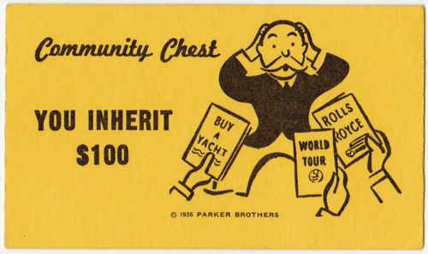
Inheritance Topics
Inheritance
  The basics
    Example: Stanford GObject class
  Polymorphism
    Example: Expression trees (final project)

Slide 3
Polymorphism
Start with how

Slide 4
Polymorphism
polymorphism: Ability for the same code to be used with different types of objects and behave differently with each.
  Templates provide a kind of compile-time polymorphism.
    Grid<int> or Grid<string> will output different things for myGrid[0][0], but we can predict at compile time which it will do
  Inheritance provides run-time polymorphism.
    someEmployee.salary() will behave differently at runtime depending on what type of employee—may not be able to predict at compile time which it is

Slide 5
Polymorphism
We will keep working with the Employee class:
  Employees have a name, years worked, salary, vacation, …
  Lawyers know how to sue and get paid 2x as much
  Programmers know how to write code and get bigger raises each year
  (Code is now on lectures page of website.)

Slide 6
Polymorphism
A pointer of type T can point to any subclass of T.
  Employee *neha = new Programmer("Neha", 2);
  Employee *diane = new Lawyer("Diane", "Stanford", 5);
  Programmer *cynthia = new Programmer("Cynthia", 10);
  Why would you do this?
    Handy if you want to have a function that works on any Employee, but takes advantage of custom behavior by specific employee type:
    void doMonthlyPaycheck(Employee *employee) {
    cout << "You are now $" << employee->salary()/12 << " wealthier!" << endl;
    }

Slide 7
Polymorphism
A pointer of type T can point to any subclass of T.
  Employee *neha = new Programmer("Neha", 2);
  Employee *diane = new Lawyer("Diane", "Stanford", 5);
  Programmer *cynthia = new Programmer("Cynthia", 10);
  When a member function is called on diane, it behaves as a Lawyer.
    diane->salary();
    (This is because all the employee functions are declared virtual.)
  You can not call any Lawyer-only members on diane (e.g. sue).
    diane->sue(); // will NOT compile!
  You can call any Programmer-only members on cynthia (e.g. code).
    cynthia->code("Java"); // ok!

Slide 8
Polymorphism examples
You can use the object's extra functionality by casting.
  Employee *diane = new Lawyer("Diane", "Stanford", 5);
  diane->vacationDays(); // ok
  diane->sue("Cynthia"); // compiler error
  ((Lawyer*) diane)->sue("Cynthia"); // ok
Pro Tip: you should not cast a pointer into something that it is not!
  It will compile, but the code will crash (or behave unpredictably)
  when you try to run it.
  Employee *carlos = new Programmer("Carlos", 3);
  carlos->code(); // compiler error
  ((Programmer*) carlos)->code("C++"); // ok
  ((Lawyer*) carlos)->sue("Cynthia"); // No!!! Compiles but crash!!

Slide 9
Rules for “virtual”: runtime calls
DerivedType * obj = new DerivedType();
If we call a method like this: obj->method(), only one thing could happen:
  DerivedType’s implementation of method is called
BaseType * obj = new DerivedType();
If we call a method like this: obj->method(), two different things could happen:
  If method is not virtual, then BaseType’s implementation of method is called
  If method is virtual, then DerivedType’s implementation of method is called

Slide 10
Rules for “virtual”: pure virtual
If a method of a class looks like this:
  virtual returntype method() = 0;
  then this method is a called “pure virtual” function
  and the class is called an “abstract class”
  Abstract classes are like Java interfaces
  You cannot do “= new Foo();” if Foo is abstract (just like Java interfaces)
  ALSO, you cannot do “= new DerivedFoo();” if DerivedFoo extends Foo and DerivedFoo does not implement all the pure virtual methods of Foo

Slide 11
class Mammal {
public:
virtual void makeSound() = 0;
string toString() { return “Mammal”; }
};
class Cat : public Mammal {
public:
virtual void makeSound() { cout << “rawr” << endl; }
string toString() { return “Cat”; }
};
class Siamese : public Cat {
public:
virtual void makeSound() { cout << “meow” << endl; }
string toString() { return “Siamese”; }
virtual void scratchCouch() { cout << “scraaaatch” << endl; }
};
What is printed?
Siamese * s = new Mammal;
cout << s->toString();
“Mammal”
“Cat”
“Siamese”
Gives an error (identify compiler or crash)
Other/none/more

Slide 12
class Mammal {
public:
virtual void makeSound() = 0;
string toString() { return “Mammal”; }
};
class Cat : public Mammal {
public:
virtual void makeSound() { cout << “rawr” << endl; }
string toString() { return “Cat”; }
};
class Siamese : public Cat {
public:
virtual void makeSound() { cout << “meow” << endl; }
string toString() { return “Siamese”; }
virtual void scratchCouch() { cout << “scraaaatch” << endl; }
};
What is printed?
Siamese * s = new Siamese;
cout << s->toString();
“Mammal”
“Cat”
“Siamese”
Gives an error (identify compiler or crash)
Other/none/more

Slide 13
class Mammal {
public:
virtual void makeSound() = 0;
string toString() { return “Mammal”; }
};
class Cat : public Mammal {
public:
virtual void makeSound() { cout << “rawr” << endl; }
string toString() { return “Cat”; }
};
class Siamese : public Cat {
public:
virtual void makeSound() { cout << “meow” << endl; }
string toString() { return “Siamese”; }
virtual void scratchCouch() { cout << “scraaaatch” << endl; }
};
What is printed?
Mammal * m = new Mammal;
cout << m->toString();
“Mammal”
“Cat”
“Siamese”
Gives an error (identify compiler or crash)
Other/none/more

Slide 14
class Mammal {
public:
virtual void makeSound() = 0;
string toString() { return “Mammal”; }
};
class Cat : public Mammal {
public:
virtual void makeSound() { cout << “rawr” << endl; }
string toString() { return “Cat”; }
};
class Siamese : public Cat {
public:
virtual void makeSound() { cout << “meow” << endl; }
string toString() { return “Siamese”; }
virtual void scratchCouch() { cout << “scraaaatch” << endl; }
};
What is printed?
Mammal * m = new Siamese;
cout << m->toString();
“Mammal”
“Cat”
“Siamese”
Gives an error (identify compiler or crash)
Other/none/more

Slide 15
class Mammal {
public:
virtual void makeSound() = 0;
string toString() { return “Mammal”; }
};
class Cat : public Mammal {
public:
virtual void makeSound() { cout << “rawr” << endl; }
string toString() { return “Cat”; }
};
class Siamese : public Cat {
public:
virtual void makeSound() { cout << “meow” << endl; }
string toString() { return “Siamese”; }
virtual void scratchCouch() { cout << “scraaaatch” << endl; }
};
What is printed?
Mammal * m = new Siamese;
m->scratchCouch();
“Mammal”
“Cat”
“Siamese”
Gives an error (identify compiler or crash)
Other/none/more

Slide 16
class Mammal {
public:
virtual void makeSound() = 0;
string toString() { return “Mammal”; }
};
class Cat : public Mammal {
public:
virtual void makeSound() { cout << “rawr” << endl; }
string toString() { return “Cat”; }
};
class Siamese : public Cat {
public:
virtual void makeSound() { cout << “meow” << endl; }
string toString() { return “Siamese”; }
virtual void scratchCouch() { cout << “scraaaatch” << endl; }
};
What is printed?
Cat * c = new Siamese;
c->makeSound();
“rawr”
“meow”
“Siamese”
Gives an error (identify compiler or crash)
Other/none/more

Slide 17
Stanford 1-2-3 Walkthrough
The Expression class

Slide 18
Walkthrough of Stanford 1-2-3
Excel-like spreadsheet
Among other things, it needs to parse expressions
    = (3 + 4) * A7
We saw something similar to this earlier in the quarter:
*
+
/
3
4
8
2

Slide 19
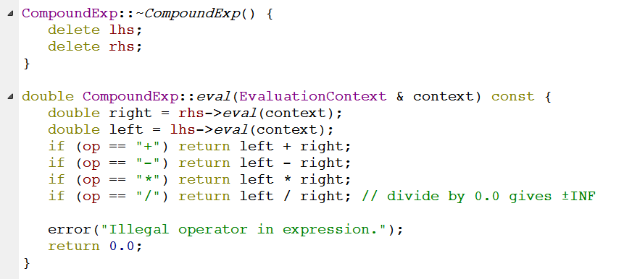
Evaluation of CompoundExp
This is in the implementation of CompoundExp—let’s take a look at the .h file to see what op, lhs, and rhs are

Slide 20
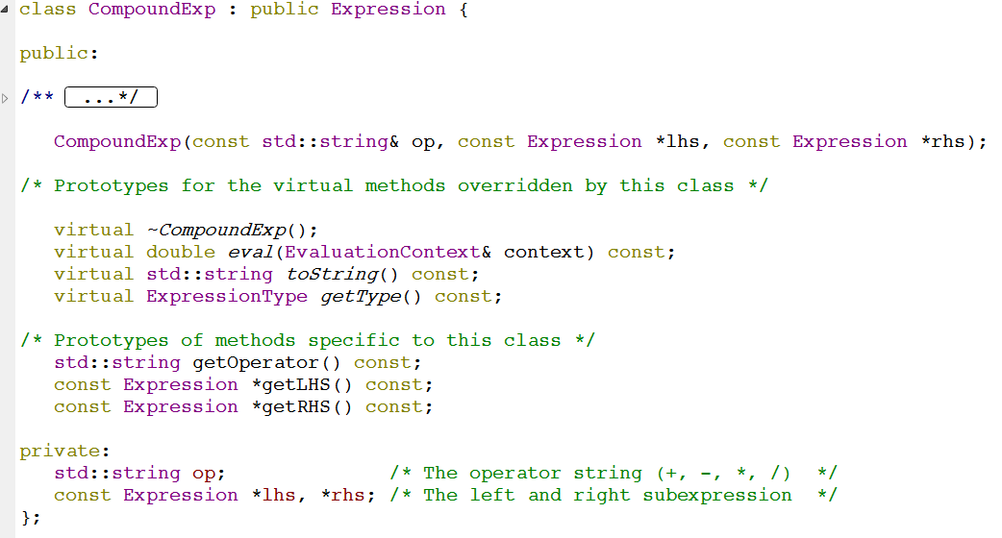
C++ and the “virtual” keyword

Slide 21
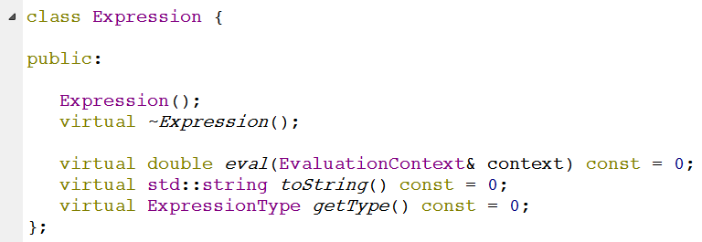
Expression (base class)
Note: you cannot actually create an Expression object
These methods are never implemented (note the “= 0”)
“pure virtual”
Expression exists solely to provide a base class to others
  “abstract”

Slide 22
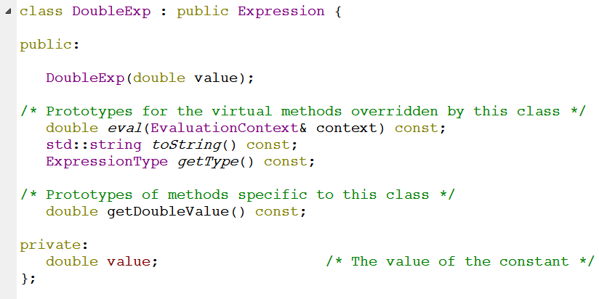
Another Derived class: DoubleExp

Slide 23
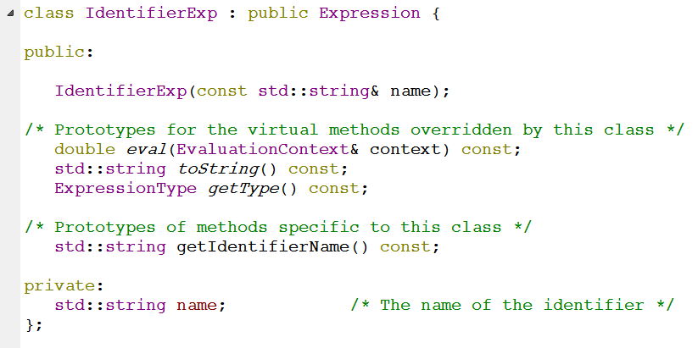
Another Derived class: IdentifierExp

Slide 24
Stanford 1-2-3 eval
Because of the “is a” relationship: lhs/rhs of compoundExp can be any of:
CompoundExp
DoubleExp
IdentifierExp
This diagram shows a CompoundExp object as the root of a tree, and the children are the LHS and RHS (private member variables of type Expressio*). LHS points to an object of type DoubleExp, with value 3.7. RHS points to an object of type IdentifierExp with name “foo”. Note that it is ok for the RHS and LHS pointers to point to DoubleExp and IdentifierExp objects, because these are derived classes of the base class Expression.

Slide 25
Stanford 1-2-3 eval
CompoundExp doesn’t want to care exactly what type its lhs and rhs are
Just calls eval() on whatever they are and gets the right value!
This diagram shows a CompoundExp object as the root of a tree, and the children are the LHS and RHS (private member variables of type Expressio*). LHS points to an object of type DoubleExp, with value 3.7. RHS points to an object of type IdentifierExp with name “foo”. Note that it is ok for the RHS and LHS pointers to point to DoubleExp and IdentifierExp objects, because these are derived classes of the base class Expression.

