Slide 1
Programming Abstractions
CS106X
Cynthia Lee

Slide 2
Today’s Topics
Quick final exam discussion
  Details/logistics, topics, sources for practice problems
Quarter wrap-up
  Putting it all together: what have we accomplished together this quarter?
What next?
  Options for continuing your passion for CS after this quarter is done
  Preview of CS107: stack exploits

Slide 3
Final Exam

Slide 4
Logistics
Open notes: 2 pages (4 sides)
Open textbook
3 hours
  In this room (Gates B01)

Slide 5
Final Exam Topics
ADTs
Recursion
Backtracking
Objects and classes
Big-O analysis
Pointers and dynamic memory
Trees: heaps, binary search trees, tries, types of traversals
Hashing
Graphs: Dijkstra's, A*, Kruskals, BFS, DFS
Inheritance, Polymorphism
Sorting algorithms

Slide 6
Final Exam Study Strategy
Don’t memorize things—either write it in notes, or learn the concept
    If you’ve got flash cards, you’re approaching this with the wrong mindset
    No big multiple choice/true-false section where “memorized” facts would be tested
  Don’t read the book
    Computer science is about creating things, so do some practice problems
    Re-do Socrative questions from lecture, do old section problems, do CS106B practice exams as warm-up for our practice exams
    Look at lecture slides or book as needed for review of things you identify as weak points
  Don’t stress
    Most of the really mind-bending topics (recursion, pointers) were on the midterm, and you’ve had more time to let those settle in

Slide 7
Big O Quick Reference (see also http://bigocheatsheet.com/)
What | Cost
Hash table average case (good design) | O(1)
Balanced trees Heap, BST with balancing such as Red-Black Binary search on sorted array | O(logn)
Linked list find Inserting into beginning/middle of array Hash table worst case Unbalanced tree (e.g. BST) worst case | O(n)
Good sorting Mergesort, Heapsort, Quicksort (expected) | O(nlogn)
Bad sorting Insertion, Bubble, Selection, Quicksort (worst case) | O(n²)

Slide 8
Quarter Wrap-Up
What did we set out to do in the beginning?
Where are we now?

Slide 9
Goals for this Course
Learn how to model and solve complex problems with computers.
To that end:
  Explore common abstractions for representing problems.
  Harness recursion and understand how to think about problems recursively.
  Bring added rigor to your understanding of algorithmic performance, so you can quantitatively compare approaches for solving problems.

Slide 10
From here on out, there are no obvious answers to any problem worth your hourly rate. ☺
Programming is all about exploring new ways to model and solve problems.
There are CHOICES and TRADEOFFS in how we model these and how we implement them! (array or linked list? BST or hash table?)
Skilled computer scientists recognize that any problem worth tackling has many possible models and many possible solutions, none of which is clearly better than the others in all dimensions—tradeoffs!

Slide 11
That’s a lot of material to cover in 10 weeks
  You are part of the most competitive group at this level,
  in the best CS department in the world,
  and you are so, so close to completing this course!
  Congratulations!!
  You’ve almost made it through CS106X!
  So…what next?

Slide 12
What comes next?
You’re conquering this mountain, let’s find some more ☺

Slide 13
The CS Core
CS106B/X
CS103
Programming
Abstractions
Mathematical
Foundations of
Computing
CS107
CS109
Systems
Theory
Computer
Organization and
Systems
Intro to Probability
for Computer
Scientists
CS110
CS161
Principles of
Computer Systems
Design and Analysis
of Algorithms

Slide 14
The CS Core
CS106B/X
CS103
Programming
Abstractions
Mathematical
Foundations of
Computing
CS107
CS109
Systems
Theory
Computer
Organization and
Systems
Intro to Probability
for Computer
Scientists
CS110
CS161
Principles of
Computer Systems
Design and Analysis
of Algorithms

Slide 15
The CS Core
CS106B/X
CS103
Programming
Abstractions
Mathematical
Foundations of
Computing
CS107
CS109
Systems
Theory
Computer
Organization and
Systems
Intro to Probability
for Computer
Scientists
CS110
CS161
Principles of
Computer Systems
Design and Analysis
of Algorithms

Slide 16
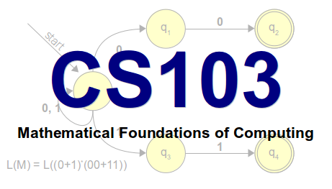
Can computers solve all problems?
Spoiler alert: no!
Why are some problems harder than others?
We can do find in an unsorted array in O(N), and we can sort an unsorted array in O(NlogN). Is sorting just inherently a harder problem, or are there better O(N) sorting algorithm yet to be discovered?
How can we be certain about this?

Slide 17
CS107
Computer Organization and Systems
How do we encode text, numbers,
programs, etc. using just 0s and 1s?
Where does memory come from?
How is it managed?
How do compilers, debuggers, etc. work?

Slide 18
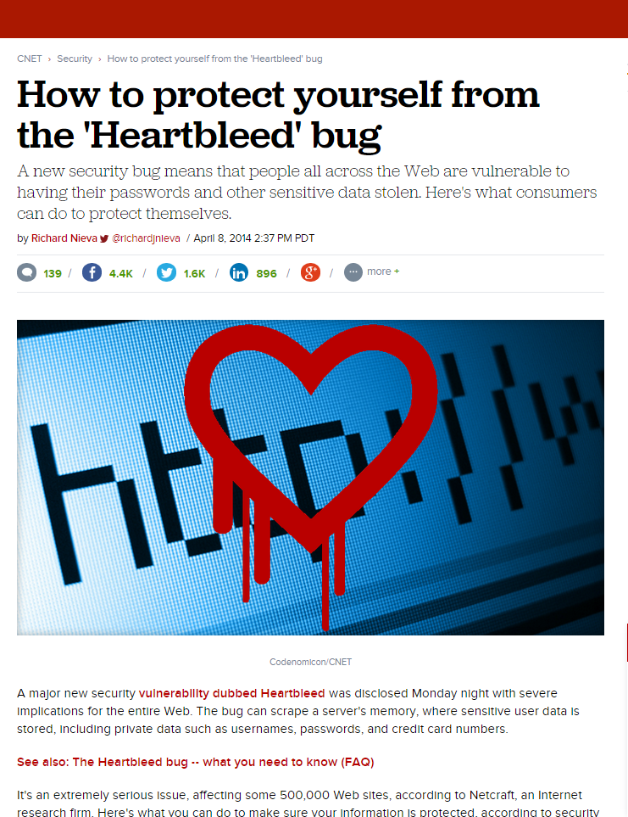
CS107 in the news: Heartbleed
In April 2014, security experts warned that users of thousands of major websites needed to change their passwords due to potential exposure caused by the “Heartbleed” vulnerability
Heartbleed exploited a buffer overrun bug in OpenSSL
    SSL is the layer that secures web interactions, i.e., it’s what make the “s” in “https://” mean something

Slide 19
CS107 in the news: Heartbleed
The protocol allows you to send “heartbeat” messages, which basically say:
    Are you still there? If you are, repeat this word back to me: "hello" [0x0005 bytes].
    Each char is one byte, so 5 letters
Unfortunately, the software also let you send messages like this:
    Are you still there? If you are, repeat this word back to me: "hello" [0xFFFF bytes].
    That’s 65535 bytes—much more than the length of "hello"!
    So the software would continue for-looping past the end of the "hello" array, sending information back
    Which causes an error, right? RIGHT?? Turns out, no.

Slide 20
What CS107 Isn't
CS107 is not a litmus test for whether you can be a computer scientist.
  You can be a great computer scientist without enjoying low-level systems programming.
CS107 is not indicative of what programming is “really like.”
  CS107 does a lot of low-level programming. You don't have to do low-level programming to be a good computer scientist.

Slide 21
CS107E
Computer Organization and Systems—Embedded
Counts for prerequisites etc. the same as regular CS107, but covers the topics with a new twist: embedded work on Rasberry Pi

Slide 22
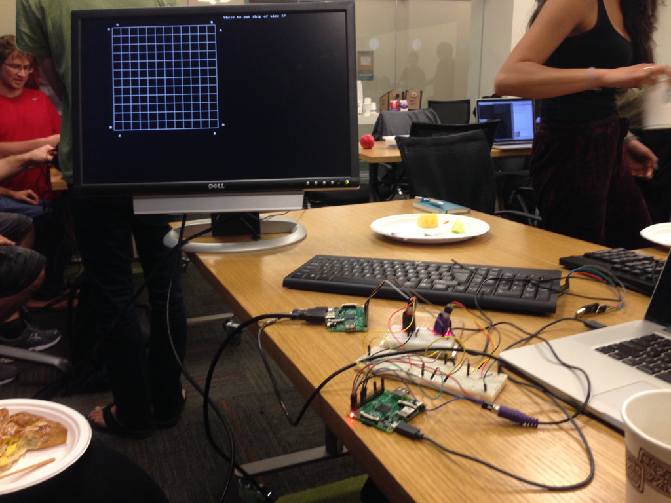
CS107E
Computer Systems from the Ground Up
Pat Hanrahan
Dawson Engler
Julie Zelenski

Slide 23
FAQ (vs CS107)
  Same goals: understand how computers represent data and execute programs; tools
  Different approach: bare metal on the Raspberry Pi; build a working personal computer from scratch
  Logistics
    Same format: weekly assignments and labs
    Assignments build on each other
    No exams, but a final project
    ARM vs X86
    More hardware (thinker Maker Faire, breadboard)
    Enrollment limited to 40; Application through cs107e on Axess; Due 12/12; still lots of openings!!
    Will be offered in winter and spring

Slide 24
Other CS Courses

Slide 25
CS9
Interviewing for Software Jobs
1 unit, 1 meeting per week, little to no outside work
Prereq: 106B/X
Practice real job interview questions
    Additional topics such as resume polish, negotiating once you have multiple offers, differences between roles (Project Management vs Developer vs Test Engineer)
Special guests from industry!
Taught by Cynthia Lee, Keith Schwarz
Offered each autumn quarter

Slide 26
CS181
Computers, Ethics, and Public Policy
Some sample news headlines recently:
  Edward Snowden reveals that NSA knows more about you than your parents do
  GamerGate: about harassing women, or about ethics in game journalism?
  How should AirBnB be taxed?
  The password to launch the US nuclear arsenal was 00000000
We have the power to control and create technology, but how should we use it?

Slide 27
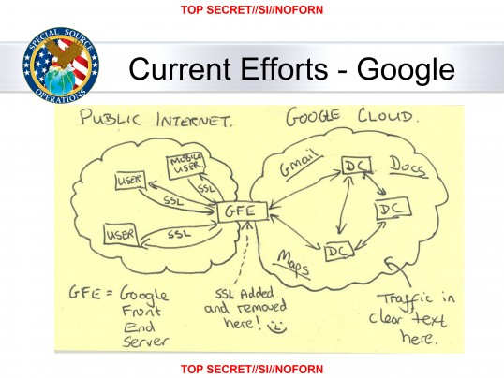

Slide 28
CS108
Object-Oriented Systems Design
How do you build large software systems in a team?
Introduction to things you need to know for work in the “real world”:
  Unit-testing frameworks
  Object-oriented design
  Multithreaded applications
  Databases and web applications
  Source control

Slide 29
CS193
Language-specific courses
Misc. offerings throughout the year, focused on specific technologies:
  CS193A: Android Programming
  CS193C: Client-Side Web Technologies
  CS193I: iOS Programming
  CS193L: Lua Programming
  CS193P: iPhone and iPad programming
Great for learning particular technologies.

Slide 30
Options besides CS Major
CS Minor: only 5 more classes!
  103, 107, 109, two your choice—fun!
CS Coterminal MS degree
Earn an MS in CS while you are here earning your BS
Possible for CS majors and other majors
    ex: Math major, CS co-term

Slide 31
CS107 preview: Remember stack frames?
Memory
main()
myfunction() x:
xfac:
10
0
factorial() n:
10
0
Heap

