Slide 1
CS107, Lecture 12
Assembly: Arithmetic, Logic and Condition Codes
Reading: B&O 3.5-3.6

Slide 2
CS107 Topic 6: How does a computer interpret and execute C programs?

Slide 3
Learning Assembly
Moving data around
Arithmetic and logical operations
Control flow
Function calls
5/6
Today
5/17
5/20

Slide 4
Learning Goals
Learn how to perform arithmetic and logical operations in assembly

Slide 5
Plan For Today
Recap: Assembly and mov
Data and Register Sizes
The lea Instruction
Logical and Arithmetic Operations

Slide 6
Plan For Today
Recap: Assembly and mov
Data and Register Sizes
The lea Instruction
Logical and Arithmetic Operations

Slide 7
Assembly
Assembly code is a human-readable form of the machine code your computer actually executes when running your programs.
Assembly works at a lower level of abstraction than C code. It works with 64-bit spaces called registers that act as “scratch paper” for the processor.
Operations in your C program ultimately are converted to operations that read or write to registers and perform calculations on these registers.

Slide 8
Our First Assembly
00000000004005b6 <sum_array>:
4005b6: ba 00 00 00 00 mov $0x0,%edx
4005bb: b8 00 00 00 00 mov $0x0,%eax
4005c0: eb 09 jmp 4005cb <sum_array+0x15>
4005c2: 48 63 ca movslq %edx,%rcx
4005c5: 03 04 8f add (%rdi,%rcx,4),%eax
4005c8: 83 c2 01 add $0x1,%edx
4005cb: 39 f2 cmp %esi,%edx
4005cd: 7c f3 jl 4005c2 <sum_array+0xc>
4005cf: f3 c3 repz retq

Slide 9
Our First Assembly
00000000004005b6 <sum_array>:
4005b6: ba 00 00 00 00 mov $0x0,%edx
4005bb: b8 00 00 00 00 mov $0x0,%eax
4005c0: eb 09 jmp 4005cb <sum_array+0x15>
4005c2: 48 63 ca movslq %edx,%rcx
4005c5: 03 04 8f add (%rdi,%rcx,4),%eax
4005c8: 83 c2 01 add $0x1,%edx
4005cb: 39 f2 cmp %esi,%edx
4005cd: 7c f3 jl 4005c2 <sum_array+0xc>
4005cf: f3 c3 repz retq
Each instruction has an operation name (“opcode”).

Slide 10
Our First Assembly
00000000004005b6 <sum_array>:
4005b6: ba 00 00 00 00 mov $0x0,%edx
4005bb: b8 00 00 00 00 mov $0x0,%eax
4005c0: eb 09 jmp 4005cb <sum_array+0x15>
4005c2: 48 63 ca movslq %edx,%rcx
4005c5: 03 04 8f add (%rdi,%rcx,4),%eax
4005c8: 83 c2 01 add $0x1,%edx
4005cb: 39 f2 cmp %esi,%edx
4005cd: 7c f3 jl 4005c2 <sum_array+0xc>
4005cf: f3 c3 repz retq
Each instruction can also have arguments (“operands”).

Slide 11
mov
The mov instruction copies bytes from one place to another.
mov src,dst
The src and dst can each be one of:
Immediate (constant value, like a number)
Register
Memory Location (at most one of src, dst)

Slide 12
Memory Location Syntax
Syntax | Meaning
0x104 | Address 0x104 (no $)
(%rax) | What’s in %rax
4(%rax) | What’s in %rax, plus 4
(%rax, %rdx) | Sum of what’s in %rax and %rdx
4(%rax, %rdx) | Sum of values in %rax and %rdx, plus 4
(, %rcx, 4) | What’s in %rcx, times 4 (multiplier can be 1, 2, 4, 8)
(%rax, %rcx, 2) | What’s in %rax, plus 2 times what’s in %rcx
8(%rax, %rcx, 2) | What’s in %rax, plus 2 times what’s in %rcx, plus 8

Slide 13
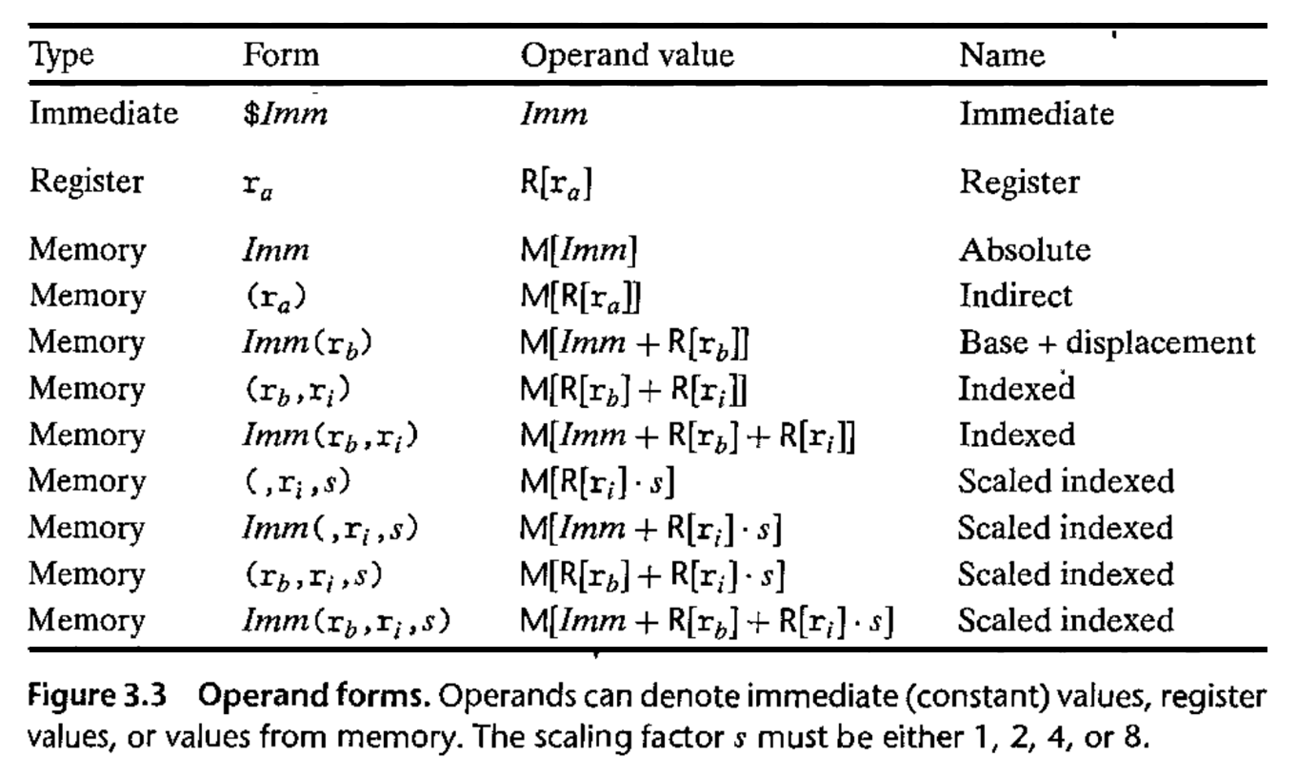
Operand Forms

Slide 14
Plan For Today
Recap: Assembly and mov
Data and Register Sizes
The lea Instruction
Logical and Arithmetic Operations
Control
  Condition Codes
  Assembly Instructions
Practice: Reverse-Engineering

Slide 15
Data Sizes
Data sizes in assembly have slightly different terminology to get used to:
A byte is….well, 1 byte!
A word is 2 bytes.
A double word is 4 bytes.
A quad word is 8 bytes.
Assembly instructions can have suffixes to refer to these sizes:
b means byte
w means word
l means double word
q means quad word

Slide 16
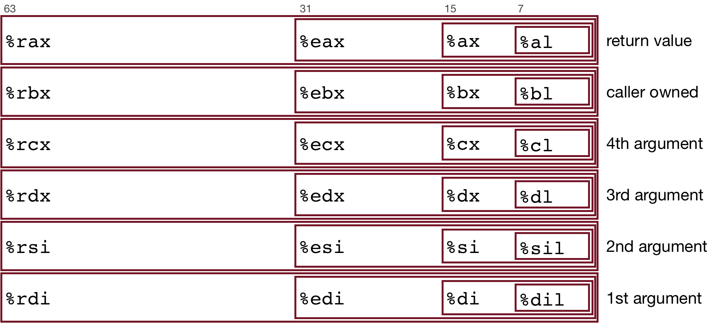
Register Sizes

Slide 17
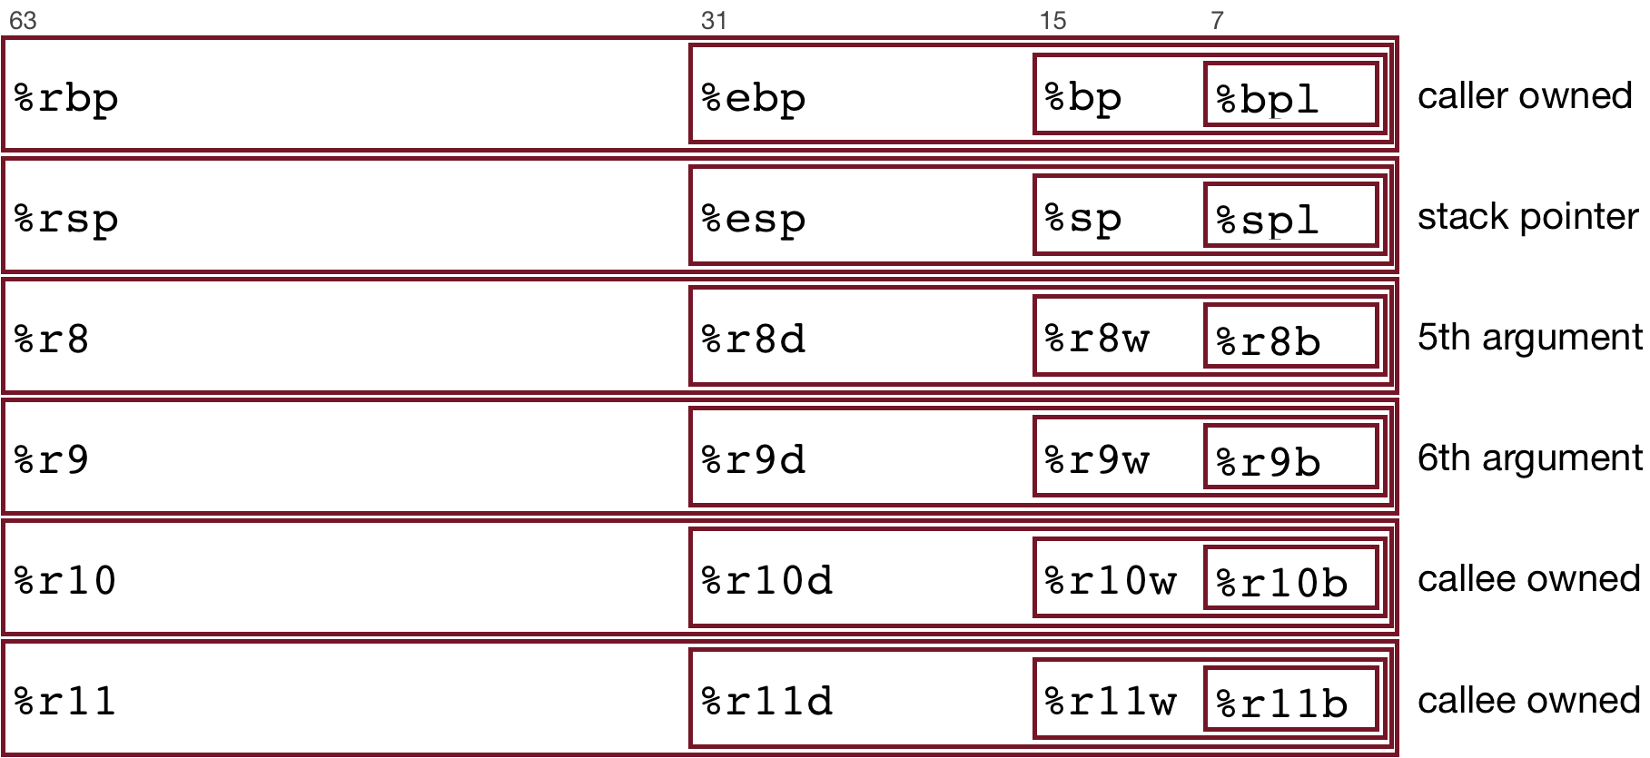
Register Sizes

Slide 18
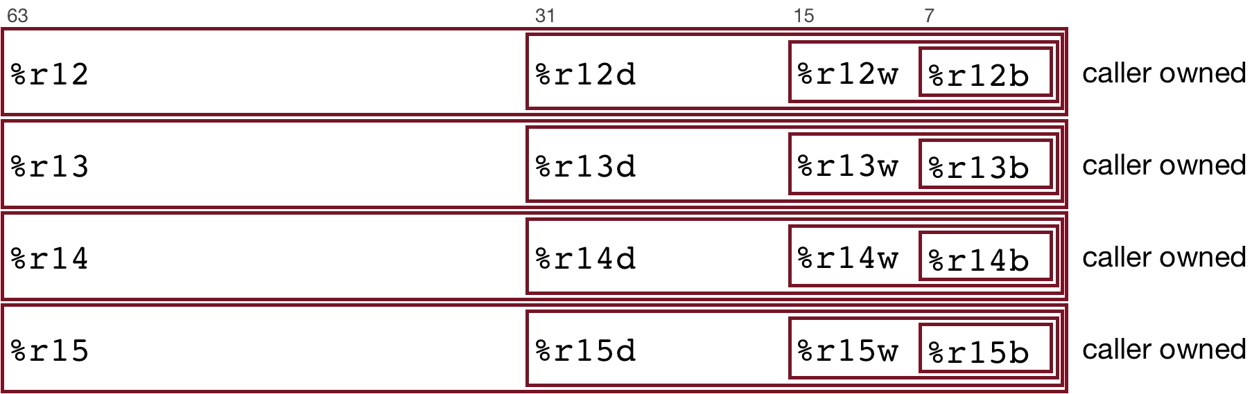
Register Sizes

Slide 19
Register Responsibilities
Some registers take on special responsibilities during program execution.
%rax stores the return value
%rdi stores the first parameter to a function
%rsi stores the second parameter to a function
%rdx stores the third parameter to a function
%rip stores the address of the next instruction to execute
%rsp stores the address of the current top of the stack
See the x86-64 Guide and Reference Sheet on the Resources webpage for more!

Slide 20
mov Variants
mov can take an optional suffix (b,w,l,q) that specifies the size of data to move: movb, movw, movl, movq
mov only updates the specific register bytes or memory locations indicated.
  Exception: movl writing to a register will also set high order 4 bytes to 0.

Slide 21
Practice: mov And Data Sizes
For each of the following mov instructions, determine the appropriate suffix based on the operands (e.g. movb, movw, movl or movq).
mov__ %eax, (%rsp)
mov__ (%rax), %dx
mov__ $0xff, %bl
mov__ (%rsp,%rdx,4),%dl
mov__ (%rdx), %rax
mov__ %dx, (%rax)
Notes:
L
W
B
B
Q
W

Slide 22
Practice: mov And Data Sizes
For each of the following mov instructions, determine the appropriate suffix based on the operands (e.g. movb, movw, movl or movq).
movl %eax, (%rsp)
movw (%rax), %dx
movb $0xff, %bl
movb (%rsp,%rdx,4),%dl
movq (%rdx), %rax
movw %dx, (%rax)
Notes:
L
W
B
B
Q
W

Slide 23
mov
The movabsq instruction is used to write a 64-bit Immediate (constant) value.
The regular movq instruction can only take 32-bit immediates.
64-bit immediate as source, only register as destination.
movabsq $0x0011223344556677, %rax

Slide 24
movz and movs
There are two mov instructions that can be used to copy a smaller source to a larger destination: movz and movs.
movz fills the remaining bytes with zeros
movs fills the remaining bytes by sign-extending the most significant bit in the source.
The source must be from memory or a register, and the destination is a register.

Slide 25
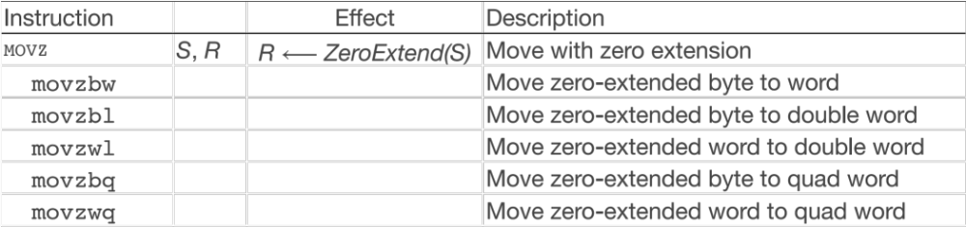
movz and movs

Slide 26
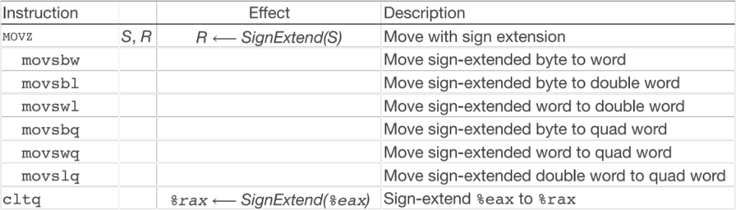
movz and movs

Slide 27
Plan For Today
Recap: Assembly and mov
Data and Register Sizes
The lea Instruction
Logical and Arithmetic Operations
Control
  Condition Codes
  Assembly Instructions
Practice: Reverse-Engineering

Slide 28
lea
The lea instruction copies an “effective address” from one place to another.
lea src,dst
Unlike mov, which copies data at the address src to the destination, lea copies the value of src itself to the destination.

Slide 29
lea vs. mov
Operands | mov Interpretation | lea Interpretation
6(%rax), %rdx | Go to the address (6 + what’s in %rax), and copy data there into %rdx | Copy 6 + what’s in %rax into %rdx.

Slide 30
lea vs. mov
Operands | mov Interpretation | lea Interpretation
6(%rax), %rdx | Go to the address (6 + what’s in %rax), and copy data there into %rdx | Copy 6 + what’s in %rax into %rdx.
(%rax, %rcx), %rdx | Go to the address (what’s in %rax + what’s in %rcx) and copy data there into %rdx | Copy (what’s in %rax + what’s in %rcx) into %rdx.

Slide 31
lea vs. mov
Operands | mov Interpretation | lea Interpretation
6(%rax), %rdx | Go to the address (6 + what’s in %rax), and copy data there into %rdx | Copy 6 + what’s in %rax into %rdx.
(%rax, %rcx), %rdx | Go to the address (what’s in %rax + what’s in %rcx) and copy data there into %rdx | Copy (what’s in %rax + what’s in %rcx) into %rdx.
(%rax, %rcx, 4), %rdx | Go to the address (%rax + 4 * %rcx) and copy data there into %rdx. | Copy (%rax + 4 * %rcx) into %rdx.

Slide 32
lea vs. mov
Operands | mov Interpretation | lea Interpretation
6(%rax), %rdx | Go to the address (6 + what’s in %rax), and copy data there into %rdx | Copy 6 + what’s in %rax into %rdx.
(%rax, %rcx), %rdx | Go to the address (what’s in %rax + what’s in %rcx) and copy data there into %rdx | Copy (what’s in %rax + what’s in %rcx) into %rdx.
(%rax, %rcx, 4), %rdx | Go to the address (%rax + 4 * %rcx) and copy data there into %rdx. | Copy (%rax + 4 * %rcx) into %rdx.
7(%rax, %rax, 8), %rdx | Go to the address (7 + %rax + 8 * %rax) and copy data there into %rdx. | Copy (7 + %rax + 8 * %rax) into %rdx.
Unlike mov, which copies data at the address src to the destination, lea copies the value of src itself to the destination.

Slide 33
Plan For Today
Recap: Assembly and mov
Data and Register Sizes
The lea Instruction
Logical and Arithmetic Operations
Control
  Condition Codes
  Assembly Instructions
Practice: Reverse-Engineering

Slide 34
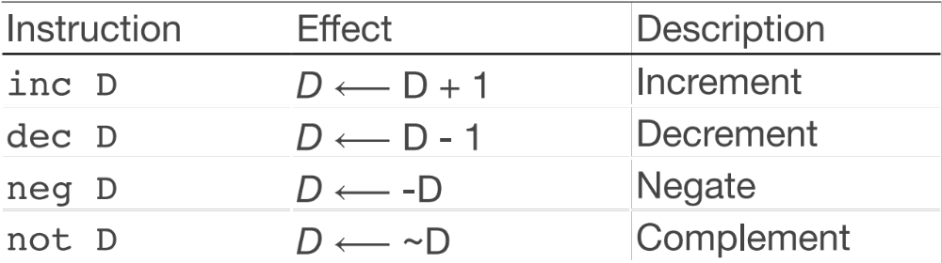
Unary Instructions
The following instructions operate on a single operand (register or memory):
Examples:
incq 16(%rax)
dec %rdx
not %rcx

Slide 35
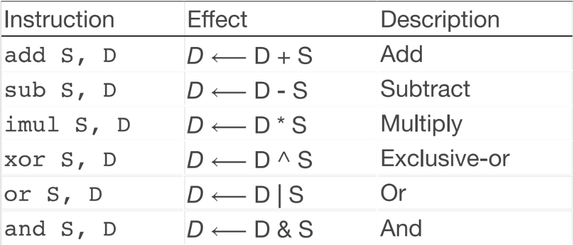
Binary Instructions
The following instructions operate on two operands (register or memory). Both cannot be memory locations. Read it as, e.g. “Subtract S from D”:
Examples:
addq %rcx,(%rax)
xorq $16,(%rax, %rdx, 8)
subq %rdx,8(%rax)

Slide 36
Large Multiplication
Multiplying 64-bit numbers can produce a 128-bit result. How does x86-64 support this with only 64-bit registers?
If you specify two operands to imul, it multiplies them together and truncates until it fits in a 64-bit register.
If you specify one operand, it multiplies that by %rax, and splits the product across 2 registers. It puts the high-order 64 bits in %rdx and the low-order 64 bits in %rax.

Slide 37
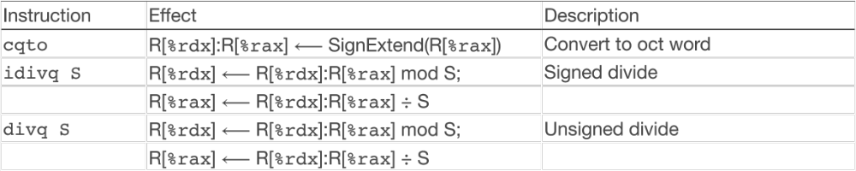
Division and Remainder
Terminology: dividend / divisor = quotient + remainder
x86-64 supports dividing up to a 128-bit value by a 64 bit value.
The high-order 64 bits of the dividend are in %rdx, and the low-order 64 bits are in %rax. The divisor is the operand to the instruction.
The quotient is stored in %rax, and the remainder in %rdx.

Slide 38
Division and Remainder
Terminology: dividend / divisor = quotient + remainder
The high-order 64 bits of the dividend are in %rdx, and the low-order 64 bits are in %rax. The divisor is the operand to the instruction.
Most division uses only 64 bit dividends. The cqto instruction sign-extends the 64-bit value in %rax into %rdx to fill both registers with the dividend, as the division instruction expects.

Slide 39
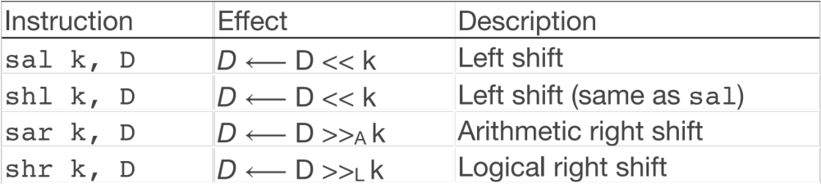
Shift Instructions
The following instructions operate on two operands, one the shift amount and the other the destination to shift. The shift amount k can be either an immediate value, or the byte register %cl (and only that register!)
Examples:
shll $3,(%rax)
shr %cl,(%rax,%rdx,8)
sar $4,8(%rax)

Slide 40
Shift Amount
When using %cl, the width of what you are shifting determines how much of %cl it is shifted by.
For w bits of data, it looks at the low-order log2(w) bits of %cl to know how much to shift.
  If %cl = 0xff, then: shlb shifts by 7 because it considers only the low-order log2(8) = 3 bits, which represent 7. shlw shifts by 15 because it considers only the low-order log2(16) = 4 bits, which represent 15.

Slide 41
Announcements
Midterms have been graded, and will be emailed out this afternoon.
Regrades accepted until the end of the day next Monday
Median: 89, Mean: 85, St. Dev. : 19

Slide 42
Assembly Exploration
Let’s pull these different commands together and see how some C code we write may be translated into assembly.
Compiler Explorer is a handy website that lets you write C code and see its assembly translation without having to log into Myth or compile/disassemble a program. Let’s check it out!
https://godbolt.org/z/NLYhVf

Slide 43
Code Reference
// Returns the sum of x and the first element in arr
int add_to_first(int x, int arr[]) {
int sum = x;
sum += arr[0];
return sum;
}
// Returns x/y, stores remainder in location stored in remainder_ptr
long full_divide(long x, long y, long *remainder_ptr) {
long quotient = x / y;
long remainder = x % y;
*remainder_ptr = remainder;
return quotient;
}

Slide 44
Recap
Recap: Assembly and mov
Data and Register Sizes
The lea Instruction
Logical and Arithmetic Operations
Next time: Control flow in assembly

