Slide 1
CS107, Lecture 13
Assembly: Control Flow
Reading: B&O 3.6

Slide 2
Learning Assembly
Moving data around
Arithmetic and logical operations
Control flow
Function calls
5/6
5/13
Today
5/20

Slide 3
Learning Goals
Learn about how assembly stores comparison and operation results in condition codes
Understand how assembly implements loops and control flow

Slide 4
Plan For Today
Recap: Arithmetic and Logic
Control Flow
  Condition Codes
  Assembly Instructions
  If statements
  While loops
  For loops

Slide 5
Plan For Today
Recap: Arithmetic and Logic
Control Flow
  Condition Codes
  Assembly Instructions
  If statements
  While loops
  For loops

Slide 6
Register Responsibilities
Some registers take on special responsibilities during program execution.
%rax stores the return value
%rdi stores the first parameter to a function
%rsi stores the second parameter to a function
%rdx stores the third parameter to a function
%rip stores the address of the next instruction to execute
%rsp stores the address of the current top of the stack
See the x86-64 Guide and Reference Sheet on the Resources webpage for more!

Slide 7
mov Variants
mov can take an optional suffix (b,w,l,q) that specifies the size of data to move: movb, movw, movl, movq
mov only updates the specific register bytes or memory locations indicated.
  Exception: movl writing to a register will also set high order 4 bytes to 0.

Slide 8
lea
The lea instruction copies an “effective address” from one place to another.
lea src,dst
Unlike mov, which copies data at the address src to the destination, lea copies the value of src itself to the destination.

Slide 9
No-Op
The nop/nopl instructions are “no-op” instructions – they do nothing!
Why? To make functions align on nice multiple-of-8 address boundaries.
“Sometimes, doing nothing is the way to be most productive.” – Philosopher Nick

Slide 10
Mov
Sometimes, you’ll see the following: mov %ebx, %ebx
What does this do? It zeros out the top 32 register bits, because when mov is performed on an e- register, the rest of the 64 bits are zeroed out.

Slide 11
xor
Sometimes, you’ll see the following: xor %ebx, %ebx
What does this do? It sets %ebx to zero! May be more efficient than using mov.

Slide 12
Assembly Exercise 1
00000000004005ac <sum_example1>:
4005bd: 8b 45 e8 mov %esi,%eax
4005c3: 01 d0 add %edi,%eax
4005cc: c3 retq
Which of the following is most likely to have generated the above assembly?
// A) void sum_example1() { int x; int y; int sum = x + y; } | // B) int sum_example1(int x, int y) { return x + y; }
// C) void sum_example1(int x, int y) { int sum = x + y; }
Notes:
Looks like we’re adding two uninitialized variables. BUT, remember register special uses!
B

Slide 13
Assembly Exercise 2
0000000000400578 <sum_example2>:
400578: 8b 47 0c mov 0xc(%rdi),%eax
40057b: 03 07 add (%rdi),%eax
40057d: 2b 47 18 sub 0x18(%rdi),%eax
400580: c3 retq
int sum_example2(int arr[]) { int sum = 0; sum += arr[0]; sum += arr[3]; sum -= arr[6]; return sum; } | What location or value in the assembly above represents the C code’s sum variable?
Notes:
%eax

Slide 14
Assembly Exercise 2
0000000000400578 <sum_example2>:
400578: 8b 47 0c mov 0xc(%rdi),%eax
40057b: 03 07 add (%rdi),%eax
40057d: 2b 47 18 sub 0x18(%rdi),%eax
400580: c3 retq
int sum_example2(int arr[]) { int sum = 0; sum += arr[0]; sum += arr[3]; sum -= arr[6]; return sum; } | What location or value in the assembly above represents the C code’s sum variable? %eax

Slide 15
Assembly Exercise 3
0000000000400578 <sum_example2>:
400578: 8b 47 0c mov 0xc(%rdi),%eax
40057b: 03 07 add (%rdi),%eax
40057d: 2b 47 18 sub 0x18(%rdi),%eax
400580: c3 retq
int sum_example2(int arr[]) { int sum = 0; sum += arr[0]; sum += arr[3]; sum -= arr[6]; return sum; } | What location or value in the assembly code above represents the C code’s 6 (as in arr[6])?

Slide 16
Assembly Exercise 3
0000000000400578 <sum_example2>:
400578: 8b 47 0c mov 0xc(%rdi),%eax
40057b: 03 07 add (%rdi),%eax
40057d: 2b 47 18 sub 0x18(%rdi),%eax
400580: c3 retq
int sum_example2(int arr[]) { int sum = 0; sum += arr[0]; sum += arr[3]; sum -= arr[6]; return sum; } | What location or value in the assembly code above represents the C code’s 6 (as in arr[6])? 0x18

Slide 17
Plan For Today
Recap: Arithmetic and Logic
Control Flow
  Condition Codes
  Assembly Instructions
  If statements
  While loops
  For loops

Slide 18
Control
In C, we have control flow statements like if, else, while, for, etc. to write programs that are more expressive than just one instruction following another.
This is conditional execution of statements: executing statements if one condition is true, executing other statements if one condition is false, etc.
How is this represented in assembly?
  A way to store conditions that we will check later
  Assembly instructions whose behavior is dependent on these conditions

Slide 19
Control
if (x > y) {
// a
} else {
// b
}
In Assembly:
Calculate the condition result
Based on the result, go to a or b
There are special “condition code” registers that automatically store the results of the most recent arithmetic or logical operation.

Slide 20
Condition Codes
Alongside normal registers, the CPU also has single-bit condition code registers. They store the results of the most recent arithmetic or logical operation.
Most common condition codes:
CF: Carry flag. The most recent operation generated a carry out of the most significant bit. Used to detect overflow for unsigned operations.
ZF: Zero flag. The most recent operation yielded zero.
SF: Sign flag. The most recent operation yielded a negative value.
OF: Overflow flag. The most recent operation caused a two’s-complement overflow-either negative or positive.

Slide 21
Condition Codes
Common Condition Codes
Which flag would be set after this code?
CF: Carry flag. The most recent operation generated a carry out of the most significant bit. Used to detect overflow for unsigned operations.
ZF: Zero flag. The most recent operation yielded zero.
SF: Sign flag. The most recent operation yielded a negative value.
OF: Overflow flag. The most recent operation caused a two’s-complement overflow-either negative or positive.
int a = 5;
int b = -5;
int t = a + b;

Slide 22
Condition Codes
Common Condition Codes
Which flag would be set after this code?
CF: Carry flag. The most recent operation generated a carry out of the most significant bit. Used to detect overflow for unsigned operations.
ZF: Zero flag. The most recent operation yielded zero.
SF: Sign flag. The most recent operation yielded a negative value.
OF: Overflow flag. The most recent operation caused a two’s-complement overflow-either negative or positive.
int a = 5;
int b = -5;
int t = a + b;

Slide 23
Condition Codes
Common Condition Codes
Which flag would be set after this code?
CF: Carry flag. The most recent operation generated a carry out of the most significant bit. Used to detect overflow for unsigned operations.
ZF: Zero flag. The most recent operation yielded zero.
SF: Sign flag. The most recent operation yielded a negative value.
OF: Overflow flag. The most recent operation caused a two’s-complement overflow-either negative or positive.
int a = 5;
int b = -20;
int t = a + b;

Slide 24
Condition Codes
Common Condition Codes
Which flag would be set after this code?
CF: Carry flag. The most recent operation generated a carry out of the most significant bit. Used to detect overflow for unsigned operations.
ZF: Zero flag. The most recent operation yielded zero.
SF: Sign flag. The most recent operation yielded a negative value.
OF: Overflow flag. The most recent operation caused a two’s-complement overflow-either negative or positive.
int a = 5;
int b = -20;
int t = a + b;

Slide 25
Condition Codes
Different combinations of condition codes can indicate different things.
  E.g. To check equality, we can look at the ZERO flag (a = b means a – b = 0)
Previously-discussed arithmetic and logical instructions update these flags. lea does not (it was intended only for address computations).
Logical operations (xor, etc.) set carry and overflow flags to zero.
Shift operations set the carry flag to the last bit shifted out, and set the overflow flag to zero.
For more complicated reasons, inc and dec set the overflow and zero flags, but leave the carry flag unchanged.

Slide 26
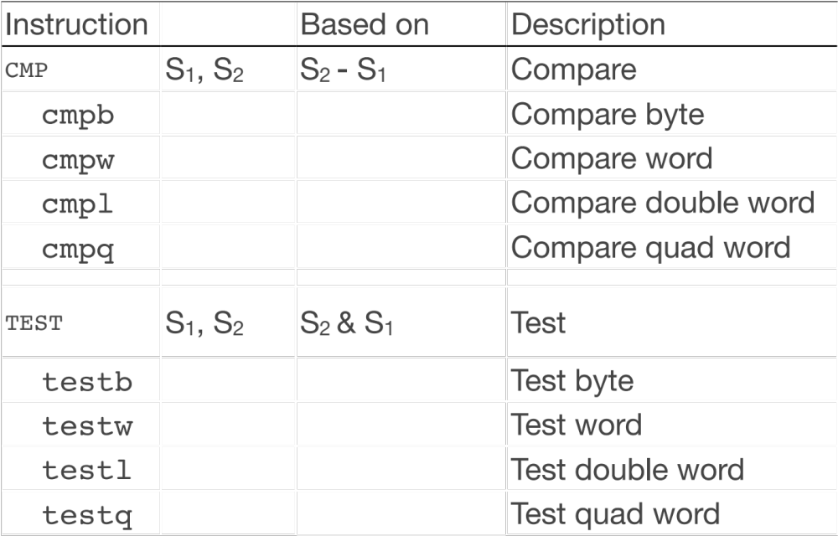
Setting Condition Codes
In addition to being set automatically from logical and arithmetic operations, we can also update condition codes ourselves.
The cmp instruction is like the subtraction instruction, but it does not store the result anywhere. It just sets condition codes. (Note the operand order!)

Slide 27
Setting Condition Codes
In addition to being set automatically from logical and arithmetic operations, we can also update condition codes ourselves.
The test instruction is like the AND instruction, but it does not store the result anywhere. It just sets condition codes.
Cool trick: if we pass the same value for both operands, we can check the sign of that value using the Sign Flag and Zero Flag condition codes!

Slide 28
Control
In C, we have control flow statements like if, else, while, for, etc. to write programs that are more expressive than just one instruction following another.
This is conditional execution of statements: executing statements if one condition is true, executing other statements if one condition is false, etc.
How is this represented in assembly?
  A way to store conditions that we will check later
  Assembly instructions whose behavior is dependent on these conditions

Slide 29
Plan For Today
Recap: Arithmetic and Logic
Control Flow
  Condition Codes
  Assembly Instructions
  If statements
  While loops
  For loops

Slide 30
Condition Code-Dependent Instructions
There are three common instruction types that use condition codes:
set instructions conditionally set a byte to 0 or 1
new versions of mov instructions conditionally move data
jmp instructions conditionally jump to a different next instruction

Slide 31
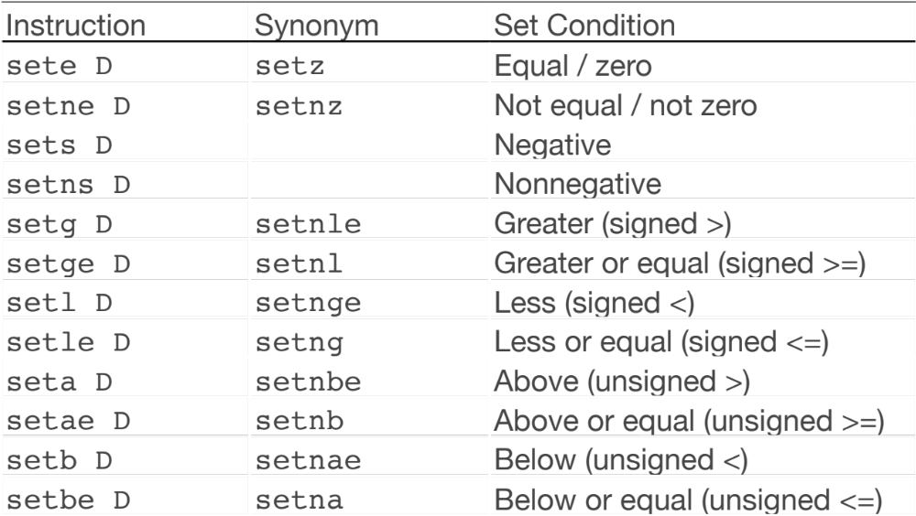
Conditionally Setting Bytes
(1 if true, 0 if false)

Slide 32
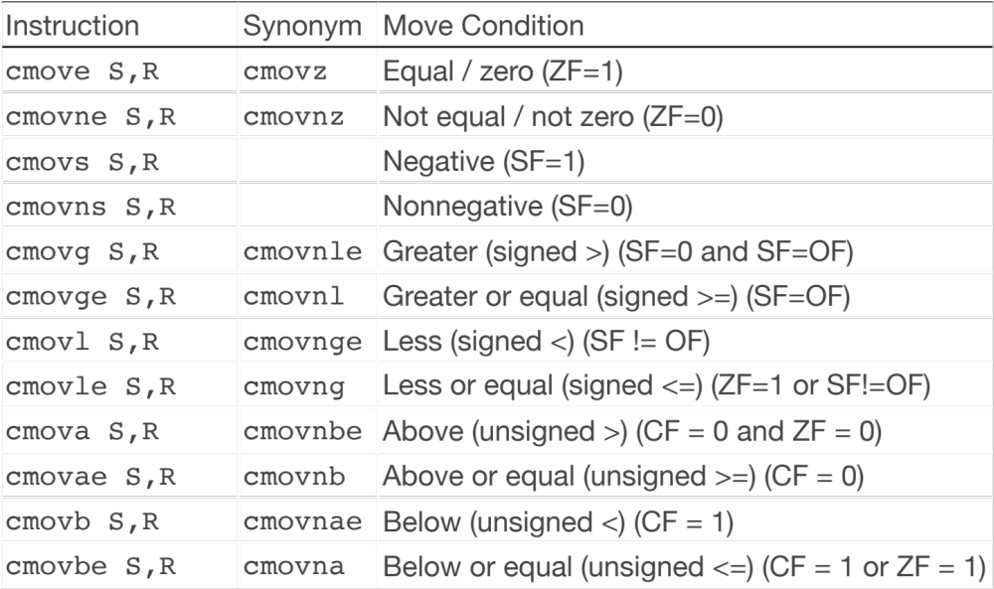
Conditionally Moving Data

Slide 33
jmp
The jmp instruction jumps to another instruction in the assembly code (“Unconditional Jump”).
jmp Label (Direct Jump)
jmp *Operand (Indirect Jump)
The destination can be hardcoded into the instruction (direct jump):
jmp 404f8 <loop+0xb> # jump to instruction at 0x404f8
The destination can also be read from a memory location (indirect jump):
jmp *%rax # jump to instruction at address in %rax

Slide 34
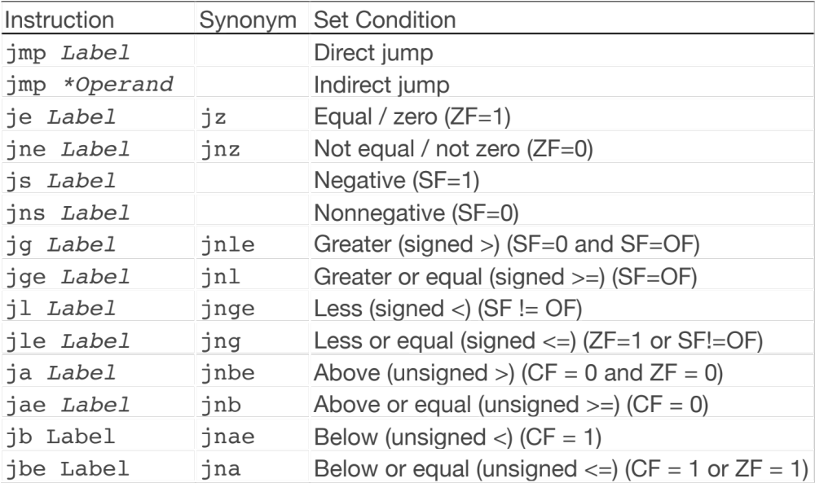
Conditional Jumps
There are also variants of jmp that jump only if certain conditions are true (“Conditional Jump”). The jump location for these must be hardcoded into the instruction.

Slide 35
Loops and Control Flow
Jump instructions are critical to implementing control flow in assembly. Let’s see why!

Slide 36
Plan For Today
Recap: Arithmetic and Logic
Control Flow
  Condition Codes
  Assembly Instructions
  If statements
  While loops
  For loops

Slide 37
Practice: Fill In The Blank
C Code
What does this assembly code translate to?
int if_then(int param1) {
if (__________) {
__________;
}
return ______;
}
00000000004004d6 <if_then>:
4004d6: cmp $0x6,%edi
4004d9: jne 4004de
4004db: add $0x1,%edi
4004de: lea (%rdi,%rdi,1),%eax
4004e1: retq

Slide 38
Practice: Fill In The Blank
C Code
What does this assembly code translate to?
int if_then(int param1) {
if (param1 == 6) {
__________;
}
return ______;
}
00000000004004d6 <if_then>:
4004d6: cmp $0x6,%edi
4004d9: jne 4004de
4004db: add $0x1,%edi
4004de: lea (%rdi,%rdi,1),%eax
4004e1: retq

Slide 39
Practice: Fill In The Blank
C Code
What does this assembly code translate to?
int if_then(int param1) {
if (param1 == 6) {
param1++;
}
return ______;
}
00000000004004d6 <if_then>:
4004d6: cmp $0x6,%edi
4004d9: jne 4004de
4004db: add $0x1,%edi
4004de: lea (%rdi,%rdi,1),%eax
4004e1: retq

Slide 40
Practice: Fill In The Blank
C Code
What does this assembly code translate to?
int if_then(int param1) {
if (param1 == 6) {
param1++;
}
return param1 * 2;
}
00000000004004d6 <if_then>:
4004d6: cmp $0x6,%edi
4004d9: jne 4004de
4004db: add $0x1,%edi
4004de: lea (%rdi,%rdi,1),%eax
4004e1: retq

Slide 41
Common If-Else Construction
If-Else In C
If-Else In Assembly
if (num > 3) {
x = 10;
} else {
x = 7;
}
num++;
Test
Jump past if-body if test fails
If-body
Jump past else-body
Else-body
Past else body

Slide 42
Announcements
Midterm statistics updated on course website
Assignment 6 released tomorrow – Assembly exercises
  Security
  Reverse engineering

Slide 43
Plan For Today
Recap: Arithmetic and Logic
Control Flow
  Condition Codes
  Assembly Instructions
  If statements
  While loops
  For loops

Slide 44
Loops and Control Flow
void loop() {
int i = 0;
while (i < 100) {
i++;
}
}
0x0000000000400570 <+0>: mov $0x0,%eax
0x0000000000400575 <+5>: jmp 0x40057a <loop+10>
0x0000000000400577 <+7>: add $0x1,%eax
0x000000000040057a <+10>: cmp $0x63,%eax
0x000000000040057d <+13>: jle 0x400577 <loop+7>
0x000000000040057f <+15>: repz retq

Slide 45
Loops and Control Flow
void loop() {
int i = 0;
while (i < 100) {
i++;
}
}
0x0000000000400570 <+0>: mov $0x0,%eax
0x0000000000400575 <+5>: jmp 0x40057a <loop+10>
0x0000000000400577 <+7>: add $0x1,%eax
0x000000000040057a <+10>: cmp $0x63,%eax
0x000000000040057d <+13>: jle 0x400577 <loop+7>
0x000000000040057f <+15>: repz retq
Set %eax (i) to 0.

Slide 46
Loops and Control Flow
void loop() {
int i = 0;
while (i < 100) {
i++;
}
}
0x0000000000400570 <+0>: mov $0x0,%eax
0x0000000000400575 <+5>: jmp 0x40057a <loop+10>
0x0000000000400577 <+7>: add $0x1,%eax
0x000000000040057a <+10>: cmp $0x63,%eax
0x000000000040057d <+13>: jle 0x400577 <loop+7>
0x000000000040057f <+15>: repz retq
Jump to another instruction.

Slide 47
Loops and Control Flow
void loop() {
int i = 0;
while (i < 100) {
i++;
}
}
0x0000000000400570 <+0>: mov $0x0,%eax
0x0000000000400575 <+5>: jmp 0x40057a <loop+10>
0x0000000000400577 <+7>: add $0x1,%eax
0x000000000040057a <+10>: cmp $0x63,%eax
0x000000000040057d <+13>: jle 0x400577 <loop+7>
0x000000000040057f <+15>: repz retq
Compare %eax (i) to 0x63 (99) by calculating %eax – 0x63. This is 0 – 99 = -99, so it sets the Sign Flag to 1.

Slide 48
Loops and Control Flow
void loop() {
int i = 0;
while (i < 100) {
i++;
}
}
0x0000000000400570 <+0>: mov $0x0,%eax
0x0000000000400575 <+5>: jmp 0x40057a <loop+10>
0x0000000000400577 <+7>: add $0x1,%eax
0x000000000040057a <+10>: cmp $0x63,%eax
0x000000000040057d <+13>: jle 0x400577 <loop+7>
0x000000000040057f <+15>: repz retq
jle means “jump if less than or equal”. The sign flag indicates the result was negative, so we jump.

Slide 49
Loops and Control Flow
void loop() {
int i = 0;
while (i < 100) {
i++;
}
}
0x0000000000400570 <+0>: mov $0x0,%eax
0x0000000000400575 <+5>: jmp 0x40057a <loop+10>
0x0000000000400577 <+7>: add $0x1,%eax
0x000000000040057a <+10>: cmp $0x63,%eax
0x000000000040057d <+13>: jle 0x400577 <loop+7>
0x000000000040057f <+15>: repz retq
Add 1 to %eax (i).

Slide 50
Loops and Control Flow
void loop() {
int i = 0;
while (i < 100) {
i++;
}
}
0x0000000000400570 <+0>: mov $0x0,%eax
0x0000000000400575 <+5>: jmp 0x40057a <loop+10>
0x0000000000400577 <+7>: add $0x1,%eax
0x000000000040057a <+10>: cmp $0x63,%eax
0x000000000040057d <+13>: jle 0x400577 <loop+7>
0x000000000040057f <+15>: repz retq
Compare %eax (i) to 0x63 (99) by calculating %eax – 0x63. This is 1 – 99 = -98, so it sets the Sign Flag to 1.

Slide 51
Loops and Control Flow
void loop() {
int i = 0;
while (i < 100) {
i++;
}
}
0x0000000000400570 <+0>: mov $0x0,%eax
0x0000000000400575 <+5>: jmp 0x40057a <loop+10>
0x0000000000400577 <+7>: add $0x1,%eax
0x000000000040057a <+10>: cmp $0x63,%eax
0x000000000040057d <+13>: jle 0x400577 <loop+7>
0x000000000040057f <+15>: repz retq
jle means “jump if less than or equal”. The sign flag indicates the result was negative, so we jump.

Slide 52
Loops and Control Flow
void loop() {
int i = 0;
while (i < 100) {
i++;
}
}
0x0000000000400570 <+0>: mov $0x0,%eax
0x0000000000400575 <+5>: jmp 0x40057a <loop+10>
0x0000000000400577 <+7>: add $0x1,%eax
0x000000000040057a <+10>: cmp $0x63,%eax
0x000000000040057d <+13>: jle 0x400577 <loop+7>
0x000000000040057f <+15>: repz retq
We continue in this pattern until we do not make this conditional jump. When will that be?

Slide 53
Loops and Control Flow
void loop() {
int i = 0;
while (i < 100) {
i++;
}
}
0x0000000000400570 <+0>: mov $0x0,%eax
0x0000000000400575 <+5>: jmp 0x40057a <loop+10>
0x0000000000400577 <+7>: add $0x1,%eax
0x000000000040057a <+10>: cmp $0x63,%eax
0x000000000040057d <+13>: jle 0x400577 <loop+7>
0x000000000040057f <+15>: repz retq
We will stop looping when this comparison says that %eax – 0x63 > 0!

Slide 54
Loops and Control Flow
void loop() {
int i = 0;
while (i < 100) {
i++;
}
}
0x0000000000400570 <+0>: mov $0x0,%eax
0x0000000000400575 <+5>: jmp 0x40057a <loop+10>
0x0000000000400577 <+7>: add $0x1,%eax
0x000000000040057a <+10>: cmp $0x63,%eax
0x000000000040057d <+13>: jle 0x400577 <loop+7>
0x000000000040057f <+15>: repz retq
Then, we return from the function.

Slide 55
Common While Loop Construction
C
Assembly
while (test) {
body
}
Jump to test
Body
Test
Jump to body if success
From Previous Slide:
0x0000000000400570 <+0>: mov $0x0,%eax
0x0000000000400575 <+5>: jmp 0x40057a <loop+10>
0x0000000000400577 <+7>: add $0x1,%eax
0x000000000040057a <+10>: cmp $0x63,%eax
0x000000000040057d <+13>: jle 0x400577 <loop+7>
0x000000000040057f <+15>: repz retq

Slide 56
Plan For Today
Recap: Arithmetic and Logic
Control Flow
  Condition Codes
  Assembly Instructions
  If statements
  While loops
  For loops

Slide 57
Common For Loop Construction
C
for (init; test; update) {
body
}

Slide 58
Common For Loop Construction
C
C Equivalent While Loop
for (init; test; update) {
body
}
init
while(test) {
body
update
}

Slide 59
Common For Loop Construction
C
C Equivalent While Loop
for (init; test; update) {
body
}
init
while(test) {
body
update
}
While Loop Assembly
Jump to test
Body
Test
Jump to body if success

Slide 60
Common For Loop Construction
C
C Equivalent While Loop
for (init; test; update) {
body
}
init
while(test) {
body
update
}
For Loop Assembly
Init
Jump to test
Body
Update
Test
Jump to body if success

Slide 61
GCC For Loop Output
GCC For Loop Output
Possible Alternative?
Initialization
Jump to test
Body
Update
Test
Jump to body if success
Initialization
Test
Jump past loop if fails
Body
Update
Jump to test

Slide 62
GCC For Loop Output
for (int i = 0; i < n; i++) // n = 100
GCC For Loop Output
Optimized For Loop Output
Initialization
Jump to test
Body
Update
Test
Jump to body if success
Initialization
Test
Jump past loop if fails
Body
Update
Test
Jump to body if succeeds

Slide 63
GCC For Loop Output
for (int i = 0; i < n; i++) // n = 100
Initialization
Jump to test
Test
Jump to body
Body
Update
Test
Jump to body
Body
Update
Test
Jump to body
...
GCC For Loop Output
Optimized For Loop Output
Initialization
Jump to test
Body
Update
Test
Jump to body if success
Initialization
Test
Jump past loop if fails
Body
Update
Test
Jump to body if succeeds

Slide 64
GCC For Loop Output
for (int i = 0; i < n; i++) // n = 100
Initialization
Jump to test
Test
Jump to body
Body
Update
Test
Jump to body
Body
Update
Test
Jump to body
...
GCC For Loop Output
Optimized For Loop Output
Initialization
Jump to test
Body
Update
Test
Jump to body if success
Initialization
Test
Jump past loop if fails
Body
Update
Test
Jump to body if succeeds

Slide 65
GCC For Loop Output
for (int i = 0; i < n; i++) // n = 100
Initialization
Test
No jump
Body
Update
Jump to test
Test
No jump
Body
Update
Jump to test
...
Standard For Loop Output
Possible Alternative?
Initialization
Jump to test
Body
Update
Test
Jump to body if success
Initialization
Test
Jump past loop if fails
Body
Update
Jump to test

Slide 66
GCC For Loop Output
for (int i = 0; i < n; i++) // n = 100
Initialization
Test
No jump
Body
Update
Jump to test
Test
No jump
Body
Update
Jump to test
...
Standard For Loop Output
Possible Alternative?
Initialization
Jump to test
Body
Update
Test
Jump to body if success
Initialization
Test
Jump past loop if fails
Body
Update
Jump to test

Slide 67
GCC For Loop Output
GCC For Loop Output
Possible Alternative?
Initialization
Jump to test
Body
Update
Test
Jump to body if success
Initialization
Test
Jump past loop if fails
Body
Update
Jump to test
Which instructions are better when n = 0?
for (int i = 0; i < n; i++) // n = 100

Slide 68
Optimizing Instruction Counts
Both of these loop forms have the same static instruction count – same number of written instructions.
But they have different dynamic instruction counts – the number of times these instructions are executed when the program is run.
  If n = 0, right is best
  If n is large, left is best
The compiler may emit static instruction counts many times longer than alternatives, but which is more efficient if loop executes many times.
Problem: the compiler may not know whether the loop will execute many times! Hard problem….. (take EE108, EE180, CS316 for more!)

Slide 69
Optimizations
Conditional Moves can sometimes eliminate “branches” (jumps), which are particularly inefficient on modern computer hardware.
Processors try to predict the future execution of instructions for maximum performance. This is difficult to do with jumps.

Slide 70
Practice: Fill In The Blank
C Code
What does this assembly code translate to?
long loop(long a, long b) {
long result = _______;
while (_________) {
result = __________;
a = _________;
}
return result;
}
// a in %rdi, b in %rsi
loop:
movl $1, %eax
jmp .L2
.L3
leaq (%rdi,%rsi), %rdx
imulq %rdx, %rax
addq $1, %rdi
.L2
cmpq %rsi, %rdi
jl .L3
rep; ret
Notes:
Think Pair. Share

Slide 71
Practice: Fill In The Blank
C Code
What does this assembly code translate to?
long loop(long a, long b) {
long result = 1;
while (a < b) {
result = result*(a+b);
a = a + 1;
}
return result;
}
// a in %rdi, b in %rsi
loop:
movl $1, %eax
jmp .L2
.L3
leaq (%rdi,%rsi), %rdx
imulq %rdx, %rax
addq $1, %rdi
.L2
cmpq %rsi, %rdi
jl .L3
rep; ret

Slide 72
Plan For Today
Recap: Arithmetic and Logic
Control Flow
  Condition Codes
  Assembly Instructions
  If statements
  While loops
  For loops
Next time: function calls in assembly

