Slide 1
CS107, Lecture 1
Welcome to CS107!
reading:
General Information page
Bryant & O’Hallaron, Ch. 1 (skim)
Honor Code and Collaboration Page

Slide 2
Plan For Today
Introduction
CS107 Course Policies
Unix and the Command Line
Getting Started With C

Slide 3

CS107 on Zoom
You are encouraged to share video!
Post questions/comments/followups on the discussion forum thread for that day’s lecture. We’ll take periodic “question breaks” to address them.
Everyone is muted by default.
Join: https://edstem.org/us/join/KejgJ4
Today’s thread: https://edstem.org/us/courses/5239/discussion/336073

Slide 4
Plan For Today
Introduction
CS107 Course Policies
Unix and the Command Line
Getting Started With C

Slide 5
What is CS107?
The CS106 series:
Taught you how to solve problems as a programmer
Many times, CS106 instructors had to say, “just don’t worry about that,” or “it probably doesn’t make sense why that happens, but ignore it for now”
CS107 finally takes you behind the scenes:
Not quite down to hardware or physics/electromagnetism (that’s for later...)
It’s how things work inside C++/Python/Java, and how your programs map onto the components of computer systems
Not only does it just feel good to know how these work, it can also inform projects you work on in the future.

Slide 6
What is CS107?
Computer Organization and Systems
How languages like C++ and Java represent data under the hood
How programming structures are encoded in bits and bytes
How to efficiently manipulate and manage memory
How computers compile programs
Uses the C programming language
Programming style and software development practices

Slide 7
CS107 Learning Goals
The goals for CS107 are for students to gain mastery of
- writing C programs with complex use of memory and pointers
- an accurate model of the address space and compile/runtime behavior of C programs
to achieve competence in
- translating C to/from assembly
- writing programs that respect the limitations of computer arithmetic
- identifying bottlenecks and improving runtime performance
- working effectively in a Unix development environment
and have exposure to
- a working understanding of the basics of computer architecture

Slide 8
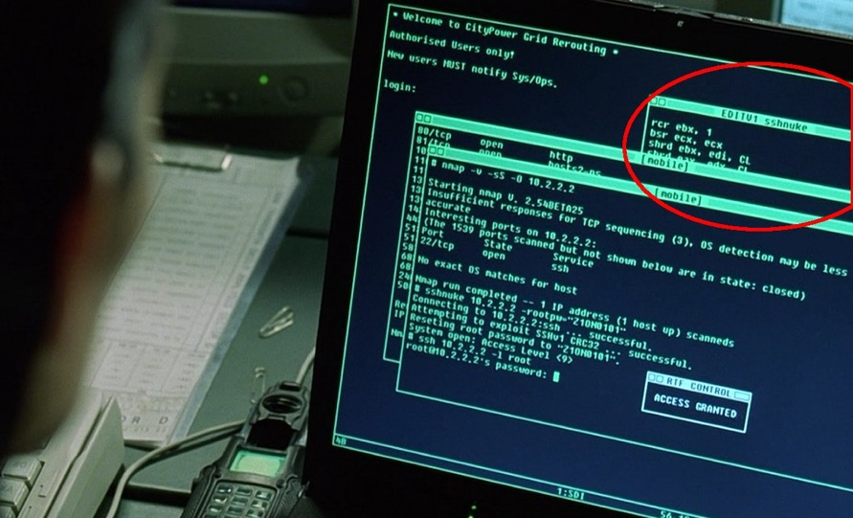
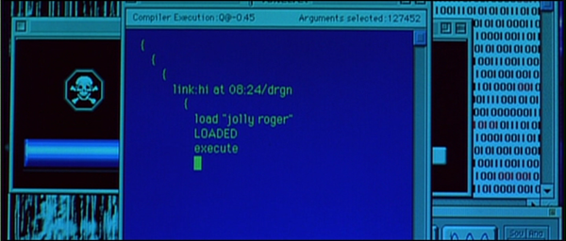
CS107 Learning Goals
(also learn to identify legitimate programmer scenes in old movies)
Jeff Goldblum’s character saving the world by uploading a virus to
the alien mothership
Independence Day, 1996
Trinity saving the world by hacking into the power grid using Nmap Network Scanning
The Matrix Reloaded, 2003

Slide 9
Course Overview
Bits and Bytes - How can a computer represent integer numbers?
Chars and C-Strings - How can a computer represent and manipulate more complex data like text?
Pointers, Stack and Heap – How can we effectively manage all types of memory in our programs?
Generics - How can we use our knowledge of memory and data representation to write code that works with any data type?
Assembly - How does a computer interpret and execute C programs?
Heap Allocators - How do core memory-allocation operations like malloc and free work?
Notes:
Don’t list everything, just pick a few

Slide 10
CS107 Online
This quarter, we are making many adjustments and changes to make CS107 the best it can be in an online format.
We are working to emphasize community and connection.
We understand the unprecedented situation this quarter presents for everyone involved.
We will constantly evaluate and listen to ensure the class is going as smoothly as possible for everyone.
Please communicate with us if any personal circumstances or issues arise! We are here to support you.

Slide 11
CS107 Online
This quarter, we are making many adjustments and changes to make CS107 the best it can be in an online format.
We are working to emphasize community and connection.
We understand the unprecedented situation this quarter presents for everyone involved.
We will constantly evaluate and listen to ensure the class is going as smoothly as possible for everyone.
Please communicate with us if any personal circumstances or issues arise! We are here to support you.

Slide 12
A Wonderful Community ❤️
Tapioca Boba tea just became a fave. I'll most likely be using it to calm my nerves when working on assignments.
I used to be a ballroom dancer and was on Dancing with The Stars as a kid :)
I started learning violin this year
I’m a whitewater kayaker and rock climber!
I'm a little worried this course is too difficult for me...
I’m starting lessons this quarter to receive my pilot’s license!
I heard this class is a weeder class?
I believe the Broadway musical "Cats" is highly underrated.
I’m filling out this form in line at Blaze pizza
*Quotes taken from CS107 welcome survey

Slide 13
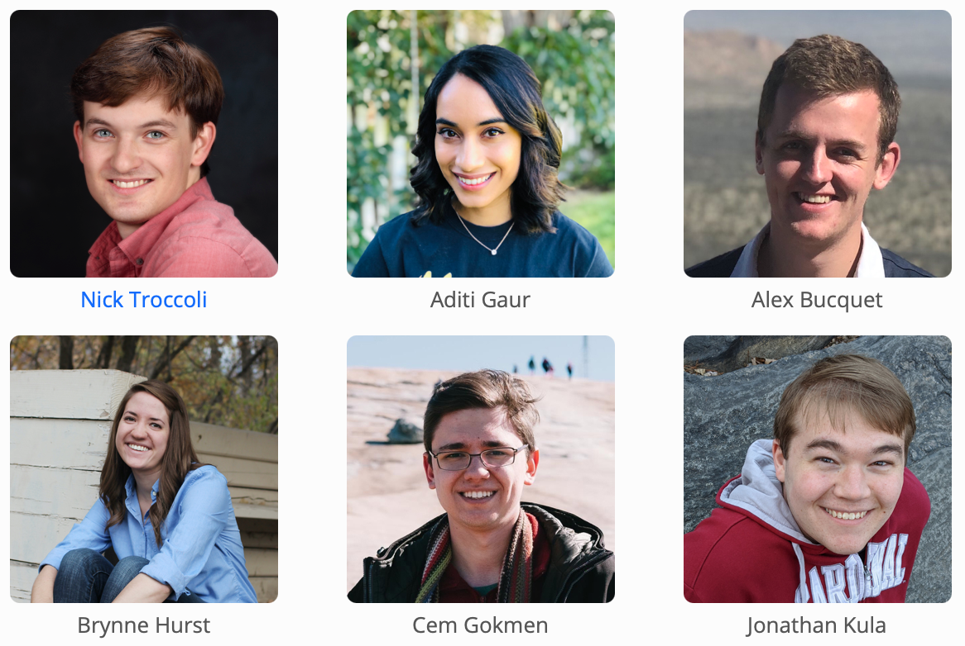

Teaching Team
About Nick Troccoli (troccoli@Stanford.edu):
Stanford BS/MS (coterm) in CS
Systems track undergrad, AI track grad
Systems has played a key part in my discovery of CS. I hope it will for you too ☺

Slide 14
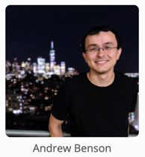
Companion Class: CS107A
CS107A is an extra 1-unit “Pathfinders” or “ACE” section with additional course support, practice and instruction.
Meets for an additional weekly section and has additional review sessions
Entry by application – see the FAQ on the course website for details

Slide 15
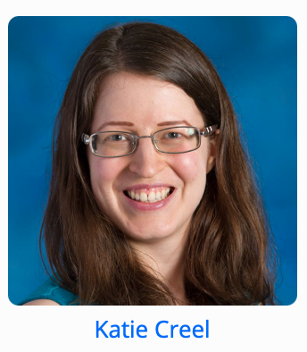
CS107 Embedded Ethics
This quarter, we’re working to embed additional ethics content throughout the course.

Slide 16
Course Website
cs107.stanford.edu
*lecture videos on Canvas
Notes:
Go there for quick tour

Slide 17
Question Break!

Slide 18
Plan For Today
Introduction
CS107 Course Policies
Unix and the Command Line
Getting Started With C

Slide 19
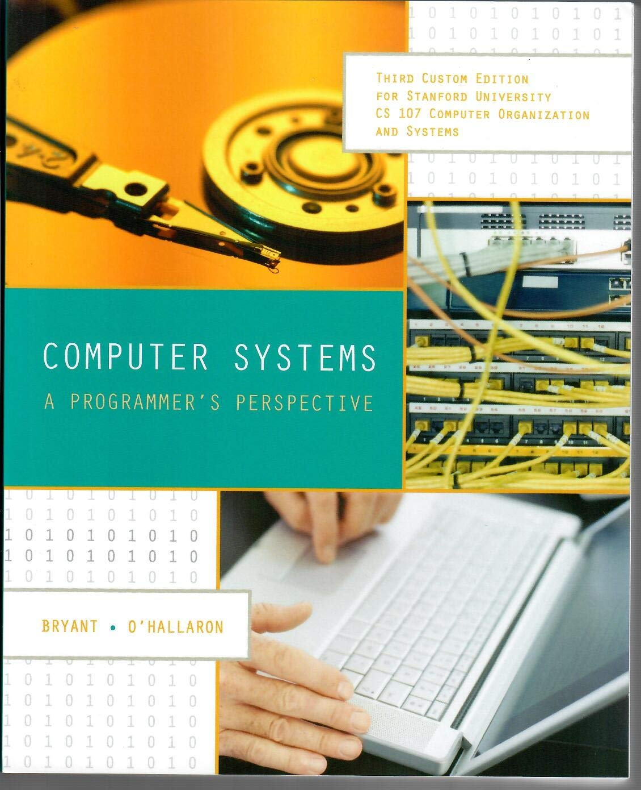

Textbook(s)
Computer Systems: A Programmer’s Perspective by Bryant & O’Hallaron, 3rd Edition
  3rd edition matters – important updates to content
  Stanford Library has generously scanned all readings for CS107 under “fair use” (private study, scholarship, research). [Canvas -> Files]. Please do not distribute.
  If you want more context, or if you plan to continue onto CS110, you may want to purchase a full copy
A C programming reference of your choice
  The C Programming Language by Kernighan and Ritchie (free link on course website Resources page)
  Other C programming books, websites, or reference sheets
Full textbook
CS107 full chapters
CS107-specific readings
The textbook (and C programming references) are very good resources in this course, especially post-midterm!
Notes:
t’s also good to give a reminder to the students that the PDF shouldn’t be distributed/reuploaded anywhere beyond their personal computers.

Slide 20
Course Structure
Lectures*: understand concepts, see demos
Assignments: build programming skills, synthesize lecture/lab content
Labs: learn tools, study code, discuss with peers
assign0: out later today, due next Monday (covers today’s lecture)
*Lectures are “flipped” (pre-recorded) on Canvas; live lecture is optional review and Q&A
Great preview of homework!
 | Monday | Tues-Thurs | Friday
Week N |  |  | Lecture: part A
Week N+1 | Lecture: part B assignN released | Lab

Slide 21
Grading
  * 10% Lecture Check-in Quizzes
  ***** 45% Assignments
  ** 20% Final Project
  * 10% Mid-quarter Assessment
  ** 15% Lab Participation
Read our full course policies document:
https://cs107.stanford.edu/syllabus.html

Slide 22
Grading
  * 10% Lecture Check-in Quizzes
  ***** 45% Assignments
  ** 20% Final Project
  * 10% Mid-quarter Assessment
  ** 15% Lab Participation
Read our full course policies document:
https://cs107.stanford.edu/syllabus.html

Slide 23
Lecture Check-in Quizzes
Main lecture material is pre-recorded in short video “bytes” (get it?) and posted in advance of live lecture.
Short “lecture check-in quizzes” after each ~1-2 videos, permitting 3 attempts, due by that live lecture.
Each day’s worth of lecture quizzes are weighted the same in aggregate.
Live lecture times are optional, will be 30-45 minutes max, and we instead review concepts further, answer questions, and do additional exercises.
You can submit questions in advance of the live lectures or bring questions!

Slide 24
Lecture Watch Parties 🎉
All lecture content (including live sessions) is recorded and available on Canvas. Main lecture material is pre-recorded; live sessions are posted afterwards.
We will be facilitating lecture watch parties to encourage you to watch lecture videos with others!
Hosted by TAs and optionally by you!
Small part of your lecture quiz grade is attending at least 1 per week
Using Nooks (website we also use for Helper Hours)
Starting next week - More info to come soon

Slide 25
Question Break!
Read our full course policies document:
https://cs107.stanford.edu/syllabus.html

Slide 26
Grading
  * 10% Lecture Check-in Quizzes
  ***** 45% Assignments
  ** 20% Final Project
  * 10% Mid-quarter Assessment
  ** 15% Lab Participation
Read our full course policies document:
https://cs107.stanford.edu/syllabus.html

Slide 27
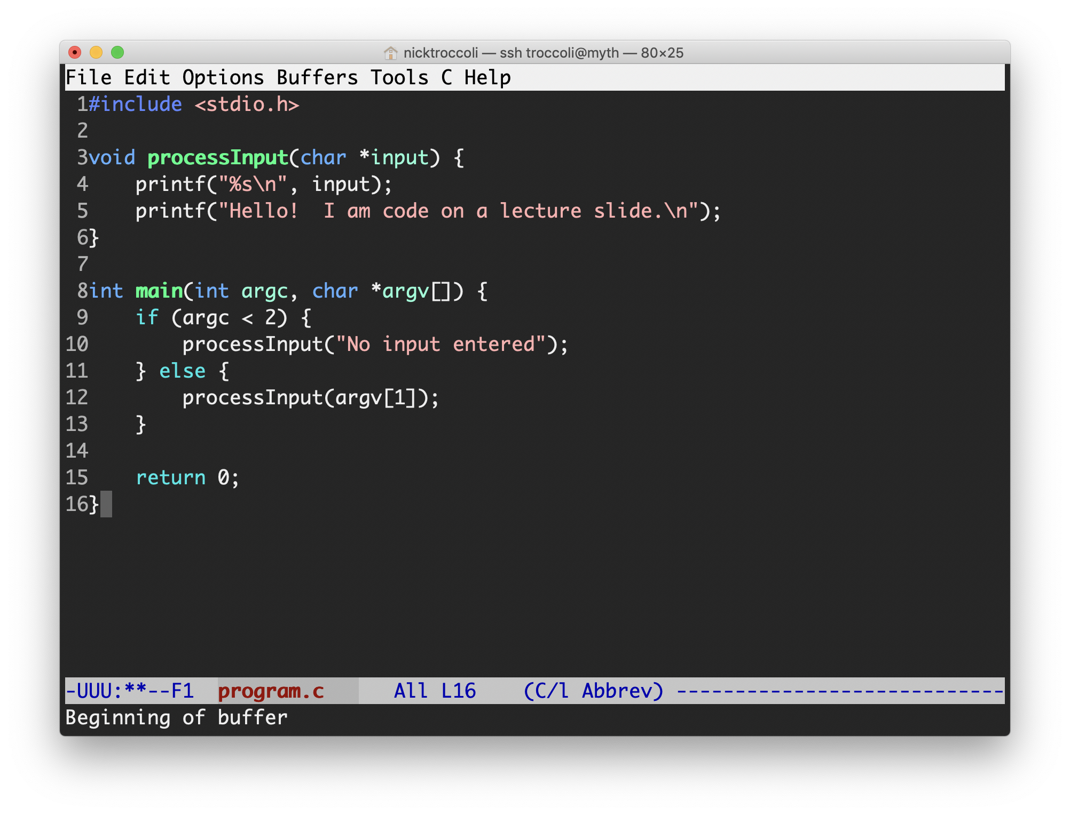
Assignments
6 programming assignments completed individually using Unix command line tools
  Free software, pre-installed on Myth machines / available on course website
  We will give out starter projects for each assignment
Graded on functionality (behavior) and style (elegance)
  Functionality graded using automated tools, given as point score – no TA review
  Style graded via automated tests and TA code review, given as bucket score
  Grades returned via course website
Notes:
AUTOMATED functionality grading

Slide 28
The Style Bucket System
+ | An outstanding job; could be used as course example code for good style.
ok | A good job; solid effort, but also opportunities for improvement.
- | Shows some effort and understanding but has larger problems that should be focused on.
- - | Shows many significant issues and does not represent passing work.
0 | No work submitted, or barely any changes from the starter assignment.
Notes:
Mostly ok

Slide 29
Late Policy
Start out with 5 “free late days”: each late day allows you to submit an assignment up to 24 additional hours late without penalty. (No late days permitted for final project)
Hard deadline 48 hours after original due date
Penalty per day after late days are exhausted (1 day: 80% cap; 2 days: 60% cap)
Late days are “pre-granted extensions” – additional extensions for exceptional circumstances must be approved by the instructor. Please communicate with us! We are here to accommodate you as much as possible.

Slide 30
Grading
  * 10% Lecture Check-in Quizzes
  ***** 45% Assignments
  ** 20% Final Project
  * 10% Mid-quarter Assessment
  ** 15% Lab Participation
Read our full course policies document:
https://cs107.stanford.edu/syllabus.html

Slide 31
Final Project
The final project has you implement your own “heap allocator” – a fundamental component of many of the programs we will write this quarter.
We first use it as clients, and then we implement it!
Capstone individual project that sums up topics from throughout the quarter.
You must do the final project in order to pass the class.

Slide 32
Question Break!
Read our full course policies document:
https://cs107.stanford.edu/syllabus.html

Slide 33
Grading
  * 10% Lecture Check-in Quizzes
  ***** 45% Assignments
  ** 20% Final Project
  * 10% Mid-quarter Assessment
  ** 15% Lab Participation
Read our full course policies document:
https://cs107.stanford.edu/syllabus.html

Slide 34
Mid-Quarter Assessment
Available from Wed. 5/5 – Fri 5/7
Open-book, timed assessment; you can choose when to start
We aim for a lower-stakes assessment instead of a traditional midterm:
  Weighted 10%
  Flexible timing
  Assessment will be written to minimize time pressure
  Primary goal: reinforce concepts learned to that point
Covers material from assign1-3 and lightly touches on assign4

Slide 35
Grading
  * 10% Lecture Check-in Quizzes
  ***** 45% Assignments
  ** 20% Final Project
  * 10% Mid-quarter Assessment
  ** 15% Lab Participation
Read our full course policies document:
https://cs107.stanford.edu/syllabus.html

Slide 36
Lab Sections
Weekly 1 hour labs led by a CA, starting next week, offered on Tuesdays, Wednesdays and Thursdays.
Hands-on practice in small groups with lecture material and course concepts.
Graded on attendance + participation
Lab preference submissions open Tuesday 3/30 at 5PM PST and are not first-come first-serve. You may submit your preferences anytime until Saturday 4/3 at 5PM PST. Sign up on the course website.

Slide 37
Question Break!
Read our full course policies document:
https://cs107.stanford.edu/syllabus.html

Slide 38
Grading
  * 10% Lecture Check-in Quizzes
  ***** 45% Assignments
  ** 20% Final Project
  * 10% Mid-quarter Assessment
  ** 15% Lab Participation
Read our full course policies document:
https://cs107.stanford.edu/syllabus.html

Slide 39
Getting Help
Post on the Discussion Forum
  Online discussion forum for students; post questions, answer other students’ questions
  Best for course material discussions, course policy questions or general assignment questions (DON’T POST ASSIGNMENT CODE!)
Visit Helper Hours
  24/7 open community where you can chat about course topics or just hang out
  Using Nooks
  Work anytime with other students or come at scheduled times for TA help; schedule will be posted on course website tomorrow.
  Best for group work, coding/debugging questions (with TAs only!) or longer course material discussions
Email the Course Staff
  cs107@cs.stanford.edu – please do not email CAs individually
  Best for private matters (e.g. grading questions, OAE accommodations).

Slide 40
Stanford Honor Code
The Honor Code is an undertaking of the students, individually and collectively:
  that they will not give or receive aid in examinations; that they will not give or receive unpermitted aid in class work, in the preparation of reports, or in any other work that is to be used by the instructor as the basis of grading;
  that they will do their share and take an active part in seeing to it that others as well as themselves uphold the spirit and letter of the Honor Code.
The faculty on its part manifests its confidence in the honor of its students by refraining from proctoring examinations and from taking unusual and unreasonable precautions to prevent the forms of dishonesty mentioned above. The faculty will also avoid, as far as practicable, academic procedures that create temptations to violate the Honor Code.
While the faculty alone has the right and obligation to set academic requirements, the students and faculty will work together to establish optimal conditions for honorable academic work.
see also: http://honorcode.stanford.edu/
It is your responsibility to ensure you have read and are familiar with the honor code guidelines posted on the main page of the CS107 course website. Please read them and come talk to us if you have any questions or concerns.
Notes:
Environment for all to do best work

Slide 41
Honor Code and CS107
Please help us ensure academic integrity:
  Indicate any assistance received on HW (books, friends, etc.).
  Do not look at other people's solution code or answers
  Do not give your solutions to others or post them on the web or our Ed forum.
  Report any inappropriate activity you see performed by others.
Assignments are checked regularly for similarity with help of software tools.
If you need help, please contact us and we will help you.
  We do not want you to feel any pressure to violate the Honor Code in order to succeed in this course.
  If you realize that you have made a mistake, you may retract your submission to any assignment at any time, no questions asked.
https://cs107.stanford.edu/collaboration

Slide 42
OAE Accommodations
Please email the course staff (cs107@cs.stanford.edu) as soon as possible with any accommodations you may need for the course.
We are eager to do everything we can to support you and make you successful in CS107!

Slide 43
Question Break!

Slide 44
Plan For Today
Introduction
CS107 Course Policies
Unix and the Command Line
Getting Started With C

Slide 45

What is Unix?
Unix: a set of standards and tools commonly used in software development.
  macOS and Linux are operating systems built on top of Unix
You can navigate a Unix system using the command line (“terminal”)
Every Unix system works with the same tools and commands

Slide 46

What is the Command Line?
The command-line is a text-based interface (i.e., terminal interface) to navigate a computer, instead of a Graphical User Interface (GUI).
Graphical User Interface
Text-based interface

Slide 47
Command Line Vs. GUI
Just like a GUI file explorer interface, a terminal interface:
shows you a specific place on your computer at any given time.
lets you go into folders and out of folders.
lets you create new files and edit files.
lets you execute programs.
Graphical User Interface
Command-line interface

Slide 48
Why Use Unix / the Command Line?
You can navigate almost any device using the same tools and commands:
  Servers
  Laptops and desktops
  Embedded devices (Raspberry Pi, etc.)
  Mobile Devices (Android, etc.)
Used frequently by software engineers:
  Web development: running servers and web tools on servers
  Machine learning: processing data on servers, running algorithms
  Systems: writing operating systems, networking code and embedded software
  Mobile Development: running tools, managing libraries
  And more…
We’ll use Unix and the command line to implement and execute our programs.
Notes:
Remote access is easy

Slide 49
Unix Commands To Try
cd – change directories (..)
ls – list directory contents
mkdir – make directory
emacs – open text editor
rm – remove file or folder
man – view manual pages
See the course website for more commands and a complete reference.

Slide 50
Demo: Using Unix and the Command Line
Get up and running with our guide:
http://cs107.stanford.edu/resources/getting-started.html
Notes:
Everything documented in next slide!

Slide 51
Unix Commands Recap
cd – change directories (..)
ls – list directory contents
mkdir – make directory
emacs – open text editor
rm – remove file or folder
man – view manual pages
See the course website for more commands and a complete reference.

Slide 52
Learning Unix and the Command Line
Using Unix and the command line can be intimidating at first:
  It looks retro!
  How do I know what to type?
It’s like learning a new language:
  At first, you may have to constantly look things up (resources on course website!)
  It’s important to spend as much time as possible (during labs and assignments) building muscle memory with the tools
Notes:
Ask questions!

Slide 53
Question Break!
Get up and running with our guide:
http://cs107.stanford.edu/resources/getting-started.html

Slide 54
Plan For Today
Introduction
CS107 Course Policies
Unix and the Command Line
Getting Started With C

Slide 55
The C Language
C was created around 1970 to make writing Unix and Unix tools easier.
Part of the C/C++/Java family of languages (C++ and Java were created later)
Design principles:
  Small, simple abstractions of hardware
  Minimalist aesthetic
  Prioritizes efficiency and minimalism over safety and high-level abstractions

Slide 56
C vs. C++ and Java
They all share:
Syntax
Basic data types
Arithmetic, relational, and logical operators
C limitations:
No advanced features like operator overloading, default arguments, pass by reference, classes and objects, ADTs, etc.
No extensive libraries (no graphics, networking, etc.) – Small language footprint means not much to learn ☺
Weak compiler and almost no runtime checks (this may cause security vulnerabilities!)

Slide 57
Programming Language Philosophies
C is procedural: you write functions, rather than define new variable types with classes and call methods on objects. C is small, fast and efficient.
C++ is procedural, with objects: you write functions, and define new variable types with classes, and call methods on objects.
Python is also procedural, but dynamically typed: you still write functions and call methods on objects, but the development process is very different.
Java is object-oriented: virtually everything is an object, and everything you write needs to conform to the object-oriented design pattern.
Notes:
C++ is C+1!

Slide 58
Why C?
Many tools (and even other languages, like Python!) are built with C.
C is the language of choice for fast, highly efficient programs.
C is popular for systems programming (operating systems, networking, etc.)
C lets you work at a lower level to manipulate and understand the underlying system.
Notes:
Manipulations that are easy in C, harder elsewhere

Slide 59
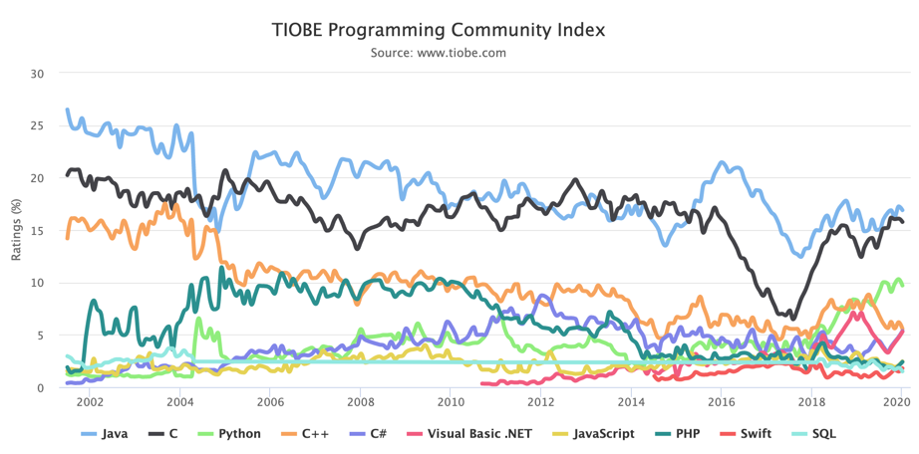
Programming Language Popularity
https://www.tiobe.com/tiobe-index/

Slide 60
Our First C Program
/*
* hello.c
* This program prints a welcome message
* to the user.
*/
#include <stdio.h> // for printf
int main(int argc, char *argv[]) {
printf("Hello, world!\n");
return 0;
}

Slide 61
Our First C Program
/*
* hello.c
* This program prints a welcome message
* to the user.
*/
#include <stdio.h> // for printf
int main(int argc, char *argv[]) {
printf("Hello, world!\n");
return 0;
}
Program comments
You can write block or inline comments.

Slide 62
Our First C Program
/*
* hello.c
* This program prints a welcome message
* to the user.
*/
#include <stdio.h> // for printf
int main(int argc, char *argv[]) {
printf("Hello, world!\n");
return 0;
}
Import statements
C libraries are written with angle brackets.
Local libraries have quotes:
#include "lib.h"

Slide 63
Our First C Program
/*
* hello.c
* This program prints a welcome message
* to the user.
*/
#include <stdio.h> // for printf
int main(int argc, char *argv[]) {
printf("Hello, world!\n");
return 0;
}
Main function – entry point for the program
Should always return an integer (0 = success)

Slide 64
Our First C Program
/*
* hello.c
* This program prints a welcome message
* to the user.
*/
#include <stdio.h> // for printf
int main(int argc, char *argv[]) {
printf("Hello, world!\n");
return 0;
}
Main parameters – main takes two parameters, both relating to the command line arguments used to execute the program.
argc is the number of arguments in argv
argv is an array of arguments (char * is C string)
Notes:
What are provided to the program when it is run on command line

Slide 65
Our First C Program
/*
* hello.c
* This program prints a welcome message
* to the user.
*/
#include <stdio.h> // for printf
int main(int argc, char *argv[]) {
printf("Hello, world!\n");
return 0;
}
printf – prints output to the screen
Notes:
\n
stdio

Slide 66
Console Output: printf
printf(text, arg1, arg2, arg3,...);
printf makes it easy to print out the values of variables or expressions.
If you include placeholders in your printed text, printf will replace each placeholder in order with the values of the parameters passed after the text.
%s (string) %d (integer) %f (double)
// Example
    char *classPrefix = "CS";
    int classNumber = 107;
    printf("You are in %s%d", classPrefix, classNumber); // You are in CS107
Notes:
TODO: motivate more by showing multiline print

Slide 67
Familiar Syntax
int x = 42 + 7 * -5; // variables, types
double pi = 3.14159;
char c = 'Q'; /* two comment styles */
for (int i = 0; i < 10; i++) { // for loops
if (i % 2 == 0) { // if statements
x += i;
}
}
while (x > 0 && c == 'Q' || b) { // while loops, logic
x = x / 2;
if (x == 42) {
return 0;
}
}
binky(x, 17, c); // function call

Slide 68
Boolean Variables
To declare Booleans, (e.g. bool b = ____), you must include stdbool.h:
#include <stdio.h> // for printf
#include <stdbool.h> // for bool
int main(int argc, char *argv[]) {
bool x = 5 > 2 && binky(argc) > 0;
if (x) {
printf("Hello, world!\n");
} else {
printf("Howdy, world!\n");
}
return 0;
}

Slide 69
Boolean Expressions
C treats a nonzero value as true, and a zero value as false:
#include <stdio.h>
int main(int argc, char *argv[]) {
int x = 5;
if (x) { // true
printf("Hello, world!\n");
} else {
printf("Howdy, world!\n");
}
return 0;
}

Slide 70
Question Break!

Slide 71
Writing, Debugging and Compiling
We will use:
the emacs text editor to write our C programs
the make tool to compile our C programs
the gdb debugger to debug our programs
the valgrind tools to debug memory errors and measure program efficiency
Now
Next week

Slide 72
Working On C Programs
ssh – remotely log in to Myth computers
Emacs – text editor to write and edit C programs
  Use the mouse to position cursor, scroll, and highlight text
  Ctl-x Ctl-s to save, Ctl-x Ctl-c to quit
make – compile program using provided Makefile
./myprogram – run executable program (optionally with arguments)
make clean – remove executables and other compiler files
Lecture code is accessible at /afs/ir/class/cs107/lecture-code/lect[N]
  Make your own copy: cp -r /afs/ir/class/cs107/lecture-code/lect[N] lect[N]
  See the website for even more commands, and a complete reference.

Slide 73
Demo: Compiling And Running A C Program
Get up and running with our guide:
http://cs107.stanford.edu/resources/getting-started.html

Slide 74
Working On C Programs Recap
ssh – remotely log in to Myth computers
Emacs – text editor to write and edit C programs
  Use the mouse to position cursor, scroll, and highlight text
  Ctl-x Ctl-s to save, Ctl-x Ctl-c to quit
make – compile program using provided Makefile
./myprogram – run executable program (optionally with arguments)
make clean – remove executables and other compiler files
Lecture code is accessible at /afs/ir/class/cs107/lecture-code/lect[N]
  Make your own copy: cp -r /afs/ir/class/cs107/lecture-code/lect[N] lect[N]
  See the website for even more commands, and a complete reference.

Slide 75
Question Break!
Get up and running with our guide:
http://cs107.stanford.edu/resources/getting-started.html

Slide 76
Assign0
Assignment 0 (Intro to Unix and C) will be released later today on the course website and is due in one week on Mon. 4/5 at 11:59PM PDT.
There are 5 parts to the assignment, which is meant to get you comfortable using the command line, and editing/compiling/running C programs:
Visit the website resources to become familiar with different Unix commands
Clone the assign0 starter project
Answer several questions in readme.txt
Compile a provided C program and modify it
Submit the assignment

Slide 77
Lectures 2 and 3
Videos/quizzes on Canvas, slides on course website.
Complete Lecture 2 quizzes by Friday 4/2 1:00pm PDT
Lecture 2 review in-class on Friday 4/2
Complete Lecture 3 quiz by Monday 4/5 1:00pm PDT
Lecture 3 review in-class on Monday 4/5

Slide 78
Recap
CS107 is a programming class in C that teaches you about what goes on under the hood of programming languages and software.
We’ll use Unix and command line tools to write, debug and run our programs.
Please visit the course website, cs107.stanford.edu, where you can read the General Information page, information about the Honor Code in CS107, and more about CS107 course policies and logistics.
We’re looking forward to an awesome quarter!

Slide 79
Preview: Next Time
Make sure to reboot Boeing Dreamliners every 248 days
Comair/Delta airline had to cancel thousands of flights days before Christmas
Many operating systems may have issues storing timestamp values beginning on Jan 19, 2038
Reported vulnerability CVE-2019-3857 in libssh2 may allow a hacker to remotely execute code
Next time: How can a computer represent integer numbers? What are the limitations?

