Slide 1
CS107, Lecture 5
More C Strings
Reading: K&R (1.6, 5.5, Appendix B3) or Essential C section 3
Notes:
https://docs.google.com/presentation/d/1z9gLUQKsMezP3gRjqizUIYGB_4ab4Ek60zWCMJfXv9A/edit?usp=drive_web

Slide 2
Lecture Plan
Searching in Strings 6
Practice: Password Verification 13
Demo: Buffer Overflow and Valgrind 16
Pointers 19
Strings in Memory 50
Security and Overflows 88
Live Session 110
cp -r /afs/ir/class/cs107/lecture-code/lect5 .

Slide 3
Lecture Plan
Searching in Strings 6
Practice: Password Verification 13
Demo: Buffer Overflow and Valgrind 16
Pointers 19
Strings in Memory 50
Security and Overflows 88
Live Session 110
cp -r /afs/ir/class/cs107/lecture-code/lect5 .

Slide 4
C Strings
C strings are arrays of characters ending with a null-terminating character '\0'.
String operations such as strlen use the null-terminating character to find the end of the string.
Side note: use strlen to get the length of a string. Don’t use sizeof!
index | 0 | 1 | 2 | 3 | 4 | 5 | 6 | 7 | 8 | 9 | 10 | 11 | 12 | 13
value | 'H' | 'e' | 'l' | 'l' | 'o' | ',' | ' ' | 'w' | 'o' | 'r' | 'l' | 'd' | '!' | '\0'

Slide 5
Common string.h Functions
Function | Description
strlen(str) | returns the # of chars in a C string (before null-terminating character).
strcmp(str1, str2), strncmp(str1, str2, n) | compares two strings; returns 0 if identical, <0 if str1 comes before str2 in alphabet, >0 if str1 comes after str2 in alphabet. strncmp stops comparing after at most n characters.
strchr(str, ch) strrchr(str, ch) | character search: returns a pointer to the first occurrence of ch in str, or NULL if ch was not found in str. strrchr find the last occurrence.
strstr(haystack, needle) | string search: returns a pointer to the start of the first occurrence of needle in haystack, or NULL if needle was not found in haystack.
strcpy(dst, src), strncpy(dst, src, n) | copies characters in src to dst, including null-terminating character. Assumes enough space in dst. Strings must not overlap. strncpy stops after at most n chars, and does not add null-terminating char.
strcat(dst, src), strncat(dst, src, n) | concatenate src onto the end of dst. strncat stops concatenating after at most n characters. Always adds a null-terminating character.
strspn(str, accept), strcspn(str, reject) | strspn returns the length of the initial part of str which contains only characters in accept. strcspn returns the length of the initial part of str which does not contain any characters in reject.

Slide 6
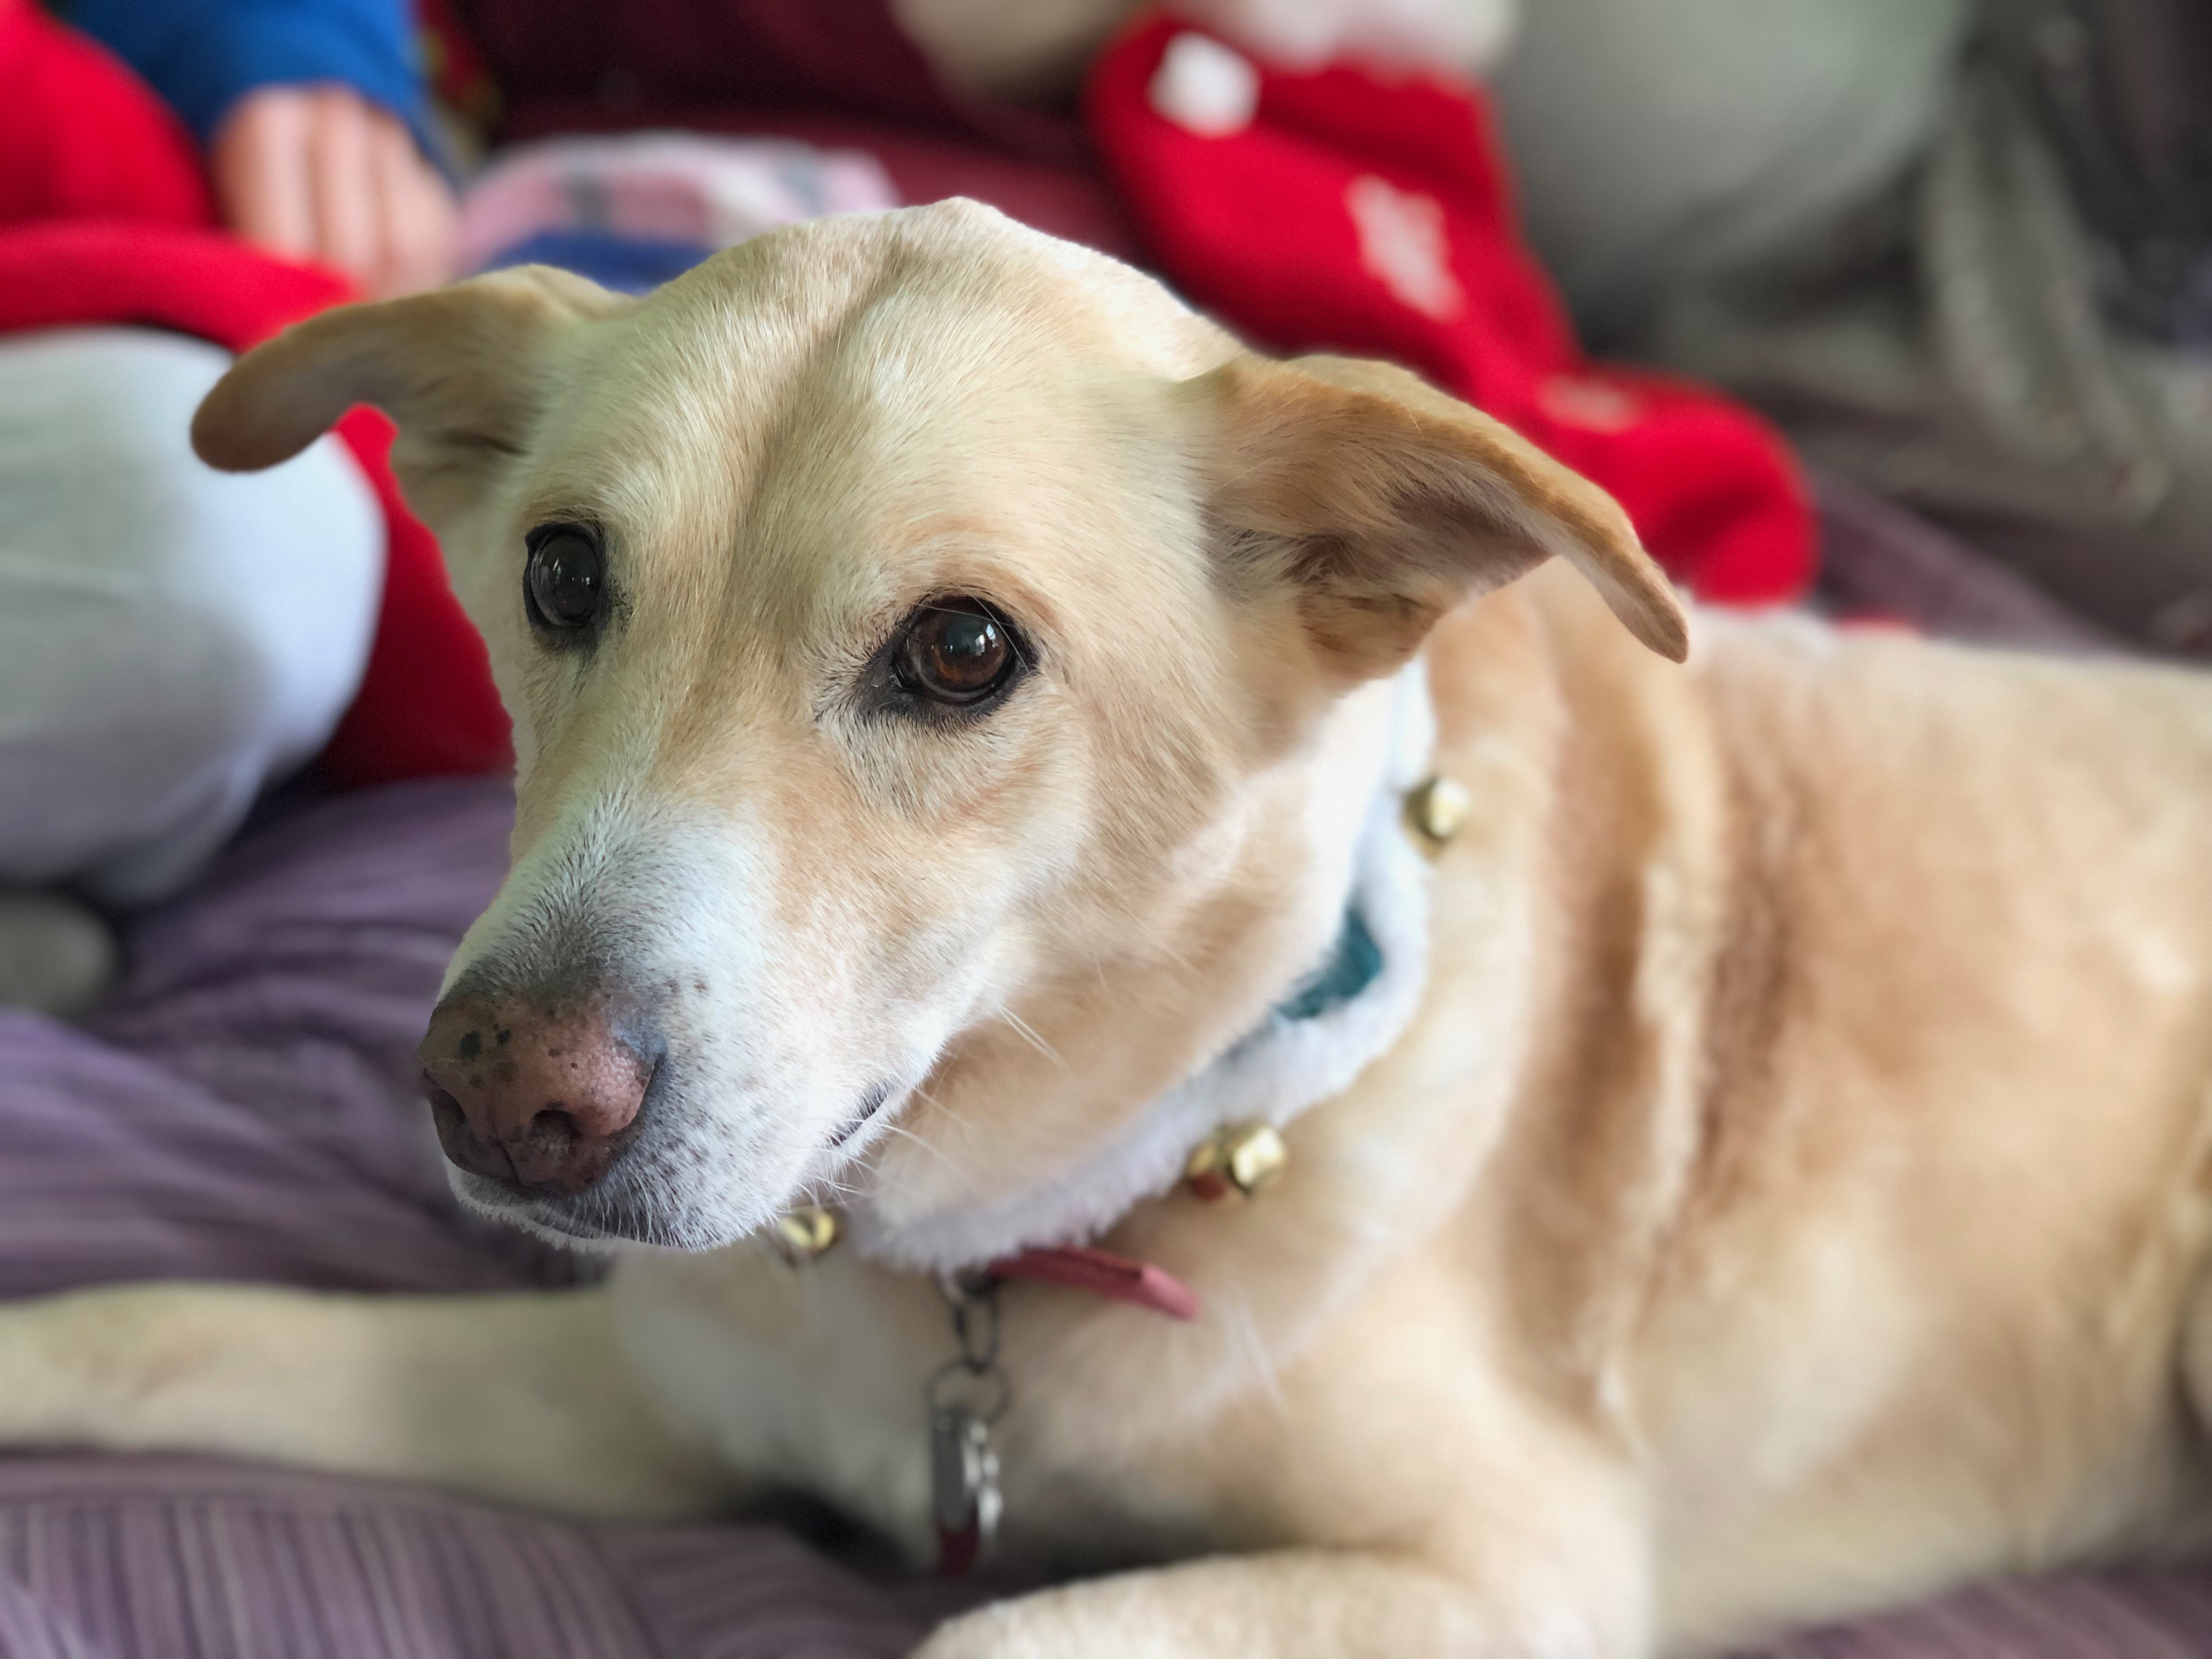
Searching For Letters
strchr returns a pointer to the first occurrence of a character in a string, or NULL if the character is not in the string.
char daisy[6];
strcpy(daisy, "Daisy");
char *letterA = strchr(daisy, 'a');
printf("%s\n", daisy); // Daisy
printf("%s\n", letterA); // aisy
If there are multiple occurrences of the letter, strchr returns a pointer to the first one. Use strrchr to obtain a pointer to the last occurrence.

Slide 7
Searching For Strings
strstr returns a pointer to the first occurrence of the second string in the first, or NULL if it cannot be found.
char daisy[10];
strcpy(daisy, "Daisy Dog");
char *substr = strstr(daisy, "Dog");
printf("%s\n", daisy); // Daisy Dog
printf("%s\n", substr); // Dog
If there are multiple occurrences of the string, strstr returns a pointer to the first one.

Slide 8
String Spans
strspn returns the length of the initial part of the first string which contains only characters in the second string.
char daisy[10];
strcpy(daisy, "Daisy Dog");
int spanLength = strspn(daisy, "aDeoi"); // 3
“How many places can we go in the first string before I encounter a character not in the second string?”

Slide 9
String Spans
strcspn (c = “complement”) returns the length of the initial part of the first string which contains only characters not in the second string.
char daisy[10];
strcpy(daisy, "Daisy Dog");
int spanLength = strcspn(daisy, "driso"); // 2
“How many places can we go in the first string before I encounter a character in the second string?”

Slide 10
C Strings As Parameters
When we pass a string as a parameter, it is passed as a char *. We can still operate on the string the same way as with a char[]. (We’ll see why today!).
int doSomething(char *str) {
char secondChar = str[1];
...
}
// can also write this, but it is really a pointer
int doSomething(char str[]) { ...

Slide 11
Arrays of Strings
We can make an array of strings to group multiple strings together:
char *stringArray[5]; // space to store 5 char *s
We can also use the following shorthand to initialize a string array:
char *stringArray[] = {
"Hello",
"Hi",
"Hey there"
};

Slide 12
Arrays of Strings
We can access each string using bracket syntax:
printf("%s\n", stringArray[0]); // print out first string
When an array is passed as a parameter in C, C passes a pointer to the first element of the array. This is what argv is in main! This means we write the parameter type as:
void myFunction(char **stringArray) {
// equivalent to this, but it is really a double pointer
void myFunction(char *stringArray[]) {

Slide 13
Practice: Password Verification
Write a function verifyPassword that accepts a candidate password and certain password criteria and returns whether the password is valid.
bool verifyPassword(char *password, char *validChars, char *badSubstrings[], int numBadSubstrings);
password is valid if it contains only letters in validChars, and does not contain any substrings in badSubstrings.

Slide 14
Practice: Password Verification
bool verifyPassword(char *password, char *validChars, char *badSubstrings[], int numBadSubstrings);
Example:
char *invalidSubstrings[] = { "1234" };
bool valid1 = verifyPassword("1572", "0123456789",
invalidSubstrings, 1); // true
bool valid2 = verifyPassword("141234", "0123456789",
invalidSubstrings, 1); // false

Slide 15
Practice: Password Verification
verify_password.c
Notes:
stdbool

Slide 16
Lecture Plan
Searching in Strings 6
Practice: Password Verification 13
Demo: Buffer Overflow and Valgrind 16
Pointers 19
Strings in Memory 50
Security and Overflows 88
Live Session 110
cp -r /afs/ir/class/cs107/lecture-code/lect5 .

Slide 17
Buffer Overflows
We must always ensure that memory operations we perform don’t improperly read or write memory.
  E.g. don’t copy a string into a space that is too small!
  E.g. don’t ask for the string length of an uninitialized string!
The Valgrind tool may be able to help track down memory-related issues.
  See cs107.stanford.edu/resources/valgrind
  We’ll talk about Valgrind more when we talk about dynamically-allocated memory.

Slide 18
Demo: Memory Errors
memory_errors.c

Slide 19
Lecture Plan
Searching in Strings 6
Practice: Password Verification 13
Demo: Buffer Overflow and Valgrind 16
Pointers 19
Strings in Memory 50
Security and Overflows 88
Live Session 110
cp -r /afs/ir/class/cs107/lecture-code/lect5 .

Slide 20
Pointers
A pointer is a variable that stores a memory address.
Because there is no pass-by-reference in C like in C++, pointers let us pass around the address of one instance of memory, instead of making many copies.
One (8 byte) pointer can refer to any size memory location!
Pointers are also essential for allocating memory on the heap, which we will cover later.
Pointers also let us refer to memory generically, which we will cover later.

Slide 21
Memory
Memory is a big array of bytes.
Each byte has a unique numeric index that is commonly written in hexadecimal.
A pointer stores one of these memory addresses.
Address | Value
 | …
0x105 | '\0'
0x104 | 'e'
0x103 | 'l'
0x102 | 'p'
0x101 | 'p'
0x100 | 'a'
 | …

Slide 22
Memory
Memory is a big array of bytes.
Each byte has a unique numeric index that is commonly written in hexadecimal.
A pointer stores one of these memory addresses.
Address | Value
 | …
261 | '\0'
260 | 'e'
259 | 'l'
258 | 'p'
257 | 'p'
256 | 'a'
 | …

Slide 23
Looking Back at C++
How would we write a program with a function that takes in an int and modifies it? We might use pass by reference.
void myFunc(int& num) {
num = 3;
}
int main(int argc, char *argv[]) {
int x = 2;
myFunc(x);
printf("%d", x); // 3!
...
}

Slide 24
Looking Ahead to C
All parameters in C are “pass by value.” For efficiency purposes, arrays (and strings, by extension) passed in as parameters are converted to pointers.
This means whenever we pass something as a parameter, we pass a copy.
If we want to modify a parameter value in the function we call and have the changes persist afterwards, we can pass the location of the value instead of the value itself. This way we make a copy of the address instead of a copy of the value.

Slide 25
Pointers
int x = 2;
// Make a pointer that stores the address of x.
// (& means "address of")
int *xPtr = &x;
// Dereference the pointer to go to that address.
// (* means "dereference")
printf("%d", *xPtr); // prints 2

Slide 26
Pointers
A pointer is a variable that stores a memory address.
void myFunc(int *intPtr) {
*intPtr = 3;
}
int main(int argc, char *argv[]) {
int x = 2;
myFunc(&x);
printf("%d", x); // 3!
...
}

Slide 27
Pointers
STACK
A pointer is a variable that stores a memory address.
void myFunc(int *intPtr) {
*intPtr = 3;
}
int main(int argc, char *argv[]) {
int x = 2;
myFunc(&x);
printf("%d", x); // 3!
...
}
main

Slide 28
Pointers
STACK
A pointer is a variable that stores a memory address.
void myFunc(int *intPtr) {
*intPtr = 3;
}
int main(int argc, char *argv[]) {
int x = 2;
myFunc(&x);
printf("%d", x); // 3!
...
}
main
x
2

Slide 29
Pointers
STACK
A pointer is a variable that stores a memory address.
void myFunc(int *intPtr) {
*intPtr = 3;
}
int main(int argc, char *argv[]) {
int x = 2;
myFunc(&x);
printf("%d", x); // 3!
...
}
main
x
2

Slide 30
Pointers
STACK
A pointer is a variable that stores a memory address.
void myFunc(int *intPtr) {
*intPtr = 3;
}
int main(int argc, char *argv[]) {
int x = 2;
myFunc(&x);
printf("%d", x); // 3!
...
}
main
x
2
myFunc
intPtr

Slide 31
Pointers
STACK
A pointer is a variable that stores a memory address.
void myFunc(int *intPtr) {
*intPtr = 3;
}
int main(int argc, char *argv[]) {
int x = 2;
myFunc(&x);
printf("%d", x); // 3!
...
}
main
x
2
myFunc
intPtr

Slide 32
Pointers
STACK
A pointer is a variable that stores a memory address.
void myFunc(int *intPtr) {
*intPtr = 3;
}
int main(int argc, char *argv[]) {
int x = 2;
myFunc(&x);
printf("%d", x); // 3!
...
}
main
x
3
myFunc
intPtr

Slide 33
Pointers
STACK
A pointer is a variable that stores a memory address.
void myFunc(int *intPtr) {
*intPtr = 3;
}
int main(int argc, char *argv[]) {
int x = 2;
myFunc(&x);
printf("%d", x); // 3!
...
}
main
x
3

Slide 34
Pointers
STACK
A pointer is a variable that stores a memory address.
void myFunc(int *intPtr) {
*intPtr = 3;
}
int main(int argc, char *argv[]) {
int x = 2;
myFunc(&x);
printf("%d", x); // 3!
...
}
main
x
3

Slide 35
Pointers
A pointer is a variable that stores a memory address.
void myFunc(int *intPtr) {
*intPtr = 3;
}
int main(int argc, char *argv[]) {
int x = 2;
myFunc(&x);
printf("%d", x); // 3!
...
}
STACK
Address | Value
 | …
0x1f0 | 2
 | …
x
main()

Slide 36
Pointers
A pointer is a variable that stores a memory address.
void myFunc(int *intPtr) {
*intPtr = 3;
}
int main(int argc, char *argv[]) {
int x = 2;
myFunc(&x);
printf("%d", x); // 3!
...
}
STACK
Address | Value
 | …
0x1f0 | 2
 | …
x
main()

Slide 37
Pointers
A pointer is a variable that stores a memory address.
void myFunc(int *intPtr) {
*intPtr = 3;
}
int main(int argc, char *argv[]) {
int x = 2;
myFunc(&x);
printf("%d", x); // 3!
...
}
STACK
Address | Value
 | …
0x1f0 | 2
 | …
0x10 | 0x1f0
 | …
x
main()
myFunc()
intPtr

Slide 38
Pointers
A pointer is a variable that stores a memory address.
void myFunc(int *intPtr) {
*intPtr = 3;
}
int main(int argc, char *argv[]) {
int x = 2;
myFunc(&x);
printf("%d", x); // 3!
...
}
STACK
Address | Value
 | …
0x1f0 | 2
 | …
0x10 | 0x1f0
 | …
x
main()
myFunc()
intPtr

Slide 39
Pointers
A pointer is a variable that stores a memory address.
void myFunc(int *intPtr) {
*intPtr = 3;
}
int main(int argc, char *argv[]) {
int x = 2;
myFunc(&x);
printf("%d", x); // 3!
...
}
STACK
Address | Value
 | …
0x1f0 | 3
 | …
0x10 | 0x1f0
 | …
x
main()
myFunc()
intPtr

Slide 40
Pointers
A pointer is a variable that stores a memory address.
void myFunc(int *intPtr) {
*intPtr = 3;
}
int main(int argc, char *argv[]) {
int x = 2;
myFunc(&x);
printf("%d", x); // 3!
...
}
STACK
Address | Value
 | …
0x1f0 | 3
 | …
x
main()

Slide 41
Pointers
A pointer is a variable that stores a memory address.
void myFunc(int *intPtr) {
*intPtr = 3;
}
int main(int argc, char *argv[]) {
int x = 2;
myFunc(&x);
printf("%d", x); // 3!
...
}
STACK
Address | Value
 | …
0x1f0 | 3
 | …
x
main()

Slide 42
Pointers Summary
If you are performing an operation with some input and do not care about any changes to the input, pass the data type itself. This makes a copy of the data.
If you are modifying a specific instance of some value, pass the location of what you would like to modify. This makes a copy of the data’s location.
If a function takes an address (pointer) as a parameter, it can go to that address if it needs the actual value.

Slide 43
Pointers
Without pointers, we would make copies.
void myFunc(int val) {
val = 3;
}
int main(int argc, char *argv[]) {
int x = 2;
myFunc(x);
printf("%d", x); // 2!
...
}
STACK
Address | Value
 | …
0x1f0 | 2
 | …
x
main()

Slide 44
Pointers
Without pointers, we would make copies.
void myFunc(int val) {
val = 3;
}
int main(int argc, char *argv[]) {
int x = 2;
myFunc(x);
printf("%d", x); // 2!
...
}
STACK
Address | Value
 | …
0x1f0 | 2
 | …
x
main()

Slide 45
Pointers
Without pointers, we would make copies.
void myFunc(int val) {
val = 3;
}
int main(int argc, char *argv[]) {
int x = 2;
myFunc(x);
printf("%d", x); // 2!
...
}
STACK
Address | Value
 | …
0x1f0 | 2
 | …
0x10 | 2
 | …
x
main()
myFunc()
val

Slide 46
Pointers
Without pointers, we would make copies.
void myFunc(int val) {
val = 3;
}
int main(int argc, char *argv[]) {
int x = 2;
myFunc(x);
printf("%d", x); // 2!
...
}
STACK
Address | Value
 | …
0x1f0 | 2
 | …
0x10 | 2
 | …
x
main()
myFunc()
val

Slide 47
Pointers
Without pointers, we would make copies.
void myFunc(int val) {
val = 3;
}
int main(int argc, char *argv[]) {
int x = 2;
myFunc(x);
printf("%d", x); // 2!
...
}
STACK
Address | Value
 | …
0x1f0 | 2
 | …
0x10 | 3
 | …
x
main()
myFunc()
val

Slide 48
Pointers
Without pointers, we would make copies.
void myFunc(int val) {
val = 3;
}
int main(int argc, char *argv[]) {
int x = 2;
myFunc(x);
printf("%d", x); // 2!
...
}
STACK
Address | Value
 | …
0x1f0 | 2
 | …
x
main()

Slide 49
Pointers
Without pointers, we would make copies.
void myFunc(int val) {
val = 3;
}
int main(int argc, char *argv[]) {
int x = 2;
myFunc(x);
printf("%d", x); // 2!
...
}
STACK
Address | Value
 | …
0x1f0 | 2
 | …
x
main()

Slide 50
Lecture Plan
Searching in Strings 6
Practice: Password Verification 13
Demo: Buffer Overflow and Valgrind 16
Pointers 19
Strings in Memory 50
Security and Overflows 88
Live Session 110
cp -r /afs/ir/class/cs107/lecture-code/lect5 .

Slide 51
Strings In Memory
If we create a string as a char[], we can modify its characters because its memory lives in our stack space.
We cannot set a char[] equal to another value, because it is not a pointer; it refers to the block of memory reserved for the original array.
If we pass a char[] as a parameter, set something equal to it, or perform arithmetic with it, it’s automatically converted to a char *.
If we create a new string with new characters as a char *, we cannot modify its characters because its memory lives in the data segment.
We can set a char * equal to another value, because it is a reassign-able pointer.
Adding an offset to a C string gives us a substring that many places past the first character.
If we change characters in a string parameter, these changes will persist outside of the function.

Slide 52
String Behavior #1: If we create a string as a char[], we can modify its characters because its memory lives in our stack space.

Slide 53
Character Arrays
When we declare an array of characters, contiguous memory is allocated on the stack to store the contents of the entire array. We can modify what is on the stack.
char str[6];
strcpy(str, "apple");
STACK
Address | Value
 | …
0x105 | '\0'
0x104 | 'e'
0x103 | 'l'
0x102 | 'p'
0x101 | 'p'
0x100 | 'a'
 | …
str

Slide 54
String Behavior #2: We cannot set a char[] equal to another value, because it is not a pointer; it refers to the block of memory reserved for the original array.

Slide 55
Character Arrays
An array variable refers to an entire block of memory. We cannot reassign an existing array to be equal to a new array.
char str[6];
strcpy(str, "apple");
char str2[8];
strcpy(str2, "apple 2");
str = str2; // not allowed!
An array’s size cannot be changed once we create it; we must create another new array instead.

Slide 56
String Behavior #3: If we pass a char[] as a parameter, set something equal to it, or perform arithmetic with it, it’s automatically converted to a char *.

Slide 57
String Parameters
How do you think the parameter str is being represented?
void fun_times(char *str) {
...
}
int main(int argc, char *argv[]) {
char local_str[5];
strcpy(local_str, "rice");
fun_times(local_str);
return 0;
}
?
str
0xa0 | 0xa1 | 0xa2 | 0xa3 | 0xa4
'r' | 'i' | 'c' | 'e' | '\0'
local_str
A copy of the array local_str
A pointer containing an address to
the first element in local_str
🤔
Notes:
The “professional programmer language.”
Takeaway #2: An string name is the address of the first element.

Slide 58
String Parameters
How do you think the parameter str is being represented?
void fun_times(char *str) {
...
}
int main(int argc, char *argv[]) {
char local_str[5];
strcpy(local_str, "rice");
fun_times(local_str);
return 0;
}
str
0xa0
0xa0 | 0xa1 | 0xa2 | 0xa3 | 0xa4
'r' | 'i' | 'c' | 'e' | '\0'
local_str
A copy of the array local_str
A pointer containing an address to
the first element in local_str
Notes:
The “professional programmer language.”
Takeaway #2: An string name is the address of the first element.

Slide 59
char * Variables
How do you think the local variable str is being represented?
int main(int argc, char *argv[]) {
char local_str[5];
strcpy(local_str, "rice");
char *str = local_str;
...
return 0;
}
?
str
0xa0 | 0xa1 | 0xa2 | 0xa3 | 0xa4
'r' | 'i' | 'c' | 'e' | '\0'
local_str
A copy of the array local_str
A pointer containing an address to
the first element in local_str
🤔
Notes:
The “professional programmer language.”
Takeaway #2: An string name is the address of the first element.

Slide 60
char * Variables
How do you think the local variable str is being represented?
int main(int argc, char *argv[]) {
char local_str[5];
strcpy(local_str, "rice");
char *str = local_str;
...
return 0;
}
str
0xa0
0xa0 | 0xa1 | 0xa2 | 0xa3 | 0xa4
'r' | 'i' | 'c' | 'e' | '\0'
local_str
A copy of the array local_str
A pointer containing an address to
the first element in local_str
Notes:
The “professional programmer language.”
Takeaway #2: An string name is the address of the first element.

Slide 61
char * Variables
How do you think the local variable str is being represented?
int main(int argc, char *argv[]) {
char local_str[5];
strcpy(local_str, "rice");
char *str = local_str + 2;
...
return 0;
}
?
str
0xa0 | 0xa1 | 0xa2 | 0xa3 | 0xa4
'r' | 'i' | 'c' | 'e' | '\0'
local_str
A copy of part of the array local_str
A pointer containing an address to
the third element in local_str
🤔
Notes:
The “professional programmer language.”
Takeaway #2: An string name is the address of the first element.

Slide 62
char * Variables
How do you think the local variable str is being represented?
int main(int argc, char *argv[]) {
char local_str[5];
strcpy(local_str, "rice");
char *str = local_str + 2;
...
return 0;
}
str
0xa2
0xa0 | 0xa1 | 0xa2 | 0xa3 | 0xa4
'r' | 'i' | 'c' | 'e' | '\0'
local_str
A copy of part of the array local_str
A pointer containing an address to
the third element in local_str
Notes:
The “professional programmer language.”
Takeaway #2: An string name is the address of the first element.

Slide 63
String Parameters
All string functions take char * parameters – they accept char[], but they are implicitly converted to char * before being passed.
  strlen(char *str)
  strcmp(char *str1, char *str2)
  …
char * is still a string in all the core ways a char[] is
  Access/modify characters using bracket notation
  Print it out
  Use string functions
  But under the hood they are represented differently!
Takeaway: We create strings as char[], pass them around as char *

Slide 64
String Behavior #4: If we create a new string with new characters as a char *, we cannot modify its characters because its memory lives in the data segment.

Slide 65
char *
There is another convenient way to create a string if we do not need to modify it later. We can create a char * and set it directly equal to a string literal.
char *myString = "Hello, world!";
char *empty = "";
myString[0] = 'h'; // crashes!
printf("%s", myString); // Hello, world!

Slide 66
char *
When we declare a char pointer equal to a string literal, the characters are not stored on the stack. Instead, they are stored in a special area of memory called the “data segment”. We cannot modify memory in this segment.
char *str = "hi";
The pointer variable (e.g. str) refers to the address of the first character of the string in the data segment.
Address | Value
 | …
0xff0 | 0x10
 | …
 | …
0x12 | '\0'
0x11 | 'i'
0x10 | 'h'
 | …
STACK
str
DATA SEGMENT
This applies only to creating new strings with char *. This does not apply for making a char * that points to an existing stack string.
Notes:
Text segment stores string literals to potentially reduce duplicate memory

Slide 67
Memory Locations
For each code snippet below, can we modify the characters in myStr?
char myStr[6];
Key Question: where do its characters live? Do they live in memory we own? Or the read-only data segment?

Slide 68
Memory Locations
For each code snippet below, can we modify the characters in myStr?
char *myStr = "Hi";
Key Question: where do its characters live? Do they live in memory we own? Or the read-only data segment?

Slide 69
Memory Locations
For each code snippet below, can we modify the characters in myStr?
Key Question: where do its characters live? Do they live in memory we own? Or the read-only data segment?
char buf[6];
strcpy(buf, "Hi");
char *myStr = buf;

Slide 70
Memory Locations
For each code snippet below, can we modify the characters in myStr?
char *otherStr = "Hi";
char *myStr = otherStr;
Key Question: where do its characters live? Do they live in memory we own? Or the read-only data segment?

Slide 71
Memory Locations
For each code snippet below, can we modify the characters in myStr?
void myFunc(char *myStr) {
...
}
int main(int argc, char *argv[]) {
char buf[6];
strcpy(buf, "Hi");
myFunc(buf);
return 0;
}
Key Question: where do its characters live? Do they live in memory we own? Or the read-only data segment?

Slide 72
Memory Locations
Q: Is there a way to check in code whether a string’s characters are modifiable?
A: No. This is something you can only tell by looking at the code itself and how the string was created.
Q: So then if I am writing a string function that modifies a string, how can I tell if the string passed in is modifiable?
A: You can’t! This is something you instead state as an assumption in your function documentation. If someone calls your function with a read-only string, it will crash, but that’s not your function’s fault :-)

Slide 73
String Behavior #5: We can set a char * equal to another value, because it is a reassign-able pointer.

Slide 74
char *
A char * variable refers to a single character. We can reassign an existing char * pointer to be equal to another char * pointer.
char *str = "apple"; // e.g. 0xfff0
char *str2 = "apple 2"; // e.g. 0xfe0
str = str2; // ok! Both store address 0xfe0

Slide 75
Arrays and Pointers
STACK
We can also make a pointer equal to an array; it will point to the first element in that array.
int main(int argc, char *argv[]) {
char str[6];
strcpy(str, "apple");
char *ptr = str;
...
}
Address | Value
 | …
0x105 | '\0'
0x104 | 'e'
0x103 | 'l'
0x102 | 'p'
0x101 | 'p'
0x100 | 'a'
0xf8 | 0x100
 | …
main()
str
ptr

Slide 76
Arrays and Pointers
STACK
We can also make a pointer equal to an array; it will point to the first element in that array.
int main(int argc, char *argv[]) {
char str[6];
strcpy(str, "apple");
char *ptr = str;
// equivalent
char *ptr = &str[0];
// confusingly equivalent, avoid
char *ptr = &str;
...
}
Address | Value
 | …
0x105 | '\0'
0x104 | 'e'
0x103 | 'l'
0x102 | 'p'
0x101 | 'p'
0x100 | 'a'
0xf8 | 0x100
 | …
main()
str
ptr

Slide 77
String Behavior #6: Adding an offset to a C string gives us a substring that many places past the first character.

Slide 78
Pointer Arithmetic
When we do pointer arithmetic, we are adjusting the pointer by a certain number of places (e.g. characters).
char *str = "apple"; // e.g. 0xff0
char *str2 = str + 1; // e.g. 0xff1
char *str3 = str + 3; // e.g. 0xff3
printf("%s", str); // apple
printf("%s", str2); // pple
printf("%s", str3); // le
TEXT SEGMENT
Address | Value
 | …
0xff5 | '\0'
0xff4 | 'e'
0xff3 | 'l'
0xff2 | 'p'
0xff1 | 'p'
0xff0 | 'a'
 | …

Slide 79
char *
When we use bracket notation with a pointer, we are performing pointer arithmetic and dereferencing:
char *str = "apple"; // e.g. 0xff0
// both of these add three places to str,
// and then dereference to get the char there.
// E.g. get memory at 0xff3.
char thirdLetter = str[3]; // 'l'
char thirdLetter = *(str + 3); // 'l'
TEXT SEGMENT
Address | Value
 | …
0xff5 | '\0'
0xff4 | 'e'
0xff3 | 'l'
0xff2 | 'p'
0xff1 | 'p'
0xff0 | 'a'
 | …

Slide 80
String Behavior #7: If we change characters in a string parameter, these changes will persist outside of the function.

Slide 81
Strings as Parameters
When we pass a char * string as a parameter, C makes a copy of the address stored in the char * and passes it to the function. This means they both refer to the same memory location.
void myFunc(char *myStr) {
...
}
int main(int argc, char *argv[]) {
char *str = "apple";
myFunc(str);
...
}
STACK
Address | Value
 | …
0xfff0 | 0x10
 | …
 | …
0xff0 | 0x10
 | …
main()
str
myFunc()
myStr

Slide 82
Strings as Parameters
STACK
When we pass a char array as a parameter, C makes a copy of the address of the first array element and passes it (as a char *) to the function.
void myFunc(char *myStr) {
...
}
int main(int argc, char *argv[]) {
char str[6];
strcpy(str, "apple");
myFunc(str);
...
}
Address | Value
 | …
0x105 | '\0'
0x104 | 'e'
0x103 | 'l'
0x102 | 'p'
0x101 | 'p'
0x100 | 'a'
 | …
 | …
0xf | 0x100
 | …
main()
str
myFunc()
myStr

Slide 83
Strings as Parameters
STACK
When we pass a char array as a parameter, C makes a copy of the address of the first array element and passes it (as a char *) to the function.
void myFunc(char *myStr) {
...
}
int main(int argc, char *argv[]) {
char str[6];
strcpy(str, "apple");
// equivalent
char *strAlt = str;
myFunc(strAlt);
...
Address | Value
 | …
0x105 | '\0'
0x104 | 'e'
0x103 | 'l'
0x102 | 'p'
0x101 | 'p'
0x100 | 'a'
 | …
 | …
0xf | 0x100
 | …
main()
str
myFunc()
myStr

Slide 84
Strings as Parameters
STACK
This means if we modify characters in myFunc, the changes will persist back in main!
void myFunc(char *myStr) {
myStr[4] = 'y';
}
int main(int argc, char *argv[]) {
char str[6];
strcpy(str, "apple");
myFunc(str);
printf("%s", str); // apply
...
}
Address | Value
 | …
0x105 | '\0'
0x104 | 'e'
0x103 | 'l'
0x102 | 'p'
0x101 | 'p'
0x100 | 'a'
 | …
 | …
0xf | 0x100
 | …
main()
str
myFunc()
myStr

Slide 85
Strings as Parameters
STACK
This means if we modify characters in myFunc, the changes will persist back in main!
void myFunc(char *myStr) {
myStr[4] = 'y';
}
int main(int argc, char *argv[]) {
char str[6];
strcpy(str, "apple");
myFunc(str);
printf("%s", str); // apply
...
}
Address | Value
 | …
0x105 | '\0'
0x104 | 'y'
0x103 | 'l'
0x102 | 'p'
0x101 | 'p'
0x100 | 'a'
 | …
 | …
0xf | 0x100
 | …
main()
str
myFunc()
myStr

Slide 86
Strings In Memory
If we create a string as a char[], we can modify its characters because its memory lives in our stack space.
We cannot set a char[] equal to another value, because it is not a pointer; it refers to the block of memory reserved for the original array.
If we pass a char[] as a parameter, set something equal to it, or perform arithmetic with it, it’s automatically converted to a char *.
If we create a new string with new characters as a char *, we cannot modify its characters because its memory lives in the data segment.
We can set a char * equal to another value, because it is a reassign-able pointer.
Adding an offset to a C string gives us a substring that many places past the first character.
If we change characters in a string parameter, these changes will persist outside of the function.

Slide 87
Lecture Plan
Searching in Strings 6
Practice: Password Verification 13
Demo: Buffer Overflow and Valgrind 16
Pointers 19
Strings in Memory 50
Security and Overflows 88
Live Session 110
cp -r /afs/ir/class/cs107/lecture-code/lect5 .

Slide 88
Recall: Integer Overflow in Practice
PSY – Gangnam Style
The End of 32-bit Time aka January 13, 2038
Gandhi in “Civilization”
Pacman Level 256
Make sure to reboot Boeing Dreamliners every 248 days
Comair/Delta airline had to cancel thousands of flights days before Christmas
Reported vulnerability CVE-2019-3857 in libssh2 may allow a hacker to remotely execute code
Donkey Kong Kill Screen

Slide 89

Assignment 1: Ariane-5 Case Study

Slide 90
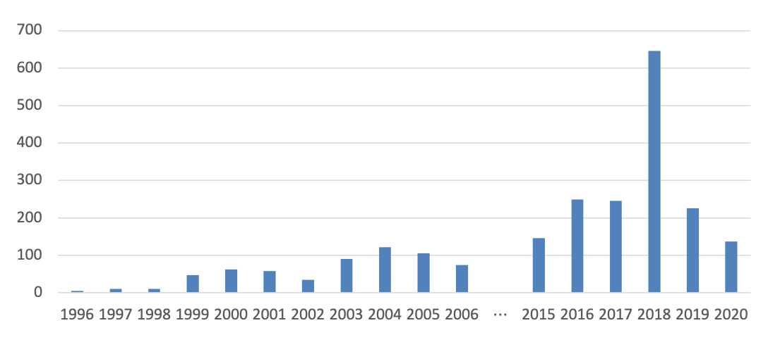
Integer Overflow in the National Vulnerability Database

Slide 91
Recall: Buffer Overflows
char str1[14];
strcpy(str1, "hello, world!");
char str2[6];
strcpy(str2, str1); // not enough space - overwrites other memory!
0 | 1 | 2 | 3 | 4 | 5 | 6 | 7 | 8 | 9 | 10 | 11 | 12 | 13
'h' | 'e' | 'l' | 'l' | 'o' | ',' | ' ' | 'w' | 'o' | 'r' | 'l' | 'd' | '!' | '\0'
str1
0 | 1 | 2 | 3 | 4 | 5
'h' | 'e' | 'l' | 'l' | 'o' | ','
' ' | 'w' | 'o' | 'r' | 'l' | 'd' | '!' | '\0'
str2
- other program memory -

Slide 92
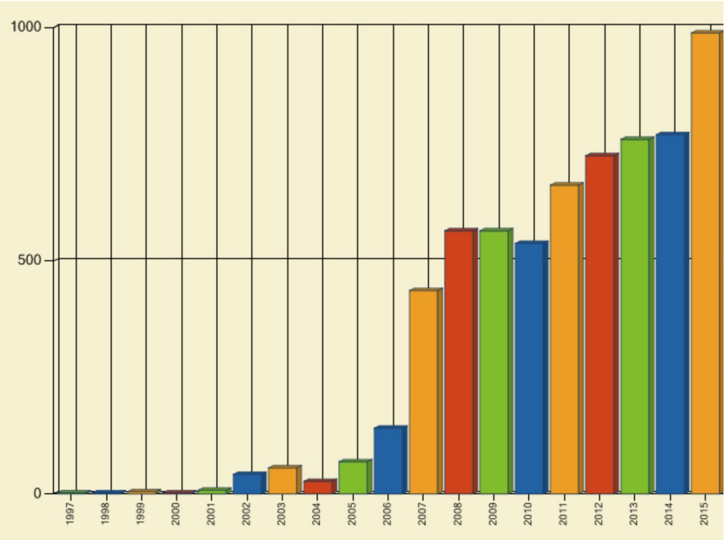
Buffer Overflow Vulnerabilities are Very Common

Slide 93
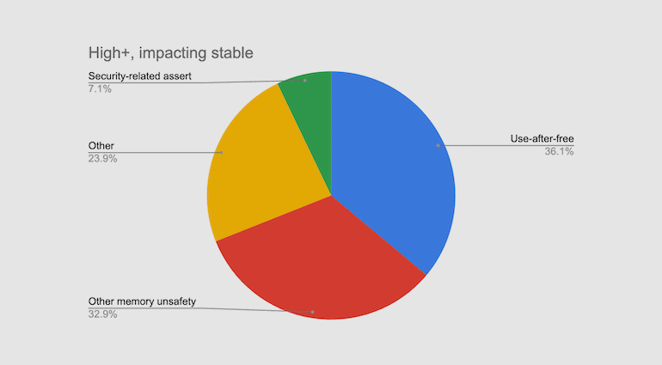
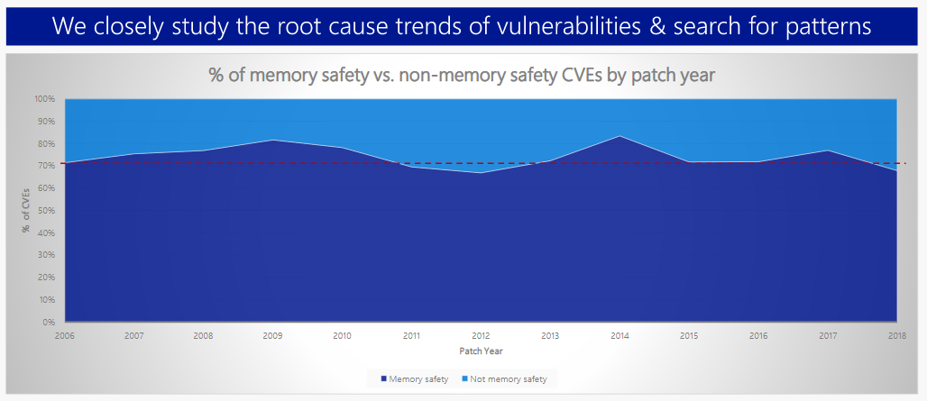
~70% of serious bugs for Chrome and Microsoft are related to memory safety
Memory safety issues include buffer overflows ...

Slide 94
How can we fix buffer overflows?
Idea 1: Constant Vigilance (While Programming)
Check all buffers and trace their possible modifications
void printCapitalized(char *str1) {
// make a copy first
char buf[BUF_SIZE];
strcpy(buf, str1);
...
}

Slide 95
How can we fix buffer overflows?
Idea 1: Constant Vigilance (While Programming)
Check all buffers and trace their possible modifications
Scrutinize functions that do not include bounds checking
  common offenders include strcpy, printf, sprintf
  int sprintf(char *str, const char *format, ...)

Slide 96
How can we fix buffer overflows?
Idea 1: Constant Vigilance (While Programming)
Check all buffers and trace their possible modifications
Scrutinize functions that do not include bounds checking
  Some library functions later deprecated for this reason
  MAN page for gets():
  “Never use gets(). Because it is impossible to tell without knowing the data in advance how many characters gets() will read, and because gets() will continue to store characters past the end of the buffer, it is extremely dangerous to use. It has been used to break computer security. Use fgets() instead.”

Slide 97
How can we fix buffer overflows?
Idea 1: Constant Vigilance (While Programming)
Check all buffers and trace their possible modifications
Scrutinize functions that do not include bounds checking
Consider use of strn- functions like strncpy
  These functions will not write more than the size you specify
  However, they do not ensure that strings are null-terminated
  Use them, but use with care

Slide 98
How can we fix buffer overflows?
Idea 1: Constant Vigilance (While Programming)
Check all buffers and trace their possible modifications
Scrutinize functions that do not include bounds checking
Consider use of strn- functions like strncopy
Conclusion: Constant vigilance is necessary but not sufficient in the struggle to identify & fix buffer overflows

Slide 99
How Can We Fix Overflows?
Idea 2: Testing
Valgrind: Your Greatest Ally
Write your own tests
Consider writing tests before writing the main program
✨ cs107.stanford.edu/testing.html ✨

Slide 100
How Can We Fix Overflows?
Idea 3: Documentation (Written by You)
Document your assumptions about what will be stored in the buffer
This will allow others (including your future self) to write better tests

Slide 101
How Can We Fix Overflows?
Idea 4: Documentation & MAN Pages (Written by Others)
  “The strcpy() function copies the string pointed to by src, including the terminating null byte (‘\0’), to the buffer pointed to by dest. The strings may not overlap, and the destination string dest must be large enough to receive the copy. Beware of buffer overruns! (See BUGS.) …
  BUGS
  If the destination string of a strcpy() is not large enough, then anything might happen. Overflowing fixed-length string buffers is a favorite cracker technique for taking complete control of the machine. Any time a program reads or copies data into a buffer, the program first needs to check that there’s enough space. This may be unnecessary if you can show that overflow is impossible, but be careful: programs can get changed over time, in ways that may make the impossible possible.”

Slide 102
Memory Safe Systems Programming
Idea 5: Choose your Tools & Languages Carefully
Existing code bases or requirements for a project may dictate what tools you use. Knowing C is crucial – it is and will remain widely used.
When you you are choosing tools for systems programming, consider languages that can help guard against programmer error.
Rust (Mozilla)
Go (Google)
Project Verona (Microsoft)

Slide 103
Why Should We Fix Overflows?
Why should I fix overflows?
  So that my program doesn’t crash

Slide 104
Why Should We Fix Overflows?
Why should I fix overflows?
  So that my program doesn’t crash
  So that my program works and accomplishes its goal

Slide 105
Why Should We Fix Overflows?
Why should I fix overflows?
  So that my program doesn’t crash
  So that my program works and accomplishes its goal
  So that I can protect others who use and interact with my code
  So that I can be a good computer scientist

Slide 106
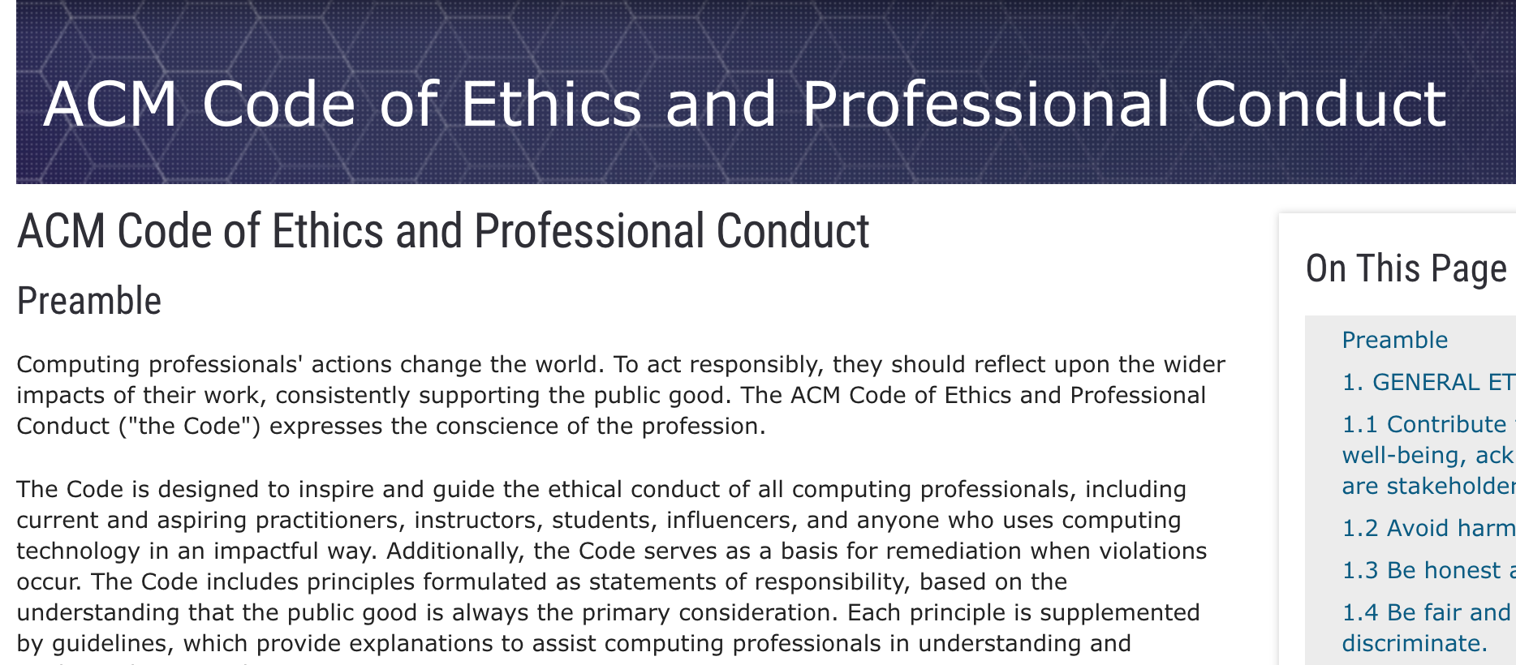
Association for Computing Machinery (ACM) Code of Ethics

Slide 107
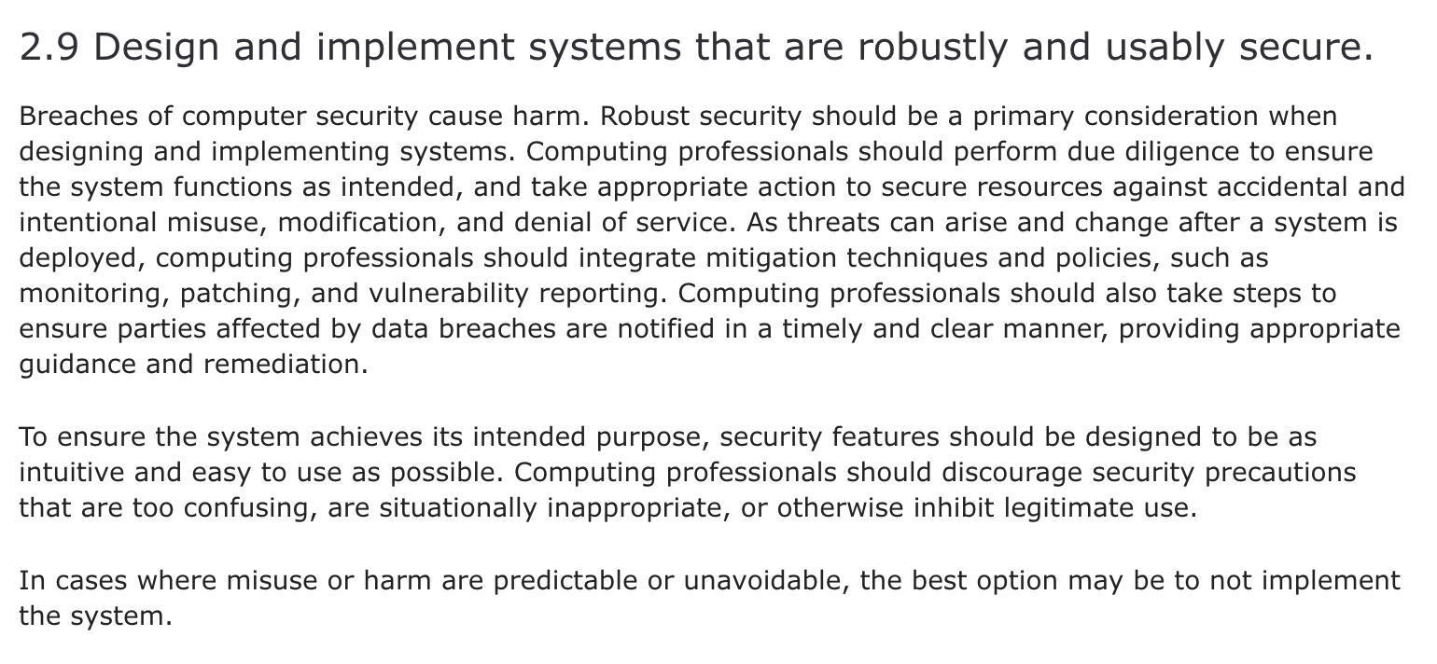
ACM Code of Ethics on Security

Slide 108
Thanks!
Visit my virtual office:
https://calendly.com/kathleencreel

Slide 109
Recap
Searching in Strings
Practice: Password Verification
Demo: Buffer Overflow and Valgrind
Pointers
Strings in Memory
Security and Overflows
Next time: Arrays and Pointers

Slide 110
Additional Live Session Slides

Slide 111
Plan For Today
5 minutes: post questions or comments on Ed for what we should discuss
15 minutes: open Q&A
25 minutes: extra practice
Lecture 5 takeaway: C strings are pointers and arrays; understanding how pointers and arrays work help us better understand C string behavior. C strings are error-prone, and issues like buffer overflows can arise!

Slide 112
Review
Parameters in C are passed by value; if we pass something as a parameter, we pass a copy of it
Therefore, if a function tries to change the value of a parameter itself, this will always change its local copy, not the original:
void myFunc(SOME_TYPE param) {
param = ... // changes local copy
...
}
int main(int argc, char *argv[]) {
SOME_TYPE x = ...
myFunc(x);
// x will always be the same here
...
}

Slide 113
Review
If we wish to have another function modify some local variable, we must pass its location (address). Thus, we pass a copy of its address, not the value.
The function can then dereference that address and modify what’s there, and the changes will persist.
void myFunc(SOME_TYPE *param) {
*param = ... // changes original copy
...
}
int main(int argc, char *argv[]) {
SOME_TYPE x = ...
myFunc(&x);
// x will be changed here
...
}

Slide 114
Arrays vs. Pointers
When you create an array, you are making space for each element in the array.
When you create a pointer, you are making space for an 8 byte address.
Arrays ”decay to pointers” when you perform arithmetic or pass as parameters.
You cannot set an array equal to something after initialization, but you can set a pointer equal to something at any time.
&arr does nothing on arrays, but &ptr on pointers gets its address
sizeof(arr) gets the size of an array in bytes, but sizeof(ptr) is always 8

Slide 115
Plan For Today
5 minutes: post questions or comments on Ed for what we should discuss
15 minutes: open Q&A
25 minutes: extra practice
Lecture 5 takeaway: C strings are pointers and arrays; understanding how pointers and arrays work help us better understand C string behavior. C strings are error-prone, and issues like buffer overflows can arise!

Slide 116
1. Pointer arithmetic
1
2
3
4
5
6
7
8
9
10
11
12
13
14
void func(char *str) {
str[0] = 'S';
str++;
*str = 'u';
str = str + 3;
str[-2] = 'm';
}
int main(int argc, const char *argv[]) {
char buf[] = "Monday";
printf("before func: %s\n", buf);
func(buf);
printf("after func: %s\n", buf);
return 0;
}
Will there be a compile error/segfault?
If no errors, what is printed?
🤔
Draw memory diagrams!
Pointers store addresses! Make up addresses if it helps your mental model.

Slide 117
1. Pointer arithmetic
1
2
3
4
5
6
7
8
9
10
11
12
13
14
void func(char *str) {
str[0] = 'S';
str++;
*str = 'u';
str = str + 3;
str[-2] = 'm';
}
int main(int argc, const char *argv[]) {
char buf[] = "Monday";
printf("before func: %s\n", buf);
func(buf);
printf("after func: %s\n", buf);
return 0;
}
func
str
main
0x60 | 0x61 | 0x62 | 0x63 | 0x64 | 0x65 | 0x66
buf
Draw memory diagrams!
Pointers store addresses! Make up addresses if it helps your mental model.

Slide 118
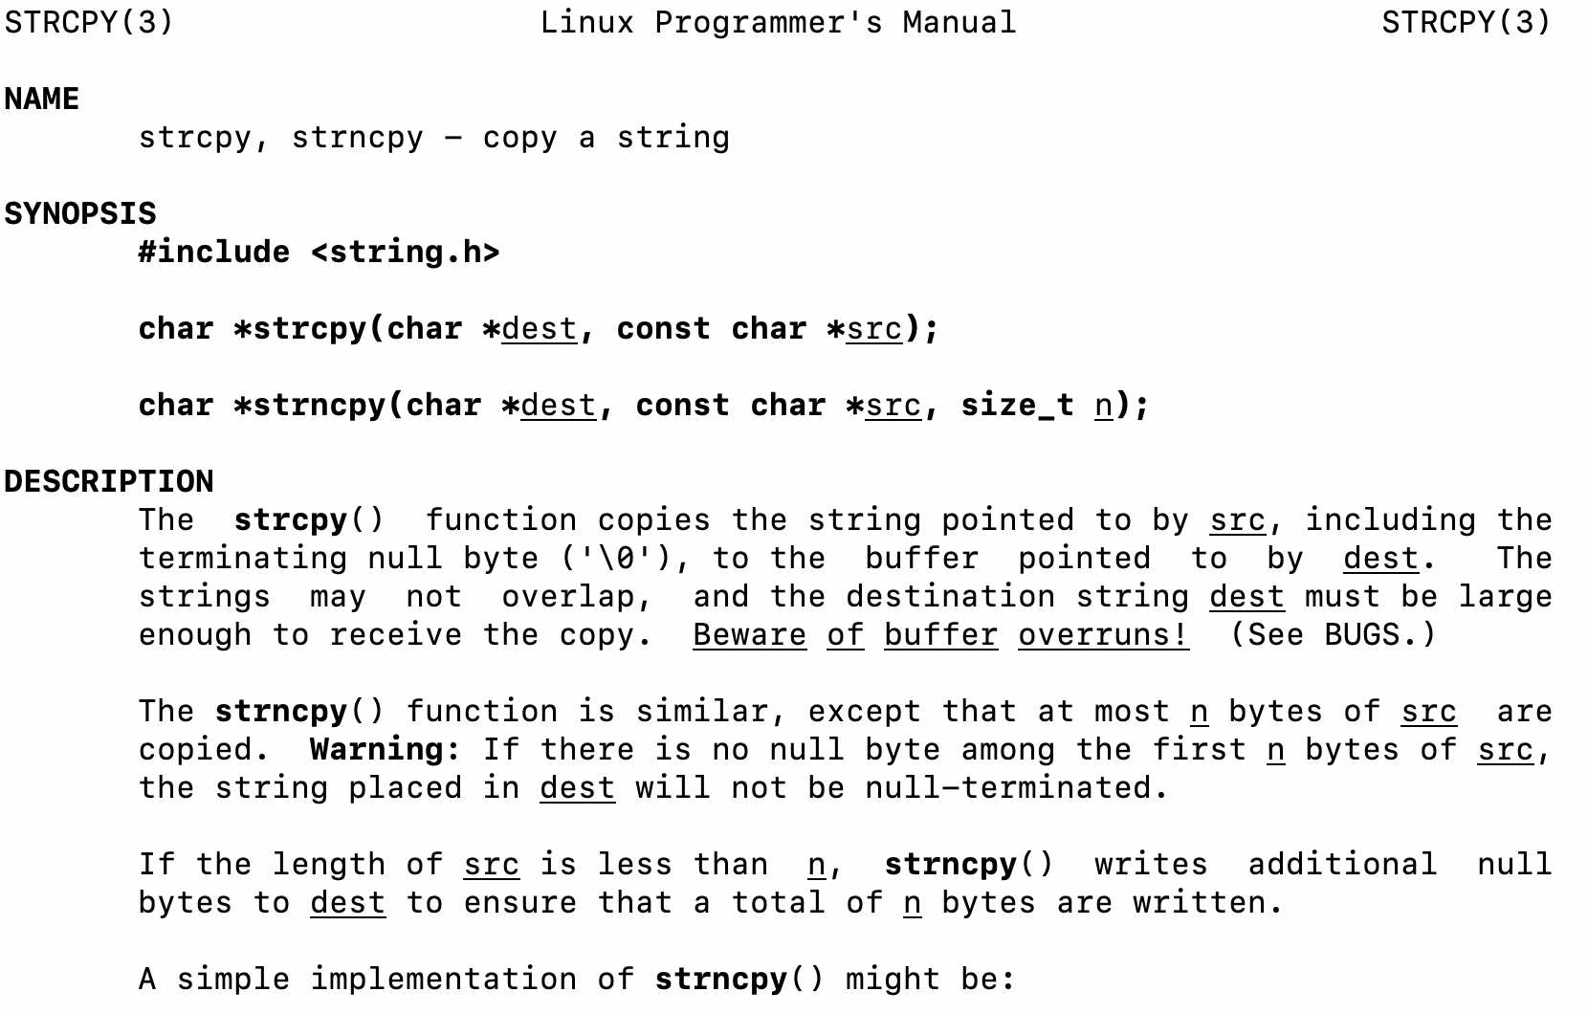
2. Code study: strncpy
0x60 | 0x61 | 0x62 | 0x63 | 0x64 | 0x65 | 0x66
'M' | 'o' | 'n' | 'd' | 'a' | 'y' | '\0'
buf
0x58 | 0x59 | 0x5a | 0x5b
'F' | 'r' | 'i' | '\0'
str
1
2
3
4
5
6
7
8
char *strncpy(char *dest, const char *src, size_t n) {
size_t i;
for (i = 0; i < n && src[i] != '\0'; i++)
dest[i] = src[i];
for ( ; i < n; i++)
dest[i] = '\0';
return dest;
}
🤔
What happens if we call strncpy(buf, str, 5);?

Slide 119
2. Code study: strncpy
0x60 | 0x61 | 0x62 | 0x63 | 0x64 | 0x65 | 0x66
'M' | 'o' | 'n' | 'd' | 'a' | 'y' | '\0'
buf
0x58 | 0x59 | 0x5a | 0x5b
'F' | 'r' | 'i' | '\0'
str
1
2
3
4
5
6
7
8
char *strncpy(char *dest, const char *src, size_t n) {
size_t i;
for (i = 0; i < n && src[i] != '\0'; i++)
dest[i] = src[i];
for ( ; i < n; i++)
dest[i] = '\0';
return dest;
}
dest
src
n
5
i
What happens if we call strncpy(buf, str, 5);?

Slide 120
3. char* vs char[] exercises
// initialize as below
A str = str + 1;
B str[1] = 'u’;
C printf("%s", str)
For each of the following initializations:
Will there be a compile error/segfault?
If no errors, what is printed?
Suppose we use a
variable str
as follows:
char str[7];
strcpy(str, "Hello1");
char *str = "Hello2";
char arr[7];
strcpy(arr, "Hello3");
char *str = arr;
char *ptr = "Hello4";
char *str = ptr;
🤔
Notes:
Let’s do some exercises related to the difference between char* and char[]. Suppose we’ve instantiated char as below, which I’ll show you, and then I update its address, with str = str + 1, and I modify its contents, with str[1] = ‘u’. Then I print it out, which is a read-only operation anyway.
For each of the four following instantiations, try to figure out whether there will be a compile error, a segmentation fault, or no error. A segmentation fault, or segfault here, is when you try to modify memory in a not okay way. Okay, pause here.
So to answer these questions, let’s just run each of these to see what they do, and we’ll try to interpret why this happens.

Slide 121
3. char* vs char[] exercises
// initialize as below
A str = str + 1;
B str[1] = 'u’;
C printf("%s", str)
For each of the following initializations:
Will there be a compile error/segfault?
If no errors, what is printed?
Suppose we use a
variable str
as follows:
char str[7];
strcpy(str, "Hello1");
char *str = "Hello2";
Line A: Compile error
(cannot reassign array)
Line B: Segmentation fault
(string literal)
char arr[7];
strcpy(arr, "Hello3");
char *str = arr;
char *ptr = "Hello4";
char *str = ptr;
Line B: Segmentation fault
(string literal)
Prints eulo3
Notes:
Let’s do some exercises related to the difference between char* and char[]. Suppose we’ve instantiated char as below, which I’ll show you, and then I update its address, with str = str + 1, and I modify its contents, with str[1] = ‘u’. Then I print it out, which is a read-only operation anyway.
For each of the four following instantiations, try to figure out whether there will be a compile error, a segmentation fault, or no error. A segmentation fault, or segfault here, is when you try to modify memory in a not okay way. Okay, pause here.
So to answer these questions, let’s just run each of these to see what they do, and we’ll try to interpret why this happens.

Slide 122
4. Bonus: Tricky addresses
1
2
3
4
5
6
7
8
9
10
11
12
void tricky_addresses() {
char buf[] = "Local";
char *ptr1 = buf;
char **double_ptr = &ptr1;
printf("ptr1's value: %p\n", ptr1);
printf("ptr1’s deref : %c\n", *ptr1);
printf(" address: %p\n", &ptr1);
printf("double_ptr value: %p\n", double_ptr);
printf("buf's address: %p\n", &buf);
char *ptr2 = &buf;
printf("ptr2's value: %s\n", ptr2);
}
What is stored in each variable? (We cover double pointers more in Lecture 6)
🤔

Slide 123
4. Bonus: Tricky addresses
1
2
3
4
5
6
7
8
9
10
11
12
void tricky_addresses() {
char buf[] = "Local";
char *ptr1 = buf;
char **double_ptr = &ptr1;
printf("ptr1's value: %p\n", ptr1);
printf("ptr1’s deref : %c\n", *ptr1);
printf(" address: %p\n", &ptr1);
printf("double_ptr value: %p\n", double_ptr);
printf("buf's address: %p\n", &buf);
char *ptr2 = &buf;
printf("ptr2's value: %s\n", ptr2);
}
0x28 | 0x29 | 0x2a | 0x2b | 0x2c | 0x2d
'L' | 'o' | 'c' | 'a' | 'l' | '\0'
buf
0x10
ptr1
0x18
double_ptr
0x20
While Line 10 raises a compiler warning, functionally it will still work—because pointers are addresses.
ptr2

