Slide 1
CS107, Lecture 6
More Pointers and Arrays
Reading: K&R (5.2-5.5) or Essential C section 6

Slide 2
CS107 Topic 3: How can we effectively manage all types of memory in our programs?

Slide 3
Lecture Plan
Pointers and Parameters 4
Double Pointers 42
Arrays in Memory 57
Arrays of Pointers 66
Pointer Arithmetic 70
Other topics: const, struct and ternary 80
Live Session 99
cp -r /afs/ir/class/cs107/lecture-code/lect06 .
Notes:
20min
25min
10min
10min
15min

Slide 4
Lecture Plan
Pointers and Parameters 4
Double Pointers 42
Arrays in Memory 57
Arrays of Pointers 66
Pointer Arithmetic 70
Other topics: const, struct and ternary 80
Live Session 99
cp -r /afs/ir/class/cs107/lecture-code/lect06 .
Notes:
20min
25min
10min
10min
15min

Slide 5
Pointers
A pointer is a variable that stores a memory address.
Because there is no pass-by-reference in C like in C++, pointers let us pass around the address of one instance of memory, instead of making many copies.
One (8 byte) pointer can represent any size memory location!
Pointers are also essential for allocating memory on the heap, which we will cover later.
Pointers also let us refer to memory generically, which we will cover later.

Slide 6
Memory
Memory is a big array of bytes.
Each byte has a unique numeric index that is commonly written in hexadecimal.
A pointer stores one of these memory addresses.
Address | Value
 | …
0x105 | '\0'
0x104 | 'e'
0x103 | 'l'
0x102 | 'p'
0x101 | 'p'
0x100 | 'a'
 | …

Slide 7
Memory
Memory is a big array of bytes.
Each byte has a unique numeric index that is commonly written in hexadecimal.
A pointer stores one of these memory addresses.
Address | Value
 | …
261 | '\0'
260 | 'e'
259 | 'l'
258 | 'p'
257 | 'p'
256 | 'a'
 | …

Slide 8
Pointers
int x = 2;
// Make a pointer that stores the address of x.
// (& means "address of")
int *xPtr = &x;
// Dereference the pointer to go to that address.
// (* means "dereference")
printf("%d", *xPtr); // prints 2

Slide 9
Pointers
A pointer is a variable that stores a memory address.
void myFunc(int *intPtr) {
*intPtr = 3;
}
int main(int argc, char *argv[]) {
int x = 2;
myFunc(&x);
printf("%d", x); // 3!
...
}
STACK
Address | Value
 | …
0x1f0 | 2
 | …
x
main()

Slide 10
Pointers
A pointer is a variable that stores a memory address.
void myFunc(int *intPtr) {
*intPtr = 3;
}
int main(int argc, char *argv[]) {
int x = 2;
myFunc(&x);
printf("%d", x); // 3!
...
}
STACK
Address | Value
 | …
0x1f0 | 2
 | …
x
main()

Slide 11
Pointers
A pointer is a variable that stores a memory address.
void myFunc(int *intPtr) {
*intPtr = 3;
}
int main(int argc, char *argv[]) {
int x = 2;
myFunc(&x);
printf("%d", x); // 3!
...
}
STACK
Address | Value
 | …
0x1f0 | 2
 | …
0x10 | 0x1f0
 | …
x
main()
myFunc()
intPtr

Slide 12
Pointers
A pointer is a variable that stores a memory address.
void myFunc(int *intPtr) {
*intPtr = 3;
}
int main(int argc, char *argv[]) {
int x = 2;
myFunc(&x);
printf("%d", x); // 3!
...
}
STACK
Address | Value
 | …
0x1f0 | 2
 | …
0x10 | 0x1f0
 | …
x
main()
myFunc()
intPtr

Slide 13
Pointers
A pointer is a variable that stores a memory address.
void myFunc(int *intPtr) {
*intPtr = 3;
}
int main(int argc, char *argv[]) {
int x = 2;
myFunc(&x);
printf("%d", x); // 3!
...
}
STACK
Address | Value
 | …
0x1f0 | 3
 | …
0x10 | 0x1f0
 | …
x
main()
myFunc()
intPtr

Slide 14
Pointers
A pointer is a variable that stores a memory address.
void myFunc(int *intPtr) {
*intPtr = 3;
}
int main(int argc, char *argv[]) {
int x = 2;
myFunc(&x);
printf("%d", x); // 3!
...
}
STACK
Address | Value
 | …
0x1f0 | 3
 | …
x
main()

Slide 15
Pointers
A pointer is a variable that stores a memory address.
void myFunc(int *intPtr) {
*intPtr = 3;
}
int main(int argc, char *argv[]) {
int x = 2;
myFunc(&x);
printf("%d", x); // 3!
...
}
STACK
Address | Value
 | …
0x1f0 | 3
 | …
x
main()

Slide 16
C Parameters
When you pass a value as a parameter, C passes a copy of that value.
void myFunction(int x) {
…
}
int main(int argc, char *argv[]) {
int num = 4;
myFunction(num); // passes copy of 4
}

Slide 17
C Parameters
When you pass a value as a parameter, C passes a copy of that value.
void myFunction(int *x) {
…
}
int main(int argc, char *argv[]) {
int num = 4;
myFunction(&num); // passes copy of e.g. 0xffed63
}

Slide 18
C Parameters
When you pass a value as a parameter, C passes a copy of that value.
void myFunction(char ch) {
…
}
int main(int argc, char *argv[]) {
char *myStr = "Hello!";
myFunction(myStr[1]); // passes copy of 'e'
}

Slide 19
C Parameters
If you are performing an operation with some input and do not care about any changes to the input, pass the data type itself.

Slide 20
C Parameters
If you are performing an operation with some input and do not care about any changes to the input, pass the data type itself.
void myFunction(char ch) {
printf("%c", ch);
}
int main(int argc, char *argv[]) {
char *myStr = "Hello!";
myFunction(myStr[1]); // prints 'e'
}

Slide 21
C Parameters
If you are performing an operation with some input and do not care about any changes to the input, pass the data type itself.
int myFunction(int num1, int num2) {
return num1 + num2;
}
int main(int argc, char *argv[]) {
int x = 5;
int y = 6;
int sum = myFunction(x, y); // returns 11
}

Slide 22
C Parameters
If you are modifying a specific instance of some value, pass the location of what you would like to modify.
Do I care about modifying this instance of my data? If so, I need to pass where that instance lives, as a parameter, so it can be modified.

Slide 23
Pointers
If you are modifying a specific instance of some value, pass the location of what you would like to modify.
void capitalize(char *ch) {
// modifies what is at the address stored in ch
}
int main(int argc, char *argv[]) {
char letter = 'h';
/* We don’t want to capitalize any instance of 'h'.
* We want to capitalize *this* instance of 'h'! */
capitalize(&letter);
printf("%c", letter); // want to print 'H';
}

Slide 24
Pointers
If you are modifying a specific instance of some value, pass the location of what you would like to modify.
void doubleNum(int *x) {
// modifies what is at the address stored in x
}
int main(int argc, char *argv[]) {
int num = 2;
/* We don’t want to double any instance of 2.
* We want to double *this* instance of 2! */
doubleNum(&num);
printf("%d", num); // want to print 4;
}

Slide 25
Pointers
If a function takes an address (pointer) as a parameter, it can go to that address if it needs the actual value.
void capitalize(char *ch) {
// *ch gets the character stored at address ch.
char newChar = toupper(*ch);
// *ch = goes to address ch and puts newChar there.
*ch = newChar;
}

Slide 26
Pointers
If a function takes an address (pointer) as a parameter, it can go to that address if it needs the actual value.
void capitalize(char *ch) {
/* go to address ch and put the capitalized version
* of what is at address ch there. */
*ch = toupper(*ch);
}

Slide 27
Pointers
If a function takes an address (pointer) as a parameter, it can go to that address if it needs the actual value.
void capitalize(char *ch) {
// this capitalizes the address ch! ☹
char newChar = toupper(ch);
// this stores newChar in ch as an address! ☹
ch = newChar;
}

Slide 28
char *
A char * is technically a pointer to a single character.
We commonly use char * as string by having the character it points to be followed by more characters and ultimately a null terminator.
A char * could also just point to a single character (not a string).

Slide 29
String Behavior #7: If we change characters in a string parameter, these changes will persist outside of the function.

Slide 30
Strings as Parameters
When we pass a char * string as a parameter, C makes a copy of the address stored in the char *, and passes it to the function. This means they both refer to the same memory location.
void myFunc(char *myStr) {
...
}
int main(int argc, char *argv[]) {
char *str = "apple";
myFunc(str);
...
}
STACK
Address | Value
 | …
0xfff0 | 0x10
 | …
 | …
0xff0 | 0x10
 | …
main()
str
myFunc()
myStr

Slide 31
Strings as Parameters
STACK
When we pass a char array as a parameter, C makes a copy of the address of the first array element, and passes it (as a char *) to the function.
void myFunc(char *myStr) {
...
}
int main(int argc, char *argv[]) {
char str[6];
strcpy(str, "apple");
myFunc(str);
...
}
Address | Value
 | …
0x105 | '\0'
0x104 | 'e'
0x103 | 'l'
0x102 | 'p'
0x101 | 'p'
0x100 | 'a'
 | …
 | …
0xf | 0x100
 | …
main()
str
myFunc()
myStr

Slide 32
Strings as Parameters
STACK
When we pass a char array as a parameter, C makes a copy of the address of the first array element, and passes it (as a char *) to the function.
void myFunc(char *myStr) {
...
}
int main(int argc, char *argv[]) {
char str[6];
strcpy(str, "apple");
// equivalent
char *strAlt = str;
myFunc(strAlt);
...
Address | Value
 | …
0x105 | '\0'
0x104 | 'e'
0x103 | 'l'
0x102 | 'p'
0x101 | 'p'
0x100 | 'a'
 | …
 | …
0xf | 0x100
 | …
main()
str
myFunc()
myStr

Slide 33
Strings as Parameters
STACK
This means if we modify characters in myFunc, the changes will persist back in main!
void myFunc(char *myStr) {
myStr[4] = 'y';
}
int main(int argc, char *argv[]) {
char str[6];
strcpy(str, "apple");
myFunc(str);
printf("%s", str); // apply
...
}
Address | Value
 | …
0x105 | '\0'
0x104 | 'e'
0x103 | 'l'
0x102 | 'p'
0x101 | 'p'
0x100 | 'a'
 | …
 | …
0xf | 0x100
 | …
main()
str
myFunc()
myStr

Slide 34
Strings as Parameters
STACK
This means if we modify characters in myFunc, the changes will persist back in main!
void myFunc(char *myStr) {
myStr[4] = 'y';
}
int main(int argc, char *argv[]) {
char str[6];
strcpy(str, "apple");
myFunc(str);
printf("%s", str); // apply
...
}
Address | Value
 | …
0x105 | '\0'
0x104 | 'y'
0x103 | 'l'
0x102 | 'p'
0x101 | 'p'
0x100 | 'a'
 | …
 | …
0xf | 0x100
 | …
main()
str
myFunc()
myStr

Slide 35
Exercise 1
We want to write a function that prints out the square of a number. What should go in each of the blanks?
void printSquare(__?__) {
int square = __?__ * __?__;
printf("%d", square);
}
int main(int argc, char *argv[]) {
int num = 3;
printSquare(__?__); // should print 9
}

Slide 36
Exercise 1
We want to write a function that prints out the square of a number. What should go in each of the blanks?
void printSquare(int x) {
int square = x * x;
printf("%d", square);
}
int main(int argc, char *argv[]) {
int num = 3;
printSquare(num); // should print 9
}
We are performing a calculation with some input and do not care about any changes to the input, so we pass the data type itself.

Slide 37
Exercise 1
We want to write a function that prints out the square of a number. What should go in each of the blanks?
void printSquare(int x) {
x = x * x;
printf("%d", x);
}
int main(int argc, char *argv[]) {
int num = 3;
printSquare(num); // should print 9
}
We are performing a calculation with some input and do not care about any changes to the input, so we pass the data type itself.

Slide 38
Exercise 2
We want to write a function that flips the case of a letter. What should go in each of the blanks?
void flipCase(__?__) {
if (isupper(__?__)) {
__?__ = __?__;
} else if (islower(__?__)) {
__?__ = __?__;
}
}
int main(int argc, char *argv[]) {
char ch = 'g';
flipCase(__?__);
printf("%c", ch); // want this to print ‘G’
}

Slide 39
Exercise 2
We want to write a function that flips the case of a letter. What should go in each of the blanks?
void flipCase(char *letter) {
if (isupper(*letter)) {
*letter = tolower(*letter);
} else if (islower(*letter)) {
*letter = toupper(*letter);
}
}
int main(int argc, char *argv[]) {
char ch = 'g';
flipCase(&ch);
printf("%c", ch); // want this to print ‘G’
}
We are modifying a specific instance of the letter, so we pass the location of the letter we would like to modify.

Slide 40
Pointers Summary
If you are performing an operation with some input and do not care about any changes to the input, pass the data type itself.
If you are modifying a specific instance of some value, pass the location of what you would like to modify.
If a function takes an address (pointer) as a parameter, it can go to that address if it needs the actual value.

Slide 41
Pointers Summary
Tip: setting a function parameter equal to a new value usually doesn’t do what you want. Remember that this is setting the function’s own copy of the parameter equal to some new value.
void doubleNum(int x) {
x = x * x; // modifies doubleNum’s own copy!
}
void advanceStr(char *str) {
str += 2; // modifies advanceStr’s own copy!
}

Slide 42
Lecture Plan
Pointers and Parameters 4
Double Pointers 42
Arrays in Memory 57
Arrays of Pointers 66
Pointer Arithmetic 70
Other topics: const, struct and ternary 80
Live Session 99
cp -r /afs/ir/class/cs107/lecture-code/lect06 .
Notes:
20min
25min
10min
10min
15min

Slide 43
Exercise 3
Sometimes, we would like to modify a string’s pointer itself, rather than just the characters it points to. E.g. we want to write a function skipSpaces that modifies a string pointer to skip past any initial spaces. What should go in each of the blanks?
void skipSpaces(__?__) {
...
}
int main(int argc, char *argv[]) {
char *str = " hello";
skipSpaces(__?__);
printf("%s", str); // should print "hello"
}

Slide 44
Exercise 3
Sometimes, we would like to modify a string’s pointer itself, rather than just the characters it points to. E.g. we want to write a function skipSpaces that modifies a string pointer to skip past any initial spaces. What should go in each of the blanks?
void skipSpaces(char **strPtr) {
...
}
int main(int argc, char *argv[]) {
char *str = " hello";
skipSpaces(&str);
printf("%s", str); // should print "hello"
}
We are modifying a specific instance of the string pointer, so we pass the location of the string pointer we would like to modify.

Slide 45
Exercise 3
Sometimes, we would like to modify a string’s pointer itself, rather than just the characters it points to. E.g. we want to write a function skipSpaces that modifies a string pointer to skip past any initial spaces. What should go in each of the blanks?
void skipSpaces(char *strPtr) {
...
}
int main(int argc, char *argv[]) {
char *str = " hello";
skipSpaces(str);
printf("%s", str); // should print "hello"
}
This advances skipSpace’s own copy of the string pointer, not the instance in main.

Slide 46
Demo: Skip Spaces
skip_spaces.c
Notes:
Memory diagram

Slide 47
Pointers to Strings
Address | Value
 | …
 | …
void skipSpaces(char **strPtr) {
int numSpaces = strspn(*strPtr, " ");
*strPtr += numSpaces;
}
int main(int argc, char *argv[]) {
char *myStr = " hi";
skipSpaces(&myStr);
printf("%s\n", myStr); // hi
return 0;
}
STACK
main()

Slide 48
Pointers to Strings
Address | Value
 | …
0x105 | 0xf
 | …
 | …
0x13 | '\0'
0x12 | 'i'
0x11 | 'h'
0x10 | ' '
0xf | ' '
 | …
void skipSpaces(char **strPtr) {
int numSpaces = strspn(*strPtr, " ");
*strPtr += numSpaces;
}
int main(int argc, char *argv[]) {
char *myStr = " hi";
skipSpaces(&myStr);
printf("%s\n", myStr); // hi
return 0;
}
STACK
main()
myStr
DATA SEGMENT

Slide 49
Pointers to Strings
Address | Value
 | …
0x105 | 0xf
 | …
 | …
0x13 | '\0'
0x12 | 'i'
0x11 | 'h'
0x10 | ' '
0xf | ' '
 | …
void skipSpaces(char **strPtr) {
int numSpaces = strspn(*strPtr, " ");
*strPtr += numSpaces;
}
int main(int argc, char *argv[]) {
char *myStr = " hi";
skipSpaces(&myStr);
printf("%s\n", myStr); // hi
return 0;
}
STACK
main()
myStr
DATA SEGMENT

Slide 50
Pointers to Strings
Address | Value
 | …
0x105 | 0xf
 | …
 | …
0xf0 | 0x105
 | …
 | …
0x13 | '\0'
0x12 | 'i'
0x11 | 'h'
0x10 | ' '
0xf | ' '
 | …
void skipSpaces(char **strPtr) {
int numSpaces = strspn(*strPtr, " ");
*strPtr += numSpaces;
}
int main(int argc, char *argv[]) {
char *myStr = " hi";
skipSpaces(&myStr);
printf("%s\n", myStr); // hi
return 0;
}
main()
myStr
STACK
skipSpaces()
strPtr
DATA SEGMENT

Slide 51
Pointers to Strings
Address | Value
 | …
0x105 | 0xf
 | …
 | …
0xf0 | 0x105
0xe8 | 2
 | …
 | …
0x13 | '\0'
0x12 | 'i'
0x11 | 'h'
0x10 | ' '
0xf | ' '
 | …
void skipSpaces(char **strPtr) {
int numSpaces = strspn(*strPtr, " ");
*strPtr += numSpaces;
}
int main(int argc, char *argv[]) {
char *myStr = " hi";
skipSpaces(&myStr);
printf("%s\n", myStr); // hi
return 0;
}
main()
myStr
STACK
strPtr
skipSpaces()
numSpaces
DATA SEGMENT

Slide 52
Pointers to Strings
Address | Value
 | …
0x105 | 0xf
 | …
 | …
0xf0 | 0x105
0xe8 | 2
 | …
 | …
0x13 | '\0'
0x12 | 'i'
0x11 | 'h'
0x10 | ' '
0xf | ' '
 | …
void skipSpaces(char **strPtr) {
int numSpaces = strspn(*strPtr, " ");
*strPtr += numSpaces;
}
int main(int argc, char *argv[]) {
char *myStr = " hi";
skipSpaces(&myStr);
printf("%s\n", myStr); // hi
return 0;
}
main()
myStr
STACK
strPtr
skipSpaces()
numSpaces
DATA SEGMENT

Slide 53
Pointers to Strings
Address | Value
 | …
0x105 | 0x11
 | …
 | …
0xf0 | 0x105
0xe8 | 2
 | …
 | …
0x13 | '\0'
0x12 | 'i'
0x11 | 'h'
0x10 | ' '
0xf | ' '
 | …
void skipSpaces(char **strPtr) {
int numSpaces = strspn(*strPtr, " ");
*strPtr += numSpaces;
}
int main(int argc, char *argv[]) {
char *myStr = " hi";
skipSpaces(&myStr);
printf("%s\n", myStr); // hi
return 0;
}
main()
myStr
STACK
strPtr
skipSpaces()
numSpaces
DATA SEGMENT
Notes:
strPtr
*strPtr
**strPtr
&myStr
myStr

Slide 54
Pointers to Strings
Address | Value
 | …
0x105 | 0x11
 | …
 | …
0x13 | '\0'
0x12 | 'i'
0x11 | 'h'
0x10 | ' '
0xf | ' '
 | …
void skipSpaces(char **strPtr) {
int numSpaces = strspn(*strPtr, " ");
*strPtr += numSpaces;
}
int main(int argc, char *argv[]) {
char *myStr = " hi";
skipSpaces(&myStr);
printf("%s\n", myStr); // hi
return 0;
}
STACK
main()
myStr
DATA SEGMENT

Slide 55
Pointers to Strings
Address | Value
 | …
0x105 | 0x11
 | …
 | …
0x13 | '\0'
0x12 | 'i'
0x11 | 'h'
0x10 | ' '
0xf | ' '
 | …
void skipSpaces(char **strPtr) {
int numSpaces = strspn(*strPtr, " ");
*strPtr += numSpaces;
}
int main(int argc, char *argv[]) {
char *myStr = " hi";
skipSpaces(&myStr);
printf("%s\n", myStr); // hi
return 0;
}
STACK
main()
myStr
DATA SEGMENT

Slide 56
Making Copies
Address | Value
 | …
0x105 | 0xf
 | …
 | …
0xf0 | 0xf
 | …
 | …
0x13 | '\0'
0x12 | 'i'
0x11 | 'h'
0x10 | ' '
0xf | ' '
 | …
void skipSpaces(char *strPtr) {
int numSpaces = strspn(strPtr, " ");
strPtr += numSpaces;
}
int main(int argc, char *argv[]) {
char *myStr = " hi";
skipSpaces(myStr);
printf("%s\n", myStr); // hi
return 0;
}
main()
myStr
STACK
skipSpaces()
strPtr
DATA SEGMENT

Slide 57
Lecture Plan
Pointers and Parameters 4
Double Pointers 42
Arrays in Memory 57
Arrays of Pointers 66
Pointer Arithmetic 70
Other topics: const, struct and ternary 80
Live Session 99
cp -r /afs/ir/class/cs107/lecture-code/lect06 .
Notes:
20min
25min
10min
10min
15min

Slide 58
Arrays
When you declare an array, contiguous memory is allocated on the stack to store the contents of the entire array.
char str[6];
strcpy(str, "apple");
The array variable (e.g. str) is not a pointer; it refers to the entire array contents. In fact, sizeof returns the size of the entire array!
int arrayBytes = sizeof(str); // 6
STACK
Address | Value
 | …
0x105 | '\0'
0x104 | 'e'
0x103 | 'l'
0x102 | 'p'
0x101 | 'p'
0x100 | 'a'
 | …
str

Slide 59
Arrays
An array variable refers to an entire block of memory. You cannot reassign an existing array to be equal to a new array.
int nums[] = {1, 2, 3};
int nums2[] = {4, 5, 6, 7};
nums = nums2; // not allowed!
An array’s size cannot be changed once you create it; you must create another new array instead.

Slide 60
Arrays as Parameters
STACK
When you pass an array as a parameter, C makes a copy of the address of the first array element, and passes it (a pointer) to the function.
void myFunc(char *myStr) {
...
}
int main(int argc, char *argv[]) {
char str[3];
strcpy(str, "hi");
myFunc(str);
...
}
Address | Value
0x1f2 | '\0'
0x1f1 | 'i'
0x1f0 | 'h'
 | ...
0xff
0xfe
0xfd
0xfc
0xfb
0xfa
0xf9
0xf8
 | ...
main()
str
0x1f0
myFunc()
mystr

Slide 61
Arrays as Parameters
STACK
When you pass an array as a parameter, C makes a copy of the address of the first array element and passes it (a pointer) to the function.
void myFunc(char *myStr) {
…
}
int main(int argc, char *argv[]) {
char str[3];
strcpy(str, "hi");
// equivalent
char *arrPtr = str;
myFunc(arrPtr);
...
}
Address | Value
0x1f2 | '\0'
0x1f1 | 'i'
0x1f0 | 'h'
0x1e8 | 0x1f0
 | …
0x10 | 0x1f0
 | …
str
main()
arrPtr
myStr
myFunc()

Slide 62
Arrays as Parameters
STACK
This also means we can no longer get the full size of the array using sizeof, because now it is just a pointer.
void myFunc(char *myStr) {
int size = sizeof(myStr); // 8
}
int main(int argc, char *argv[]) {
char str[3];
strcpy(str, "hi");
int size = sizeof(str); // 3
myFunc(str);
...
}
Address | Value
0x1f2 | '\0'
0x1f1 | 'i'
0x1f0 | 'h'
 | ...
0xff
0xfe
0xfd
0xfc
0xfb
0xfa
0xf9
0xf8
main()
str
0x1f0
myFunc()
mystr

Slide 63
sizeof returns the size of an array, or 8 for a pointer. Therefore, when we pass an array as a parameter, we can no longer use sizeof to get its full size.

Slide 64
Arrays and Pointers
STACK
You can also make a pointer equal to an array; it will point to the first element in that array.
int main(int argc, char *argv[]) {
char str[3];
strcpy(str, "hi");
char *ptr = str;
...
}
Address | Value
0x1f2 | '\0'
0x1f1 | 'i'
0x1f0 | 'h'
0x1ef
0x1ee
0x1ed
0x1ec
0x1eb
0x1ea
0x1e9
0x1e8
str
main()
0x1f0
ptr

Slide 65
Arrays and Pointers
STACK
You can also make a pointer equal to an array; it will point to the first element in that array.
int main(int argc, char *argv[]) {
char str[3];
strcpy(str, "hi");
char *ptr = str;
// equivalent
char *ptr = &str[0];
// equivalent, but avoid
char *ptr = &str;
...
}
Address | Value
0x1f2 | '\0'
0x1f1 | 'i'
0x1f0 | 'h'
0x1ef
0x1ee
0x1ed
0x1ec
0x1eb
0x1ea
0x1e9
0x1e8
str
main()
0x1f0
ptr

Slide 66
Lecture Plan
Pointers and Parameters 4
Double Pointers 42
Arrays in Memory 57
Arrays of Pointers 66
Pointer Arithmetic 70
Other topics: const, struct and ternary 80
cp -r /afs/ir/class/cs107/lecture-code/lect06 .
Notes:
20min
25min
10min
10min
15min

Slide 67
Arrays Of Pointers
You can make an array of pointers to e.g. group multiple strings together:
char *stringArray[5]; // space to store 5 char *s
This stores 5 char *s, not all of the characters for 5 strings!
char *str0 = stringArray[0]; // first char *

Slide 68
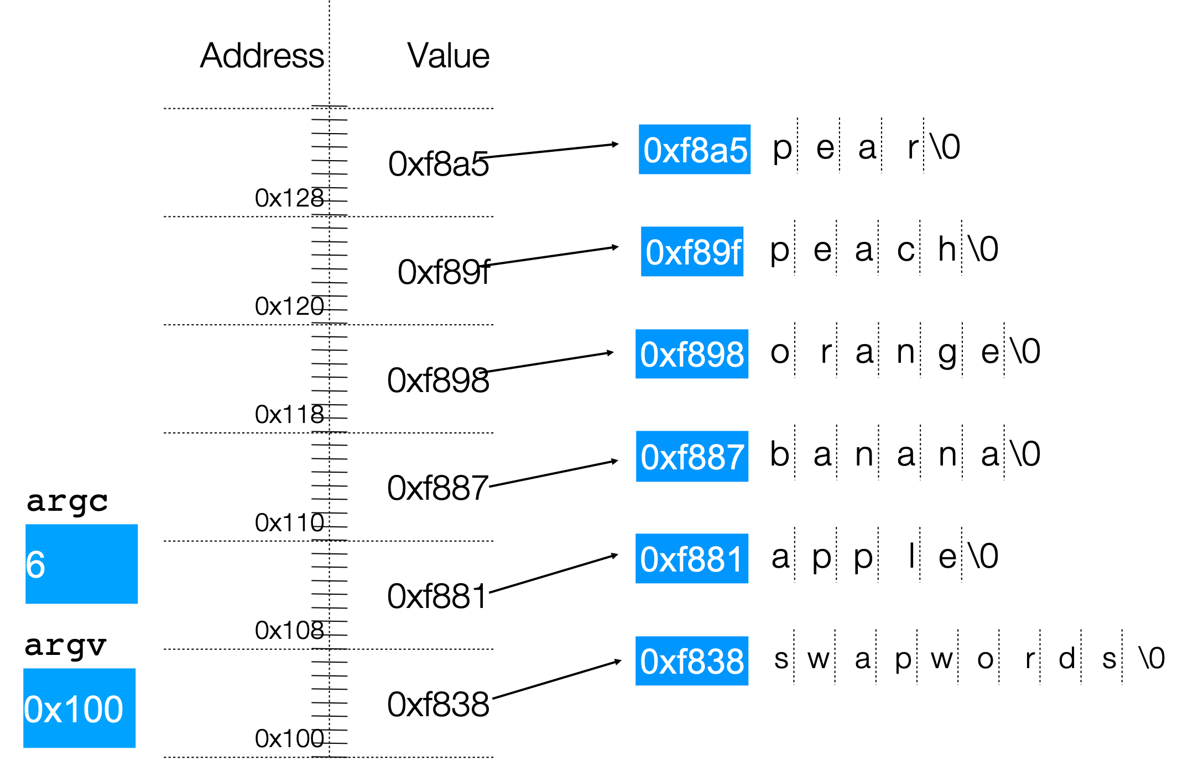
Arrays Of Pointers
./swapwords apple banana orange peach pear

Slide 69
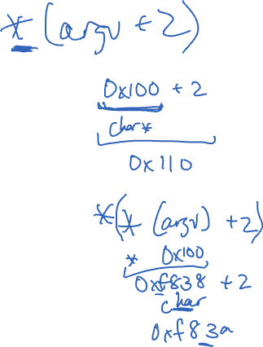
Arrays Of Pointers
./swapwords apple banana orange peach pear
What is the value of argv[2] in this diagram?

Slide 70
Lecture Plan
Pointers and Parameters 4
Double Pointers 42
Arrays in Memory 57
Arrays of Pointers 66
Pointer Arithmetic 70
Other topics: const, struct and ternary 80
Live Session 99
cp -r /afs/ir/class/cs107/lecture-code/lect06 .
Notes:
20min
25min
10min
10min
15min

Slide 71
Pointer Arithmetic
When you do pointer arithmetic, you are adjusting the pointer by a certain number of places (e.g. characters).
char *str = "apple"; // e.g. 0xff0
char *str1 = str + 1; // e.g. 0xff1
char *str3 = str + 3; // e.g. 0xff3
printf("%s", str); // apple
printf("%s", str1); // pple
printf("%s", str3); // le
DATA SEGMENT
Address | Value
 | …
0xff5 | '\0'
0xff4 | 'e'
0xff3 | 'l'
0xff2 | 'p'
0xff1 | 'p'
0xff0 | 'a'
 | …

Slide 72
Pointer Arithmetic
Pointer arithmetic does not work in bytes. Instead, it works in the size of the type it points to.
// nums points to an int array
int *nums = … // e.g. 0xff0
int *nums1 = nums + 1; // e.g. 0xff4
int *nums3 = nums + 3; // e.g. 0xffc
printf("%d", *nums); // 52
printf("%d", *nums1); // 23
printf("%d", *nums3); // 34
STACK
Address | Value
 | …
0x1004 | 1
0x1000 | 16
0xffc | 34
0xff8 | 12
0xff4 | 23
0xff0 | 52
 | …

Slide 73
Pointer Arithmetic
Pointer arithmetic does not work in bytes. Instead, it works in the size of the type it points to.
// nums points to an int array
int *nums = … // e.g. 0xff0
int *nums3 = nums + 3; // e.g. 0xffc
int *nums2 = nums3 - 1; // e.g. 0xff8
printf("%d", *nums); // 52
printf("%d", *nums2); // 12
printf("%d", *nums3); // 34
STACK
Address | Value
 | …
0x1004 | 1
0x1000 | 16
0xffc | 34
0xff8 | 12
0xff4 | 23
0xff0 | 52
 | …

Slide 74
Pointer Arithmetic
When you use bracket notation with a pointer, you are actually performing pointer arithmetic and dereferencing:
char *str = "apple"; // e.g. 0xff0
// both of these add two places to str,
// and then dereference to get the char there.
// E.g. get memory at 0xff2.
char thirdLetter = str[2]; // 'p'
char thirdLetter = *(str + 2); // 'p'
DATA SEGMENT
Address | Value
 | …
0xff5 | '\0'
0xff4 | 'e'
0xff3 | 'l'
0xff2 | 'p'
0xff1 | 'p'
0xff0 | 'a'
 | …

Slide 75
Pointer Arithmetic
Pointer arithmetic with two pointers does not give the byte difference. Instead, it gives the number of places they differ by.
// nums points to an int array
int *nums = … // e.g. 0xff0
int *nums3 = nums + 3; // e.g. 0xffc
int diff = nums3 - nums; // 3
STACK
Address | Value
 | …
0x1004 | 1
0x1000 | 16
0xffc | 34
0xff8 | 12
0xff4 | 23
0xff0 | 52
 | …

Slide 76
String Behavior #6: Adding an offset to a C string gives us a substring that many places past the first character.

Slide 77
Pointer Arithmetic
How does the code know how many bytes it should look at once it visits an address?
int x = 2;
int *xPtr = &x; // e.g. 0xff0
// How does it know to print out just the 4 bytes at xPtr?
printf("%d", *xPtr); // 2

Slide 78
Pointer Arithmetic
How does the code know how many bytes it should add when performing pointer arithmetic?
int nums[] = {1, 2, 3};
// How does it know to add 4 bytes here?
int *intPtr = nums + 1;
char str[6];
strcpy(str, "CS107");
// How does it know to add 1 byte here?
char *charPtr = str + 1;

Slide 79
Pointer Arithmetic
At compile time, C can figure out the sizes of different data types, and the sizes of what they point to.
For this reason, when the program runs, it knows the correct number of bytes to address or add/subtract for each data type.

Slide 80
Lecture Plan
Pointers and Parameters 4
Double Pointers 42
Arrays in Memory 57
Arrays of Pointers 66
Pointer Arithmetic 70
Other topics: const, struct and ternary 80
Live Session 99
cp -r /afs/ir/class/cs107/lecture-code/lect06 .
Notes:
20min
25min
10min
10min
15min

Slide 81
Const
Use const to declare global constants in your program. This indicates the variable cannot change after being created.
const double PI = 3.1415;
const int DAYS_IN_WEEK = 7;
int main(int argc, char *argv[]) {
…
if (x == DAYS_IN_WEEK) {
…
}
…
}

Slide 82
Const
Use const with pointers to indicate that the data that is pointed to cannot change.
char str[6];
strcpy(str, "Hello");
const char *s = str;
// Cannot use s to change characters it points to
s[0] = 'h';

Slide 83
Const
Sometimes we use const with pointer parameters to indicate that the function will not / should not change what it points to. The actual pointer can be changed, however.
// This function promises to not change str’s characters
int countUppercase(const char *str) {
int count = 0;
for (int i = 0; i < strlen(str); i++) {
if (isupper(str[i])) {
count++;
}
}
return count;
}

Slide 84
Const
By definition, C gets upset when you set a non-const pointer equal to a const pointer. You need to be consistent with const to reflect what you cannot modify.
// This function promises to not change str’s characters
int countUppercase(const char *str) {
// compiler warning and error
char *strToModify = str;
strToModify[0] = …
}

Slide 85
Const
By definition, C gets upset when you set a non-const pointer equal to a const pointer. You need to be consistent with const to reflect what you cannot modify. Think of const as part of the variable type.
// This function promises to not change str’s characters
int countUppercase(const char *str) {
const char *strToModify = str;
strToModify[0] = …
}

Slide 86
Const
const can be confusing to interpret in some variable types.
// cannot modify this char
const char c = 'h';
// cannot modify chars pointed to by str
const char *str = …
// cannot modify chars pointed to by *strPtr
const char **strPtr = …

Slide 87
Structs
A struct is a way to define a new variable type that is a group of other variables.
struct date { // declaring a struct type
int month;
int day; // members of each date structure
};
…
struct date today; // construct structure instances
today.month = 1;
today.day = 28;
struct date new_years_eve = {12, 31}; // shorter initializer syntax

Slide 88
Structs
Wrap the struct definition in a typedef to avoid having to include the word struct every time you make a new variable of that type.
typedef struct date {
int month;
int day;
} date;
…
date today;
today.month = 1;
today.day = 28;
date new_years_eve = {12, 31};

Slide 89
Structs
If you pass a struct as a parameter, like for other parameters, C passes a copy of the entire struct.
void advance_day(date d) {
d.day++;
}
int main(int argc, char *argv[]) {
date my_date = {1, 28};
advance_day(my_date);
printf("%d", my_date.day); // 28
return 0;
}

Slide 90
Structs
If you pass a struct as a parameter, like for other parameters, C passes a copy of the entire struct. Use a pointer to modify a specific instance.
void advance_day(date *d) {
(*d).day++;
}
int main(int argc, char *argv[]) {
date my_date = {1, 28};
advance_day(&my_date);
printf("%d", my_date.day); // 29
return 0;
}

Slide 91
Structs
The arrow operator lets you access the field of a struct pointed to by a pointer.
void advance_day(date *d) {
d->day++; // equivalent to (*d).day++;
}
int main(int argc, char *argv[]) {
date my_date = {1, 28};
advance_day(&my_date);
printf("%d", my_date.day); // 29
return 0;
}

Slide 92
Structs
C allows you to return structs from functions as well. It returns whatever is contained within the struct.
date create_new_years_date() {
date d = {1, 1};
return d; // or return (date){1, 1};
}
int main(int argc, char *argv[]) {
date my_date = create_new_years_date();
printf("%d", my_date.day); // 1
return 0;
}

Slide 93
Structs
sizeof gives you the entire size of a struct, which is the sum of the sizes of all its contents.
typedef struct date {
int month;
int day;
} date;
int main(int argc, char *argv[]) {
int size = sizeof(date); // 8
return 0;
}

Slide 94
Arrays of Structs
You can create arrays of structs just like any other variable type.
typedef struct my_struct {
int x;
char c;
} my_struct;
…
my_struct array_of_structs[5];

Slide 95
Arrays of Structs
To initialize an entry of the array, you must use this special syntax to confirm the type to C.
typedef struct my_struct {
int x;
char c;
} my_struct;
…
my_struct array_of_structs[5];
array_of_structs[0] = (my_struct){0, 'A'};

Slide 96
Arrays of Structs
You can also set each field individually.
typedef struct my_struct {
int x;
char c;
} my_struct;
…
my_struct array_of_structs[5];
array_of_structs[0].x = 2;
array_of_structs[0].c = 'A';

Slide 97
Ternary Operator
The ternary operator is a shorthand for using if/else to evaluate to a value.
condition ? expressionIfTrue : expressionIfFalse
int x;
if (argc > 1) {
x = 50;
} else {
x = 0;
}
// equivalent to
int x = argc > 1 ? 50 : 0;

Slide 98
Recap
Pointers and Parameters
Double Pointers
Arrays in Memory
Arrays of Pointers
Pointer Arithmetic
Other topics: const, struct and ternary
Next Time: dynamically allocated memory
Notes:
20min
25min
10min
10min
15min

Slide 99
Additional Live Session Slides

Slide 100
Plan For Today
10 minutes: general review
5 minutes: post questions or comments on Ed for what we should discuss
15 minutes: open Q&A
25 minutes: extra practice
Lecture 6 takeaway: pointers let us store the addresses of data and pass them as parameters. We can perform arithmetic with pointers to change where they point to. Arrays in C also “decay to pointers” as parameters and in arithmetic expressions.

Slide 101
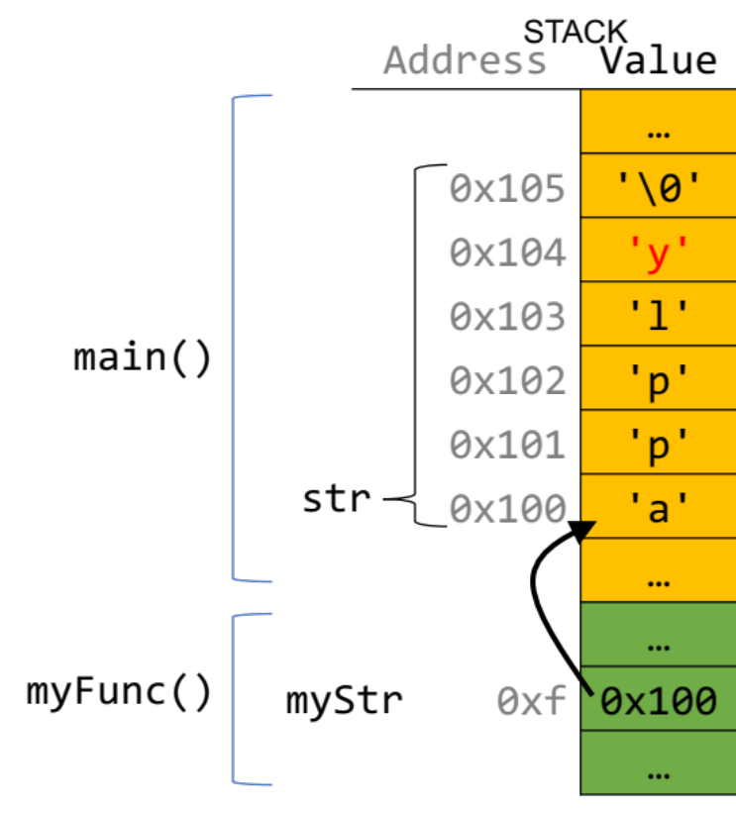
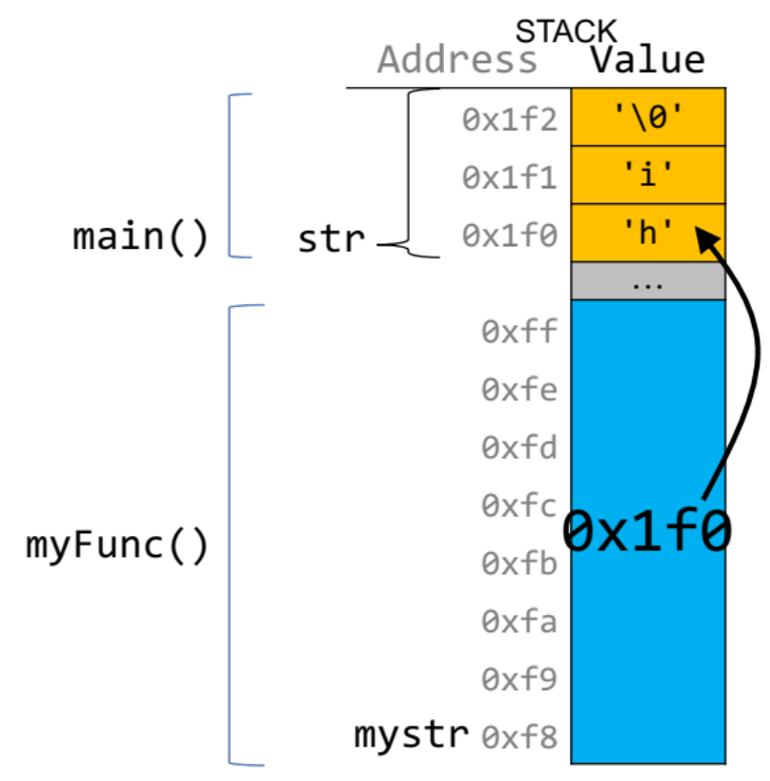
How to draw memory diagrams?
Slide 34
Slide 62
Slide 68
Choose whatever style is convenient for you, keeping in mind that (1) memory is contiguous, and (2) C types are different sizes.

Slide 102
Is there a difference?
size_t get_total_strlen(char *strs[], size_t num) {
…
}
void *skip_spaces(char **p_str) {
…
}
Intent: strs is an array of strings
Intent: p_str is a pointer to a string
No difference to the compiler—it’s char**!
But it clarifies the intent of a function/a parameter for the programmer.

Slide 103
Pointer arithmetic
Array indexing is “syntactic sugar” for pointer arithmetic:
ptr + i ⬄ &ptr[i]
*(ptr + i) ⬄ ptr[i]
This means too-large/negative subscripts will compile ☺
arr[99] arr[-1]
You can use either syntax on either pointer or array.
⚠️ Pointer arithmetic does not work in bytes; it works on the type it points to.
On int* addresses scale by sizeof(int), on char* scale by sizeof(char) .
Notes:
This is a very big detail that I ignored on Friday when we talked about it!
Add i integers to this address

Slide 104
Translating C into English
If declaration: “pointer”
ex: int * is "pointer to an int”
If operation: "dereference/the value at address”
ex: *num is "the value at address num"
“address of”
&
*
address
address (except sizeof)
<ptr name>
<arr name>
// initializes stack array
// with 4 ints
1.
2.
3.
4.
int arr[] = {3, 4, -1, 2};
int *ptr0 = arr;
int *elt0 = *arr;
int elt = *(arr + 3);
int **ptr1 = &ptr;
🤔
Type check with a diagram!

Slide 105
Translating C into English
If declaration: “pointer”
ex: int * is "pointer to an int”
If operation: "dereference/the value at address”
ex: *num is "the value at address num"
“address of”
&
*
address
address (except sizeof)
<ptr name>
<arr name>
// initializes stack array
// with 4 ints
1.
2.
3.
4.
int arr[] = {3, 4, -1, 2};
int *ptr0 = arr;
int *elt0 = *arr;
int elt = *(arr + 3);
int **ptr1 = &ptr;
Address arr
Value at address arr
The value at address <3 ints after address arr>
address of ptr
Type check with a diagram!

Slide 106
Translating C into English
If declaration: “pointer”
ex: int * is "pointer to an int”
If operation: "dereference/the value at address”
ex: *num is "the value at address num"
“address of”
&
*
address
address (except sizeof)
<ptr name>
<arr name>
// initializes stack array
// with 4 ints
1.
2.
3.
4.
int arr[] = {3, 4, -1, 2};
int *ptr0 = arr;
int *elt0 = *arr;
int elt = *(arr + 3);
int **ptr1 = &ptr;
Type check with a diagram!

Slide 107
Pointers to Strings
Address | Value
 | …
0x105 | 0x11
 | …
 | …
0xf0 | 0x105
0xe8 | 2
 | …
 | …
0x13 | '\0'
0x12 | 'i'
0x11 | 'h'
0x10 | ' '
0xf | ' '
 | …
void skipSpaces(char **strPtr) {
int numSpaces = strspn(*strPtr, " ");
*strPtr += numSpaces;
}
int main(int argc, char *argv[]) {
char *myStr = " hi";
skipSpaces(&myStr);
printf("%s\n", myStr); // hi
return 0;
}
main()
myStr
STACK
strPtr
skipSpaces()
numSpaces
Weird thought – 0x11 is a string.
DATA SEGMENT
Notes:
strPtr
*strPtr
**strPtr
&myStr
myStr

Slide 108
Plan For Today
10 minutes: general review
5 minutes: post questions or comments on Ed for what we should discuss
15 minutes: open Q&A
25 minutes: extra practice
Lecture 6 takeaway: pointers let us store the addresses of data and pass them as parameters. We can perform arithmetic with pointers to change where they point to. Arrays in C also “decay to pointers” as parameters and in arithmetic expressions.

Slide 109
Pen and paper: A * Wars Story
1
2
3
4
5
6
7
8
9
void binky() {
int a = 10;
int b = 20;
int *p = &a;
int *q = &b;
*p = *q;
p = q;
}
Lines 2-5: Draw a diagram.
Line 7: Update your diagram.
Line 8: Update your diagram.
0xffe800
10
0xffe808
0xffe800
a
p
0xffe804
20
0xffe810
0xffe804
b
q
🤔

Slide 110
Pen and paper: A * Wars Story
1
2
3
4
5
6
7
8
9
void binky() {
int a = 10;
int b = 20;
int *p = &a;
int *q = &b;
*p = *q;
p = q;
}
Lines 2-5: Draw a diagram.
Line 7: Update your diagram.
Line 8: Update your diagram.
0xffe800
10
0xffe808
0xffe800
a
20
p
0xffe804
20
0xffe810
0xffe804
b
q

Slide 111
Pen and paper: A * Wars Story
1
2
3
4
5
6
7
8
9
void binky() {
int a = 10;
int b = 20;
int *p = &a;
int *q = &b;
*p = *q;
p = q;
}
Lines 2-5: Draw a diagram.
Line 7: Update your diagram.
Line 8: Update your diagram.
0xffe800
20
0xffe808
0xffe800
a
p
0xffe804
0xffe804
20
0xffe810
0xffe804
b
q
Notes:
If you want to play around with this code in gdb, I encourage you to! It’s located in this arrptr.c.

Slide 112
* Wars: Episode I (of 2)
In variable declaration, * creates a pointer.
0xf0
'r'
char ch = 'r';
ch stores a char
ch
0xe8
0xf0
char *cptr = &ch;
cptr stores an address of a char
(points to a char)
cptr
char **strptr = &cptr;
strptr stores an address of a char *
(points to a char *)
0xe0
0xe8
strptr
Notes:
I’ve always found pointers difficult because there are really two use cases for the star operator. One of them happens when you are creating the variable, and the other one is when you actually access the variable. Let’s talk about the first one.

Slide 113
* Wars: Episode II (of 2)
In reading values from/storing values, * dereferences a pointer.
0xf0
'r'
char ch = 'r';
ch = ch + 1;
Increment value stored in ch
ch
's'
0xe8
0xf0
char *cptr = &ch;
cptr
char **strptr = &cptr;
0xe0
0xe8
strptr
Notes:
Okay, so that was variable declaration. When you first make the metaphorical box that has the metaphorical arrow pointing to a metaphorical other box.
The second case to use the star (asterisk) is when you are reading/writing values. This is called dereferencing.

Slide 114
* Wars: Episode II (of 2)
In reading values from/storing values, * dereferences a pointer.
0xf0
's'
char ch = 'r';
ch = ch + 1;
Increment value stored in ch
ch
't'
0xe8
0xf0
char *cptr = &ch;
*cptr = *cptr + 1;
Increment value stored at memory address in cptr
(increment char pointed to)
cptr
char **strptr = &cptr;
0xe0
0xe8
strptr
Notes:
First line here, declare the pointer variable. Okay. Now, the second line dereferences to read and also dereferences to write.
Read the value. From where? From the address that cptr points to. ‘s’. + 1. ‘t’.
Store the value. To where? To the address that cptr points to.

Slide 115
* Wars: Episode II (of 2)
In reading values from/storing values, * dereferences a pointer.
0xf0
't'
0xf1
?
char ch = 'r';
ch = ch + 1;
Increment value stored in ch
ch
0xe8
0xf0
0xe8
0xf1
char *cptr = &ch;
*cptr = *cptr + 1;
Increment value stored at memory address in cptr
(increment char pointed to)
cptr
char **strptr = &cptr;
*strptr = *strptr + 1;
Increment value stored at memory address in cptr
(increment address pointed to)
0xe0
0xe8
strptr
Notes:
The exact same thing happens with double pointers.

Slide 116
Exercise: Implementation
The below function sums up the string lengths of the num strings in strs.
Try both 1. array [] syntax and 2. pointer arithmetic!
1
2
3
4
5
6
7
size_t get_total_strlen(char *strs[], size_t num) {
size_t total_length = 0;
for (int i = 0; i < num; i++) {
// fill this in
}
return total_length;
}
🤔

Slide 117
Exercise: Implementation
The below function sums up the string lengths of the num strings in strs.
Try both 1. array [] syntax and 2. pointer arithmetic!
1
2
3
4
5
6
7
size_t get_total_strlen(char *strs[], size_t num) {
size_t total_length = 0;
for (int i = 0; i < num; i++) {
// TODO: fill this in two ways
}
return total_length;
}
Equivalent:
1. total_length += strlen(strs[i]);
2. total_length += strlen(*(strs + i));

Slide 118
Skip spaces
1
2
3
4
5
6
7
8
9
10
  void skip_spaces(char **p_str) {
  int num = strspn(*p_str, " ");
  *p_str = *p_str + num;
  }
  int main(int argc, char *argv[]){
  char *str = " Hi!";
  skip_spaces(&str);
  printf("%s", str); // "Hi!"
  return 0;
  }
' ' | ' ' | 'H' | 'i' | '!' | '\0'
str
p_str
' ' | ' ' | 'H' | 'i' | '!' | '\0'
str
p_str
What diagram most accurately depicts program state at Line 4 (before skip_spaces returns to main)?
' ' | ' ' | 'H' | 'i' | '!' | '\0'
🤔
str
p_str

Slide 119
Skip spaces
1
2
3
4
5
6
7
8
9
10
  void skip_spaces(char **p_str) {
  int num = strspn(*p_str, " ");
  *p_str = *p_str + num;
  }
  int main(int argc, char *argv[]){
  char *str = " Hi!";
  skip_spaces(&str);
  printf("%s", str); // "Hi!"
  return 0;
  }
' ' | ' ' | 'H' | 'i' | '!' | '\0'
str
p_str
' ' | ' ' | 'H' | 'i' | '!' | '\0'
str
p_str
What diagram most accurately depicts program state at Line 4 (before skip_spaces returns to main)?
' ' | ' ' | 'H' | 'i' | '!' | '\0'
str
p_str

Slide 120
const vs #define
#define THIRD_BIT 1 << 3
// cannot modify this char
const char c = 'h';
// cannot modify chars pointed to by str
const char *str = …
// cannot modify chars pointed to by *strPtr
const char **strPtr = …
#define is a hard-coded substitution that gcc will make when compiling your code.
Const signals that this variable (in this scope) should not be modified.
In CS107, you often won’t have to declare const variables, but you will be provided parameters or use functions that have it
Const directly modifies the adjacent keyword
(Slide 86)

Slide 121
const (from the quiz)
1 char buf[6];
2 strcpy(buf, "Hello");
3 const char *str = buf;
4 str[0] = 'M';
5 str = "Mello";
6 buf[0] = 'M';
Which lines (if any) above will cause an error due to violating const? Remember that const char * means that the characters at the location it stores cannot be changed.

Slide 122
const (from the quiz)
Line 1 makes a typical modifiable character array of 6 characters.
1 char buf[6];
2 strcpy(buf, "Hello");
3 const char *str = buf;
4 str[0] = 'M';
5 str = "Mello";
6 buf[0] = 'M';
Which lines (if any) above will cause an error due to violating const? Remember that const char * means that the characters at the location it stores cannot be changed.
✅

Slide 123
const (from the quiz)
Line 2 copies characters into this modifiable character array.
1 char buf[6];
2 strcpy(buf, "Hello");
3 const char *str = buf;
4 str[0] = 'M';
5 str = "Mello";
6 buf[0] = 'M';
Which lines (if any) above will cause an error due to violating const? Remember that const char * means that the characters at the location it stores cannot be changed.
✅
✅

Slide 124
const (from the quiz)
Line 3 makes a const pointer that points to the first element of buf. We cannot use str to change the characters it points to because it is const.
1 char buf[6];
2 strcpy(buf, "Hello");
3 const char *str = buf;
4 str[0] = 'M';
5 str = "Mello";
6 buf[0] = 'M';
Which lines (if any) above will cause an error due to violating const? Remember that const char * means that the characters at the location it stores cannot be changed.
✅
✅
✅

Slide 125
const (from the quiz)
Line 4 is not allowed – it attempts to use a const pointer to characters to modify those characters.
1 char buf[6];
2 strcpy(buf, "Hello");
3 const char *str = buf;
4 str[0] = 'M';
5 str = "Mello";
6 buf[0] = 'M';
Which lines (if any) above will cause an error due to violating const? Remember that const char * means that the characters at the location it stores cannot be changed.
✅
✅
✅
❌

Slide 126
const (from the quiz)
Line 5 is ok – str’s type means that while you cannot change the characters at which it points, you can change str itself to point somewhere else. str is not const – its characters are.
1 char buf[6];
2 strcpy(buf, "Hello");
3 const char *str = buf;
4 str[0] = 'M';
5 str = "Mello";
6 buf[0] = 'M';
Which lines (if any) above will cause an error due to violating const? Remember that const char * means that the characters at the location it stores cannot be changed.
✅
✅
✅
❌
✅

Slide 127
const (from the quiz)
Line 6 is ok – buf is a modifiable char array, and we can use it to change its characters. Declaring str as const doesn’t mean that place in memory is not modifiable at all – it just means that you cannot modify it using str.
1 char buf[6];
2 strcpy(buf, "Hello");
3 const char *str = buf;
4 str[0] = 'M';
5 str = "Mello";
6 buf[0] = 'M';
Which lines (if any) above will cause an error due to violating const? Remember that const char * means that the characters at the location it stores cannot be changed.
✅
✅
✅
❌
✅
✅

Slide 128
Exim Internet Mailer
As of October 2019, about 57% of publicly reachable internet mail servers use Exim (Source).
Exim has string processing code in C that escapes 2-character sequences beginning with a ‘\’ while parsing text. (Source)
Vulnerability: what if the string ends with a ‘\’?
Exploit: hackers can gain root access to the machine! (Source)

Slide 129
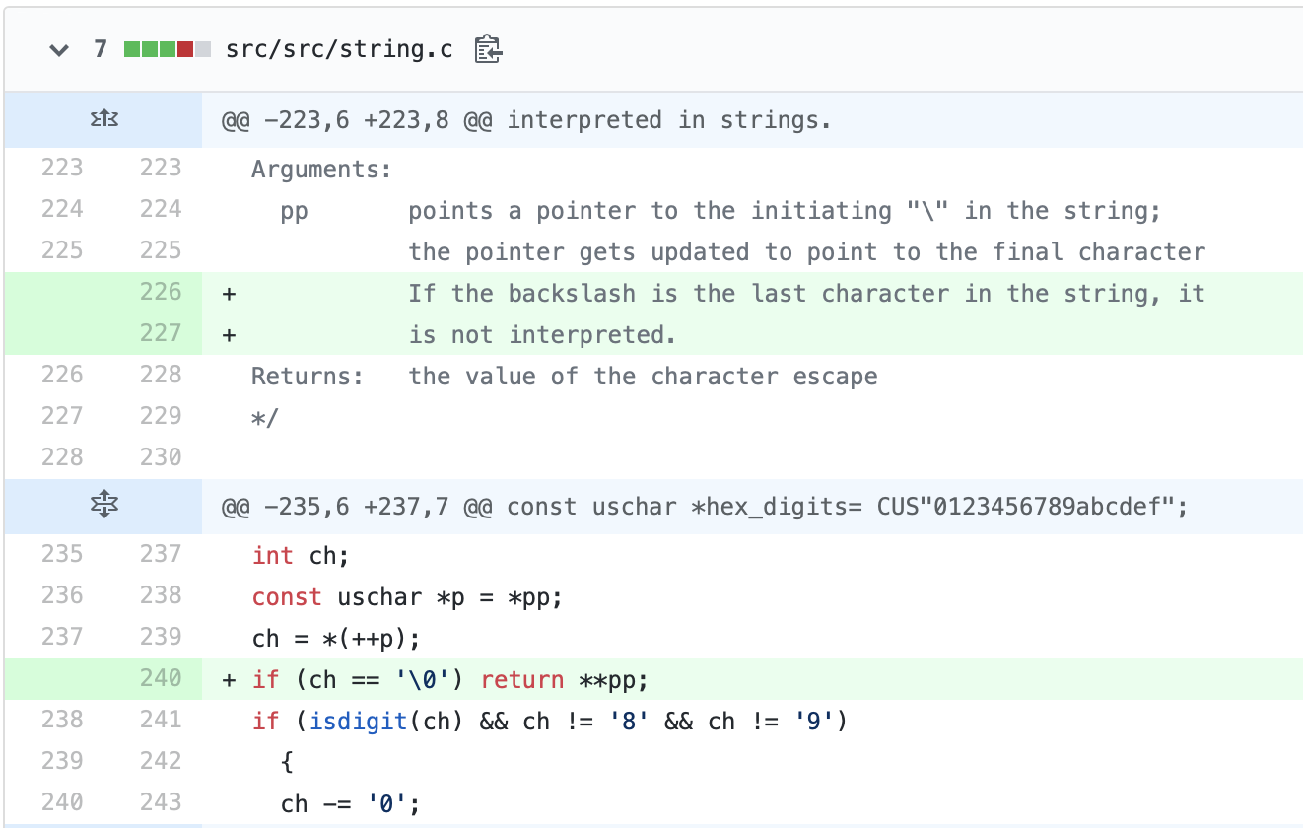
Exim Internet Mailer: Patch
https://github.com/Exim/exim/commit/c3aefacc72991f4960486052775ab47cd83c5fae#diff-2df79c106af94fb3d05bc3f75d7f2abb

