Slide 1
CS107, Lecture 10
Introduction to Assembly
Reading: B&O 3.1-3.4

Slide 2
Course Overview
Bits and Bytes - How can a computer represent integer numbers?
Chars and C-Strings - How can a computer represent and manipulate more complex data like text?
Pointers, Stack and Heap – How can we effectively manage all types of memory in our programs?
Generics - How can we use our knowledge of memory and data representation to write code that works with any data type?
Assembly - How does a computer interpret and execute C programs?
Heap Allocators - How do core memory-allocation operations like malloc and free work?
Notes:
Don’t list everything, just pick a few

Slide 3
CS107 Topic 5: How does a computer interpret and execute C programs?

Slide 4
Learning Assembly
Moving data around
Arithmetic and logical operations
Control flow
Function calls
This Lecture
Lecture 11
Lecture 12
Lecture 13

Slide 5
Learning Goals
Learn what assembly language is and why it is important
Become familiar with the format of human-readable assembly and x86
Learn the mov instruction and how data moves around at the assembly level

Slide 6
Lecture Plan
Overview: GCC and Assembly 7
Demo: Looking at an executable 11
Registers and The Assembly Level of Abstraction 24
The mov Instruction 35
Live Session 57
cp -r /afs/ir/class/cs107/lecture-code/lect10 .

Slide 7
Lecture Plan
Overview: GCC and Assembly 7
Demo: Looking at an executable 11
Registers and The Assembly Level of Abstraction 24
The mov Instruction 35
Live Session 57
cp -r /afs/ir/class/cs107/lecture-code/lect10 .

Slide 8
Bits all the way down
Data representation so far
Integer (unsigned int, 2’s complement signed int)
char (ASCII)
Address (unsigned long)
Aggregates (arrays, structs)
The code itself is binary too!
Instructions (machine encoding)
Notes:
Who is dealing with this encoding? Is it C? Is it something else? (it’s x86, the assembly language)
We’ve seen many data types so far:
› Integers:
• char/int/long (encoding as unsigned or two’s complement signed)
› Letters/punctutation:
• Char(ASCIIencoding)
› Real numbers:
• float/double(IEEEfloatingpointencoding)
› Memory addresses:
• pointertypes(unsignedlongencoding)
› Now a new one.....the code itself!
• Instructions(AMD64encoding)
Function pointers?

Slide 9
GCC
GCC is the compiler that converts your human-readable code into machine-readable instructions.
C, and other languages, are high-level abstractions we use to write code efficiently. But computers don’t really understand things like data structures, variable types, etc. Compilers are the translator!
Pure machine code is 1s and 0s – everything is bits, even your programs! But we can read it in a human-readable form called assembly. (Engineers used to write code in assembly before C).
There may be multiple assembly instructions needed to encode a single C instruction.
We’re going to go behind the curtain to see what the assembly code for our programs looks like.

Slide 10
Lecture Plan
Overview: GCC and Assembly 7
Demo: Looking at an executable 11
Registers and The Assembly Level of Abstraction 24
The mov Instruction 35
Live Session 57
cp -r /afs/ir/class/cs107/lecture-code/lect10 .

Slide 11
Demo: Looking at an Executable (objdump -d)

Slide 12
Our First Assembly
int sum_array(int arr[], int nelems) {
int sum = 0;
for (int i = 0; i < nelems; i++) {
sum += arr[i];
}
return sum;
}
What does this look like in assembly?

Slide 13
Our First Assembly
int sum_array(int arr[], int nelems) {
int sum = 0;
for (int i = 0; i < nelems; i++) {
sum += arr[i];
}
return sum;
}
00000000004005b6 <sum_array>:
4005b6: ba 00 00 00 00 mov $0x0,%edx
4005bb: b8 00 00 00 00 mov $0x0,%eax
4005c0: eb 09 jmp 4005cb <sum_array+0x15>
4005c2: 48 63 ca movslq %edx,%rcx
4005c5: 03 04 8f add (%rdi,%rcx,4),%eax
4005c8: 83 c2 01 add $0x1,%edx
4005cb: 39 f2 cmp %esi,%edx
4005cd: 7c f3 jl 4005c2 <sum_array+0xc>
4005cf: f3 c3 repz retq
make
objdump -d sum

Slide 14
Our First Assembly
00000000004005b6 <sum_array>:
4005b6: ba 00 00 00 00 mov $0x0,%edx
4005bb: b8 00 00 00 00 mov $0x0,%eax
4005c0: eb 09 jmp 4005cb <sum_array+0x15>
4005c2: 48 63 ca movslq %edx,%rcx
4005c5: 03 04 8f add (%rdi,%rcx,4),%eax
4005c8: 83 c2 01 add $0x1,%edx
4005cb: 39 f2 cmp %esi,%edx
4005cd: 7c f3 jl 4005c2 <sum_array+0xc>
4005cf: f3 c3 repz retq
Notes:
Read top to bottom

Slide 15
Our First Assembly
00000000004005b6 <sum_array>:
4005b6: ba 00 00 00 00 mov $0x0,%edx
4005bb: b8 00 00 00 00 mov $0x0,%eax
4005c0: eb 09 jmp 4005cb <sum_array+0x15>
4005c2: 48 63 ca movslq %edx,%rcx
4005c5: 03 04 8f add (%rdi,%rcx,4),%eax
4005c8: 83 c2 01 add $0x1,%edx
4005cb: 39 f2 cmp %esi,%edx
4005cd: 7c f3 jl 4005c2 <sum_array+0xc>
4005cf: f3 c3 repz retq
This is the name of the function (same as C) and the memory address where the code for this function starts.

Slide 16
Our First Assembly
00000000004005b6 <sum_array>:
4005b6: ba 00 00 00 00 mov $0x0,%edx
4005bb: b8 00 00 00 00 mov $0x0,%eax
4005c0: eb 09 jmp 4005cb <sum_array+0x15>
4005c2: 48 63 ca movslq %edx,%rcx
4005c5: 03 04 8f add (%rdi,%rcx,4),%eax
4005c8: 83 c2 01 add $0x1,%edx
4005cb: 39 f2 cmp %esi,%edx
4005cd: 7c f3 jl 4005c2 <sum_array+0xc>
4005cf: f3 c3 repz retq
These are the memory addresses where each of the instructions live. Sequential instructions are sequential in memory.

Slide 17
Our First Assembly
00000000004005b6 <sum_array>:
4005b6: ba 00 00 00 00 mov $0x0,%edx
4005bb: b8 00 00 00 00 mov $0x0,%eax
4005c0: eb 09 jmp 4005cb <sum_array+0x15>
4005c2: 48 63 ca movslq %edx,%rcx
4005c5: 03 04 8f add (%rdi,%rcx,4),%eax
4005c8: 83 c2 01 add $0x1,%edx
4005cb: 39 f2 cmp %esi,%edx
4005cd: 7c f3 jl 4005c2 <sum_array+0xc>
4005cf: f3 c3 repz retq
This is the assembly code: “human-readable” versions of each machine code instruction.

Slide 18
Our First Assembly
00000000004005b6 <sum_array>:
4005b6: ba 00 00 00 00 mov $0x0,%edx
4005bb: b8 00 00 00 00 mov $0x0,%eax
4005c0: eb 09 jmp 4005cb <sum_array+0x15>
4005c2: 48 63 ca movslq %edx,%rcx
4005c5: 03 04 8f add (%rdi,%rcx,4),%eax
4005c8: 83 c2 01 add $0x1,%edx
4005cb: 39 f2 cmp %esi,%edx
4005cd: 7c f3 jl 4005c2 <sum_array+0xc>
4005cf: f3 c3 repz retq
This is the machine code: raw hexadecimal instructions, representing binary as read by the computer. Different instructions may be different byte lengths.

Slide 19
Our First Assembly
00000000004005b6 <sum_array>:
4005b6: ba 00 00 00 00 mov $0x0,%edx
4005bb: b8 00 00 00 00 mov $0x0,%eax
4005c0: eb 09 jmp 4005cb <sum_array+0x15>
4005c2: 48 63 ca movslq %edx,%rcx
4005c5: 03 04 8f add (%rdi,%rcx,4),%eax
4005c8: 83 c2 01 add $0x1,%edx
4005cb: 39 f2 cmp %esi,%edx
4005cd: 7c f3 jl 4005c2 <sum_array+0xc>
4005cf: f3 c3 repz retq

Slide 20
Our First Assembly
00000000004005b6 <sum_array>:
4005b6: ba 00 00 00 00 mov $0x0,%edx
4005bb: b8 00 00 00 00 mov $0x0,%eax
4005c0: eb 09 jmp 4005cb <sum_array+0x15>
4005c2: 48 63 ca movslq %edx,%rcx
4005c5: 03 04 8f add (%rdi,%rcx,4),%eax
4005c8: 83 c2 01 add $0x1,%edx
4005cb: 39 f2 cmp %esi,%edx
4005cd: 7c f3 jl 4005c2 <sum_array+0xc>
4005cf: f3 c3 repz retq
Each instruction has an operation name (“opcode”).

Slide 21
Our First Assembly
00000000004005b6 <sum_array>:
4005b6: ba 00 00 00 00 mov $0x0,%edx
4005bb: b8 00 00 00 00 mov $0x0,%eax
4005c0: eb 09 jmp 4005cb <sum_array+0x15>
4005c2: 48 63 ca movslq %edx,%rcx
4005c5: 03 04 8f add (%rdi,%rcx,4),%eax
4005c8: 83 c2 01 add $0x1,%edx
4005cb: 39 f2 cmp %esi,%edx
4005cd: 7c f3 jl 4005c2 <sum_array+0xc>
4005cf: f3 c3 repz retq
Each instruction can also have arguments (“operands”).

Slide 22
Our First Assembly
00000000004005b6 <sum_array>:
4005b6: ba 00 00 00 00 mov $0x0,%edx
4005bb: b8 00 00 00 00 mov $0x0,%eax
4005c0: eb 09 jmp 4005cb <sum_array+0x15>
4005c2: 48 63 ca movslq %edx,%rcx
4005c5: 03 04 8f add (%rdi,%rcx,4),%eax
4005c8: 83 c2 01 add $0x1,%edx
4005cb: 39 f2 cmp %esi,%edx
4005cd: 7c f3 jl 4005c2 <sum_array+0xc>
4005cf: f3 c3 repz retq
$[number] means a constant value, or “immediate” (e.g. 1 here).

Slide 23
Our First Assembly
00000000004005b6 <sum_array>:
4005b6: ba 00 00 00 00 mov $0x0,%edx
4005bb: b8 00 00 00 00 mov $0x0,%eax
4005c0: eb 09 jmp 4005cb <sum_array+0x15>
4005c2: 48 63 ca movslq %edx,%rcx
4005c5: 03 04 8f add (%rdi,%rcx,4),%eax
4005c8: 83 c2 01 add $0x1,%edx
4005cb: 39 f2 cmp %esi,%edx
4005cd: 7c f3 jl 4005c2 <sum_array+0xc>
4005cf: f3 c3 repz retq
%[name] means a register, a storage location on the CPU (e.g. edx here).

Slide 24
Lecture Plan
Overview: GCC and Assembly 7
Demo: Looking at an executable 11
Registers and The Assembly Level of Abstraction 24
The mov instruction 35
cp -r /afs/ir/class/cs107/lecture-code/lect10 .

Slide 25
Assembly Abstraction
C abstracts away the low-level details of machine code. It lets us work using variables, variable types, and other higher-level abstractions.
C and other languages let us write code that works on most machines.
Assembly code is just bytes! No variable types, no type checking, etc.
Assembly/machine code is processor-specific.
What is the level of abstraction for assembly code?
Notes:
C code works on computer and phone, but needs to be recompiled!

Slide 26
Registers
%rax

Slide 27
Registers
%rax
%rsi
%r8
%r12
%rbx
%rdi
%r9
%r13
%rcx
%rbp
%r10
%r14
%rdx
%rsp
%r11
%r15

Slide 28
Registers
What is a register?
A register is a fast read/write memory slot right on the CPU that can hold variable values.
Registers are not located in memory.

Slide 29
Registers
A register is a 64-bit space inside the processor.
There are 16 registers available, each with a unique name.
Registers are like “scratch paper” for the processor. Data being calculated or manipulated is moved to registers first. Operations are performed on registers.
Registers also hold parameters and return values for functions.
Registers are extremely fast memory!
Processor instructions consist mostly of moving data into/out of registers and performing arithmetic on them. This is the level of logic your program must be in to execute!

Slide 30
Machine-Level Code
Assembly instructions manipulate these registers. For example:
One instruction adds two numbers in registers
One instruction transfers data from a register to memory
One instruction transfers data from memory to a register

Slide 31

Computer architecture
registers accessed by name
ALU is main workhorse of CPU
memory needed
for program
execution
(stack, heap, etc.)
accessed by address
disk/server stores program
when not executing

Slide 32
GCC And Assembly
GCC compiles your program – it lays out memory on the stack and heap and generates assembly instructions to access and do calculations on those memory locations.
Here’s what the “assembly-level abstraction” of C code might look like:
C | Assembly Abstraction
int sum = x + y; | Copy x into register 1 Copy y into register 2 Add register 2 to register 1 Write register 1 to memory for sum

Slide 33

Assembly
We are going to learn the x86-64 instruction set architecture. This instruction set is used by Intel and AMD processors.
There are many other instruction sets: ARM, MIPS, etc.

Slide 34
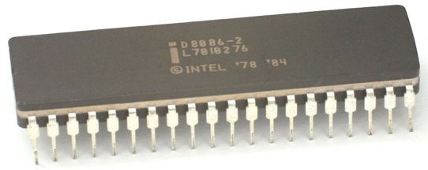
Instruction set architecture (ISA)
A contract between program/compiler and hardware:
Defines operations that the processor (CPU) can execute
Data read/write/transfer operations
Control mechanisms
Intel originally designed their instruction set back in 1978.
  Legacy support is a huge issue for x86-64
  Originally 16-bit processor, then 32 bit, now 64 bit.
  These design choices dictated the register sizes
  (and even register/instruction names).
Application program
Compiler
OS
ISA
CPU design
Circuit design
Chip layout
Notes:
legacy and backwards compatibility!!

Slide 35
Lecture Plan
Overview: GCC and Assembly 7
Demo: Looking at an executable 11
Registers and The Assembly Level of Abstraction 24
The mov Instruction 35
Live Session 57
cp -r /afs/ir/class/cs107/lecture-code/lect10 .

Slide 36
mov
The mov instruction copies bytes from one place to another;
it is similar to the assignment operator (=) in C.
mov src,dst
The src and dst can each be one of:
Immediate (constant value, like a number) (only src)
Register
Memory Location
(at most one of src, dst)
$0x104
%rbx
0x6005c0
Direct address

Slide 37
Operand Forms: Immediate
mov $0x104,_____
Copy the value 0x104 into some destination.

Slide 38
Operand Forms: Registers
Copy the value in register %rbx into some destination.
mov %rbx,____
mov ____,%rbx
Copy the value from some source into register %rbx.

Slide 39
Operand Forms: Absolute Addresses
Copy the value at address 0x104 into some destination.
mov 0x104,_____
mov _____,0x104
Copy the value from some source into the memory at address 0x104.

Slide 40
Practice #1: Operand Forms
What are the results of the following move instructions (executed separately)? For this problem, assume the value 5 is stored at address 0x42, and the value 8 is stored in %rbx.
mov $0x42,%rax
mov 0x42,%rax
mov %rbx,0x55
Notes:
Move 0x42 into %rax
Move 5 into %rax
Move 8 to address 0x55

Slide 41
Operand Forms: Indirect
Copy the value at the address stored in register %rbx into some destination.
mov (%rbx),_____
mov _____,(%rbx)
Copy the value from some source into the memory at the address stored in register %rbx.

Slide 42
Operand Forms: Base + Displacement
Copy the value at the address (0x10 plus what is stored in register %rax) into some destination.
mov 0x10(%rax),_________
mov __________,0x10(%rax)
Copy the value from some source into the memory at the address (0x10 plus what is stored in register %rax).

Slide 43
Operand Forms: Indexed
Copy the value at the address which is (the sum of the values in registers %rax and %rdx) into some destination.
mov (%rax,%rdx),__________
mov ___________,(%rax,%rdx)
Copy the value from some source into the memory at the address which is (the sum of the values in registers %rax and %rdx).

Slide 44
Operand Forms: Indexed
Copy the value at the address which is (the sum of 0x10 plus the values in registers %rax and %rdx) into some destination.
mov 0x10(%rax,%rdx),______
mov _______,0x10(%rax,%rdx)
Copy the value from some source into the memory at the address which is (the sum of 0x10 plus the values in registers %rax and %rdx).

Slide 45
Practice #2: Operand Forms
What are the results of the following move instructions (executed separately)? For this problem, assume the value 0x11 is stored at address 0x10C, 0xAB is stored at address 0x104, 0x100 is stored in register %rax and 0x3 is stored in %rdx.
mov $0x42,(%rax)
mov 4(%rax),%rcx
mov 9(%rax,%rdx),%rcx
Imm(r_{b}, r_{i}) is equivalent to address Imm + R[r_{b}] + R[r_{i}]
Displacement: positive or negative constant (if missing, = 0)
Base: register (if missing, = 0)
Index: register (if missing, = 0)
Notes:
Move 0x42 to memory address 0x100
Move 0xAB into %rcx
Move 0x11 into %rcx

Slide 46
Operand Forms: Scaled Indexed
Copy the value at the address which is (4 times the value in register %rdx) into some destination.
mov (,%rdx,4),______
mov _______,(,%rdx,4)
The scaling factor (e.g. 4 here) must be hardcoded to be either 1, 2, 4 or 8.
Copy the value from some source into the memory at the address which is (4 times the value in register %rdx).

Slide 47
Operand Forms: Scaled Indexed
Copy the value at the address which is (4 times the value in register %rdx, plus 0x4), into some destination.
mov 0x4(,%rdx,4),______
mov _______,0x4(,%rdx,4)
Copy the value from some source into the memory at the address which is (4 times the value in register %rdx, plus 0x4).

Slide 48
Operand Forms: Scaled Indexed
Copy the value at the address which is (the value in register %rax plus 2 times the value in register %rdx) into some destination.
mov (%rax,%rdx,2),________
mov _________,(%rax,%rdx,2)
Copy the value from some source into the memory at the address which is (the value in register %rax plus 2 times the value in register %rdx).

Slide 49
Operand Forms: Scaled Indexed
Copy the value at the address which is (0x4 plus the value in register %rax plus 2 times the value in register %rdx) into some destination.
mov 0x4(%rax,%rdx,2),_____
mov ______,0x4(%rax,%rdx,2)
Copy the value from some source into the memory at the address which is (0x4 plus the value in register %rax plus 2 times the value in register %rdx).

Slide 50
Most General Operand Form
Imm(r_{b},r_{i},s)
is equivalent to…
Imm + R[r_{b}] + R[r_{i}]*s

Slide 51
Most General Operand Form
Imm(r_{b}, r_{i}, s) is equivalent to
address Imm + R[r_{b}] + R[r_{i}]*s
Displacement: pos/neg constant (if missing, = 0)
Index: register (if missing, = 0)
Base: register (if missing, = 0)
Scale must be 1,2,4, or 8
(if missing, = 1)

Slide 52

Operand Forms
Type | Form | Operand Value | Name
Immediate | $$\$Imm$$ | $$Imm$$ | Immediate
Register | $$r_{a}$$ | $$R[r_{a}]$$ | Register
Memory | $$Imm$$ | $$M[Imm]$$ | Absolute
Memory | $${(r}_{a})$$ | $$M[R\left[r_{a}\right]]$$ | Indirect
Memory | $$Imm(r_{b})$$ | $$M[Imm+ R\left[r_{b}\right]]$$ | Base + displacement
Memory | $${(r}_{b},r_{i})$$ | $$M[R\left[r_{b}\right]+R\left[r_{i}\right]]$$ | Indexed
Memory | $$Imm{(r}_{b},r_{i})$$ | $$M[Imm+R\left[r_{b}\right]+R\left[r_{i}\right]]$$ | Indexed
Memory | $$(,r_{i},s)$$ | $$M[R\left[r_{i}\right] ∙s]$$ | Scaled indexed
Memory | $$Imm(,r_{i},s)$$ | $$M[Imm+R\left[r_{i}\right] ∙s]$$ | Scaled indexed
Memory | $${(r}_{b},r_{i},s)$$ | $$M[R\left[r_{b}\right]+R\left[r_{i}\right] ∙s]$$ | Scaled indexed
Memory | $$Imm{(r}_{b},r_{i},s)$$ | $$M[Imm+R\left[r_{b}\right]+ R\left[r_{i}\right] ∙s]$$ | Scaled indexed
Figure 3.3 from the book: “Operand forms. Operands can denote immediate (constant) values, register values, or values from memory. The scaling factor s must be either. 1, 2, 4, or 8.”

Slide 53
Practice #3: Operand Forms
What are the results of the following move instructions (executed separately)? For this problem, assume the value 0x1 is stored in register %rcx, the value 0x100 is stored in register %rax, the value 0x3 is stored in register %rdx, and value 0x11 is stored at address 0x10C.
mov $0x42,0xfc(,%rcx,4)
mov (%rax,%rdx,4),%rbx
Imm(r_{b}, r_{i}, s) is equivalent to address Imm + R[r_{b}] + R[r_{i}]*s
Displacement
Base
Index
Scale
(1,2,4,8)
Notes:
Move 0x42 to memory address 0x100
Move 0x11 to %rbx

Slide 54
Goals of indirect addressing: C
Why are there so many forms of indirect addressing?
We see these indirect addressing paradigms in C as well!

Slide 55
Our First Assembly
int sum_array(int arr[], int nelems) {
int sum = 0;
for (int i = 0; i < nelems; i++) {
sum += arr[i];
}
return sum;
}
00000000004005b6 <sum_array>:
4005b6: ba 00 00 00 00 mov $0x0,%edx
4005bb: b8 00 00 00 00 mov $0x0,%eax
4005c0: eb 09 jmp 4005cb <sum_array+0x15>
4005c2: 48 63 ca movslq %edx,%rcx
4005c5: 03 04 8f add (%rdi,%rcx,4),%eax
4005c8: 83 c2 01 add $0x1,%edx
4005cb: 39 f2 cmp %esi,%edx
4005cd: 7c f3 jl 4005c2 <sum_array+0xc>
4005cf: f3 c3 repz retq
We’re 1/4th of the way to understanding assembly! What looks understandable right now?
Some notes:
Registers store addresses and values
mov src, dst copies value into dst
sizeof(int) is 4
Instructions executed sequentially
We’ll come back to this example in future lectures!
🤔

Slide 56
Recap
Overview: GCC and Assembly
Demo: Looking at an executable
Registers and The Assembly Level of Abstraction
The mov instruction
Next time: diving deeper into assembly

Slide 57
Live Session Slides

Slide 58
Plan For Today
10 minutes: general review
5 minutes: post questions or comments on Ed for what we should discuss
15 minutes: open Q&A
25 minutes: extra practice
Lecture 10 takeaway: Assembly is the human-readable version of the form our programs are ultimately executed in by the processor. The compiler translates source code to machine code. The most common assembly instruction is mov to move data around.

Slide 59

Central Processing Units (CPUs)
Intel 8086, 16-bit microprocessor
($86.65, 1978)
Raspberry Pi BCM2836
32-bit ARM microprocessor
($35 for everything, 2015)
Intel Core i9-9900K 64-bit
8-core multi-core processor
($449, 2018)
Notes:
Intel 8086: $341.52 adjusting for inflation to current day
Broadcom 2836
i7 quad-core chip
microprocessor vs multi-core processor

Slide 60
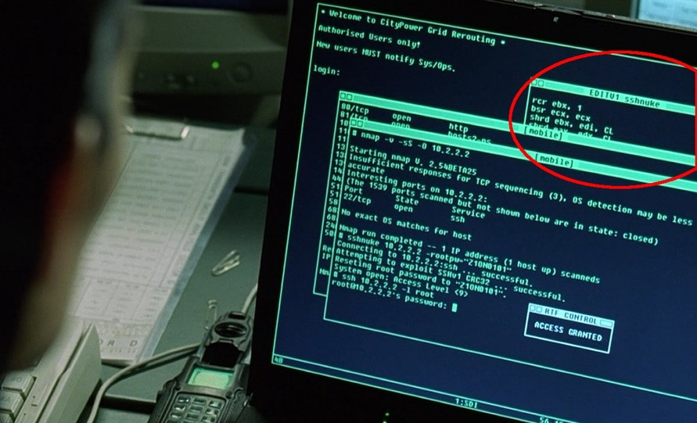
Assembly code in movies
Trinity saving the world by hacking into the power grid using Nmap Network Scanning
The Matrix Reloaded, 2003
Notes:
32 bit lol

Slide 61
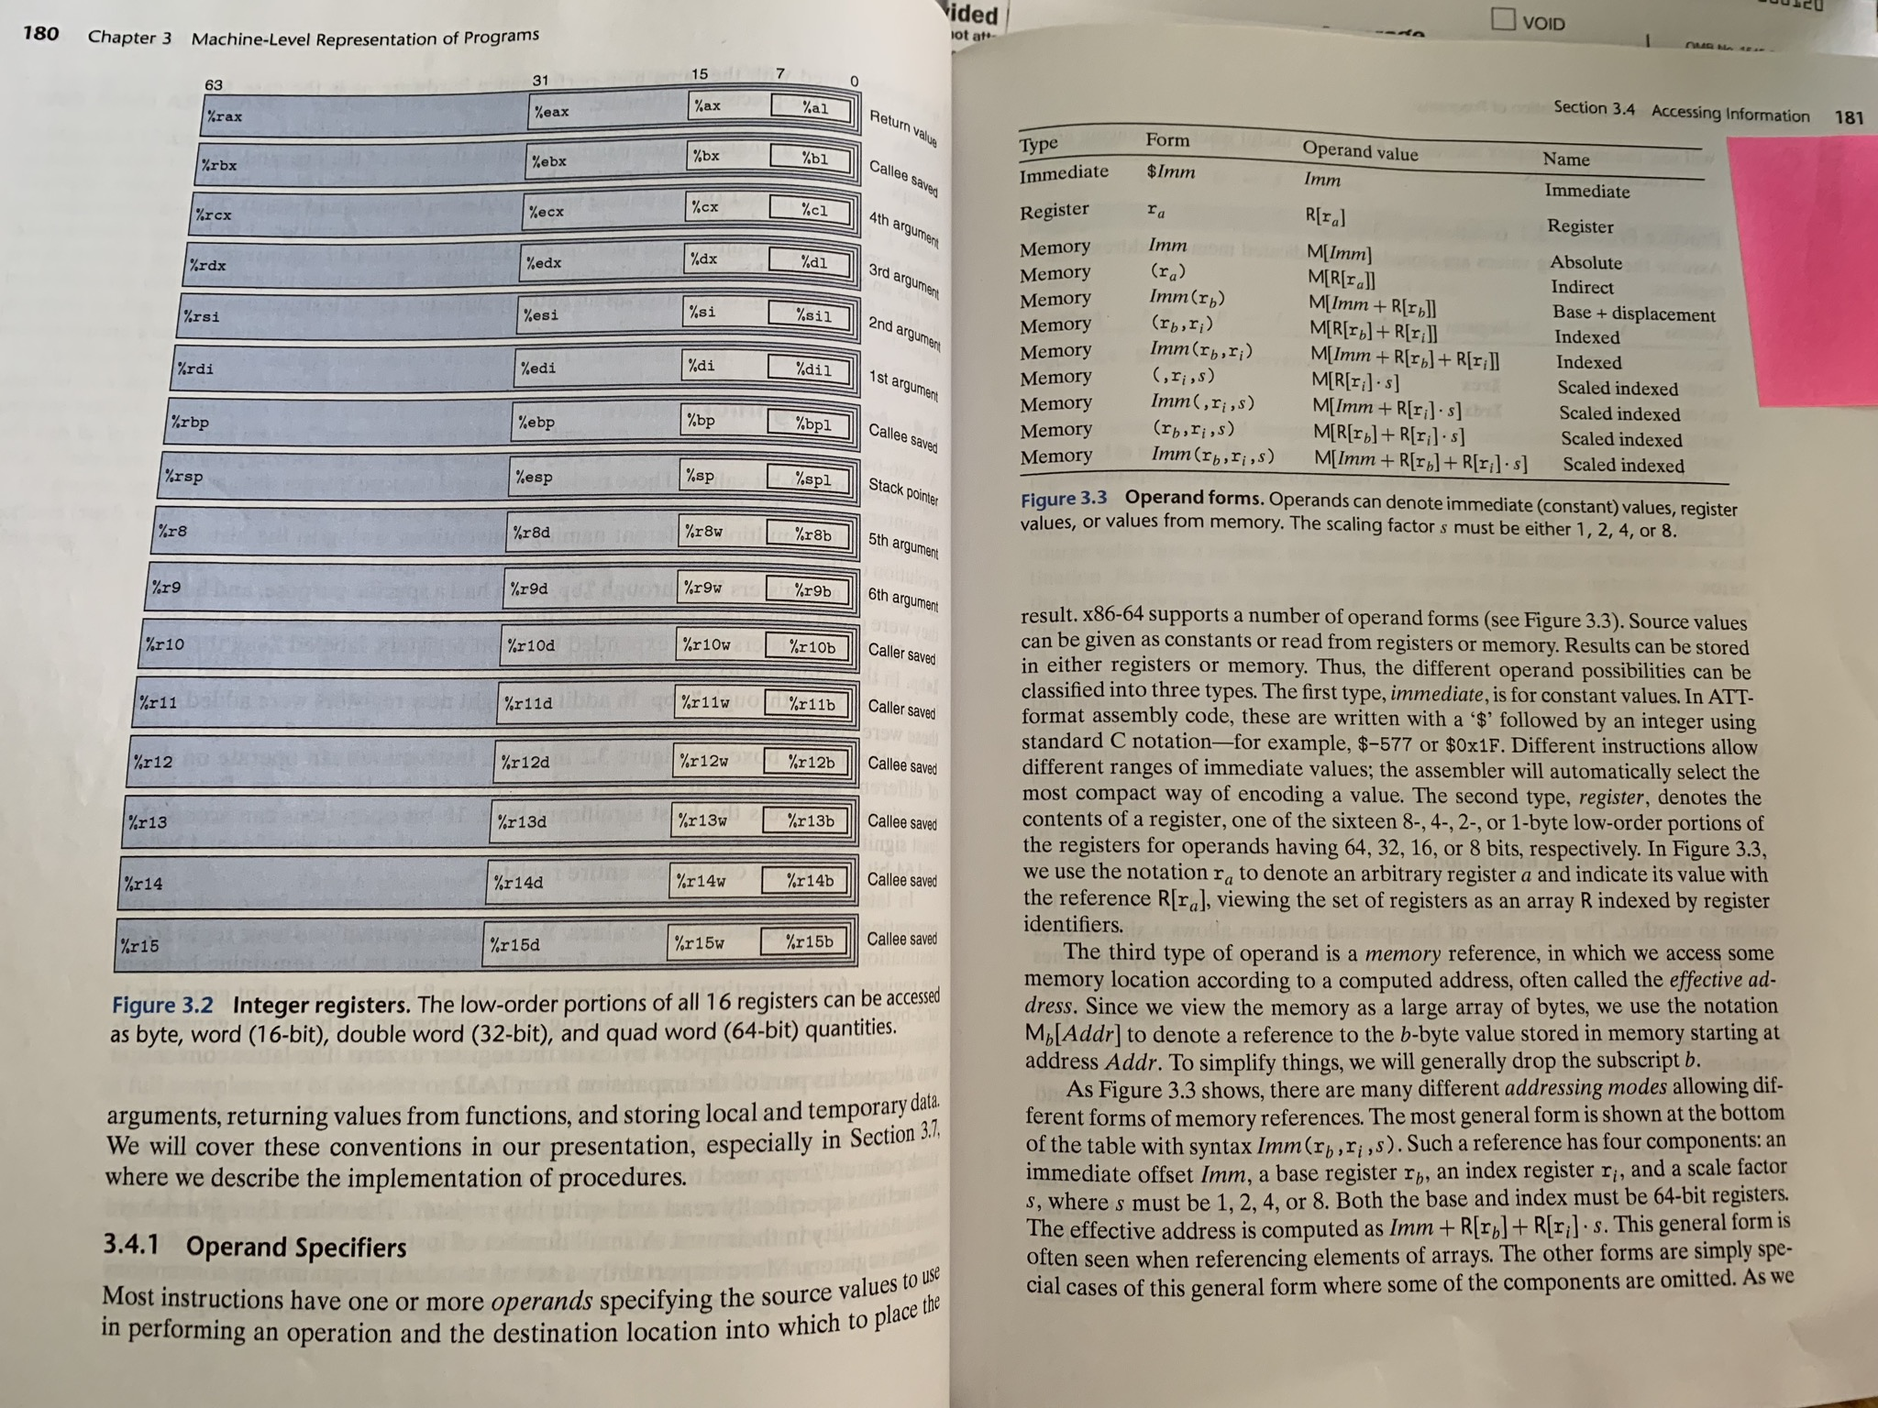

🌟 Keep a resource guide handy 🌟
https://web.stanford.edu/class/cs107/resources/x86-64-reference.pdf
B&O book:
  Canvas -> Files
  -> Bryant_OHallaron_ch3.1-3.8.pdf
It’s like study abroad:
  You took LANG 1A
  Your tools give too much/too little information
  (a book reference, a rudimentary translator)
  No one expects you to speak the language
  fluently…
  …But the more you internalize,
  the better you can use tools to read the language
Chapter 3, Figures 3.2-3.3 (p. 180-181)

Slide 62
Why are we reading assembly?
idea
C code
Assembly code
Machine code
Programmer-
generated
gcc (compiler+assembler) generated
Main goal: Information retrieval
We will not be writing assembly! (that’s the compiler’s job)
Rather, we want to translate the assembly back into our C code.
Knowing how our C code is converted into machine instructions gives us insight into how to write more efficient, cleaner code.

Slide 63
Plan For Today
10 minutes: general review
5 minutes: post questions or comments on Ed for what we should discuss
15 minutes: open Q&A
25 minutes: extra practice
Lecture 10 takeaway: Assembly is the human-readable version of the form our programs are ultimately executed in by the processor. The compiler translates source code to machine code. The most common assembly instruction is mov to move data around.

Slide 64
Extended warmup: Information Synthesis
Spend a few minutes thinking about the main paradigms of the mov instruction.
What might be the equivalent C-like operation?
Examples (note %r__ registers are 64-bit):
mov $0x0,%rdx
mov %rdx,%rcx
mov $0x42,(%rdi)
mov (%rax,%rcx,8),%rax
🤔

Slide 65
Extended warmup: Information Synthesis
Spend a few minutes thinking about the main paradigms of the mov instruction.
What might be the equivalent C-like operation?
Examples (note %r__ registers are 64-bit):
mov $0x0,%rdx -> maybe long x = 0
mov %rdx,%rcx -> maybe long x = y;
mov $0x42,(%rdi) -> maybe *ptr = 0x42;
mov (%rax,%rcx,8),%rax -> maybe long x = arr[i];
Indirect addressing is like pointer arithmetic/deref!
🤔

Slide 66
1. Extra Practice
Fill in the blank to complete the C code that 1. generates this assembly
2. has this register layout
int x = ...
int *ptr = malloc(…);
...
___???___ = _???_;
mov %ecx,(%rax)
<val of x>
<val of ptr>
(Pedantic: You should sub in <x> and <ptr> with actual values, like 4 and 0x7fff80)
🤔
%ecx
%rax

Slide 67
1. Extra Practice
Fill in the blank to complete the C code that 1. generates this assembly
2. has this register layout
int x = ...
int *ptr = malloc(…);
...
___???___ = _???_;
mov %ecx,(%rax)
*ptr = x;
<val of x>
<val of ptr>
%ecx
%rax

Slide 68
2. Extra Practice
Fill in the blank to complete the C code that 1. generates this assembly
2. results in this register layout
long arr[5];
...
long num = ____???___;
mov (%rdi, %rcx, 8),%rax
<val of num>
3
<val of arr>
🤔
%rax
%rcx
%rdi

Slide 69
2. Extra Practice
Fill in the blank to complete the C code that 1. generates this assembly
2. results in this register layout
long arr[5];
...
long num = ____???___;
mov (%rdi, %rcx, 8),%rax
long num = arr[3];
long num = *(arr + 3);
long num = *(arr + y);
(assume long y = 3; declared earlier)
<val of num>
3
<val of arr>
%rax
%rcx
%rdi

Slide 70
3. Extra Practice
Fill in the blank to complete the C code that 1. generates this assembly
2. has this register layout
char str[5];
...
___???___ = 'c';
mov $0x63,(%rcx,%rdx,1)
<val of str>
2
🤔
%rcx
%rdx

Slide 71
3. Extra Practice
Fill in the blank to complete the C code that 1. generates this assembly
2. has this register layout
char str[5];
...
___???___ = 'c';
mov $0x63,(%rcx,%rdx,1)
str[2] = 'c';
*(str + 2) = 'c';
<val of str>
2
%rcx
%rdx

Slide 72
Bonus: Sneak peek into Lecture 11
The below code is the objdump of a C function, foo.
  foo keeps its 1st and 2nd parameters are in registers %rdi and %rsi, respectively.
0x4005b6 <foo> mov (%rdi),%rax
0x4005b9 <foo+3> mov (%rsi),%rdx
0x4005bc <foo+6> mov %rdx,(%rdi)
0x4005bf <foo+9> mov %rax,(%rsi)
42
1000
0x7fffe870
0x7fffe868
8 bytes
What does this function do?
What C code could have generated this assembly?
(Hints: make up C variable names as needed, assume all regs 64-bit)
0x7fffe868
0x7fffe870
%rdi
%rsi
%rax
%rdx
🤔

Slide 73
Bonus: Sneak peek into Lecture 11
The below code is the objdump of a C function, foo.
  foo keeps its 1st and 2nd parameters are in registers %rdi and %rsi, respectively.
0x4005b6 <foo> mov (%rdi),%rax
0x4005b9 <foo+3> mov (%rsi),%rdx
0x4005bc <foo+6> mov %rdx,(%rdi)
0x4005bf <foo+9> mov %rax,(%rsi)
42
1000
0x7fffe870
0x7fffe868
8 bytes
0x7fffe868
0x7fffe870
%rdi
%rsi
%rax
%rdx

