Slide 1
CS107, Lecture 15
Optimization
Reading: B&O 5

Slide 2
CS107 Topic 6: How do the core malloc/realloc/free memory-allocation operations work?

Slide 3
Learning Goals
Understand how we can optimize our code to improve efficiency and speed
Learn about the optimizations GCC can perform

Slide 4
Lecture Plan
What is optimization? 5
GCC Optimization 8
Limitations of GCC Optimization 34
Caching 38
Live Session Slides 45
cp -r /afs/ir/class/cs107/lecture-code/lect15 .

Slide 5
Lecture Plan
What is optimization? 5
GCC Optimization 8
Limitations of GCC Optimization 34
Caching 38
Live Session Slides 45
cp -r /afs/ir/class/cs107/lecture-code/lect15 .

Slide 6
Optimization
Optimization is the task of making your program faster or more efficient with space or time. You’ve seen explorations of efficiency with Big-O notation!
Targeted, intentional optimizations to alleviate bottlenecks can result in big gains. But it’s important to only work to optimize where necessary.

Slide 7
Optimization
  Most of what you need to do with optimization can be summarized by:
  If doing something seldom and only on small inputs, do whatever is simplest to code, understand, and debug
  If doing things thing a lot, or on big inputs, make the primary algorithm’s Big-O cost reasonable
  Let gcc do its magic from there
  Optimize explicitly as a last resort

Slide 8
Lecture Plan
What is optimization? 5
GCC Optimization 8
Limitations of GCC Optimization 34
Caching 38
Live Session Slides 45
cp -r /afs/ir/class/cs107/lecture-code/lect15 .

Slide 9
GCC Optimization
  Today, we’ll be comparing two levels of optimization in the gcc compiler:
    gcc –O0 // mostly just literal translation of C
    gcc –O2 // enable nearly all reasonable optimizations
    (we use –Og, like –O0 but with less needless use of the stack)
  There are other custom and more aggressive levels of optimization, e.g.:
    -O3 //more aggressive than O2, trade size for speed
    -Os //optimize for size
    -Ofast //disregard standards compliance (!!)
  Exhaustive list of gcc optimization-related flags:
    https://gcc.gnu.org/onlinedocs/gcc/Optimize-Options.html

Slide 10
Example: Matrix Multiplication
  Here’s a standard matrix multiply, a triply-nested for loop:
      void mmm(double a[][DIM], double b[][DIM], double c[][DIM], int n) {
      for (int i = 0; i < n; i++) {
      for (int j = 0; j < n; j++) {
      for (int k = 0; k < n; k++) {
      c[i][j] += a[i][k] * b[k][j];
      }
      }
      }
      }
./mult // -O0 (no optimization)
  matrix multiply 25^2: cycles 0.43M
  matrix multiply 50^2: cycles 3.02M
  matrix multiply 100^2: cycles 24.82M
./mult_opt // -O2 (with optimization)
  matrix multiply 25^2: cycles 0.13M (opt)
  matrix multiply 50^2: cycles 0.66M (opt)
  matrix multiply 100^2: cycles 5.55M (opt)

Slide 11
GCC Optimizations
Constant Folding
Common Sub-expression Elimination
Dead Code
Strength Reduction
Code Motion
Tail Recursion
Loop Unrolling
Psychic Powers

Slide 12
GCC Optimizations
Constant Folding
Common Sub-expression Elimination
Dead Code
Strength Reduction
Code Motion
Tail Recursion
Loop Unrolling
Psychic Powers
(kidding)

Slide 13
GCC Optimizations
Optimizations may target one or more of:
Static instruction count
Dynamic instruction count
Cycle count / execution time

Slide 14
GCC Optimizations
Constant Folding
Common Sub-expression Elimination
Dead Code
Strength Reduction
Code Motion
Tail Recursion
Loop Unrolling

Slide 15
Constant Folding
Constant Folding pre-calculates constants at compile-time where possible.
int seconds = 60 * 60 * 24 * n_days;
What is the consequence of this for you as a programmer? What should you do differently or the same knowing that compilers can do this for you?

Slide 16
Constant Folding
int fold(int param) {
char arr[5];
int a = 0x107;
int b = a * sizeof(arr);
int c = sqrt(2.0);
return a * param + (a + 0x15 / c + strlen("Hello") * b - 0x37) / 4;
}

Slide 17
Constant Folding: Before (-O0)
0000000000400626 <fold>:
400626: 55 push %rbp
400627: 53 push %rbx
400628: 48 83 ec 08 sub $0x8,%rsp
40062c: 89 fd mov %edi,%ebp
40062e: f2 0f 10 05 da 00 00 movsd 0xda(%rip),%xmm0
400635: 00
400636: e8 d5 fe ff ff callq 400510 <sqrt@plt>
40063b: f2 0f 2c c8 cvttsd2si %xmm0,%ecx
40063f: 69 ed 07 01 00 00 imul $0x107,%ebp,%ebp
400645: b8 15 00 00 00 mov $0x15,%eax
40064a: 99 cltd
40064b: f7 f9 idiv %ecx
40064d: 8d 98 07 01 00 00 lea 0x107(%rax),%ebx
400653: bf 04 07 40 00 mov $0x400704,%edi
400658: e8 93 fe ff ff callq 4004f0 <strlen@plt>
40065d: 48 69 c0 23 05 00 00 imul $0x523,%rax,%rax
400664: 48 63 db movslq %ebx,%rbx
400667: 48 8d 44 18 c9 lea -0x37(%rax,%rbx,1),%rax
40066c: 48 c1 e8 02 shr $0x2,%rax
400670: 01 e8 add %ebp,%eax
400672: 48 83 c4 08 add $0x8,%rsp
400676: 5b pop %rbx
400677: 5d pop %rbp
400678: c3 retq

Slide 18
Constant Folding: After (-O2)
00000000004004f0 <fold>:
4004f0: 69 c7 07 01 00 00 imul $0x107,%edi,%eax
4004f6: 05 a5 06 00 00 add $0x6a5,%eax
4004fb: c3 retq
4004fc: 0f 1f 40 00 nopl 0x0(%rax)

Slide 19
GCC Optimizations
Constant Folding
Common Sub-expression Elimination
Dead Code
Strength Reduction
Code Motion
Tail Recursion
Loop Unrolling

Slide 20
Common Sub-Expression Elimination
Common Sub-Expression Elimination prevents the recalculation of the same thing many times by doing it once and saving the result.
  int a = (param2 + 0x107);
  int b = param1 * (param2 + 0x107) + a;
  return a * (param2 + 0x107) + b * (param2 + 0x107);

Slide 21
Common Sub-Expression Elimination
Common Sub-Expression Elimination prevents the recalculation of the same thing many times by doing it once and saving the result.
  int a = (param2 + 0x107);
  int b = param1 * (param2 + 0x107) + a;
  return a * (param2 + 0x107) + b * (param2 + 0x107);
  00000000004004f0 <subexp>:
  4004f0: 81 c6 07 01 00 00 add $0x107,%esi
  4004f6: 0f af fe imul %esi,%edi
  4004f9: 8d 04 77 lea (%rdi,%rsi,2),%eax
  4004fc: 0f af c6 imul %esi,%eax
  4004ff: c3 retq
This optimization is done even at –O0!

Slide 22
GCC Optimizations
Constant Folding
Common Sub-expression Elimination
Dead Code
Strength Reduction
Code Motion
Tail Recursion
Loop Unrolling

Slide 23
Dead Code
Dead code elimination removes code that doesn’t serve a purpose:
if (param1 < param2 && param1 > param2) {
printf("This test can never be true!\n");
}
// Empty for loop
for (int i = 0; i < 1000; i++);
// If/else that does the same operation in both cases
if (param1 == param2) {
param1++;
} else {
param1++;
}
// If/else that more trickily does the same operation in both cases
if (param1 == 0) {
return 0;
} else {
return param1;
}

Slide 24
Dead Code: Before (-O0)
00000000004004d6 <dead_code>:
4004d6: b8 00 00 00 00 mov $0x0,%eax
4004db: eb 03 jmp 4004e0 <dead_code+0xa>
4004dd: 83 c0 01 add $0x1,%eax
4004e0: 3d e7 03 00 00 cmp $0x3e7,%eax
4004e5: 7e f6 jle 4004dd <dead_code+0x7>
4004e7: 39 f7 cmp %esi,%edi
4004e9: 75 05 jne 4004f0 <dead_code+0x1a>
4004eb: 8d 47 01 lea 0x1(%rdi),%eax
4004ee: eb 03 jmp 4004f3 <dead_code+0x1d>
4004f0: 8d 47 01 lea 0x1(%rdi),%eax
4004f3: f3 c3 repz retq

Slide 25
Dead Code: After (-O2)
00000000004004f0 <dead_code>:
4004f0: 8d 47 01 lea 0x1(%rdi),%eax
4004f3: c3 retq
4004f4: 66 2e 0f 1f 84 00 00 nopw %cs:0x0(%rax,%rax,1)
4004fb: 00 00 00
4004fe: 66 90 xchg %ax,%ax

Slide 26
GCC Optimizations
Constant Folding
Common Sub-expression Elimination
Dead Code
Strength Reduction
Code Motion
Tail Recursion
Loop Unrolling

Slide 27
Strength Reduction
Strength reduction changes divide to multiply, multiply to add/shift, and mod to AND to avoid using instructions that cost many cycles (multiply and divide).
int a = param2 * 32;
int b = a * 7;
int c = b / 3;
int d = param2 % 2;
for (int i = 0; i <= param2; i++) {
c += param1[i] + 0x107 * i;
}
return c + d;

Slide 28
GCC Optimizations
Constant Folding
Common Sub-expression Elimination
Dead Code
Strength Reduction
Code Motion
Tail Recursion
Loop Unrolling

Slide 29
Code Motion
Code motion moves code outside of a loop if possible.
  for (int i = 0; i < n; i++) {
  sum += arr[i] + foo * (bar + 3);
  }
Common subexpression elimination deals with expressions that appear multiple times in the code. Here, the expression appears once, but is calculated each loop iteration.

Slide 30
GCC Optimizations
Constant Folding
Common Sub-expression Elimination
Dead Code
Strength Reduction
Code Motion
Tail Recursion
Loop Unrolling

Slide 31
Tail Recursion
Tail recursion is an example of where GCC can identify recursive patterns that can be more efficiently implemented iteratively.
  long factorial(int n) {
  if (n <= 1) {
  return 1;
  }
  else return n * factorial(n - 1);
  }
You saw this in the last lab!

Slide 32
GCC Optimizations
Constant Folding
Common Sub-expression Elimination
Dead Code
Strength Reduction
Code Motion
Tail Recursion
Loop Unrolling

Slide 33
Loop Unrolling
Loop Unrolling: Do n loop iterations’ worth of work per actual loop iteration, so we save ourselves from doing the loop overhead (test and jump) every time, and instead incur overhead only every n-th time.
for (int i = 0; i <= n - 4; i += 4) {
sum += arr[i];
sum += arr[i + 1];
sum += arr[i + 2];
sum += arr[i + 3];
} // after the loop handle any leftovers

Slide 34
Lecture Plan
What is optimization? 5
GCC Optimization 8
Limitations of GCC Optimization 34
Caching 38
Live Session Slides 45
cp -r /afs/ir/class/cs107/lecture-code/lect15 .

Slide 35
Limitations of GCC Optimization
GCC can’t optimize everything! You ultimately may know more than GCC does.
int char_sum(char *s) {
int sum = 0;
for (size_t i = 0; i < strlen(s); i++) {
sum += s[i];
}
return sum;
}
What is the bottleneck?
What can GCC do?
strlen called for every character
code motion – pull strlen out of loop

Slide 36
Limitations of GCC Optimization
GCC can’t optimize everything! You ultimately may know more than GCC does.
void lower1(char *s) {
for (size_t i = 0; i < strlen(s); i++) {
if (s[i] >= 'A' && s[i] <= 'Z') {
s[i] -= ('A' - 'a');
}
}
}
What is the bottleneck?
What can GCC do?
strlen called for every character
nothing! s is changing, so GCC doesn’t know if length is constant across iterations. But we know its length doesn’t change.

Slide 37
Demo: limitations.c
Notes:
Demo overflow etc.

Slide 38
Lecture Plan
What is optimization? 5
GCC Optimization 8
Limitations of GCC Optimization 34
Caching 38
Live Session Slides 45
cp -r /afs/ir/class/cs107/lecture-code/lect15 .

Slide 39


Caching
Processor speed is not the only bottleneck in program performance – memory access is perhaps even more of a bottleneck!
Memory exists in levels and goes from really fast (registers) to really slow (disk).
As data is more frequently used, it ends up in faster and faster memory.

Slide 40
Caching
All caching depends on locality.
Temporal locality
Repeat access to the same data tends to be co-located in TIME
Intuitively: things I have used recently, I am likely to use again soon
Spatial locality
Related data tends to be co-located in SPACE
Intuitively: data that is near a used item is more likely to also be accessed

Slide 41
Caching
All caching depends on locality.
Realistic scenario:
97% cache hit rate
Cache hit costs 1 cycle
Cache miss costs 100 cycles
How much of your memory access time is spent on 3% of accesses that are cache misses?
Notes:
97 for hits, 300 for misses! 300 / 397 = 75%

Slide 42
Demo: cache.c
Notes:
Demo overflow etc.

Slide 43
Optimizing Your Code
Explore various optimizations you can make to your code to reduce instruction count and runtime.
  More efficient Big-O for your algorithms
  Explore other ways to reduce instruction count
    Look for hotspots using callgrind
    Optimize using –O2
    And more…

Slide 44
Recap
What is optimization?
GCC Optimization
Limitations of GCC Optimization
Caching
Next time: wrap up

Slide 45
Live Session Slides
Post any questions you have to today’s lecture thread on the discussion forum!

Slide 46
Plan For Today
10 minutes: general review
5 minutes: post questions or comments on Ed for what we should discuss
15 minutes: open Q&A
25 minutes: extra practice
Lecture 15 takeaway: Compilers can apply various optimizations to make our code more efficient, without us having to rewrite code. However, there are limitations to these optimizations, and sometimes we must optimize ourselves, using tools like Callgrind.

Slide 47
Optimization
Slide 7
  Most of what you need to do with optimization can be summarized by:
  If doing something seldom and only on small inputs, do whatever
  is simplest to code, understand, and debug
  If doing things thing a lot, or on big inputs, make the primary
  algorithm’s Big-O cost reasonable
  Let gcc do its magic from there
  Optimize explicitly as a last resort
Use -Og

Slide 48
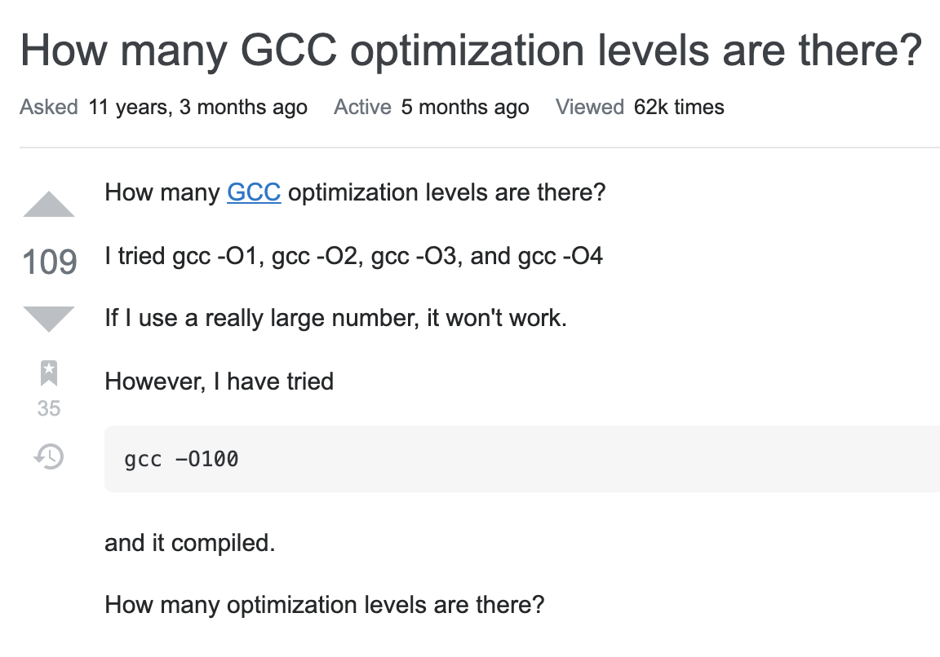
Compiler optimizations
Gcc supports numbers up to 3. Anything above is interpreted as 3
https://stackoverflow.com/questions/1778538/how-many-gcc-optimization-levels-are-there

Slide 49
Questions you may have
Why not always just compile with –O2?
Difficult to debug optimized executables – only optimize when complete
Optimizations may not always improve your program. The compiler does its best, but may not work, or slow things down, etc. Experiment to see what works best!
Why should we bother saving repeated calculations in variables if the compiler has common subexpression elimination?
The compiler may not always be able to optimize every instance. Plus, it can help reduce redundancy!
Humans read your code too—not just computers ☺

Slide 50
Plan For Today
10 minutes: general review
5 minutes: post questions or comments on Ed for what we should discuss
15 minutes: open Q&A
25 minutes: extra practice
Lecture 15 takeaway: Compilers can apply various optimizations to make our code more efficient, without us having to rewrite code. However, there are limitations to these optimizations, and sometimes we must optimize ourselves, using tools like Callgrind.

Slide 51
Common Sub-Expression Elimination
Slide 21
Common Sub-Expression Elimination prevents the recalculation of the same thing many times by doing it once and saving the result.
  int a = (param2 + 0x107);
  int b = param1 * (param2 + 0x107) + a;
  return a * (param2 + 0x107) + b * (param2 + 0x107);
  // = 2 * a * a + param1 * a * a
  00000000000011b0 <subexp>: // param1 in %edi, param2 in %esi
  11b0: lea 0x107(%rsi),%eax // %eax stores a
  11b6: imul %eax,%edi // param1 * a
  11b9: lea (%rdi,%rax,2),%esi // 2 * a + param1 * a
  11bc: imul %esi,%eax // a * (2 * a + param1 * a)
  11bf: retq
This optimization is not done at –O0.
Notes:
a * a + b * a
a * a + (param1 * a + a) * a
a^2 + param1 * a^2 + a^2
2a^2 + param1 * a^2

Slide 52
Tail recursion example: Lab6 bonus
Recall the factorial problem from Lecture 13:
unsigned int factorial(unsigned int n) {
if (n <= 1) {
return 1;
}
return n * factorial(n - 1);
}
What happens with factorial(-1)?
Infinite recursion → Literal stack overflow!
Compiled with -0g!
https://web.stanford.edu/class/cs107/lab6/extra.html

Slide 53
Factorial: -Og
vs –O2
401146 <+0>: cmp $0x1,%edi
401149 <+3>: jbe 0x40115b <factorial+21>
40114b <+5>: push %rbx
40114c <+6>: mov %edi,%ebx
40114e <+8>: lea -0x1(%rdi),%edi
401151 <+11>: callq 0x401146 <factorial>
401156 <+16>: imul %ebx,%eax
401159 <+19>: pop %rbx
40115a <+20>: retq
40115b <+21>: mov $0x1,%eax
401160 <+26>: retq
🤔
-02:
What happened?
Did the compiler “fix” the infinite recursion?
4011e0 <+0>: mov $0x1,%eax
4011e5 <+5>: cmp $0x1,%edi
4011e8 <+8>: jbe 0x4011fd <factorial+29>
4011ea <+10>: nopw 0x0(%rax,%rax,1)
4011f0 <+16>: mov %edi,%edx
4011f2 <+18>: sub $0x1,%edi
4011f5 <+21>: imul %edx,%eax
4011f8 <+24>: cmp $0x1,%edi
4011fb <+27>: jne 0x4011f0 <factorial+16>
4011fd <+29>: retq

