Slide 1
CS107 Lecture 17
Floating Point
reading:
B&O 2.4
Slides by Jerry Cain and Lisa Yan, who leveraged prior work by Nick Troccoli, Julie Zelenski, Marty Stepp, Cynthia Lee, Chris Gregg, and others.

Slide 2
How can a computer represent real numbers?

Slide 3
Learning Goals
Understand the design and compromises of the floating point representation, including:
Fixed point vs. floating point
How a floating point number is represented in binary
Issues with floating point imprecision
Other potential pitfalls using floating point numbers in programs

Slide 4
Plan For Today
Representing real numbers and (thought experiment) fixed point
Floating Point: Normalized values
Joke Break
Floating Point: Special/denormalized values
Floating Point Arithmetic
cp -r /afs/ir/class/cs107/samples/lectures/lect10 .

Slide 5
Plan For Today
Representing real numbers and (thought experiment) fixed point
Floating Point: Normalized values
Joke Break
Floating Point: Special/denormalized values
Number representations in C
Floating point arithmetic

Slide 6
Base 2 conversion
Convert the following number/fractions to base 10 (decimal) and base 2.
Number/fraction Base 10 Base 2
1/2 0.5 0.1
5
9/8
1/3
1/10 (bonus)
🤔

Slide 7
Base 2 conversion
Convert the following number/fractions to base 10 (decimal) and base 2.
Number/fraction Base 10 Base 2
1/2 0.5 0.1
5
9/8
1/3
1/10 (bonus)
5.0 101.0
1.125 1.001

Slide 8
Base 2 conversion
Convert the following number/fractions to base 10 (decimal) and base 2.
Number/fraction Base 10 Base 2
1/2 0.5 0.1
5
9/8
1/3
1/10 (bonus)
5.0 101.0
1.125 1.001
0.3333… 0.01010101…
0.1 0.00011001100…
Conceptual goal: How can we represent real numbers with a fixed number of bits?
Learning goal: Appreciate the IEEE floating point format!

Slide 9

Approximating real numbers
How can we represent real numbers with a fixed number of bits?
In the world of real numbers:
The real number line extends forever (infinite range).
Real numbers have infinite resolution (infinite precision).
In the base-2 world of computers, we must approximate:
Each variable type is fixed width (float: 32 bits, double: 64 bits).
Compromises are inevitable (range and precision). Like with int, we need to make choices about which numbers make the cut and which don’t.
← range
range →
precision

Slide 10
Thought experiment: Fixed point
Base 10, decimal case:
Base 2, binary case:
5934.216123121…₁₀
1011.0101010101…₂
5 | 9 | 3 | 4 | . | 2 | 1 | 6 | 7
10³ | 10² | 10¹ | 10⁰ |  | 10⁻¹ | 10⁻² | 10⁻³ | 10⁻⁴
1 | 0 | 1 | 1 | . | 0 | 1 | 0 | 1
2³ | 2² | 2¹ | 2⁰ |  | 2⁻¹ | 2⁻² | 2⁻³ | 2⁻⁴
Decide on fixed granularity, e.g., 1/16
Assign bits to represent powers from 2³ to 2⁻⁴
Notes:
Let’s say we had a fixed with of 8 bits to work with.

Slide 11
Thought experiment: Fixed point
Strategy evaluation
What values can be represented?
Largest magnitude? Smallest? To what precision?
How hard to implement?
How to convert int into 32-bit fixed point? 32-bit fixed point to int?
Can existing integer ops (add, multiply, shift) be repurposed?
How well does this meet our needs?
Base 2, binary case:
1011.0101010101…₂
1 | 0 | 1 | 1 | . | 0 | 1 | 0 | 1
2³ | 2² | 2¹ | 2⁰ |  | 2⁻¹ | 2⁻² | 2⁻³ | 2⁻⁴
Decide on fixed granularity, e.g., 1/16
Assign bits to represent powers from 2³ to 2⁻⁴
🤔
Notes:
Not very large, not very small, integer ops are actually not too hard to implement

Slide 12
The problem with fixed point
Problem: We must fix where the decimal point is in our representation. This fixes our precision.
6.022e23 =
11.....0.0
(base 10)
79 bits
(base 2)
6.626e-34 =
0.0.....01
111 bits
To store both these numbers in the same fixed-point representation, the bit width of the type would need to be at least 190 bits wide!
Notes:
The Avogadro number, sometimes denoted N or N0, is the number of constituent particles (usually molecules, atoms or ions) that are contained in one mole
Planck's constant, denoted h, is a physical constant that is the quantum of electromagnetic action, which relates the energy carried by a photon to its frequency

Slide 13
Scientific notation to the rescue (1/2)
We have a need for relative rather than absolute precision.
How much error/approximation is tolerable? Radius of atom, bowling ball, planet?
Consider for decimal values:
3,650,123 → 3.65 x 10⁶
0.0000072491 → 7.25 x 10⁻⁶
As a datatype, store mantissa and exponent separately
Allocations of bits to exponent and mantissa (respectively)
determines range and precision
1 digit for
exponent
3 digits for mantissa (and round)

Slide 14
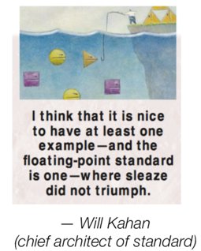
IEEE floating point
IEEE Standard 754
Established in 1985 as a uniform standard for
floating point arithmetic
Supported by all major systems today
Hardware: specialized co-processor vs. integrated into main chip
Driven by numerical concerns
Behavior defined in mathematical terms
Clear standards for rounding, overflow, underflow
Support for transcendental functions (roots, trig, exponentials, logs)
Hard to make fast in hardware
Numerical analysts predominated over hardware designers in defining standard
Notes:
(received Turing award, 1989) William “kahn”

Slide 15
Plan For Today
Representing real numbers and fixed point
Floating Point: Normalized values
Joke Break
Floating Point: Special/denormalized values
Number representations in C
Floating point arithmetic

Slide 16
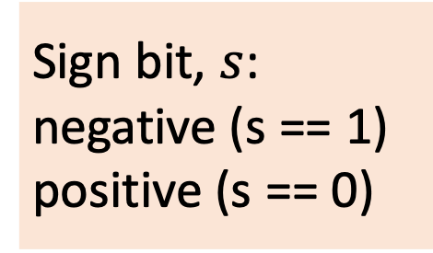
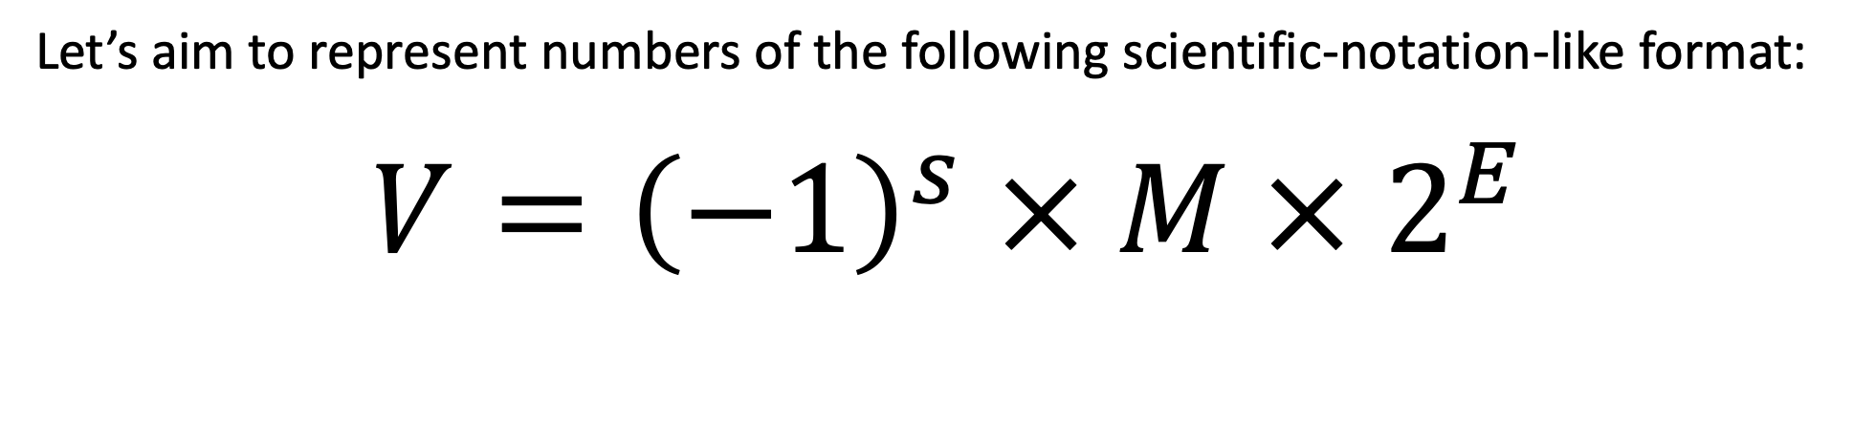
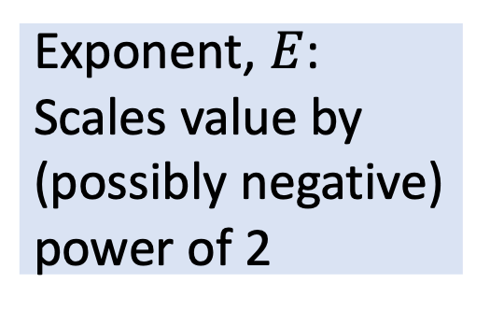
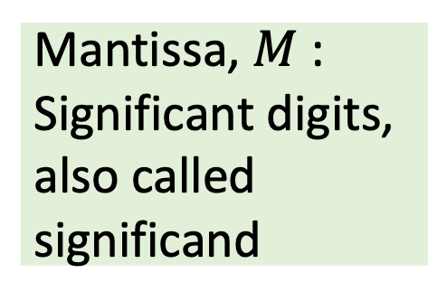
IEEE Floating Point
Let’s aim to represent numbers of the following scientific-notation-like format:
$$V={\left(−1\right)}^{s} × M × 2^{E}$$
Sign bit, $s$:
negative (s == 1)
positive (s == 0)
Mantissa, $M$:
Significant digits, also called significand
Exponent, $E$:
Scales value by (possibly negative) power of 2

Slide 17
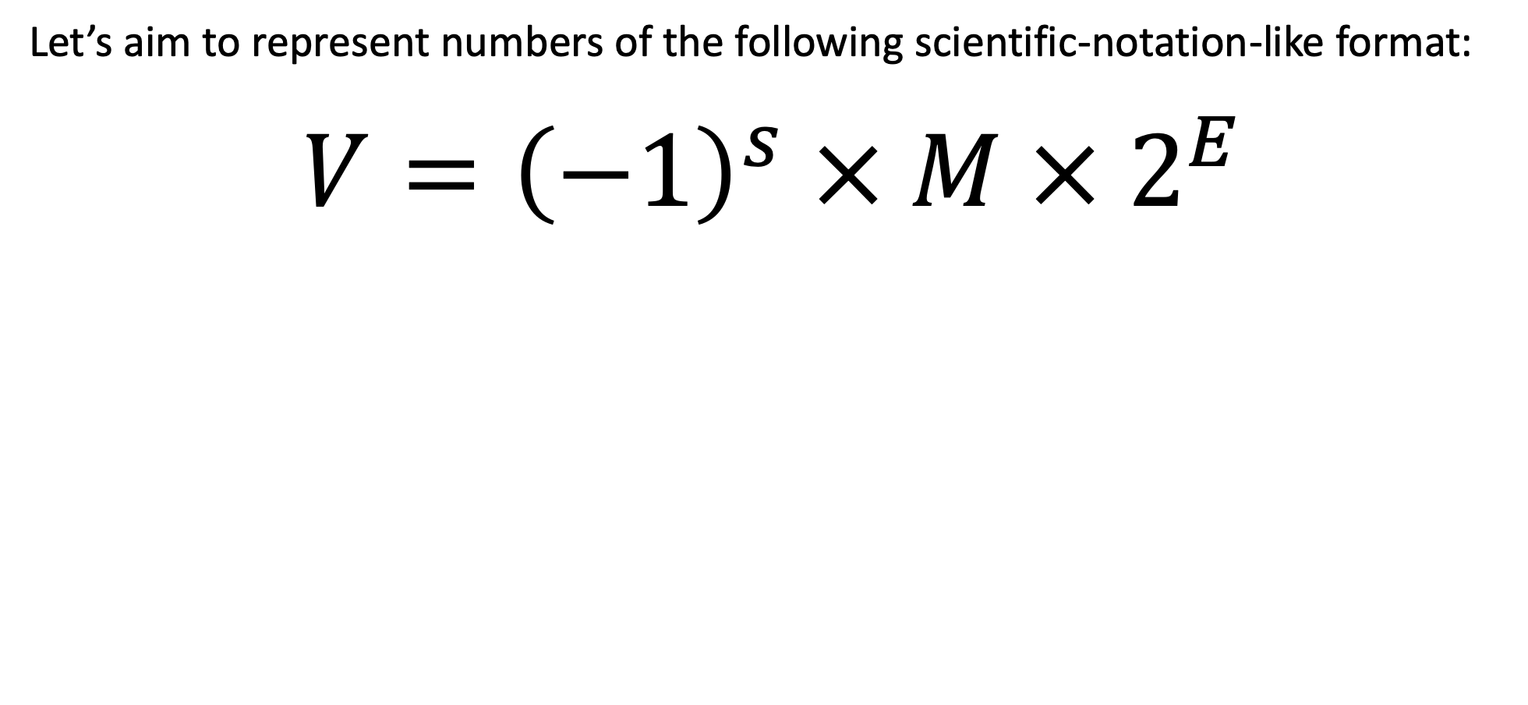
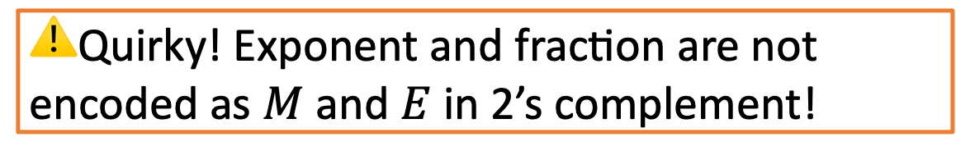
IEEE Floating Point
Let’s aim to represent numbers of the following scientific-notation-like format:
$$V={\left(−1\right)}^{s} × M × 2^{E}$$
s | exponent (8 bits) |  |  | fraction (23 bits)
31 | 30 |  | 23 | 22 |  |  |  |  | 0
⚠️Quirky! Exponent and fraction are not encoded as $M$ and $E$ in 2’s complement!
Notes:
“uhhhhh, this is going to be complicated”
“we’ll go through it slowly, and remember our goal is to appreciate this particular floating point encoding and what design choices it made.”
It is based on decisions and choices that were made, with good reason (we will discuss those reasons).
It is efficient, and attempts to eek out as much as it can from those 32 or 64 bits — computing is often about efficiency, and the people who came up with the standard really thought hard about it.
We don't want you to think "I could never come up with that!" — rather, we want you to appreciate it for what it is.

Slide 18
Example for the next few slides
What is the number represented by the following 32-bit float?
s | exponent (8 bits) | fraction (23 bits)
0 | 1000 0000 | 0100 0000 0000 0000 0000 000

Slide 19
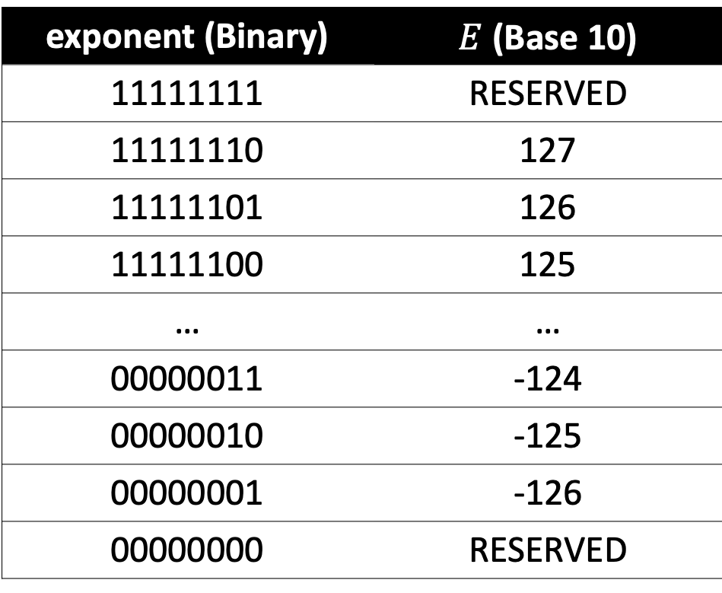
Exponent
s | exponent (8 bits) | fraction (23 bits)
exponent (Binary)
11111111
11111110
11111101
11111100
…
00000011
00000010
00000001
00000000
exponent (Binary) | $E$ (Base 10)
11111111 | RESERVED
11111110 | 127
11111101 | 126
11111100 | 125
… | …
00000011 | -124
00000010 | -125
00000001 | -126
00000000 | RESERVED
special
normalized
denormalized

Slide 20
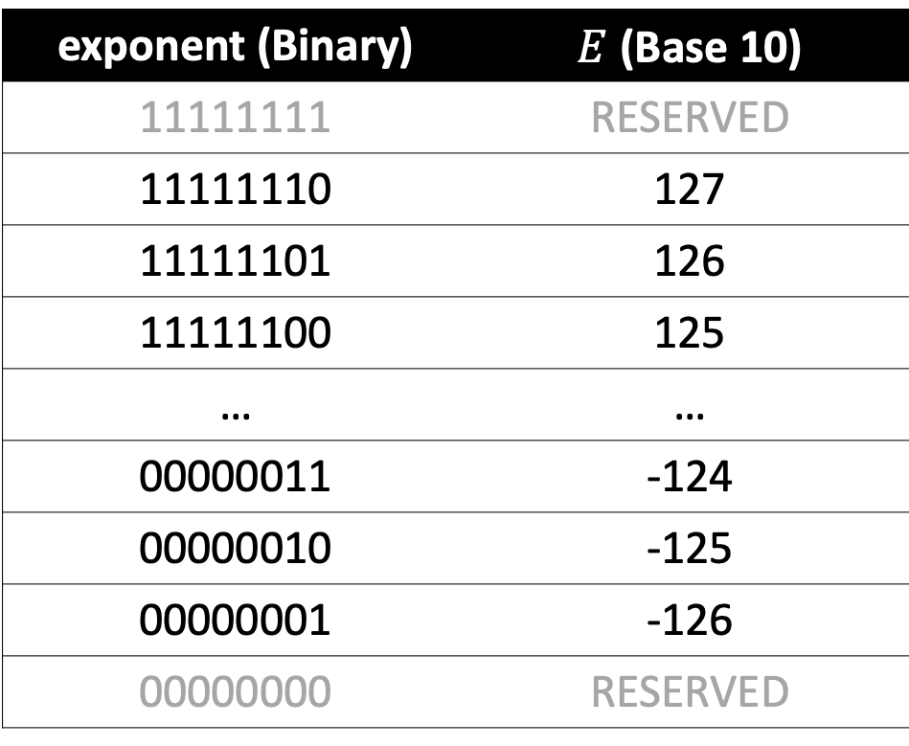
Exponent: Normalized values
s | exponent (8 bits) | fraction (23 bits)
exponent (Binary) | $E$ (Base 10)
11111111 | RESERVED
11111110 | 127
11111101 | 126
11111100 | 125
… | …
00000011 | -124
00000010 | -125
00000001 | -126
00000000 | RESERVED
Based on this table, how do we compute an exponent from a binary value?
Why would this be a good idea? (hint: what if we wanted to compare two floats with >, <, =?)
🤔

Slide 21
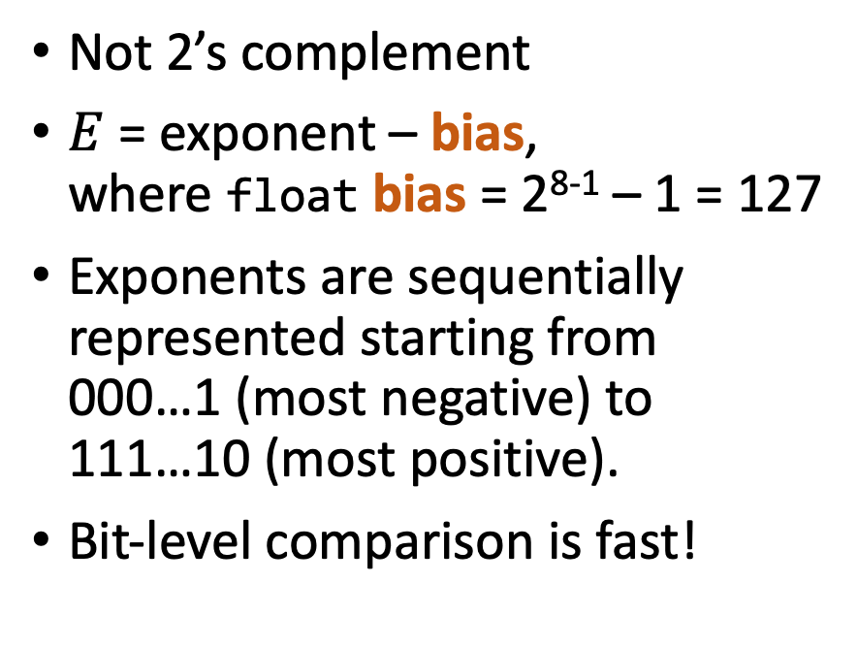
Exponent: Normalized values
s | exponent (8 bits) | fraction (23 bits)
exponent (Binary) | $E$ (Base 10)
11111111 | RESERVED
11111110 | 127
11111101 | 126
11111100 | 125
… | …
00000011 | -124
00000010 | -125
00000001 | -126
00000000 | RESERVED
Not 2’s complement
$E$ = exponent – bias,
where float bias = 2⁸⁻¹ – 1 = 127
Exponents are sequentially represented starting from 000…1 (most negative) to 111…10 (most positive).
Bit-level comparison is fast!

Slide 22
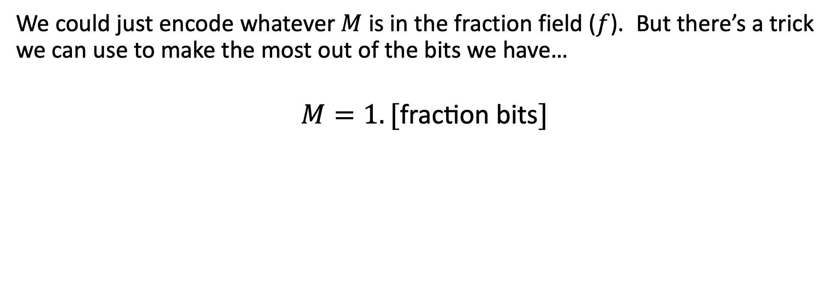
Fraction: Normalized values
s | exponent (8 bits) | fraction (23 bits)
We could just encode whatever $M$ is in the fraction field ($f$). But there’s a trick we can use to make the most out of the bits we have…
$$M=1.[\text{fraction} \text{bits}]$$
What???

Slide 23
Scientific notation to the rescue (2/2)
Correct scientific notation:
In the mantissa, always keep one non-zero digit to the left of the decimal point.
For base 10: 42.4 x 10⁵ → 4.24 x 10⁶
324.5 x 10⁵ → 3.245 x 10⁷
0.624 x 10⁵ → 6.24 x 10⁴
For base 2: 10.1 x 2⁵ → 1.01 x 2⁶
1011.1 x 2⁵ → 1.0111 x 2⁸
0.110 x 2⁵ → 1.10 x 2⁴
Observation: in base 2, this means there is always a 1 to the left of the decimal point!

Slide 24
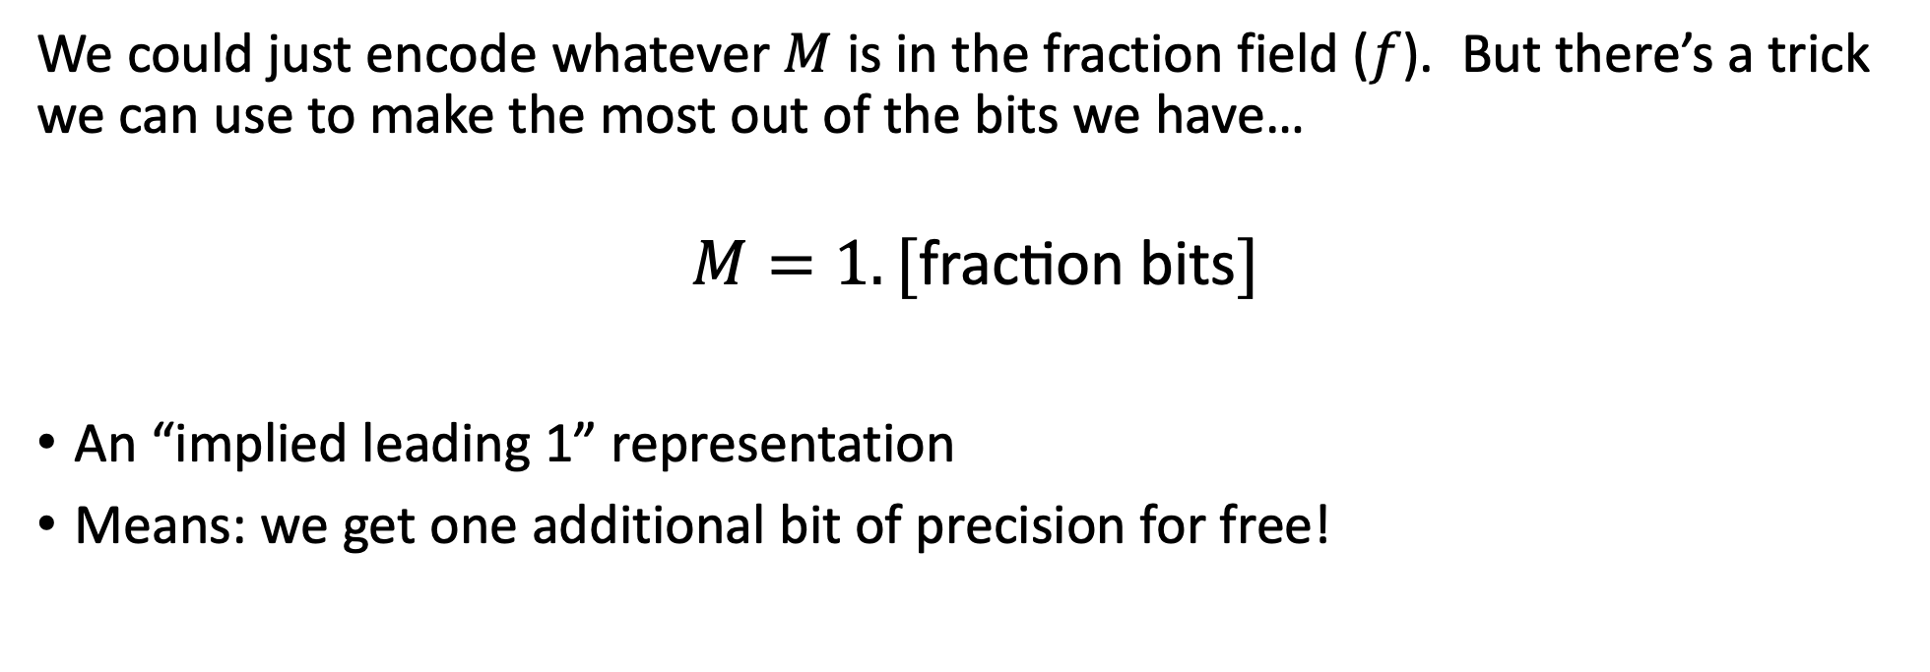
Fraction: Normalized values
s | exponent (8 bits) | fraction (23 bits)
We could just encode whatever $M$ is in the fraction field ($f$). But there’s a trick we can use to make the most out of the bits we have…
$$M=1.[\text{fraction} \text{bits}]$$
An “implied leading 1” representation
Means: we get one additional bit of precision for free!
Thanks, Will!

Slide 25
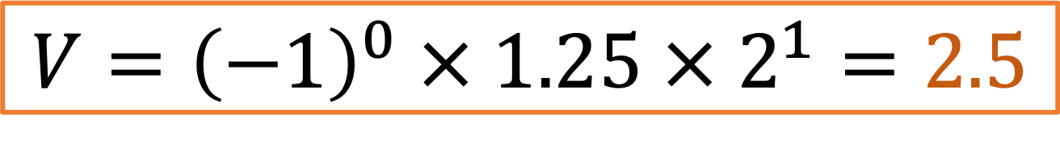

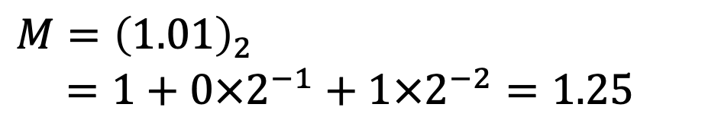
Example from the past few slides
What is the number represented by the following 32-bit float?
s | exponent (8 bits) | fraction (23 bits)
0 | 1000 0000 | 0100 0000 0000 0000 0000 000
Subtract bias
(2⁸⁻¹ – 1 = 127)
Add implicit 1
$$E=128−127=1$$
$M={\left(1.01\right)}_{2}$
$=1+0×2^{−1}+1×2^{−2}=1.25$
(base 2)
(base 10)
$$V={\left(−1\right)}^{0} × 1.25 × 2^{1}=2.5$$

Slide 26
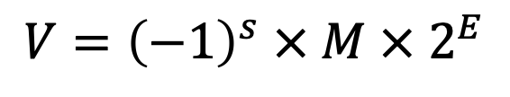
Practice #1
$$V={\left(−1\right)}^{s} × M × 2^{E}$$
s | exponent (8 bits) | fraction (23 bits)
0 | 0111 1110 | 0000 0000 0000 0000 0000 000
Is this number:
Is this number:
Bonus: What is the number?
Greater than 0?
Less than 0?
Less than -1?
Between -1 and 1?
Greater than 1?
🤔
Notes:
1 – A
2 – B
1.0 × 2^(−1)=0.5

Slide 27
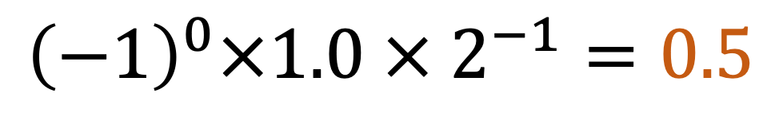
Practice #1
$$V={\left(−1\right)}^{s} × M × 2^{E}$$
s | exponent (8 bits) | fraction (23 bits)
0 | 0111 1110 | 0000 0000 0000 0000 0000 000
Is this number:
Is this number:
Bonus: What is the number?
Greater than 0?
Less than 0?
Less than -1?
Between -1 and 1?
Greater than 1?
$${\left(−1\right)}^{0}×1.0 × 2^{−1}=0.5$$
Notes:
1 – A
2 – B
0.5

Slide 28
Plan For Today
Representing real numbers and fixed point
Floating Point: Normalized values
Joke Break
Floating Point: Special/denormalized values
Number representations in C
Floating point arithmetic

Slide 29
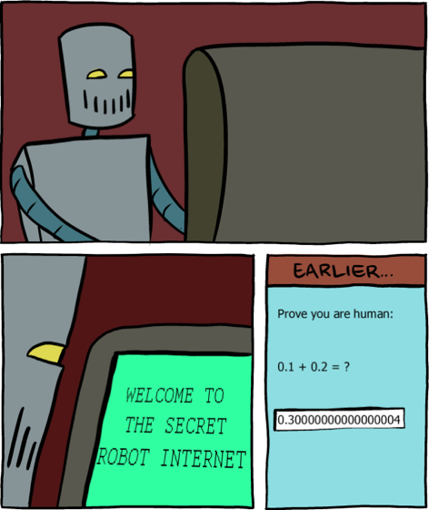
Joke break
https://www.smbc-comics.com/comic/2013-06-05
Slightly off from the real float 0.3 ☺
https://www.h-schmidt.net/FloatConverter/IEEE754.html

Slide 30
Plan For Today
Representing real numbers and fixed point
Floating Point: Normalized values
Joke Break
Floating Point: Special/denormalized values
Number representations in C
Floating point arithmetic

Slide 31
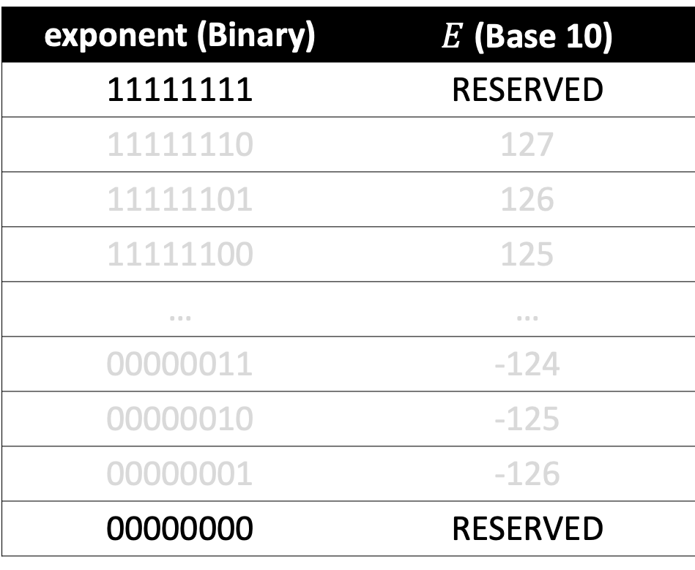
Reserved exponent values
s | exponent (8 bits) | fraction (23 bits)
exponent (Binary) | $E$ (Base 10)
11111111 | RESERVED
11111110 | 127
11111101 | 126
11111100 | 125
… | …
00000011 | -124
00000010 | -125
00000001 | -126
00000000 | RESERVED
special
normalized
denormalized

Slide 32
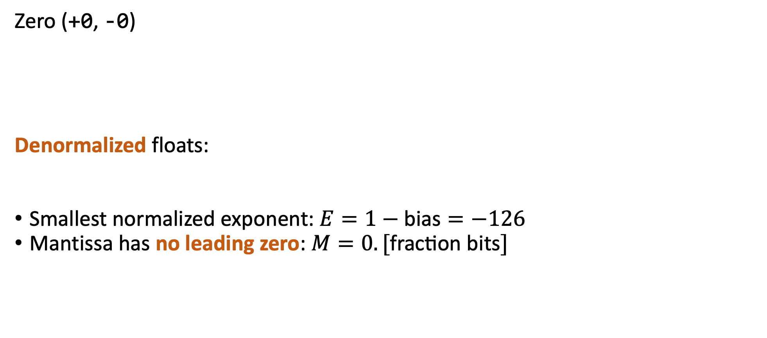
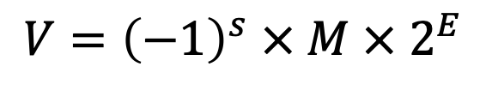
All zeros: Zero + denormalized floats
Zero (+0, -0)
Denormalized floats:
Smallest normalized exponent: $E=1−\text{bias}=−126$
Mantissa has no leading zero: $M=0.[\text{fraction} \text{bits}]$
s | exponent (8 bits) | fraction (23 bits)
any | 0000 0000 | all zeros
Why would two zeros be okay?
s | exponent (8 bits) | fraction (23 bits)
any | 0000 0000 | any nonzero
$$V={\left(−1\right)}^{s} × M × 2^{E}$$
🤔
Why would we want so much precision for tiny numbers?

Slide 33
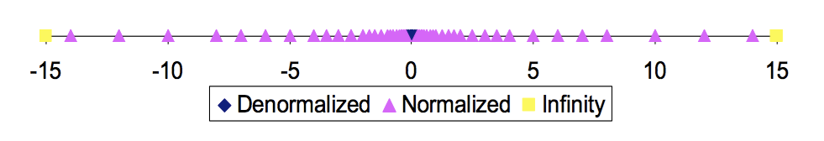
All zeros: Zero + denormalized floats
Zero (+0, -0)
Denormalized floats:
Smallest normalized exponent: $E=1−\text{bias}=−126$
Mantissa has no leading zero: $M=0.[\text{fraction} \text{bits}]$
s | exponent (8 bits) | fraction (23 bits)
any | 0000 0000 | all zeros
s | exponent (8 bits) | fraction (23 bits)
any | 0000 0000 | any nonzero
$$V={\left(−1\right)}^{s} × M × 2^{E}$$
Denormalized values enable gradual underflow (too-small-to-represent floats).

Slide 34
All ones: Infinity and NaN
Infinity (+inf, -inf)
Not a number (NaN):
Computation result that is an
invalid mathematical real number.
s | exponent (8 bits) | fraction (23 bits)
any | 1111 1111 | all zeros
Why would we want to represent infinity?
s | exponent (8 bits) | fraction (23 bits)
any | 1111 1111 | any nonzero
What kind of mathematical computation would result in a non-real number? (hint: square root)
🤔

Slide 35
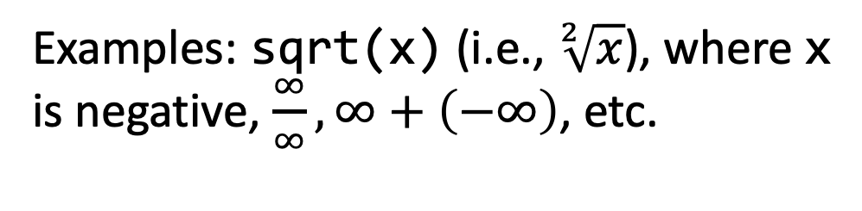
All ones: Infinity and NaN
Infinity (+inf, -inf)
Not a number (NaN):
Computation result that is an
invalid mathematical real number.
s | exponent (8 bits) | fraction (23 bits)
any | 1111 1111 | all zeros
Floats have built-in handling of overflow: infinity + anything = infinity.
s | exponent (8 bits) | fraction (23 bits)
any | 1111 1111 | any nonzero
Examples: sqrt(x) (i.e., $\sqrt[2]{x}$), where x is negative, $\frac{∞}{∞}, ∞+\left(−∞\right)$, etc.
What kind of mathematical computation would result in a non-real number? (hint: square root)

Slide 36
Questions?

Slide 37
Plan For Today
Representing real numbers and fixed point
Floating Point: Normalized values
Joke Break
Floating Point: Special/denormalized values
Number representations in C
Floating point arithmetic

Slide 38
Skipping Numbers
We said that it’s not possible to represent all real numbers using a fixed-width representation. What does this look like?
Float Converter
https://www.h-schmidt.net/FloatConverter/IEEE754.html
Floats and Graphics
https://www.shadertoy.com/view/4tVyDK

Slide 39
float and double
float (32 bits)
8-bit exponent ranges from -126 to +127,
2¹²⁷ = 10³⁷
double (64 bits)
11-bit exponent ranges from -1022 to +1023,
2¹⁰²³ = 10³⁰⁸
s | exponent (8 bits) | Fraction (23 bits)
s | exponent (11 bits) | Fraction (52 bits)
Notes:
Number of atoms in universe: 10⁸²
They figured multiplying 8 different floats together shouldn’t overflow a double.
https://retrocomputing.stackexchange.com/questions/13493/where-did-the-free-parameters-of-ieee-754-come-from
Designed in collaboration with numerical analysts!
Planck’s constant 6.626070040 × 10⁻³⁴
Avogadro’s constant 6.022140857 × 10²³

Slide 40
float vs int
32-bit integer (type int): :
–2,147,483,648 to 2147483647
64-bit integer (type long):
−9,223,372,036,854,775,80
to 9,223,372,036,854,775,807
32-bit floating point (type float):
~1.7 x10⁻³⁸ to ~3.4 x10³⁸ (+ negative range)
64-bit floating point (type double):
~9 x10⁻³⁰⁷ to ~1.8 x10³⁰⁸ (+ negative range)
All integers in these ranges can be represented.
  Not all numbers can be represented.
  Gaps can get quite large: larger the exponent, larger the gap between successive fraction values.
(normalized float/double ranges)
Notes:
They figured multiplying 8 different floats together shouldn’t overflow a double.
https://retrocomputing.stackexchange.com/questions/13493/where-did-the-free-parameters-of-ieee-754-come-from
Designed in collaboration with numerical analysts!
Planck’s constant 6.626070040 × 10⁻³⁴
Avogadro’s constant 6.022140857 × 10²³

Slide 41
Plan For Today
Representing real numbers and fixed point
Floating Point: Normalized values
Joke Break
Floating Point: Special/denormalized values
Number representations in C
Floating point arithmetic

Slide 42
Key (floating) points
Approximation and rounding is inevitable.
Single operations are commutative, but sequence is not associative.
(a + b) equals (b + a)
But (a + b) + c may not equal a + (b + c)
Equality comparison operations are often unwise.

Slide 43
Key (floating) points
Approximation and rounding is inevitable.
Single operations are commutative, but sequence is not associative.
(a + b) equals (b + a)
But (a + b) + c may not equal a + (b + c)
Equality comparison operations are often unwise.

Slide 44
It’s easy !
Lisa’s Official Guide To Making Money
FAST!
You can lose money, too!

Slide 45
Demo: Float Arithmetic
Try it yourself:
./bank 100 1 # deposit
./bank 100 -1 # withdraw
./bank 100000000 -1 # make bank
./bank 16777216 1 # lose bank
Why is 2²⁴ special?
bank.c
Notes:
100 million dollars

Slide 46
Introducing “Minifloat”
For a more compact example representation, we will use an 8 bit “minifloat” with a 4 bit exponent, 3 bit fraction and bias of 7 (note: minifloat is just for example purposes, and is not a real datatype).
7 | 6 |  |  |  |  | 3 | 2 |  |  |  |  | 0
s | exponent (4 bits) |  |  |  |  |  |  | fraction (3 bits)

Slide 47
Floating Point Arithmetic
In minifloat, with a balance of $128, a deposit of $4 would not be recorded at Lisa’s Bank. Why not?
Let’s step through the calculations to add these two numbers (note: this is just for understanding; real float calculations are more efficient).
128
+ 4
128?

Slide 48
Floating Point Arithmetic
128
0 | 1110 | 000
128.00
+ 4.00
132.00
1.00 x 2^7
+ 1.00 x 2^2
+
4
0 | 1001 | 000
aligned
not aligned
Float arithmetic (at a high level): x floatop y = Round(x op y)
Manipulate significand and exponents independently to align
Compute exact result (x op y)
Round and put in floating point
(FPU)
132
(next slide)

Slide 49

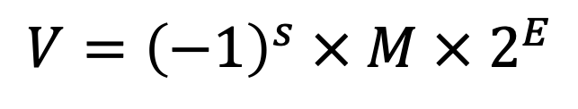

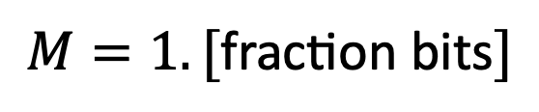
Practice #2
7 | 6 |  |  |  |  | 3 | 2 |  |  |  |  | 0
s | exponent (4 bits) |  |  |  |  |  |  | fraction (3 bits)
? | ???? |  |  |  |  |  |  | ???
$$V={\left(−1\right)}^{s} × M × 2^{E}$$
$$E=\text{exponent}−\text{bias}$$
$$M=1.[\text{fraction} \text{bits}]$$
$$\text{bias}=2^{4−1}−1=7$$
What is 132 as a minifloat?
🤔

Slide 50
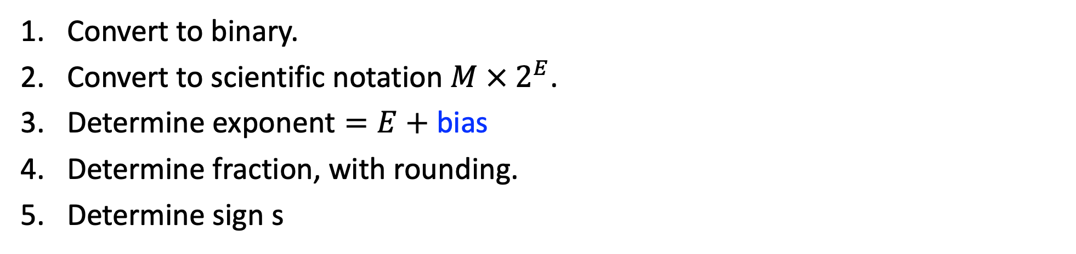
Practice #2
7 | 6 |  |  |  |  | 3 | 2 |  |  |  |  | 0
s | exponent (4 bits) |  |  |  |  |  |  | fraction (3 bits)
? | ???? |  |  |  |  |  |  | ???
$$V={\left(−1\right)}^{s} × M × 2^{E}$$
$$E=\text{exponent}−\text{bias}$$
0
1110
000
$$M=1.[\text{fraction} \text{bits}]$$
$$\text{bias}=2^{4−1}−1=7$$
What is 132 as a minifloat?
(1000 0100)₂
Convert to binary.
Convert to scientific notation $M × 2^{E}$.
Determine $\text{exponent}=E+\text{bias}$
Determine fraction, with rounding.
Determine sign s
(1.0000100)₂ x 2⁷
7 + 7 = 14 = (1110)₂
(1.0000100)₂
0 (positive)

Slide 51
Approximation error is inevitable
128
0 | 1110 | 000
+
4
0 | 1001 | 000
132?
0 | 1110 | 000
We didn’t have enough bits to differentiate between 128 and 132.

Slide 52
Approximation error is inevitable
0 | 1110 | 000
Another way to corroborate this: the next-largest minifloat that can be represented after 128 is 144. 132 isn’t representable!
128
+
4
0 | 1001 | 000
144:
0 | 1110 | 001
132
0 | 1110 | 000
Key Idea: the smallest float “hop” we can take is to adjust the fractional component by 1.
We didn’t have enough bits to differentiate between 128 and 132.

Slide 53
Key (floating) points
Approximation and rounding is inevitable.
Single operations are commutative, but sequence is not associative.
(a + b) equals (b + a)
But (a + b) + c may not equal a + (b + c)
Equality comparison operations are often inaccurate.

Slide 54
Floating Point Arithmetic
Is this just over/underflowing? It turns out it’s more subtle.
  float a = 3.14;
  float b = 1e20;
  printf("(3.14 + 1e20) - 1e20 = %g\n", (a + b) - b); // 0
  printf("3.14 + (1e20 - 1e20) = %g\n", a + (b - b)); // 3.14
Floating point arithmetic is not associative. The order of operations matters!
The first line loses precision when first adding 3.14 and 1e20 (as we have seen)
The second line first evaluates 1e20 – 1e20 = 0, and then adds 3.14
Notes:
%e Scientific notation (mantissa/exponent), lowercase3.9265e+2
%E Scientific notation (mantissa/exponent), uppercase3.9265E+2
%g Use the shortest representation: %e or %f

Slide 55
Key (floating) points
Approximation and rounding is inevitable.
Single operations are commutative, but sequence is not associative.
(a + b) equals (b + a)
But (a + b) + c may not equal a + (b + c)
Equality comparison operations are often unwise inaccurate.

Slide 56
Demo: Float Equality
float_equality.c
Notes:
The rounding that happens during the calculation of 0.1 + 0.2 produces a different number than 0.3!

Slide 57
Floating point in other languages
Float arithmetic is an issue with most languages, not just C!
http://geocar.sdf1.org/numbers.html

Slide 58
Key (floating) points
Approximation and rounding is inevitable.
Single operations are commutative, but sequence is not associative.
(a + b) equals (b + a)
But (a + b) + c may not equal a + (b + c)
Equality comparison operations are often unwise inaccurate.

Slide 59
Let’s Get Real Representation
What would be nice to have in a real number representation?
Represent widest range of numbers possible
Flexible “floating” decimal point
Still be able to compare quickly
Represent scientific notation numbers, e.g. 1.2 x 10⁶
Have more predictable overflow behavior
s | exponent (8 bits) |  |  | fraction (23 bits)
31 | 30 |  | 23 | 22 |  |  |  |  | 0

