Slide 1
Friday, January 7, 2022
CS 107
Lecture 2: Integer Representations
Computer Systems
Winter 2022
Stanford University
Computer Science Department
Reading: Reader: Bits and Bytes, Textbook: Chapter 2.2
Lecturer: Chris Gregg

Slide 2
Today's Topics
Logistics
  Assign0 — Due Monday
  Labs start Tuesday
  Office hours in full coverage
Reading: Reader: Bits and Bytes, Textbook: Chapter 2.2 (very mathy…)
Integer Representations
  Unsigned numbers
  Signed numbers
    two's complement
  Signed vs Unsigned numbers
  Casting in C
  Signed and unsigned comparisons
  The sizeof operator
  Min and Max integer values
  Truncating integers
  two's complement overflow

Slide 3
Information Storage
In C, everything can be thought of as a block of 8 bits

Slide 4
Information Storage
In C, everything can be thought of as a block of 8 bits
called a "byte"

Slide 5
Information Storage
We will discuss manipulating bytes on a bit-by-bit level, but we won't be able to consider an individual bit on its own.
In a computer, the memory system is simply a large array of bytes (sound familiar, from CS106B?)
values (chars):
address (decimal):
address (hex):
7 | 2 | 8 | 3 | 14 | 99 | -6 | 3 | 45 | 11
200 | 201 | 202 | 203 | 204 | 205 | 206 | 207 | 208 | 209
0xc8 | 0xc9 | 0xca | 0xcb | 0xcc | 0xcd | 0xce | 0xcf | 0xd0 | 0xd1
Each address (a pointer!) represents the next byte in memory.
E.g., address 0 is a byte, then address 1 is the next full byte, etc.
Again: you can't address a bit. You must address at the byte level.

Slide 6
Byte Range
Because a byte is made up of 8 bits, we can represent the range of a byte as follows:
00000000 to 11111111
This range is 0 to 255 in decimal.
But, neither binary nor decimal is particularly convenient to write out bytes (binary is too long, and decimal isn't numerically friendly for byte representation)
So, we use "hexadecimal," (base 16).

Slide 7
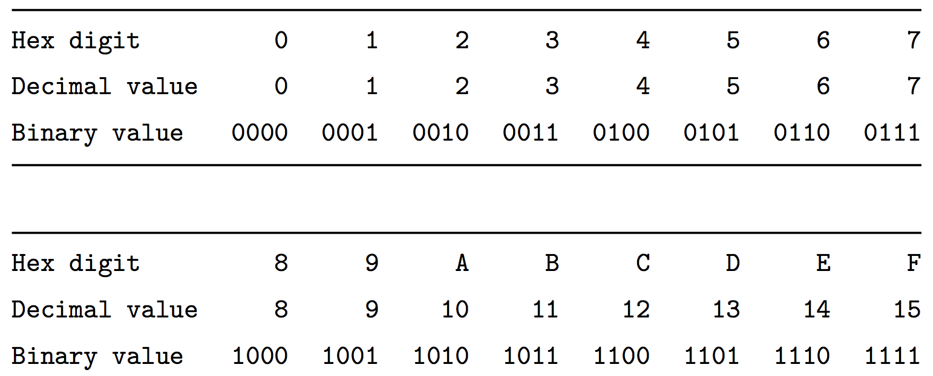
Hexadecimal
Hexadecimal has 16 digits, so we augment our normal 0-9 digits with six more digits: A, B, C, D, E, and F.
Figure 2.2 in the textbook shows the hex digits and their binary and decimal values:

Slide 8
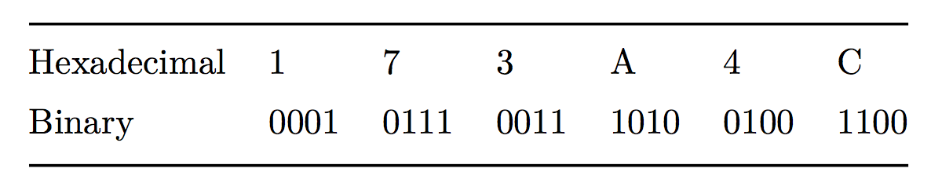
Hexadecimal
In C, we write a hexadecimal with a starting 0x. So, you will see numbers such as 0xfa1d37b, which means that it is a hex number.
You should memorize the binary representations for each hex digit. One trick is to memorize A (1010), C (1100), and F (1111), and the others are easy to figure out.
Let's practice some hex to binary and binary to hex conversions:
Convert: 0x173A4C to binary.
0x173A4C is binary
0b000101110011101001001100

Slide 9
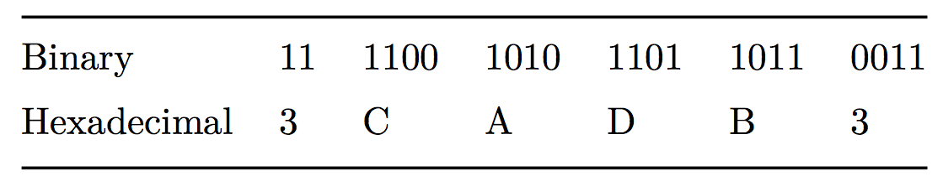
Hexadecimal
Convert: 0b1111001010110110110011 to hexadecimal.
(start from the right)
0b1111001010110110110011
is hexadecimal 3CADB3

Slide 10
Hexadecimal
Convert: 0b1111001010110110110011 to hexadecimal.
(start from the right)
0b1111001010110110110011
is hexadecimal 3CADB3

Slide 11
Hexadecimal
Convert: 0b1111001010110110110011 to hexadecimal.
(start from the right)
0b1111001010110110110011
is hexadecimal 3CADB3

Slide 12
Hexadecimal
Convert: 0b1111001010110110110011 to hexadecimal.
(start from the right)
0b1111001010110110110011
is hexadecimal 3CADB3

Slide 13
Hexadecimal
Convert: 0b1111001010110110110011 to hexadecimal.
(start from the right)
0b1111001010110110110011
is hexadecimal 3CADB3

Slide 14
Hexadecimal
Convert: 0b1111001010110110110011 to hexadecimal.
(start from the right)
0b1111001010110110110011
is hexadecimal 3CADB3

Slide 15
Hexadecimal
Convert: 0b1111001010110110110011 to hexadecimal.
(start from the right)
0b1111001010110110110011
is hexadecimal 3CADB3

Slide 16
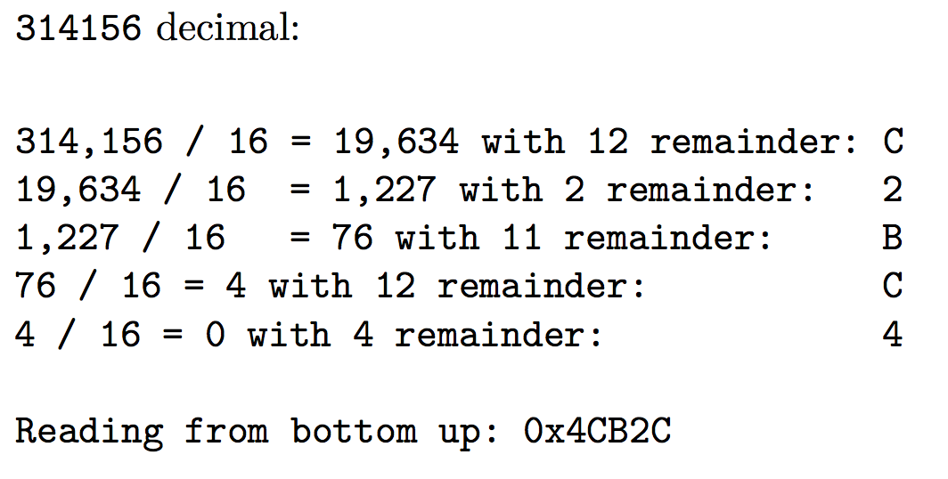
Decimal to Hexadecimal
To convert from decimal to hexadecimal, you need to repeatedly divide
the number in question by 16, and the remainders make up the digits of
the hex number:

Slide 17
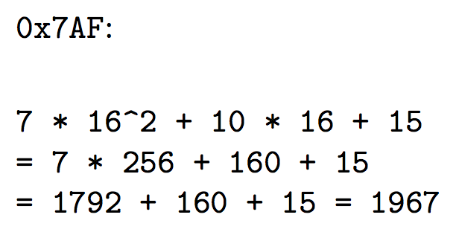
Hexidecimal to Decimal
To convert from hexadecimal to decimal, multiply each of the hexadecimal
digits by the appropriate power of 16:

Slide 18
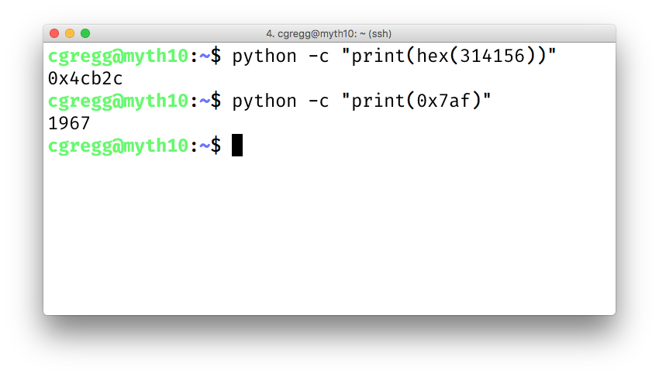
Let the computer do it!
Honestly, hex to decimal and vice versa are easy to let the computer handle. You can either use a search engine (Google does this automatically), or you can use a python one-liner:

Slide 19
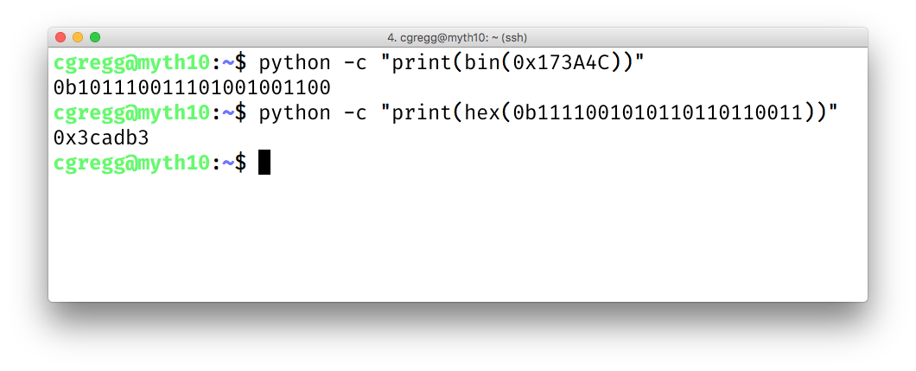
Let the computer do it!
You can also use Python to convert to and from binary:
(but you should memorize this as it is easy and you will use it frequently)

Slide 20
Integer Representations

Slide 21
Integer Representations
The C language has two different ways to represent numbers, unsigned and signed:
unsigned: can only represent non-negative numbers
signed: can represent negative, zero, and positive numbers
We are going to talk about these representations, and also about what happens when we expand or shrink an encoded integer to fit into a different type (e.g., int to long)

Slide 22
Unsigned Integers
For positive (unsigned) integers, there is a 1-to-1 relationship between the decimal representation of a number and its binary representation. If you have a 4-bit number, there are 16 possible combinations, and the unsigned numbers go from 0 to 15:
0b0000 = 0 0b0001 = 1 0b0010 = 2 0b0011 = 3
0b0100 = 4 0b0101 = 5 0b0110 = 6 0b0111 = 7
0b1000 = 8 0b1001 = 9 0b1010 = 10 0b1011 = 11
0b1100 = 12 0b1101 = 13 0b1110 = 14 0b1111 = 15
The range of an unsigned number is 0 → 2^{w} - 1, where w is the number of bits in our integer. For example, a 32-bit int can represent numbers from 0 to 2³² - 1, or 0 to 4,294,967,295.

Slide 23
Signed Integers: How do we represent them?
What if we want to represent negative numbers? We have choices!
One way we could encode a negative number is simply to designate some bit as a "sign" bit, and then interpret the rest of the number as a regular binary number and then apply the sign. For instance, for a four-bit number:
0 001 = 1
0 010 = 2
0 011 = 3
0 100 = 4
0 101 = 5
0 110 = 6
0 111 = 7
1 001 = -1
1 010 = -2
1 011 = -3
1 100 = -4
1 101 = -5
1 110 = -6
1 111 = -7
This might be okay...but we've only represented 14 of our 16 available numbers...

Slide 24
Signed Integers: How do we represent them?
What about 0 000 and 1 000? What should they represent?
Well...this is a bit tricky!
0 001 = 1
0 010 = 2
0 011 = 3
0 100 = 4
0 101 = 5
0 110 = 6
0 111 = 7
1 001 = -1
1 010 = -2
1 011 = -3
1 100 = -4
1 101 = -5
1 110 = -6
1 111 = -7

Slide 25
Signed Integers: How do we represent them?
What about 0 000 and 1 000? What should they represent?
Well...this is a bit tricky!
0 001 = 1
0 010 = 2
0 011 = 3
0 100 = 4
0 101 = 5
0 110 = 6
0 111 = 7
1 001 = -1
1 010 = -2
1 011 = -3
1 100 = -4
1 101 = -5
1 110 = -6
1 111 = -7
Let's look at the bit patterns:
0 000 1 000
Should we make the 0 000 just represent decimal 0? What about 1 000? We could make it 0 as well, or maybe -8, or maybe even 8, but none of the choices are nice.

Slide 26
Signed Integers: How do we represent them?
What about 0 000 and 1 000? What should they represent?
Well...this is a bit tricky!
0 001 = 1
0 010 = 2
0 011 = 3
0 100 = 4
0 101 = 5
0 110 = 6
0 111 = 7
1 001 = -1
1 010 = -2
1 011 = -3
1 100 = -4
1 101 = -5
1 110 = -6
1 111 = -7
Let's look at the bit patterns:
0 000 1 000
Should we make the 0 000 just represent decimal 0? What about 1 000? We could make it 0 as well, or maybe -8, or maybe even 8, but none of the choices are nice.
Fine. Let's just make 0 000 to be equal to decimal 0. How does arithmetic work?
Well…to add two numbers, you need to know the sign, then you might have to subtract (borrow and carry, etc.), and the sign might change…this is going to get ugly!

Slide 27
Signed Integers: How do we represent them?
There is a better way!

Slide 28
Signed Integers: How do we represent them?
Behold: the "two's complement" circle:
In the early days of computing*, two's complement was determined to be an excellent way to store binary numbers.
In two's complement notation, positive numbers are represented as themselves (phew), and negative numbers are represented as the two's complement of themselves (definition to follow).
This leads to some amazing arithmetic properties!
*John von Neumann suggested it in 1945, for the EDVAC computer.

Slide 29
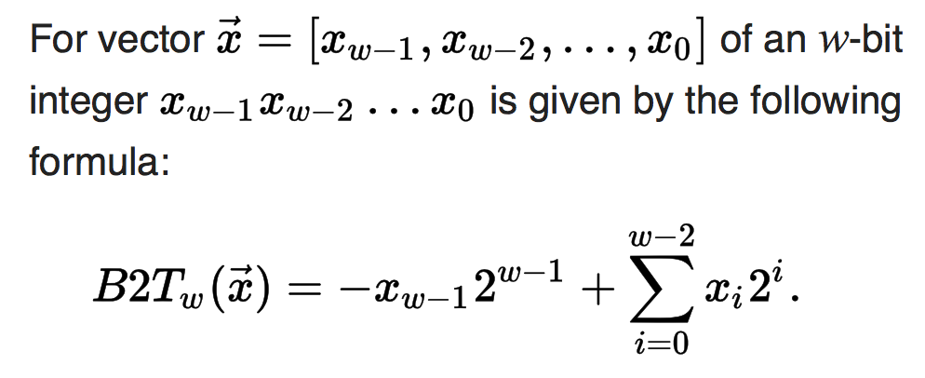
Two's Complement
A two's-complement number system encodes positive and negative numbers in a binary number representation. The weight of each bit is a power of two, except for the most significant bit, whose weight is the negative of the corresponding power of two.
Definition:
B2Tw means "Binary to Two's complement function"
In practice, a negative number in two's complement is obtained by inverting all the bits of its positive counterpart*, and then adding 1.
*Inverting all the bits of a number is its "one's complement"

Slide 30
Two's Complement
In practice, a negative number in two's complement is obtained by inverting all the bits of its positive counterpart*, and then adding 1, or: x = ~x + 1
Example: The number 2 is represented as normal in binary: 0010
-2 is represented by inverting the bits, and adding 1:
0010 ☞ 1101
1101
+ 1
1110
*Inverting all the bits of a number is its "one's complement"

Slide 31
Two's Complement
Trick: to convert a positive number to its negative in two's complement, start from the right of the number, and write down all the digits until you get to a 1. Then invert the rest of the digits:
Example: The number 2 is represented as normal in binary: 0010
Going from the right, write down numbers until you get to a 1:
10
Then invert the rest of the digits:
1110
*Inverting all the bits of a number is its "one's complement"

Slide 32
Two's Complement
To convert a negative number to a positive number, perform the same steps!
Example: The number -5 is represented in two's complements as: 1011
5 is represented by inverting the bits, and adding 1:
1011 ☞ 0100
0100
+ 1
0101
Shortcut: start from the right, and write down numbers until you get to a 1:
1
Now invert all the rest of the digits:
0101

Slide 33
Two's Complement: Neat Properties
There are a number of useful properties associated with two's complement numbers:
There is only one zero (yay!)
The highest order bit (left-most) is 1 for negative, 0 for positive (so it is easy to tell if a number is negative)
Adding two numbers is just…adding!
Example:
2 + -5 = -3
0010 ☞ 2
+1011 ☞ -5
1101 ☞ -3 decimal (wow!)

Slide 34
Two's Complement: Neat Properties
More useful properties:
Subtracting two numbers is simply performing the two's complement on one of them and then adding.
Example:
4 - 5 = -1
0100 ☞ 4, 0101 ☞ 5
Find the two's complement of 5: 1011
add:
0100 ☞ 4
+1011 ☞ -5
1111 ☞ -1 decimal

Slide 35
Two's Complement: Neat Properties
More useful properties:
Multiplication of two's complement works just by multiplying (throw away overflow digits).
Example: -2 * -3 = 6
1110 ☞ -2
x1101 ☞ -3
1110
0000
1110
+1110
10110110 ☞ 6

Slide 36
Two's Complement: Powers of two remain!
From the definition of a two's complement number, we can see that we are still dealing with bits being equal to their powers-of-two place: there isn't anything magical about the placement of the bits:
-5 = 1 0 1 1
(1 * -2³) + (0 * 2²) + (1 * 2¹) + (1 * 2⁰)

Slide 37
Practice
Convert the following 4-bit numbers from positive to negative, or from negative to positive using two's complement notation:
-4 (1100) ☞
7 (0111) ☞
3 (0011) ☞
-8 (1000) ☞

Slide 38
Practice
Convert the following 4-bit numbers from positive to negative, or from negative to positive using two's complement notation:
-4 (1100) ☞
7 (0111) ☞
3 (0011) ☞
-8 (1000) ☞
0100
1001
1101
1000 (?! If you look at the chart, +8 cannot be represented in two's complement with 4 bits!)

Slide 39
Practice
Convert the following 8-bit numbers from positive to negative, or from negative to positive using two's complement notation:
-4 (11111100) ☞
27 (00011011) ☞
-127 (10000001) ☞
1 (00000001) ☞
00000100
11100101
01111111
11111111

Slide 40
Casting Between Signed and Unsigned
Converting between two numbers in C can happen explicitly (using a parenthesized cast), or implicitly (without a cast):
explicit
implicit
1 2 3 4 5
int tx, ty;
unsigned ux, uy;
…
tx = (int) ux;
uy = (unsigned) ty;
1 2 3 4 5
int tx, ty;
unsigned ux, uy;
…
tx = ux; // cast to signed
uy = ty; // cast to unsigned
When casting: the underlying bits do not change, so there isn't any conversion going on, except that the variable is treated as the type that it is. You cannot convert a signed number to its unsigned counterpart using a cast!

Slide 41
Casting Between Signed and Unsigned
When casting: the underlying bits do not change, so there isn't any conversion going on, except that the variable is treated as the type that it is. You cannot convert a signed number to its unsigned counterpart using a cast!
1 2 3 4 5
6
7
8
9
10
11
12
// test_cast.c
#include<stdio.h>
#include<stdlib.h>
int main() {
int v = -12345;
unsigned int uv = (unsigned int) v;
printf("v = %d, uv = %u\n",v,uv);
return 0;
}
$ ./test_cast
v = -12345, uv = 4294954951

Slide 42
Casting Between Signed and Unsigned
printf has three 32-bit integer representations:
%d : signed 32-bit int
%u : unsigned 32-bit int
%x : hex 32-bit int
As long as the value is a 32-bit type, printf will treat it according to the formatter it is applying:
1 2 3 4 5
6
7
8
9
10
11
12
int x = -1;
unsigned u = 3000000000; // 3 billion
printf("x = %u = %d\n", x, x);
printf("u = %u = %d\n", u, u);
$ ./test_printf
x = 4294967295 = -1
u = 3000000000 = -1294967296

Slide 43
Signed vs Unsigned Number Wheels

Slide 44
Comparison between signed and unsigned integers
When a C expression has combinations of signed and unsigned variables, you need to be careful!
If an operation is performed that has both a signed and an unsigned value, C implicitly casts the signed argument to unsigned and performs the operation assuming both numbers are non-negative. Let's take a look…
Expression | Type | Evaluation
0 == 0U
-1 < 0
-1 < 0U
2147483647 > -2147483647 - 1
2147483647U > -2147483647 - 1
2147483647 > (int)2147483648U
-1 > -2
(unsigned)-1 > -2

Slide 45
Comparison between signed and unsigned integers
When a C expression has combinations of signed and unsigned variables, you need to be careful!
If an operation is performed that has both a signed and an unsigned value, C implicitly casts the signed argument to unsigned and performs the operation assuming both numbers are non-negative. Let's take a look…
Expression | Type | Evaluation
0 == 0U | Unsigned | 1
-1 < 0 | Signed | 1
-1 < 0U | Unsigned | 0
2147483647 > -2147483647 - 1 | Signed | 1
2147483647U > -2147483647 - 1 | Unsigned | 0
2147483647 > (int)2147483648U | Signed | 1
-1 > -2 | Signed | 1
(unsigned)-1 > -2 | Unsigned | 1

Slide 46
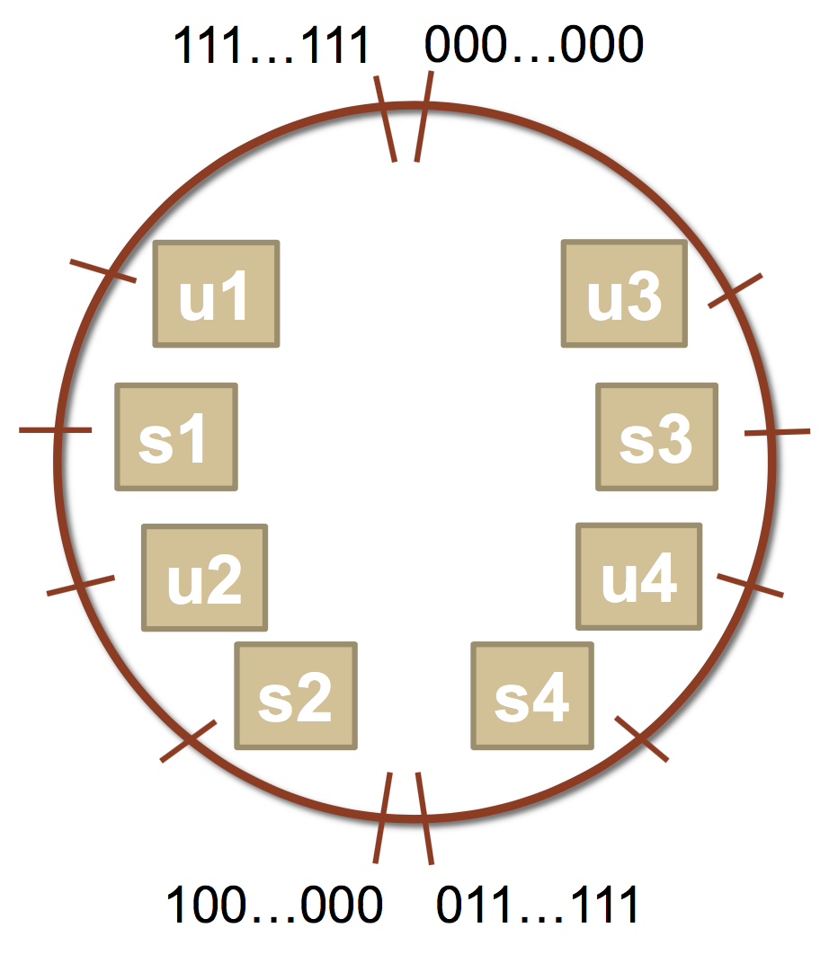
Comparison between signed and unsigned integers
Let's try some more…a bit more abstractly.
int s1, s2, s3, s4;
unsigned int u1, u2, u3, u4;
Which many of the following statements are true? (assume that
variables are set to values that place them in the spots shown)
s3 > u3
u2 > u4
s2 > s4
s1 > s2
u1 > u2
s1 > u3

Slide 47
Comparison between signed and unsigned integers
Let's try some more…a bit more abstractly.
int s1, s2, s3, s4;
unsigned int u1, u2, u3, u4;
Which many of the following statements are true? (assume that
variables are set to values that place them in the spots shown)
s3 > u3 : true
u2 > u4 : true
s2 > s4 : false
s1 > s2 : true
u1 > u2 : true
s1 > u3 : true

Slide 48
The sizeof Operator
As we have seen, integer types are limited by the number of bits they hold. On the 64-bit myth machines, we can use the sizeof operator to find how many bytes each type uses:
int main() {
printf("sizeof(char): %d\n", (int) sizeof(char));
printf("sizeof(short): %d\n", (int) sizeof(short));
printf("sizeof(int): %d\n", (int) sizeof(int));
printf("sizeof(unsigned int): %d\n", (int) sizeof(unsigned int));
printf("sizeof(long): %d\n", (int) sizeof(long));
printf("sizeof(long long): %d\n", (int) sizeof(long long));
printf("sizeof(size_t): %d\n", (int) sizeof(size_t));
printf("sizeof(void *): %d\n", (int) sizeof(void *));
return 0;
}
$ ./sizeof
sizeof(char): 1
sizeof(short): 2
sizeof(int): 4
sizeof(unsigned int): 4
sizeof(long): 8
sizeof(long long): 8
sizeof(size_t): 8
sizeof(void *): 8
Type | Width in bytes | Width in bits
char | 1 | 8
short | 2 | 16
int | 4 | 32
long | 8 | 64
void * | 8 | 64

Slide 49
MIN and MAX values for integers
Because we now know how bit patterns for integers works, we can figure out the maximum and minimum values, designated by INT_MAX, UINT_MAX, INT_MIN, (etc.), which are defined in limits.h
Type | Width (bytes) | Width (bits) | Min in hex (name) | Max in hex (name)
char | 1 | 8 | 80 (CHAR_MIN) | 7F (CHAR_MAX)
unsigned char | 1 | 8 | 0 | FF (UCHAR_MAX)
short | 2 | 16 | 8000 (SHRT_MIN) | 7FFF (SHRT_MAX)
unsigned short | 2 | 16 | 0 | FFFF (USHRT_MAX)
int | 4 | 32 | 80000000 (INT_MIN) | 7FFFFFFF (INT_MAX)
unsigned int | 4 | 32 | 0 | FFFFFFFF (UINT_MAX)
long | 8 | 64 | 8000000000000000 (LONG_MIN) | 7FFFFFFFFFFFFFFF (LONG_MAX)
unsigned long | 8 | 64 | 0 | FFFFFFFFFFFFFFFF (ULONG_MAX)

Slide 50
Expanding the bit representation of a number
Sometimes we want to convert between two integers having different sizes. E.g., a short to an int, or an int to a long.
We might not be able to convert from a bigger data type to a smaller data type, but we do want to always be able to convert from a smaller data type to a bigger data type.
This is easy for unsigned values: simply add leading zeros to the representation (called "zero extension").
unsigned short s = 4;
// short is a 16-bit format, so s = 0000 0000 0000 0100b
unsigned int i = s;
// conversion to 32-bit int, so i = 0000 0000 0000 0000 0000 0000 0000 0100b

Slide 51
Expanding the bit representation of a number
For signed values, we want the number to remain the same, just with more bits. In this case, we perform a "sign extension" by repeating the sign of the value for the new digits. E.g.,
short s = 4;
// short is a 16-bit format, so s = 0000 0000 0000 0100b
int i = s;
// conversion to 32-bit int, so i = 0000 0000 0000 0000 0000 0000 0000 0100b
— or —
short s = -4;
// short is a 16-bit format, so s = 1111 1111 1111 1100b
int i = s;
// conversion to 32-bit int, so i = 1111 1111 1111 1111 1111 1111 1111 1100b

Slide 52
Sign-extension Example
// show_bytes() defined on pg. 45, Bryant and O'Halloran
int main() {
short sx = -12345; // -12345
unsigned short usx = sx; // 53191
int x = sx; // -12345
unsigned ux = usx; // 53191
printf("sx = %d:\t", sx);
show_bytes((byte_pointer) &sx, sizeof(short));
printf("usx = %u:\t", usx);
show_bytes((byte_pointer) &usx, sizeof(unsigned short));
printf("x = %d:\t", x);
show_bytes((byte_pointer) &x, sizeof(int));
printf("ux = %u:\t", ux);
show_bytes((byte_pointer) &ux, sizeof(unsigned));
return 0;
}
$ ./sign_extension
sx = -12345: c7 cf
usx = 53191: c7 cf
x = -12345: c7 cf ff ff
ux = 53191: c7 cf 00 00
(careful: this was printed on the little-endian myth machines!)

Slide 53
Back to right shift: arithmetic -vs- logical
The right-shift (>>) operator behaves differently for unsigned and signed numbers:
Unsigned numbers are logically-right shifted (by shifting in 0s, always)
Signed numbers are arithmetically-right shifted (by shifting in the sign bit)
// show_bytes() defined on pg. 45, Bryant and O'Halloran
int main() {
int a = 1048576;
int a_rs8 = a >> 8;
int b = -1048576;
int b_rs8 = b >> 8;
printf("a = %d:\t", a);
show_bytes((byte_pointer) &a, sizeof(int));
printf("a >> 8 = %d:\t", a_rs8);
show_bytes((byte_pointer) &a_rs8, sizeof(int));
printf("b = %d:\t", b);
show_bytes((byte_pointer) &b, sizeof(int));
printf("b >> 8 = %d:\t", b_rs8);
show_bytes((byte_pointer) &b_rs8, sizeof(int));
return 0;
}
$ ./right_shift
a = 1048576: 00 00 10 00
a >> 8 = 4096: 00 10 00 00
b = -1048576: 00 00 f0 ff
b >> 8 = -4096: 00 f0 ff ff
(run on a little-endian machine)

Slide 54
Truncating Numbers: Signed
What if we want to reduce the number of bits that a number holds? E.g.
int x = 53191;
short sx = (short) x;
int y = sx;
What happens here? Let's look at the bits in x (a 32-bit int), 53191:
0000 0000 0000 0000 1100 1111 1100 0111
When we cast x to a short, it only has 16-bits, and C truncates the number:
1100 1111 1100 0111
What is this number in decimal? Well, it must be negative (b/c of the initial 1), and it is -12345.

Slide 55
Truncating Numbers: Signed
What if we want to reduce the number of bits that a number holds? E.g.
int x = 53191; // 53191
short sx = (short) x; // -12345
int y = sx;
This is a form of overflow! We have altered the value of the number.
Be careful!
We don't have enough bits to store the int in the short for the value we have in the int, so the strange values occur.
What is y above? We are converting a short to an int, so we sign-extend, and we get -12345!
1100 1111 1100 0111 becomes
1111 1111 1111 1111 1100 1111 1100 0111
Play around here: http://www.convertforfree.com/twos-complement-calculator/

Slide 56
Truncating Numbers: Signed
If the number does fit into the smaller representation in the current form, it will convert just fine.
int x = -3; // -3
short sx = (short) -3; // -3
int y = sx; // -3
x: 1111 1111 1111 1111 1111 1111 1111 1101 becomes
sx: 1111 1111 1111 1101
Play around here: http://www.convertforfree.com/twos-complement-calculator/

Slide 57
Truncating Numbers: Unsigned
We can also lose information with unsigned numbers:
unsigned int x = 128000;
unsigned short sx = (short) x;
unsigned int y = sx;
Bit representation for x = 128000 (32-bit unsigned int):
0000 0000 0000 0001 1111 0100 0000 0000
Truncated unsigned short sx:
1111 0100 0000 0000
which equals 62464 decimal.
Converting back to an unsigned int, y = 62464

Slide 58
Overflow in Unsigned Addition
When integer operations overflow in C, the runtime does not produce an error:
#include<stdio.h>
#include<stdlib.h>
#include<limits.h> // for UINT_MAX
int main() {
unsigned int a = UINT_MAX;
unsigned int b = 1;
unsigned int c = a + b;
printf("a = %u\n",a);
printf("b = %u\n",b);
printf("a + b = %u\n",c);
return 0;
}
$ ./unsigned_overflow
a = 4294967295
b = 1
a + b = 0
Technically, unsigned integers in C don't overflow, they just wrap. You need to be aware of the size of your numbers. Here is one way to test if an addition will fail:
// for addition
#include <limits.h>
unsigned int a = <something>;
unsigned int x = <something>;
if (a > UINT_MAX - x) /* `a + x` would overflow */;

Slide 59
Overflow in Signed Addition
Signed overflow wraps around to the negative numbers:
YouTube fell into this trap — their view counter was a signed, 32-bit int. They fixed it after it was noticed, but for a while, the view count for Gangnam Style (the first video with over INT_MAX number of views) was negative.

Slide 60
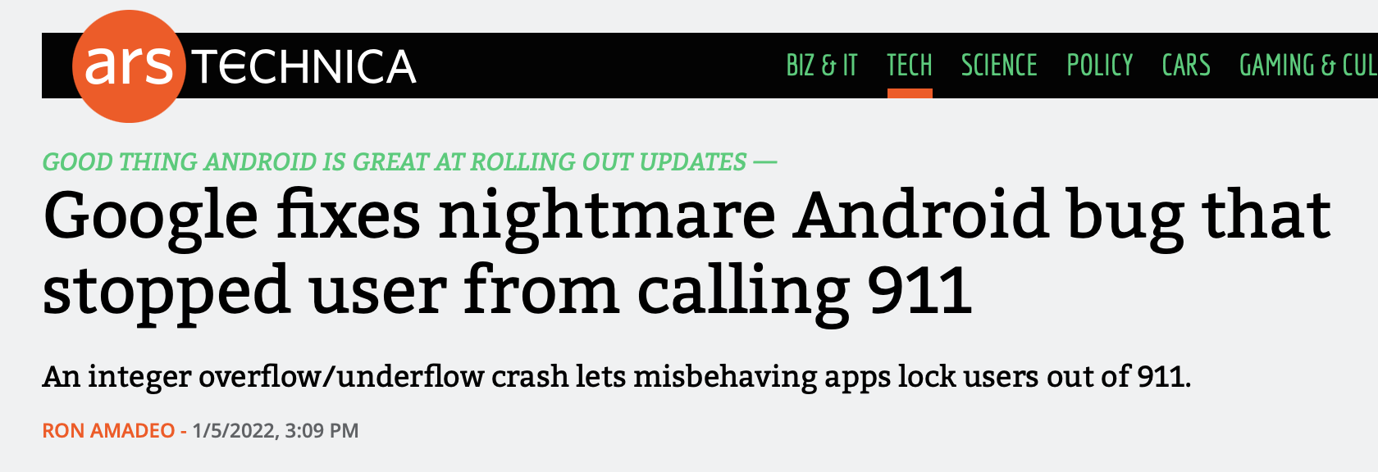
Overflow in Signed Addition
In the news on January 5, 2022 (!):
https://arstechnica.com/gadgets/2022/01/google-fixes-nightmare-android-bug-that-stopped-user-from-calling-911/

Slide 61
Overflow in Signed Addition
Signed overflow wraps around to the negative numbers.
#include<stdio.h>
#include<stdlib.h>
#include<limits.h> // for INT_MAX
int main() {
int a = INT_MAX;
int b = 1;
int c = a + b;
printf("a = %d\n",a);
printf("b = %d\n",b);
printf("a + b = %d\n",c);
return 0;
}
$ ./signed_overflow
a = 2147483647
b = 1
a + b = -2147483648
Technically, signed integers in C produce undefined behavior when they overflow. On two's complement machines (virtually all machines these days), it does overflow predictably. You can test to see if your addition will be correct:
// for addition
#include <limits.h>
int a = <something>;
int x = <something>;
if ((x > 0) && (a > INT_MAX - x)) /* `a + x` would overflow */;
if ((x < 0) && (a < INT_MIN - x)) /* `a + x` would underflow */;

Slide 62
References and Advanced Reading
References:
  Two's complement calculator: http://www.convertforfree.com/twos-complement-calculator/
  Wikipedia on Two's complement: https://en.wikipedia.org/wiki/Two%27s_complement
  The sizeof operator: http://www.geeksforgeeks.org/sizeof-operator-c/
Advanced Reading:
  Signed overflow: https://stackoverflow.com/questions/16056758/c-c-unsigned-integer-overflow
  Integer overflow in C: https://www.gnu.org/software/autoconf/manual/autoconf-2.62/html_node/Integer-Overflow.html
  https://stackoverflow.com/questions/34885966/when-an-int-is-cast-to-a-short-and-truncated-how-is-the-new-value-determined

Slide 63
0
1
-1
0000
2
1111
0001
-2
1110
0010
3
1101
-3
0011
4-bit
two's complement signed integer representation
1100
0100
4
-4
1011
0101
-8
7
1010
-7
0110
1001
1000
0111
6
-6
5
-5

Slide 64
0
15
1
0000
14
1111
0001
2
1110
0010
13
3
1101
0011
1100
12
4
4-bit
unsigned integer representation
0100
1011
0101
8
7
9
1010
0110
6
10
1001
1000
0111
5
11

