Slide 1
Monday, January 10, 2022
CS 107
Lecture 3: Bits and Bytes
Computer Systems
Winter 2022
Stanford University
Computer Science Department
Reading: Reader: Number Formats Used in CS 107 and Bits and BytesTextbook: Chapter 2.1
Lecturer: Chris Gregg

Slide 2
Logistics
Labs start Tuesday -- you will want to watch Monday's lecture before your lab.
Assign0 Due on Monday at 11:59pm
Assign1 Released today

Slide 3
Today's Topics
More on extending the bit representation of numbers
Truncating numbers
Data Sizes
Addressing and Byte Ordering
Boolean Algebra

Slide 4
Expanding the bit representation of a number
Sometimes we want to convert between two integers having different sizes. E.g., a short to an int, or an int to a long.
We might not be able to convert from a bigger data type to a smaller data type, but we do want to always be able to convert from a smaller data type to a bigger data type.
This is easy for unsigned values: simply add leading zeros to the representation (called "zero extension").
unsigned short s = 4;
// short is a 16-bit format, so s = 0000 0000 0000 0100b
unsigned int i = s;
// conversion to 32-bit int, so i = 0000 0000 0000 0000 0000 0000 0000 0100b

Slide 5
Expanding the bit representation of a number
For signed values, we want the number to remain the same, just with more bits. In this case, we perform a "sign extension" by repeating the sign of the value for the new digits. E.g.,
short s = 4;
// short is a 16-bit format, so s = 0000 0000 0000 0100b
int i = s;
// conversion to 32-bit int, so i = 0000 0000 0000 0000 0000 0000 0000 0100b
— or —
short s = -4;
// short is a 16-bit format, so s = 1111 1111 1111 1100b
int i = s;
// conversion to 32-bit int, so i = 1111 1111 1111 1111 1111 1111 1111 1100b

Slide 6
Sign-extension Example
// show_bytes() defined on pg. 45, Bryant and O'Halloran
int main() {
short sx = -12345; // -12345
unsigned short usx = sx; // 53191
int x = sx; // -12345
unsigned ux = usx; // 53191
printf("sx = %d:\t", sx);
show_bytes((byte_pointer) &sx, sizeof(short));
printf("usx = %u:\t", usx);
show_bytes((byte_pointer) &usx, sizeof(unsigned short));
printf("x = %d:\t", x);
show_bytes((byte_pointer) &x, sizeof(int));
printf("ux = %u:\t", ux);
show_bytes((byte_pointer) &ux, sizeof(unsigned));
return 0;
}
$ ./sign_extension
sx = -12345: c7 cf
usx = 53191: c7 cf
x = -12345: c7 cf ff ff
ux = 53191: c7 cf 00 00
(careful: this was printed on the little-endian myth machines!)

Slide 7
Back to right shift: arithmetic -vs- logical
The right-shift (>>) operator behaves differently for unsigned and signed numbers:
Unsigned numbers are logically-right shifted (by shifting in 0s, always)
Signed numbers are arithmetically-right shifted (by shifting in the sign bit)
// show_bytes() defined on pg. 45, Bryant and O'Halloran
int main() {
int a = 1048576;
int a_rs8 = a >> 8;
int b = -1048576;
int b_rs8 = b >> 8;
printf("a = %d:\t", a);
show_bytes((byte_pointer) &a, sizeof(int));
printf("a >> 8 = %d:\t", a_rs8);
show_bytes((byte_pointer) &a_rs8, sizeof(int));
printf("b = %d:\t", b);
show_bytes((byte_pointer) &b, sizeof(int));
printf("b >> 8 = %d:\t", b_rs8);
show_bytes((byte_pointer) &b_rs8, sizeof(int));
return 0;
}
$ ./right_shift
a = 1048576: 00 00 10 00
a >> 8 = 4096: 00 10 00 00
b = -1048576: 00 00 f0 ff
b >> 8 = -4096: 00 f0 ff ff
(run on a little-endian machine)

Slide 8
Truncating Numbers: Signed
What if we want to reduce the number of bits that a number holds? E.g.
int x = 53191;
short sx = (short) x;
int y = sx;
What happens here? Let's look at the bits in x (a 32-bit int), 53191:
0000 0000 0000 0000 1100 1111 1100 0111
When we cast x to a short, it only has 16-bits, and C truncates the number:
1100 1111 1100 0111
What is this number in decimal? Well, it must be negative (b/c of the initial 1), and it is -12345.

Slide 9
Truncating Numbers: Signed
What if we want to reduce the number of bits that a number holds? E.g.
int x = 53191; // 53191
short sx = (short) x; // -12345
int y = sx;
This is a form of overflow! We have altered the value of the number.
Be careful!
We don't have enough bits to store the int in the short for the value we have in the int, so the strange values occur.
What is y above? We are converting a short to an int, so we sign-extend, and we get -12345!
1100 1111 1100 0111 becomes
1111 1111 1111 1111 1100 1111 1100 0111
Play around here: http://www.convertforfree.com/twos-complement-calculator/

Slide 10
Truncating Numbers: Signed
If the number does fit into the smaller representation in the current form, it will convert just fine.
int x = -3; // -3
short sx = (short) -3; // -3
int y = sx; // -3
x: 1111 1111 1111 1111 1111 1111 1111 1101 becomes
sx: 1111 1111 1111 1101
Play around here: http://www.convertforfree.com/twos-complement-calculator/

Slide 11
Truncating Numbers: Unsigned
We can also lose information with unsigned numbers:
unsigned int x = 128000;
unsigned short sx = (short) x;
unsigned int y = sx;
Bit representation for x = 128000 (32-bit unsigned int):
0000 0000 0000 0001 1111 0100 0000 0000
Truncated unsigned short sx:
1111 0100 0000 0000
which equals 62464 decimal.
Converting back to an unsigned int, y = 62464

Slide 12
Overflow in Unsigned Addition
When integer operations overflow in C, the runtime does not produce an error:
#include<stdio.h>
#include<stdlib.h>
#include<limits.h> // for UINT_MAX
int main() {
unsigned int a = UINT_MAX;
unsigned int b = 1;
unsigned int c = a + b;
printf("a = %u\n",a);
printf("b = %u\n",b);
printf("a + b = %u\n",c);
return 0;
}
$ ./unsigned_overflow
a = 4294967295
b = 1
a + b = 0
Technically, unsigned integers in C don't overflow, they just wrap. You need to be aware of the size of your numbers. Here is one way to test if an addition will fail:
// for addition
#include <limits.h>
unsigned int a = <something>;
unsigned int x = <something>;
if (a > UINT_MAX - x) /* `a + x` would overflow */;

Slide 13
Overflow in Signed Addition
Signed overflow wraps around to the negative numbers:
YouTube fell into this trap — their view counter was a signed, 32-bit int. They fixed it after it was noticed, but for a while, the view count for Gangnam Style (the first video with over INT_MAX number of views) was negative.

Slide 14
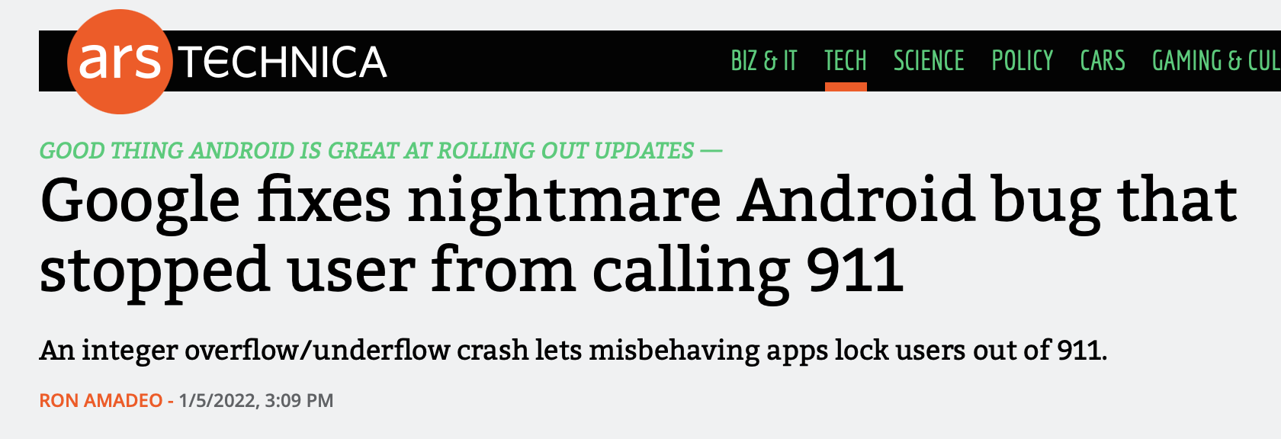
Overflow in Signed Addition
In the news on January 5, 2022 (!):
https://arstechnica.com/gadgets/2022/01/google-fixes-nightmare-android-bug-that-stopped-user-from-calling-911/

Slide 15
Overflow in Signed Addition
Signed overflow wraps around to the negative numbers.
#include<stdio.h>
#include<stdlib.h>
#include<limits.h> // for INT_MAX
int main() {
int a = INT_MAX;
int b = 1;
int c = a + b;
printf("a = %d\n",a);
printf("b = %d\n",b);
printf("a + b = %d\n",c);
return 0;
}
$ ./signed_overflow
a = 2147483647
b = 1
a + b = -2147483648
Technically, signed integers in C produce undefined behavior when they overflow. On two's complement machines (virtually all machines these days), it does overflow predictably. You can test to see if your addition will be correct:
// for addition
#include <limits.h>
int a = <something>;
int x = <something>;
if ((x > 0) && (a > INT_MAX - x)) /* `a + x` would overflow */;
if ((x < 0) && (a < INT_MIN - x)) /* `a + x` would underflow */;

Slide 16
Data Sizes

Slide 17
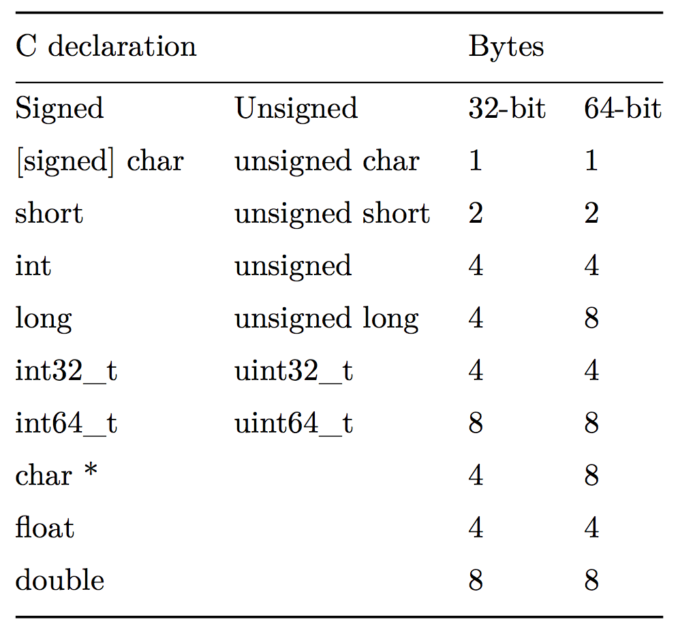
Data Sizes
We found out above that on the myth computers, the int representation is comprised of 32-bits, or four 8-bit bytes. but the C language does not mandate this. To the right is Figure 2.3 from your textbook:

Slide 18
Data Sizes
There are guarantees on the lower-bounds for type sizes, but you should expect that the myth machines will have the numbers in the 64-bit column.

Slide 19
Data Sizes
You can be guaranteed the sizes for int32_t (4 bytes) and int64_t (8 bytes)

Slide 20
Data Sizes
We briefly mentioned unsigned types on the first day of class. These are integer types that are strictly positive.
By default, integer types are signed.

Slide 21
Data Sizes
C allows a variety of ways to order keywords to define a type. The following all have the same meaning:
unsigned long
unsigned long int
long unsigned
long unsigned int

Slide 22
Addressing and Byte Ordering
On the myth machines, pointers are 64-bits long, meaning that a program can "address" up to 2⁶⁴ bytes of memory, because each byte is individually addressable.
This is a lot of memory! It is 16 exabytes, or 1.84 x 10¹⁹ bytes. Older, 32-bit machines could only address 2³² bytes, or 4 Gigabytes.
64-bit machines can address 4 billion times more memory than 32-bit machines...
Machines will not need to address more than 2⁶⁴ bytes of memory for a long, long time.

Slide 23
Addressing and Byte Ordering
We've already talked about the fact that a memory address (pointer) points to a particular byte. But, what if we want to store a data type that has more than one byte?
The int type on our machines is 4 bytes long. So, how is a byte stored in memory?
We have choices!
First, let's talk about the ordering of the bytes in a 4-byte hex number. We can represent an ints as 8-digit hex numbers:
0x01234567
We can separate out the bytes:
0x 01 23 45 67

Slide 24
Addressing and Byte Ordering
01 23 45 67
0000 0001 0010 0011 0100 0101 0110 0111
--------- --------- --------- ---------
most significant least significant
• Some machines choose to store the bytes ordered from least significant byte to most significant byte, called “little endian” (because the “little end” comes first).
• Other machines choose to store the bytes ordered from most significant byte to least significant byte, called “big endian” (because the “big end” comes first).

Slide 25
Addressing and Byte Ordering
Our 0x01234567 number would look like this in memory for a little endian computer (which, by the way, is the way the myth computers store ints):
byte: | 67 | 45 | 23 | 01
address: | 0x100 | 0x101 | 0x102 | 0x103
A big-endian representation would look like this:
byte: | 01 | 23 | 45 | 67
address: | 0x100 | 0x101 | 0x102 | 0x103
Many times we don’t care how our integers are stored, but in cs107 we will! Let’s look at a sample program and dig under the hood to see how little-endian works.

Slide 26
Addressing and Byte Ordering
Our 0x01234567 number would look like this in memory for a little endian computer (which, by the way, is the way the myth computers store ints):
address: 0x100 0x101 0x102 0x103
value: 67 45 23 01
A big-endian representation would look like this:
address: 0x100 0x101 0x102 0x103
value: 01 23 45 67
Many times we don’t care how our integers are stored, but in cs107 we will! Let’s look at a sample program and dig under the hood to see how little-endian works.

Slide 27
Addressing and Byte Ordering
1
2
3
4
5
6
7
8
9
10
11
#include<stdio.h>
#include<stdlib.h>
int main() {
// a variable
int a = 0x01234567;
// print the variable in big endian format
printf("a's value: 0x%.8x\n",a);
return 0;
}

Slide 28
Addressing and Byte Ordering
$ gcc -g -O0 -std=gnu99 big_endian.c -o big_endian
$ ./big_endian
a's value: 0x01234567
$ gdb big_endian
GNU gdb (Ubuntu 7.7.1-0ubuntu5~14.04.3) 7.7.1
...
(gdb) break main
Breakpoint 1 at 0x400535: file big_endian.c, line 6.
(gdb) run
Starting program: /afs/.ir.stanford.edu/users/c/g/cgregg/107/lectures/lecture2_bits_bytes_continued/big_endian
Breakpoint 1, main () at big_endian.c:6
6 int a = 0x01234567;
(gdb) n
9 printf("a's value: 0x%08x\n",a);
(gdb) p/x a
$1 = 0x1234567
(gdb) p &a
$2 = (int *) 0x7fffffffe98c
(gdb) x/16bx &a
0x7fffffffe98c: 0x67 0x45 0x23 0x01 0x00 0x00 0x00 0x00
0x7fffffffe994: 0x00 0x00 0x00 0x00 0x45 0x2f 0xa3 0xf7
(gdb)
Note the ordering: 0x01234567 is stored as Little Endian!

Slide 29
3 Minute Break!

Slide 30
Boolean Algebra

Slide 31
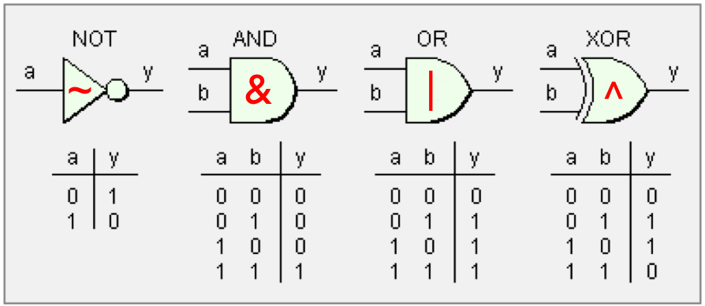
Boolean Algebra
Because computers store values in binary, we need to learn about boolean algebra. Most of you have already studied this in some form in math classes before, but we are going to quantify it and discuss it in the context of computing and programming.
We can define Boolean algebra over a 2-element set, 0 and 1, where 0 represents false and 1 represents true.
The symbols are: ~ for NOT, & for AND, | for OR, and ^ for "exclusive or," which means that if one and only one of the values is true, the expression is true.

Slide 32
Boolean Algebra
Be careful! There are logical analogs to some of these that you have used in C++ and other programming languages: ! (logical NOT), && (logical AND), and || (logical OR), but we are now talking about bit operations that result in 0 or 1 for each bit in a number.
The bitwise operators use single character representations for AND and OR, not double-characters.

Slide 33
Boolean Algebra
When a boolean operator is applied to two numbers (or, in the case of ~, a single number), the operator is applied to the corresponding bits in each number. For example:
0110
& 1100
----
0100
0110
| 1100
----
1110
0110
^ 1100
----
1010
~ 1100
----
0011

Slide 34
Boolean Algebra: Mystery Function
Let's look at a mystery function!
1
2
3
4
5
6
7
8
9
10
11
12
13
14
15
16
17
18
19
20
21
22
23
// mystery1.c
#include<stdlib.h>
#include<stdio.h>
void mystery(int *x, int *y) {
if (x != y) {
*y = *x ^ *y;
*x = *x ^ *y;
*y = *x ^ *y;
}
}
int main(int argc, char *argv[]) {
int x = atoi(argv[1]);
int y = atoi(argv[2]);
printf("x:%d, y:%d\n",x,y);
mystery(&x,&y);
printf("x:%d, y:%d\n",x,y);
return 0;
}
$ ./mystery 4 5

Slide 35
Boolean Algebra: Mystery Function
Let's look at a mystery function!
1
2
3
4
5
6
7
8
9
10
11
12
13
14
15
16
17
18
19
20
21
22
23
// mystery1.c
#include<stdlib.h>
#include<stdio.h>
void mystery(int *x, int *y) {
if (x != y) {
*y = *x ^ *y;
*x = *x ^ *y;
*y = *x ^ *y;
}
}
int main(int argc, char *argv[]) {
int x = atoi(argv[1]);
int y = atoi(argv[2]);
printf("x:%d, y:%d\n",x,y);
mystery(&x,&y);
printf("x:%d, y:%d\n",x,y);
return 0;
}
$ ./mystery 4 5
x:4, y:5
x:5, y:4
https://en.wikipedia.org/wiki/XOR_swap_algorithm
This relies on the fact that x^x == 0, and the associativity and commutativity of the exclusive or function.
Incidentally, if you XOR a number with all 1s, you get the complement!

Slide 36
Boolean Algebra: Operations on bit flags
We can represent finite sets with bit vectors, where we can perform set functions such as union, intersection, and complement. For example:
bit vector a = [01101001] encodes the set A = {0,3,5,6} (reading the 1 positions from right to left, with #0 being the right-most, #7 being the left-most)
bit vector b = [01010101] encodes the set B = {0,2,4,6}
The | operator produces a set union:
a | b → [01111101], or A ∪ B = {0,2,3,4,5,6}
The & operator produces a set intersection:
a & b → [01000001], or A ∩ B = {0,6}

Slide 37
Boolean Algebra: Bit Masking
A common use of bit-level operations is to implement masking operations, where a mask is a bit pattern that will be used to choose a selected set of bits in a word. For example, the mask of 0xFF means the lowest byte in an integer. To get the low-order byte out of an integer, we simply use the bitwise AND operator with the mask:
int j = 0x89ABCDEF;
int k = j & 0xFF; // k now holds the value 0xEF,
// which is the low-order byte of j
A useful expression is ~0, which makes an integer with all 1s, regardless of the size of the integer.

Slide 38
Boolean Algebra: Bit Masking
Challenge 1: write an expression that sets the least significant byte to all ones, and all other bytes of the number (assume it is the variable j) left unchanged E.g.
0x87654321 → 0x876543FF
Possible answer: j | 0xFF
Challenge 2: write an expression that complements all but the least significant byte of j, with the least significant byte unchanged. E.g.
0x87654321 → 0x789ABC21
Possible answer: j ^ ~0xFF

Slide 39
Boolean Algebra: Shift Operations
C provides operations to shift bit patterns to the left and to the right.
The << operator moves the bits to the left, replacing the lower order bits with zeros and dropping any values that would be bigger than the type can hold:
x << k will shift x to the left by k number of bits.
Examples for an 8-bit binary number:
00110111 << 2 returns 11011100
01100011 << 4 returns 00110000
10010101 << 4 returns 01010000

Slide 40
Boolean Algebra: Shift Operations
There are actually two flavors of right shift, which work differently depending on the value and type of the number you are shifting.
A logical right shift moves the values to the right, replacing the upper bits with 0s.
An arithmetic right shift moves the values to the right, replacing the upper bits with a copy of the most significant bit. This may seem weird! But, we will see why this is useful soon!
Examples for an 8-bit binary number:
Logical right shift:
00110111 >> 2 returns 00001101
10110111 >> 2 returns 00101101
01100011 >> 4 returns 00000110
10010101 >> 4 returns 00001001
Examples for an 8-bit binary number:
Artithmetic right shift:
00110111 >> 2 returns 00001101
10110111 >> 2 returns 11101101
01100011 >> 4 returns 00000110
10010101 >> 4 returns 11111001

Slide 41
Shift Operation Pitfalls
There are two important things you need to consider when using the shift operators:
The C standard does not precisely define whether a right shift for signed integers is logical or arithmetic. Almost all compilers / machines use arithmetic shifts for signed integers, and you can most likely assume this. Don't be surprised if some Internet pedant yells at you about it some day. :) All unsigned integers will always use a logical right shift (more on this later!)
Operator precedence can be tricky! Example:
1<<2 + 3<<4 means this: 1 << (2 + 3) << 4, because addition and subtraction have a higher precedence than shifts!
Always parenthesize to be sure:
(1<<2) + (3<<4)

Slide 42
Practice!
Let's take a look at lots of examples:
If you want to try the examples out yourself. On myth:
$ cd CS107
$ cp -r /afs/ir/class/cs107/lecture-code/lect3 .
cd lect3
make
ls # to see the files

Slide 43
References and Advanced Reading
References:
  argc and argv: http://crasseux.com/books/ctutorial/argc-and-argv.html
  The C Language: https://en.wikipedia.org/wiki/C_(programming_language)
  Kernighan and Ritchie (K&R) C: https://www.youtube.com/watch?v=de2Hsvxaf8M
  C Standard Library: http://www.cplusplus.com/reference/clibrary/
  https://en.wikipedia.org/wiki/Bitwise_operations_in_C
  http://en.cppreference.com/w/c/language/operator_precedence
Advanced Reading:
  After All These Years, the World is Still Powered by C Programming
  Is C Still Relevant in the 21st Century?
  Why Every Programmer Should Learn C

